Slide 1
T9 and Tries

Slide 2
T9 Predictive Text
What is T9? Demo
T9onyms:
1. 22737: acres, bards, barer, bares, baser, bases, caper, capes, cards, cares, cases
2. 46637: goner, goods, goofs, homer, homes, honer, hones, hoods, hoofs, inner
3. 2273: acre, bard, bare, base, cape, card, care, case
4. 729: paw, pay, Paz, raw, ray, saw, sax, say
5. 76737: pores, poser, poses, roper, ropes, roses, sorer, sores
How does T9 order T9onyms?
Assignment Requirement: Alphabetical order
Extra credit options: Frequency, Dynamic Frequency
Notes:
-T9onym is a word that shows up on mobile phones that have T9 text entry that is equivalent through T9 to other words
-When T9 encounters T9onyms, it weights the words by how commonly a word is used. In other words, T9 will predict the word you are trying to type by determining which of the T9onyms you use more often. NOTE: T9 orders words differently than what we are requiring from you.

Slide 3
Trie
Tree structure: n-ary tree
We use a trie to store pieces of data that have a key (used to identify the data) from an alphabet
Optionally can also hold a value (which holds any additional data associated with the key).
Applications:
Spell checkers
Auto-complete
Data compression
T9 predictive text input for cell phones
String search
Notes:
multi-way tree structure useful for storing keys from a list of keys
A binary tree, is a two way trie, thus an n-ary tree would be an n-way trie

Slide 4
Example: String Search
Goal:
Determine if a given word appears in a block of text.
Optimize for multiple searches in the same block of text
What do we do?
Place each word in the block of text into a data structure
Use data structure to determine whether a word exists in that block of text
Which data structure should we use?
Notes:
Note: There exist many different data structures that can be used for string searching, which may not be optimized for multiple searches over the same block of text.

Slide 5
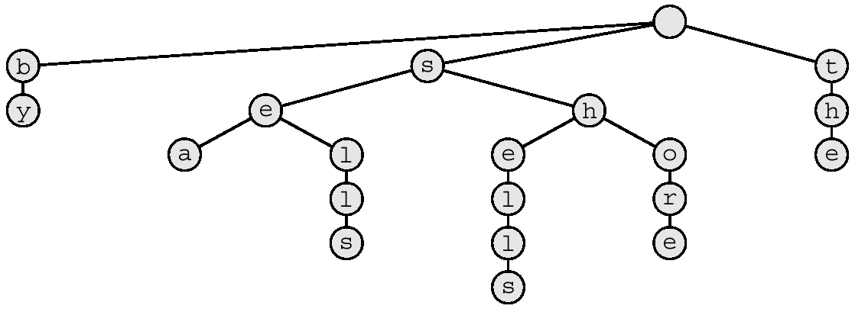
String Search Trie
Text: sells sea shells by the shore
[by]
[sea]
[the]
[sells]
[shore]
[shells]

Slide 6
String Search Trie
s
h
e
l
l
s
Search for:
[by]
[sea]
[the]
[sells]
[shore]
[shells]

Slide 7
Building a Trie for T9
How is a T9 Trie different?
Alphabet: {2-9}
2
3
4
5
6
7
8
9
2
6
2
3
4
5
8
3
6
9
7
9
5
2
[is]
3
4
9
5
6
7
8
[cap]
Notes:
Note, since numbers -> characters, you can compress the trie. What does this mean? You will be given a text file as the dictionary of words your trie should be able to predict. Take each word in the text file and translate it to its corresponding T9 sequence, and add the sequence and its word/words to the trie.

Slide 8
Handling T9onyms
2
3
4
5
6
7
8
9
2
6
2
3
4
5
8
3
6
9
7
9
5
2
[is]
3
[car]
4
9
5
6
7
8
[cap]

Slide 9
Handling T9onyms
2
3
4
5
6
7
8
9
#
2
#
2
3
4
5
6
8
3
6
9
#
7
9
5
2
[is]
3
#
4
9
[cap]
[car]
5
6
7
8
2
3
4
5
6
7
8
9
#

Slide 10
Extra Credit
More accurately implement T9:
Store the prefix of each word in the text file in the trie—
- example: foobar- “f”, “fo”, “foo”, “foob”, “fooba”, “foobar”
Order a word in the Trie by its frequency
-A word with a higher frequency will be predicted before a lower frequency word. In the text file (listed on assignment), the format of an entry will be
word frequency
Update the frequency of a word
Each time a word is used, increment the word’s frequency
Prediction of words should use updated frequencies

