Slide 1
Sets
Cse 311 Autumn 20
Lecture 10

Slide 2
Announcements
Midterm logistical information is posted.
Don’t worry it’s not for a while! Just posting the information now so you can prepare.
1. It’ll be from 11:59 PM Thursday Nov. 12 to 11:59 PM Sunday Nov. 15.
2. You can work with up to 3 others, otherwise collaboration rules are like a homework assignment.
3. If you expect DRS accommodations to apply (and I haven’t already talked to you) please send me an email as soon as possible.

Slide 3
Today
Is a laundry list day – everything you ever wanted to know about sets.
By the end, we’ll get to do two proofs.
No activity today– polleverywhere will be open all day
Asking you what we should keep/
Start/stop in lectures.
It’s anonymous (so you can give
honest feedback).
Fill out the poll everywhere for Activity Credit!
Go to pollev.com/cse311 and login with your UW identity
Or text cse311 to 22333

Slide 4
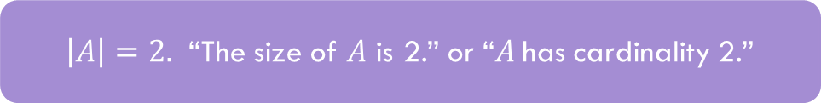
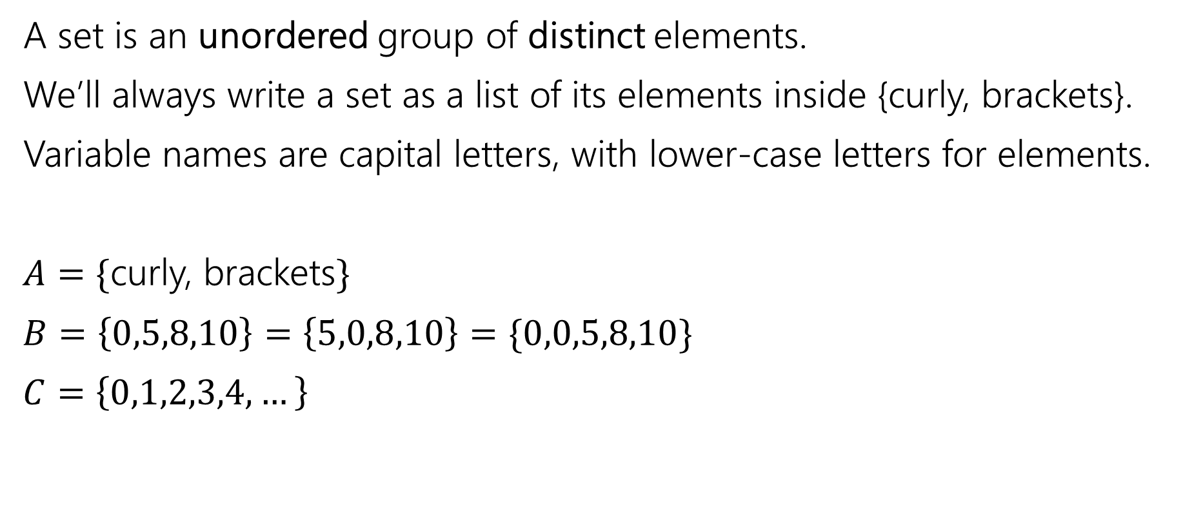
Sets
A set is an unordered group of distinct elements.
We’ll always write a set as a list of its elements inside {curly, brackets}.
Variable names are capital letters, with lower-case letters for elements.
$A=\{$curly, brackets$\}$
$B=\left\{0,5,8,10\right\}=\left\{5,0,8,10\right\}=\{0,0,5,8,10\}$
$C=\left\{0,1,2,3,4,…\right\}$
$\left|A\right|=2.$ “The size of $A$ is 2.” or “$A$has cardinality 2.”

Slide 5
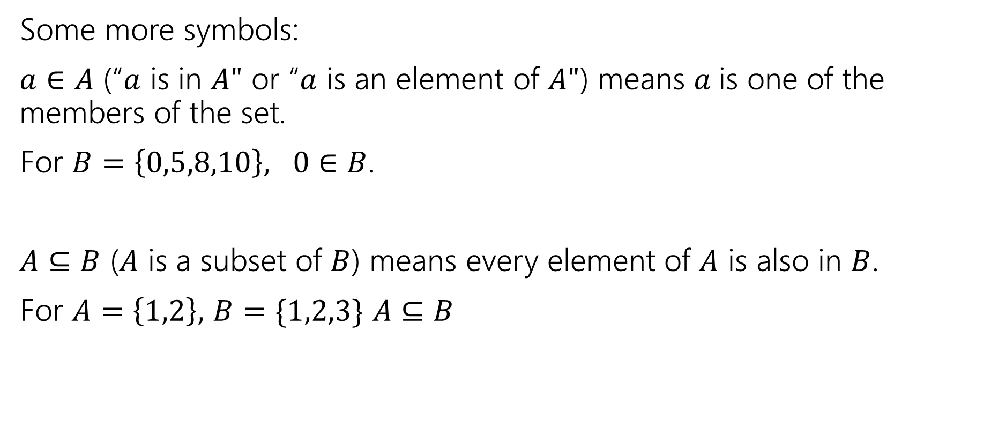
Sets
Some more symbols:
$a∈A$ (“$a$ is in $A"$ or “$a$ is an element of $A"$) means $a$is one of the members of the set.
For $B=\left\{0,5,8,10\right\}, 0∈B$.
$A⊆B$ ($A$ is a subset of $B$) means every element of $A$ is also in $B$.
For $A=\left\{1,2\right\},$ $B=\{1,2,3\}$ $A⊆B$

Slide 6

Sets
Be careful about these two operations:
If $A=\{1,2,3,4,5\}$
$\left\{1\right\}⊆A$, but $\left\{1\right\}∉A$
$∈$ asks: is this item in that box?
$⊆$ asks: is everything in this box also in that box?

Slide 7

Try it!
Let $A=\left\{1,2,3,4,5\right\}$
$B=\{1,2,5\}$
Is $A⊆A?$
Is $B⊆A?$
Is $A⊆B$?
Is $\left\{1\right\}∈A$?
Is $1∈A$?
Yes!
Yes
No
No
Yes

Slide 8
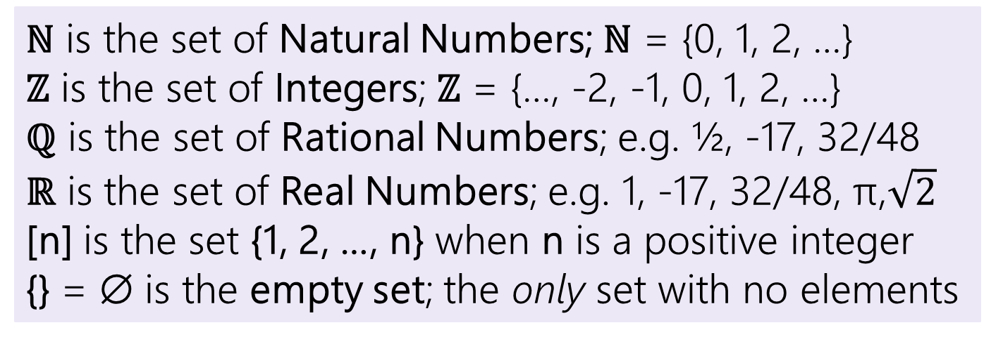
Some old friends (and some new ones)
ℕ is the set of Natural Numbers; ℕ = {0, 1, 2, …}
ℤ is the set of Integers; ℤ = {…, -2, -1, 0, 1, 2, …}
ℚ is the set of Rational Numbers; e.g. ½, -17, 32/48
ℝ is the set of Real Numbers; e.g. 1, -17, 32/48, π,$\sqrt{2}$
[n] is the set {1, 2, …, n} when n is a positive integer
{} = ∅ is the empty set; the only set with no elements

Slide 9


Definitions
$A⊆B$($"A$ is a subset of $B"$) iff every element of $A$ is also in $B$.
$A=B$ ($"A$ equals $B"$) iff $A$ and $B$ have identical elements.
$A⊆B≡∀x(x∈A→x∈B)$
$A=B≡∀x\left(x∈A↔x∈B\right)≡$ $A⊆B∧B⊆A$

Slide 10
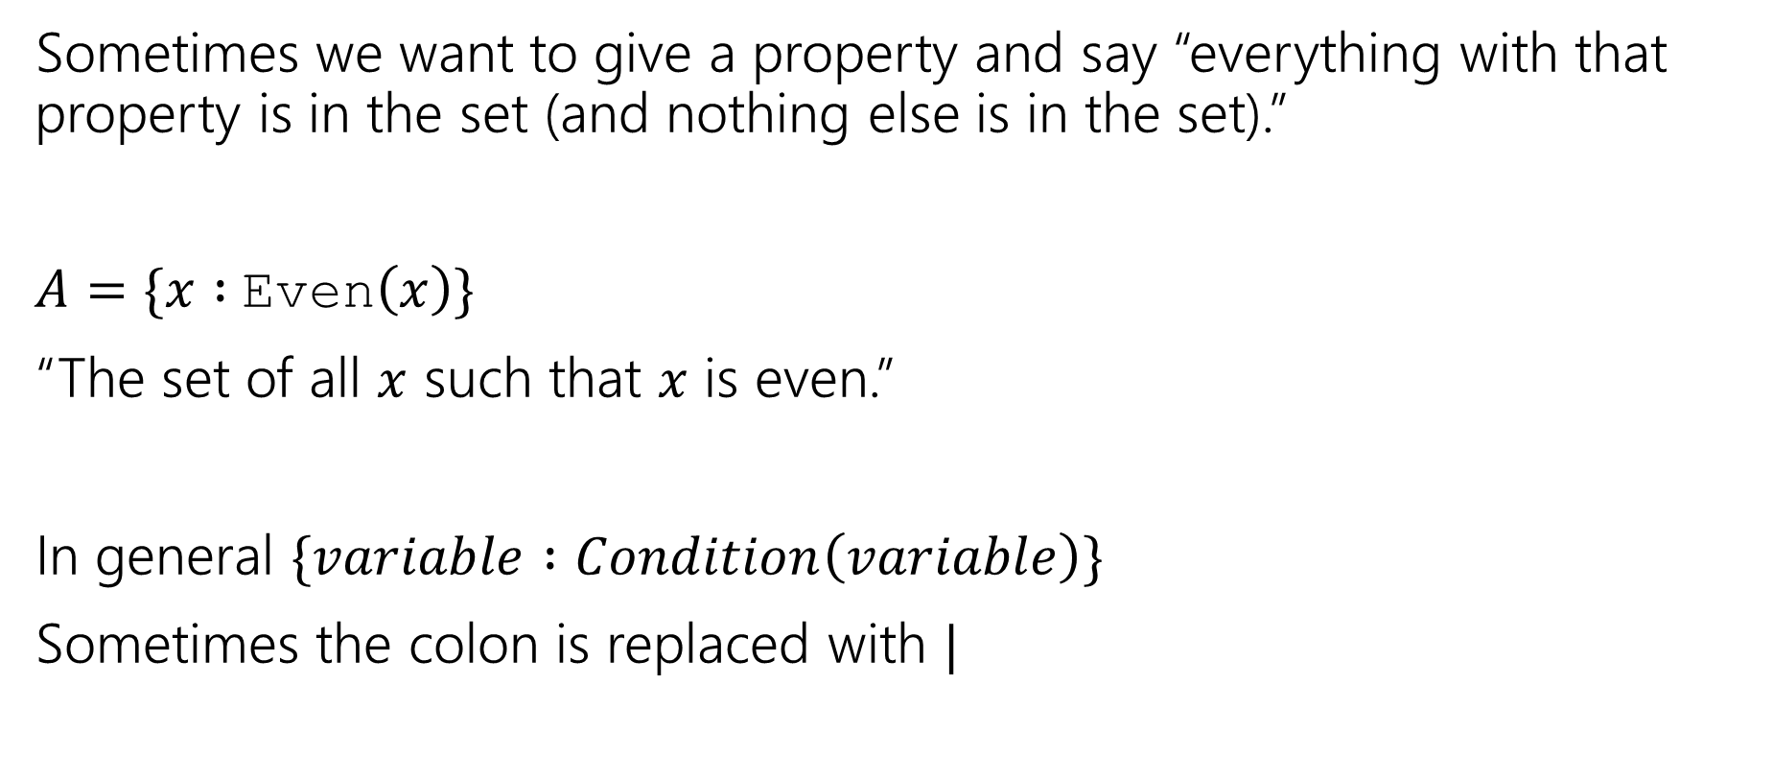
Set Builder Notation
Sometimes we want to give a property and say “everything with that property is in the set (and nothing else is in the set).”
$A=\{x :$Even$\left(x\right)\}$
“The set of all $x$ such that $x$ is even.”
In general $\{variable :Condition\left(variable\right)\}$
Sometimes the colon is replaced with $|$

Slide 11


What do we do with sets?
We combined propositions with $∨,∧,¬$.
We combine sets with $∩\left[intersection\right],∪,[union] ¯[complement]$
$A∪B=\{x:x∈A∨x∈B\}$
$A∩B=\{x:x∈A∧x∈B\}$
$\overline{A}=\{x:x∉A\}$
That’s a lot of elements…if we take the complement, we’ll have some “universe” $𝒰$, and $\overline{A}=\{x:x∈U∧x∉A\}$
It’s a lot like the domain of discourse.

Slide 12
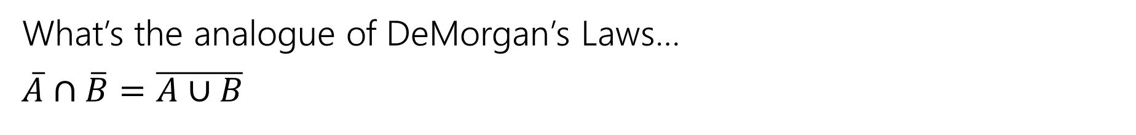
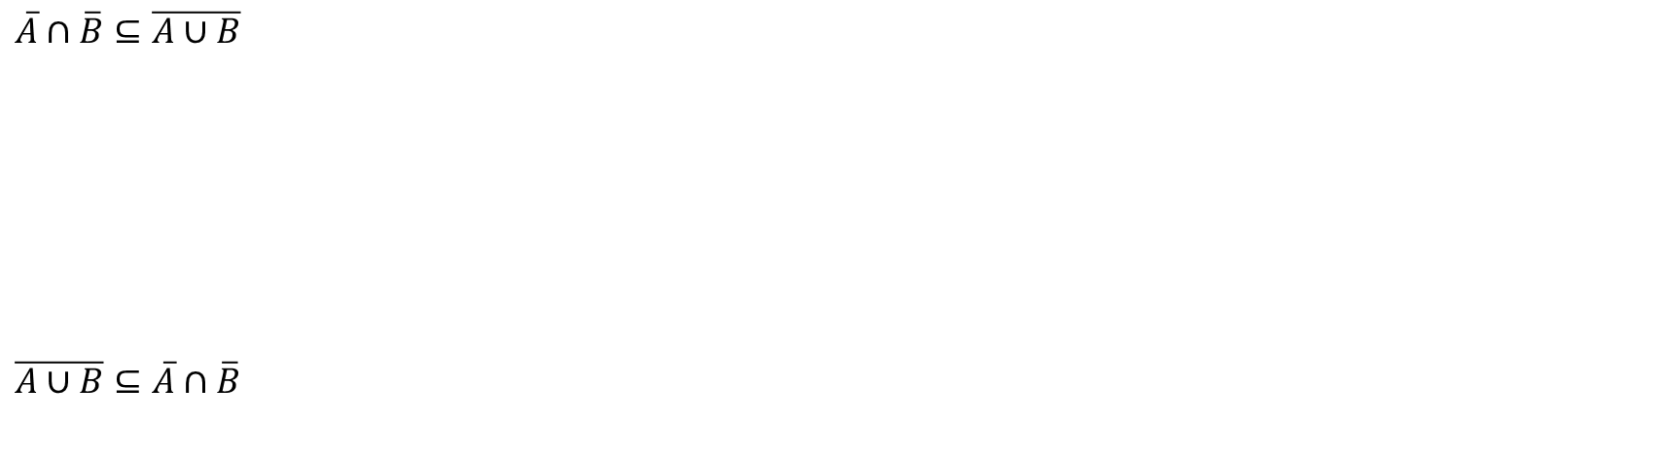
A proof!
What’s the analogue of DeMorgan’s Laws…
$\overline{A}∩\overline{B}=\overline{A∪B}$
$A=B≡∀x\left(x∈A↔x∈B\right)≡$ $A⊆B∧B⊆A$
$\overline{A}∩\overline{B}⊆\overline{A∪B}$
$\overline{A∪B}⊆\overline{A}∩\overline{B}$

Slide 13
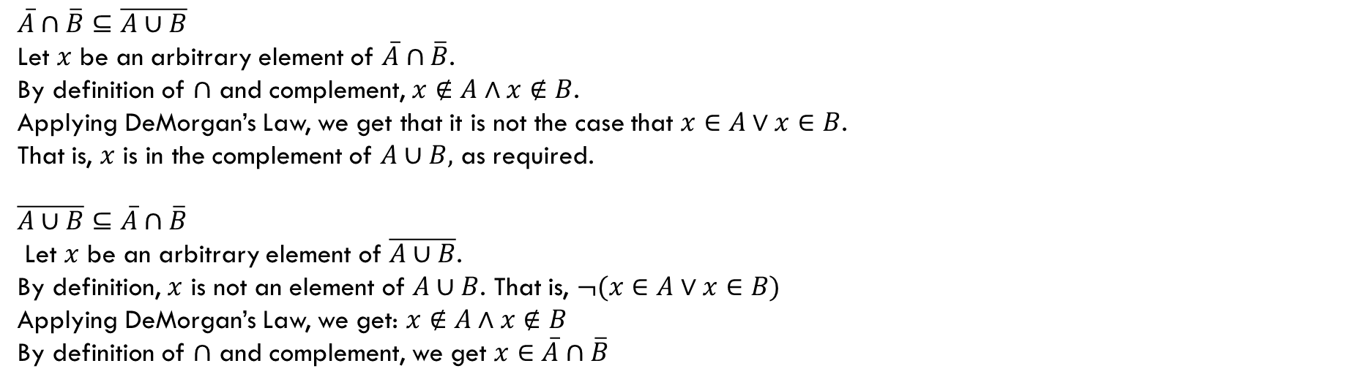
A proof!
What’s the analogue of DeMorgan’s Laws…
$\overline{A}∩\overline{B}=\overline{A∪B}$
$A=B≡∀x\left(x∈A↔x∈B\right)≡$ $A⊆B∧B⊆A$
$\overline{A}∩\overline{B}⊆\overline{A∪B}$
Let $x$ be an arbitrary element of $\overline{A}∩\overline{B}$.
By definition of $∩$ and complement, $x∉A∧x∉B$.
Applying DeMorgan’s Law, we get that it is not the case that $x∈A∨x∈B$.
That is, $x$ is in the complement of $A∪B,$ as required.
$\overline{A∪B}⊆\overline{A}∩\overline{B}$
Let $x$ be an arbitrary element of $\overline{A∪B}$.
By definition, $x$ is not an element of $A∪B$. That is, $¬(x∈A∨x∈B)$
Applying DeMorgan’s Law, we get: $x∉A∧x∉B$
By definition of $∩$ and complement, we get $x∈\overline{A}∩\overline{B}$

Slide 14
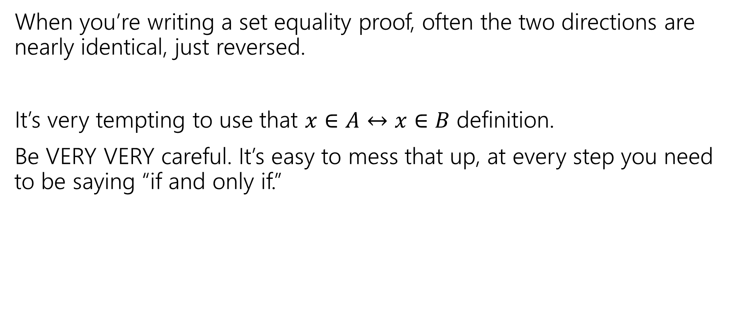
Proof-writing advice
When you’re writing a set equality proof, often the two directions are nearly identical, just reversed.
It’s very tempting to use that $x∈A↔x∈B$ definition.
Be VERY VERY careful. It’s easy to mess that up, at every step you need to be saying “if and only if.”

Slide 15

More connectors!
$A∖B$ “A minus B”
$A⊕B$ “XOR” (also called “symmetric difference”)
$$A∖B=\{x:x∈A∧x∉B\}$$
$$A⊕B=\{x:x∈A⊕x∈B\}$$

Slide 16
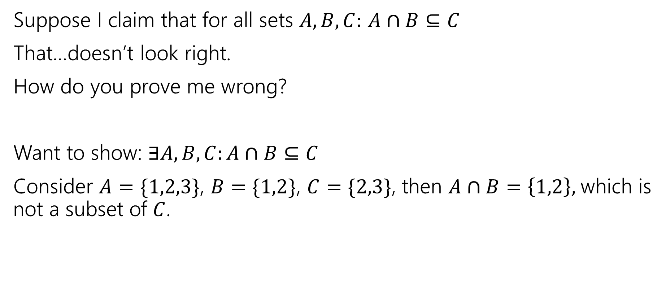
Two claims, two proof techniques
Suppose I claim that for all sets $A,B,C:$ $A∩B⊆C$
That…doesn’t look right.
How do you prove me wrong?
Want to show: $∃A,B,C:A∩B⊆C$
Consider $A=\{1,2,3\}$, $B=\{1,2\}$, $C=\{2,3\}$, then $A∩B=\left\{1,2\right\},$which is not a subset of $C$.

Slide 17
Proof By [Counter]Example
To prove an existential statement (or disprove a universal statement), provide an example, and demonstrate that it is the needed example.
You don’t have to explain where it came from! (In fact, you shouldn’t)
Computer scientists and mathematicians like to keep an air of mystery around our proofs.
  (or more charitably, we want to focus on just enough to believe the claim)

Slide 18
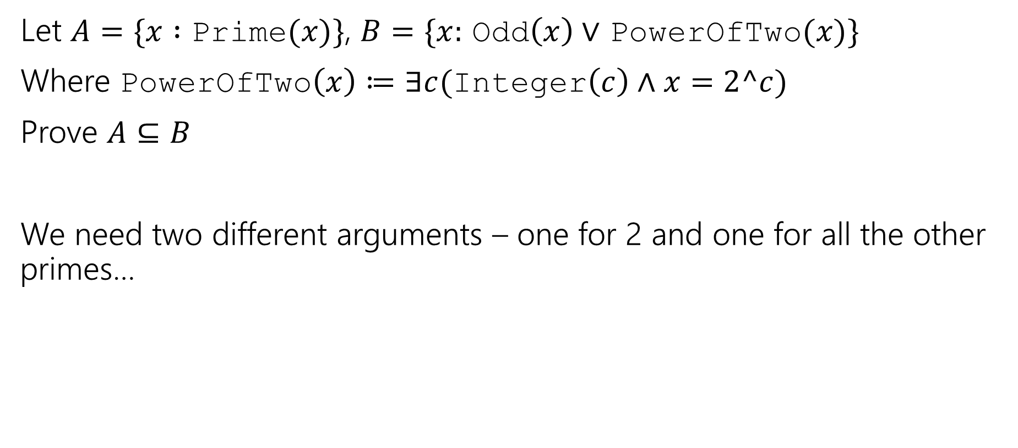
Proof by Cases
Let $A=\{x :$ Prime$(x)\}$, $B=\{x:$ Odd$\left(x\right)∨$ PowerOfTwo$(x)\}$
Where PowerOfTwo$\left(x\right)≔∃c($Integer$\left(c\right)∧x=2^c)$
Prove $A⊆B$
We need two different arguments – one for 2 and one for all the other primes…

Slide 19
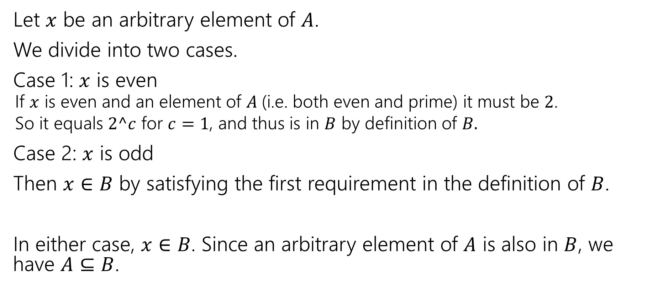
Proof By Cases
Let $x$ be an arbitrary element of $A$.
We divide into two cases.
Case 1: $x$ is even
  If $x$ is even and an element of $A$(i.e. both even and prime) it must be $2$.
  So it equals $2^c$ for $c=1$, and thus is in $B$ by definition of $B.$
Case 2: $x$ is odd
Then $x∈B$ by satisfying the first requirement in the definition of $B$.
In either case, $x∈B$. Since an arbitrary element of $A$ is also in $B$, we have $A⊆B$.

Slide 20
Proof By Cases
Make it clear how you decide which case your in.
It should be obvious your cases are “exhaustive”
Reach the same conclusion in each of the cases, and you can say you’ve got that conclusion no matter what (outside the cases).
Advanced version: sometimes you end up arguing a certain case “can’t happen”

Slide 21

Two More Set Operations
Given a set, let’s talk about it’s powerset.
$𝒫\left(A\right)=\{X:X$ is a subset of $A\}$
The powerset of $A$ is the set of all subsets of $A.$
$𝒫\left(\left\{1,2\right\}\right)=\{∅, \left\{1\right\}, \left\{2\right\}, \left\{1,2\right\}\}$

Slide 22
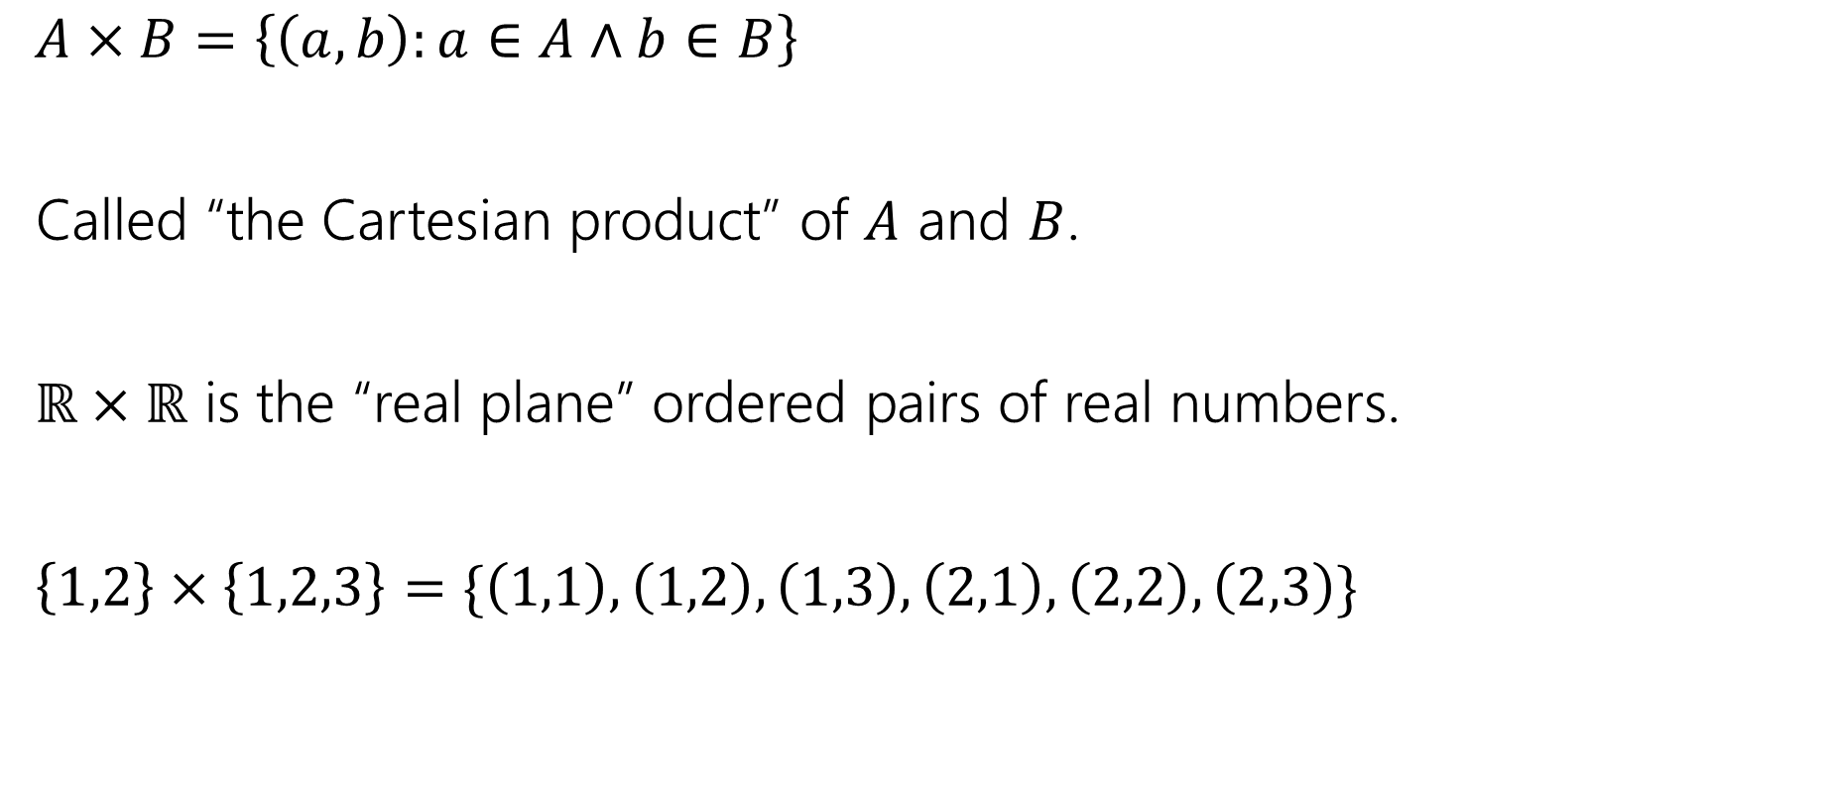
Two More Set Operations
$A×B=\left\{\left(a,b\right):a∈A∧b∈B\right\}$
Called “the Cartesian product” of $A$ and $B$.
$ℝ×ℝ$ is the “real plane” ordered pairs of real numbers.
$\left\{1,2\right\}×\left\{1,2,3\right\}=\{\left(1,1\right),\left(1,2\right),\left(1,3\right), \left(2,1\right), \left(2,2\right), \left(2,3\right)\}$

Slide 23
Number Theory

Slide 24
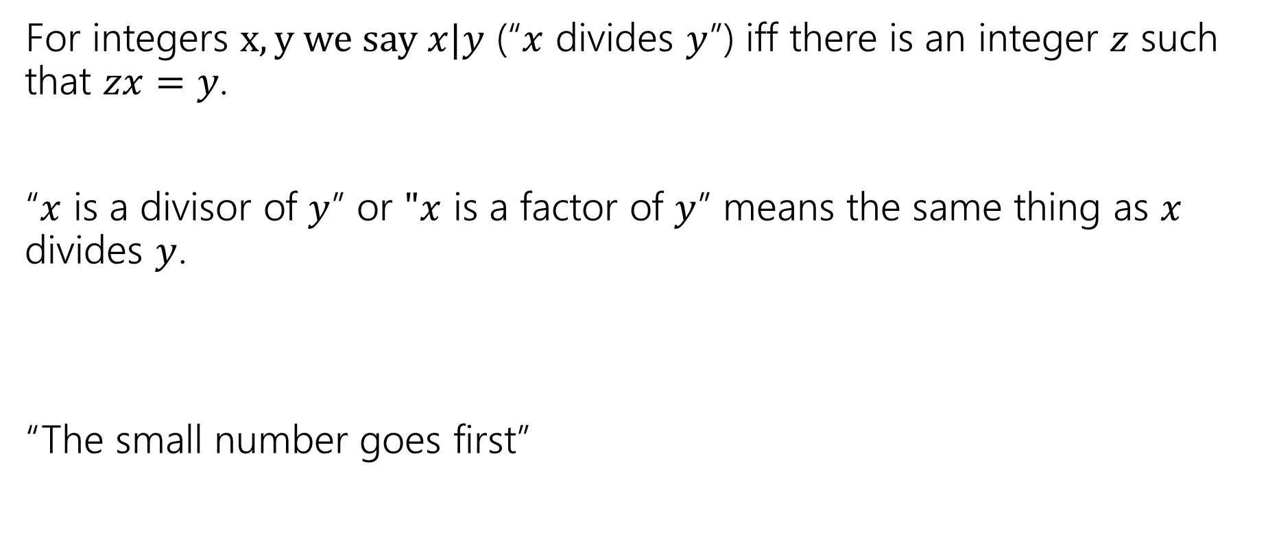
Divides
For integers $x,y we say x|y$ (“$x$ divides $y$”) iff there is an integer $z$ such that $zx=y$.
“$x$ is a divisor of $y$” or $"x$ is a factor of $y$” means the same thing as $x$ divides $y$.
“The small number goes first”

