Slide 1
Halting Problem

Slide 2
A Practical Uncomputable Problem
Every pressed the run button on your code and have it take a long time?
Like an infinitely long time?
What didn’t your compiler…like, tell you not to push the button yet.
It tells you when your code doesn’t compile before it runs it…why doesn’t it check for infinite loops?

Slide 3
The Halting Problem
Given: source code for a program $P$ and $x$ an input we could give to $P$
Return: True if $P$ will halt on $x$, False if it runs forever (e.g. goes in an infinite loop or infinitely recurses)
The Halting Problem
This would be super useful to solve!
We can’t solve it…let’s find out why.

Slide 4
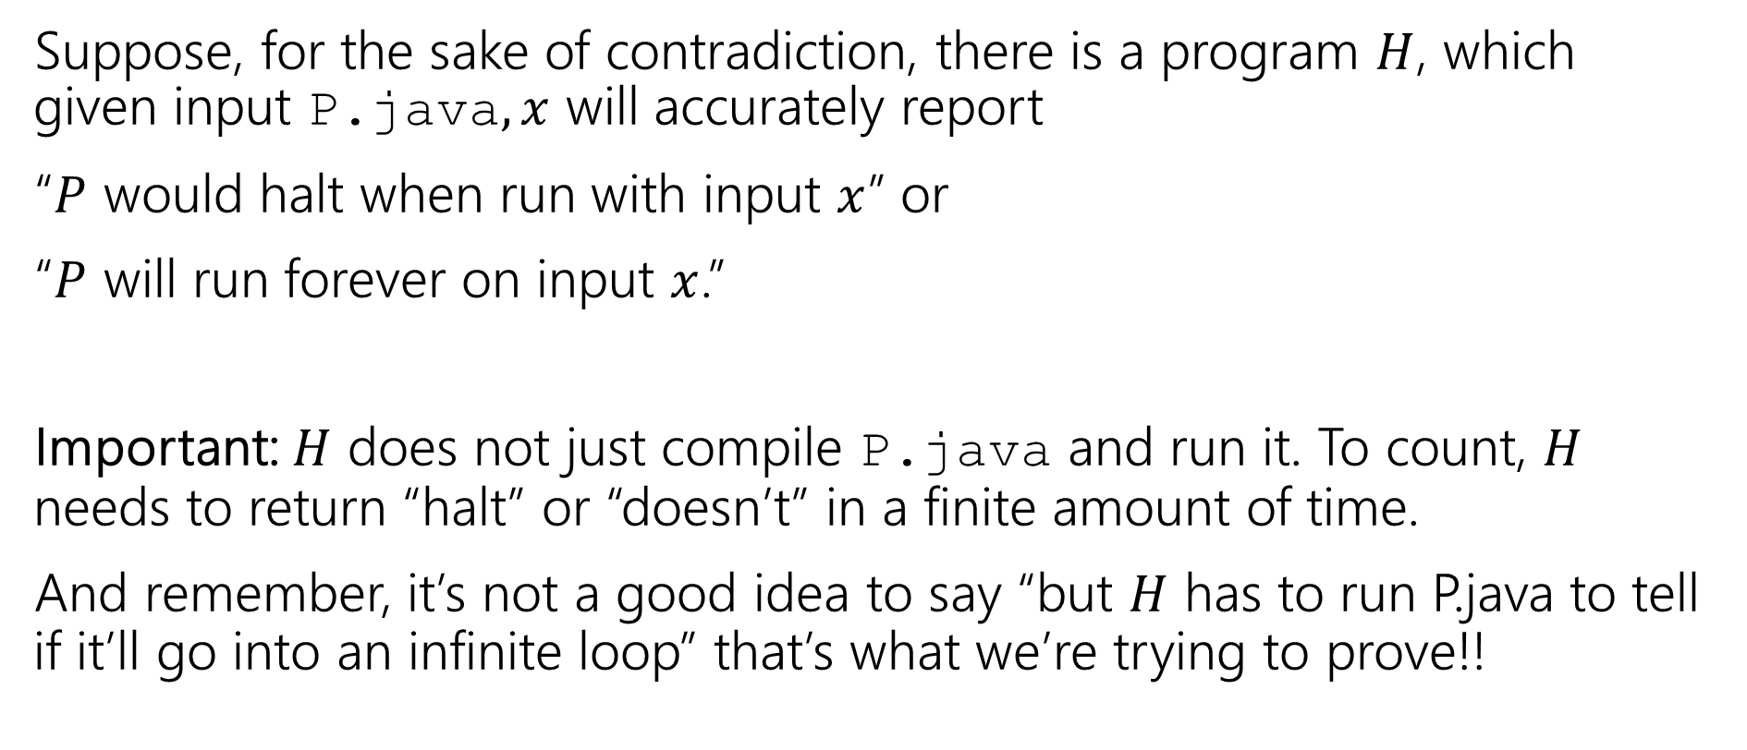
A Proof By Contradiction
Suppose, for the sake of contradiction, there is a program $H$, which given input P.java$,x$ will accurately report
“$P$ would halt when run with input $x$” or
“$P$ will run forever on input $x$.”
Important: $H$ does not just compile P.java and run it. To count, $H$ needs to return “halt” or “doesn’t” in a finite amount of time.
And remember, it’s not a good idea to say “but $H$ has to run P.java to tell if it’ll go into an infinite loop” that’s what we’re trying to prove!!

Slide 5
A Very Tricky Program.
Diagonal.java(String x){
Run H.exe on input <x, x>
if(H.exe says “x halts on x”)
while(true){//Go into an infinite loop
int x=2+2;
}
else //H.exe says “x doesn’t halt on x”
return; //halt.
}

Slide 6
So, uhh that’s a weird program.
What do we do with it?
USE IT TO BREAK STUFF
Does Diagonal.java halt when its input is Diagonal.java?
Let’s assume it does and see what happens…

Slide 7
A Very Tricky Program.
Imagine Diagonal.java halts on Diagonal.java.
Then H better say it halts.
So it goes into an infinite loop.
Wait shoot.
Diagonal.java(String x){
Run H.exe on input <x, x>
if(H.exe says “x halts on x”)
while(true){//Go into an infinite loop
int x=2+2;
}
else //H.exe says “x doesn’t halt on x”
return; //halt.
}

Slide 8
So, uhh that’s a weird program.
What do we do with it?
USE IT TO BREAK STUFF
Does Diagonal.java halt when its input is Diagonal.java?
Let’s assume it does and see what happens…
That didn’t work.
Let’s assume it doesn’t and see what happens…

Slide 9
A Very Tricky Program.
Imagine Diagonal.java doesn’t halt on Diagonal.java.
Then H better say it doesn’t halt.
So we go into the else branch.
And it halts
Wait shoot.
Diagonal.java(String x){
Run H.exe on input <x, x>
if(H.exe says “x halts on x”)
while(true){//Go into an infinite loop
int x=2+2;
}
else //H.exe says “x doesn’t halt on x”
return; //halt.
}

Slide 10
So, uhh that’s a weird program.
What do we do with it?
USE IT TO BREAK STUFF
Does Diagonal.java halt when its input is Diagonal.java?
Let’s assume it does and see what happens…
That didn’t work.
Let’s assume it doesn’t and see what happens…
That didn’t work either.
There’s no third option. It either halts or it doesn’t. And it doesn’t do either. That’s a contradiction! H.exe can’t exist.

Slide 11
So…
So there is no general-purpose algorithm that decides whether any input program (on any input string).
The Halting Problem is undecidable (i.e. uncomputable) there is no algorithm that solves every instance of the problem correctly.

Slide 12
What that does and doesn’t mean
That doesn’t mean that there aren’t algorithms that often get the answer right
For example, if there’s no loops, no recursion, and no method calls, it definitely halts. No problem with that kind of program existing.
This isn’t just a failure of computers – if you think you can do this by hand, well…
…you cant either.

Slide 13
Takeaways
Don’t expect that there’s a better IDE/better compiler/better programming language coming that will make it possible to tell if your code is going to hit an infinite loop.
It’s not coming.

Slide 14
More Uncomputable problems
Imagine we gave the following task to 142 students:
Write a program that prints “Hello World”
Can you make an autograder?
Technically…NO!

Slide 15
More Uncomputable problems
Imagine we gave the following task to 142 students:
Write a program that prints “Hello World”
Can you make an autograder?
Technically…NO!
In practice, we declare the program wrong if it runs for 1 minute or so. That’s not right 100% of the time, but it’s good enough for your programming classes.

Slide 16
How Would we prove that?
With a reduction
Suppose, for the sake of contradiction, I can solve the HelloWorld problem. (i.e. on input P.java I can tell whether it eventually prints HelloWorld)
Let W.exe solve that problem.
Consider this program…

Slide 17
A Reduction
Trick(P,x){
Run P on x, //(but only simulate printing if P prints things)
Print “Hello World”
}
This actually prints “hello world” iff P halts on x.
Plug Trick into W and….we solved the Halting Problem!

Slide 18
Reductions in General
The big idea for reductions is “reusing code”
Just like calling a library
But doing it in contrapositive form.
Instead of
“If I have a library, then I can solve a new problem” reductions do the contrapositive: “If I can solve a problem I know I shouldn’t be able to, then that library function can’t exist”

Slide 19
Fun (Scary?) Fact
Rice’s Theorem
Says any “non-trivial” behavior of programs cannot be computed (in finite time).

Slide 20
What Comes next?
CSE 312 (foundations II)
Fewer proofs ☹
Basics of probability theory (super useful in algorithms, ML, and just everyday life). Fundamental statistics.
CSE 332 (data structures and parallelism)
Data structures, a few fundamental algorithms, parallelism.
Graphs. Graphs everywhere.
Also, induction. [same for 421, 422 the algorithms courses]
CSE 431 (complexity theory)
What can’t you do with computers in a reasonable amount of time.
Beautiful theorems – more on CFGs, DFAs/NFAs as well.

Slide 21
We’ve Covered A LOT
Propositional Logic.
Boolean logic and circuits.
Boolean algebra.
Predicates, quantifiers and predicate logic.
Inference rules and formal proofs for propositional and predicate logic.
English proofs.
Set theory.
Modular arithmetic.
Prime numbers.
GCD, Euclid's algorithm and modular inverse
You’ll use quantifiers in 332 to define big-O
431 is basically 10 weeks of fun set proofs.
Interested in crypto? They’ll come back.

Slide 22
No really. A lot
Induction and Strong Induction.
Recursively defined functions and sets.
Structural induction.
Regular expressions.
Context-free grammars and languages.
Relations and composition.
Transitive-reflexive closure.
Graph representation of relations and their closures.
Lots of induction proof [sketches] in 332
You’ll see these in compilers
You’ll use graphs at least once a week for the rest of your CS career.

Slide 23
Like A lot a lot.
DFAs, NFAs and language recognition.
Cross Product construction for DFAs.
Finite state machines with outputs at states.
Conversion of regular expressions to NFAs.
Powerset construction to convert NFAs to DFAs.
Equivalence of DFAs, NFAs, Regular Expressions
Method to prove languages not accepted by DFAs.
Cardinality, countability and diagonalization
Undecidability: Halting problem and evaluating properties of programs.
Promise you won’t ever try to solve the Halting Problem? It’s tempting to try to sometimes if you don’t remember it’s undecidable

