Slide 1
More English Proofs
CSE 311 Fall 23
Lecture 8

Slide 2
About Grades
Grades were critical in your lives up until now.
  If you were in high school, they’re critical for getting into college.
  If you were at UW or CC applying to CSE, they were key to that application
Regardless of where you’re going next, what you learn in this course matters FAR more than what your grade is in this course.
If you’re planning on industry – interviews matter more than grades.
If you’re planning on grad school – letters matter most, those are based on doing work outside of class building off what you learned in class.

Slide 3
About Grades
What that means:
The TAs and I are going to prioritize your learning over debating whether -2 or -1 is “ more fair”
If you’re worried about “have I explained enough” – write more!
It’ll take you longer to write the Ed question than write the extended answer. We don’t take off for too much work.
  And the extra writing is going to help you learn more anyway.

Slide 4
Regrades
TAs make mistakes!
When I was a TA, I made errors on 1 or 2% of my grading that needed to be corrected. If we made a mistake, file a regrade request on gradescope.
But those are only for mistakes, not for whether “-1 would be more fair”
If you are confused, please talk to us!
  My favorite office hours questions are “can we talk about the best way to do something on the homework we just got back?”
  If after you do a regrade request on gradescope, you still think a grading was incorrect, send email to Robbie.
  Regrade requests will close about 1 week after homework is returned.

Slide 5


Integer
We need a basic starting point to be able to prove things.
Objects to work with.
Some definitions to analyze
An integer: is any real number with no fractional part.
Even(x) := An integer, $x,$ is even if and only if there is an integer $k$such that $x=2k.$
Odd(x) := An integer, $x,$ is odd
if and only if there is an integer $k$such that $x=2k+1.$
Even
Odd
Notes:
This isn’t the “real” definition of integer---it relies on real numbers! Which we haven’t defined (go visit the math department)
For our purposes, there’s no need to dig deeper

Slide 6

A word on definitions
Definitions are fundamental. Our goal is to communicate precisely.
When you come across an edge case, a definition is the way to solve it.
  Is -4 even? Well $∃k(−4=2k)$ (take $k=−2$), so yes it is!
  We go to the definition. Not your gut feeling about what feels right.
How do we know something is true? Usually we verify the definition!

Slide 7
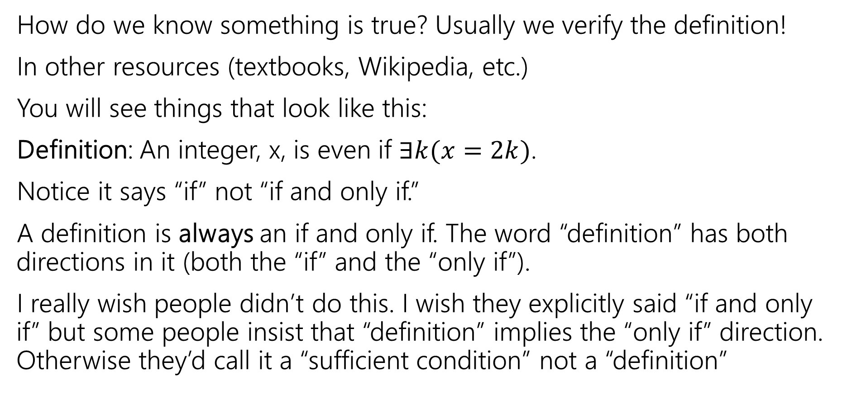
A word on definitions
How do we know something is true? Usually we verify the definition!
In other resources (textbooks, Wikipedia, etc.)
You will see things that look like this:
Definition: An integer, x, is even if $∃k(x=2k)$.
Notice it says “if” not “if and only if.”
A definition is always an if and only if. The word “definition” has both directions in it (both the “if” and the “only if”).
I really wish people didn’t do this. I wish they explicitly said “if and only if” but some people insist that “definition” implies the “only if” direction. Otherwise they’d call it a “sufficient condition” not a “definition”

Slide 8
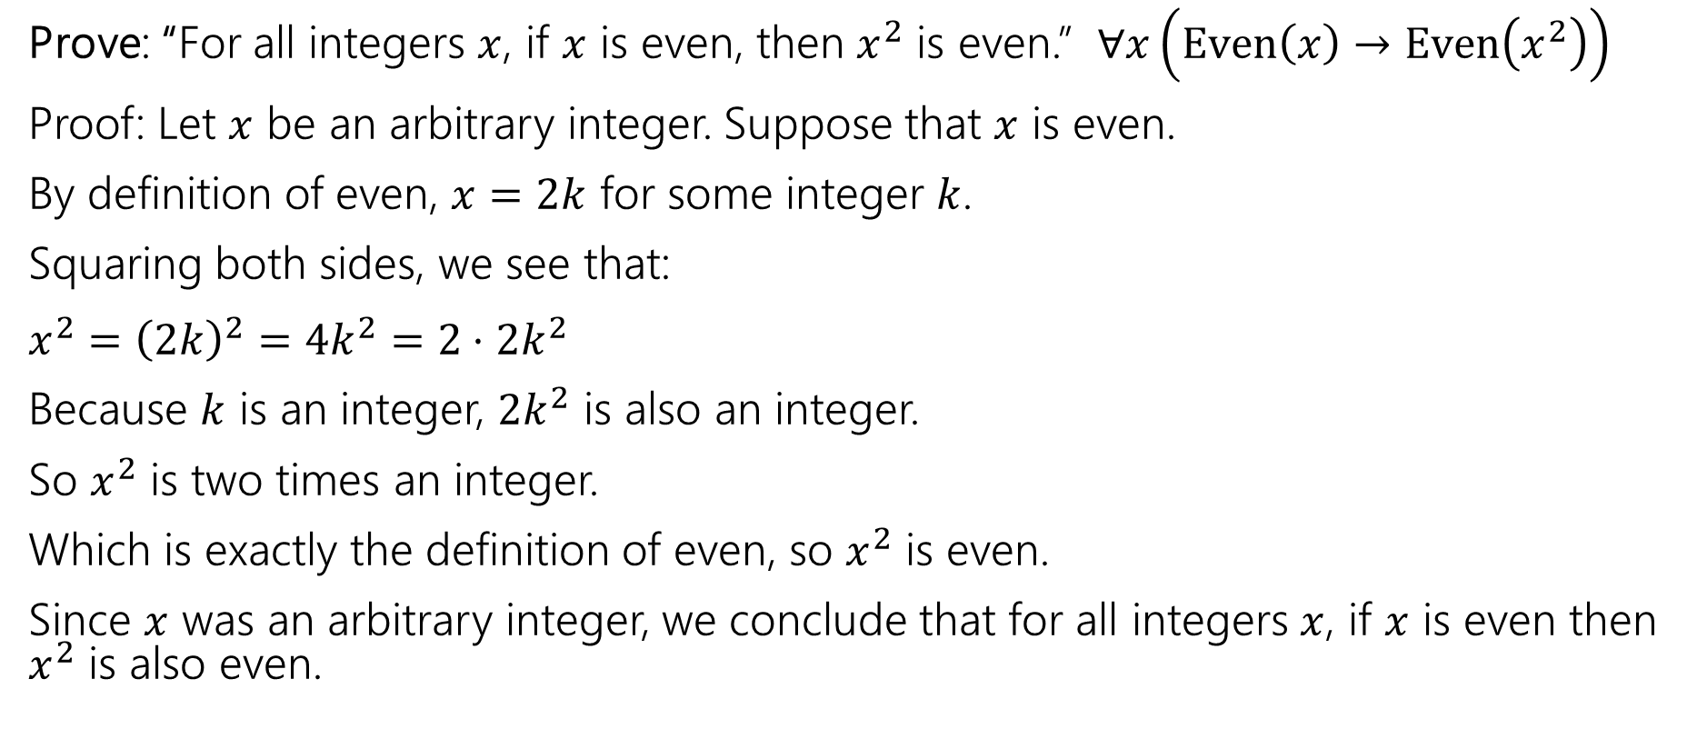
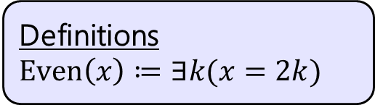
Our First Direct Proof
Definitions
$Even\left(x\right)≔∃k(x=2k)$
Prove: “For all integers $x$, if $x$ is even, then $x^{2}$ is even.” $∀x\left(Even\left(x\right)→Even\left(x^{2}\right)\right)$
Proof: Let $x$ be an arbitrary integer. Suppose that $x$ is even.
By definition of even, $x=2k$ for some integer $k$.
Squaring both sides, we see that:
$x^{2}={\left(2k\right)}^{2}=4k^{2}=2⋅2k^{2}$
Because $k$ is an integer, $2k^{2}$ is also an integer.
So $x^{2}$ is two times an integer.
Which is exactly the definition of even, so $x^{2}$ is even.
Since $x$ was an arbitrary integer, we conclude that for all integers $x$, if $x$ is even then $x^{2}$ is also even.
Notes:
Let $x$ be an arbitrary integer. Suppose that $x$ is even. Then by definition of even, there exists some integer $k$ such that $x=2k$. Squaring both sides, we see that:
$$x^{2}={\left(2k\right)}^{2}=4k^{2}=2⋅2k^{2}$$
Because $k$ is an integer, then $2k^{2}$ is also an integer. So $x^{2}$ is two times an integer.
So by definition of even, $x^{2}$ is even.
Since $x$ was an arbitrary integer, we can conclude that for all integers $x$, if $x$ is even
then $x^{2}$ is even.
Run through with a number

Slide 9
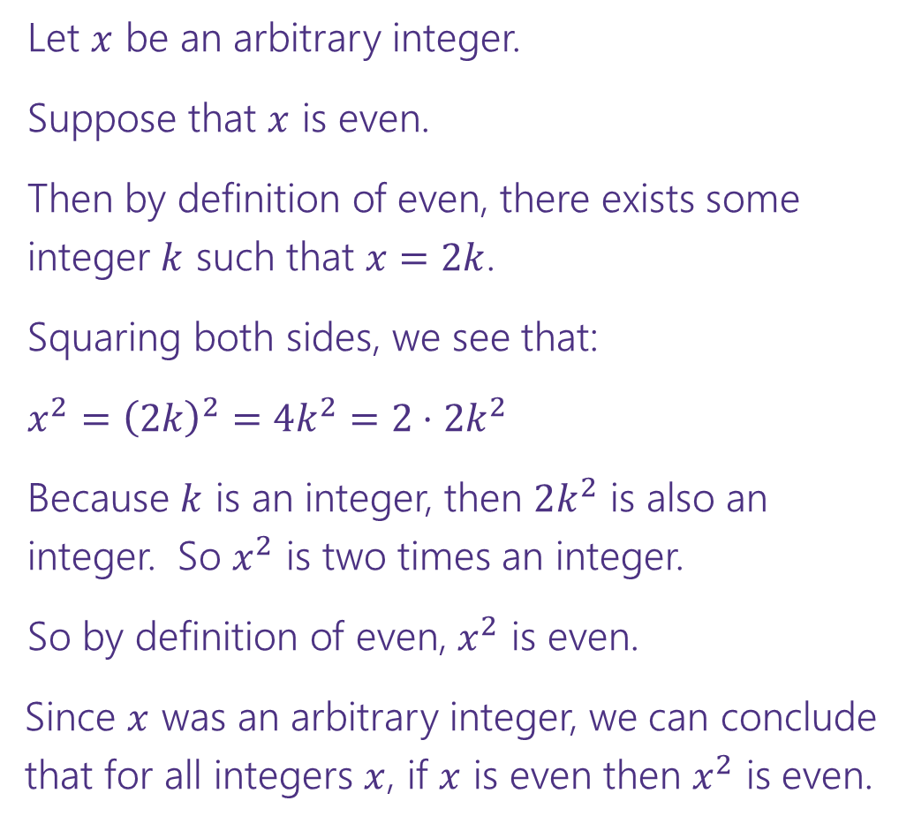


Direct Proof Template
Prove: $∀x\left(Even\left(x\right)→Even\left(x^{2}\right)\right)$
  Declare an arbitrary variable for each $∀$.
Let $x$ be an arbitrary integer.
Suppose that $x$ is even.
Then by definition of even, there exists some integer $k$ such that $x=2k$.
Squaring both sides, we see that:
$x^{2}={\left(2k\right)}^{2}=4k^{2}=2⋅2k^{2}$
Because $k$ is an integer, then $2k^{2}$ is also an integer. So $x^{2}$ is two times an integer.
So by definition of even, $x^{2}$ is even.
Since $x$ was an arbitrary integer, we can conclude
that for all integers $x$, if $x$ is even then $x^{2}$ is even.
  Assume the left side of the implication.
  Unroll the predicate definitions.
  Manipulate towards the goal.
  Reroll definitions into the right side of the implication.
  Conclude that you have proved the claim.

Slide 10
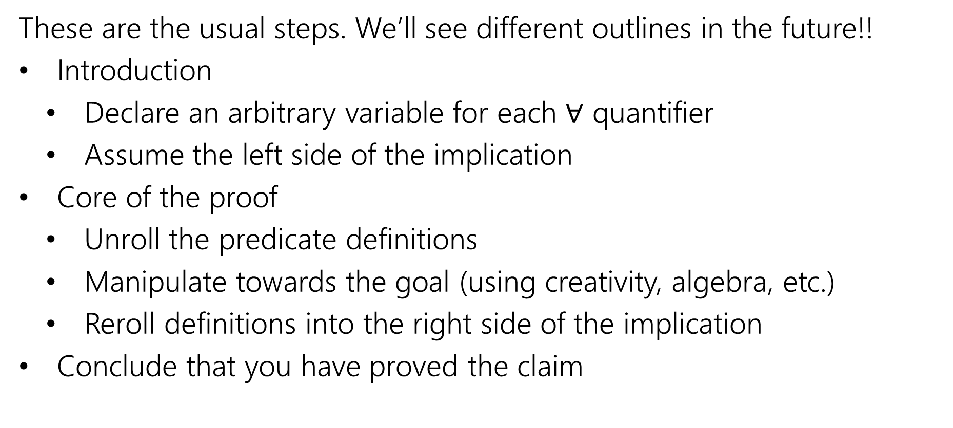
Direct Proof Steps
  These are the usual steps. We’ll see different outlines in the future!!
  Introduction
    Declare an arbitrary variable for each $∀$ quantifier
    Assume the left side of the implication
  Core of the proof
    Unroll the predicate definitions
    Manipulate towards the goal (using creativity, algebra, etc.)
    Reroll definitions into the right side of the implication
  Conclude that you have proved the claim

Slide 11
Another Direct Proof
  Prove: “The product of two odd integers is odd.”
  What’s the claim in logic?
  How would we prove this claim?
Notes:
Prove: “The product of two odd integers is odd.”
Intuition: is this true?
What’s the claim in logic? $∀x∀y \left(\left(Odd\left(x\right)∧Odd\left(y\right)\right)→Odd\left(xy\right)\right)$
How would we prove this claim?
Direct Proof. In particular, we’ll let $x,y$ be arbitrary integers. We’ll suppose $x,y$ are odd. We’ll show that $x⋅y$ is odd.

Slide 12

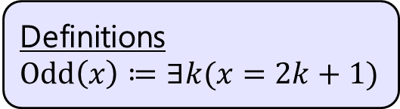
Another Direct Proof
Definitions
$Odd\left(x\right)≔∃k(x=2k+1)$
Prove: “The product of two odd integers is odd.”
$∀x∀y\left(\left(Odd\left(x\right)∧Odd\left(y\right)\right)→Odd\left(xy\right)\right)$
Notes:
At each step, reference the direct proof template. Discuss the role of the formal logic claim.
Let $x$ and $y$ be arbitrary integers. Suppose that $x$ and $y$ are odd. Then by definition of odd, there exists some integer $k$ such that $x=2k+1$, and some integer $j$ such that $y=2j+1$.
Then multiplying $x$ and $y$, we can see that:
$$xy=\left(2k+1\right)⋅\left(2j+1\right)=4kj+2j+2k+1=2\left(2kj+j+k\right)+1$$
Since $k,j$ are integers, $2kj+j+k$ is an integer. So by definition of odd, $xy$ is odd. Since $x,y$ were arbitrary, we have shown that the product of two odd integers is odd.

Slide 13
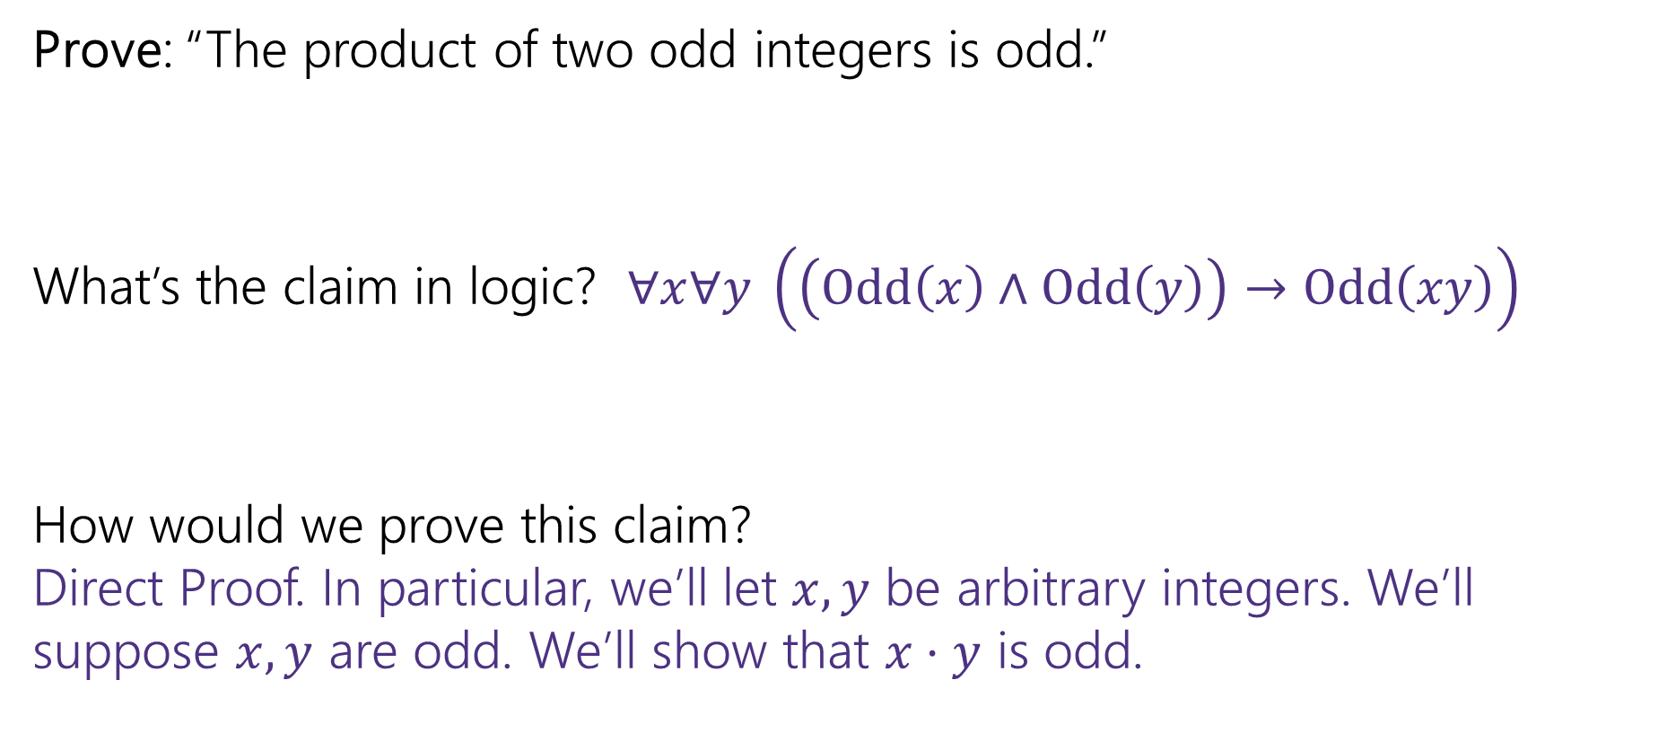
Another Direct Proof
  Prove: “The product of two odd integers is odd.”
  What’s the claim in logic? $∀x∀y \left(\left(Odd\left(x\right)∧Odd\left(y\right)\right)→Odd\left(xy\right)\right)$
  How would we prove this claim?
  Direct Proof. In particular, we’ll let $x,y$ be arbitrary integers. We’ll suppose $x,y$ are odd. We’ll show that $x⋅y$ is odd.

Slide 14
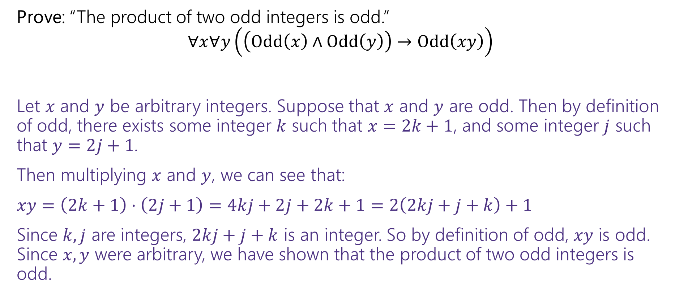
Another Direct Proof
Definitions
$Odd\left(x\right)≔∃k(x=2k+1)$
Prove: “The product of two odd integers is odd.”
$∀x∀y\left(\left(Odd\left(x\right)∧Odd\left(y\right)\right)→Odd\left(xy\right)\right)$
Let $x$ and $y$ be arbitrary integers. Suppose that $x$ and $y$ are odd. Then by definition of odd, there exists some integer $k$ such that $x=2k+1$, and some integer $j$ such that $y=2j+1$.
Then multiplying $x$ and $y$, we can see that:
$xy=\left(2k+1\right)⋅\left(2j+1\right)=4kj+2j+2k+1=2\left(2kj+j+k\right)+1$
Since $k,j$ are integers, $2kj+j+k$ is an integer. So by definition of odd, $xy$ is odd. Since $x,y$ were arbitrary, we have shown that the product of two odd integers is odd.

Slide 15
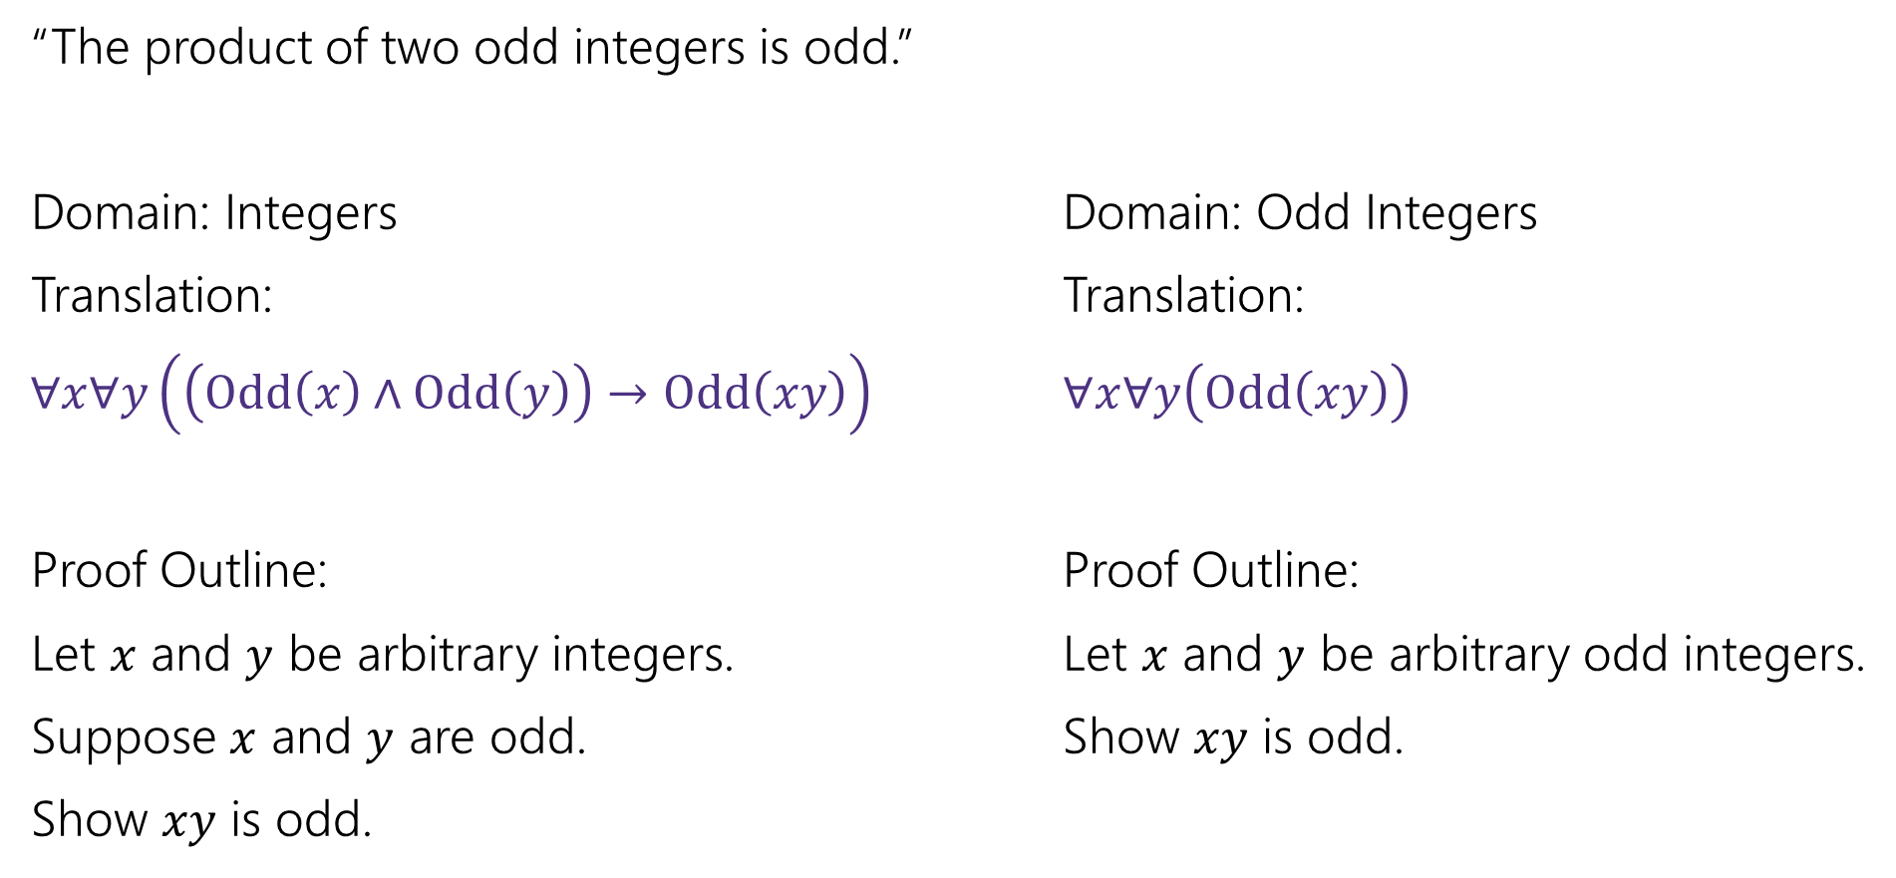
A note on Domain of Discourse
“The product of two odd integers is odd.”
Domain: Integers Domain: Odd Integers
Translation: Translation:
$∀x∀y\left(\left(Odd\left(x\right)∧Odd\left(y\right)\right)→Odd\left(xy\right)\right)$ $∀x∀y\left(Odd\left(xy\right)\right)$
Proof Outline: Proof Outline:
Let $x$ and $y$ be arbitrary integers. Let $x$ and $y$ be arbitrary odd integers.
Suppose $x$ and $y$ are odd. Show $xy$ is odd.
Show $xy$ is odd.

Slide 16
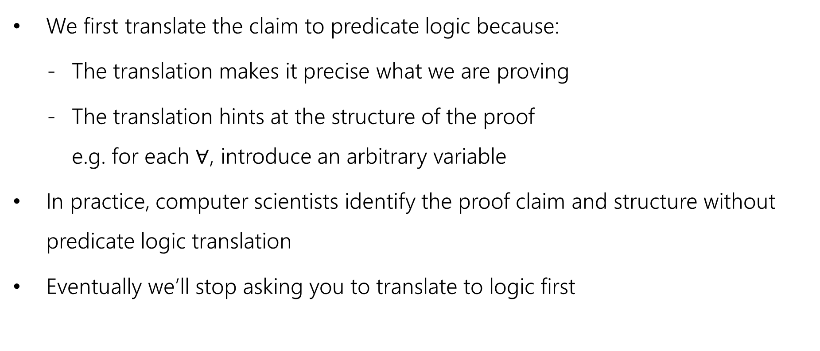
A note on Translation to Logic
  We first translate the claim to predicate logic because:
      The translation makes it precise what we are proving
      The translation hints at the structure of the proof
      e.g. for each $∀$, introduce an arbitrary variable
  In practice, computer scientists identify the proof claim and structure without predicate logic translation
  Eventually we’ll stop asking you to translate to logic first

Slide 17

Square
  Definition:
  An integer $x$ is square iff there exists an integer $k$ such that $x=k^{2}$.
  $Square\left(x\right)≔∃k \left(x=k^{2}\right)$

Slide 18

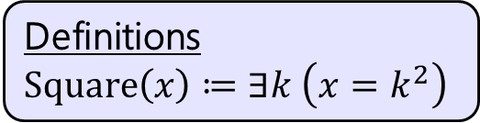
Yet Another Direct Proof
Definitions
$Square\left(x\right)≔∃k \left(x=k^{2}\right)$
Prove: The product of two square integers is square.
  What’s the claim in logic?
  $$∀n∀m\left(\left(Square\left(n\right)∧Square\left(m\right)\right)→Square\left(nm\right)\right)$$
  Prove this claim.

Slide 19

Yet Another Direct Proof
Definitions
$Square\left(x\right)≔∃k \left(x=k^{2}\right)$
Prove: “The product of two square integers is square.”
$$∀n∀m\left(\left(Square\left(n\right)∧Square\left(m\right)\right)→Square\left(nm\right)\right)$$

Slide 20
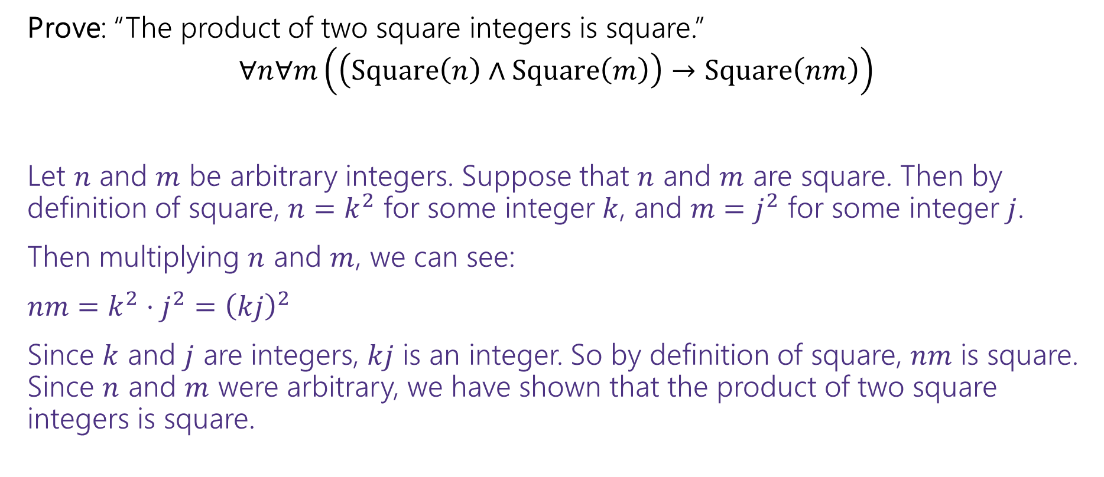
Yet Another Direct Proof
Definitions
$Square\left(x\right)≔∃k \left(x=k^{2}\right)$
Prove: “The product of two square integers is square.”
$$∀n∀m\left(\left(Square\left(n\right)∧Square\left(m\right)\right)→Square\left(nm\right)\right)$$
Let $n$ and $m$ be arbitrary integers. Suppose that $n$ and $m$ are square. Then by definition of square, $n=k^{2}$ for some integer $k$, and $m=j^{2}$ for some integer $j$.
Then multiplying $n$ and $m$, we can see:
$nm=k^{2}⋅j^{2}={\left(kj\right)}^{2}$
Since $k$ and $j$ are integers, $kj$ is an integer. So by definition of square, $nm$ is square. Since $n$ and $m$ were arbitrary, we have shown that the product of two square integers is square.

Slide 21
Inference Proofs

Slide 22
A Brief Return to Training Wheels
For about 1.5 lectures, we’re going to study “inference proofs”
The rules for these proofs are
1. Strict enough that computers can check them (there are languages designed to do that!)
2. More general than the simplification rules we’ve seen so far.
  You’ll still use the simplification rules!
  But you’ll find we can prove more things (at least without significant difficulty).
3. More similar to the proofs we spend most of the quarter writing.

Slide 23
A Brief Return to Training Wheels
The claims and proofs are quite abstract!
Why spend time here?
Some computer scientists use the fully formal (computer-checkable) version of the rules.
  Our PL group here contains experts in these topics!
We want your takeaways to be
  In principle, any proof we write in this class could be made fully formal and checked.
  But it can be a lot of work, so we usually think and communicate in English. We’re people after all!

Slide 24
Inference Proofs
A new way of thinking of proofs:
Here’s one way to get an iron-clad guarantee:
1. Write down all the facts we know.
2. Combine the things we know to derive new facts.
3. Continue until what we want to show is a fact.

Slide 25
Drawing Conclusions
You know “If it is raining, then I have my umbrella”
And “It is raining”
You should conclude….
For whatever you conclude, convert the statement to propositional logic – will your statement hold for any propositions, or is it specific to raining and umbrellas?
I have my umbrella!
I know $(p→q)$ and $p$, I can conclude $q$
Or said another way: $\left[\left(p→q\right)∧p\right]→q$

Slide 26
Modus Ponens
The inference from the last slide is always valid. I.e.
$$\left[\left(p→q\right)∧p\right]→q$$
Has only True rows in its truth table (it’s a tautology)

Slide 27
Modus Ponens – a formal proof
$$\left[\left(p→q\right)∧p\right]→q$$
$≡[\left(¬p∨q\right)∧p]→q$
$≡\left[p∧\left(¬p∨q\right)\right]→q$
$≡\left[\left(p∧¬p\right)∨\left(p∧q\right)\right]→q$
$≡\left[F∨\left(p∧q\right)\right]→q$
$≡\left[\left(p∧q\right)∨F\right]→q$
$≡\left[\left(p∧q\right)\right]→q$
$≡\left[¬\left(p∧q\right)\right]∨q$
$≡\left[¬p∨¬q\right]∨q$
$≡¬p∨[¬q∨q]$
$≡¬p∨[q∨¬q]$
$≡¬p∨T$
$≡T$
Law of Implication
Commutativity
Distributivity
Negation
Commutativity
Identity
Law of Implication
DeMorgan’s Law
Associativity
Commutativity
Negation
Domination

Slide 28
Modus Ponens
The inference from the last slide is always valid. I.e.
$$\left[\left(p→q\right)∧p\right]→q≡T$$
We use that inference A LOT
So often people gave it a name (“Modus Ponens”)
So often…we don’t have time to repeat that 12 line proof EVERY TIME.
Let’s make this another law we can apply in a single step.
Just like refactoring a method in code.

Slide 29
Notation – Laws of Inference
We’re using the “$→“$ symbol A LOT.
Too much
Some new notation to make our lives easier.
If we know both $A$and$B$
$$A,B$$
$$∴$$
We can conclude any (or all) of $C,D$
$$∴$$
$$C,D$$
“$∴$” means “therefore” – I knew $A,B$ therefore I can conclude $C,D$.
$$p→q,p$$
Modus Ponens, i.e. $\left[\left(p→q\right)∧p\right]→q$), in our new notation.
$$∴$$
$$q$$

Slide 30
Another Proof
Let’s keep going.
I know “If it is raining then I have my umbrella” and “I do not have my umbrella”
I can conclude…
What’s the general form?
How do you think the proof will go?
  If you had to convince a friend of this claim in English, how would you do it?
It is not raining!
$$[(p→q)∧¬q]→¬p$$

Slide 31
A proof!
We know $p→q$ and $¬q$; we want to conclude $¬p.$
Let’s try to prove it. Our goal is to list facts until our goal becomes a fact.
We’ll number our facts, and put a justification for each new one.

Slide 32
A proof!
We know $p→q$ and $¬q$; we want to conclude $¬p.$
Let’s try to prove it. Our goal is to list facts until our goal becomes a fact.
We’ll number our facts, and put a justification for each new one.
$p→ q$
$¬q$
$¬q→¬p$
$¬p$
Given
Given
Contrapositive of 1.
Modus Ponens on 3,2.

Slide 33
Try it yourselves
Suppose you know $p→q,¬s→¬q,$and$p.$
Give an argument to conclude $s.$
Pollev.com/robbie
Help me adjust my explanation!

Slide 34
Try it yourselves
Suppose you know $p→q,¬s→¬q,$and$p.$
Give an argument to conclude $s.$
$p→q$
$¬s→¬q$
$p$
$q$
$q→s$
$s$
Given
Given
Given
Modus Ponens 1,3
Contrapositive of 2
Modus Ponens 5,4

Slide 35
That was abstract!
Imagine that instead someone had said:
If next is null, then we go down the else-branch
If the input list is non-empty, then we don’t go down the else-branch.
This test uses a non-empty list as input.
Can you conclude anything?

Slide 36
So…why do the abstract proof?
Mostly to practice…
Though sometimes it’s helpful to make things abstract.
The more general you make a claim…
  The more abstract it is, and therefore more difficult to understand on the surface…
  But the more different contexts it can be used in.

Slide 37
More Inference Rules
We need a couple more inference rules.
These rules set us up to get facts in exactly the right form to apply the really useful rules.
A lot like commutativity and associativity in the propositional logic rules.
$$A∧B$$
I know the fact $A∧B$
Eliminate ∧
$$∴$$
$$A, B$$
$$∴$$
I can conclude $A$is a fact and $B$is a fact separately.

Slide 38
More Inference Rules
In total, we have two for $∧$ and two for $∨$, one to create the connector, and one to remove it.
None of these rules are surprising, but they are useful.
$$A∧B$$
$$A,B$$
Eliminate ∧
Intro ∧
$$∴$$
$$∴$$
$$A∧B$$
$$A, B$$
$$A∨B, ¬A$$
$$A$$
Eliminate $∨$
Intro $∨$
$$∴$$
$$∴$$
$$A∨B, B∨A$$
$$B$$

