Slide 1
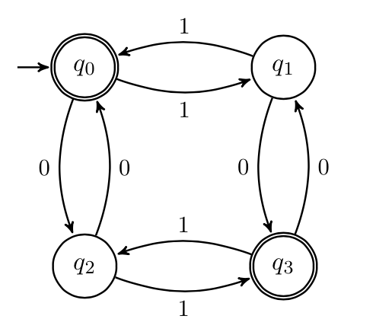
Finite State Machines
CSE 311 Autumn 2023
Lecture 24

Slide 2
Announcements
Last day to turn in HW6 is today (would be using 3 late days)
HW7 is out! (due Friday)
Mix of induction problems and regular expression/CFG practice
The regular expression and CFG problems are autograded. You have a limited number of guesses (and we don’t give partial credit on them).

Slide 3
Last Two Weeks
What computers can and can’t do…
Given any finite amount of time.
We’ll start with a simple model of a computer – finite state machines.
What do we want computers to do? Let’s start very simple. We’ll give them an input (in a string format), and we want them to say “yes” or “no” for that string on a certain question. Example questions one might want to answer.
Does this input java code compile to a valid program?
Does this input string match a particular regular expression?
Is this input list sorted?
Depending on the “computer” some questions might be out of reach.

Slide 4
Deterministic Finite Automaton
Our machine is going to get a string as input.
It will read one character at a time and update “its state.”
At every step, the machine thinks of itself as in one of the (finite number) vertices.
When it reads the character it follows the arrow labeled with that character to its next state.
Start at the “start state” (unlabeled, incoming arrow).
After you’ve read the last character, accept the string if and only if you’re in a “final state” (double circle).

Slide 5
Let’s see an example
Input string:
011
1010

Slide 6
Let’s see an example
Input string:
011
1010

Slide 7
Let’s see an example
Input string:
011
1010

Slide 8
Let’s see an example
Input string:
011
1010

Slide 9
Let’s see an example
Input string:
011
1010

Slide 10
Let’s see an example
Input string:
011
1010

Slide 11
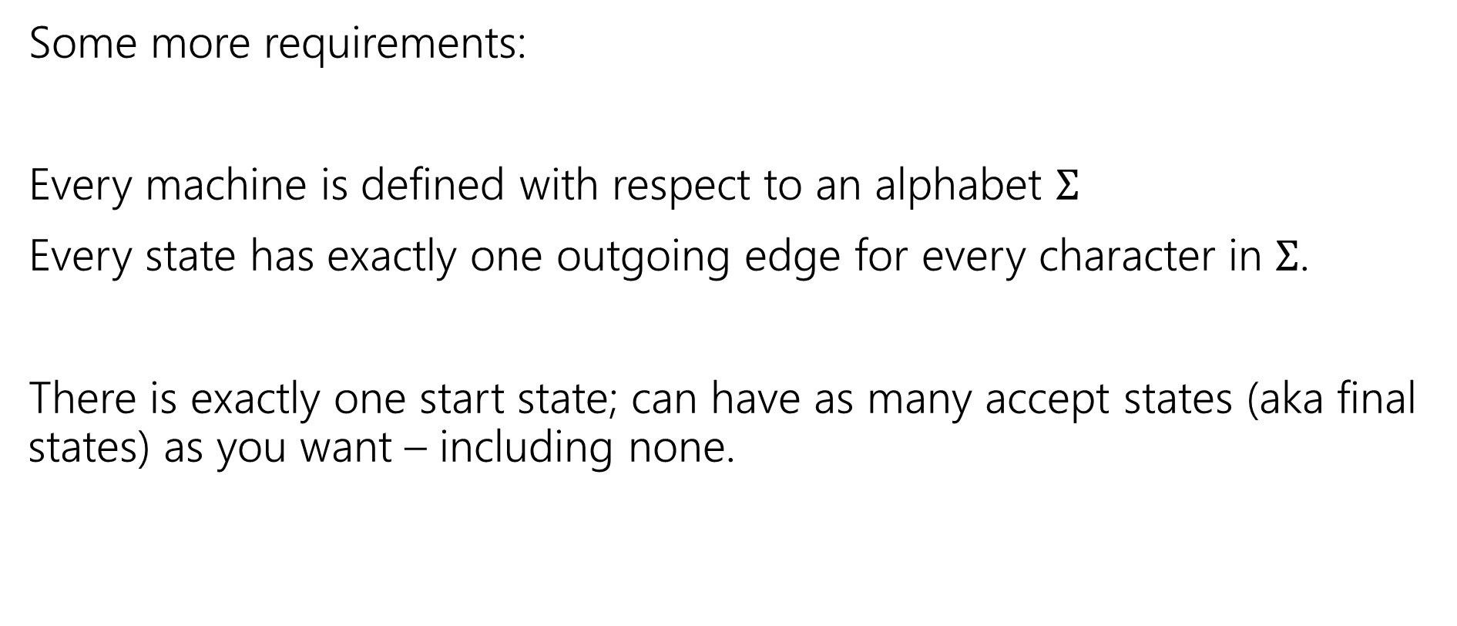
Deterministic Finite Automata
Some more requirements:
Every machine is defined with respect to an alphabet $Σ$
Every state has exactly one outgoing edge for every character in $Σ$.
There is exactly one start state; can have as many accept states (aka final states) as you want – including none.

Slide 12
Deterministic Finite Automata
Can also represent transitions with a table.
Old State | 0 | 1
s₀ | s₀ | s₁
s₁ | s₀ | s₂
s₂ | s₀ | s₃
s₃ | s₃ | s₃
0
0
1
1
1
s₀
s₁
s₂
s₃
0
0,1

Slide 13
Deterministic Finite Automata
What is the language of this DFA?
I.e. the set of all strings it accepts?
Old State | 0 | 1
s₀ | s₀ | s₁
s₁ | s₀ | s₂
s₂ | s₀ | s₃
s₃ | s₃ | s₃
0
0
1
1
1
s₀
s₁
s₂
s₃
0
0,1

Slide 14
Deterministic Finite Automata
If the string has $111$, then you’ll end up in $s_{3}$ and never leave.
If you end with a $0$ you’re back in $s_{0}$ which also accepts.
And…$ε$ is also accepted
$\left[{\left(0∪1\right)}^{∗}111{\left(0∪1\right)}^{∗}\right]∪{\left[{\left(0∪1\right)}^{∗}0\right]}^{∗}$
Old State | 0 | 1
s₀ | s₀ | s₁
s₁ | s₀ | s₂
s₂ | s₀ | s₃
s₃ | s₃ | s₃
0
0
1
1
1
s₀
s₁
s₂
s₃
0
0,1

Slide 15
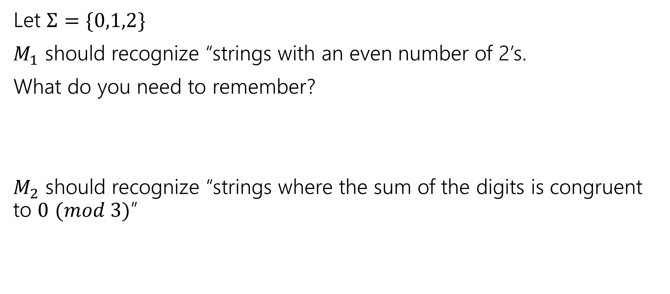
Design some DFAs
Let $Σ=\{0,1,2\}$
$M_{1}$ should recognize “strings with an even number of 2’s.
What do you need to remember?
$M_{2}$ should recognize “strings where the sum of the digits is congruent to $0$ $(mod 3)$”

Slide 16

Design some DFAs
Let $Σ=\{0,1,2\}$
$M_{1}$ should recognize “strings with an even number of 2’s.
$M_{2}$ should recognize “strings where the sum of the digits is congruent to $0$ $(mod 3)"$
2
s₁
s₀
2
0,1
0,1
1
$$t_{2}$$
1
2
2
$$t_{1}$$
2
$$t_{0}$$
0
1
0

Slide 17
Designing DFAs notes
DFAs can’t “count arbitrarily high”
For example, we could not make a DFA that remembers the overall sum of all the digits (not taken % 3)
That would have infinitely many states! We’re only allowed a finite number.

Slide 18
Strings over {0,1,2} w/ even number of 2’s and sum%3=0
s₀t₁
s₁t₂
s₀t₀
s₁t₀
s₀t₂
s₁t₁

Slide 19
Strings over {0,1,2} w/ even number of 2’s and sum%3=0
0
0
s₀t₁
2
s₁t₂
2
1
1
1
0
0
s₀t₀
2
s₁t₀
2
1
1
1
2
s₀t₂
s₁t₁
0
2
0

Slide 20
Strings over {0,1,2} w/ even number of 2’s and sum%3=0
s₀t₀
s₁t₀
s₀t₁
s₁t₁
s₀t₂
s₁t₂

Slide 21
Strings over {0,1,2} w/ even number of 2’s and sum%3=0
Changed notation – final states with bold outlines.
0
0
s₀t₀
s₁t₀
2
2
1
1
0
0
s₀t₁
2
2
s₁t₁
1
1
1
1
Called the “cross product” construction (because you have a set of states equal to $Q_{1}×Q_{2}$ where first two DFAs had states $Q_{1},Q_{2}$.
A very common trick to combine DFAs.
2
2
s₀t₂
s₁t₂
0
0

Slide 22
Strings over {0,1,2} w/ even number of 2’s and sum%3=0
Changed notation – final states with bold outlines.
0
0
s₀t₀
s₁t₀
2
2
1
1
0
0
s₀t₁
2
2
s₁t₁
1
1
1
1
Called the “cross product” construction (because you have a set of states equal to $Q_{1}×Q_{2}$ where first two DFAs had states $Q_{1},Q_{2}$.
A very common trick to combine DFAs.
2
2
s₀t₂
s₁t₂
0
0
“even # 2’s”
“odd # 2’s”

Slide 23
Strings over {0,1,2} w/ even number of 2’s and sum%3=0
Changed notation – final states with bold outlines.
0
0
s₀t₀
s₁t₀
2
2
“sum%3 = 0”
1
1
0
0
s₀t₁
2
2
s₁t₁
1
1
“sum%3 = 1”
1
1
Called the “cross product” construction (because you have a set of states equal to $Q_{1}×Q_{2}$ where first two DFAs had states $Q_{1},Q_{2}$.
A very common trick to combine DFAs.
2
2
s₀t₂
s₁t₂
0
0
“sum%3 = 2”

Slide 24
Strings over {0,1,2} w/ even number of 2’s OR sum%3=0
0
0
s₀t₀
s₁t₀
Want to change the and to or – don’t need to change states or transitions…
2
2
1
1
0
0
s₀t₁
2
2
s₁t₁
1
1
1
1
2
2
s₀t₂
s₁t₂
0
0

Slide 25
Strings over {0,1,2} w/ even number of 2’s OR sum%3=0
0
0
s₀t₀
s₁t₀
Want to change the and to or – don’t need to change states or transitions…
Just which accept.
2
2
1
1
0
0
s₀t₁
2
2
s₁t₁
1
1
1
1
2
2
s₀t₂
s₁t₂
0
0

Slide 26
The set of binary strings with a 1 in the 3rd position from the start

Slide 27
The set of binary strings with a 1 in the 3rd position from the start
R
0,1
0
s₀
0,1
s₁
0,1
s₂
1
A
0,1

Slide 28
The set of binary strings with a 1 in the 3rd position from the end
What do we need to remember?
We can’t know what string was third from the end until we have read the last character.
So we’ll need to keep track of “the character that was 3 ago” in case this was the end of the string.
But if it’s not…we’ll need the character 2 ago, to update what the character 3 ago becomes. Same with the last character.

Slide 29
3 bit shift register
“Remember the last three bits”
001
1
011
1
0
1
1
1
0
000
1
010
101
0
111
1
0
0
1
0
0
100
0
110

Slide 30
The set of binary strings with a 1 in the 3rd position from the end
0
1
0
1
0
1
0
1
00
01
10
11
1
1
1
1
0
0
0
0
001
1
011
1
0
1
1
1
0
000
1
010
101
0
111
1
0
0
1
0
0
100
0
110

Slide 31
The set of binary strings with a 1 in the 3rd position from the end
001
1
011
1
0
1
1
1
0
000
1
010
101
0
111
1
0
0
1
0
0
100
0
110

Slide 32
The beginning versus the end
R
0
0,1
s₀
0,1
s₁
0,1
s₂
1
A
0,1
001
1
011
1
0
1
1
1
0
000
1
010
101
0
111
1
0
0
0
1
0
100
0
110

Slide 33
From the beginning was “easier” than “from the end”
At least in the sense that we needed fewer states.
That might be surprising since a java program wouldn’t be much different for those two.
Not being able to access the full input at once limits your abilities somewhat and makes some jobs harder than others.

Slide 34
What language does this machine recognize?
1
s₀
s₁
1
0
0
0
0
1
s₂
s₃
1

Slide 35
What language does this machine recognize?
1
s₀
s₁
1
0
0
0
0
1
s₂
s₃
1
#1s even
#1s odd

Slide 36
What language does this machine recognize?
1
s₀
s₁
#0s even
1
0
0
0
0
1
s₂
s₃
#0s odd
1

Slide 37
What language does this machine recognize?
1
s₀
s₁
1
0
0
#0s is congruent to #1s (mod 2)
Wait…there’s an easier way to describe that….
0
0
1
s₂
s₃
1

Slide 38
What language does this machine recognize?
1
s₀
s₁
That’s all binary strings of even length.
1
0
0
0,1
0
0
s₀
s₁
1
0,1
s₂
s₃
1

Slide 39
Takeaways
The first DFA might not be the simplest.
Try to think of other descriptions – you might realize you can keep track of fewer things than you thought.
Boy…it’d be nice if we could know that we have the smallest possible DFA for a given language…

Slide 40
DFA Minimization
We can know!
Fun fact: there is a unique minimum DFA for every language (up to renaming the states)
High level idea – final states and non-final states must be different.
Otherwise, hope that states can be the same, and iteratively separate when they have to go to different spots.
In some quarters, we cover it in detail. But…we ran out of time. Optional slides will be posted – won’t be required in HW or final but you might find it useful/interesting for your own learning.

Slide 41
Next Time
What if we give the DFAs a little more power…try to get them to do more things.

