Slide 1
CSE 311 Midterm Review!
Midterm Review

Slide 2
Administrivia

Slide 3
Announcements & Reminders
TONIGHT @ 6-7:30 pm in BAG 131 and 154
Please bring an ID (Husky Card or other ID) to the exam. We’ll be checking those during the exam.
Remember you’re allowed one piece of paper of handwritten notes. Please read details on the exams page.
Check your email for room assignments

Slide 4
Set Theory

Slide 5
Problem 4- Section 04
Write an English proof, proving the following set identity
Let the universal set be u . Prove A ∩ B’ ⊆ A\B for any sets A, B.
Work on this problem with the people around you.
Translate the claim to predicate
Write out the skeleton

Slide 6
Problem 4- Section 04
Write an English proof, proving the following set identity
Let the universal set be u . Prove A ∩ B’ ⊆ A\B for any sets A, B.
Work on this problem with the people around you.
Translate the claim to predicate
∀x(x ∈ A ∩ B’ → x ∈ A\B)
Write out the skeleton

Slide 7
Remember the Skeleton!

Slide 8
Let’s Write it Out:
∀x(x ∈ A ∩ B’ → x ∈ A\B)

Slide 9
Problem 4- Section 04
Write an English proof, proving the following set identity
Let the universal set be u . Prove A ∩ B’ ⊆ A\B for any sets A, B.
Let x be an arbitrary element and suppose that x ∈ A ∩ B’.
…
…
…So x ∈ A\B.
Since x was arbitrary, we can conclude that A ∩ B’ ⊆ A\B by definition of subset

Slide 10
Problem 4- Section 04
Write an English proof, proving the following set identity
Let the universal set be u . Prove A ∩ B’ ⊆ A\B for any sets A, B.
Let x be an arbitrary element and suppose that x ∈ A ∩ B’.
By definition of intersection, x ∈ A and x ∈ B’
…
…So x ∈ A\B.
Since x was arbitrary, we can conclude that A ∩ B’ ⊆ A\B by definition of subset

Slide 11
Problem 4- Section 04
Write an English proof, proving the following set identity
Let the universal set be u . Prove A ∩ B’ ⊆ A\B for any sets A, B.
Let x be an arbitrary element and suppose that x ∈ A ∩ B’.
By definition of intersection, x ∈ A and x ∈ B’
So by definition of complement, x ∉ B
…So x ∈ A\B.
Since x was arbitrary, we can conclude that A ∩ B’ ⊆ A\B by definition of subset

Slide 12
Problem 4- Section 04
Write an English proof, proving the following set identity
Let the universal set be u . Prove A ∩ B’ ⊆ A\B for any sets A, B.
Let x be an arbitrary element and suppose that x ∈ A ∩ B’.
By definition of intersection, x ∈ A and x ∈ B’
So by definition of complement, x ∉ B
Then, by definition of set difference, x ∈ A\B.
Since x was arbitrary, we can conclude that A ∩ B’ ⊆ A\B by definition of subset

Slide 13
Strong Induction

Slide 14
Problem 6 - Section 06 (23sp)
Work on this problem with the people around you.

Slide 15
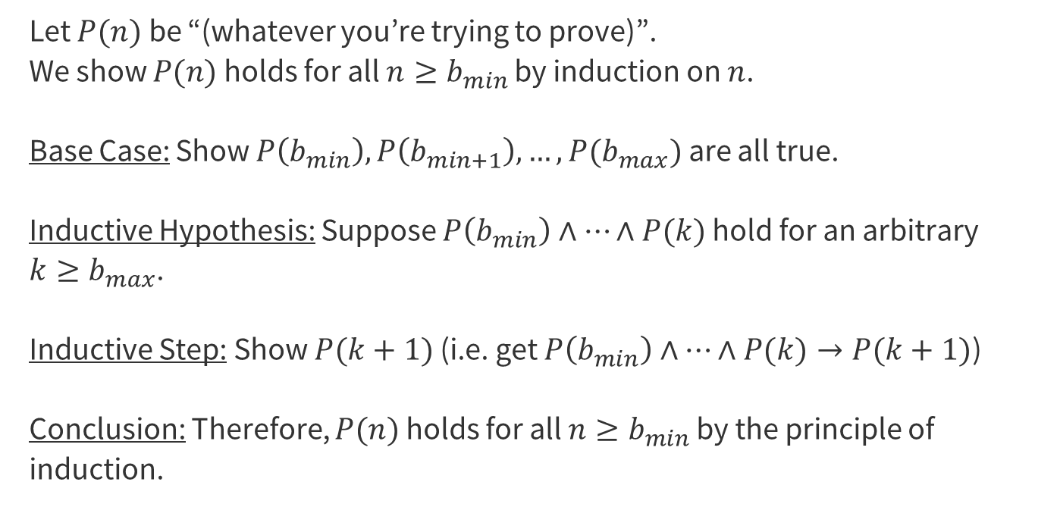
Remember our Strong Induction Template!

Slide 16
Let’s Write it Out:

Slide 17
Problem 6
Let P(ｎ) be “”.
We show P(ｎ) holds…
Base Cases:
Inductive Hypothesis:
Inductive Step:
Conclusion: Therefore, P(ｎ) holds for all … by the principle of induction

Slide 18
Problem 6
Let P(ｎ) be “a(n) = 2n - 1”.
We show P(ｎ) holds…
Base Cases:
Inductive Hypothesis:
Inductive Step:
Conclusion: Therefore, P(ｎ) holds for all … by the principle of induction

Slide 19
Problem 6
Let P(ｎ) be “a(n) = 2n - 1”.
We show P(ｎ) holds for all n ≥ 1 by induction on n.
Base Cases:
Inductive Hypothesis:
Inductive Step:
Conclusion: Therefore, P(ｎ) holds for all n ≥ 1 by the principle of induction

Slide 20
Problem 6
Let P(ｎ) be “a(n) = 2n - 1”.
We show P(ｎ) holds for all n ≥ 1 by induction on n.
Base Cases: (n = 1, n = 2) a(1) = 1 = 2(1) - 1 and a(2) = 3 = 2(2) - 1 by definition of a.
Inductive Hypothesis:
Inductive Step:
Conclusion: Therefore, P(ｎ) holds for all n ≥ 1 by the principle of induction

Slide 21
Problem 6
Let P(ｎ) be “a(n) = 2n - 1”.
We show P(ｎ) holds for all n ≥ 1 by induction on n.
Base Cases: (n = 1, n = 2) a(1) = 1 = 2(1) - 1 and a(2) = 3 = 2(2) - 1 by definition of a.
Inductive Hypothesis: Suppose P(1) ⋏ P(2) ⋏ … ⋏ P(k) hold for an arbitrary k ≥ 2.
i.e. a(k) = 2k - 1, a(k - 1) = 2(k - 1) - 1, a(k - 2) = 2(k - 2) - 1, etc.
Inductive Step:
Conclusion: Therefore, P(ｎ) holds for all n ≥ 1 by the principle of induction

Slide 22
Problem 6
Let P(ｎ) be “a(n) = 2n - 1”.
We show P(ｎ) holds for all n ≥ 1 by induction on n.
Base Cases: (n = 1, n = 2) a(1) = 1 = 2(1) - 1 and a(2) = 3 = 2(2) - 1 by definition of a.
Inductive Hypothesis: Suppose P(1) ⋏ P(2) ⋏ … ⋏ P(k) hold for an arbitrary k ≥ 2.
i.e. a(k) = 2k - 1, a(k - 1) = 2(k - 1) - 1, a(k - 2) = 2(k - 2) - 1, etc.
Inductive Step: Goal: Show P(k + 1): a(k + 1) = 2(k + 1) - 1
Conclusion: Therefore, P(ｎ) holds for all n ≥ 1 by the principle of induction

Slide 23
Problem 6
Let P(ｎ) be “a(n) = 2n - 1”.
We show P(ｎ) holds for all n ≥ 1 by induction on n.
Base Cases: (n = 1, n = 2) a(1) = 1 = 2(1) - 1 and a(2) = 3 = 2(2) - 1 by definition of a.
Inductive Hypothesis: Suppose P(1) ⋏ P(2) ⋏ … ⋏ P(k) hold for an arbitrary k ≥ 2.
i.e. a(k) = 2k - 1, a(k - 1) = 2(k - 1) - 1, a(k - 2) = 2(k - 2) - 1, etc.
Inductive Step: Goal: Show P(k + 1): a(k + 1) = 2(k + 1) - 1
a(k + 1) = …
…
= 2(k + 1) - 1
Conclusion: Therefore, P(ｎ) holds for all n ≥ 1 by the principle of induction

Slide 24
Problem 6
Let P(ｎ) be “a(n) = 2n - 1”.
We show P(ｎ) holds for all n ≥ 1 by induction on n.
Base Cases: (n = 1, n = 2) a(1) = 1 = 2(1) - 1 and a(2) = 3 = 2(2) - 1 by definition of a.
Inductive Hypothesis: Suppose P(1) ⋏ P(2) ⋏ … ⋏ P(k) hold for an arbitrary k ≥ 2.
i.e. a(k) = 2k - 1, a(k - 1) = 2(k - 1) - 1, a(k - 2) = 2(k - 2) - 1, etc.
Inductive Step: Goal: Show P(k + 1): a(k + 1) = 2(k + 1) - 1
a(k + 1) = 2a(k) - a(k - 1) [Definition of a]
…
= 2(k + 1) - 1
Conclusion: Therefore, P(ｎ) holds for all n ≥ 1 by the principle of induction

Slide 25
Problem 6
Let P(ｎ) be “a(n) = 2n - 1”.
We show P(ｎ) holds for all n ≥ 1 by induction on n.
Base Cases: (n = 1, n = 2) a(1) = 1 = 2(1) - 1 and a(2) = 3 = 2(2) - 1 by definition of a.
Inductive Hypothesis: Suppose P(1) ⋏ P(2) ⋏ … ⋏ P(k) hold for an arbitrary k ≥ 2.
i.e. a(k) = 2k - 1, a(k - 1) = 2(k - 1) - 1, a(k - 2) = 2(k - 2) - 1, etc.
Inductive Step: Goal: Show P(k + 1): a(k + 1) = 2(k + 1) - 1
a(k + 1) = 2a(k) - a(k - 1) [Definition of a]
= 2(2k - 1) - (2(k - 1) - 1) [Inductive Hypothesis]
…
= 2(k + 1) - 1
Conclusion: Therefore, P(ｎ) holds for all n ≥ 1 by the principle of induction

Slide 26
Problem 6
Let P(ｎ) be “a(n) = 2n - 1”.
We show P(ｎ) holds for all n ≥ 1 by induction on n.
Base Cases: (n = 1, n = 2) a(1) = 1 = 2(1) - 1 and a(2) = 3 = 2(2) - 1 by definition of a.
Inductive Hypothesis: Suppose P(1) ⋏ P(2) ⋏ … ⋏ P(k) hold for an arbitrary k ≥ 2.
i.e. a(k) = 2k - 1, a(k - 1) = 2(k - 1) - 1, a(k - 2) = 2(k - 2) - 1, etc.
Inductive Step: Goal: Show P(k + 1): a(k + 1) = 2(k + 1) - 1
a(k + 1) = 2a(k) - a(k - 1) [Definition of a]
= 2(2k - 1) - (2(k - 1) - 1) [Inductive Hypothesis]
= 2k + 1 [Algebra]
= 2(k + 1) - 1 [Algebra
Conclusion: Therefore, P(ｎ) holds for all n ≥ 1 by the principle of induction

Slide 27
Questions?
Topics:
Translations & Predicate Logic
English Proofs
Number Theory
Set Theory
Strong Induction
Weak Induction

Slide 28
That’s All Folks!
Breathe, you are going to do great!

