Slide 1
Proofs, Alternate Notation
CSE 311 Winter 2024
Lecture 4

Slide 2
Announcements
We’re putting resources on the resources page:
The list of logical equivalences
A Translation Tips reading (for going from English to Logic)
Might be useful if you’re still working on homework 1.
There’s a lot of other resources on the page that will be useful as we get further along (e.g. reference sheets for particular topics).
We’ll try to remind you about important ones, but it’s good to keep in mind that it’s there.

Slide 3
Our First Proof

Slide 4
Our First Proof
We could make another truth table (you should! It’s a good exercise)
But we have another technique that is nicer.
Let’s try that one
Then talk about why it’s another good option.
We’re going to give an iron-clad guarantee that:
$\left(p∧q\right)∨\left(¬p∧q\right)∨\left(¬p∧¬q\right)≡¬p∨q$
i.e. that this is another valid “law of implication”

Slide 5
Our First Proof
This will be a long proof! Longer than most of the ones on homeworks.
I’m starting with a hard one so you see all the tricks.
This process will be easier if we change variables, we’re going to show
$\left(a∧b\right)∨\left(¬a∧b\right)∨\left(¬a∧¬b\right)≡¬a∨b$
How do we write a proof?
It’s not always plug-and-chug…we’ll be highlighting strategies throughout the quarter.
To start with:
Make sure we know what we want to show…
Notes:
Just replaced p with a and q with b. Same as if you replaced the “I” in a for-loop with a “j” everywhere in that loop.

Slide 6
Our First Proof
$\left(a∧b\right)∨\left(¬a∧b\right)∨(¬a∧¬b)$
$≡\left(p∧q\right)∨[\left(¬p∧q\right)∨\left(¬p∧¬q\right)]$
$≡\left(p∧q\right)∨\left[¬p∧\left(q∨¬q\right)\right]$
$≡\left(p∧q\right)∨[¬p∧T]$
$≡\left(p∧q\right)∨[¬p]$
$≡\left[¬p\right]∨(p∧q)$
$≡\left(¬p∨p\right)∧\left(¬p∨q\right)$
$≡T∧\left(¬p∨q\right)$
$≡$ $\left(¬p∨q\right)∧T$
$≡(¬a∨b)$
None of the rules look like this
Practice of Proof-Writing: Big Picture…WHY do we think this might be true?
The last two “pieces” came from the vacuous proof lines…maybe the “$¬a$” came from there? Maybe that simplifies down to $¬a$

Slide 7
Let’s apply a rule
$\left(¬a∧b\right)∨(¬a∧¬b)$
The law says:
$p∧\left(q∨r\right)≡\left(p∧q\right)∨(p∧r)$
$\left(¬a∧b\right)∨\left(¬a∧¬b\right)≡¬a∧(b∨¬b)$

Slide 8
Our First Proof
$\left(a∧b\right)∨\left(¬a∧b\right)∨(¬a∧¬b)$
$≡\left(p∧q\right)∨[\left(¬p∧q\right)∨\left(¬p∧¬q\right)]$
$≡\left(p∧q\right)∨\left[¬p∧\left(q∨¬q\right)\right]$
$≡\left(p∧q\right)∨[¬p∧T]$
$≡\left(p∧q\right)∨[¬p]$
$≡\left[¬p\right]∨(p∧q)$
$≡\left(¬p∨p\right)∧\left(¬p∨q\right)$
$≡T∧\left(¬p∨q\right)$
$≡$ $\left(¬p∨q\right)∧T$
$≡(¬a∨b)$
None of the rules look like this
Practice of Proof-Writing: Big Picture…WHY do we think this might be true?
The last two “pieces” came from the vacuous proof lines…maybe the “$¬a$” came from there? Maybe that simplifies down to $¬a$

Slide 9
Our First Proof
$\left(a∧b\right)∨\left(¬a∧b\right)∨(¬a∧¬b)$
$≡\left(a∧b\right)∨[\left(¬a∧b\right)∨\left(¬a∧¬b\right)]$
$≡\left[¬p\right]∨(p∧q)$
$≡\left(\begin{aligned}¬p \\ \\ \\ \\ ∨p\end{aligned}\right)∧\left(¬p∨q\right)$
$≡T∧\left(¬p∨q\right)$
$≡$ $\left(¬p∨q\right)∧T$
$≡(¬a∨b)$
Set ourselves an intermediate goal.
Let’s try to simplify those last two pieces
Associative law
Connect up the things we’re working on.

Slide 10
Our First Proof
$\left(a∧b\right)∨\left(¬a∧b\right)∨(¬a∧¬b)$
$≡\left(a∧b\right)∨[\left(¬a∧b\right)∨\left(¬a∧¬b\right)]$
$≡\left(a∧b\right)∨\left[¬a∧\left(b∨¬b\right)\right]$
$≡\left[¬p\right]∨(p∧q)$
$≡\left(¬p∨p\right)∧\left(¬p∨q\right)$
$≡T∧\left(¬p∨q\right)$
$≡$ $\left(¬p∨q\right)∧T$
$≡(¬a∨b)$
Set ourselves an intermediate goal.
Let’s try to simplify those last two pieces
Distributive law
We think $¬a$ is important, let’s isolate it.

Slide 11
Our First Proof
$\left(a∧b\right)∨\left(¬a∧b\right)∨(¬a∧¬b)$
$≡\left(a∧b\right)∨[\left(¬a∧b\right)∨\left(¬a∧¬b\right)]$
$≡\left(a∧b\right)∨\left[¬a∧\left(b∨¬b\right)\right]$
$≡\left(a∧b\right)∨[¬a∧T]$
$≡\left[¬p\right]∨(p∧q)$
$≡\left(¬p∨p\right)∧\left(¬p∨q\right)$
$≡T∧\left(¬p∨q\right)$
$≡$ $\left(¬p∨q\right)∧T$
$≡(¬a∨b)$
Set ourselves an intermediate goal.
Let’s try to simplify those last two pieces
Negation
Should make things simpler.

Slide 12
Our First Proof
$\left(a∧b\right)∨\left(¬a∧b\right)∨(¬a∧¬b)$
$≡\left(a∧b\right)∨[\left(¬a∧b\right)∨\left(¬a∧¬b\right)]$
$≡\left(a∧b\right)∨\left[¬a∧\left(b∨¬b\right)\right]$
$≡\left(a∧b\right)∨[¬a∧T]$
$≡\left(a∧b\right)∨[¬a]$
$≡\left[¬p\right]∨(p∧q)$
$≡\left(\begin{aligned}¬p \\ ∨p\end{aligned}\right)∧\left(¬p∨q\right)$
$≡T∧\left(¬p∨q\right)$
$≡$ $\left(¬p∨q\right)∧T$
$≡(¬a∨b)$
Set ourselves an intermediate goal.
Let’s try to simplify those last two pieces
Identity
Should make things simpler.

Slide 13
Our First Proof
$\left(a∧b\right)∨\left(¬a∧b\right)∨(¬a∧¬b)$
$≡\left(a∧b\right)∨[\left(¬a∧b\right)∨\left(¬a∧¬b\right)]$
$≡\left(a∧b\right)∨\left[¬a∧\left(b∨¬b\right)\right]$
$≡\left(a∧b\right)∨[¬a∧T]$
$≡\left(a∧b\right)∨[¬a]$
$≡(¬a∨b)$
Stay on target:
We met our intermediate goal.
Don‘t forget the final goal!
We want to end up at $\left(¬a∨b\right)$
If we apply the distribution rule,
We’d get a $(¬a∨b)$

Slide 14
Our First Proof
$\left(a∧b\right)∨\left(¬a∧b\right)∨(¬a∧¬b)$
$≡\left(a∧b\right)∨[\left(¬a∧b\right)∨\left(¬a∧¬b\right)]$
$≡\left(a∧b\right)∨\left[¬a∧\left(b∨¬b\right)\right]$
$≡\left(a∧b\right)∨[¬a∧T]$
$≡\left(a∧b\right)∨[¬a]$
$≡\left[¬a\right]∨(a∧b)$
$≡(¬a∨b)$
Stay on target:
We met our intermediate goal.
Don‘t forget the final goal!
We want to end up at $\left(¬a∨b\right)$
If we apply the distribution rule,
We’d get a $(¬a∨b)$
Commutative
Make the expression look exactly like the law (more on this later)

Slide 15
Our First Proof
$\left(a∧b\right)∨\left(¬a∧b\right)∨(¬a∧¬b)$
$≡\left(a∧b\right)∨[\left(¬a∧b\right)∨\left(¬a∧¬b\right)]$
$≡\left(a∧b\right)∨\left[¬a∧\left(b∨¬b\right)\right]$
$≡\left(a∧b\right)∨[¬a∧T]$
$≡\left(a∧b\right)∨[¬a]$
$≡\left[¬a\right]∨(a∧b)$
$≡\left(¬a∨a\right)∧\left(¬a∨b\right)$
$≡(¬a∨b)$
Stay on target:
We met our intermediate goal.
Don‘t forget the final goal!
We want to end up at $\left(¬a∨b\right)$
If we apply the distribution rule,
We’d get a $(¬a∨b)$
Distributive
Creates the $(¬a∨b)$ we were hoping for.

Slide 16
Our First Proof
$\left(a∧b\right)∨\left(¬a∧b\right)∨(¬a∧¬b)$
$≡\left(a∧b\right)∨[\left(¬a∧b\right)∨\left(¬a∧¬b\right)]$
$≡\left(a∧b\right)∨\left[¬a∧\left(b∨¬b\right)\right]$
$≡\left(a∧b\right)∨[¬a∧T]$
$≡\left(a∧b\right)∨[¬a]$
$≡\left[¬a\right]∨(a∧b)$
$≡\left(¬a∨a\right)∧\left(¬a∨b\right)$
$≡\left(a∨¬a\right)∧(¬a∨b)$
$≡T∧\left(¬a∨b\right)$
$≡(¬a∨b)$
Stay on target:
We met our intermediate goal.
Don‘t forget the final goal!
We want to end up at $\left(¬a∨b\right)$
If we apply the distribution rule,
We’d get a $(¬a∨b)$
Commutative
Make the expression look exactly like the law (more on this later)
Negation
Simplifies the part we want to disappear.

Slide 17
Simplify T$∧(¬a∨b)$ to $(¬a∨b)$
These identities hold for all propositions $p,q,r$
Identity
$p∧T≡p$
$p∨F≡p$
Domination
$p∨T≡T$
$p∧F≡F$
Idempotent
$p∨p≡p$
$p∧p≡p$
Commutative
$p∨q≡q∨p$
$p∧q≡q∧p$
Associative
$\left(p∨q\right)∨r≡p∨\left(q∨r\right)$
$\left(p∧q\right)∧r≡p∧\left(q∧r\right)$
Distributive
$p∧\left(q∨r\right)≡\left(p∧q\right)∨\left(p∧r\right)$
$p∨\left(q∧r\right)≡\left(p∨q\right)∧(p∨r)$
Absorption
$p∨\left(p∧q\right)≡p$
$p∧\left(p∨q\right)≡p$
Negation
$p∨¬p≡T$
$p∧¬p≡F$

Slide 18
Our First Proof
$\left(a∧b\right)∨\left(¬a∧b\right)∨(¬a∧¬b)$
$≡\left(a∧b\right)∨[\left(¬a∧b\right)∨\left(¬a∧¬b\right)]$
$≡\left(a∧b\right)∨\left[¬a∧\left(b∨¬b\right)\right]$
$≡\left(a∧b\right)∨[¬a∧T]$
$≡\left(a∧b\right)∨[¬a]$
$≡\left[¬a\right]∨(a∧b)$
$≡\left(¬a∨a\right)∧\left(¬a∨b\right)$
$≡\left(a∨¬a\right)∧(¬a∨b)$
$≡T∧\left(¬a∨b\right)$
$≡\left(¬a∨b\right)∧T$
$≡(¬a∨b)$
Stay on target:
We met our intermediate goal.
Don‘t forget the final goal!
We want to end up at $\left(¬a∨b\right)$
If we apply the distribution rule,
We’d get a $(¬a∨b)$
Commutative followed by Identity
Look exactly like the law, then apply it.
We’re done!!!

Slide 19
Commutativity
We had the expression $\left(a∧b\right)∨[¬a]$
But before we applied the distributive law, we switched the order…why?
The law says $p∨\left(q∧r\right)≡\left(p∨q\right)∧(p∨r)$
not $\left(q∧r\right)∨p≡\left(q∨p\right)∧(r∨p)$
So technically we needed to commute first.
Eventually (in about 2 weeks) we’ll skip this step. For now, we’re doing two separate steps.
Remember this is the “training wheel” stage. The point is to be careful.

Slide 20
More on Our First Proof
We now have an ironclad guarantee that
$\left(a∧b\right)∨\left(¬a∧b\right)∨\left(¬a∧¬b\right)≡(¬a∨b)$
Hooray! But we could have just made a truth-table. Why a proof?
Here’s one reason.
Proofs don’t just give us an ironclad guarantee. They’re also an explanation of why the claim is true.
The key insight to our simplification was “the last two pieces were the vacuous truth parts – the parts where $p$ was false”
That’s in there, in the proof.

Slide 21
Our First Proof
$\left(a∧b\right)∨\left(¬a∧b\right)∨(¬a∧¬b)$
$≡\left(a∧b\right)∨[\left(¬a∧b\right)∨\left(¬a∧¬b\right)]$
$≡\left(a∧b\right)∨\left[¬a∧\left(b∨¬b\right)\right]$
$≡\left(a∧b\right)∨[¬a∧T]$
$≡\left(a∧b\right)∨[¬a]$
$≡\left[¬a\right]∨(a∧b)$
$≡\left(¬a∨a\right)∧\left(¬a∨b\right)$
$≡\left(a∨¬a\right)∧(¬a∨b)$
$≡T∧\left(¬a∨b\right)$
$≡\left(¬a∨b\right)∧T$
$≡(¬a∨b)$
Associative
Distributive
Negation
Identity
Commutative
Distributive
Commutative
Negation
Commutative
Identity
The last two terms are “vacuous truth” – they simplify to $¬a$
$a$ no longer matters in $a∧b$ if $¬a$ automatically makes the expression true.

Slide 22
More on Our First Proof
With practice (and quite a bit of squinting) you can see not just the ironclad guarantee, but also the reason why something is true.
That’s not easy with a truth table.
Proofs can also communicate intuition about why a statement is true.
We’ll practice extracting intuition from proofs more this quarter.

Slide 23
Modifying Implications

Slide 24
Converse, Contrapositive
Implication:
p → q
Converse:
q → p
Contrapositive:
¬q → ¬p
Inverse:
¬p → ¬q
If it’s raining, then I have my umbrella.
If I don’t have my umbrella, then it is not raining.
If I have my umbrella, then it is raining.
If it is not raining, then I don’t have my umbrella.
How do these relate to each other?
p | q | p → q | q → p | ¬p | ¬q | ¬p → ¬q | ¬q → ¬p
T | T
T | F
F | T
F | F

Slide 25
Converse, Contrapositive
Implication:
p → q
Converse:
q → p
Contrapositive:
¬q → ¬p
Inverse:
¬p → ¬q
An implication and its contrapositive have the same truth value!
p | q | p → q | q → p | ¬p | ¬q | ¬p → ¬q | ¬q → ¬p
T | T | T | T | F | F | T | T
T | F | F | T | F | T | T | F
F | T | T | F | T | F | F | T
F | F | T | T | T | T | T | T

Slide 26
Contrapositive
We showed $p→q≡¬q→¬p$ with a truth table. Let’s do a proof.
Try this one on your own. Remember
Know what you’re trying to show.
Stay on target – take steps to get closer to your goal.
Hint: think about your tools.
There are lots of rules with AND/OR/NOT,
but very few with implications…
pollev.com/robbie
Help me adjust my explanation!

Slide 27
Contrapositive
$p→q$
$≡¬p∨q$
$≡q∨¬p$
$≡¬¬q∨¬p$
$≡¬q→¬p$
Law of Implication
Commutativity
Double Negation
Law of Implication
All of our rules deal with ORs and ANDs, let’s switch the implication to just use AND/NOT/OR.
And do the same with our target
It’s ok to work from both ends. In fact it’s a very common strategy!
Now how do we get the top to look like the bottom?
Just a few more rules and we’re done!

Slide 28
Work from both ends, but…
…make sure at the end, if you read from top-to-bottom, every step makes sense.
When proving an equivalence you must: 1. Start with the left side (or right side)
2. Modify what you had in the last step (using an equivalence)
3. Derive the right side (or left side if you started with the right)
You may not start with the equivalence you’re trying to show, and simplify to something “obviously true.”
More on why later in the quarter, but tl;dr for now is you can’t use your goal as a starting assumption (it’s what you’re trying to show! If you knew it, no need to write a proof).

Slide 29
Digital Logic

Slide 30
Vocabulary!
Tautology if it is always true.
Contradiction if it is always false.
Contingency if it can be both true and false.
A proposition is a….
$$p∨¬p$$
Tautology
If $p$ is true, $p∨¬p$ is true; if $p$ is false, $p∨¬p$is true.
$$p⊕p$$
Contradiction
If $p$ is true, $p⊕p$ is false; if $p$ is false, $p⊕p$is false.
$$\left(p→q\right)∧p$$
Contingency If $p$ is true and $q$ is true, $\left(p→q\right)∧p$is true;
If $p$ is true and $q$ is false, $\left(p→q\right)∧p$is false.

Slide 31
On notation…
Logic is fundamental. Computer scientists use it in programs, mathematicians use it in proofs, engineers use it in hardware, philosophers use it in arguments,….
…so everyone uses different notation to represent the same ideas.
Since we don’t know exactly what you’re doing next, we’re going to show you a bunch of them; but don’t think one is “better” than the others!

Slide 32
Digital Circuits
Computing With Logic
T corresponds to 1 or “high” voltage
F corresponds to 0 or “low” voltage
Gates
Take inputs and produce outputs (functions)
Several kinds of gates
Correspond to propositional connectives (most of them)

Slide 33
And Gate
AND Connective
vs.
AND Gate
p ∧ q
p
AND
OUT
q
p | q | p ∧ q
T | T | T
T | F | F
F | T | F
F | F | F
p | q | OUT
1 | 1 | 1
1 | 0 | 0
0 | 1 | 0
0 | 0 | 0
p
q
AND
OUT
“block looks like D of AND”

Slide 34
Or Gate
OR Connective
vs.
OR Gate
p ∨ q
p
OR
OUT
q
p | q | p ∨ q
T | T | T
T | F | T
F | T | T
F | F | F
p | q | OUT
1 | 1 | 1
1 | 0 | 1
0 | 1 | 1
0 | 0 | 0
p
OR
OUT
q
“arrowhead block looks like V”

Slide 35
Not Gates
NOT Connective
vs.
NOT Gate
¬p
p
NOT
OUT
Also called
inverter
p | ¬ p
T | F
F | T
p | OUT
1 | 0
0 | 1
p
NOT
OUT

Slide 36
Blobs are Okay!
You may write gates using blobs instead of shapes!
p
q
AND
OUT
p
q
OR
OUT
p
NOT
OUT

Slide 37
Combinational Logic Circuits
p
NOT
AND
OUT
q
NOT
AND
r
s
OR
Values get sent along wires connecting gates

Slide 38
Combinational Logic Circuits
p
NOT
AND
OUT
q
NOT
AND
r
s
OR
Values get sent along wires connecting gates

Slide 39
Combinational Logic Circuits
p
AND
q
NOT
OR
OUT
r
AND
Wires can send one value to multiple gates!

Slide 40
Combinational Logic Circuits
p
AND
q
NOT
OR
OUT
r
AND
Wires can send one value to multiple gates!
$$\left(p∧¬q \right)∨(¬q∧r)$$

Slide 41
More Practice
Some quarters, we spend about half-a-lecture building out a circuit to represent a moderately complicated function.
It’s 50% a way to practice with the different notation, 50% fun historical context (people used to build circuits by-hand a lot. It’s less common now – decent programs exist to do it now).
If you want to get that extra practice, I’ll post an extra video with that content.
But you’ll also have practice in section if you would rather get the content that way.
There are no new principles/ideas here. Only new ways of representing them.

Slide 42
More Vocabulary

Slide 43
Meet Boolean Algebra
Preferred by some mathematicians and circuit designers.
“or” is $+$
“and” is $⋅$ (i.e. “multiply”)
“not” is ‘ (an apostrophe after a variable)
Why?
Mathematicians like to study “operations that work kinda like ‘plus’ and ‘times’ on integers.”
Circuit designers have a lot of variables, and this notation is more compact.

Slide 44
Meet Boolean Algebra
Name | Variables | “True/False” | “And” | “Or” | “Not” | Implication
Java Code | boolean b | true,false | && | || | ! | No special symbol
Propositional Logic | $$"p,q,r"$$ | T, F | $$∧$$ | $$∨$$ | $$¬$$ | $$→$$
Circuits | Wires | 1, 0 |  |  |  | No special symbol
Boolean Algebra | $$a,b,c$$ | 1,0 | $$⋅$$ (“multiplication”) | $$+$$ (“addition”) | $$′$$ (apostrophe after variable) | No special symbol
Propositional logic
Boolean Algebra
$$\left(p∧q∧r\right)∨s∨¬t$$
$$pqr+s+t′$$

Slide 45
Comparison
Propositional logic
Boolean Algebra
$$\left(p∧q∧r\right)∨s∨¬t$$
$$pqr+s+t′$$
Remember this is just an alternate notation for the same underlying ideas.
So that big list of identities? Just change the notation and you get another big list of identities!
Sometimes names are different (“involution” instead of “double negation”), but the core ideas are the same.

Slide 46
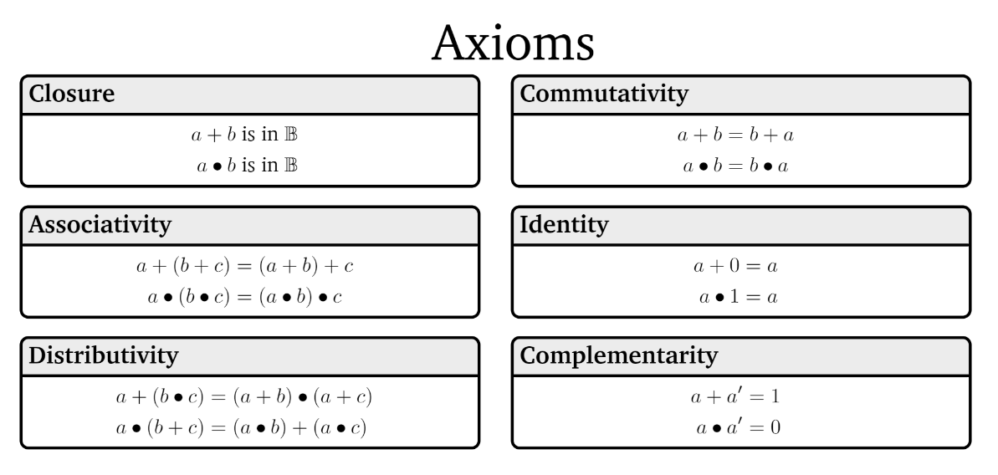
Boolean Algebra

Slide 47
Boolean Algebra

Slide 48
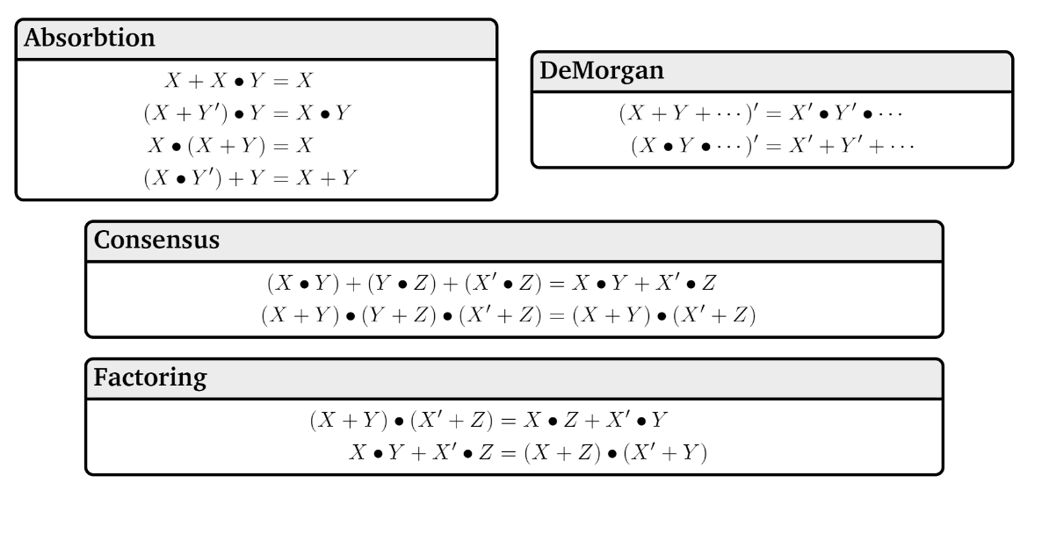
Boolean Algebra

Slide 49
A Few Fun Facts
That you’re not responsible for:
The identities are divided into “axioms” and “theorems”
Mathematicians (and some computer scientists, like me ☺ ) will sometimes study what minimum starting points (“the axioms”) will be enough to derive all the usual facts we rely on (“the theorems”)
That’s what I meant by “operations that work kinda like plus and times”
For our purposes, we won’t make a distinction here, but we will use similar thinking later in the course.
Boolean algebra makes things like commutativity axioms (starting points, things we assume) with propositional logic, we start from the truth tables and can derive that commutativity is true. For this class, though, it’s a fact you can use either way.

Slide 50
Why ANOTHER way of writing down logic?
This is the third one!?
Because, in your future courses, you’ll use any/all of them.
Remember there aren’t new concepts here, just new representations.
We mostly use propositional notation ($∧,∨,¬,$etc.) but we’ll use them all a bit so you’re ready for any of them in your future courses.
Practice in section and on homework.

Slide 51
Canonical Forms
Back to the old notation.

Slide 52
Canonical Forms
A truth table is a unique representation of a Boolean Function.
If you describe a function, there’s only one possible truth table for it.
Given a truth table you can find many circuits and many compound prepositions to represent it.
Think back to when we were developing the law of implication…
It would be nice to have a “standard” proposition (or standard circuit) we could always write as a starting point.
So we have a (possibly) shorter way of telling if we have the same function.

Slide 53
Using Our Rules
WOW that was a lot of rules.
Why do we need them? Simplification!
Let’s go back to the “law of implication” example.
$p$ | $q$ | $$p→q$$
T | T | T
T | F | F
F | T | T
F | F | T
When is the implication true? Just “or” each of the three “true” lines!
$$\left(p∧q\right)∨\left(¬p∧q\right)∨(¬p∧¬q)$$
Also seems pretty reasonable
So is $\left(p∧q\right)∨\left(¬p∧q\right)∨\left(¬p∧¬q\right)≡(¬p∨q)$
i.e. are these both alternative representations of $p→q$?

Slide 54
Disjunctive Normal Form (DNF)
a.k.a. OR of ANDs
a.k.a Sum-of-Products Form
a.k.a. Minterm Expansion
Read the true rows of the truth table
AND together all the settings in a given (true) row.
OR together the true rows.

Slide 55
Disjunctive Normal Form
Read the true rows of the truth table
AND together all the settings in a given (true) row.
OR together the true rows.
$p$ | $q$ | $$G(p,q)$$
T | T | T
T | F | F
F | T | T
F | F | F
$$p∧q$$
$$¬p∧q$$
$$G\left(p,q\right)≡\left(p∧q\right)∨(¬p∧q)$$

Slide 56
Another Canonical Form
DNF is a great way to represent functions that are usually false.
If there are only a few true rows, the representation is short.
What about functions that are usually true?
Well $G$ is equivalent to $¬¬G$, and $¬G$ is a function that is usually false.
Let’s try taking the Sum-of-Products of $¬G$ and negating it.

Slide 57
Another Canonical Form
Read the true rows of the truth table
AND together all the settings in a given (true) row.
OR together the true rows.
$p$ | $q$ | $$G(p,q)$$ | $$¬G(p,q)$$
T | T | T | F
T | F | F | T
F | T | T | F
F | F | F | T
$$p∧¬q$$
$$¬p∧¬q$$
$$¬G\left(p,q\right)≡\left(p∧¬q\right)∨(¬p∧¬q)$$
$$G\left(p,q\right)≡¬[\left(p∧¬q\right)∨\left(¬p∧¬q\right)]$$
$$G\left(p,q\right)≡\left[¬\left(p∧¬q\right)∧¬\left(¬p∧¬q\right)\right]$$
$$G\left(p,q\right)≡[\left(¬p∨q\right)∧\left(p∨q\right)]$$
This is not in Disjunctive Normal Form! It’s something else, though…

Slide 58
Conjunctive Normal Form
a.k.a. AND of ORs
a.k.a. Product-of-Sums Form
a.k.a. Maxterm Expansion
Read the false rows of the truth table
OR together the negations of all the settings in the false rows.
AND together the false rows.
Or take the DNF of the negation of the function you care about, and distribute the negation.

Slide 59
Normal Forms
Don’t simplify any further! Don’t factor anything out (even if you can). The point of the canonical form is we know exactly what it looks like, you might simplify differently than someone else.
Why? Easier to understand for people.
Inside the parentheses are only ORs between the parentheses are only ANDs (or vice versa).
You’ll use these more in later courses.

Slide 60
Properties of Logical Connectives
These identities hold for all propositions $p,q,r$
Identity
$p∧T≡p$
$p∨F≡p$
Domination
$p∨T≡T$
$p∧F≡F$
Idempotent
$p∨p≡p$
$p∧p≡p$
Commutative
$p∨q≡q∨p$
$p∧q≡q∧p$
Associative
$\left(p∨q\right)∨r≡p∨\left(q∨r\right)$
$\left(p∧q\right)∧r≡p∧\left(q∧r\right)$
Distributive
$p∧\left(q∨r\right)≡\left(p∧q\right)∨\left(p∧r\right)$
$p∨\left(q∧r\right)≡\left(p∨q\right)∧(p∨r)$
Absorption
$p∨\left(p∧q\right)≡p$
$p∧\left(p∨q\right)≡p$
Negation
$p∨¬p≡T$
$p∧¬p≡F$
DeMorgan’s Laws
$¬\left(p∨q\right)≡¬p∧¬q$
$¬\left(p∧q\right)≡¬p∨¬q$
Double Negation
$¬¬p≡p$
Law of Implication
$p→q≡¬p∨q$
Contrapositive
$p→q≡¬q→¬p$

