Slide 1
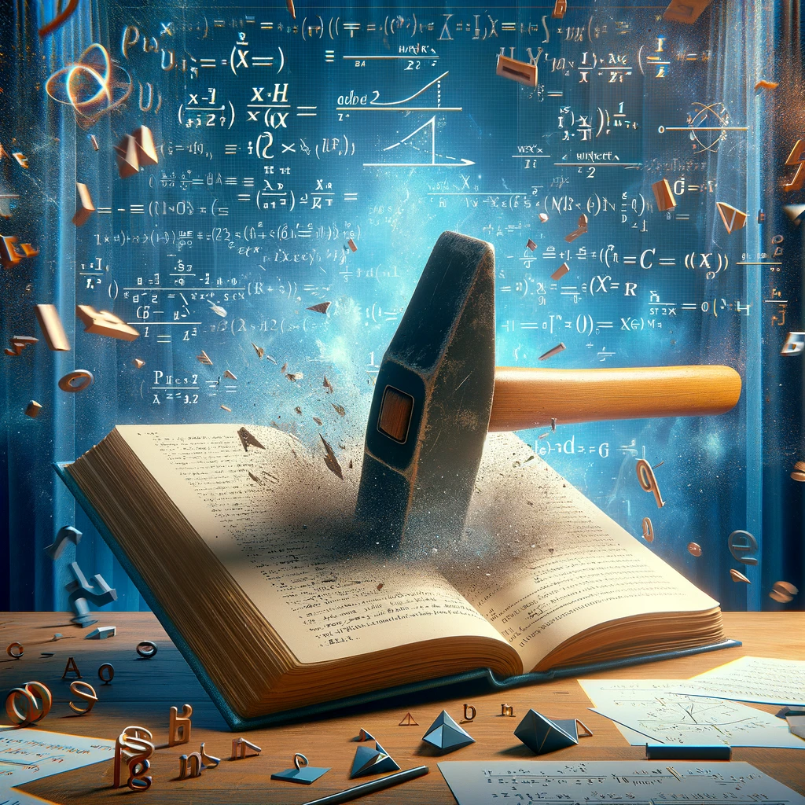
Proof By Contradiction

Slide 2
In real life!
Claim: My Tire is Leaking
Suppose that this tire was not leaking
This means the tire pressure should be constant
I observe the pressure is dropping at a moderate rate
But there should be constant pressure if it was not leaking
Therefore, it must be leaking

Slide 3
Proof by Contradiction Skeleton
Claim: p is true.
Suppose for the sake of contradiction $¬p$.
…
Then some statement $s$ must hold.
…
And some statement $¬s$ must hold.
But $s$ and $¬s$ is a contradiction. So $p$ must be true.
My tire is leaking
Suppose my tire is not leaking
The tire pressure must be constant
The tire pressure is decreasing
My Tire is leaking

Slide 4
Why does this work?
Let’s say the claim you are trying to prove is $p$.
A proof by contradiction shows the following implication:
$¬p→False$
Why does this implication show $p$?
The contrapositive is $True→p$ which simplifies to just $p$.
This means that by proving $¬p→False$, you have proved $p$ is True!
Hint think contrapositive

Slide 5
Graph Example
Can we travel on every road, without going on a road twice?
Start
There is no path, let’s prove it!
Stuck!

Slide 6
Graph Example
Claim: it is impossible to travel on every road visiting each road exactly once
Proof: Suppose that it is possible to travel on every road visiting each road exactly once.
Consider how many times each vertex would be passed through on this path.
However [] is a contradiction!
Therefore, it must be impossible to visit every road exactly once

Slide 7
We enter and exit a landmark

Slide 8
Graph Example

Slide 9
We enter and exit a landmark
Notice that this means there are an even number of roads that we drove on connected to this landmark

Slide 10
We enter and exit a landmark
Even if we go through it again on new roads, this holds

Slide 11
We Start at the Landmark
Notice we drove on only one road, (as we started in the landmark) making it have an odd number of roads that connect to it

Slide 12
We End at the Landmark
Notice we drove on only one road, (as we ended in the landmark) making it have an odd number of roads that connect to it

Slide 13
Graph Example
Claim: it is impossible to travel on every road visiting each road exactly once
Proof: Suppose that it is possible to travel on every road visiting each road exactly once.
Consider how many times each landmark would be passed through on this path.
As we observed, all of the landmarks on our path must have an even number of roads, except for the starting and ending one, making us have exactly 2 landmarks with an odd number of connecting roads.
However [] is a contradiction!
Therefore, it must be impossible to visit every road exactly once

Slide 14
Graph Example
Claim: it is impossible to travel on every road visiting each road exactly once
Proof: Suppose that it is possible to travel on every road visiting each road exactly once.
Consider how many times each landmark would be passed through on this path.
As we observed, all of the landmarks on our path must have an even number of roads, except for the starting and ending one, making us have exactly 2 landmarks with an odd number of connecting roads.
However, our graph has 4 landmarks with an odd number of roads coming out of it.
However [] is a contradiction!
Therefore, it must be impossible to visit every road exactly once

Slide 15
Graph Example
Claim: it is impossible to travel on every road visiting each road exactly once
Proof: Suppose that it is possible to travel on every road visiting each road exactly once.
Consider how many times each landmark would be passed through on this path.
As we observed, all of the landmarks on our path must have an even number of roads, except for the starting and ending one, making us have exactly 2 landmarks with an odd number of connecting roads.
However, our graph has 4 landmarks with an odd number of roads coming out of it.
But since 2 is not 4, this is a contradiction!
Therefore, it must be impossible to visit every road exactly once

Slide 16
Proof by Contradiction Examples

Slide 17
Proof By Contradiction
If $a^{2}$ is even, then a is even
Claim:$\sqrt{2 }$ is irrational (i.e not rational)
Proof:

Slide 18
Proof By Contradiction
If $a^{2}$ is even, then a is even
Claim:$\sqrt{2 }$ is irrational (i.e not rational)
Proof:
Suppose for the sake of contradiction that $\sqrt{2 }$ is rational
But [] is a contradiction! Thus, we can conclude that $\sqrt{2 }$ is irrational.
Notice target is unknown

Slide 19
Proof By Contradiction
If $a^{2}$ is even, then a is even
If $a^{2}$ is even, then a is even
Claim:$\sqrt{2 }$ is irrational (i.e not rational)
Proof:
Suppose for the sake of contradiction that $\sqrt{2 }$ is rational.
By definition of rational, there are integers s, t such that $t≠0$ and $\sqrt{2}= \frac{s}{t}$
Without loss of generality, suppose that s, t are in lowest terms (i.e it is the reduced fraction and 1 is s, t greatest common factor)
But [] is a contradiction! Thus, we can conclude that $\sqrt{2 }$ is irrational.

Slide 20
What is “Without Loss of Generality”?
You can use this when it looks like you are introducing a new assumption, but you are not, and the claim is still general. Only use if it would be immediately obvious to the reader why it is the case
In this case: if s and t share a factor other than 1, i.e k, we can just cancel out their common factor and continue the proof. (i.e $\frac{s′k}{t′k}=\frac{s}{t}$)
Another example:
Let x,y be integers; without loss of generality, assume $x ≥y$.

Slide 21
Proof By Contradiction
If $a^{2}$ is even, then a is even
Claim:$\sqrt{2 }$ is irrational (i.e not rational)
Proof:
Suppose for the sake of contradiction that $\sqrt{2 }$ is rational.
By definition of rational, there are integers s, t such that $t≠0$ and $\sqrt{2}= \frac{s}{t}$
Without loss of generality, suppose that s, t are in lowest terms (i.e it is the reduced fraction and 1 is s, t greatest common factor)
But [] is a contradiction! Thus, we can conclude that $\sqrt{2 }$ is irrational.

Slide 22
Proof By Contradiction
If $a^{2}$ is even, then a is even
Claim:$\sqrt{2 }$ is irrational (i.e not rational)
Proof:
Suppose for the sake of contradiction that $\sqrt{2 }$ is rational.
By definition of rational, there are integers s, t such that $t≠0$ and $\sqrt{2}= \frac{s}{t}$
Without loss of generality, suppose that s, t are in lowest terms (i.e it is the reduced fraction and 1 is s, t greatest common factor)
$$\sqrt{2 }= \frac{s}{t}$$
But [] is a contradiction! Thus, we can conclude that $\sqrt{2 }$ is irrational.

Slide 23
Proof By Contradiction
If $a^{2}$ is even, then a is even
Claim:$\sqrt{2 }$ is irrational (i.e not rational)
Proof:
Suppose for the sake of contradiction that $\sqrt{2 }$ is rational.
By definition of rational, there are integers s, t such that $t≠0$ and $\sqrt{2}= \frac{s}{t}$
Without loss of generality, suppose that s, t are in lowest terms (i.e it is the reduced fraction and 1 is s, t greatest common factor)
$$\sqrt{2 }= \frac{s}{t}$$
$$2= \frac{s^{2}}{t^{2}}$$
But [] is a contradiction! Thus, we can conclude that $\sqrt{2 }$ is irrational.

Slide 24
Proof By Contradiction
If $a^{2}$ is even, then a is even
Claim:$\sqrt{2 }$ is irrational (i.e not rational)
Proof:
Suppose for the sake of contradiction that $\sqrt{2 }$ is rational.
By definition of rational, there are integers s, t such that $t≠0$ and $\sqrt{2}= \frac{s}{t}$
Without loss of generality, suppose that s, t are in lowest terms (i.e it is the reduced fraction and 1 is s, t greatest common factor)
$$\sqrt{2 }= \frac{s}{t}$$
$$2= \frac{s^{2}}{t^{2}}$$
Thus: $2t^{2}=s^{2}$
But [] is a contradiction! Thus, we can conclude that $\sqrt{2 }$ is irrational.

Slide 25
Proof By Contradiction
If $a^{2}$ is even, then a is even
Claim:$\sqrt{2 }$ is irrational (i.e not rational)
Proof:
Suppose for the sake of contradiction that $\sqrt{2 }$ is rational.
By definition of rational, there are integers s, t such that $t≠0$ and $\sqrt{2}= \frac{s}{t}$
Without loss of generality, suppose that s, t are in lowest terms (i.e it is the reduced fraction and 1 is s, t greatest common factor)
$$\sqrt{2 }= \frac{s}{t}$$
$$2= \frac{s^{2}}{t^{2}}$$
Thus: $2t^{2}=s^{2}$ So $s^{2}$ is even, making $s$ even by our lemma. This means that $s=2k$ for some integer $k$
But [] is a contradiction! Thus, we can conclude that $\sqrt{2 }$ is irrational.

Slide 26
Proof By Contradiction
If $a^{2}$ is even, then a is even
Claim:$\sqrt{2 }$ is irrational (i.e not rational)
Proof:
Suppose for the sake of contradiction that $\sqrt{2 }$ is rational.
By definition of rational, there are integers s, t such that $t≠0$ and $\sqrt{2}= \frac{s}{t}$
Without loss of generality, suppose that s, t are in lowest terms (i.e it is the reduced fraction and 1 is s, t greatest common factor)
$$\sqrt{2 }= \frac{s}{t}$$
$$2= \frac{s^{2}}{t^{2}}$$
Thus: $2t^{2}=s^{2}$ So $s^{2}$ is even, making $s$ even by our lemma. This means that $s=2k$ for some integer $k$
Squaring both sides, we get $s^{2}=4k^{2}$
But [] is a contradiction! Thus, we can conclude that $\sqrt{2 }$ is irrational.

Slide 27
Proof By Contradiction
If $a^{2}$ is even, then a is even
Claim:$\sqrt{2 }$ is irrational (i.e not rational)
Proof:
Suppose for the sake of contradiction that $\sqrt{2 }$ is rational.
By definition of rational, there are integers s, t such that $t≠0$ and $\sqrt{2}= \frac{s}{t}$
Without loss of generality, suppose that s, t are in lowest terms (i.e it is the reduced fraction and 1 is s, t greatest common factor)
$$\sqrt{2 }= \frac{s}{t}$$
$$2= \frac{s^{2}}{t^{2}}$$
Thus: $2t^{2}=s^{2}$ So $s^{2}$ is even, making $s$ even by our lemma. This means that $s=2k$ for some integer $k$
Squaring both sides, we get $s^{2}=4k^{2}$, which we can plug back into $2t^{2}=s^{2}$to get $2t^{2}=4k^{2}$
But [] is a contradiction! Thus, we can conclude that $\sqrt{2 }$ is irrational.

Slide 28
Proof By Contradiction
If $a^{2}$ is even, then a is even
Claim:$\sqrt{2 }$ is irrational (i.e not rational)
Proof:
Suppose for the sake of contradiction that $\sqrt{2 }$ is rational.
By definition of rational, there are integers s, t such that $t≠0$ and $\sqrt{2}= \frac{s}{t}$
Without loss of generality, suppose that s, t are in lowest terms (i.e it is the reduced fraction and 1 is s, t greatest common factor)
$$\sqrt{2 }= \frac{s}{t}$$
$$2= \frac{s^{2}}{t^{2}}$$
Thus: $2t^{2}=s^{2}$ So $s^{2}$ is even, making $s$ even by our lemma. This means that $s=2k$ for some integer $k$
Squaring both sides, we get $s^{2}=4k^{2}$, which we can plug back into $2t^{2}=s^{2}$to get $2t^{2}=4k^{2}$
Dividing both sides by two, we get $t^{2}=2k^{2}$
But [] is a contradiction! Thus, we can conclude that $\sqrt{2 }$ is irrational.

Slide 29
Proof By Contradiction
If $a^{2}$ is even, then a is even
Claim:$\sqrt{2 }$ is irrational (i.e not rational)
Proof:
Suppose for the sake of contradiction that $\sqrt{2 }$ is rational.
By definition of rational, there are integers s, t such that $t≠0$ and $\sqrt{2}= \frac{s}{t}$
Without loss of generality, suppose that s, t are in lowest terms (i.e it is the reduced fraction and 1 is s, t greatest common factor)
$$\sqrt{2 }= \frac{s}{t}$$
$$2= \frac{s^{2}}{t^{2}}$$
Thus: $2t^{2}=s^{2}$ So $s^{2}$ is even, making $s$ even by our lemma. This means that $s=2k$ for some integer $k$
Squaring both sides, we get $s^{2}=4k^{2}$, which we can plug back into $2t^{2}=s^{2}$to get $2t^{2}=4k^{2}$
Dividing both sides by two, we get $t^{2}=2k^{2}$, making $t^{2}$ is even, making $t$ even by our lemma.
But [] is a contradiction! Thus, we can conclude that $\sqrt{2 }$ is irrational.

Slide 30
Proof By Contradiction
If $a^{2}$ is even, then a is even
Claim:$\sqrt{2 }$ is irrational (i.e not rational)
Proof:
Suppose for the sake of contradiction that $\sqrt{2 }$ is rational.
By definition of rational, there are integers s, t such that $t≠0$ and $\sqrt{2}= \frac{s}{t}$
Without loss of generality, suppose that s, t are in lowest terms (i.e it is the reduced fraction and 1 is s, t greatest common factor)
$$\sqrt{2 }= \frac{s}{t}$$
$$2= \frac{s^{2}}{t^{2}}$$
Thus: $2t^{2}=s^{2}$ So $s^{2}$ is even, making $s$ even by our lemma. This means that $s=2k$ for some integer $k$
Squaring both sides, we get $s^{2}=4k^{2}$, which we can plug back into $2t^{2}=s^{2}$to get $2t^{2}=4k^{2}$
Dividing both sides by two, we get $t^{2}=2k^{2}$, making $t^{2}$ is even, making $t$ even by our lemma.
But if both $s$ and $t$ are even, they must have a common factor of 2. But we said that the fraction $\frac{s}{t}$ was irreducible.
This is a contradiction! Thus, we can conclude that $\sqrt{2 }$ is irrational.

Slide 31
Proof by Contradiction
Proof by contradiction is a strategy for proving statements of any form.
The general strategy to prove $p$ is to assume $¬p$ and derive $False$.
Examples:
The strategy to prove $p→q$ is to assume $p∧¬q$ and derive $False$.
The strategy to prove $p∨q$ is to assume $¬p∧¬q$ and derive $False$.
The strategy to prove $∀x(P\left(x\right))$ is to assume $∃x\left(¬P\left(x\right)\right)$ and derive $False$.
The strategy to prove $∃x(P\left(x\right))$ is to assume $∀x(¬P\left(x\right))$ and derive $False$.

Slide 32
Another Proof by Contradiction
Claim: There are infinitely many primes
Proof:

Slide 33
Another Proof by Contradiction
Claim: There are infinitely many primes
Proof:
Suppose for the sake of contradiction, there are only finitely many primes. Call them $p_{1},p_{2},…, p_{k}.$
But [] is a contradiction! So, there must be infinitely many primes.

Slide 34
Another Proof by Contradiction
Claim: There are infinitely many primes
Proof:
Suppose for the sake of contradiction, there are only finitely many primes. Call them $p_{1},p_{2},…, p_{k}.$
But [] is a contradiction! So, there must be infinitely many primes.
Where can we find a contradiction?
Show our list is non inclusive (i.e create a different prime number)
Show one of the numbers in our list is not prime
Create a contradiction with facts about prime factorization
Show 1 = 2
Show p is odd and even at the same time
Proof by cases with a mix of the above

Slide 35
Proof by Contradiction: Remarks
Unlike other proof techniques, we don’t know where we’re going. We’re trying to find any contradiction. That can make it harder.
Contradiction is a sledge-hammer. It can be used to prove many things. But it makes a mess.
You can find a contradiction directly with your assumption

Slide 36
Another Proof by Contradiction
Claim: There are infinitely many primes
Proof:
Suppose for the sake of contradiction, there are only finitely many primes. Call them $p_{1},p_{2},…, p_{k}.$
Consider the number $q= p_{1}⋅p_{2}⋅…⋅p_{k}+1$
But [] is a contradiction! So, there must be infinitely many primes.

Slide 37
Another Proof by Contradiction
Claim: There are infinitely many primes
Proof:
Suppose for the sake of contradiction, there are only finitely many primes. Call them $p_{1},p_{2},…, p_{k}.$
Consider the number $q= p_{1}⋅p_{2}⋅…⋅p_{k}+1$
Case 1: $q$ is prime:
But [] is a contradiction! So, there must be infinitely many primes.

Slide 38
Another Proof by Contradiction
Claim: There are infinitely many primes
Proof:
Suppose for the sake of contradiction, there are only finitely many primes. Call them $p_{1},p_{2},…, p_{k}.$
Consider the number $q= p_{1}⋅p_{2}⋅…⋅p_{k}+1$
Case 1: $q$ is prime:
Notice that q is prime and must be larger that every prime in $p_{1},p_{2},…, p_{k}.$ But every prime was in the list, therefore this is a contradiction!
But [] is a contradiction! So, there must be infinitely many primes.

Slide 39
Another Proof by Contradiction
Claim: There are infinitely many primes
Proof:
Suppose for the sake of contradiction, there are only finitely many primes. Call them $p_{1},p_{2},…, p_{k}.$
Consider the number $q= p_{1}⋅p_{2}⋅…⋅p_{k}+1$
Case 1: $q$ is prime:
Notice that q is prime and must be larger that every prime in $p_{1},p_{2},…, p_{k}.$ But every prime was in the list, therefore this is a contradiction!
Case 2: $q$ is not prime (i.e composite):
But [] is a contradiction! So, there must be infinitely many primes.

Slide 40
Another Proof by Contradiction
Claim: There are infinitely many primes
Proof:
Suppose for the sake of contradiction, there are only finitely many primes. Call them $p_{1},p_{2},…, p_{k}.$
Consider the number $q= p_{1}⋅p_{2}⋅…⋅p_{k}+1$
Case 1: $q$ is prime:
Notice that q is prime and must be larger that every prime in$p_{1},p_{2},…, p_{k}.$ But every prime was in the list, therefore this is a contradiction!
Case 2: $q$ is not prime (i.e composite):
Since q is composite, we know that some prime $p_{i}$ must divide q.
But [] is a contradiction! So, there must be infinitely many primes.

Slide 41
Another Proof by Contradiction
Claim: There are infinitely many primes
Proof:
Suppose for the sake of contradiction, there are only finitely many primes. Call them $p_{1},p_{2},…, p_{k}.$
Consider the number $q= p_{1}⋅p_{2}⋅…⋅p_{k}+1$
Case 1: $q$ is prime:
Notice that q is prime and must be larger that every prime in $p_{1},p_{2},…, p_{k}.$ But every prime was in the list, therefore this is a contradiction!
Case 2: $q$ is not prime (i.e composite):
Since q is composite, we know that some prime $p_{i}$ must divide q. This means that $q \% p_{i}=0$.
But [] is a contradiction! So, there must be infinitely many primes.

Slide 42
Another Proof by Contradiction
Claim: There are infinitely many primes
Proof:
Suppose for the sake of contradiction, there are only finitely many primes. Call them $p_{1},p_{2},…, p_{k}.$
Consider the number $q= p_{1}⋅p_{2}⋅…⋅p_{k}+1$
Case 1: $q$ is prime:
Notice that q is prime and must be larger that every prime in $p_{1},p_{2},…, p_{k}.$ But every prime was in the list, therefore this is a contradiction!
Case 2: $q$ is not prime (i.e composite):
Since q is composite, we know that some prime $p_{i}$ must divide q. This means that $q \% p_{i}=0$.
Also, notice that $q \% p_{i}=\left(p_{1}⋅p_{2}⋅…⋅p_{k}\right)+1 \% p_{i}$ using the definition of q,
But [] is a contradiction! So, there must be infinitely many primes.

Slide 43
Another Proof by Contradiction
Claim: There are infinitely many primes
Proof:
Suppose for the sake of contradiction, there are only finitely many primes. Call them $p_{1},p_{2},…, p_{k}.$
Consider the number $q= p_{1}⋅p_{2}⋅…⋅p_{k}+1$
Case 1: $q$ is prime:
Notice that q is prime and must be larger that every prime in $p_{1},p_{2},…, p_{k}.$ But every prime was in the list, therefore this is a contradiction!
Case 2: $q$ is not prime (i.e composite):
Since q is composite, we know that some prime $p_{i}$ must divide q. This means that $q \% p_{i}=0$.
Also, notice that $q \% p_{i}=\left(p_{1}⋅p_{2}⋅…⋅p_{k}\right)+1 \% p_{i}$ using the definition of q, which gives us:
$$q \% p_{i}=$$
But [] is a contradiction! So, there must be infinitely many primes.

Slide 44
Another Proof by Contradiction
Claim: There are infinitely many primes
Proof:
Suppose for the sake of contradiction, there are only finitely many primes. Call them $p_{1},p_{2},…, p_{k}.$
Consider the number $q= p_{1}⋅p_{2}⋅…⋅p_{k}+1$
Case 1: $q$ is prime:
Notice that q is prime and must be larger that every prime in $p_{1},p_{2},…, p_{k}.$ But every prime was in the list, therefore this is a contradiction!
Case 2: $q$ is not prime (i.e composite):
Since q is composite, we know that some prime $p_{i}$ must divide q. This means that $q \% p_{i}=0$.
Also, notice that $q \% p_{i}=\left(p_{1}⋅p_{2}⋅…⋅p_{k}\right)+1 \% p_{i}$ using the definition of q, which gives us:
$$q \% p_{i}=\left(p_{1}⋅p_{2}⋅…⋅p_{k}\right)+1 \% p_{i}=$$
But [] is a contradiction! So, there must be infinitely many primes.

Slide 45
Another Proof by Contradiction
Claim: There are infinitely many primes
Proof:
Suppose for the sake of contradiction, there are only finitely many primes. Call them $p_{1},p_{2},…, p_{k}.$
Consider the number $q= p_{1}⋅p_{2}⋅…⋅p_{k}+1$
Case 1: $q$ is prime:
Notice that q is prime and must be larger that every prime in $p_{1},p_{2},…, p_{k}.$ But every prime was in the list, therefore this is a contradiction!
Case 2: $q$ is not prime (i.e composite):
Since q is composite, we know that some prime $p_{i}$ must divide q. This means that $q \% p_{i}=0$.
Also, notice that $q \% p_{i}=\left(p_{1}⋅p_{2}⋅…⋅p_{k}\right)+1 \% p_{i}$ using the definition of q, which gives us:
$$q \% p_{i}=\left(p_{1}⋅p_{2}⋅…⋅p_{k}\right)+1 \% p_{i}=\left(p_{1}⋅…p_{i}⋅…⋅p_{k}\right)+1 \% p_{i}$$
But [] is a contradiction! So, there must be infinitely many primes.

Slide 46
Another Proof by Contradiction
Claim: There are infinitely many primes
Proof:
Suppose for the sake of contradiction, there are only finitely many primes. Call them $p_{1},p_{2},…, p_{k}.$
Consider the number $q= p_{1}⋅p_{2}⋅…⋅p_{k}+1$
Case 1: $q$ is prime:
Notice that q is prime and must be larger that every prime in $p_{1},p_{2},…, p_{k}.$ But every prime was in the list, therefore this is a contradiction!
Case 2: $q$ is not prime (i.e composite):
Since q is composite, we know that some prime $p_{i}$ must divide q. This means that $q \% p_{i}=0$.
Also, notice that $q \% p_{i}=\left(p_{1}⋅p_{2}⋅…⋅p_{k}\right)+1 \% p_{i}$ using the definition of q, which gives us:
$$q \% p_{i}=\left(p_{1}⋅p_{2}⋅…⋅p_{k}\right)+1 \% p_{i}=\left(p_{1}⋅…p_{i}⋅…⋅p_{k}\right)+1 \% p_{i}=1$$
But [] is a contradiction! So, there must be infinitely many primes.

Slide 47
Another Proof by Contradiction
Claim: There are infinitely many primes
Proof:
Suppose for the sake of contradiction, there are only finitely many primes. Call them $p_{1},p_{2},…, p_{k}.$
Consider the number $q= p_{1}⋅p_{2}⋅…⋅p_{k}+1$
Case 1: $q$ is prime:
Notice that q is prime and must be larger that every prime in $p_{1},p_{2},…, p_{k}.$ But every prime was in the list, therefore this is a contradiction!
Case 2: $q$ is not prime (i.e composite):
Since q is composite, we know that some prime $p_{i}$ must divide q. This means that $q \% p_{i}=0$.
Also, notice that $q \% p_{i}=\left(p_{1}⋅p_{2}⋅…⋅p_{k}\right)+1 \% p_{i}$ using the definition of q, which gives us:
$$q \% p_{i}=\left(p_{1}⋅p_{2}⋅…⋅p_{k}\right)+1 \% p_{i}=\left(p_{1}⋅…p_{i}⋅…⋅p_{k}\right)+1 \% p_{i}=1$$
This means that $q \% p_{i}$ equals both $1$ and $0$, which is impossible!
In both cases, this is a contradiction! So, there must be infinitely many primes.

Slide 48
Bonus Proof!
Claim: if $a^{2}$ is even, than $a$ is even.
Proof:
Suppose for the sake of contradiction that $a^{2}$ is even and $a$ is odd for some integer a.
This means that $a=2k+1$for some k.
Substituting this in, we have $a^{2}={\left(2k+1\right)}^{2}=4k^{2}+4k+1=2\left(2k^{2}+2k\right)+1$
Since $2k^{2}+2k$ is an integer, we have that $a^{2}$ is odd!
This is a contradiction however as $a^{2}$ cannot be both even and odd. Therefore through proof by contradiction, if $a^{2}$ is even, than $a$ is even.
Notes:
Show it with contradiction

Slide 49
Another Proof by Contradiction
Claim: There are infinitely many primes
Proof:
Suppose for the sake of contradiction, there are only finitely many primes. Call them $p_{1},p_{2},…, p_{k}.$
Consider the number $q= p_{1}⋅p_{2}⋅…⋅p_{k}+1$
Case 1: $q$ is prime:
Case 2: $q$ is not prime (i.e composite):
Since q is composite, we know that some prime $p_{i}$ must divide q. This means that $q \% p_{i}=0$.
Also, notice that $q \% p_{i}=\left(p_{1}⋅p_{2}⋅…⋅p_{k}\right)+1 \% p_{i}$ using the definition of q, which gives us:
$$q \% p_{i}=\left(p_{1}⋅p_{2}⋅…⋅p_{k}\right)+1 \% p_{i}$$
In both cases, this is a contradiction! So, there must be infinitely many primes.

Slide 50
Graph Example
Can we travel on every road, without going on a road twice?
Start
Stuck!

