Slide 1
Irregular Languages
CSE 311 Winter 2024
Lecture 27

Slide 2

What can’t NFAs/DFAs/Regexes do?
There are languages that can’t be recognized by a DFA.
$\{0^{k}1^{k}|k≥0\}$ is the classic example.
Let’s prove it.

Slide 3
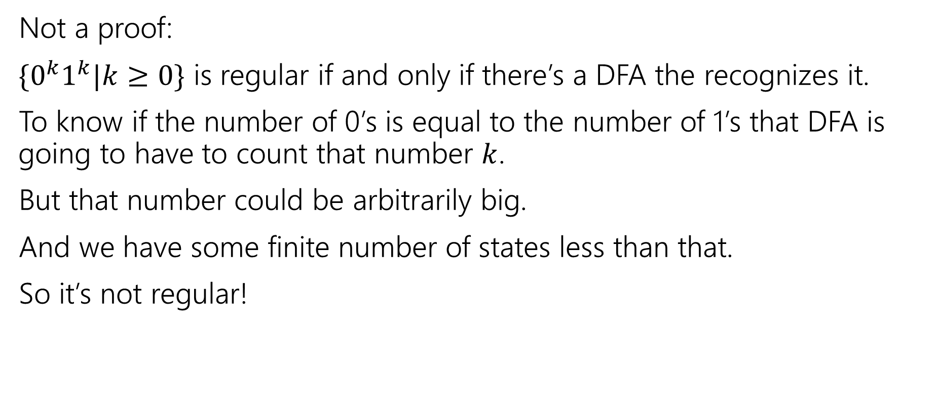
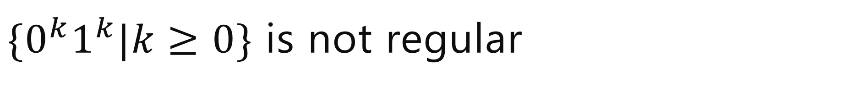
$\{0^{k}1^{k}|k≥0\}$ is not regular
Not a proof:
$\{0^{k}1^{k}|k≥0\}$ is regular if and only if there’s a DFA the recognizes it.
To know if the number of 0’s is equal to the number of 1’s that DFA is going to have to count that number $k$.
But that number could be arbitrarily big.
And we have some finite number of states less than that.
So it’s not regular!
“the DFA must work like this” isn’t a rigorous argument.

Slide 4
“The DFA must do this”
Consider “The set of all binary strings, where the number of “01” substrings is equal to the number of “10” substrings.”
The DFA must count the number of “01” and “10” substrings, right?
NO!
Between every 01 substring there’s a 10 substring.
0001111000011101011
You don’t have to count the total, just the difference between them. And that difference never exceeds 1.

Slide 5
In general…
Try to avoid saying “in order to solve problem X, a machine must do Y”
  It’s almost impossible to rigorously justify.
  And it’s easy to trick yourself – you’ll have to argue no one is more clever than you are.
The right way to argue around this claim is to argue by contradiction. Show that every conceivable DFA does the wrong thing (rather than indirectly that they aren’t doing what you think they should).

Slide 6
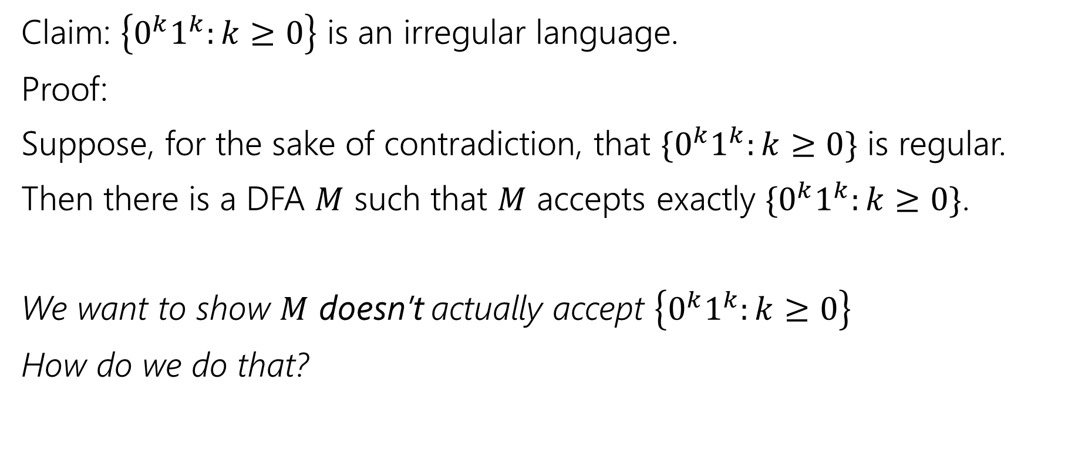
A Proof Outline
Claim: $\left\{0^{k}1^{k}:k≥0\right\}$ is an irregular language.
Proof:
Suppose, for the sake of contradiction, that $\{0^{k}1^{k}:k≥0\}$ is regular.
Then there is a DFA $M$ such that $M$ accepts exactly $\{0^{k}1^{k}:k≥0\}$.
We want to show $M$ doesn’t actually accept $\left\{0^{k}1^{k}:k≥0\right\}$
How do we do that?

Slide 7
Forcing a Mistake
We don’t know anything about the DFA.
Well except that it is a DFA.
So it is deterministic. I.e. if you’re in a particular state and you read a certain character there’s only one place to go.
It’s also finite. I.e. there are not an infinite number of states.

Slide 8
Forcing a Mistake
What if…
We could find a set of strings that all must be in different states.
Too many of them. Enough that two must be in the same state.
If we had a 4 state machine, how many strings would guarantee a “collision”? 5 strings. If there are more strings than states, they can’t all get their own state.
How many strings is enough for us?
infinity

Slide 9
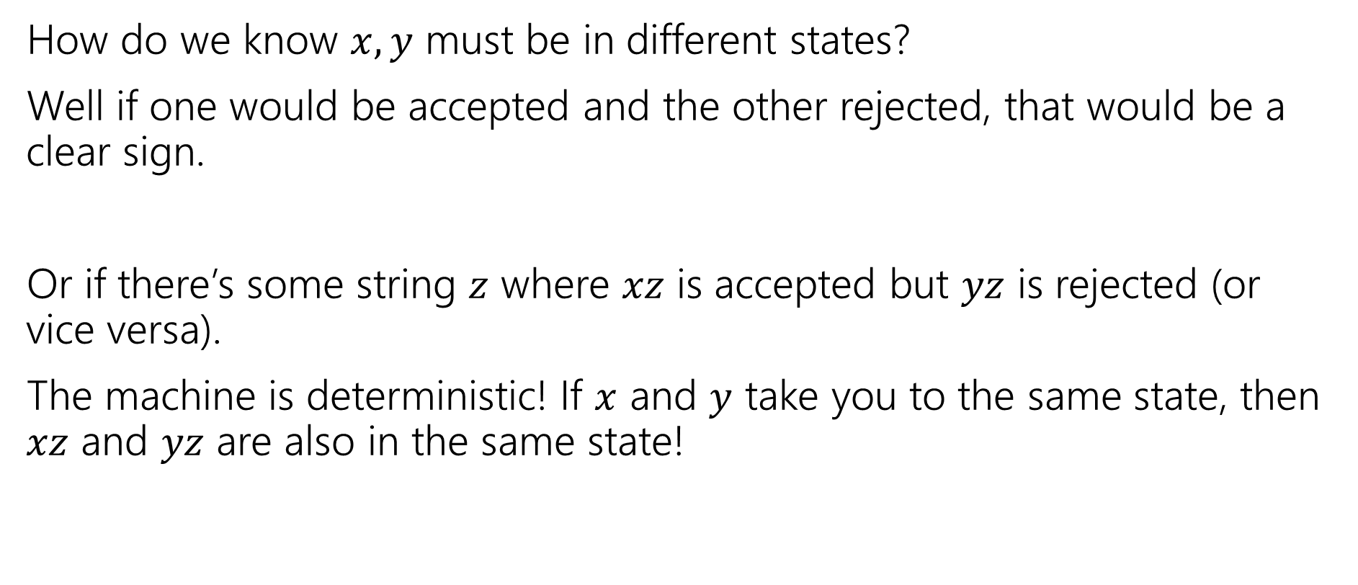
Forcing a Mistake
How do we know $x,y$ must be in different states?
Well if one would be accepted and the other rejected, that would be a clear sign.
Or if there’s some string $z$ where $xz$ is accepted but $yz$ is rejected (or vice versa).
The machine is deterministic! If $x$ and $y$ take you to the same state, then $xz$ and $yz$ are also in the same state!

Slide 10
A Proof Outline
Claim: $\left\{0^{k}1^{k}:k≥0\right\}$ is an irregular language.
Proof:
Suppose, for the sake of contradiction, that $\{0^{k}1^{k}:k≥0\}$ is regular.
Then there is a DFA $M$ such that $M$ accepts exactly $\{0^{k}1^{k}:k≥0\}$.
We want to show $M$ doesn’t actually accept $\left\{0^{k}1^{k}:k≥0\right\}$
How do we do that?

Slide 11
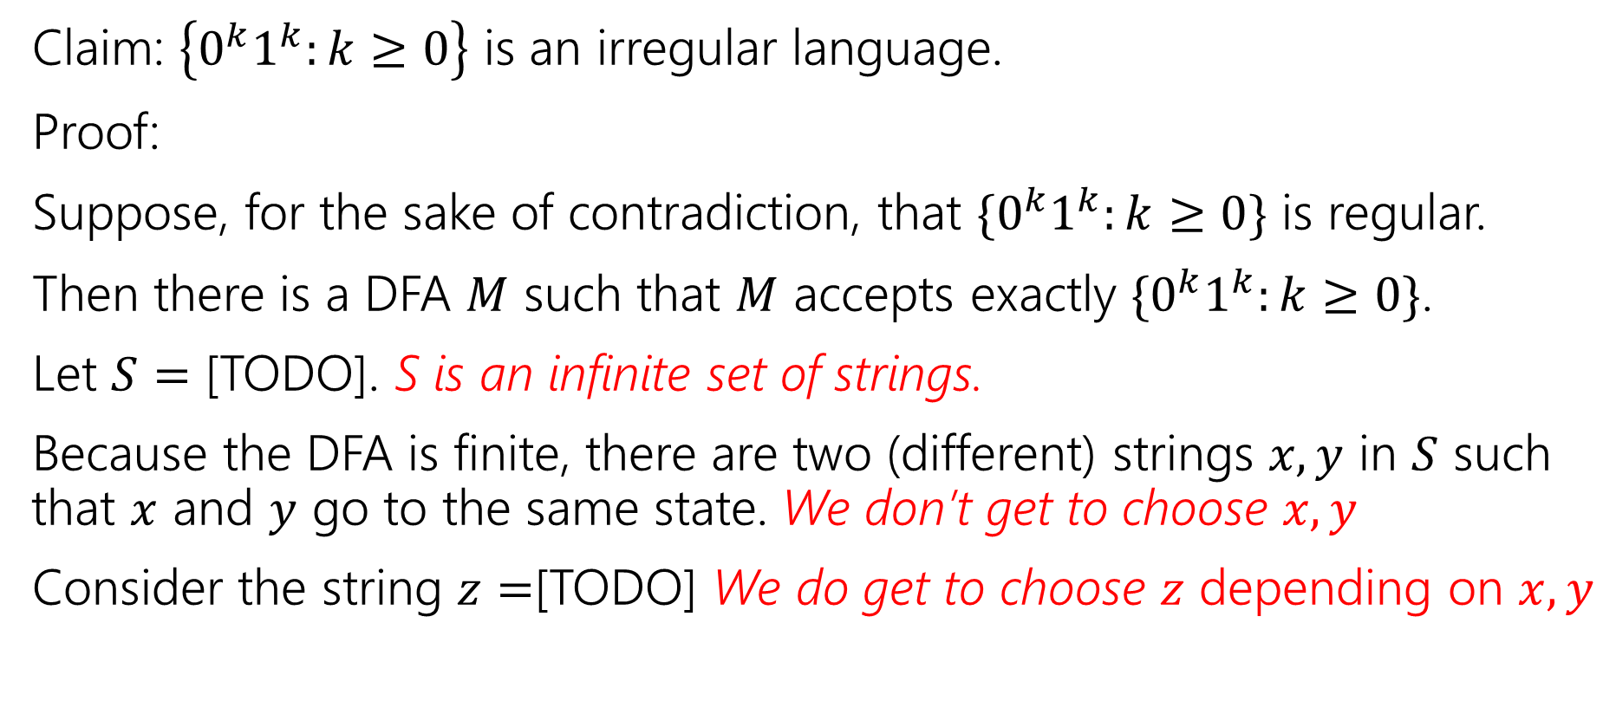
A Proof Outline
Claim: $\left\{0^{k}1^{k}:k≥0\right\}$ is an irregular language.
Proof:
Suppose, for the sake of contradiction, that $\{0^{k}1^{k}:k≥0\}$ is regular.
Then there is a DFA $M$ such that $M$ accepts exactly $\{0^{k}1^{k}:k≥0\}$.
Let $S=$ [TODO]. S is an infinite set of strings.
Because the DFA is finite, there are two (different) strings $x,y$ in $S$ such that $x$ and $y$ go to the same state. We don’t get to choose $x,y$
Consider the string $z=$[TODO] We do get to choose $z$ depending on $x,y$

Slide 12
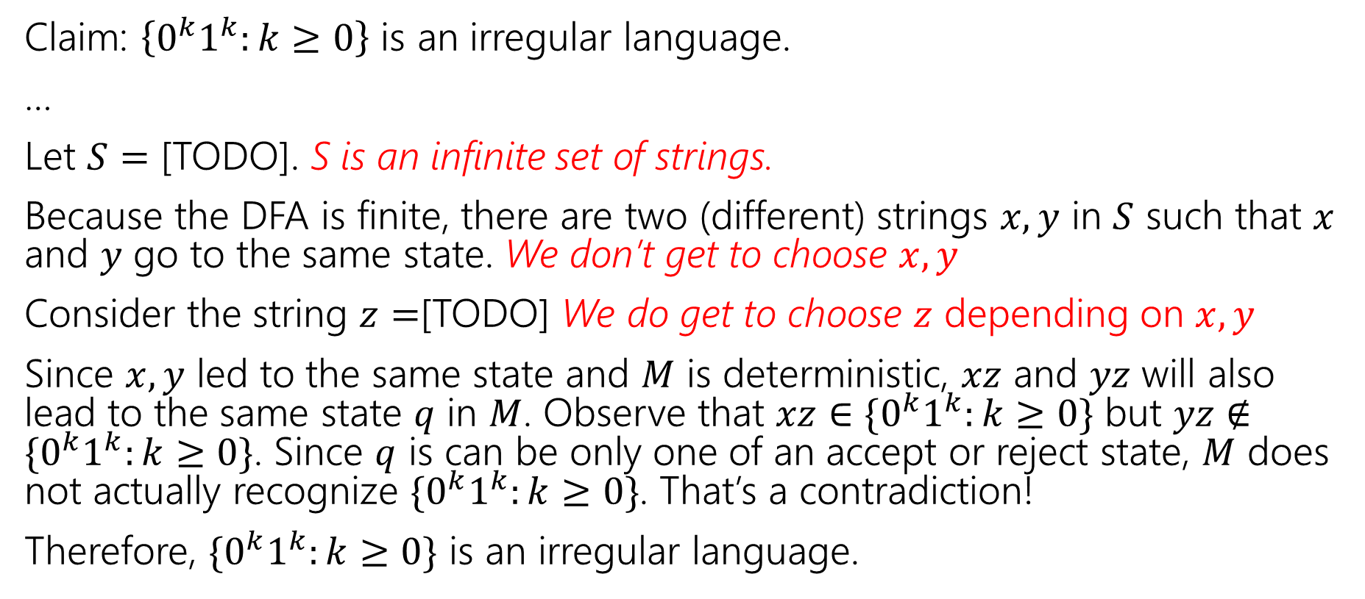
A Proof Outline
Claim: $\left\{0^{k}1^{k}:k≥0\right\}$ is an irregular language.
…
Let $S=$ [TODO]. S is an infinite set of strings.
Because the DFA is finite, there are two (different) strings $x,y$ in $S$ such that $x$ and $y$ go to the same state. We don’t get to choose $x,y$
Consider the string $z=$[TODO] We do get to choose $z$ depending on $x,y$
Since $x,y$ led to the same state and $M$ is deterministic, $xz$ and $yz$ will also lead to the same state $q$ in $M$. Observe that $xz∈\{0^{k}1^{k}:k≥0\}$ but $yz∉\{0^{k}1^{k}:k≥0\}$. Since $q$ is can be only one of an accept or reject state, $M$ does not actually recognize $\{0^{k}1^{k}:k≥0\}$. That’s a contradiction!
Therefore, $\{0^{k}1^{k}:k≥0\}$ is an irregular language.

Slide 13
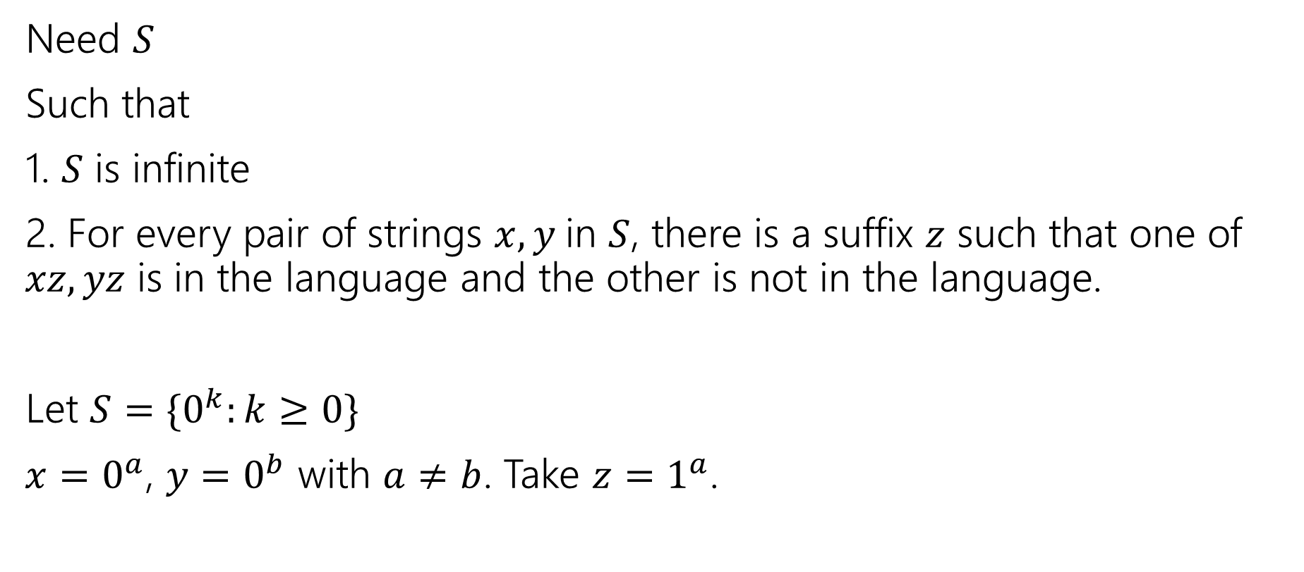
Filling in the blanks
Need $S$
Such that
1. $S$ is infinite
2. For every pair of strings $x,y$in $S$, there is a suffix $z$ such that one of $xz,yz$ is in the language and the other is not in the language.
Let $S=\{0^{k}:k≥0\}$
$x=0^{a}$, $y=0^{b}$ with $a≠b$. Take $z=1^{a}$.

Slide 14
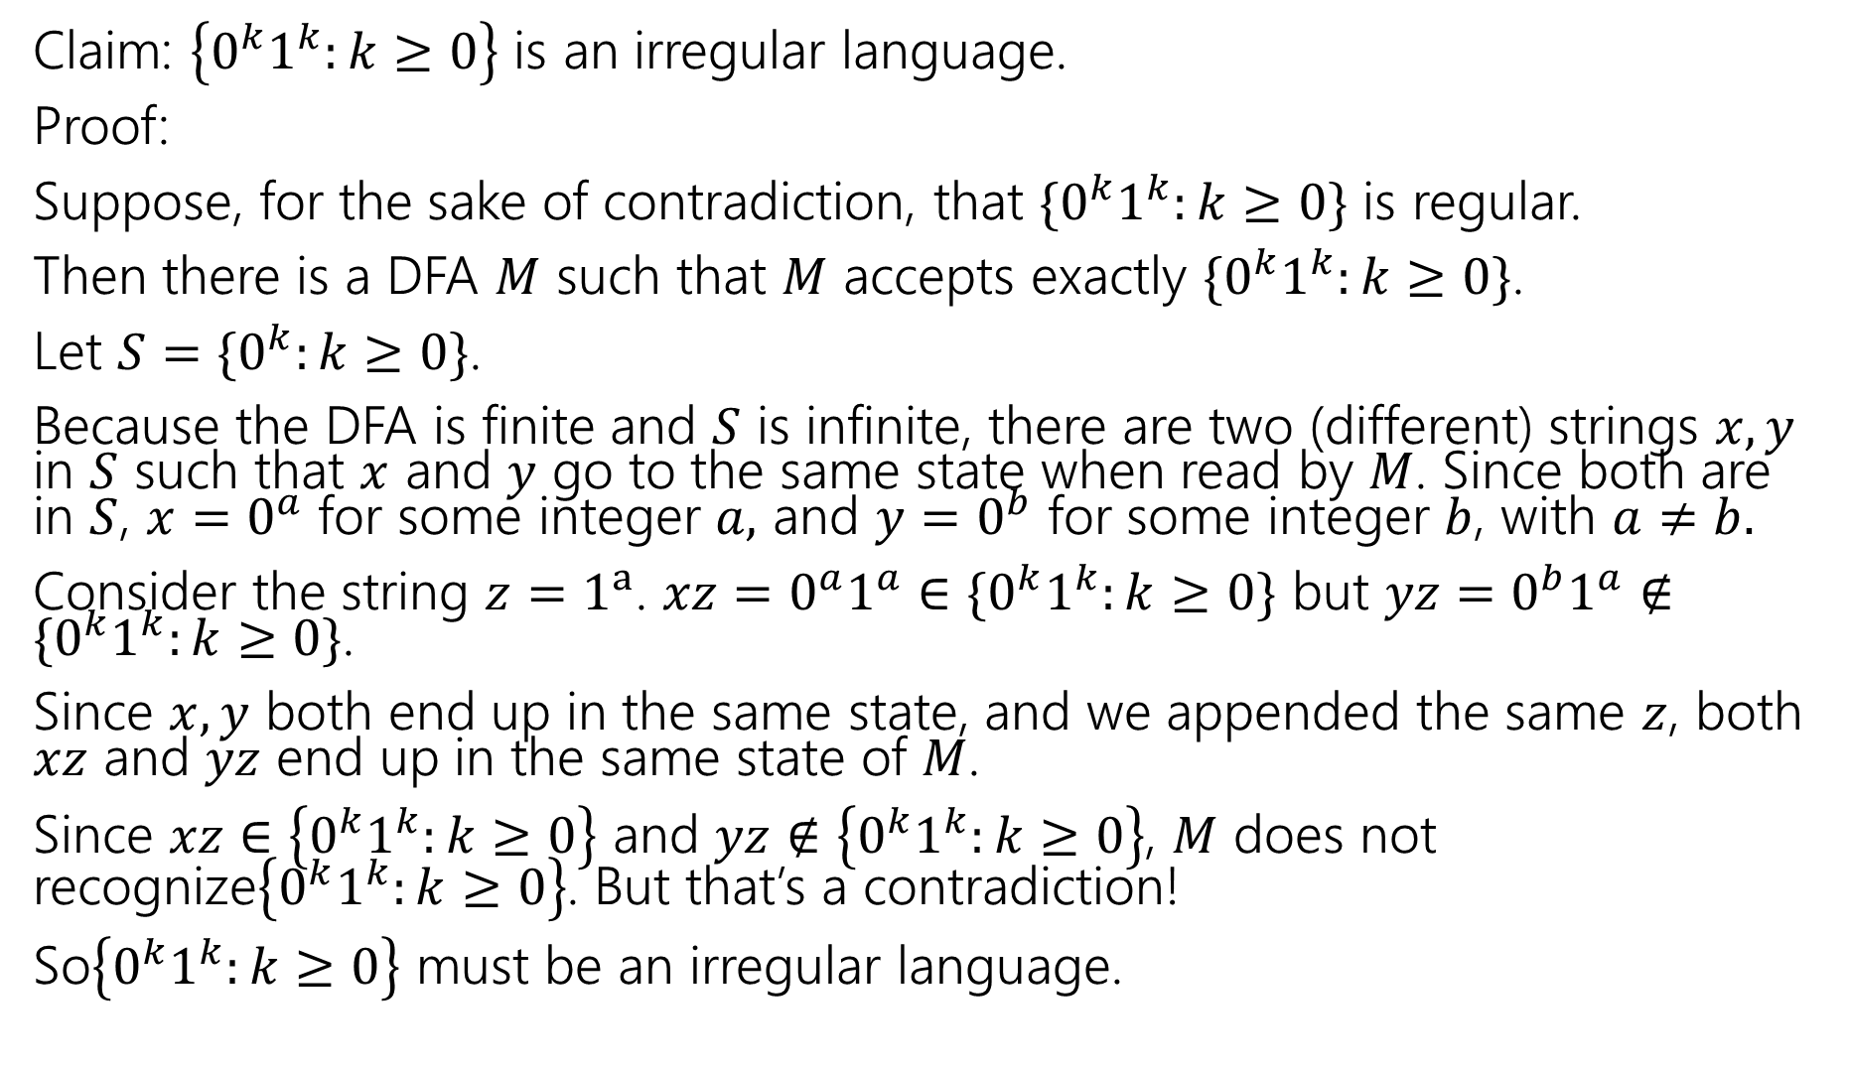
Claim: $\left\{0^{k}1^{k}:k≥0\right\}$ is an irregular language.
Proof:
Suppose, for the sake of contradiction, that $\{0^{k}1^{k}:k≥0\}$ is regular.
Then there is a DFA $M$ such that $M$ accepts exactly $\{0^{k}1^{k}:k≥0\}$.
Let $S=$ $\{0^{k}:k≥0\}$.
Because the DFA is finite and $S$ is infinite, there are two (different) strings $x,y$ in $S$ such that $x$ and $y$ go to the same state when read by $M$. Since both are in $S$, $x=0^{a}$ for some integer $a,$ and $y=0^{b}$ for some integer $b$, with $a≠b.$
Consider the string $z=1^{a}$. $xz=0^{a}1^{a}∈\{0^{k}1^{k}:k≥0\}$ but $yz=0^{b}1^{a}∉\{0^{k}1^{k}:k≥0\}$.
Since $x,y$ both end up in the same state, and we appended the same $z$, both $xz$ and $yz$ end up in the same state of $M$.
Since $xz∈$ $\left\{0^{k}1^{k}:k≥0\right\}$ and $yz∉\left\{0^{k}1^{k}:k≥0\right\}$, $M$ does not recognize$\left\{0^{k}1^{k}:k≥0\right\}$. But that’s a contradiction!
So$\left\{0^{k}1^{k}:k≥0\right\}$ must be an irregular language.

Slide 15
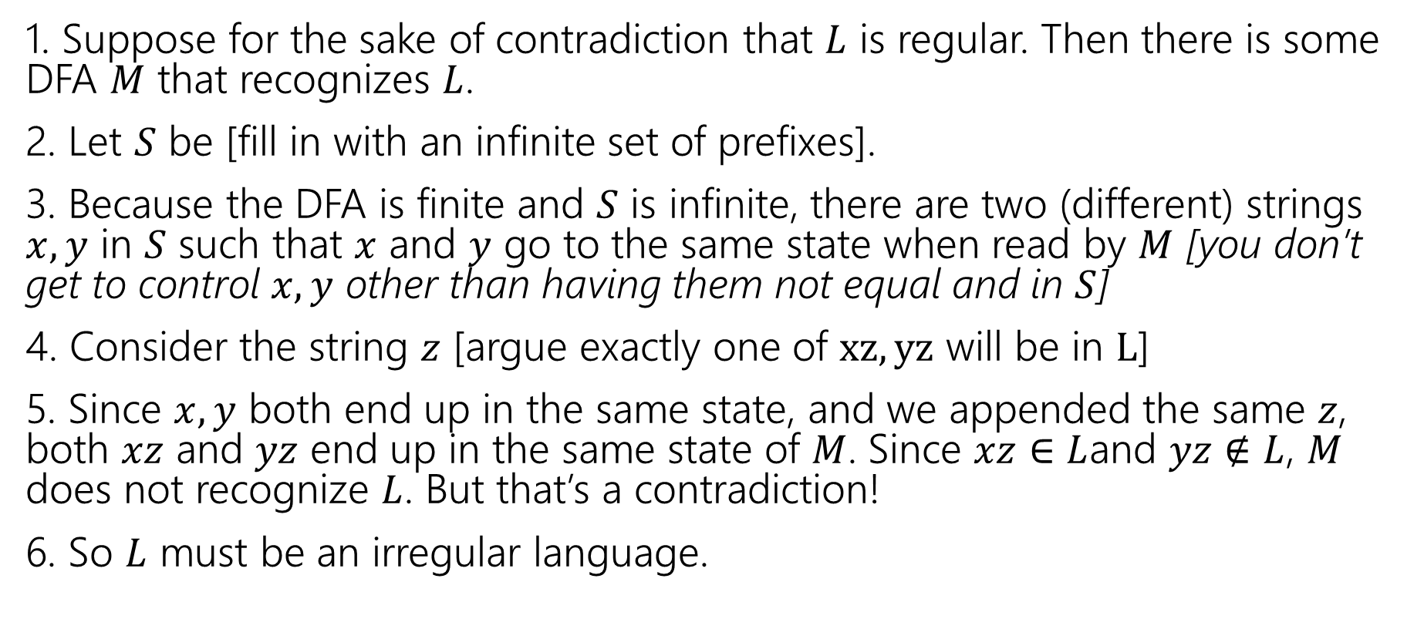
Full outline
1. Suppose for the sake of contradiction that $L$ is regular. Then there is some DFA $M$ that recognizes $L$.
2. Let $S$ be [fill in with an infinite set of prefixes].
3. Because the DFA is finite and $S$ is infinite, there are two (different) strings $x,y$ in $S$ such that $x$ and $y$ go to the same state when read by $M$ [you don’t get to control $x,y$ other than having them not equal and in $S$]
4. Consider the string $z$ [argue exactly one of $xz, yz$ will be in $L$]
5. Since $x,y$ both end up in the same state, and we appended the same $z$, both $xz$ and $yz$ end up in the same state of $M$. Since $xz∈$ $L$and $yz∉L$, $M$ does not recognize $L$. But that’s a contradiction!
6. So $L$ must be an irregular language.

Slide 16
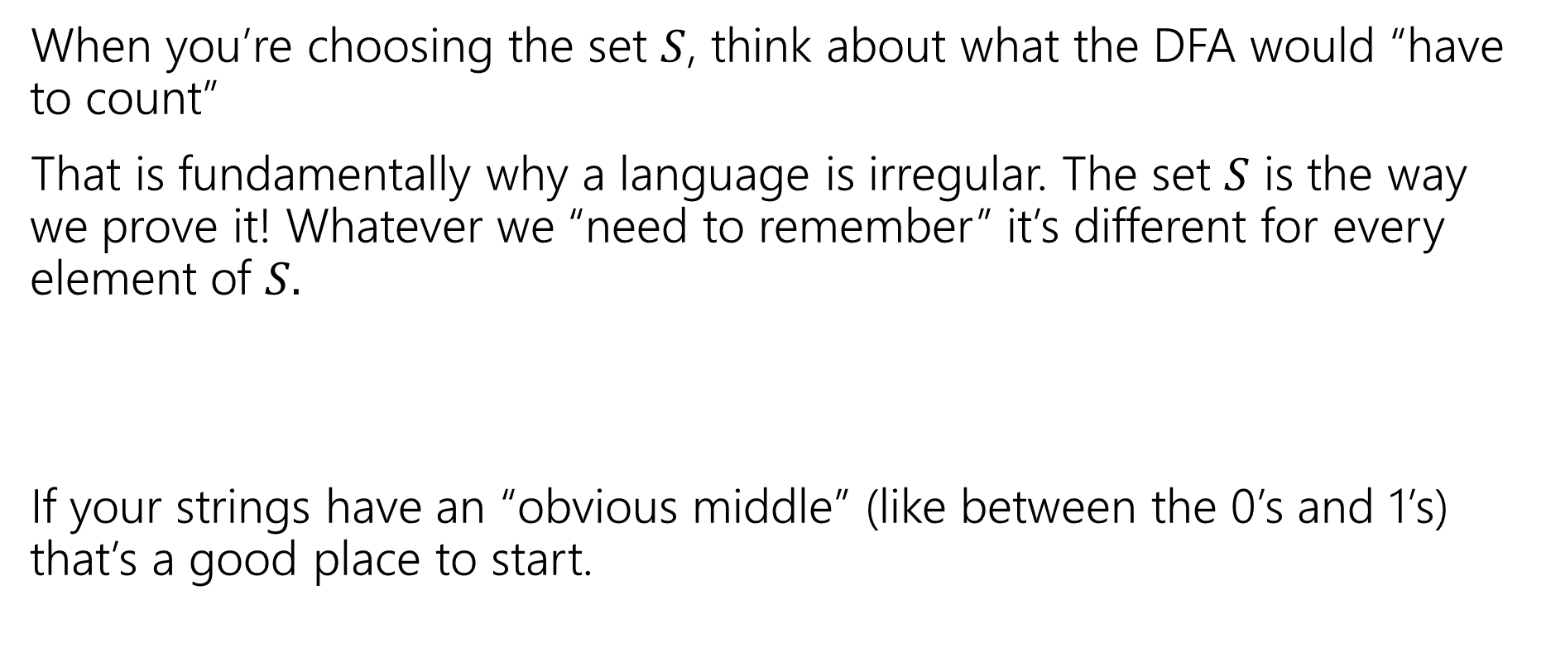
Practical Tips
When you’re choosing the set $S$, think about what the DFA would “have to count”
That is fundamentally why a language is irregular. The set $S$ is the way we prove it! Whatever we “need to remember” it’s different for every element of $S.$
If your strings have an “obvious middle” (like between the 0’s and 1’s) that’s a good place to start.

Slide 17

Let’s Try another
The set of strings with balanced parentheses is not regular.
What do you want $S$to be? What would you have to count?
The number of unclosed parentheses.
Let $S=$…

Slide 18
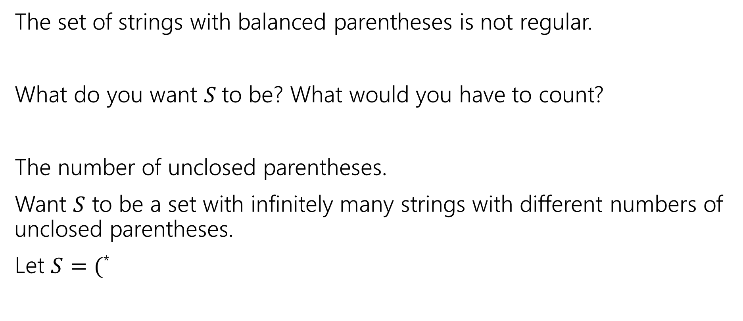
Let’s Try another
The set of strings with balanced parentheses is not regular.
What do you want $S$to be? What would you have to count?
The number of unclosed parentheses.
Want $S$ to be a set with infinitely many strings with different numbers of unclosed parentheses.
Let $S=($*

Slide 19
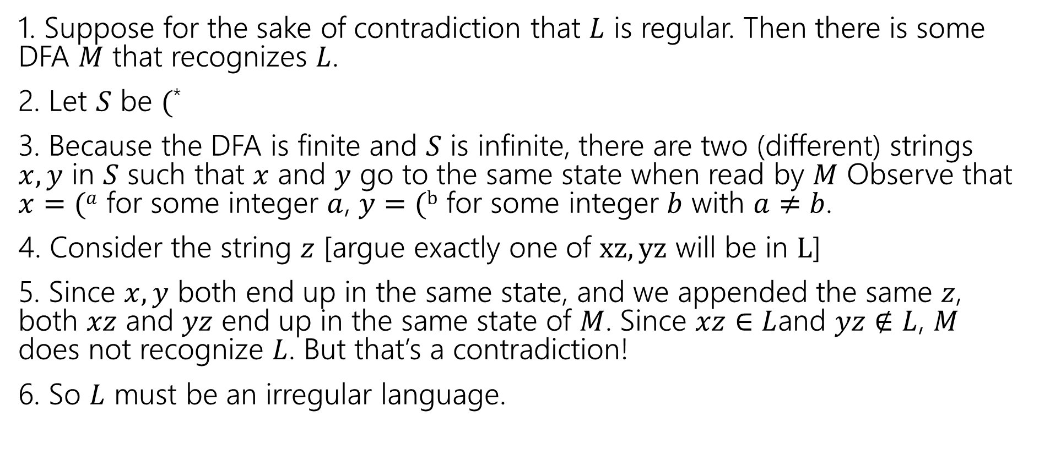

Outline for $(^{∗}$
1. Suppose for the sake of contradiction that $L$ is regular. Then there is some DFA $M$ that recognizes $L$.
2. Let $S$ be $($*
3. Because the DFA is finite and $S$ is infinite, there are two (different) strings $x,y$ in $S$ such that $x$ and $y$ go to the same state when read by $M$ Observe that $x=(a$ for some integer $a$, $y=(b$ for some integer $b$ with $a≠b$.
4. Consider the string $z$ [argue exactly one of $xz, yz$ will be in $L$]
5. Since $x,y$ both end up in the same state, and we appended the same $z$, both $xz$ and $yz$ end up in the same state of $M$. Since $xz∈$ $L$and $yz∉L$, $M$ does not recognize $L$. But that’s a contradiction!
6. So $L$ must be an irregular language.

Slide 20
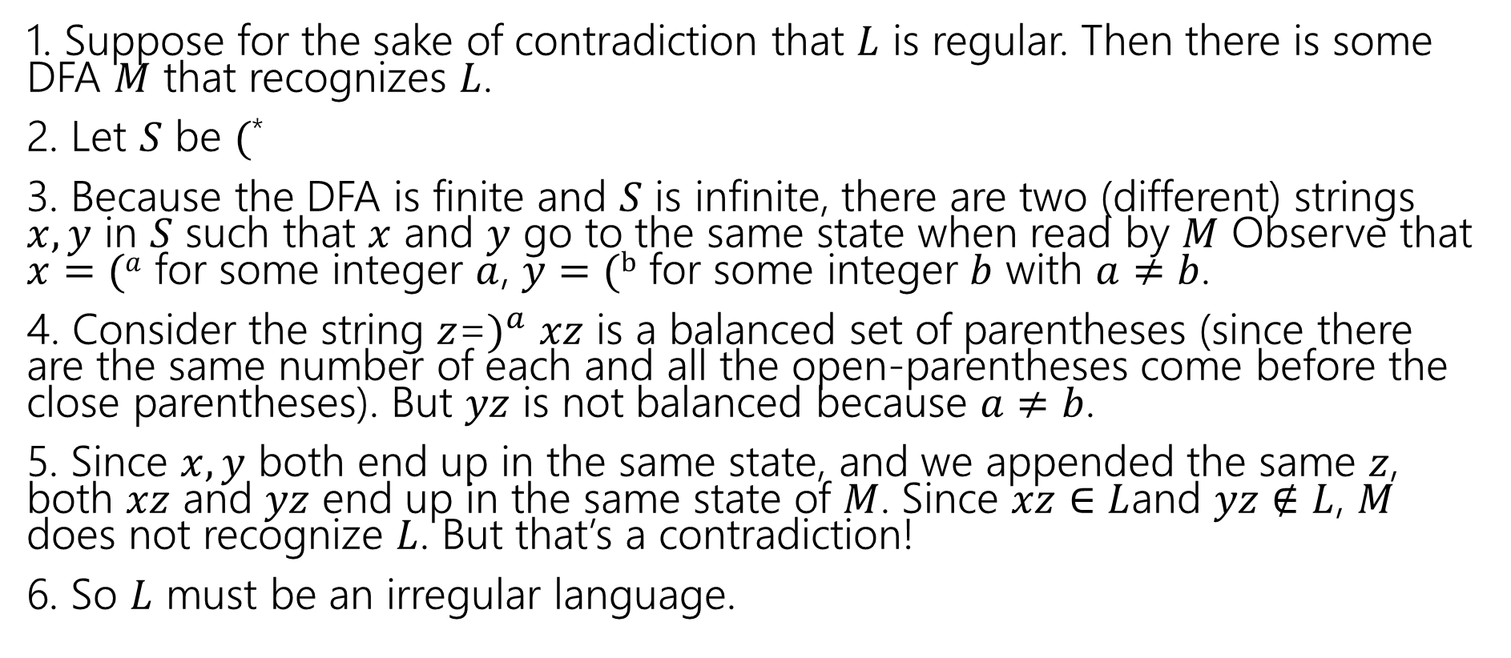
Full outline
1. Suppose for the sake of contradiction that $L$ is regular. Then there is some DFA $M$ that recognizes $L$.
2. Let $S$ be $($*
3. Because the DFA is finite and $S$ is infinite, there are two (different) strings $x,y$ in $S$ such that $x$ and $y$ go to the same state when read by $M$ Observe that $x=(a$ for some integer $a$, $y=(b$ for some integer $b$ with $a≠b$.
4. Consider the string $z$=$)^{a}$ $xz$ is a balanced set of parentheses (since there are the same number of each and all the open-parentheses come before the close parentheses). But $yz$ is not balanced because $a≠b$.
5. Since $x,y$ both end up in the same state, and we appended the same $z$, both $xz$ and $yz$ end up in the same state of $M$. Since $xz∈$ $L$and $yz∉L$, $M$ does not recognize $L$. But that’s a contradiction!
6. So $L$ must be an irregular language.

Slide 21

One more, just the key steps
What about $\{a^{k}b^{k}c^{k}:k≥0\}$?

Slide 22
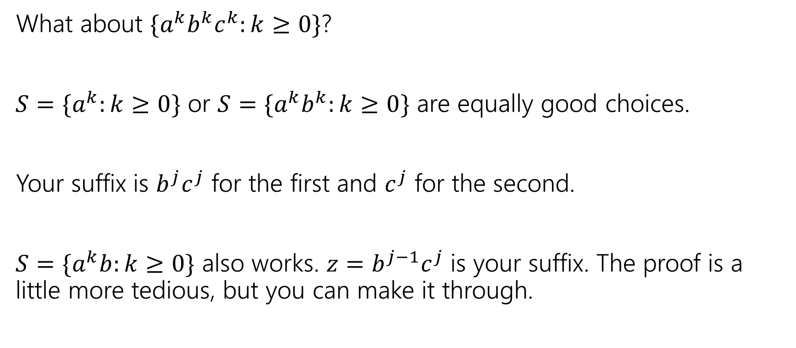
One more, just the key steps
What about $\{a^{k}b^{k}c^{k}:k≥0\}$?
$S=\{a^{k}:k≥0\}$ or $S=\{a^{k}b^{k}:k≥0\}$ are equally good choices.
Your suffix is $b^{j}c^{j}$ for the first and $c^{j}$ for the second.
$S=\{a^{k}b:k≥0\}$ also works. $z=b^{j−1}c^{j}$ is your suffix. The proof is a little more tedious, but you can make it through.

