Slide 1
Halting Problem
CSE 311 Winter 2024
Lecture 26

Slide 2
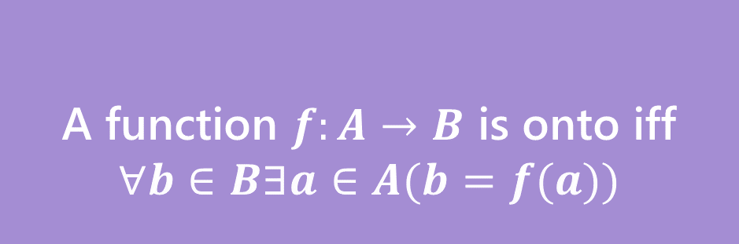

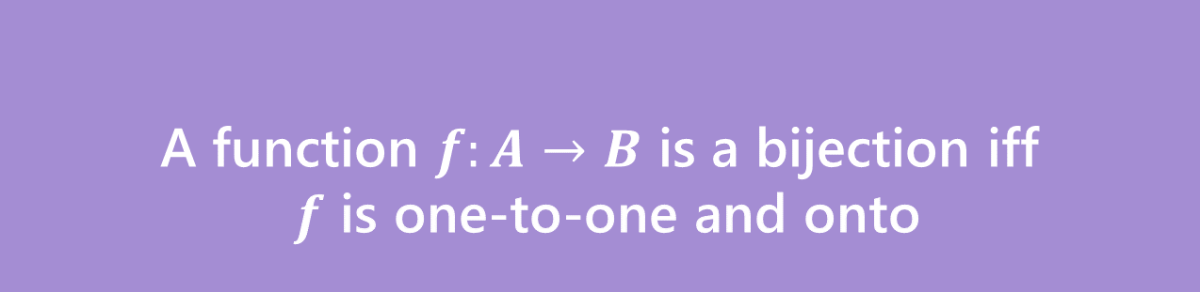
Bijection
A function $f$ is one-to-one iff
$$∀a∀b(f\left(a\right)=f\left(b\right)→a=b)$$
A function $f:A→B$ is onto iff
$$∀b∈B∃a∈A(b=f(a))$$
One-to-one (aka injection)
Onto (aka surjection)
A function $f:A→B$ is a bijection iff
$f$ is one-to-one and onto
Bijection
A bijection maps every element of the domain to exactly one element of the co-domain, and every element of the domain to exactly one element of the domain.

Slide 3
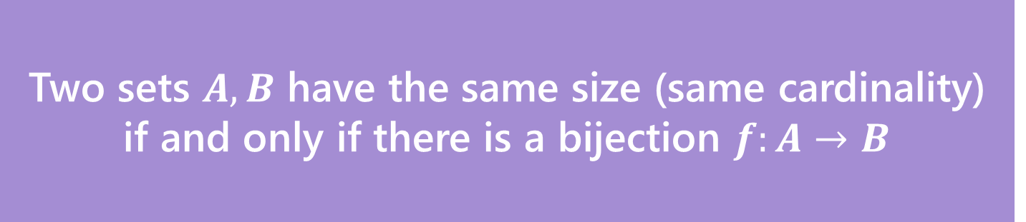
Definition
Two sets $A,B$ have the same size (same cardinality) if and only if there is a bijection $f:A→B$
This matches our intuition on finite sets.
But it also works for infinite sets!
Let’s see just how infinite these sets are.

Slide 4
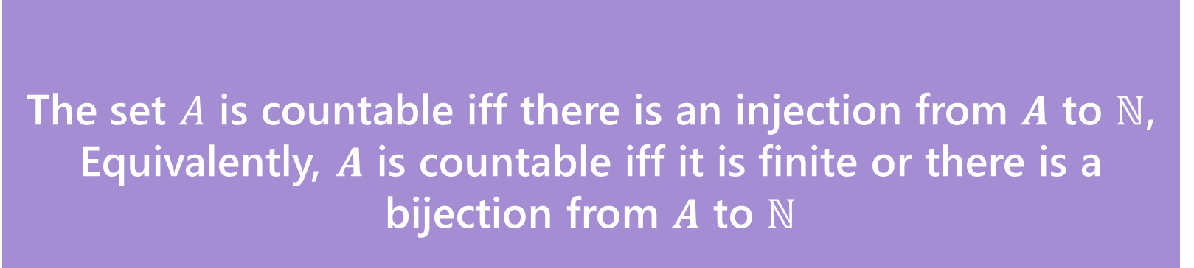
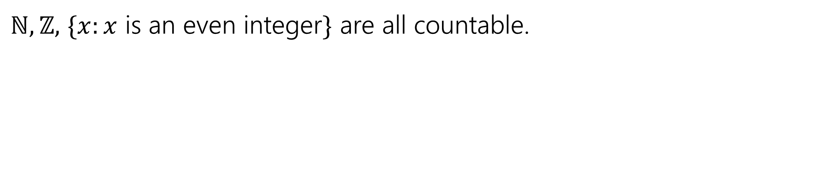
Countable
The set $A$ is countable iff there is an injection from $A$ to $ℕ$,
Equivalently, $A$ is countable iff it is finite or there is a bijection from $A$ to $ℕ$
Countable
$ℕ,ℤ,$ $\{x:x$ is an even integer$\}$ are all countable.

Slide 5
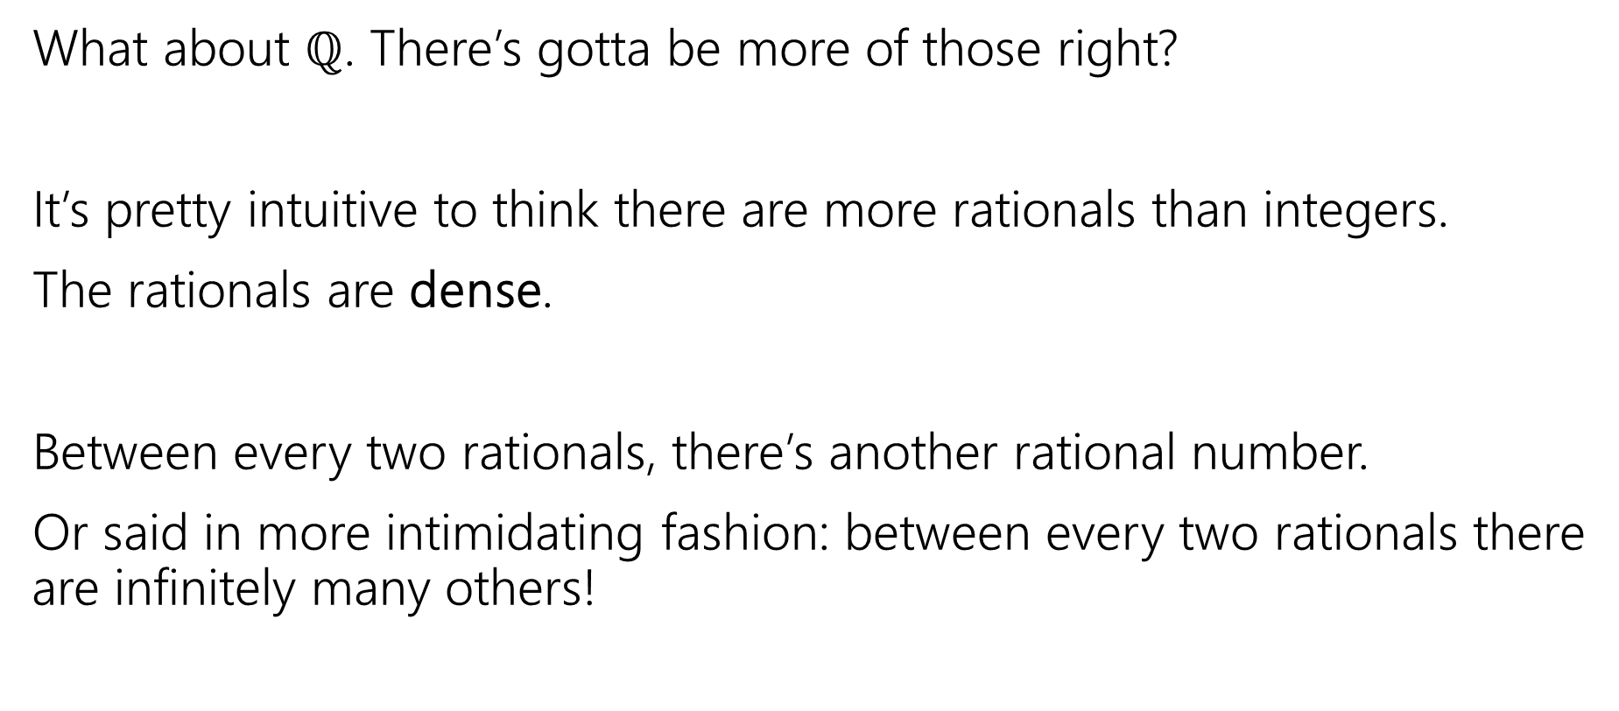
Let’s Try one that’s a little harder
What about $ℚ$. There’s gotta be more of those right?
It’s pretty intuitive to think there are more rationals than integers.
The rationals are dense.
Between every two rationals, there’s another rational number.
Or said in more intimidating fashion: between every two rationals there are infinitely many others!

Slide 6
The set of positive rational numbers
1/1 | 1/2 | 1/3 | 1/4 | 1/5 | 1/6 | 1/7 | 1/8 | ...
2/1 | 2/2 | 2/3 | 2/4 | 2/5 | 2/6 | 2/7 | 2/8 | ...
3/1 | 3/2 | 3/3 | 3/4 | 3/5 | 3/6 | 3/7 | 3/8 | ...
4/1 | 4/2 | 4/3 | 4/4 | 4/5 | 4/6 | 4/7 | 4/8 | ...
5/1 | 5/2 | 5/3 | 5/4 | 5/5 | 5/6 | 5/7 | ...
6/1 | 6/2 | 6/3 | 6/4 | 6/5 | 6/6 | ...
7/1 | 7/2 | 7/3 | 7/4 | 7/5 | ....
... | ... | ... | ... | ...

Slide 7
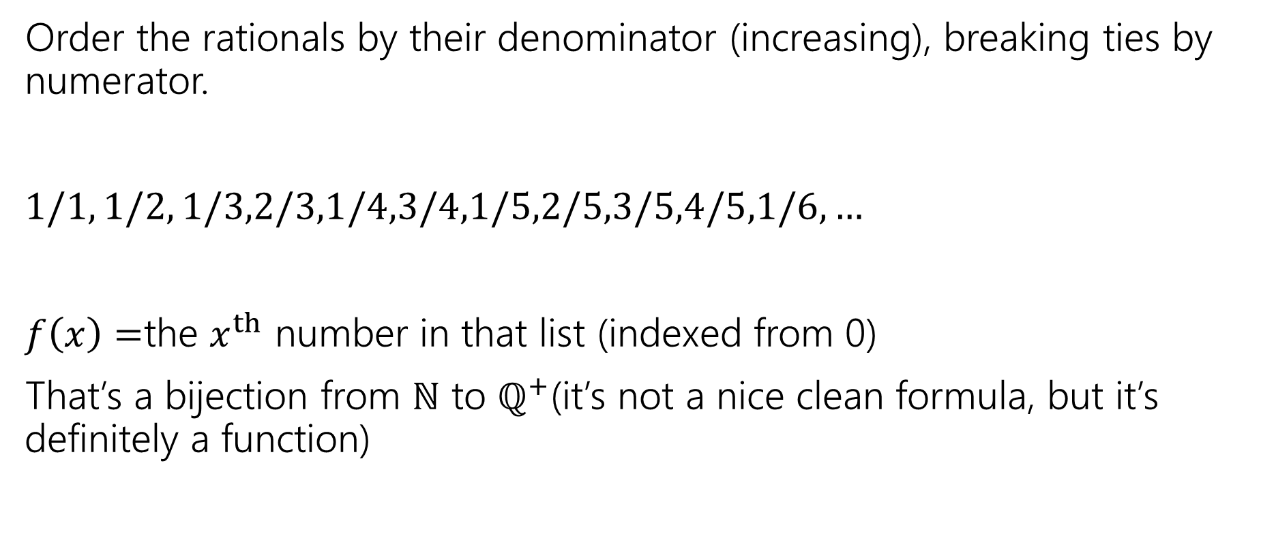
In bijection with the natural numbers
Order the rationals by their denominator (increasing), breaking ties by numerator.
$1/1, 1/2, 1/3,2/3,1/4,3/4,1/5,2/5,3/5,4/5,1/6,…$
$f\left(x\right)=$the $x^{th}$ number in that list (indexed from 0)
That’s a bijection from $ℕ$ to $ℚ^{+}$(it’s not a nice clean formula, but it’s definitely a function)

Slide 8
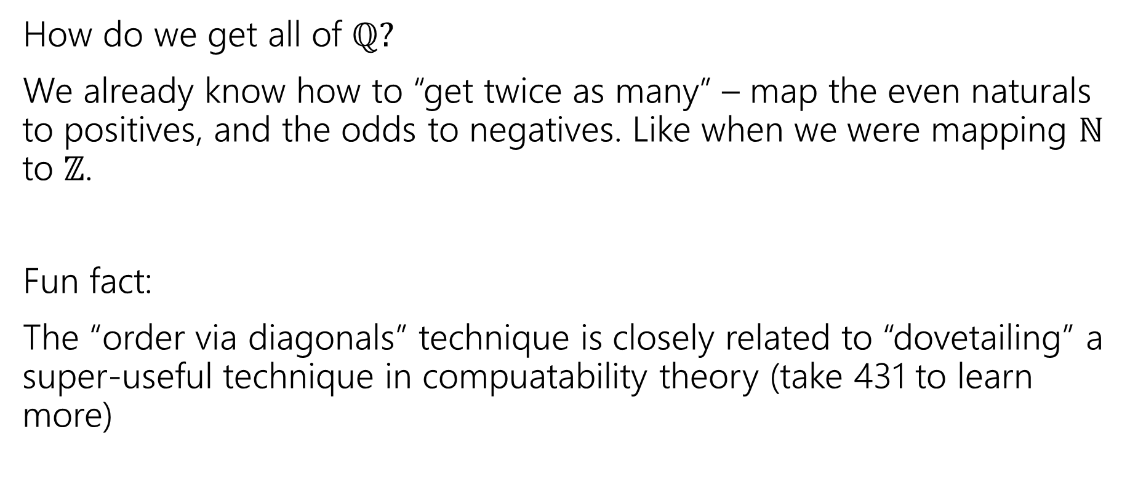
In Bijection with the natural numbers
How do we get all of $ℚ?$
We already know how to “get twice as many” – map the even naturals to positives, and the odds to negatives. Like when we were mapping $ℕ$ to $ℤ$.
Fun fact:
The “order via diagonals” technique is closely related to “dovetailing” a super-useful technique in compuatability theory (take 431 to learn more)

Slide 9

Uncountable
Alright. There are clever ways to build bijections.
Is there anything that’s bigger than $ℕ$?
And…like…how would we prove it?

Slide 10
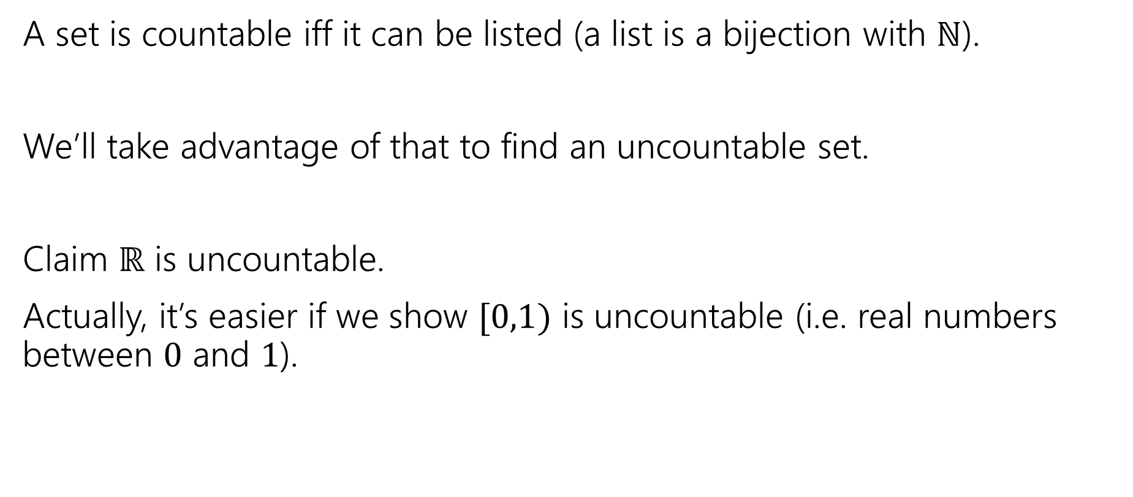
A proof idea
A set is countable iff it can be listed (a list is a bijection with $ℕ$).
We’ll take advantage of that to find an uncountable set.
Claim $ℝ$ is uncountable.
Actually, it’s easier if we show $[0,1)$ is uncountable (i.e. real numbers between $0$ and $1$).

Slide 11
What do real numbers look like
0. | 3 | 3 | 3 | 3 | 3 | 3 | 3 | 3…
0. | 2 | 7 | 2 | 7 | 2 | 8 | 5 | 4…
0. | 1 | 4 | 1 | 5 | 9 | 2 | 6 | 5…
0. | 2 | 2 | 2 | 2 | 2 | 2 | 2 | 2…
0. | 1 | 2 | 3 | 4 | 5 | 6 | 7 | 8…
0. | 9 | 8 | 7 | 6 | 5 | 4 | 3 | 2…
0. | 8 | 2 | 7 | 6 | 4 | 5 | 7 | 4…
0. | 5 | 9 | 4 | 2 | 7 | 5 | 1 | 7…
A string of digits!
Well not a “string” An infinitely long sequence of digits is more accurate.

Slide 12

Uncountable
Suppose, for the sake of contradiction, that $[0,1)$ is countable.
Then there is a bijection $f:ℕ→[0,1)$.
Use that bijection to make the following table…

Slide 13
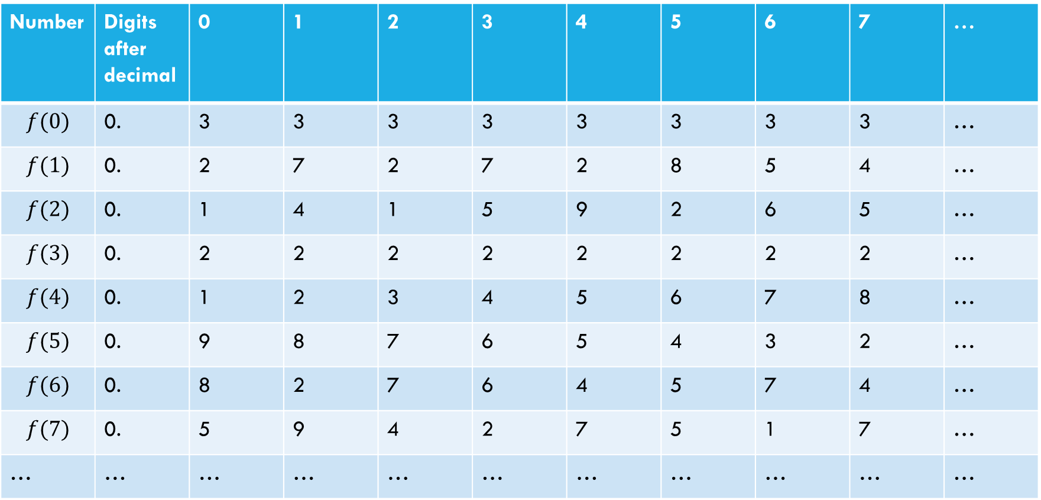
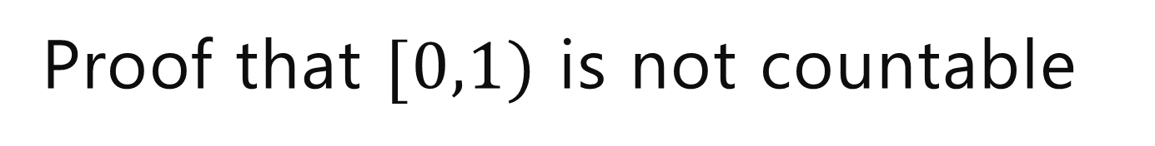
Proof that $[0,1)$ is not countable
Suppose, for the sake of contradiction, that there is a list of them:
Number | Digits after decimal | 0 | 1 | 2 | 3 | 4 | 5 | 6 | 7 | …
$$f(0)$$ | 0. | 3 | 3 | 3 | 3 | 3 | 3 | 3 | 3 | …
$$f(1)$$ | 0. | 2 | 7 | 2 | 7 | 2 | 8 | 5 | 4 | …
$$f(2)$$ | 0. | 1 | 4 | 1 | 5 | 9 | 2 | 6 | 5 | …
$$f(3)$$ | 0. | 2 | 2 | 2 | 2 | 2 | 2 | 2 | 2 | …
$$f(4)$$ | 0. | 1 | 2 | 3 | 4 | 5 | 6 | 7 | 8 | …
$$f(5)$$ | 0. | 9 | 8 | 7 | 6 | 5 | 4 | 3 | 2 | …
$$f(6)$$ | 0. | 8 | 2 | 7 | 6 | 4 | 5 | 7 | 4 | …
$$f(7)$$ | 0. | 5 | 9 | 4 | 2 | 7 | 5 | 1 | 7 | …
… | … | … | … | … | … | … | … | … | … | …

Slide 14
Proof that $[0,1)$ is not countable
Suppose, for the sake of contradiction, that there is a list of them:
Number | Digits after decimal | 0 | 1 | 2 | 3 | 4 | 5 | 6 | 7 | …
$$f(0)$$ | 0. | 3 | 3 | 3 | 3 | 3 | 3 | 3 | 3 | …
$$f(1)$$ | 0. | 2 | 7 | 2 | 7 | 2 | 8 | 5 | 4 | …
$$f(2)$$ | 0. | 1 | 4 | 1 | 5 | 9 | 2 | 6 | 5 | …
$$f(3)$$ | 0. | 2 | 2 | 2 | 2 | 2 | 2 | 2 | 2 | …
$$f(4)$$ | 0. | 1 | 2 | 3 | 4 | 5 | 6 | 7 | 8 | …
$$f(5)$$ | 0. | 9 | 8 | 7 | 6 | 5 | 4 | 3 | 2 | …
$$f(6)$$ | 0. | 8 | 2 | 7 | 6 | 4 | 5 | 7 | 4 | …
$$f(7)$$ | 0. | 5 | 9 | 4 | 2 | 7 | 5 | 1 | 7 | …
… | … | … | … | … | … | … | … | … | … | …
Goal: find a real number between 0 and 1 that isn’t on our table.
(contradiction to bijection)

Slide 15

Proof that $[0,1)$ is not countable
Suppose, for the sake of contradiction, that there is a list of them:
Number | Digits after decimal | 0 | 1 | 2 | 3 | 4 | 5 | 6 | 7 | …
$$f(0)$$ | 0. | 3 | 3 | 3 | 3 | 3 | 3 | 3 | 3 | …
$$f(1)$$ | 0. | 2 | 7 | 2 | 7 | 2 | 8 | 5 | 4 | …
$$f(2)$$ | 0. | 1 | 4 | 1 | 5 | 9 | 2 | 6 | 5 | …
$$f(3)$$ | 0. | 2 | 2 | 2 | 2 | 2 | 2 | 2 | 2 | …
$$f(4)$$ | 0. | 1 | 2 | 3 | 4 | 5 | 6 | 7 | 8 | …
$$f(5)$$ | 0. | 9 | 8 | 7 | 6 | 5 | 4 | 3 | 2 | …
$$f(6)$$ | 0. | 8 | 2 | 7 | 6 | 4 | 5 | 7 | 4 | …
$$f(7)$$ | 0. | 5 | 9 | 4 | 2 | 7 | 5 | 1 | 7 | …
… | … | … | … | … | … | … | … | … | … | …
How do we find a number that’s not in our list?
Well let’s make sure whatever our number is, it’s not $f(0)$

Slide 16
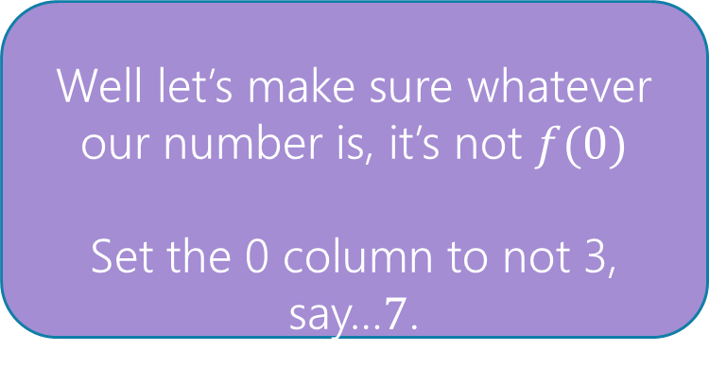
Proof that $[0,1)$ is not countable
Suppose, for the sake of contradiction, that there is a list of them:
Number | Digits after decimal | 0 | 1 | 2 | 3 | 4 | 5 | 6 | 7 | …
$$f(0)$$ | 0. | 3 | 3 | 3 | 3 | 3 | 3 | 3 | 3 | …
$$f(1)$$ | 0. | 2 | 7 | 2 | 7 | 2 | 8 | 5 | 4 | …
$$f(2)$$ | 0. | 1 | 4 | 1 | 5 | 9 | 2 | 6 | 5 | …
$$f(3)$$ | 0. | 2 | 2 | 2 | 2 | 2 | 2 | 2 | 2 | …
$$f(4)$$ | 0. | 1 | 2 | 3 | 4 | 5 | 6 | 7 | 8 | …
$$f(5)$$ | 0. | 9 | 8 | 7 | 6 | 5 | 4 | 3 | 2 | …
$$f(6)$$ | 0. | 8 | 2 | 7 | 6 | 4 | 5 | 7 | 4 | …
$$f(7)$$ | 0. | 5 | 9 | 4 | 2 | 7 | 5 | 1 | 7 | …
… | … | … | … | … | … | … | … | … | … | …
Well let’s make sure whatever our number is, it’s not $f(0)$
Set the 0 column to not 3, say…$7$.
0.7

Slide 17
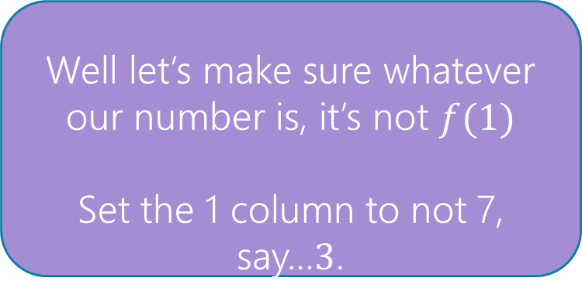
Proof that $[0,1)$ is not countable
Suppose, for the sake of contradiction, that there is a list of them:
Number | Digits after decimal | 0 | 1 | 2 | 3 | 4 | 5 | 6 | 7 | …
$$f(0)$$ | 0. | 3 | 3 | 3 | 3 | 3 | 3 | 3 | 3 | …
$$f(1)$$ | 0. | 2 | 7 | 2 | 7 | 2 | 8 | 5 | 4 | …
$$f(2)$$ | 0. | 1 | 4 | 1 | 5 | 9 | 2 | 6 | 5 | …
$$f(3)$$ | 0. | 2 | 2 | 2 | 2 | 2 | 2 | 2 | 2 | …
$$f(4)$$ | 0. | 1 | 2 | 3 | 4 | 5 | 6 | 7 | 8 | …
$$f(5)$$ | 0. | 9 | 8 | 7 | 6 | 5 | 4 | 3 | 2 | …
$$f(6)$$ | 0. | 8 | 2 | 7 | 6 | 4 | 5 | 7 | 4 | …
$$f(7)$$ | 0. | 5 | 9 | 4 | 2 | 7 | 5 | 1 | 7 | …
… | … | … | … | … | … | … | … | … | … | …
Well let’s make sure whatever our number is, it’s not $f(1)$
Set the 1 column to not 7, say…$3$.
0.73

Slide 18
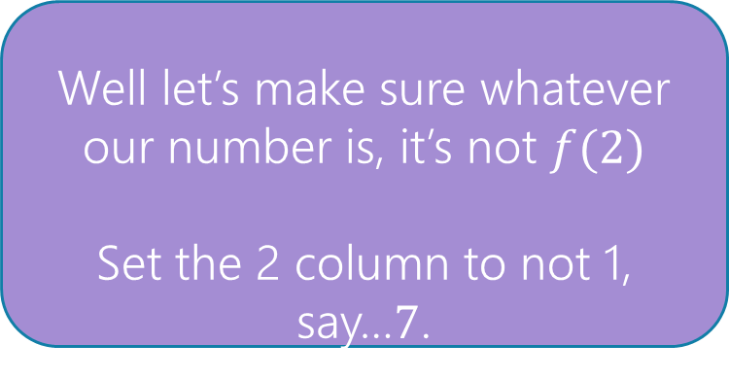
Proof that $[0,1)$ is not countable
Suppose, for the sake of contradiction, that there is a list of them:
Number | Digits after decimal | 0 | 1 | 2 | 3 | 4 | 5 | 6 | 7 | …
$$f(0)$$ | 0. | 3 | 3 | 3 | 3 | 3 | 3 | 3 | 3 | …
$$f(1)$$ | 0. | 2 | 7 | 2 | 7 | 2 | 8 | 5 | 4 | …
$$f(2)$$ | 0. | 1 | 4 | 1 | 5 | 9 | 2 | 6 | 5 | …
$$f(3)$$ | 0. | 2 | 2 | 2 | 2 | 2 | 2 | 2 | 2 | …
$$f(4)$$ | 0. | 1 | 2 | 3 | 4 | 5 | 6 | 7 | 8 | …
$$f(5)$$ | 0. | 9 | 8 | 7 | 6 | 5 | 4 | 3 | 2 | …
$$f(6)$$ | 0. | 8 | 2 | 7 | 6 | 4 | 5 | 7 | 4 | …
$$f(7)$$ | 0. | 5 | 9 | 4 | 2 | 7 | 5 | 1 | 7 | …
… | … | … | … | … | … | … | … | … | … | …
Well let’s make sure whatever our number is, it’s not $f(2)$
Set the 2 column to not 1, say…$7$.
0.737

Slide 19


Proof that $[0,1)$ is not countable
Suppose, for the sake of contradiction, that there is a list of them:
Number | Digits after decimal | 0 | 1 | 2 | 3 | 4 | 5 | 6 | 7 | …
$$f(0)$$ | 0. | 3 | 3 | 3 | 3 | 3 | 3 | 3 | 3 | …
$$f(1)$$ | 0. | 2 | 7 | 2 | 7 | 2 | 8 | 5 | 4 | …
$$f(2)$$ | 0. | 1 | 4 | 1 | 5 | 9 | 2 | 6 | 5 | …
$$f(3)$$ | 0. | 2 | 2 | 2 | 2 | 2 | 2 | 2 | 2 | …
$$f(4)$$ | 0. | 1 | 2 | 3 | 4 | 5 | 6 | 7 | 8 | …
$$f(5)$$ | 0. | 9 | 8 | 7 | 6 | 5 | 4 | 3 | 2 | …
$$f(6)$$ | 0. | 8 | 2 | 7 | 6 | 4 | 5 | 7 | 4 | …
$$f(7)$$ | 0. | 5 | 9 | 4 | 2 | 7 | 5 | 1 | 7 | …
… | … | … | … | … | … | … | … | … | … | …
Flipping Rule: let’s set the $i^{th}$ column to:
$7$ if $f(i)$’s $i^{th}$ column is not $7$
$3$if $f{\left(i\right)}^{′}s$ $i^{th}$ column is $7$.
0.73777733…

Slide 20
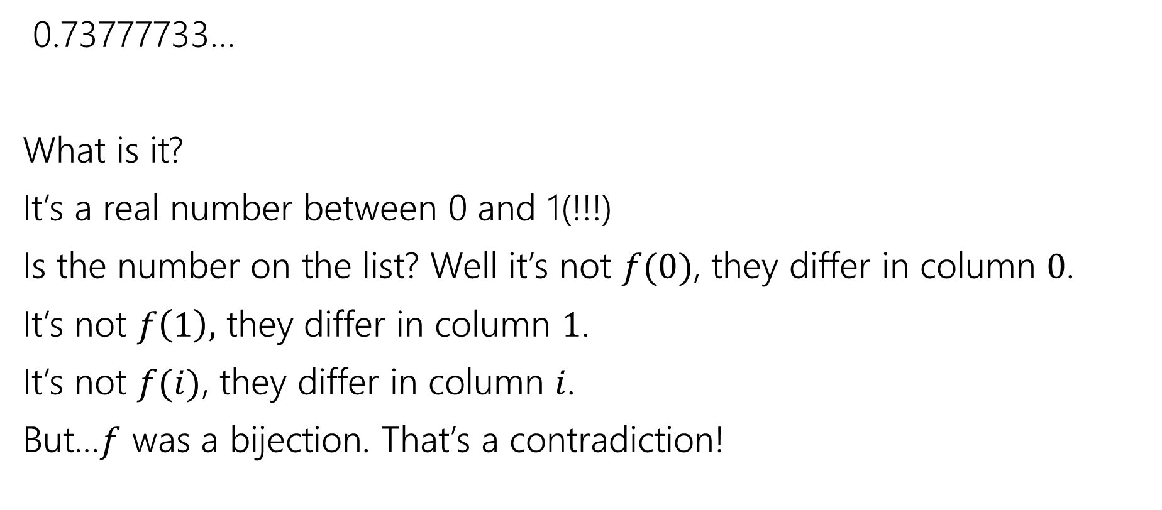
Wrapping Up
0.73777733…
What is it?
It’s a real number between 0 and 1(!!!)
Is the number on the list? Well it’s not $f(0)$, they differ in column $0$.
It’s not $f\left(1\right),$ they differ in column $1$.
It’s not $f(i)$, they differ in column $i$.
But…$f$ was a bijection. That’s a contradiction!

Slide 21
Diagonalization
This proof technique is called diagonalization
Often “Cantor’s Diagonalization” (after Cantor, who developed it).

Slide 22
Takeaway 1
There are differing levels of infinity.
Some infinite sets are equal in size.
Other infinite sets are bigger than others.
If this is mind-bending you’re in good company.
Cantor’s contemporaries accused him of being a “scientific charlatan” and a “corruptor of youth”
But Cantor was right – and his ideas eventually were recognized as correct.

Slide 23
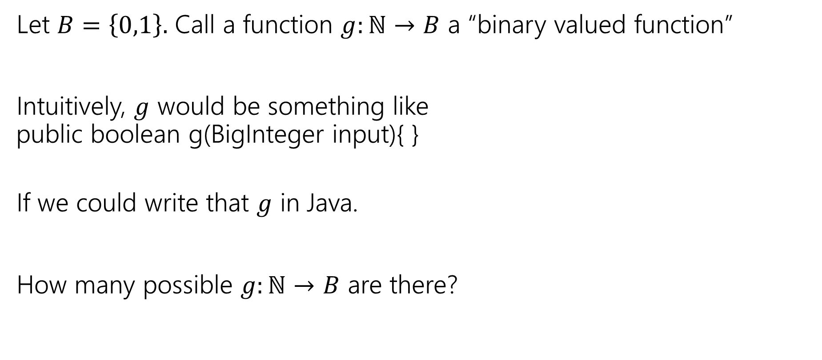
Let’s Do Another!
Let $B=\left\{0,1\right\}.$ Call a function $g:ℕ→B$ a “binary valued function”
Intuitively, $g$ would be something like
public boolean g(BigInteger input){ }
If we could write that $g$ in Java.
How many possible $g:ℕ→B$ are there?

Slide 24
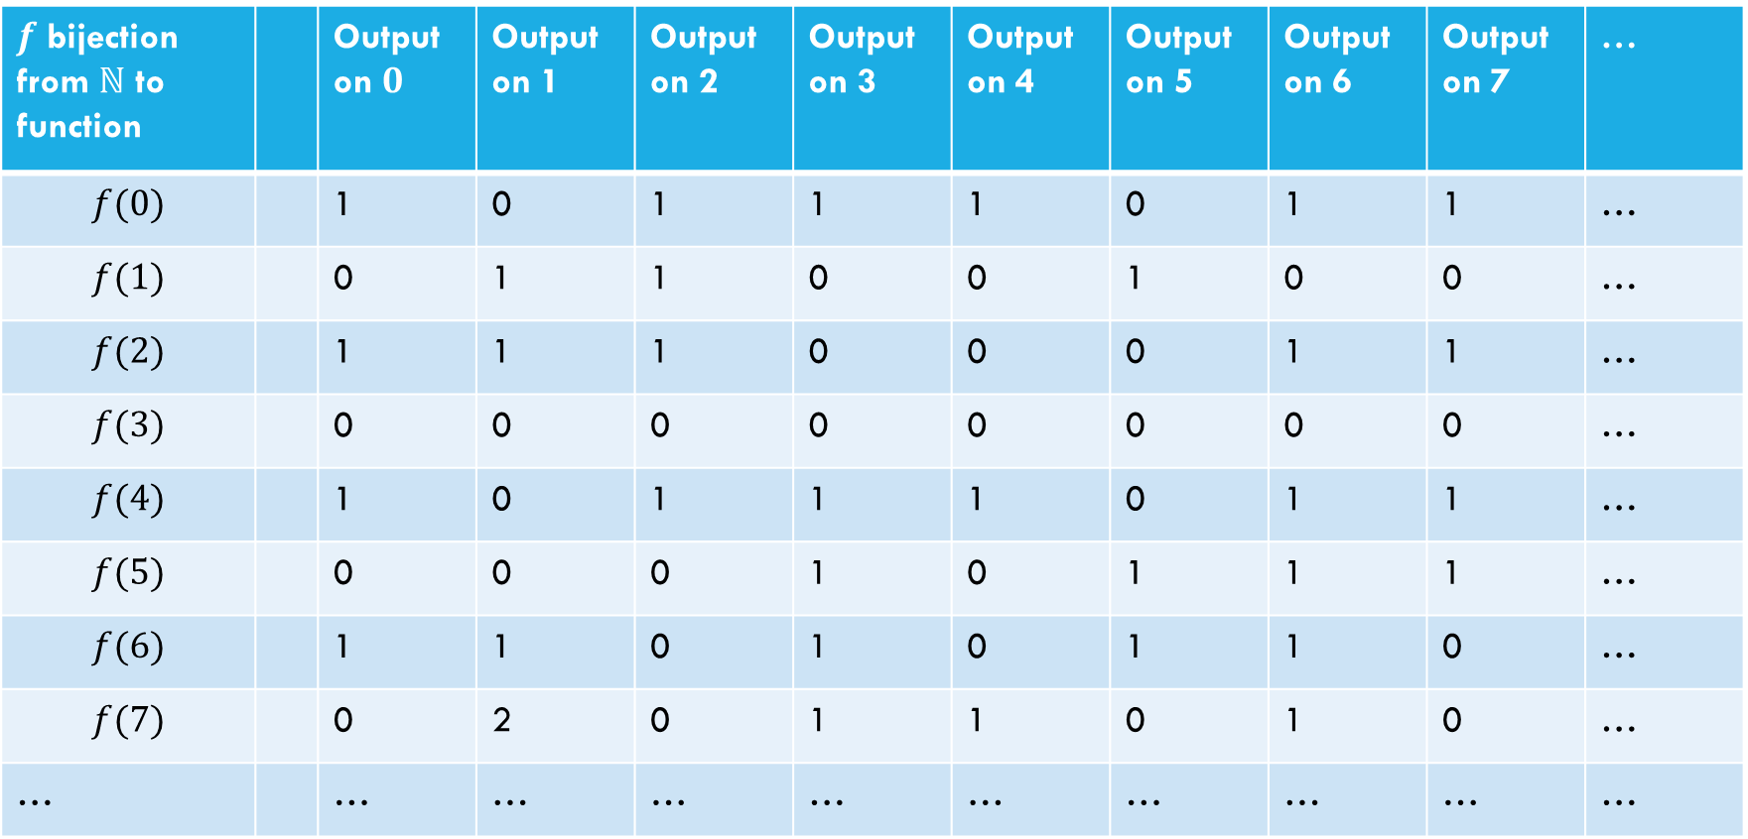
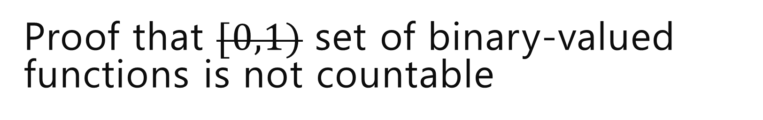
Proof that $[0,1)$ set of binary-valued functions is not countable
Suppose, for the sake of contradiction, that there is a list of them:
$f$ bijection from $ℕ$ to function |  | Output on $0$ | Output on 1 | Output on 2 | Output on 3 | Output on 4 | Output on 5 | Output on 6 | Output on 7 | …
$$f(0)$$ |  | 1 | 0 | 1 | 1 | 1 | 0 | 1 | 1 | …
$$f(1)$$ |  | 0 | 1 | 1 | 0 | 0 | 1 | 0 | 0 | …
$$f(2)$$ |  | 1 | 1 | 1 | 0 | 0 | 0 | 1 | 1 | …
$$f(3)$$ |  | 0 | 0 | 0 | 0 | 0 | 0 | 0 | 0 | …
$$f(4)$$ |  | 1 | 0 | 1 | 1 | 1 | 0 | 1 | 1 | …
$$f(5)$$ |  | 0 | 0 | 0 | 1 | 0 | 1 | 1 | 1 | …
$$f(6)$$ |  | 1 | 1 | 0 | 1 | 0 | 1 | 1 | 0 | …
$$f(7)$$ |  | 0 | 2 | 0 | 1 | 1 | 0 | 1 | 0 | …
… |  | … | … | … | … | … | … | … | … | …

Slide 25


Proof that $[0,1)$ set of binary-valued functions is not countable
Suppose, for the sake of contradiction, that there is a list of them:
$f$ bijection from $ℕ$ to function |  | Output on $0$ | Output on 1 | Output on 2 | Output on 3 | Output on 4 | Output on 5 | Output on 6 | Output on 7 | …
$$f(0)$$ |  | 1 | 0 | 1 | 1 | 1 | 0 | 1 | 1 | …
$$f(1)$$ |  | 0 | 1 | 1 | 0 | 0 | 1 | 0 | 0 | …
$$f(2)$$ |  | 1 | 1 | 1 | 0 | 0 | 0 | 1 | 1 | …
$$f(3)$$ |  | 0 | 0 | 0 | 0 | 0 | 0 | 0 | 0 | …
$$f(4)$$ |  | 1 | 0 | 1 | 1 | 1 | 0 | 1 | 1 | …
$$f(5)$$ |  | 0 | 0 | 0 | 1 | 0 | 1 | 1 | 1 | …
$$f(6)$$ |  | 1 | 1 | 0 | 1 | 0 | 1 | 1 | 0 | …
$$f(7)$$ |  | 0 | 2 | 0 | 1 | 1 | 0 | 1 | 0 | …
… |  | … | … | … | … | … | … | … | … | …
Goal: find a function$g_{diag}:ℕ→\left\{0,1\right\}$ that isn’t on our table.
(contradiction to bijection)

Slide 26


Proof that $[0,1)$ set of binary-valued functions is not countable
Suppose, for the sake of contradiction, that there is a list of them:
$f$ bijection from $ℕ$ to function |  | Output on $0$ | Output on 1 | Output on 2 | Output on 3 | Output on 4 | Output on 5 | Output on 6 | Output on 7 | …
$$f(0)$$ |  | 1 | 0 | 1 | 1 | 1 | 0 | 1 | 1 | …
$$f(1)$$ |  | 0 | 1 | 1 | 0 | 0 | 1 | 0 | 0 | …
$$f(2)$$ |  | 1 | 1 | 1 | 0 | 0 | 0 | 1 | 1 | …
$$f(3)$$ |  | 0 | 0 | 0 | 0 | 0 | 0 | 0 | 0 | …
$$f(4)$$ |  | 1 | 0 | 1 | 1 | 1 | 0 | 1 | 1 | …
$$f(5)$$ |  | 0 | 0 | 0 | 1 | 0 | 1 | 1 | 1 | …
$$f(6)$$ |  | 1 | 1 | 0 | 1 | 0 | 1 | 1 | 0 | …
$$f(7)$$ |  | 0 | 2 | 0 | 1 | 1 | 0 | 1 | 0 | …
… |  | … | … | … | … | … | … | … | … | …
How do we find a function not on our list?
Well to make sure it’s not $f(0)$ (the function in the first row)
Have $g_{diag}\left(0\right)=0$
$$g_{diag}\left(x\right)=\left\{\begin{aligned}0 if x=1 \\ … \\ …\end{aligned}\right.$$

Slide 27
Proof that $[0,1)$ set of binary-valued functions is not countable
Suppose, for the sake of contradiction, that there is a list of them:
$f$ bijection from $ℕ$ to function |  | Output on $0$ | Output on 1 | Output on 2 | Output on 3 | Output on 4 | Output on 5 | Output on 6 | Output on 7 | …
$$f(0)$$ |  | 1 | 0 | 1 | 1 | 1 | 0 | 1 | 1 | …
$$f(1)$$ |  | 0 | 1 | 1 | 0 | 0 | 1 | 0 | 0 | …
$$f(2)$$ |  | 1 | 1 | 1 | 0 | 0 | 0 | 1 | 1 | …
$$f(3)$$ |  | 0 | 0 | 0 | 0 | 0 | 0 | 0 | 0 | …
$$f(4)$$ |  | 1 | 0 | 1 | 1 | 1 | 0 | 1 | 1 | …
$$f(5)$$ |  | 0 | 0 | 0 | 1 | 0 | 1 | 1 | 1 | …
$$f(6)$$ |  | 1 | 1 | 0 | 1 | 0 | 1 | 1 | 0 | …
$$f(7)$$ |  | 0 | 2 | 0 | 1 | 1 | 0 | 1 | 0 | …
… |  | … | … | … | … | … | … | … | … | …
How do we find a function not on our list?
Well to make sure it’s not $f(0)$ (the function in the first row)
Have $g_{diag}\left(0\right)=0$
$$g_{diag}\left(x\right)=\left\{\begin{aligned}0 if x=1 \\ … \\ …\end{aligned}\right.$$

Slide 28
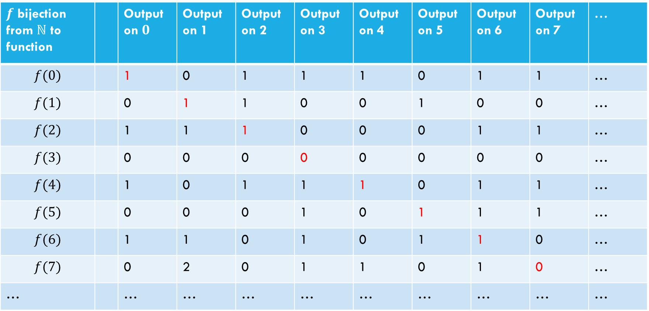

Proof that $[0,1)$ set of binary-valued functions is not countable
Suppose, for the sake of contradiction, that there is a list of them:
$f$ bijection from $ℕ$ to function |  | Output on $0$ | Output on 1 | Output on 2 | Output on 3 | Output on 4 | Output on 5 | Output on 6 | Output on 7 | …
$$f(0)$$ |  | 1 | 0 | 1 | 1 | 1 | 0 | 1 | 1 | …
$$f(1)$$ |  | 0 | 1 | 1 | 0 | 0 | 1 | 0 | 0 | …
$$f(2)$$ |  | 1 | 1 | 1 | 0 | 0 | 0 | 1 | 1 | …
$$f(3)$$ |  | 0 | 0 | 0 | 0 | 0 | 0 | 0 | 0 | …
$$f(4)$$ |  | 1 | 0 | 1 | 1 | 1 | 0 | 1 | 1 | …
$$f(5)$$ |  | 0 | 0 | 0 | 1 | 0 | 1 | 1 | 1 | …
$$f(6)$$ |  | 1 | 1 | 0 | 1 | 0 | 1 | 1 | 0 | …
$$f(7)$$ |  | 0 | 2 | 0 | 1 | 1 | 0 | 1 | 0 | …
… |  | … | … | … | … | … | … | … | … | …
How do we find a function not on our list?
Well to make sure it’s not $f(i)$ (the function in the $i^{th}$ row)
Have $g_{diag}\left(i\right)=1−f\left(i\right)\left(i\right)$
$$g_{diag}\left(x\right)=\left\{\begin{aligned}0 if x=1 \\ … \\ …\end{aligned}\right.$$

Slide 29
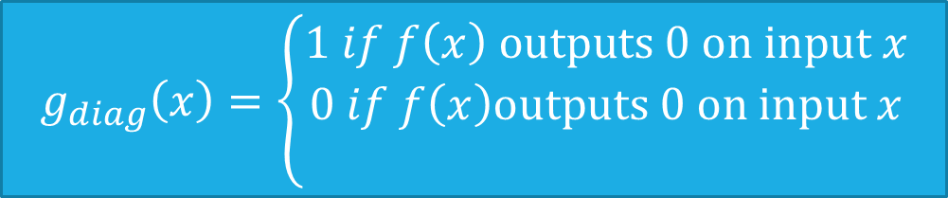
Proof that $[0,1)$ set of binary-valued functions is not countable
Suppose, for the sake of contradiction, that there is a list of them:
$f$ bijection from $ℕ$ to function |  | Output on $0$ | Output on 1 | Output on 2 | Output on 3 | Output on 4 | Output on 5 | Output on 6 | Output on 7 | …
$$f(0)$$ |  | 1 | 0 | 1 | 1 | 1 | 0 | 1 | 1 | …
$$f(1)$$ |  | 0 | 1 | 1 | 0 | 0 | 1 | 0 | 0 | …
$$f(2)$$ |  | 1 | 1 | 1 | 0 | 0 | 0 | 1 | 1 | …
$$f(3)$$ |  | 0 | 0 | 0 | 0 | 0 | 0 | 0 | 0 | …
$$f(4)$$ |  | 1 | 0 | 1 | 1 | 1 | 0 | 1 | 1 | …
$$f(5)$$ |  | 0 | 0 | 0 | 1 | 0 | 1 | 1 | 1 | …
$$f(6)$$ |  | 1 | 1 | 0 | 1 | 0 | 1 | 1 | 0 | …
$$f(7)$$ |  | 0 | 2 | 0 | 1 | 1 | 0 | 1 | 0 | …
… |  | … | … | … | … | … | … | … | … | …
How do we find a function not on our list?
Well to make sure it’s not $f(i)$ (the function in the $i^{th}$ row)
Have $g_{diag}\left(i\right)=1−f\left(i\right)\left(i\right)$
$$g_{diag}\left(x\right)=\left\{\begin{aligned}1 if f\left(x\right) outputs 0 on input x \\ 0 if f\left(x\right)outputs 0 on input x \\ \end{aligned}\right.$$

Slide 30
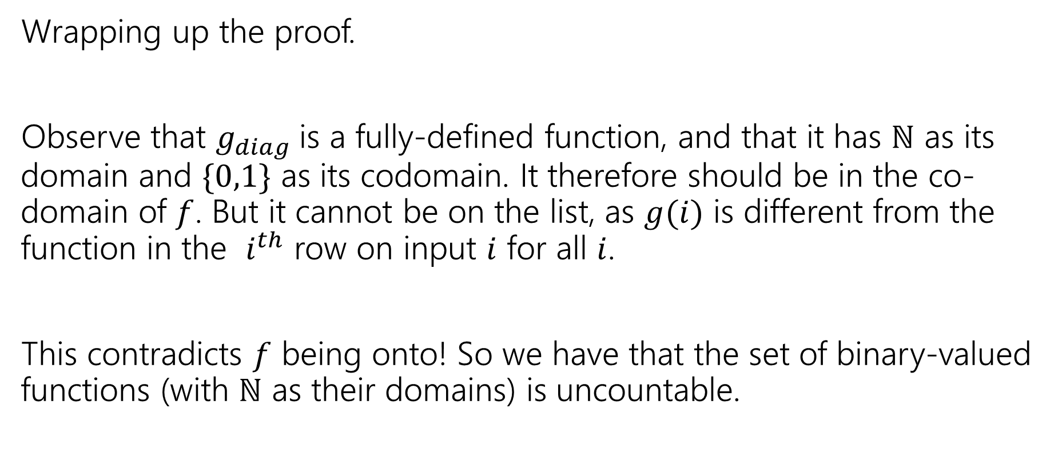
Wrapping up the proof
Wrapping up the proof.
Observe that $g_{diag}$is a fully-defined function, and that it has $ℕ$ as its domain and $\{0,1\}$ as its codomain. It therefore should be in the co-domain of $f$. But it cannot be on the list, as $g(i)$ is different from the function in the $i^{th}$ row on input $i$ for all $i$.
This contradicts $f$ being onto! So we have that the set of binary-valued functions (with $ℕ$ as their domains) is uncountable.

Slide 31
Our Second big takeaway
How many Java methods can we write:
public boolean g(int input) ?
Can you list them?
Yeah!! Put them in lexicographic order
i.e. in increasing order of length, with ties broken by alphabetical order.
Wait…that means the number of such Java programs is countable.
And…the number of functions we’re supposed to write is uncountable.

Slide 32
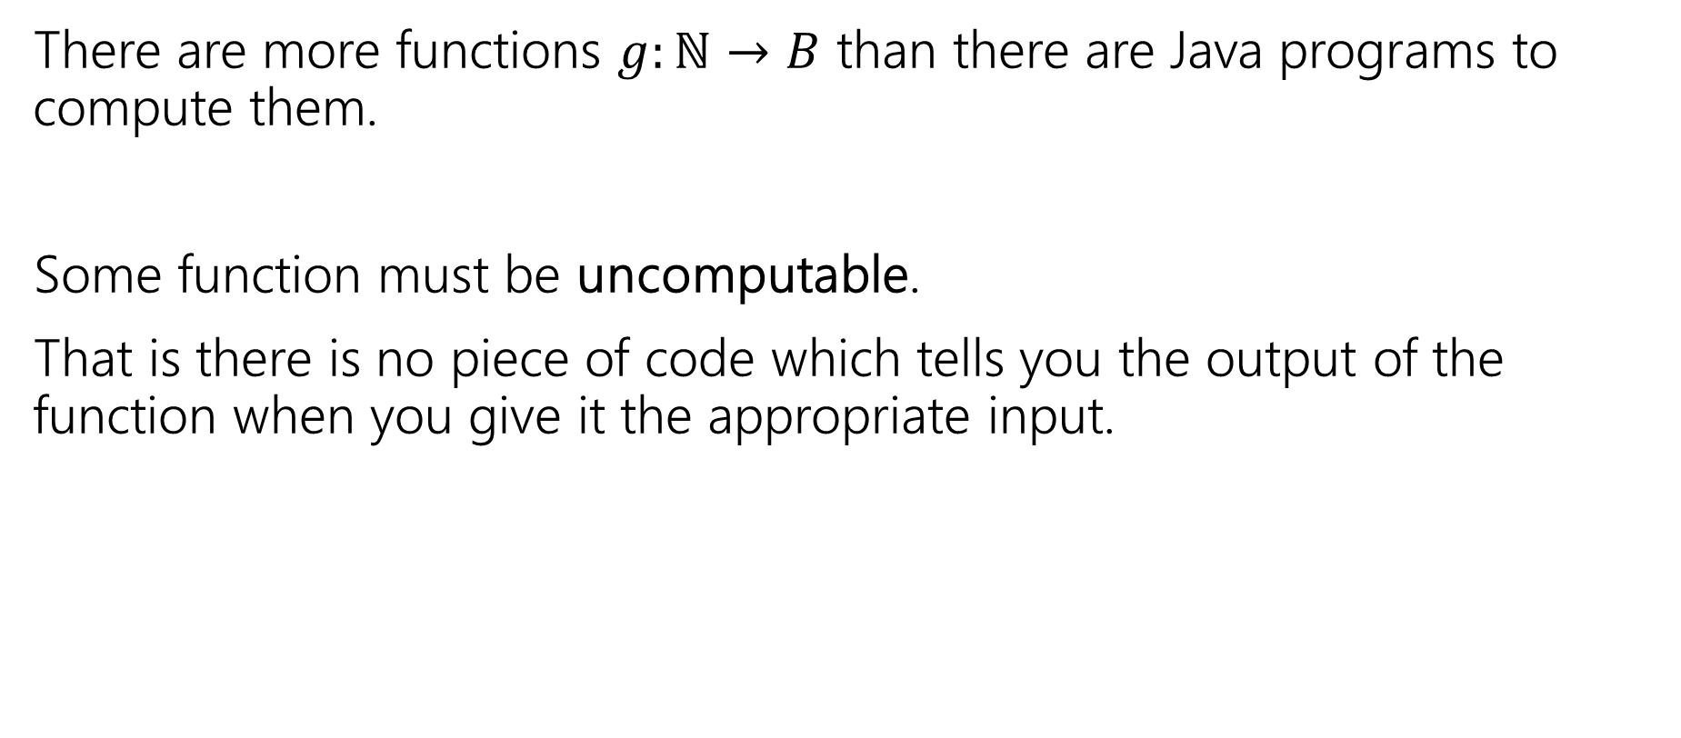
Our Second big takeaway
There are more functions $g:ℕ→B$ than there are Java programs to compute them.
Some function must be uncomputable.
That is there is no piece of code which tells you the output of the function when you give it the appropriate input.

Slide 33
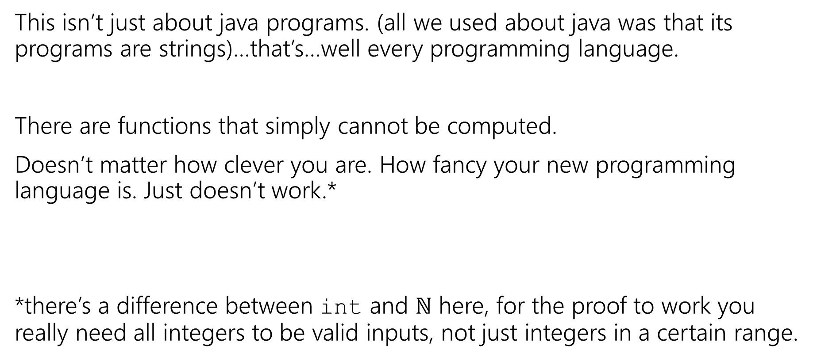
Not just Java
This isn’t just about java programs. (all we used about java was that its programs are strings)…that’s…well every programming language.
There are functions that simply cannot be computed.
Doesn’t matter how clever you are. How fancy your new programming language is. Just doesn’t work.*
*there’s a difference between int and $ℕ$ here, for the proof to work you really need all integers to be valid inputs, not just integers in a certain range.

Slide 34
Does this matter?
It’s even worse than that – almost all functions are not computable.
So…how come this has never happened to you?
This might not be meaningful yet. Almost all functions are also inexpressible in a finite amount of English (English is a language too!)
You’ve probably never decided to write a program that computes a function you couldn’t describe in English…
Are there any problems anyone is interested in solving that aren’t computable?

Slide 35
The Halting Problem

Slide 36
A Practical Uncomputable Problem
Ever pressed the run button on your code and have it take a long time?
Like an infinitely long time?
What didn’t your compiler…like, tell you not to push the button yet.
It tells you when your code doesn’t compile before it runs it…why doesn’t it check for infinite loops?

Slide 37
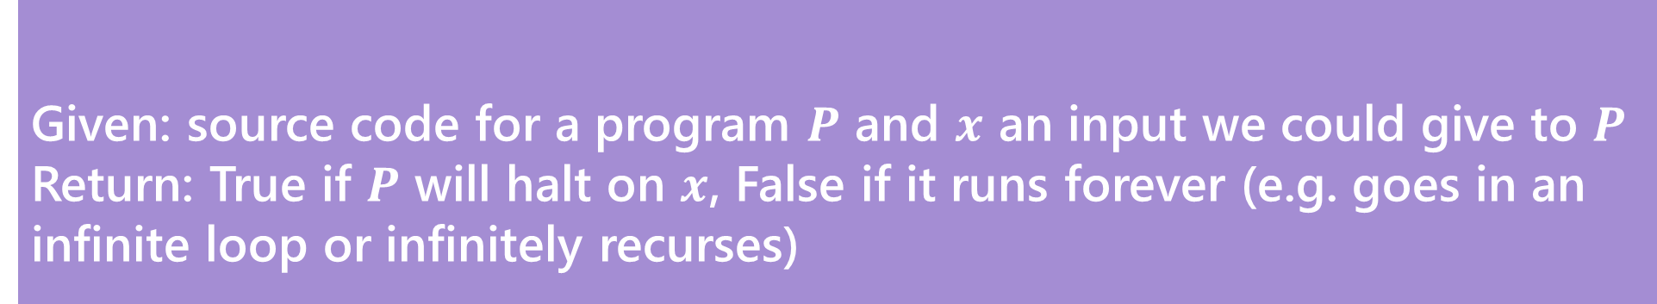
The Halting Problem
Given: source code for a program $P$ and $x$ an input we could give to $P$
Return: True if $P$ will halt on $x$, False if it runs forever (e.g. goes in an infinite loop or infinitely recurses)
The Halting Problem
This would be super useful to solve!
We can’t solve it…let’s find out why.

Slide 38
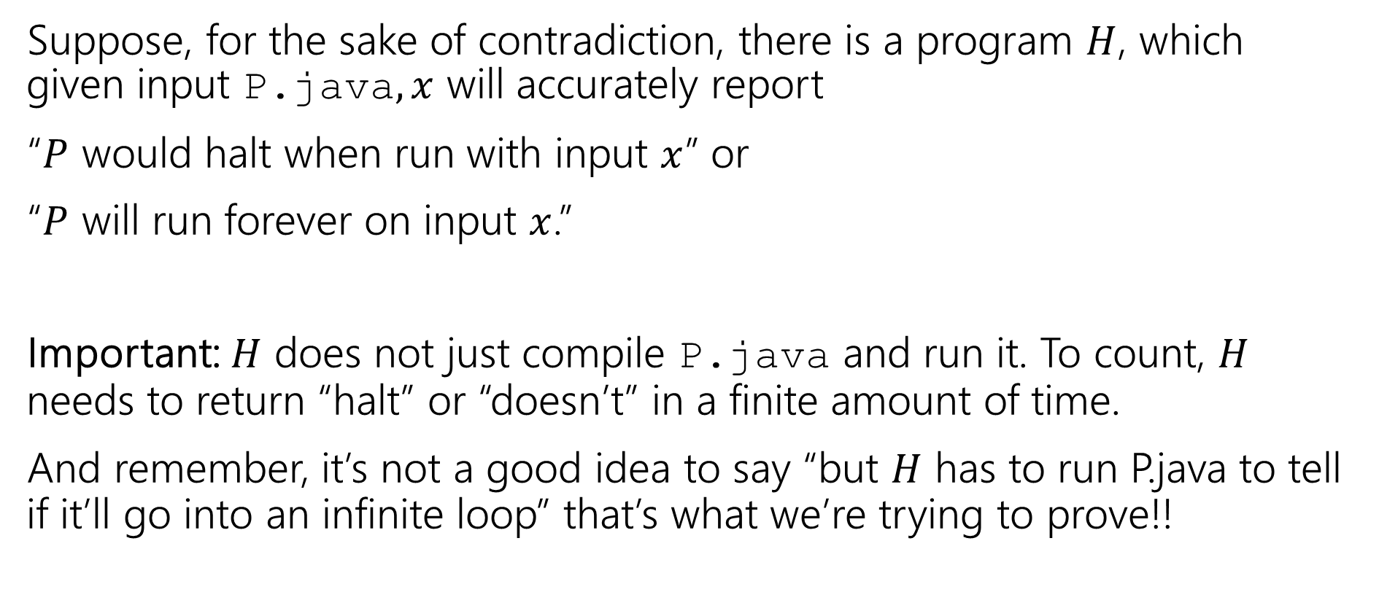
A Proof By Contradiction
Suppose, for the sake of contradiction, there is a program $H$, which given input P.java$,x$ will accurately report
“$P$ would halt when run with input $x$” or
“$P$ will run forever on input $x$.”
Important: $H$ does not just compile P.java and run it. To count, $H$ needs to return “halt” or “doesn’t” in a finite amount of time.
And remember, it’s not a good idea to say “but $H$ has to run P.java to tell if it’ll go into an infinite loop” that’s what we’re trying to prove!!

Slide 39
A Very Tricky Program.
Diagonal.java(String x){
Run H.exe on input <x, x>
if(H.exe says “x halts on x”)
while(true){//Go into an infinite loop
int x=2+2;
}
else //H.exe says “x doesn’t halt on x”
return; //halt.
}

Slide 40
So, uhh that’s a weird program.
What do we do with it?
USE IT TO BREAK STUFF
Does Diagonal.java halt when its input is Diagonal.java?
Let’s assume it does and see what happens…

Slide 41
A Very Tricky Program.
Imagine Diagonal.java halts on Diagonal.java.
Then H better say it halts.
So it goes into an infinite loop.
Wait shoot.
Diagonal.java(String x){
Run H.exe on input <x, x>
if(H.exe says “x halts on x”)
while(true){//Go into an infinite loop
int x=2+2;
}
else //H.exe says “x doesn’t halt on x”
return; //halt.
}

Slide 42
So, uhh that’s a weird program.
What do we do with it?
USE IT TO BREAK STUFF
Does Diagonal.java halt when its input is Diagonal.java?
Let’s assume it does and see what happens…
  That didn’t work.
Let’s assume it doesn’t and see what happens…

Slide 43
A Very Tricky Program.
Imagine Diagonal.java doesn’t halt on Diagonal.java.
Then H better say it doesn’t halt.
So we go into the else branch.
And it halts
Wait shoot.
Diagonal.java(String x){
Run H.exe on input <x, x>
if(H.exe says “x halts on x”)
while(true){//Go into an infinite loop
int x=2+2;
}
else //H.exe says “x doesn’t halt on x”
return; //halt.
}

Slide 44
So, uhh that’s a weird program.
What do we do with it?
USE IT TO BREAK STUFF
Does Diagonal.java halt when its input is Diagonal.java?
Let’s assume it does and see what happens…
  That didn’t work.
Let’s assume it doesn’t and see what happens…
  That didn’t work either.
There’s no third option. It either halts or it doesn’t. And it doesn’t do either. That’s a contradiction! H.exe can’t exist.

Slide 45
So…
So there is no general-purpose algorithm that decides whether any input program (on any input string).
The Halting Problem is undecidable (i.e. uncomputable) there is no algorithm that solves every instance of the problem correctly.

Slide 46
What that does and doesn’t mean
That doesn’t mean that there aren’t algorithms that often get the answer right
  For example, if there’s no loops, no recursion, and no method calls, it definitely halts. No problem with that kind of program existing.
  This isn’t just a failure of computers – if you think you can do this by hand, well…
  …you cant either.

Slide 47
Takeaways
Don’t expect that there’s a better IDE/better compiler/better programming language coming that will make it possible to tell if your code is going to hit an infinite loop.
It’s not coming.

Slide 48
More Uncomputable problems
Imagine we gave the following task to 121 students:
Write a program that prints “Hello World”
Can you make an autograder?
Technically…NO!

Slide 49
More Uncomputable problems
Imagine we gave the following task to 121 students:
Write a program that prints “Hello World”
Can you make an autograder?
Technically…NO!
In practice, we declare the program wrong if it runs for 1 minute or so. That’s not right 100% of the time, but it’s good enough for your programming classes.

Slide 50
How Would we prove that?
With a reduction
Suppose, for the sake of contradiction, I can solve the HelloWorld problem. (i.e. on input P.java I can tell whether it eventually prints HelloWorld)
Let W.exe solve that problem.
Consider this program…

Slide 51
A Reduction
Trick(P,x){
Run P on x, //(but only simulate printing if P prints things)
Print “Hello World”
}
This actually prints “hello world” iff P halts on x.
Plug Trick into W and….we solved the Halting Problem!

Slide 52
Reductions in General
The big idea for reductions is “reusing code”
Just like calling a library
But doing it in contrapositive form.
Instead of
“If I have a library, then I can solve a new problem” reductions do the contrapositive:
“If I can solve a problem I know I shouldn’t be able to, then that library function can’t exist”

Slide 53
Fun (Scary?) Fact
Rice’s Theorem
Says any “non-trivial” behavior of programs cannot be computed (in finite time).

Slide 54
What Comes next?
CSE 312 (foundations II)
  Fewer proofs ☹
  Basics of probability theory (super useful in algorithms, ML, and just everyday life). Fundamental statistics.
CSE 332 (data structures and parallelism)
  Data structures, a few fundamental algorithms, parallelism.
  Graphs. Graphs everywhere.
  Also, induction. [same for 421, 422 the algorithms courses]
CSE 431 (complexity theory)
  What can’t you do with computers in a reasonable amount of time.
  Beautiful theorems – more on CFGs, DFAs/NFAs as well.

Slide 55
We’ve Covered A LOT
Propositional Logic.
Boolean logic and circuits.
Boolean algebra.
Predicates, quantifiers and predicate logic.
Inference rules and formal proofs for propositional and predicate logic.
English proofs.
Set theory.
Modular arithmetic.
Prime numbers.
GCD, Euclid's algorithm and modular inverse
You’ll use quantifiers in 332 to define big-O
431 is basically 10 weeks of fun set proofs.
Interested in crypto? They’ll come back.

Slide 56
No really. A lot
Induction and Strong Induction.
Recursively defined functions and sets.
Structural induction.
Regular expressions.
Context-free grammars and languages.
Relations and composition.
Transitive-reflexive closure.
Graph representation of relations and their closures.
Lots of induction proof [sketches] in 332
You’ll see these in compilers
You’ll use graphs at least once a week for the rest of your CS career.

Slide 57
Like A lot a lot.
DFAs, NFAs and language recognition.
Cross Product construction for DFAs.
Finite state machines with outputs at states.
Conversion of regular expressions to NFAs.
Powerset construction to convert NFAs to DFAs.
Equivalence of DFAs, NFAs, Regular Expressions
Method to prove languages not accepted by DFAs.
Cardinality, countability and diagonalization
Undecidability: Halting problem and evaluating properties of programs.
Promise you won’t ever try to solve the Halting Problem? It’s tempting to try to sometimes if you don’t remember it’s undecidable

