Slide 1
Random Variables
CSE 312 Summer 21
Lecture 8

Slide 2
Conditional Independence

Slide 3
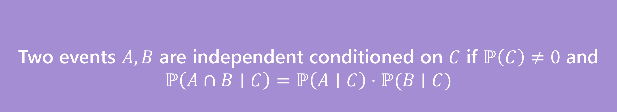

Conditional Independence
We say $A$ and $B$ are conditionally independent on $C$ if
$ℙ\left(A∩B | C\right)=ℙ\left(A | C\right)⋅ℙ(B|C)$
i.e. if you condition on $C$, they are independent.
Two events $A,B$ are independent conditioned on $C$ if $ℙ\left(C\right)≠0$ and
$$ℙ\left(A∩B∣C\right)=ℙ\left(A∣C\right)⋅ℙ(B∣C)$$
Conditional Independence

Slide 4
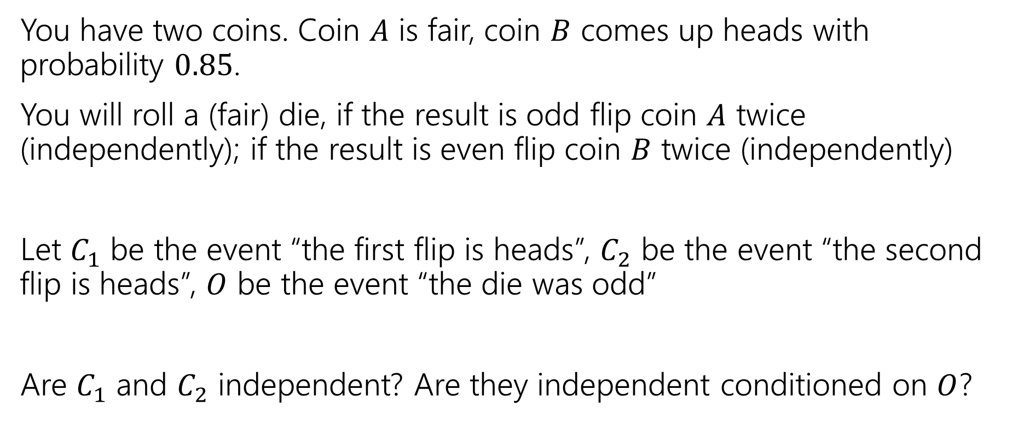
Conditional Independence Example
You have two coins. Coin $A$ is fair, coin $B$ comes up heads with probability $0.85$.
You will roll a (fair) die, if the result is odd flip coin $A$ twice (independently); if the result is even flip coin $B$ twice (independently)
Let $C_{1}$ be the event “the first flip is heads”, $C_{2}$ be the event “the second flip is heads”, $O$ be the event “the die was odd”
Are $C_{1}$ and $C_{2}$ independent? Are they independent conditioned on $O$?

Slide 5
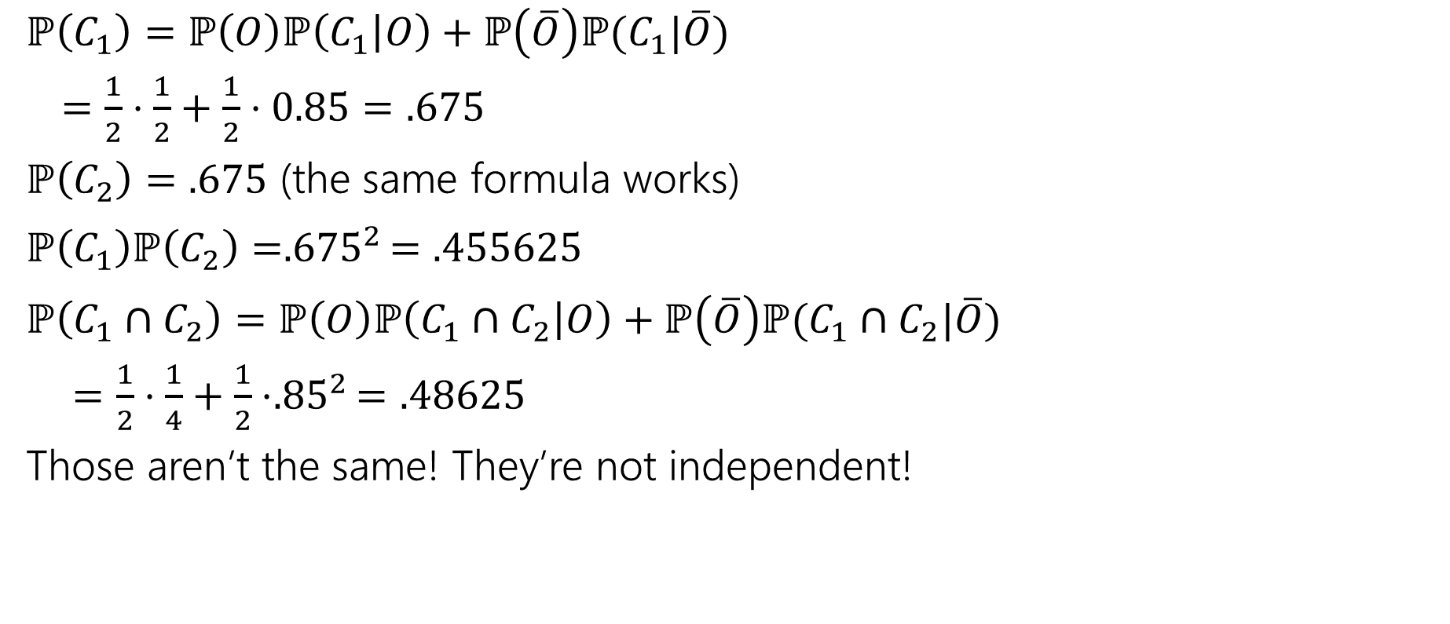
(Unconditioned) Independence
$ℙ\left(C_{1}\right)=ℙ\left(O\right)ℙ\left(C_{1} | O\right)+ℙ\left(\overline{O}\right)ℙ(C_{1}|\overline{O})$
$=\frac{1}{2}⋅\frac{1}{2}+\frac{1}{2}⋅0.85=.675$
$ℙ\left(C_{2}\right)=.675$ (the same formula works)
$ℙ\left(C_{1}\right)ℙ\left(C_{2}\right)={.675}^{2}=.455625$
$ℙ\left(C_{1}∩C_{2}\right)=ℙ\left(O\right)ℙ\left(C_{1}∩C_{2} | O\right)+ℙ\left(\overline{O}\right)ℙ(C_{1}∩C_{2}|\overline{O})$
$=\frac{1}{2}⋅\frac{1}{4}+\frac{1}{2}⋅{.85}^{2}=.48625$
Those aren’t the same! They’re not independent!
Intuition: seeing a head gives you information – information that it’s more likely you got the biased coin and so the next head is more likely.

Slide 6

Conditional Independence
$ℙ\left(C_{1} | O\right)=1/2$
$ℙ\left(C_{2} | O\right)=1/2$
$ℙ\left(C_{1}∩C_{2} | O\right)=\frac{1}{2}⋅\frac{1}{2}=1/4$
$ℙ\left(C_{1} | O\right)ℙ\left(C_{2} | O\right)=ℙ(C_{1}∩C_{2}|O)$
Yes! $C_{1}$ and $C_{2}$ are conditionally independent, conditioned on $O$.

Slide 7
Takeaway
Read a problem carefully – when we say “these steps are independent of each other” about some part of a sequential process, it’s usually “conditioned on all prior steps, these steps are conditionally independent of each other.”
Those conditional steps are usually dependent (without conditioning) because they might give you information about which branch you took.

Slide 8
Setting the stage: Random Variables

Slide 9
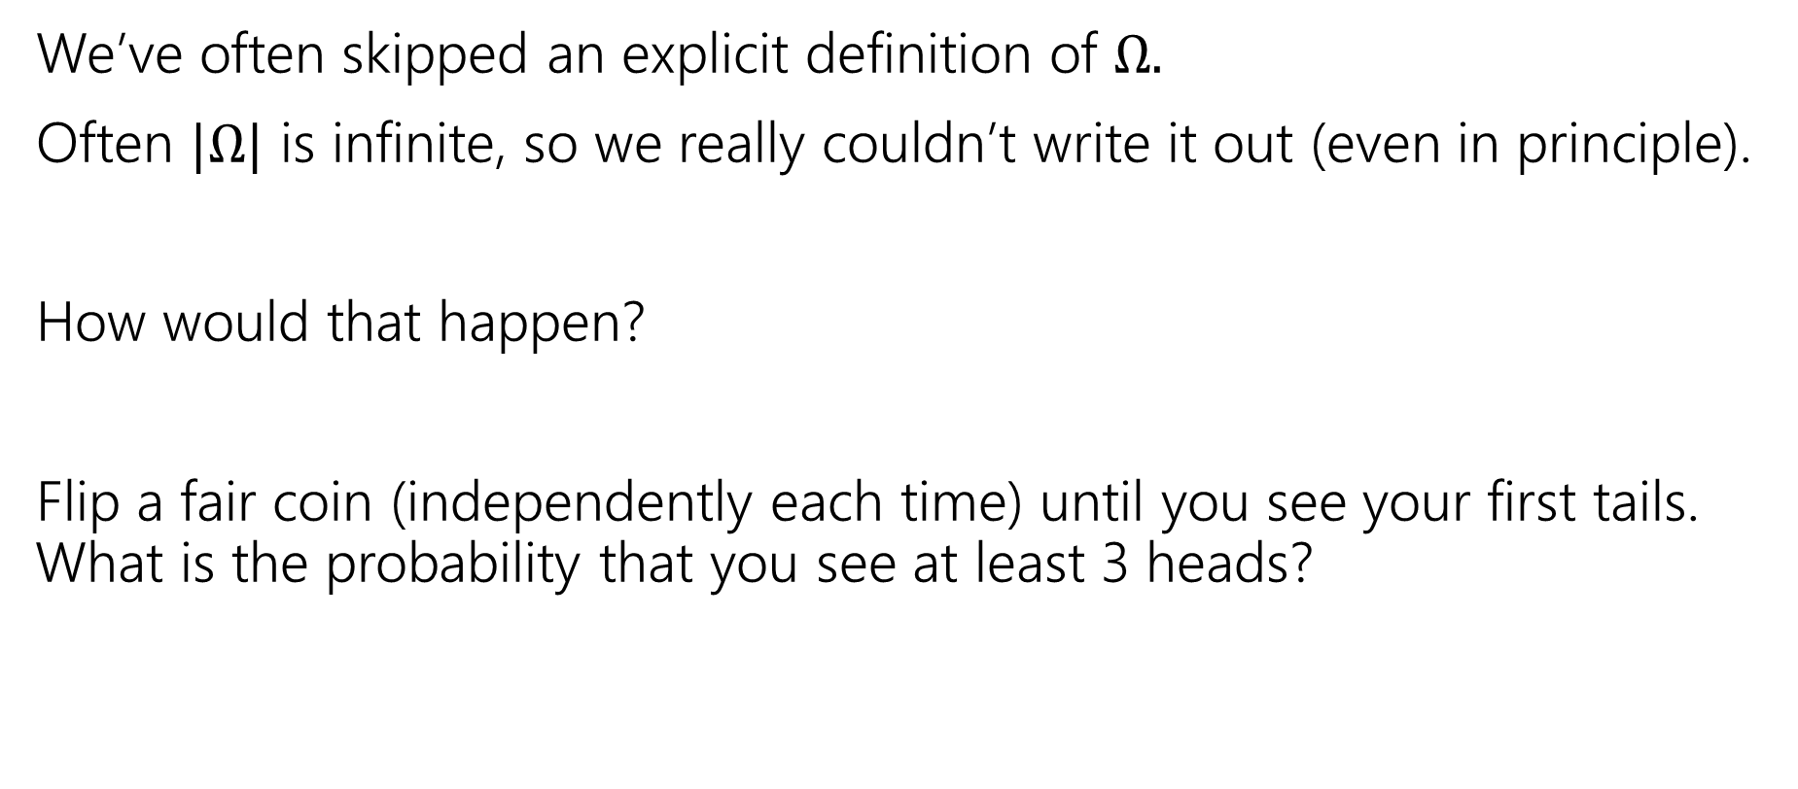

Implicitly defining $Ω$
We’ve often skipped an explicit definition of $Ω.$
Often $|Ω|$ is infinite, so we really couldn’t write it out (even in principle).
How would that happen?
Flip a fair coin (independently each time) until you see your first tails. What is the probability that you see at least 3 heads?

Slide 10

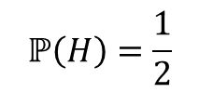

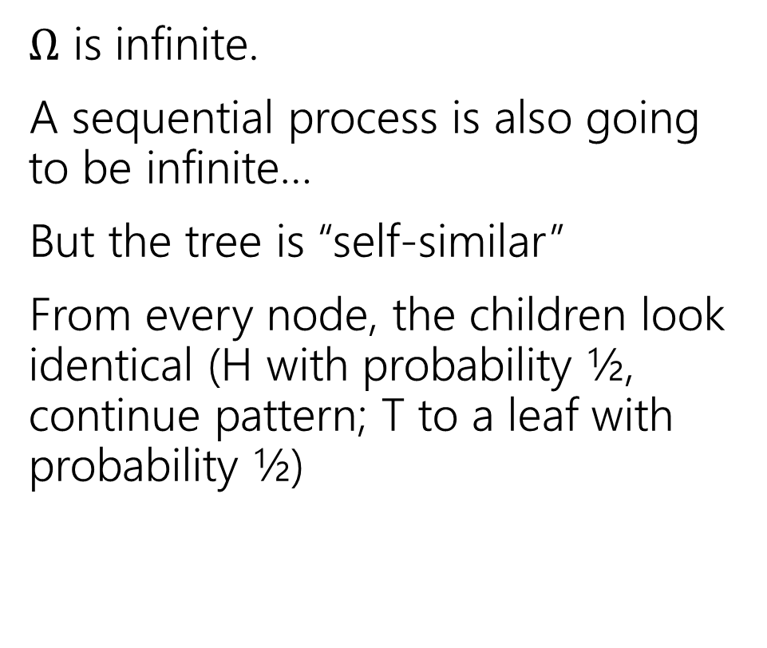




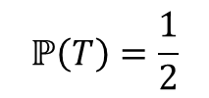

An infinite process.
$Ω$ is infinite.
A sequential process is also going to be infinite…
But the tree is “self-similar”
From every node, the children look identical (H with probability ½, continue pattern; T to a leaf with probability ½)
$$ℙ\left(H\right)=\frac{1}{2}$$
$$ℙ\left(T\right)=\frac{1}{2}$$
H
$$ℙ\left(T\right)=1/2$$
$$ℙ\left(HH|H\right)=\frac{1}{2}$$
$$ℙ\left(HT|H\right)=\frac{1}{2}$$
H
$$ℙ\left(HT\right)=1/4$$
$$ℙ\left(HHH|HH\right)=\frac{1}{2}$$
$$ℙ\left(HHT|HH\right)=\frac{1}{2}$$
H
$$ℙ\left(HHT\right)=1/8$$
…

Slide 11
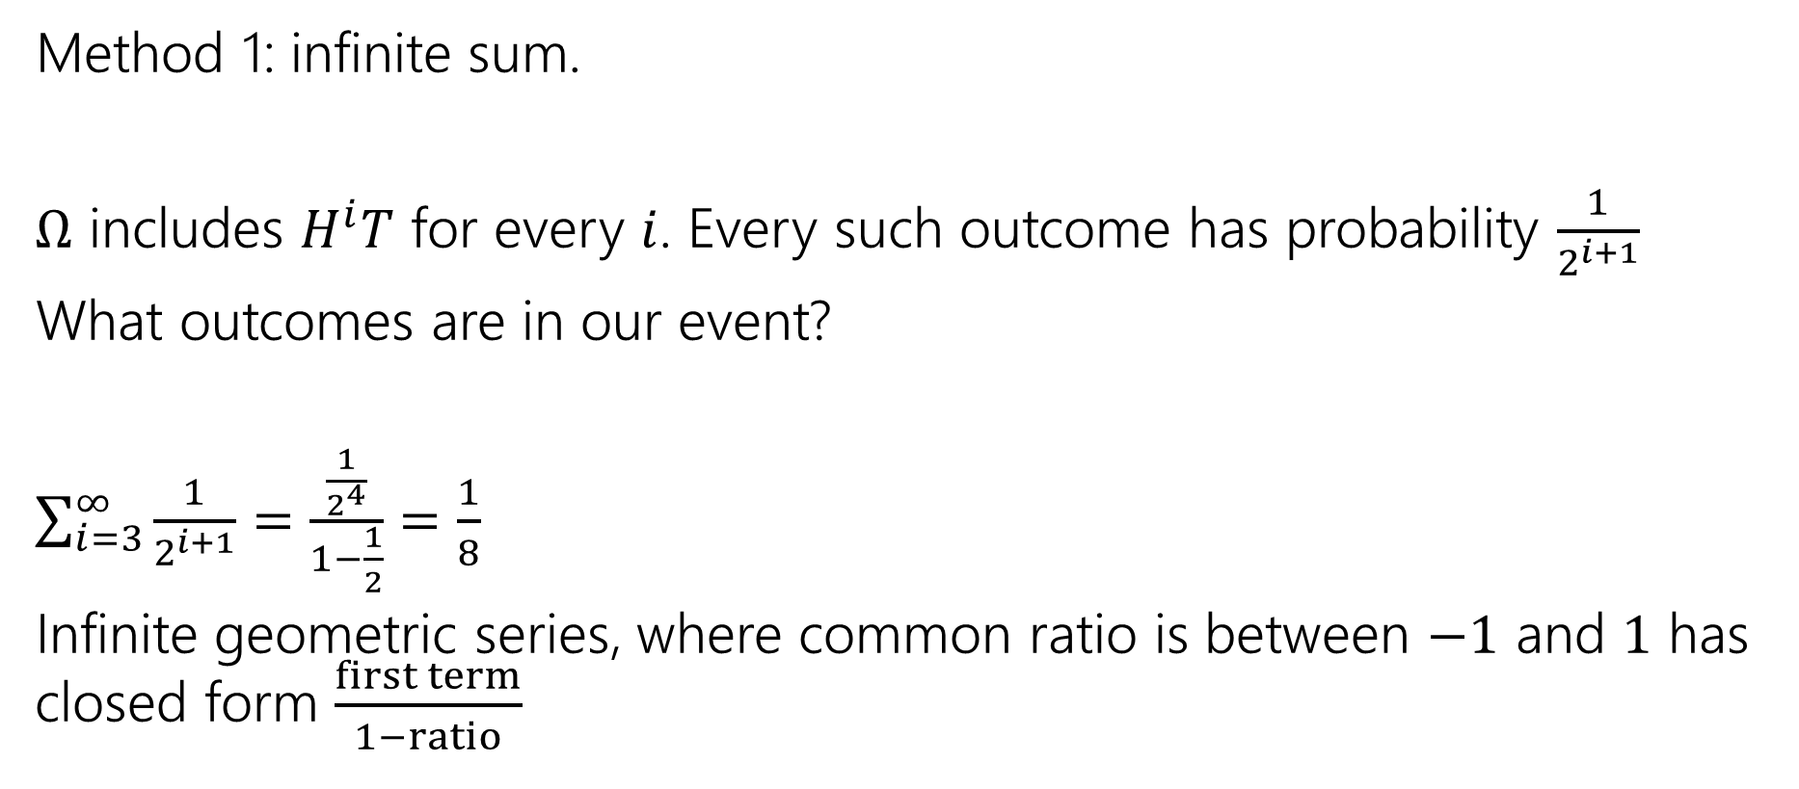

Finding $ℙ($at least $3$ heads)
Method 1: infinite sum.
$Ω$ includes $H^{i}T$ for every $i$. Every such outcome has probability $\frac{1}{2^{i+1}}$
What outcomes are in our event?
$\sum_{i=3}^{∞}{\frac{1}{2^{i+1}}}=$ $\frac{\frac{1}{2^{4}}}{1−\frac{1}{2}}=\frac{1}{8}$
Infinite geometric series, where common ratio is between $−1$ and $1$ has closed form $\frac{first term}{1−ratio}$

Slide 12

Finding $ℙ($at least $3$ heads)
Method 2:
Calculate the complement
$ℙ($at most 2 heads) = $\frac{1}{2}+\frac{1}{4}+\frac{1}{8}$
$ℙ($at least 3 heads)= $1−\left(\frac{1}{2}+\frac{1}{4}+\frac{1}{8}\right)=\frac{1}{8}$

Slide 13
Random Variables

Slide 14
Random Variable
Often, we want to capture quantitative properties of the outcome of a random experiment.
Examples:
  What is the sum of two dice rolls?
  What is the number of coin tosses needed to see the first heads?
  What is the number of heads among 2 coin tosses?

Slide 15
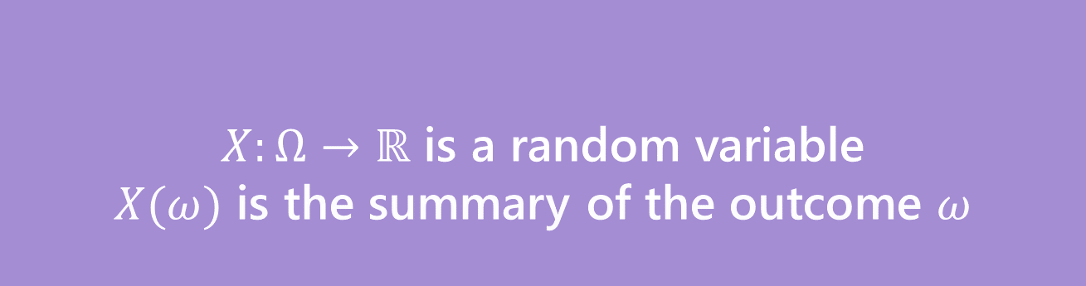
Random Variable
Formally:
Informally: A random variable is a way to summarize the important (numerical) information from your outcome.
$X:Ω→ℝ$ is a random variable
$X(ω)$ is the summary of the outcome $ω$
Random Variable

Slide 16

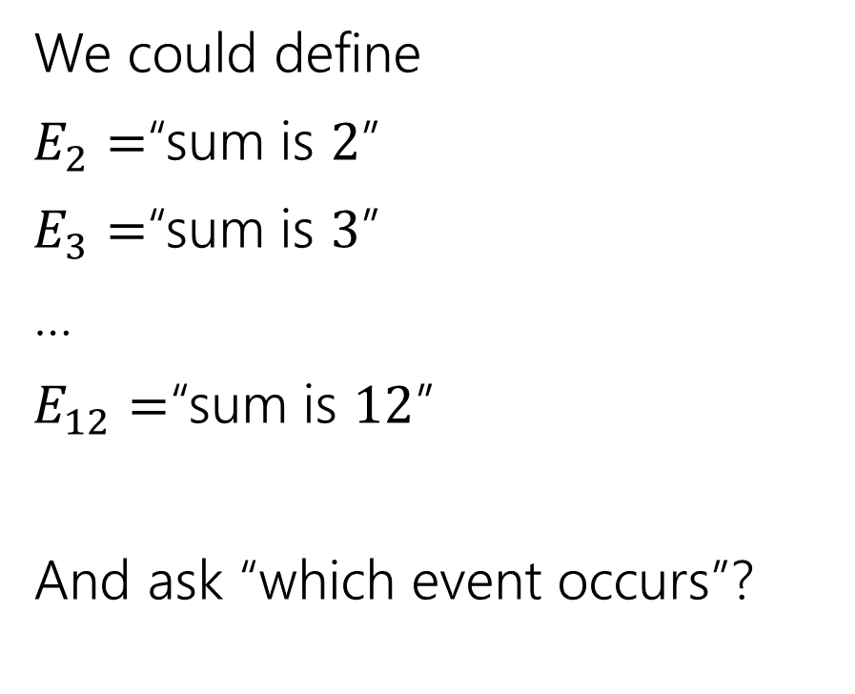
The sum of two dice
Events
Random variable
We could define
$E_{2}=$“sum is $2$”
$E_{3}=$“sum is $3$”
…
$E_{12}=$“sum is $12$”
And ask “which event occurs”?
$X:Ω→ℝ$
$X$is the sum of the two dice.

Slide 17
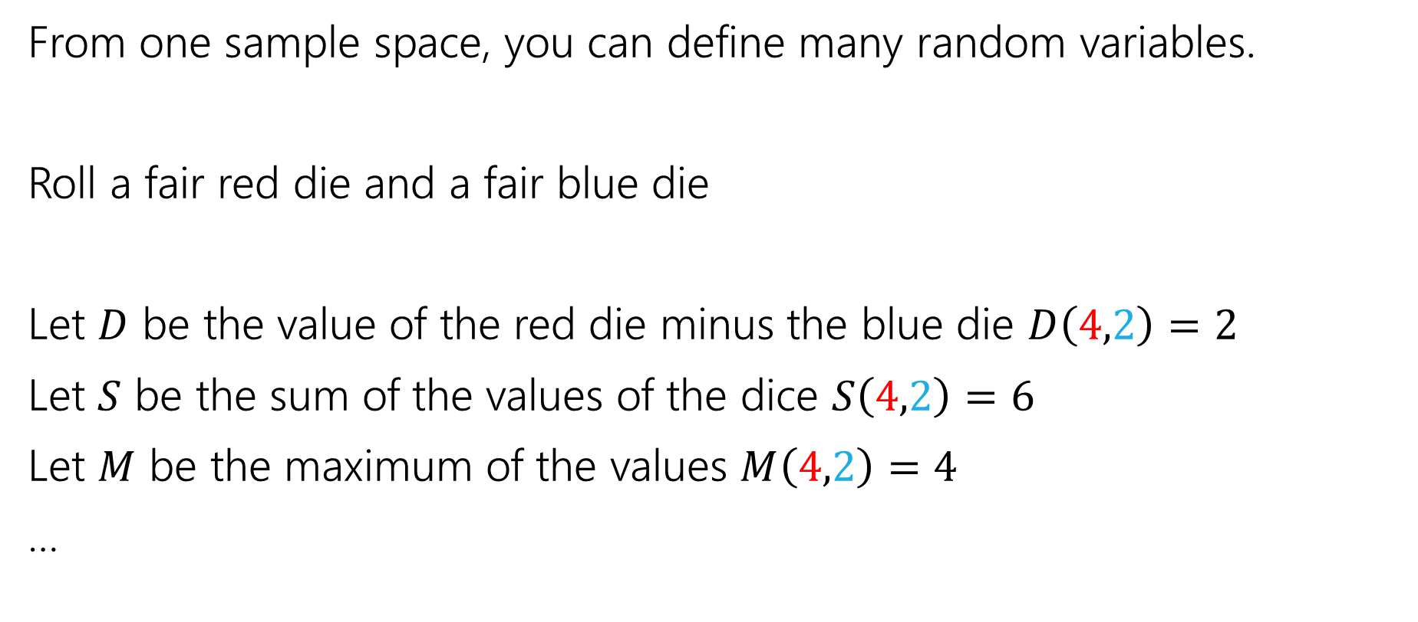
More random variables
From one sample space, you can define many random variables.
Roll a fair red die and a fair blue die
Let $D$ be the value of the red die minus the blue die $D\left(4,2\right)=2$
Let $S$ be the sum of the values of the dice $S\left(4,2\right)=6$
Let $M$ be the maximum of the values $M\left(4,2\right)=4$
…

Slide 18
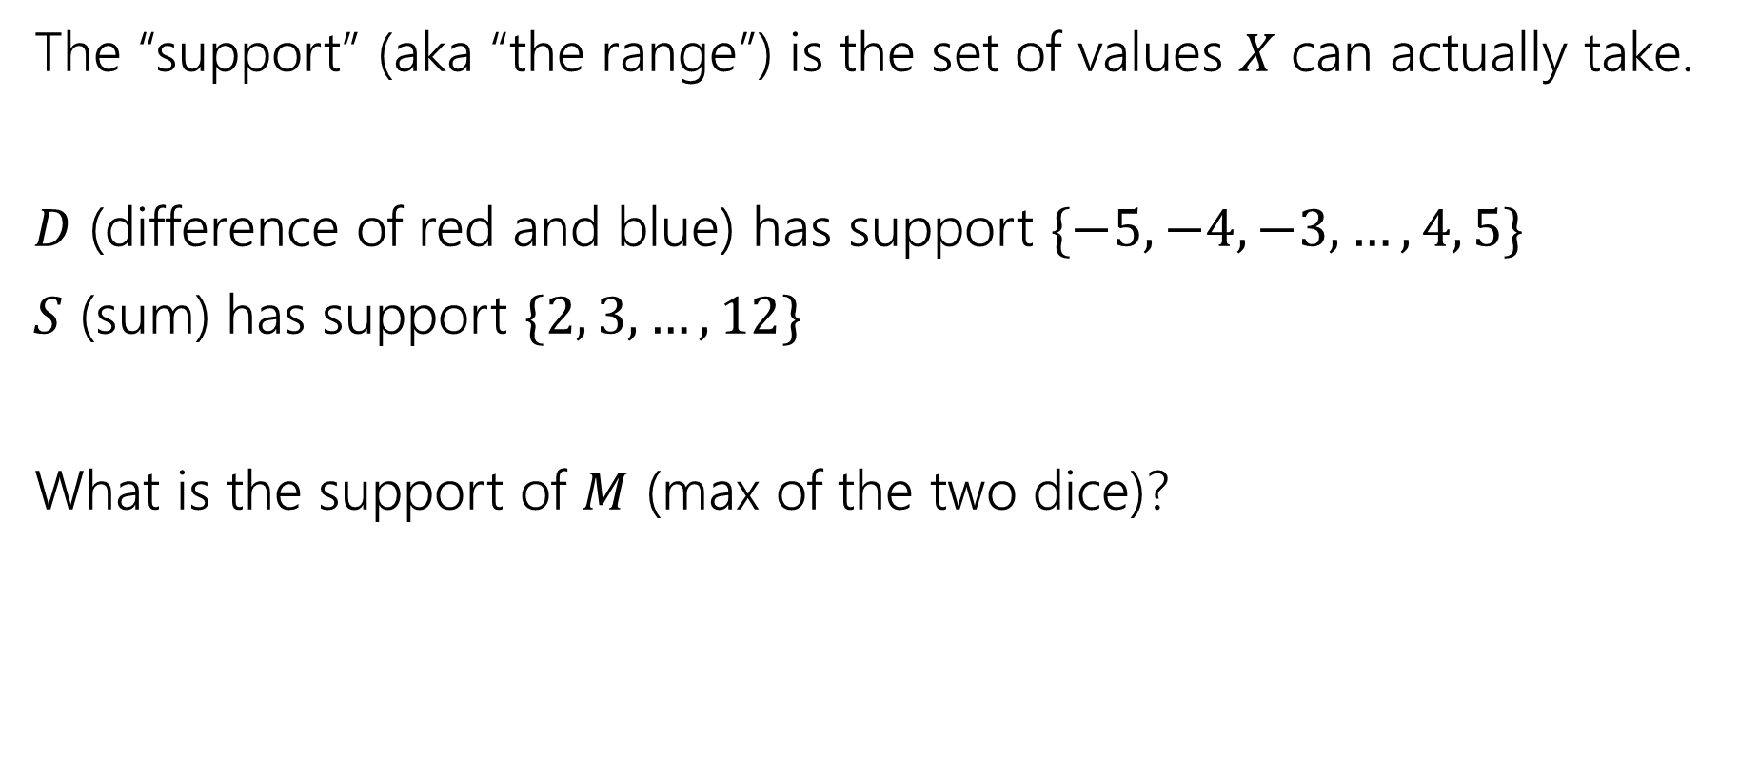
Support
The “support” (aka “the range”) is the set of values $X$ can actually take.
$D$ (difference of red and blue) has support $\{−5,−4,−3,…,4, 5\}$
$S$ (sum) has support $\{2, 3,…,12\}$
What is the support of $M$ (max of the two dice)?

Slide 19
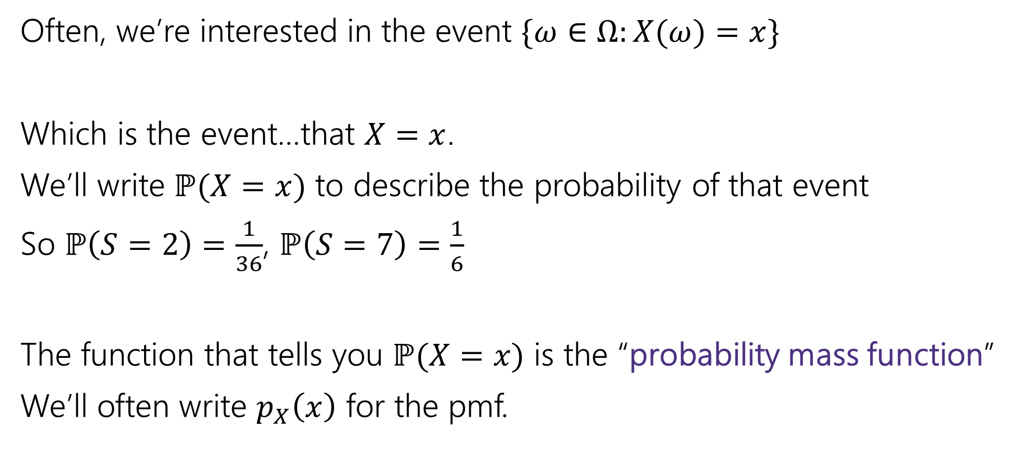
Probability Mass Function
Often, we’re interested in the event $\{ω∈Ω:X(ω)=x\}$
Which is the event…that $X=x$.
We’ll write $ℙ(X=x)$ to describe the probability of that event
So $ℙ\left(S=2\right)=\frac{1}{36}$, $ℙ\left(S=7\right)=\frac{1}{6}$
The function that tells you $ℙ(X=x)$ is the “probability mass function”
We’ll often write $p_{X}\left(x\right)$ for the pmf.

Slide 20
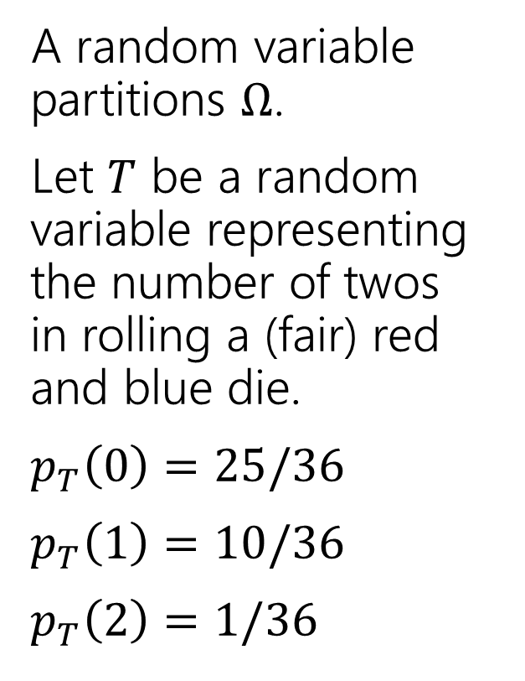
Partition
A random variable partitions $Ω$.
Let $T$ be a random variable representing the number of twos in rolling a (fair) red and blue die.
$p_{T}\left(0\right)=25/36$
$p_{T}\left(1\right)=10/36$
$p_{T}\left(2\right)=1/36$
 | D2=1 | D2=2 | D2=3 | D2=4 | D2=5 | D2=6
D1=1 | (1,1) | (1,2) | (1,3) | (1,4) | (1,5) | (1,6)
D1=2 | (2,1) | (2,2) | (2,3) | (2,4) | (2,5) | (2,6)
D1=3 | (3,1) | (3,2) | (3,3) | (3,4) | (3,5) | (3,6)
D1=4 | (4,1) | (4,2) | (4,3) | (4,4) | (4,5) | (4,6)
D1=5 | (5,1) | (5,2) | (5,3) | (5,4) | (5,5) | (5,6)
D1=6 | (6,1) | (6,2) | (6,3) | (6,4) | (6,5) | (6,6)

Slide 21
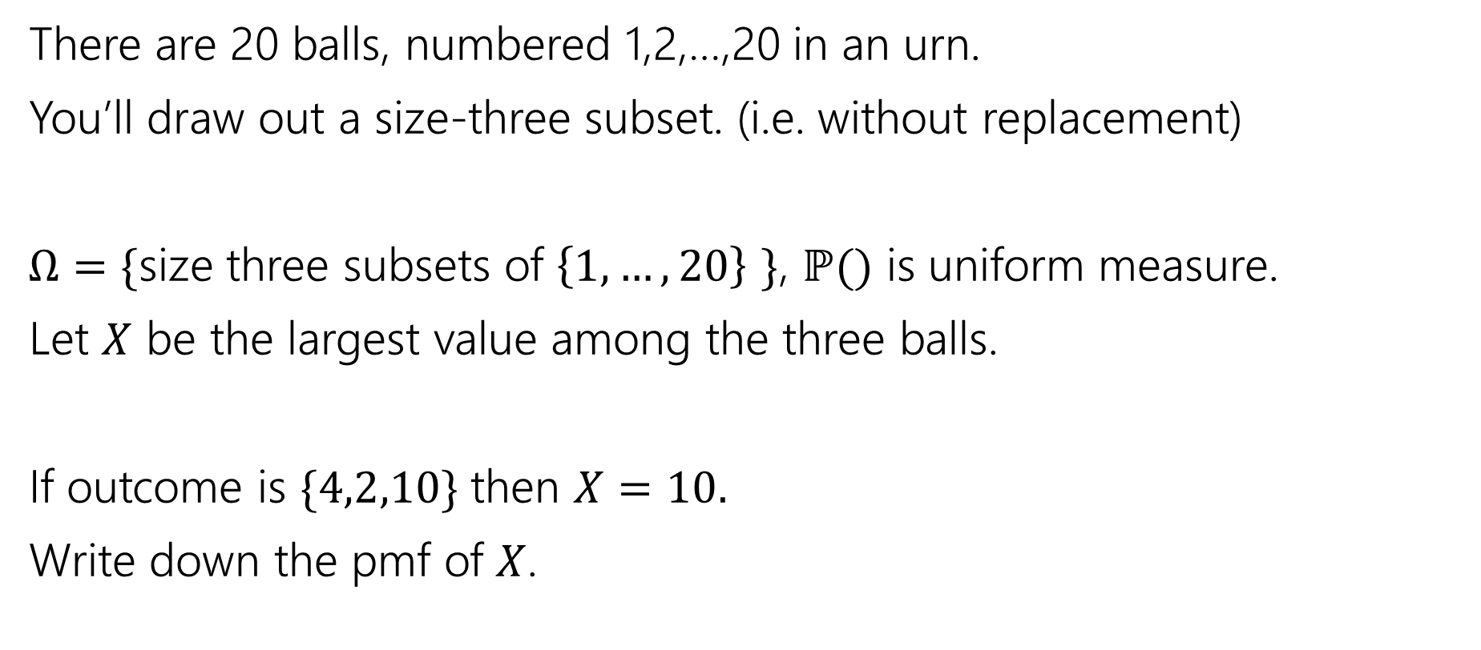
Try It Yourself
There are 20 balls, numbered 1,2,…,20 in an urn.
You’ll draw out a size-three subset. (i.e. without replacement)
$Ω=\{$size three subsets of $\left\{1,…,20\right\}$ $\}$, $ℙ()$ is uniform measure.
Let $X$ be the largest value among the three balls.
If outcome is $\{4,2,10\}$ then $X=10.$
Write down the pmf of $X$.

Slide 22
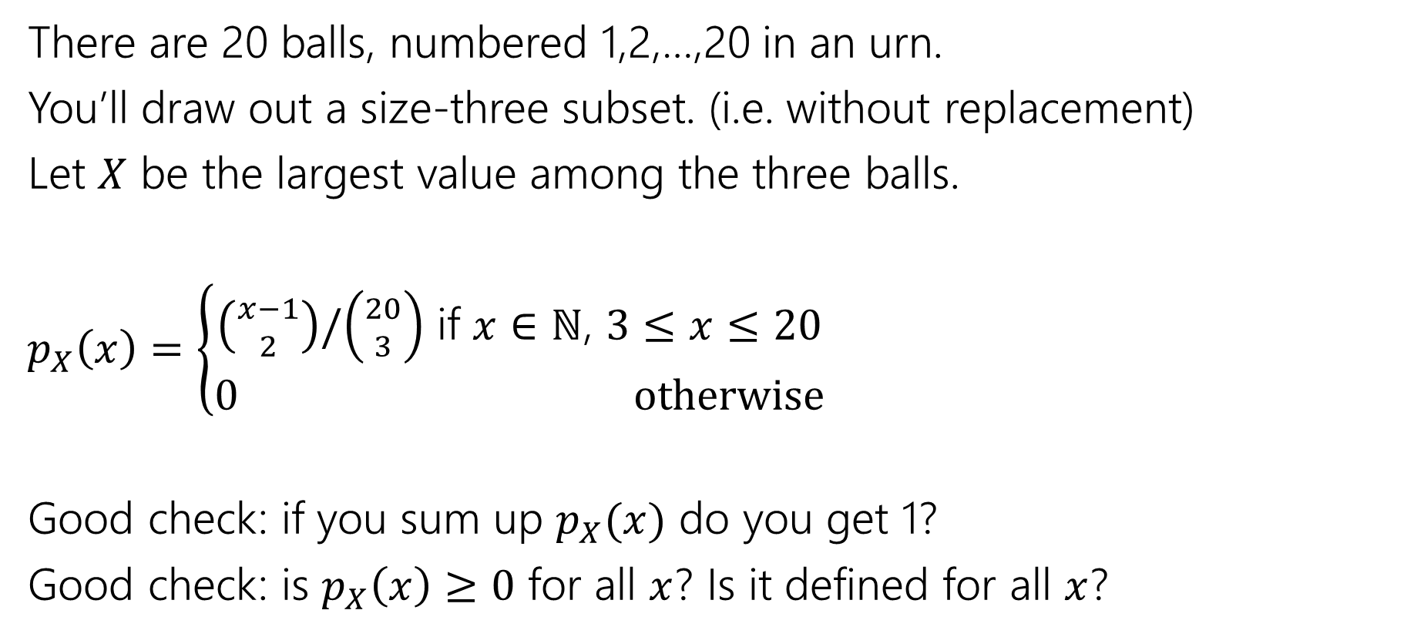
Try It Yourself
There are 20 balls, numbered 1,2,…,20 in an urn.
You’ll draw out a size-three subset. (i.e. without replacement)
Let $X$ be the largest value among the three balls.
$p_{X}\left(x\right)=\left\{\begin{aligned}\left({x−1 \atop 2}\right)/\left({20 \atop 3}\right) \text{if} x∈ℕ\text{, }3≤x≤20 \\ 0 otherwise\end{aligned}\right.$
Good check: if you sum up $p_{X}(x)$ do you get 1?
Good check: is $p_{X}\left(x\right)≥0$ for all $x$? Is it defined for all $x$?

Slide 23
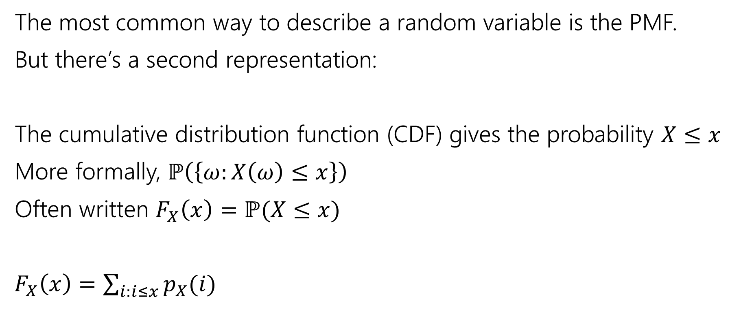
Describing a Random Variable
The most common way to describe a random variable is the PMF.
But there’s a second representation:
The cumulative distribution function (CDF) gives the probability $X≤x$
More formally, $ℙ\left(\left\{ω:X\left(ω\right)≤x\right\}\right)$
Often written $F_{X}\left(x\right)=ℙ(X≤x)$
$F_{X}\left(x\right)=\sum_{i:i≤x}{p_{X}(i)}$

Slide 24

Try It Yourself
What is the CDF of $X$ where $X$ be the largest value among the three balls? (Drawing 3 of the 20 without replacement)
Fill out the poll everywhere so Kushal knows how long to explain
Go to pollev.com/cse312su21

Slide 25
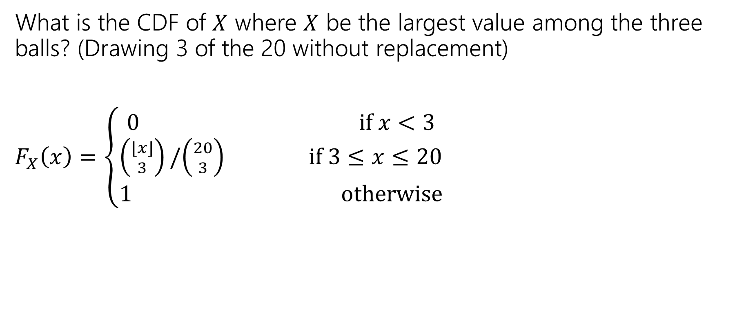
Try It Yourself
What is the CDF of $X$ where $X$ be the largest value among the three balls? (Drawing 3 of the 20 without replacement)
$F_{X}\left(x\right)=\left\{\begin{aligned}\begin{aligned}0 if x<3 \\ \left({⌊x⌋ \atop 3}\right)/\left({20 \atop 3}\right) \text{if} 3≤x≤20\end{aligned} \\ 1 otherwise\end{aligned}\right.$

Slide 26
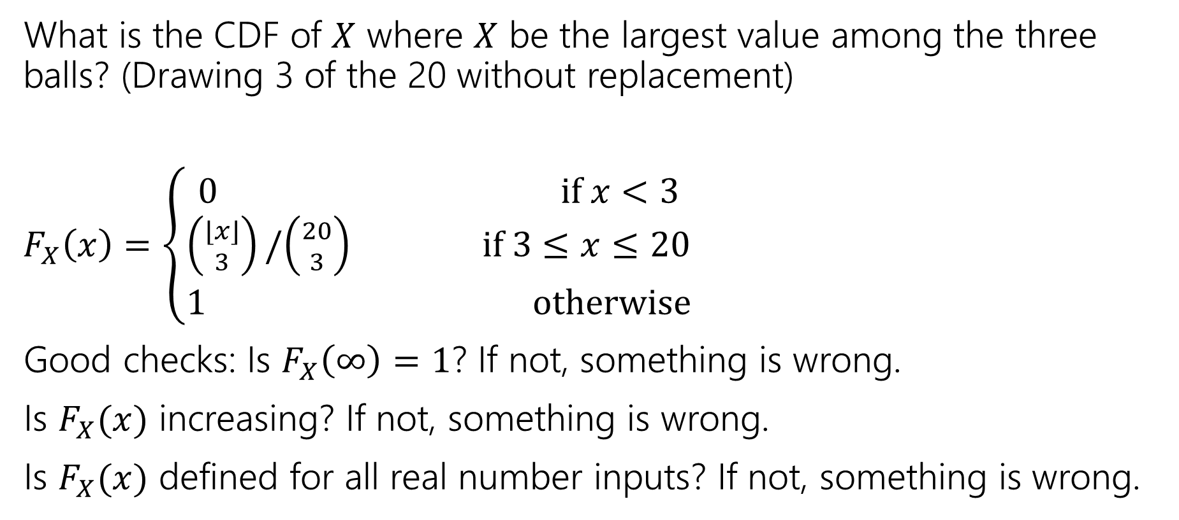
Try It Yourself
What is the CDF of $X$ where $X$ be the largest value among the three balls? (Drawing 3 of the 20 without replacement)
$F_{X}\left(x\right)=\left\{\begin{aligned}\begin{aligned}0 if x<3 \\ \left({⌊x⌋ \atop 3}\right)/\left({20 \atop 3}\right) \text{if} 3≤x≤20\end{aligned} \\ 1 otherwise\end{aligned}\right.$
Good checks: Is $F_{X}\left(∞\right)=1$? If not, something is wrong.
Is $F_{X}(x)$ increasing? If not, something is wrong.
Is $F_{X}(x)$ defined for all real number inputs? If not, something is wrong.

Slide 27
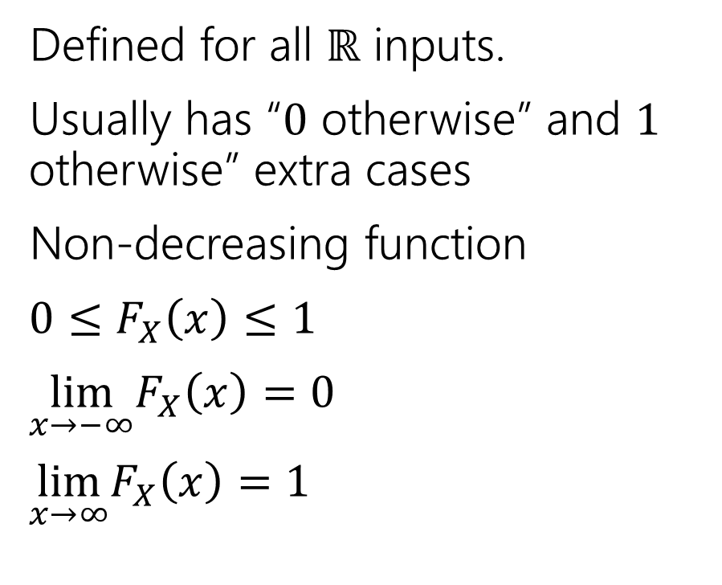
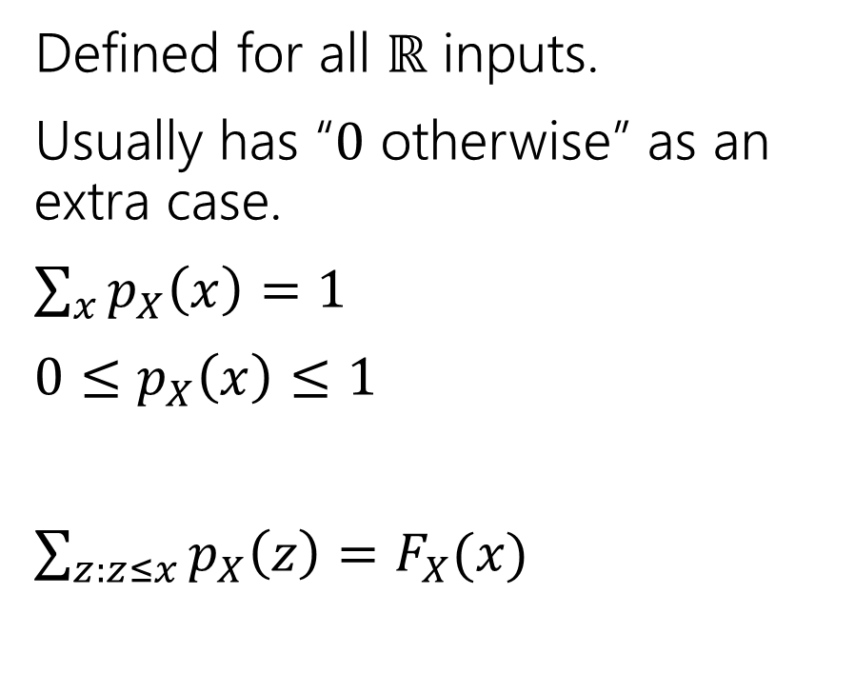
Two descriptions
Probability mass function
Cumulative Distribution function
Defined for all $ℝ$ inputs.
Usually has “$0$ otherwise” as an extra case.
$\sum_{x}{p_{X}\left(x\right)=1}$
$0≤p_{X}\left(x\right)≤1$
$\sum_{z:z≤x}^{ }{p_{X}\left(z\right)=F_{X}(x)}$
Defined for all $ℝ$ inputs.
Usually has “$0$ otherwise” and $1$ otherwise” extra cases
Non-decreasing function
$0≤F_{X}\left(x\right)≤1$
$\lim_{x→−∞}F_{X}\left(x\right)=0$
$\lim_{x→∞}F_{X}\left(x\right)=1⁡$

Slide 28
More Practice: Random Variables

Slide 29

More Random Variable Practice
Roll a fair die $n$ times. Let $X$ be the number of rolls that are $5s$ or $6s$.
What is the pmf?
Don’t try to write the CDF…it’s a mess…
Or try for a few minutes to realize it isn’t nice.

Slide 30
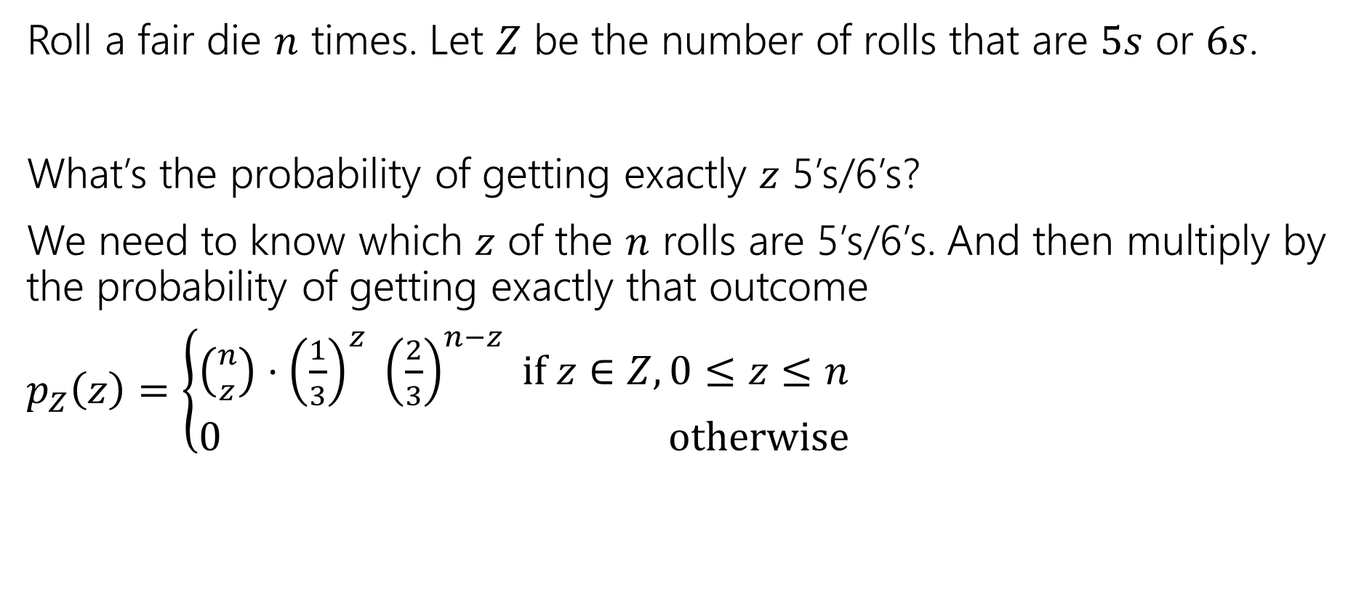
More Random Variable Practice
Roll a fair die $n$ times. Let $Z$ be the number of rolls that are $5s$ or $6s$.
What’s the probability of getting exactly $z$ 5’s/6’s?
We need to know which $z$ of the $n$ rolls are 5’s/6’s. And then multiply by the probability of getting exactly that outcome
$p_{Z}\left(z\right)=\left\{\begin{aligned}\left({n \atop z}\right)⋅{\left(\frac{1}{3}\right)}^{z} {\left(\frac{2}{3}\right)}^{n−z} if z∈Z,0≤z≤n \\ 0 otherwise\end{aligned}\right.$

Slide 31
More Practice: Infinite sequential processes

Slide 32
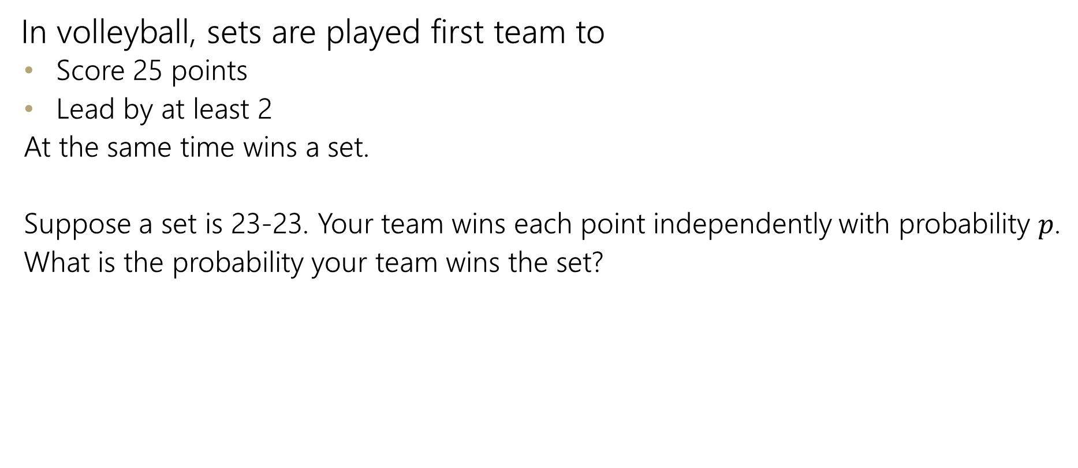
Infinite sequential process
In volleyball, sets are played first team to
  Score 25 points
  Lead by at least 2
  At the same time wins a set.
  Suppose a set is 23-23. Your team wins each point independently with probability $p$.
  What is the probability your team wins the set?

Slide 33
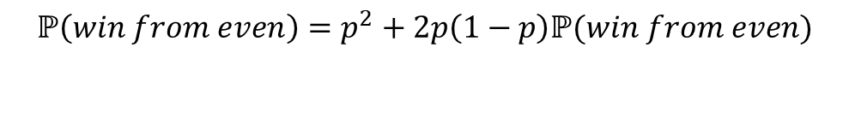
Sequential Process
0
$$ℙ\left(win from even\right)=p^{2}+2p\left(1−p\right)ℙ(win from even)$$
+
-
W
0
L
+
-
W
0
L
+
-
…

Slide 34
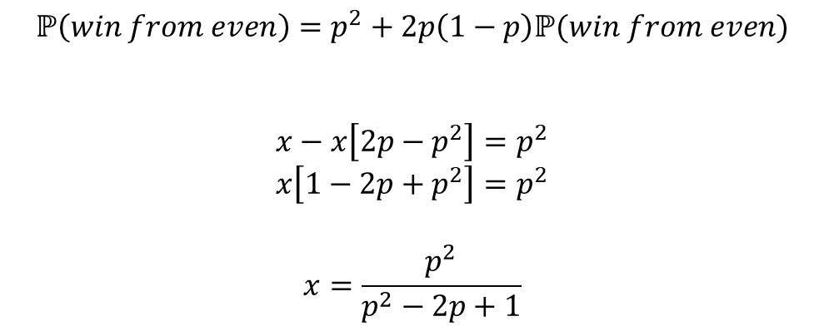
Sequential Process
0
$$ℙ\left(win from even\right)=p^{2}+2p\left(1−p\right)ℙ(win from even)$$
$$x−x\left[2p−p^{2}\right]=p^{2}$$
$$x\left[1−2p+p^{2}\right]=p^{2}$$
$$x=\frac{p^{2}}{p^{2}−2p+1}$$
+
-
W
0
L
+
-
W
0
L
+
-
…

