Slide 1
Central Limit Theorem
CSE 312 Summer 21
Lecture 16

Slide 2
Announcements
Review Summary 2 due this Friday.
Programming question in HW 6.

Slide 3
Table of Standard Normal CDF
The way we’ll evaluate the CDF of a normal is to: 1. convert to a standard normal
2. Round the “z-score” to the hundredths place.
3. Look up the value in the table.
It’s 2021, we’re using a table?
The table makes sure we have consistent rounding rules (makes it easier for us to debug with you).
You can’t evaluate this by hand – the “z-score” can give you intuition right away.

Slide 4
More Practice
Let $X\sim 𝒩(3, 2)$
What is the probability of $1≤X≤4 ?$
$ℙ\left(1≤X≤4\right)$
$=ℙ\left(\frac{1−3}{√2}≤\frac{X−3}{√2}≤\frac{4−3}{√2}\right)$
$=ℙ\left(−1.41≤\frac{X−3}{\sqrt{2}}≤0.71\right)$
$=Φ(0.71)− Φ(−1.41)$
$=Φ\left(0.71\right)−\left(1−Φ\left(1.41\right)\right)=0.76115 −\left(1−0.92073\right)=0.68188$

Slide 5
Why Learn Normals?
When we add together independent normal random variables, you get another normal random variable.
The sum of any independent random variables approaches a normal distribution.
Let $X_{1},X_{2},…,X_{n}$ be i.i.d. random variables, with mean $μ$ and variance $σ^{2}$. Let $Y_{n}=\frac{X_{1}+X_{2}+…+X_{n}−nμ}{σ\sqrt{n}}$
As $n→∞$, the CDF of $Y_{n}$ converges to the CDF of $𝒩(0,1)$
Central Limit Theorem

Slide 6
Breaking down the theorem
Let $X_{1},X_{2},…,X_{n}$ be i.i.d. random variables, with mean $μ$ and variance $σ^{2}$. Let $Y_{n}=\frac{X_{1}+X_{2}+…+X_{n}−nμ}{σ\sqrt{n}}$
As $n→∞$, the CDF of $Y_{n}$ converges to the CDF of $𝒩(0,1)$
Central Limit Theorem

Slide 7
Proof of the CLT?
No.
How is the proof done?
Step 1: Prove that for all positive integers $k and Z\sim 𝒩\left(0,1\right), 𝔼\left[{\left(Y_{n}\right)}^{k}\right]→𝔼[Z^{k}]$
Step 2: Prove that if $𝔼\left[{\left(Y_{n}\right)}^{k}\right]=𝔼\left[Z^{k}\right]$ for all $k$ then $F_{Y_{n}}\left(z\right)=F_{Z}(z)$

Slide 8
“Proof by example”
The dotted lines show an “empirical pmf” – a pmf estimated by running the experiment a large number of times.
The blue line is the normal rv that the CLT predicts.
Shown are $n=1,2,3,10$

Slide 9
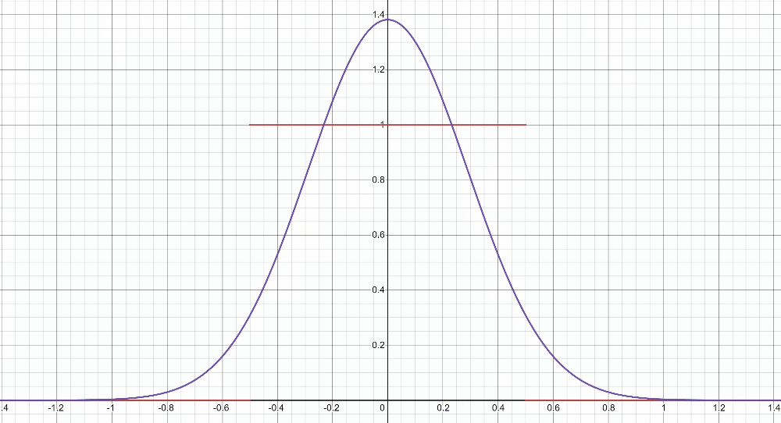
“Proof by example” -- uniform
https://www.desmos.com/calculator/2n2m05a9km

Slide 10
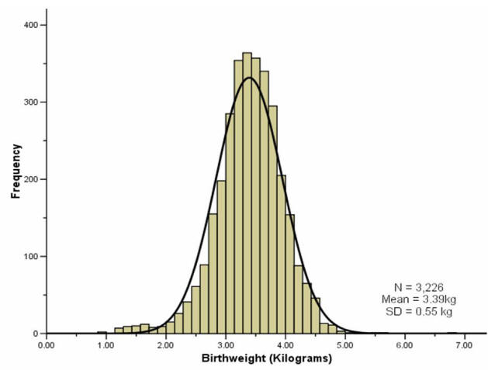
“Proof by real-world”
A lot of real-world bell-curves can be explained as:
1. The random variable comes from a combination of independent factors.
2. The CLT says the distribution will become like a bell curve.
birthweight

Slide 11
Theory vs. Practice
The formal theorem statement is “in the limit”
You might not get exactly a normal distribution for any finite $n$ (e.g. if you sum indicators, your random variable is always discrete and will be discontinuous for every finite $n$.
In practice, the approximations get very accurate very quickly (at least with a few tricks we’ll see soon).
They won’t be exact (unless the $X_{i}$ are normals) but it’s close enough to use even with relatively small $n$.

Slide 12
Using the Central Limit Theorem
Suppose you are managing a factory, that produces widgets. Each widget produced is defective (independently) with probability 5%.
Your factory will produce 1000 (possibly defective) widgets. You want to know what the chances are of having a “very bad day” where “very bad” means producing at most 940 non-defective widgets. (In expectation, you produce 950 non-defective widgets)
What is the probability?

Slide 13
True Answer
Let $X\sim Bin(1000,.95)$
What is $ℙ(X≤940)$?
The cdf is ugly…and that’s a big summation.
$\sum_{k=0}^{940}{\left({1000 \atop k}\right)(0.{95)}^{k}⋅(0.{05)}^{1000−k}≈}0.08673$
What does the CLT give?

Slide 14
CLT setup
Bin(1000,.95) is the sum of a bunch of independent random variables (the indicators/Bernoullis we summed to get the binomial)
So, let’s use the CLT instead
$𝔼\left[X_{i}\right]=p=0.95$.
$Var\left(X_{i}\right)=p\left(1−p\right)=0.0475$
$Y_{1000}=\frac{\sum_{i=1}^{1000}{X_{i}}−1000⋅0.95}{\sqrt{1000⋅0.0475}}$ is approximately $𝒩(0,1)$.

Slide 15
With the CLT.
The event we’re interested in is $ℙ(X≤940)$
$ℙ(X≤940$)
$=ℙ\left(\frac{X−1000⋅0.95}{\sqrt{1000⋅0.0475}}≤\frac{940−1000⋅0.95}{\sqrt{1000⋅0.0475}}\right)$
$=ℙ(Y_{1000}≤\frac{940−1000⋅0.95}{\sqrt{1000⋅0.0475}})$
$≈ℙ\left(Y≤\frac{940−1000⋅0.95}{\sqrt{1000⋅0.0475}}\right)$ by CLT
$=Φ\left(\frac{940−1000⋅0.95}{\sqrt{1000⋅0.0475}}\right)$
$≈Φ\left(−1.45\right)=1−Φ(1.45)$
$≈1−0.92647=0.07353$.

Slide 16
It’s an approximation!
The true probability is
$1−\sum_{k=941}^{1000}{\left({1000 \atop k}\right)(0.{95)}^{k}⋅(0.{05)}^{1000−k}≈}0.08673$
The CLT estimate is off by about 1.3 percentage points.
We can get a better estimate if we fix a subtle issue with this approximation.

Slide 17
A problem
What’s the probability that $X=950$? (exactly)
True value, we can get with binomial:
$\left({1000 \atop 950}\right)⋅(0.{95)}^{950}⋅(0.05)^{50}≈0.05779$
What does the CLT say?
$=ℙ\left(\frac{X−1000⋅0.95}{\sqrt{1000}⋅0.0475}=\frac{950−1000⋅0.95}{\sqrt{1000}⋅0.0475}\right)$
$≈ℙ\left(Y=0\right)$
$=0$
Uh oh.

Slide 18
Continuity Correction
The binomial distribution is discrete, but the normal is continuous.
Let’s correct for that (called a “continuity correction”)
Before we switch from the binomial to the normal, ask “what values of a continuous random variable would round to this event?”

Slide 19
Applying the continuity correction
$ℙ(X=950)$
$=ℙ\left(949.5≤X<950.5\right)$
$=ℙ\left(\frac{949.5−950}{\sqrt{1000⋅0.0475}}≤\frac{X−950}{\sqrt{1000⋅0.0475}}<\frac{950.5−950}{\sqrt{1000⋅0.0475}}\right)$
$≈ℙ\left(\frac{949.5−950}{\sqrt{1000⋅0.0475}}≤Y<\frac{950.5−950}{\sqrt{1000⋅0.0475}}\right)$ By CLT
$=Φ\left(\frac{950.5−950}{\sqrt{1000⋅0.0475}}\right)−Φ\left(\frac{949.5−950}{\sqrt{1000⋅0.0475}}\right)$
$≈Φ\left(0.07\right)−Φ\left(−0.07\right)=Φ\left(0.07\right)−(1−Φ(0.07)$)
$≈0.5279−\left(1−0.5279\right)=0.0558$
Continuity correction. This is an “exactly equal to” The discrete rv $X$ can’t equal $950.2.$

Slide 20
Still an Approximation
$\left({1000 \atop 950}\right)⋅(0.{95)}^{950}⋅(0.05)^{50}≈0.05779$ is the true value
The CLT approximates: $0.0558$
Very close! But still not perfect.

Slide 21
Let’s fix that other one
Question was “what’s the probability of seeing at most 940 non-defective widgets?”

Slide 22
With the CLT.
The event we’re interested in is $ℙ(X≤940)$
$ℙ(X≤940$)
$=ℙ\left(\frac{X−1000⋅0.95}{\sqrt{1000⋅0.0475}}≤\frac{940−1000⋅0.95}{\sqrt{1000⋅0.0475}}\right)$
$≈ℙ\left(Y≤\frac{940−1000⋅0.95}{\sqrt{1000⋅0.0475}}\right)$ By CLT
$=Φ\left(\frac{940−1000⋅0.95}{\sqrt{1000⋅0.0475}}\right)$
$≈Φ\left(−1.45\right)=1−Φ(1.45)$
$≈1−0.92647=0.07353$.
$ℙ(X≤940.5$)
$=ℙ\left(\frac{X−1000⋅0.95}{\sqrt{1000⋅0.0475}}≤\frac{940.5−1000⋅.95}{\sqrt{1000⋅.0475}}\right)$
$≈ℙ\left(Y≤\frac{940.5−1000⋅0.95}{\sqrt{1000⋅0.0475}}\right)$By CLT
$=Φ\left(\frac{940.5−1000⋅0.95}{\sqrt{1000⋅0.0475}}\right)$
$≈Φ\left(−1.38\right)=1−Φ(1.38)$
$≈1−0.91621=0.08379$.
True answer: $0.08673$

Slide 23
Approximating a continuous distribution
You buy lightbulbs that burn out according to an exponential distribution with parameter of $λ=1.8$ lightbulbs per year.
You buy a 10 pack of (independent) light bulbs. What is the probability that your 10-pack lasts at least 5 years?
Let $X_{i}$ be the time it takes for lightbulb $i$ to burn out.
Let $X$ be the total time. Estimate $ℙ(X≥5)$.

Slide 24
Where’s the continuity correction?
There’s no correction to make – it was already continuous!!
$ℙ\left(X≥5\right)$
$=ℙ\left(\frac{X−10/1.8}{\sqrt{10/{1.8}^{2}} }≥\frac{5−10/1.8}{\sqrt{10/{1.8}^{2}}}\right)$
$≈ℙ\left(Y≥\frac{5−10/1.8}{\sqrt{10/{1.8}^{2}}}\right)$ By CLT
$≈ℙ(Y≥−0.32)$
$=1−Φ\left(−0.32\right)=Φ(0.32)$
$≈0.62552$
True value (needs a distribution not in our zoo) is $≈0.58741$

Slide 25
Outline of CLT steps
1. Write event you are interested in, in terms of sum of random variables.
2. Apply continuity correction if RVs are discrete.
3. Normalize RV to have mean $0$ and standard deviation $1$.
4. Replace RV with $𝒩(0,1)$.
5. Write event in terms of $Φ$
6. Look up in table.

