Slide 1
Tail Bounds
CSE 312 Summer 21
Lecture 19

Slide 2
Announcements
Point values for Question 4 in Problem Set 6 has been updated.
The Distinct Elements question has been updated to direct you to the correct page on the textbook. Look for the CDF on page 334.

Slide 3
What’s a Tail Bound?
When we were finding our margin of error, we didn’t need an exact calculation of the probability.
We needed an inequality: the probability of being outside the margin of error was at most 5% (the example discussed mentioned that most of the data lied within the margin of error at least 95% of the time).
A tail bound (or concentration inequality) is a statement that bounds the probability in the “tails” of the distribution (says there’s very little probability far from the center) or (equivalently) says that the probability is concentrated near the expectation.

Slide 4
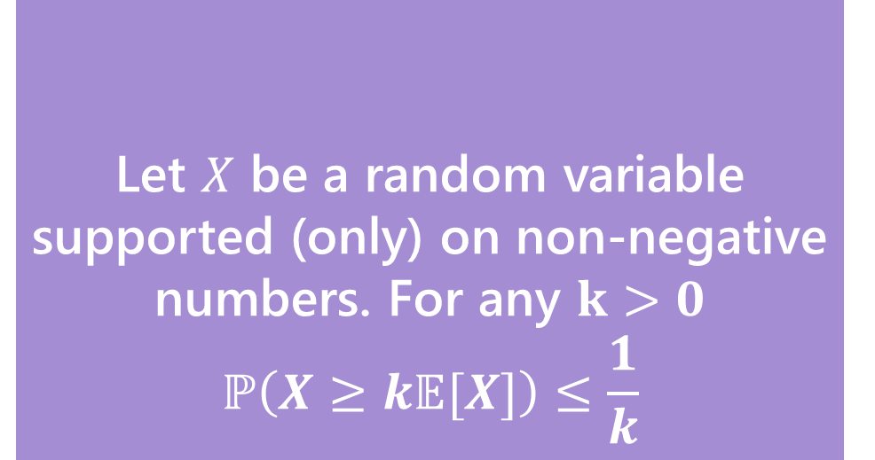
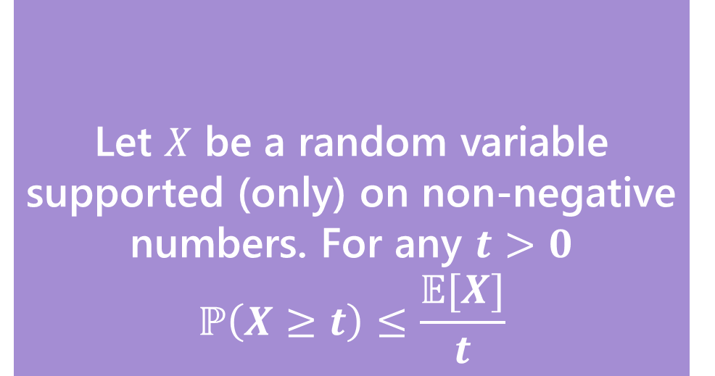
Our First bound
Two statements are equivalent. Left form is often easier to use. Right form is more intuitive.
Let $X$ be a random variable supported (only) on non-negative numbers. For any $t>0$
$$ℙ\left(X≥t\right)≤\frac{𝔼[X]}{t}$$
Let $X$ be a random variable supported (only) on non-negative numbers. For any $k>0$
$$ℙ\left(X≥k𝔼[X]\right)≤\frac{1}{k}$$
Markov’s Inequality
Markov’s Inequality
To apply this bound you only need to know:
1. it’s non-negative
2. Its expectation.

Slide 5
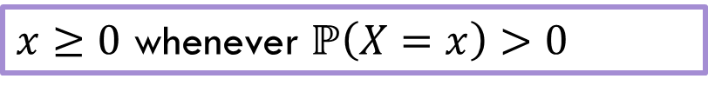
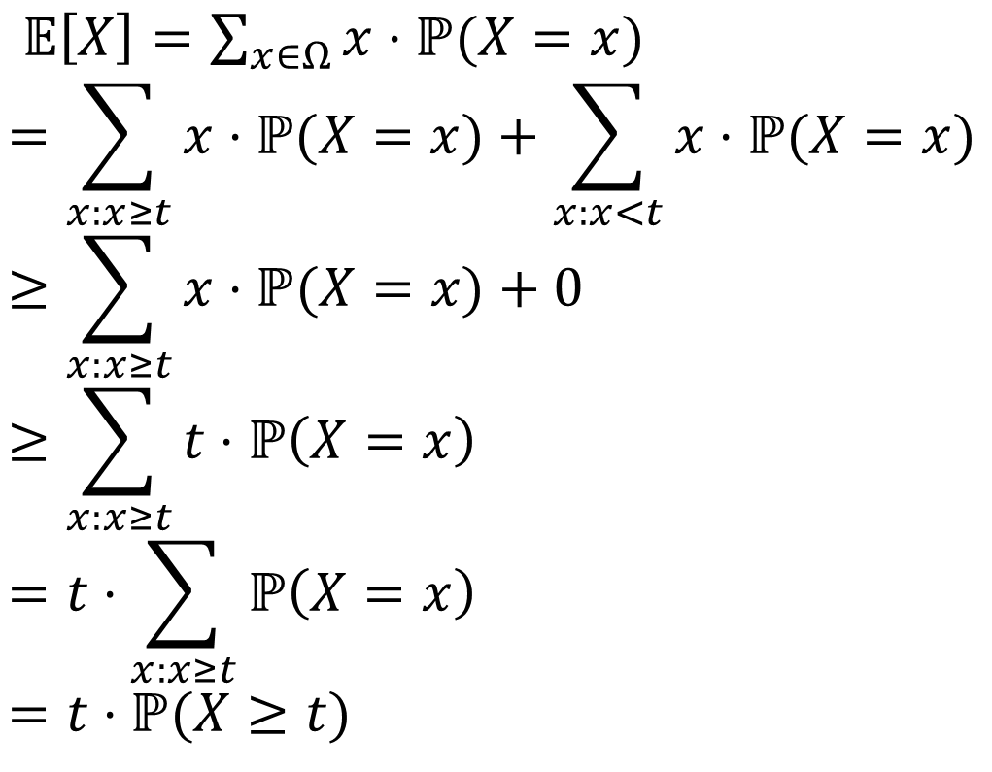
Proof
$𝔼\left[X\right]=\sum_{x∈Ω}{x⋅ℙ(X=x)}$
$$=\sum_{x:x≥t}{x⋅ℙ(X=x)}+\sum_{x:x<t}{x⋅ℙ(X=x)}$$
$$≥\sum_{x:x≥t}{x⋅ℙ(X=x)}+0$$
$$≥\sum_{x:x≥t}{t⋅ℙ\left(X=x\right)}$$
$$=t⋅\sum_{x:x≥t}{ℙ\left(X=x\right)}$$
$$=t⋅ℙ(X≥t)$$
$x≥0$ whenever $ℙ\left(X=x\right)>0$
Let $X$ be a random variable supported (only) on non-negative numbers. For any $t>0$
$$ℙ\left(X≥t\right)≤\frac{𝔼[X]}{t}$$
Markov’s Inequality

Slide 6

Example with geometric RV
Suppose you roll a fair (6-sided) die until you see a 6. Let $X$ be the number of rolls.
Bound the probability that $X≥12$
Let $X$ be a random variable supported (only) on non-negative numbers. For any $t>0$
$$ℙ\left(X≥t\right)≤\frac{𝔼[X]}{t}$$
Markov’s Inequality

Slide 7
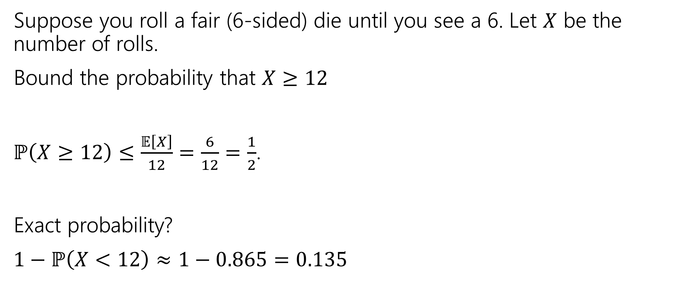
Example with geometric RV
Suppose you roll a fair (6-sided) die until you see a 6. Let $X$ be the number of rolls.
Bound the probability that $X≥12$
$ℙ\left(X≥12\right)≤\frac{𝔼\left[X\right]}{12}=\frac{6}{12}=\frac{1}{2}$.
Exact probability?
$1−ℙ\left(X<12\right)≈1−0.865=0.135$
Let $X$ be a random variable supported (only) on non-negative numbers. For any $t>0$
$$ℙ\left(X≥t\right)≤\frac{𝔼[X]}{t}$$
Markov’s Inequality

Slide 8
A Second Example
Suppose the average number of ads you see on a website is 25. Give an upper bound on the probability of seeing a website with 75 or more ads.
Let $X$ be a random variable supported (only) on non-negative numbers. For any $t>0$
$$ℙ\left(X≥t\right)≤\frac{𝔼[X]}{t}$$
Markov’s Inequality
Fill out the poll everywhere so Kushal knows how long to explain
Go to pollev.com/cse312su21

Slide 9

A Second Example
Suppose the average number of ads you see on a website is 25. Give an upper bound on the probability of seeing a website with 75 or more ads.
$ℙ\left(X≥75\right)≤\frac{𝔼\left[X\right]}{75}=\frac{25}{75}=\frac{1}{3}$
Let $X$ be a random variable supported (only) on non-negative numbers. For any $t>0$
$$ℙ\left(X≥t\right)≤\frac{𝔼[X]}{t}$$
Markov’s Inequality

Slide 10
Useless Example
Suppose the average number of ads you see on a website is 25. Give an upper bound on the probability of seeing a website with 20 or more ads.
Let $X$ be a random variable supported (only) on non-negative numbers. For any $t>0$
$$ℙ\left(X≥t\right)≤\frac{𝔼[X]}{t}$$
Markov’s Inequality
Fill out the poll everywhere so Kushal knows how long to explain
Go to pollev.com/cse312su21

Slide 11
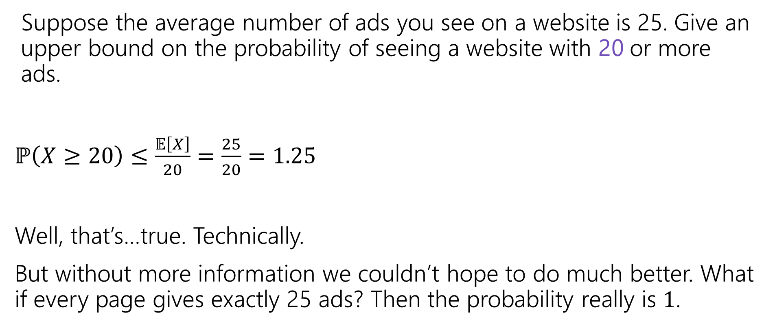
Useless Example
Suppose the average number of ads you see on a website is 25. Give an upper bound on the probability of seeing a website with 20 or more ads.
$ℙ\left(X≥20\right)≤\frac{𝔼\left[X\right]}{20}=\frac{25}{20}=1.25$
Well, that’s…true. Technically.
But without more information we couldn’t hope to do much better. What if every page gives exactly 25 ads? Then the probability really is $1$.

Slide 12
So…what do we do?
A better inequality!
We’re trying to bound the tails of the distribution.
What parameter of a random variable describes the tails?
The variance!

Slide 13
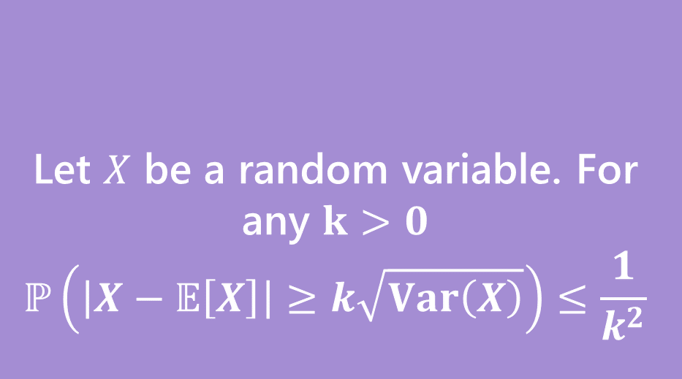
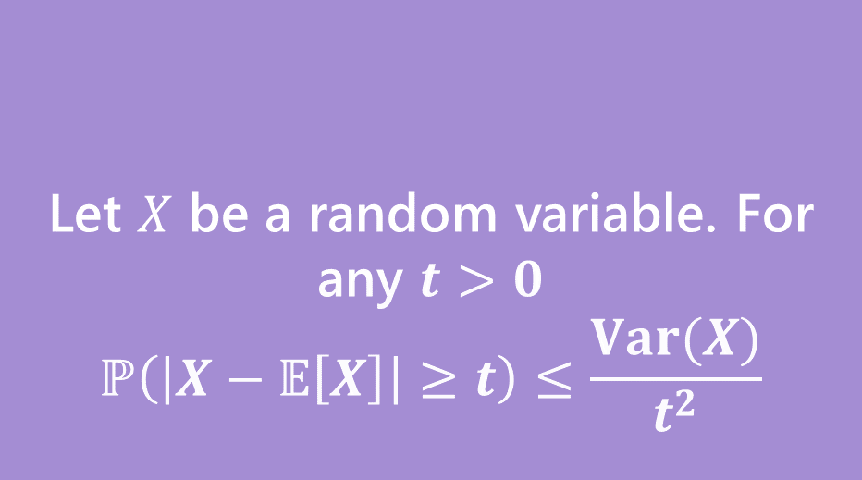
Chebyshev’s Inequality
Two statements are equivalent. Left form is often easier to use. Right form is more intuitive.
Let $X$ be a random variable. For any $t>0$
$$ℙ\left(\left|X−𝔼\left[X\right]\right|≥t\right)≤\frac{Var(X)}{t^{2}}$$
Let $X$ be a random variable. For any $k>0$
$$ℙ\left(\left|X−𝔼\left[X\right]\right|≥k\sqrt{Var\left(X\right)}\right)≤\frac{1}{k^{2}}$$
Chebyshev’s Inequality
Chebyshev’s Inequality

Slide 14

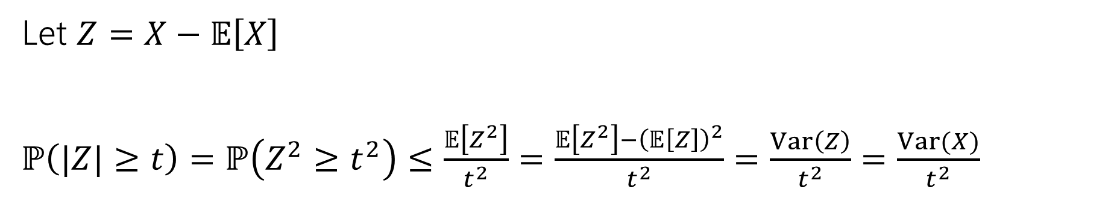

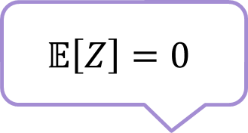
Proof of Chebyshev
Let $X$ be a random variable. For any $t>0$
$$ℙ\left(\left|X−𝔼\left[X\right]\right|≥t\right)≤\frac{Var(X)}{t^{2}}$$
Chebyshev’s Inequality
Let $Z=X−𝔼\left[X\right]$
$ℙ\left(|Z|≥t\right)=ℙ\left(Z^{2}≥t^{2}\right)≤\frac{𝔼\left[Z^{2}\right]}{t^{2}}=\frac{𝔼\left[Z^{2}\right]−{\left(𝔼\left[Z\right]\right)}^{2}}{t^{2}}=\frac{Var\left(Z\right)}{t^{2}}=\frac{Var(X)}{t^{2}}$
Markov’s Inequality
$$𝔼\left[Z\right]=0$$
Inequalities are equivalent (square each side).
$Z$ is just $X$ shifted. Variance is unchanged.

Slide 15

Example with geometric RV (again)
Suppose you roll a fair (6-sided) die until you see a 6. Let $X$ be the number of rolls.
Bound the probability that $X≥12$
Let $X$ be a random variable. For any $t>0$
$$ℙ\left(\left|X−𝔼\left[X\right]\right|≥t\right)≤\frac{Var(X)}{t^{2}}$$
Chebyshev’s Inequality

Slide 16
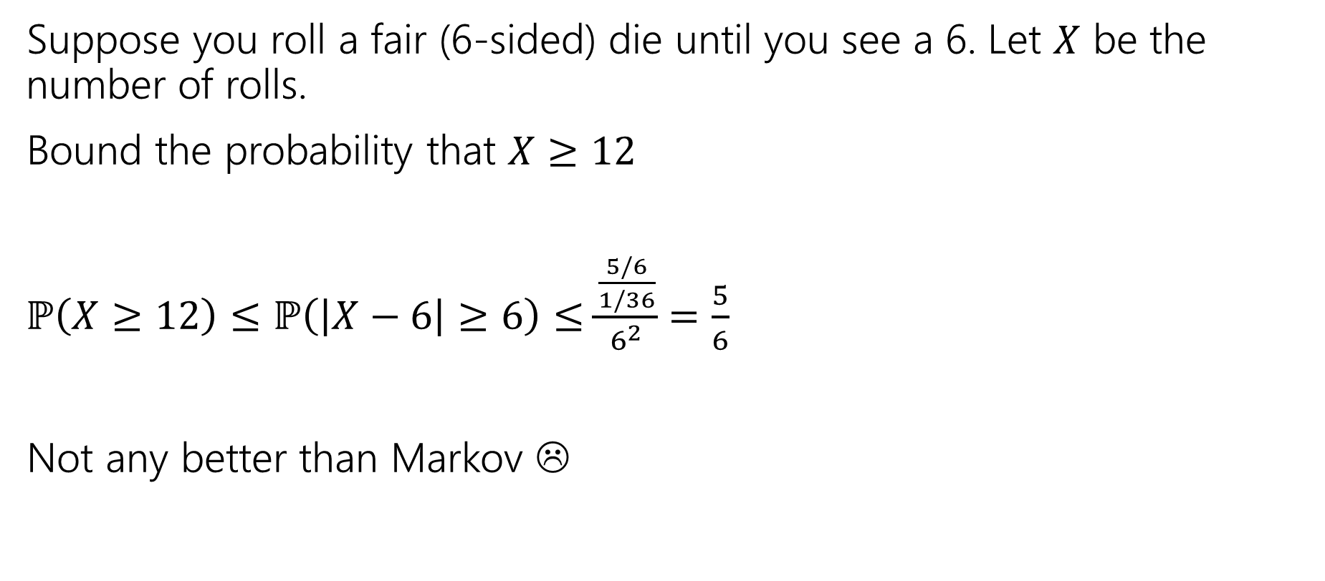
Example with geometric RV (again)
Suppose you roll a fair (6-sided) die until you see a 6. Let $X$ be the number of rolls.
Bound the probability that $X≥12$
$ℙ\left(X≥12\right)≤ℙ\left(\left|X−6\right|≥6\right)≤\frac{\frac{5/6}{1/36}}{6^{2}}$ $=\frac{5}{6}$
Not any better than Markov ☹
Let $X$ be a random variable. For any $t>0$
$$ℙ\left(\left|X−𝔼\left[X\right]\right|≥t\right)≤\frac{Var(X)}{t^{2}}$$
Chebyshev’s Inequality

Slide 17
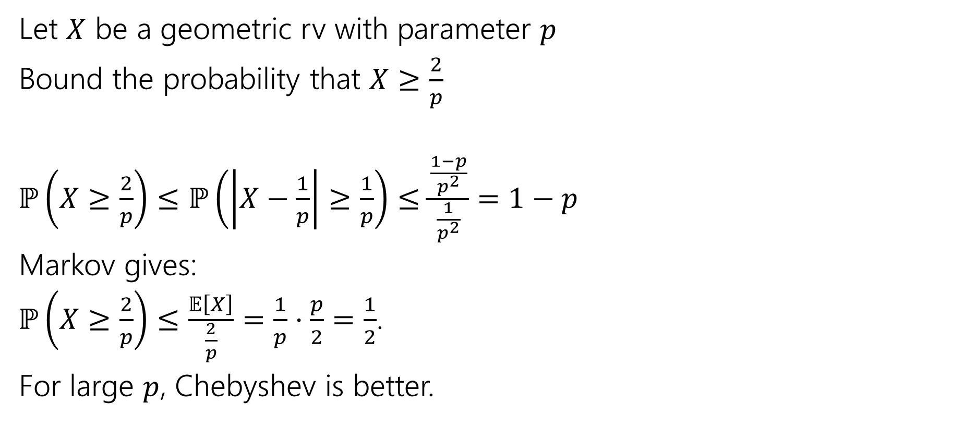
Example with geometric RV (diff bound)
Let $X$ be a geometric rv with parameter $p$
Bound the probability that $X≥\frac{2}{p}$
$ℙ\left(X≥\frac{2}{p}\right)≤ℙ\left(\left|X−\frac{1}{p}\right|≥\frac{1}{p}\right)≤\frac{\frac{1−p}{p^{2}}}{\frac{1}{p^{2}}}$ $=1−p$
Markov gives:
$ℙ\left(X≥\frac{2}{p}\right)≤\frac{𝔼\left[X\right]}{\frac{2}{p}}=\frac{1}{p}⋅\frac{p}{2}=\frac{1}{2}$.
For large $p$, Chebyshev is better.
Let $X$ be a random variable. For any $t>0$
$$ℙ\left(\left|X−𝔼\left[X\right]\right|≥t\right)≤\frac{Var(X)}{t^{2}}$$
Chebyshev’s Inequality

Slide 18
Better Example
Suppose the average number of ads you see on a website is 25. And the variance of the number of ads is 16. Give an upper bound on the probability of seeing a website with 30 or more ads.
Let $X$ be a random variable. For any $t>0$
$$ℙ\left(\left|X−𝔼\left[X\right]\right|≥t\right)≤\frac{Var(X)}{t^{2}}$$
Chebyshev’s Inequality
Fill out the poll everywhere so Kushal knows how long to explain
Go to pollev.com/cse312su21

Slide 19
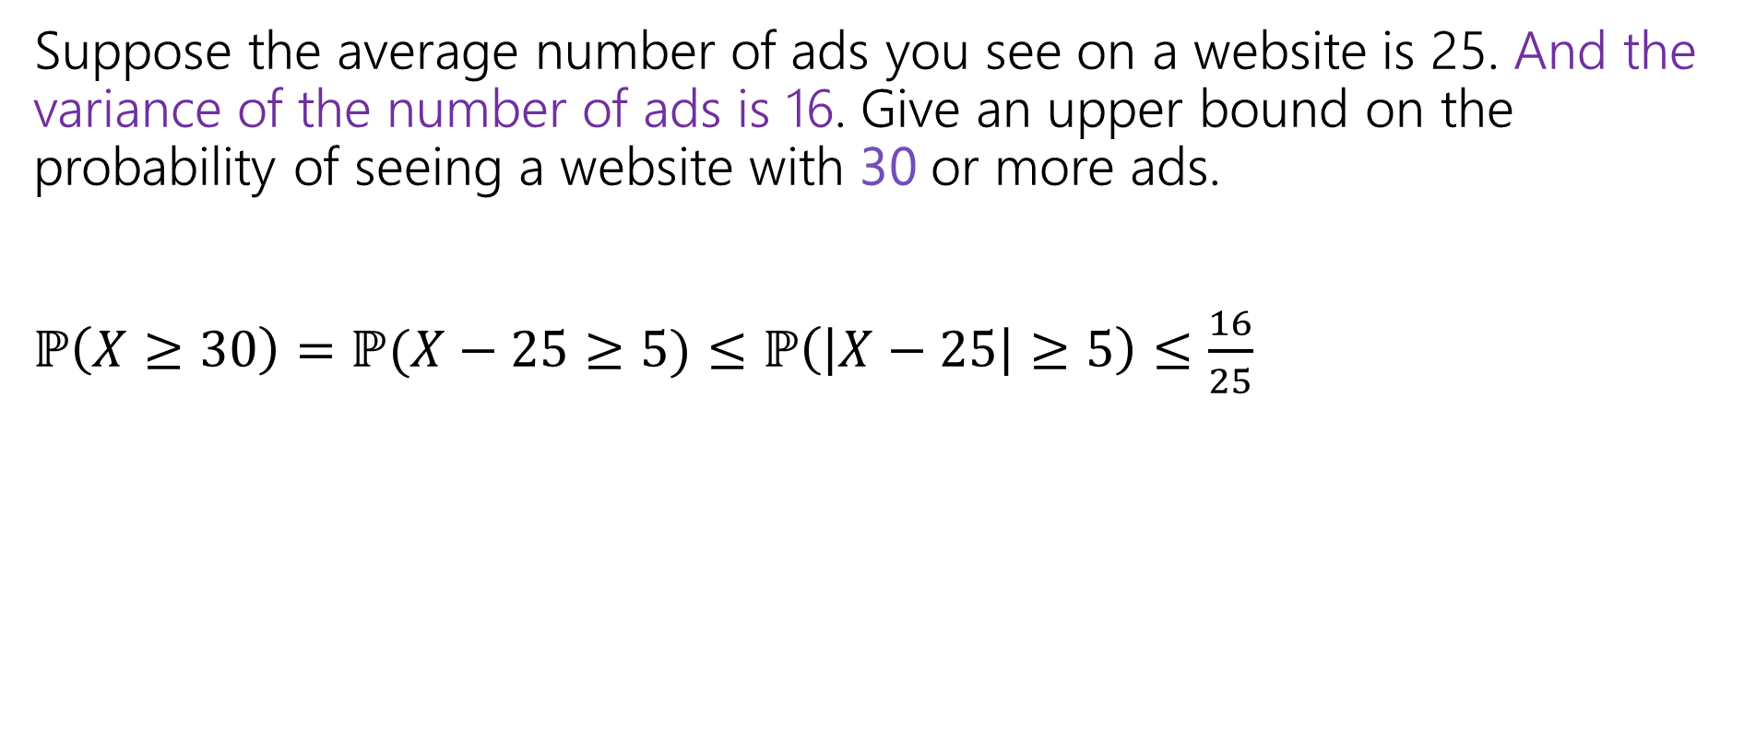
Better Example
Suppose the average number of ads you see on a website is 25. And the variance of the number of ads is 16. Give an upper bound on the probability of seeing a website with 30 or more ads.
$ℙ\left(X≥30\right)=ℙ(X−25≥5)≤ℙ\left(\left|X−25\right|≥5\right)≤\frac{16}{25}$

Slide 20

Near the mean
Suppose you run a poll of $1000$people where in the true population 60% of the population supports you. What is the probability that the poll is not within 10-percentage-points of the true value?
Let $X$ be a random variable. For any $t>0$
$$ℙ\left(\left|X−𝔼\left[X\right]\right|≥t\right)≤\frac{Var(X)}{t^{2}}$$
Chebyshev’s Inequality

Slide 21
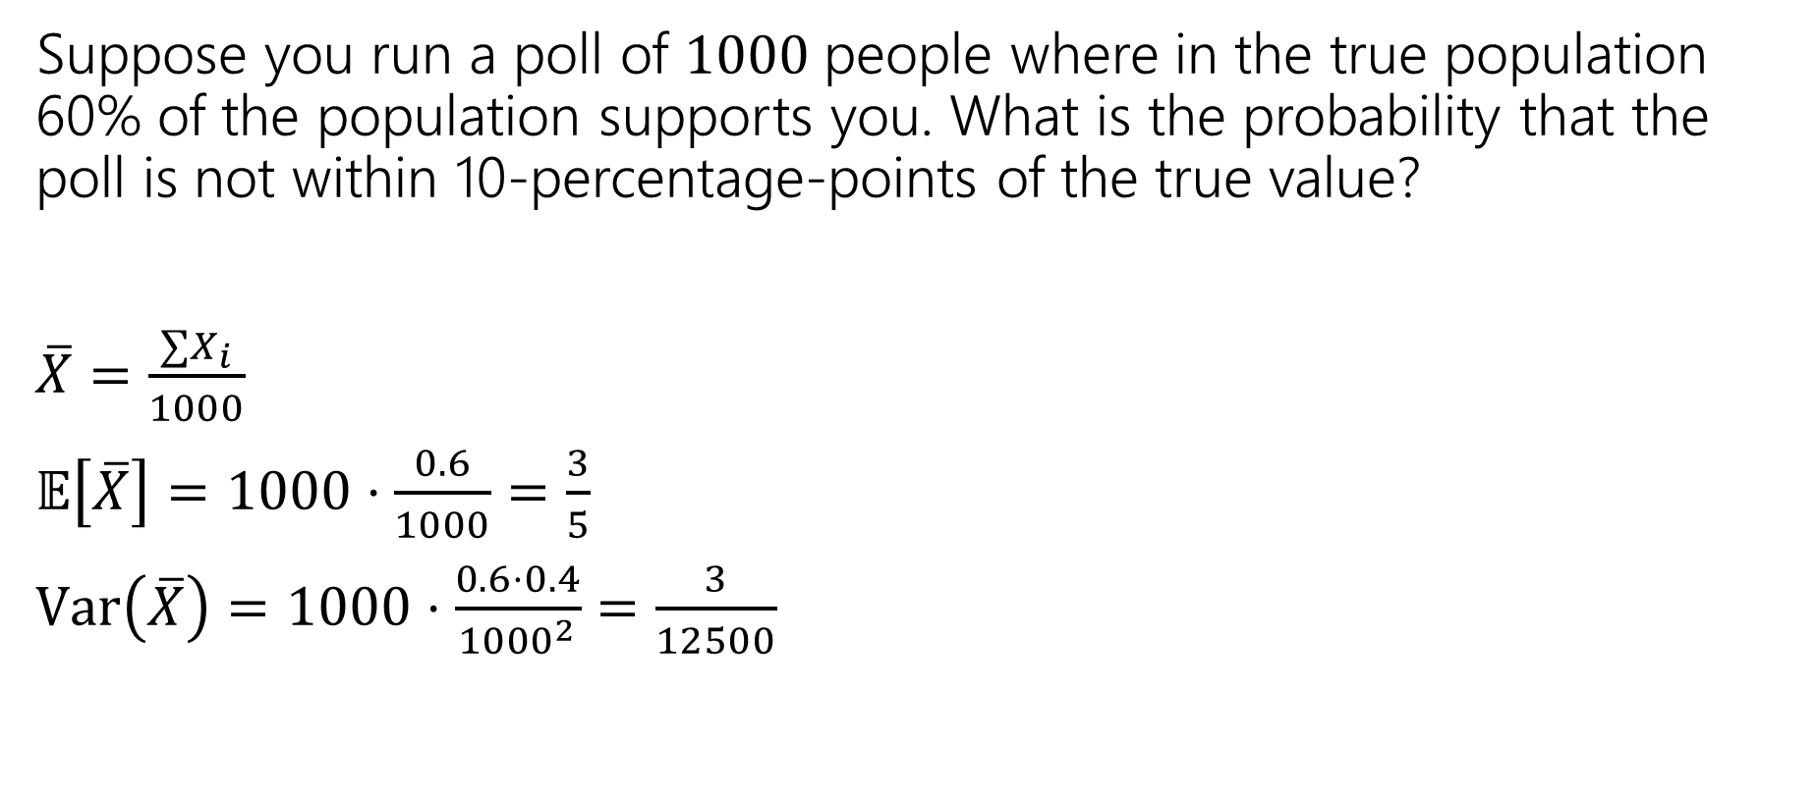
Near the mean
Suppose you run a poll of $1000$people where in the true population 60% of the population supports you. What is the probability that the poll is not within 10-percentage-points of the true value?
$\overline{X}=\frac{∑X_{i}}{1000}$
$𝔼\left[\overline{X}\right]=1000⋅\frac{0.6}{1000}=\frac{3}{5}$
$Var\left(\overline{X}\right)=1000⋅\frac{0.6⋅0.4}{{1000}^{2}}=\frac{3}{12500}$
Let $X$ be a random variable. For any $t>0$
$$ℙ\left(\left|X−𝔼\left[X\right]\right|≥t\right)≤\frac{Var(X)}{t^{2}}$$
Chebyshev’s Inequality

Slide 22
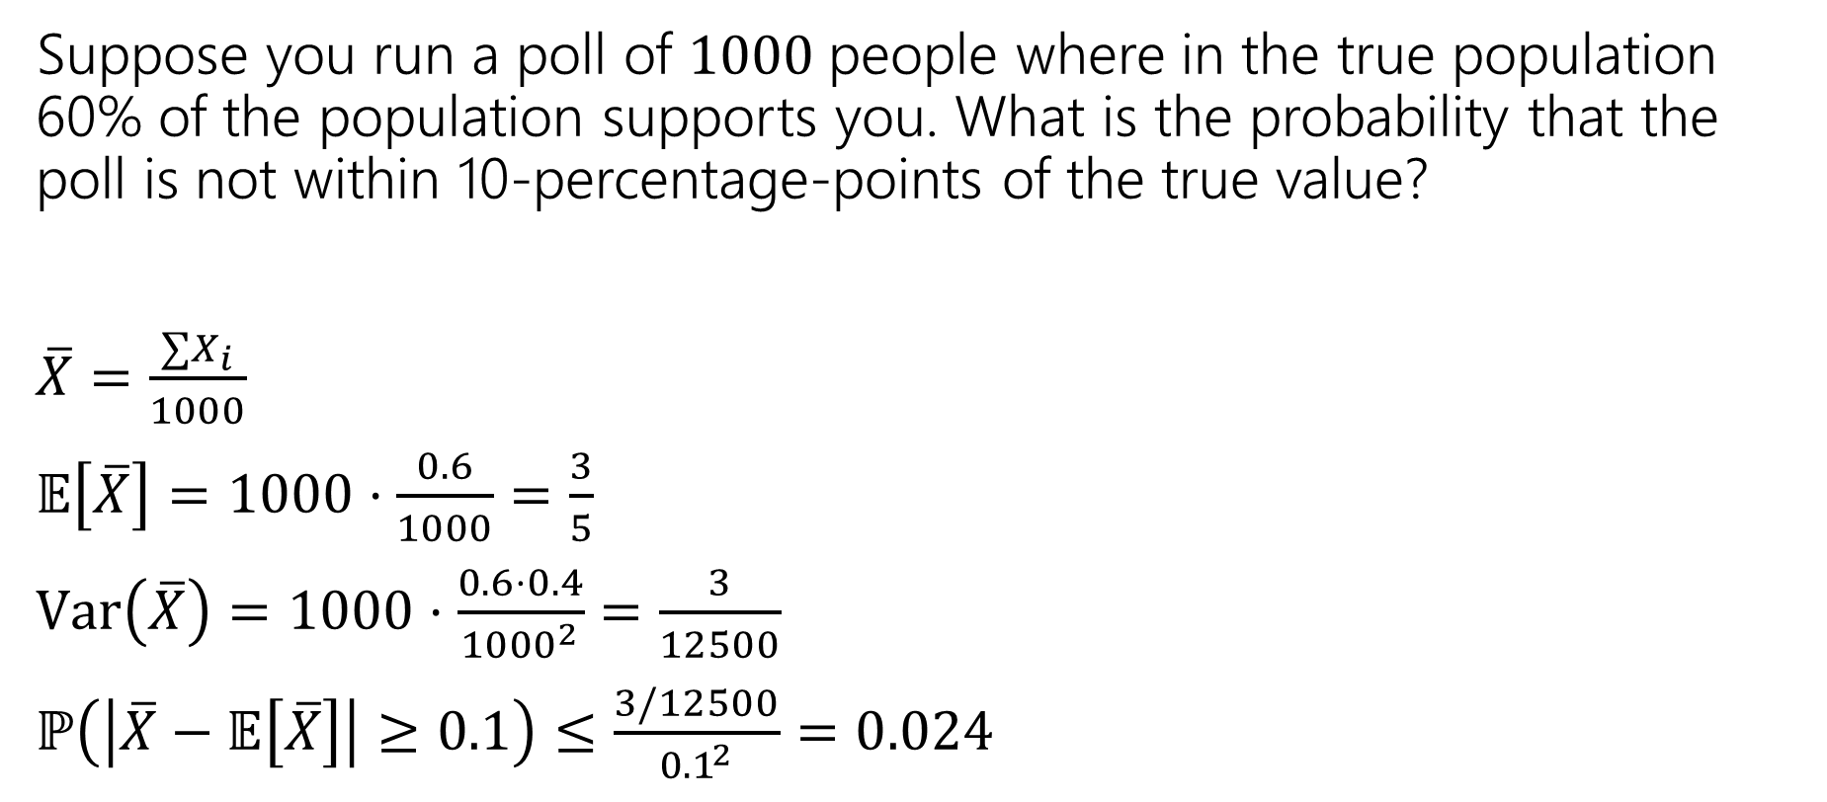
Near the mean
Suppose you run a poll of $1000$people where in the true population 60% of the population supports you. What is the probability that the poll is not within 10-percentage-points of the true value?
$\overline{X}=\frac{∑X_{i}}{1000}$
$𝔼\left[\overline{X}\right]=1000⋅\frac{0.6}{1000}=\frac{3}{5}$
$Var\left(\overline{X}\right)=1000⋅\frac{0.6⋅0.4}{{1000}^{2}}=\frac{3}{12500}$
$ℙ\left(\left|\overline{X}−𝔼\left[\overline{X}\right]\right|≥0.1\right)≤\frac{3/12500}{0{.1}^{2}}$ $=0.024$
Let $X$ be a random variable. For any $t>0$
$$ℙ\left(\left|X−𝔼\left[X\right]\right|≥t\right)≤\frac{Var(X)}{t^{2}}$$
Chebyshev’s Inequality

Slide 23

Chebyshev’s – Repeated Experiments
How many coin flips (each head with probability $p$) are needed until you get $n$ heads?
Let $X$ be the number necessary. What is probability $X≥\frac{2n}{p}$?
Markov
Chebyshev

Slide 24
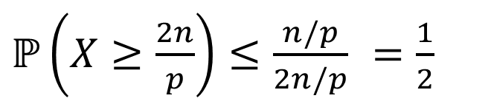
Chebyshev’s – Repeated Experiments
How many coin flips (each head with probability $p$) are needed until you get $n$ heads?
Let $X$ be the number necessary. What is probability $X≥\frac{2n}{p}$?
Markov
Chebyshev
$ℙ\left(X≥\frac{2n}{p}\right)≤\frac{n/p}{2n/p}$ $=\frac{1}{2}$
$ℙ\left(X≥\frac{2n}{p}\right)≤ℙ\left(\left|X−\frac{n}{p}\right|≥\frac{n}{p}\right)≤\frac{Var(X)}{n^{2}/p^{2}}$ $=\frac{n(1−p)/p^{2}}{n^{2}/p^{2}}$ $=\frac{1−p}{n}$

Slide 25
Takeaway
Chebyshev gets more powerful as the variance shrinks.
Repeated experiments are a great way to cause that to happen.

