Slide 1
CSE 332 Autumn 2023
Lecture 9: AVL Trees
Nathan Brunelle
http://www.cs.uw.edu/332

Slide 2
Dictionary (Map) ADT
Contents:
  Sets of key+value pairs
  Keys must be comparable
Operations:
  insert(key, value)
    Adds the (key,value) pair into the dictionary
    If the key already has a value, overwrite the old value
      Consequence: Keys cannot be repeated
  find(key)
    Returns the value associated with the given key
  delete(key)
    Remove the key (and its associated value)

Slide 3
Less Naïve attempts
Binary Search Trees (Friday)
Tries (Project)
AVL Trees (Today)
B-Trees (this week)
HashTables (next week)
Red-Black Trees (not included in this course)
Splay Trees (not included in this course)

Slide 4
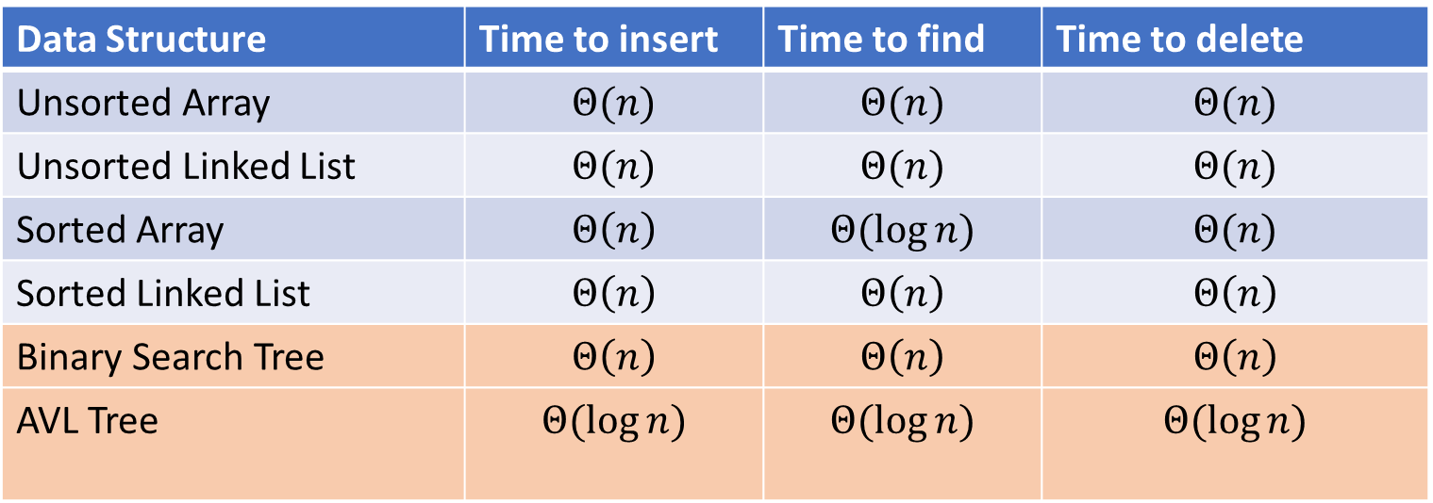
Dictionary Data Structures
Data Structure | Time to insert | Time to find | Time to delete
Unsorted Array | $$Θ(n)$$ | $$Θ(n)$$ | $$Θ(n)$$
Unsorted Linked List | $$Θ(n)$$ | $$Θ(n)$$ | $$Θ(n)$$
Sorted Array | $$Θ\left(n\right)$$ | $$Θ(\log{n})$$ | $$Θ(n)$$
Sorted Linked List | $$Θ\left(n\right)$$ | $$Θ\left(n\right)$$ | $$Θ\left(n\right)$$
Binary Search Tree | $$Θ\left(n\right)$$ | $$Θ\left(n\right)$$ | $$Θ\left(n\right)$$
AVL Tree | $$Θ(\log{n})$$ | $$Θ(\log{n})$$ | $$Θ(\log{n})$$

Slide 5
Binary Search Tree
7
3
10
1
6
8
16
Binary Tree
  Definition:
  Every node has at most 2 children
Order Property
  All keys in the left subtree are smaller than the root
  All keys in the right subtree are larger than the root
  Apply recursively
Why?
  Makes searching quicker
    Worst case: tree’s height
0
2

Slide 6
Find Operation (recursive)
7
3
10
find(key, root){
if (root == Null){
return Null;
{
if (key == root.key){
return root.value;
}
if (key < root.key){
return find(key, root.left);
}
if (key > root.key){
return find(key, root.right);
}
return Null;
}
1
6
16
0

Slide 7
Find Operation (iterative)
7
3
10
find(key, root){
while (root != Null && key != root.key){
if (key < root.key){
root = root.left;
}
else if (key > root.key){
root = root.right;
}
}
if (root == Null){
return Null;
}
return root.value;
}
1
6
16
0

Slide 8
Insert Operation (iterative)
7
3
10
insert(key, value, root){
if (root == Null){ this.root = new Node(key, value); }
parent = Null;
while (root != Null && key != root.key){
parent = root;
if (key < root.key){ root = root.left; }
else if (key > root.key){ root = root.right; }
}
if (root != Null){ root.value = value; }
else if (key < parent.key){ parent.left = new Node(key, value); }
else{ parent.right = new Node (key, value); }
}
1
6
16
0
Note: Insert happens only at the leaves!

Slide 10
Delete Operation (iterative)
9
3
10
delete(key, root){
while (root != Null && key != root.key){
if (key < root.key){ root = root.left; }
else if (key > root.key){ root = root.right; }
}
if (root == Null){ return; }
// Now root is the node to delete, what happens next?
}
1
6
16
0
5
7

Slide 11
Delete – 3 Cases
9
3
10
1
6
16
0 Children (i.e. it’s a leaf)
1 Child
2 Children
0
5
7

Slide 12
Finding the Max and Min
9
3
10
maxNode(root){
if (root == Null){ return Null; }
while (root.right != Null){
root = root.right;
}
return root;
}
6
16
1
Max of a BST:
  Right-most Thing
Min of a BST:
  Left-most Thing
0
5
7
minNode(root){
if (root == Null){ return Null; }
while (root.left != Null){
root = root.left;
}
return root;
}

Slide 13
Delete Operation (iterative)
9
3
10
delete(key, root){
while (root != Null && key != root.key){
if (key < root.key){ root = root.left; }
else if (key > root.key){ root = root.right; }
}
if (root == Null){ return; }
if (root has no children){
make parent point to Null Instead;
}
if (root has one child){
make parent point to that child instead;
}
if (root has two children){
make parent point to either the max from the left or min from the right
}
}
1
6
16
0
5
7

Slide 14
Improving the worst case
How can we get a better worst case running time?

Slide 15
“Balanced” Binary Search Trees
We get better running times by having “shorter” trees
Trees get tall due to them being “sparse” (many one-child nodes)
Idea: modify how we insert/delete to keep the tree more “full”

Slide 16
Idea 1: Both Subtrees of Root have same # Nodes

Slide 17
Idea 2: Both Subtrees of Root have same height

Slide 18
Idea 3: Both Subtrees of every Node have same # Nodes

Slide 19
Idea 4: Both Subtrees of every Node have same height

Slide 20
AVL Tree
A Binary Search tree that maintains that the left and right subtrees of every node have heights that differ by at most one.
  height of left subtree and height of right subtree off by at most 1
  Not too weak (ensures trees are short)
  Not too strong (works for any number of nodes)
Idea of AVL Tree:
  When you insert/delete nodes, if tree is “out of balance” then modify the tree
  Modification = “rotation”

Slide 21
Is it an AVL Tree?
9
9
3
10
3
10
6
16
1
1
6
0
5
0
5
9
9
3
10
3
10
6
16
1
6
16
5
0
5
7

Slide 22
Using AVL Trees
Key = 9
Value = “hello”
Height = 3
Left = Node 3
Right = Node 10
Each node has:
  Key
  Value
  Height
  Left child
  Right child
9
3
10
1
6
16
0
5
7

Slide 23
Inserting into an AVL Tree
Starts out the same way as BST:
  “Find” where the new node should go
  Put it in the right place (it will be a leaf)
Next check the balance
  If the tree is still balanced, you’re done!
  Otherwise we need to do rotations

Slide 24
Insert Example
18
9
3
10
1
6
16
0
2
7

Slide 25
Insert Example
-1
9
3
10
1
6
16
0
2
7

Slide 26
Not Balanced!
Solution: rotate the whole tree to the right
9
Height = 3
Height = 1
3
10
1
6
16
0
2
7
-1

Slide 27
Balanced!
3
1
9
0
6
10
-1
2
7
16

Slide 28
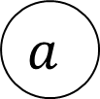
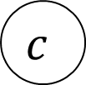






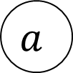







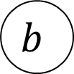

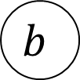



Right Rotation
Make the left child the new root
Make the old root the right child of the new
Make the new root’s right subtree the old root’s left subtree
$$h+3$$
$$h+2$$
$$b$$
$$a$$
$$h+2$$
$$h$$
$$h+1$$
$$b$$
$$z$$
$$x$$
$$h+1$$
$$a$$
Right Rotation
$$h+1$$
$$h$$
$$h$$
$$h$$
$$x$$
$$y$$
$$y$$
$$z$$
$$c$$
$$c$$

Slide 29
Insert Example
20
9
3
11
1
6
10
16
0
2
18

Slide 30
Not Balanced!
Solution: rotate the deepest imbalance to the left
9
Height = 2
3
11
Height = 3
Height = 2
1
6
10
16
0
2
Height = 0
18
20

Slide 31
Balanced!
9
3
16
1
6
11
18
0
2
10
20

Slide 32





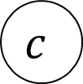


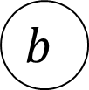













Left Rotation
Make the right child the new root
Make the old root the left child of the new
Make the new root’s left subtree the old root’s right subtree
$$h+3$$
$$a$$
$$h+2$$
$$b$$
$$h+1$$
$$h+1$$
$$h+1$$
$$x$$
$$h+2$$
$$b$$
$$a$$
$$z$$
Left Rotation
$$h$$
$$h+1$$
$$h$$
$$h$$
$$y$$
$$z$$
$$x$$
$$y$$
$$c$$
$$c$$

Slide 33
Insertion Story So Far
After insertion, update the heights of the node’s ancestors
Check for imbalance
If there’s imbalance then at the deepest root of imbalance:
  If the left subtree was deeper then rotate right
  If the right subtree was deeper then rotate left
This is incomplete!
There are some cases where this doesn’t work!
9
9
5
Insert 7
Right Rotation
5
5
9
7
7

Slide 34
Insertion Story So Far
After insertion, update the heights of the node’s ancestors
Check for imbalance
If there’s imbalance then at the deepest root of imbalance:
  Case LL: If we inserted in the left subtree of the left child then rotate right
  Case RR: If we inserted in the right subtree of the right child then rotate left
  Case LR: If we inserted into the right subtree of the left child then ???
  Case RL: If we inserted into the left subtree of the right child then ???
Cases LR and RL require 2 rotations!

Slide 35
Case LR
From “root” of the deepest imbalance:
  Rotate left at the left child
  Rotate right at the root
9
9
9
Insert 7
Rotate Left at 5
5
Rotate Right at 9
7
5
7
7
5
9
5

Slide 36
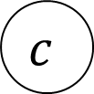
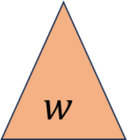





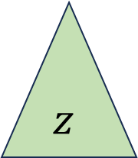
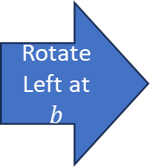

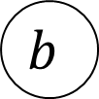






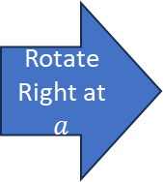
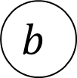



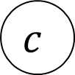

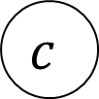




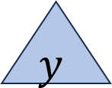

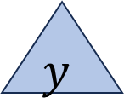

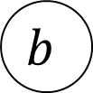










Case LR in General
Imbalance caused by inserting in the left child’s right subtree
Rotate left at the left child
Rotate right at the imbalanced node
$$h+3$$
$$h+3$$
$$a$$
$$h+2$$
$$a$$
$$c$$
Rotate Left at $b$
Rotate Right at $a$
$$h+2$$
$$h+2$$
$$h$$
$$h$$
$$c$$
$$z$$
$$h+1$$
$$b$$
$$z$$
$$b$$
$$h+1$$
$$a$$
$$h+1$$
$$h$$
$$h+1$$
$$c$$
$$b$$
$$y$$
$$h$$
$$h$$
$$w$$
$$w$$
$$x$$
$$y$$
$$z$$
$$h$$
$$x$$
$$y$$
$$w$$
$$x$$
$$d$$
$$d$$
$$d$$
$$d$$
$$d$$
$$d$$

Slide 37


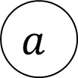

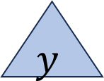
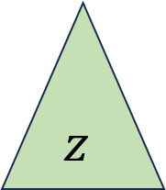














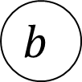


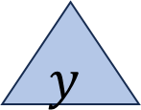









Case RL in General
Imbalance caused by inserting in the right child’s left subtree
Rotate right at the right child
Rotate left at the imbalanced node
$$h+3$$
$$a$$
$$h+2$$
$$c$$
$$h+3$$
$$a$$
Rotate right at $b$
Rotate Left at $a$
$$h+2$$
$$b$$
$$h$$
$$c$$
$$h+1$$
$$b$$
$$h$$
$$w$$
$$h+2$$
$$a$$
$$h+1$$
$$w$$
$$h+1$$
$$c$$
$$h$$
$$h+1$$
$$b$$
$$h$$
$$h$$
$$z$$
$$x$$
$$w$$
$$x$$
$$y$$
$$z$$
$$h$$
$$x$$
$$y$$
$$y$$
$$z$$
$$d$$
$$d$$
$$d$$
$$d$$
$$d$$
$$d$$

Slide 38
Insert Summary
After a BST insertion, update the heights of the node’s ancestors
Check for imbalance
If there’s imbalance then at the deepest root of imbalance:
  Case LL: If we inserted in the left subtree of the left child then: rotate right
  Case RR: If we inserted in the right subtree of the right child then: rotate left
  Case LR: If we inserted into the right subtree of the left child then: rotate left at the left child and then rotate right at the root
  Case RL: If we inserted into the left subtree of the right child then: rotate right at the right child and then rotate left at the root

