Slide 1
CSE341: Programming Languages Lecture 28 Victory Lap
Dan Grossman
Fall 2011

Slide 2
Final Exam
As also indicated in class-list email:
Next Tuesday, 2:30-4:20
Intention is to focus primarily on material since the midterm
Including topics on homeworks and not on homeworks
Will also have a little ML, just like the course has had
You will need to write code and English
I hope you will pick up your exams once they are available
Even if you stop by in January

Slide 3
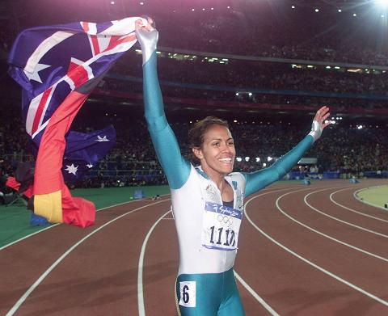
Victory Lap
A victory lap is an extra trip
around the track
By the exhausted victors (us) ☺
Review course goals
Slides from Lectures 1, 7.5
Plus syllabus and the ACM/IEEE CS2013 draft
Some big themes and perspectives
Stuff for five years from now more than for the final
Course evaluations: please do take some time

Slide 4
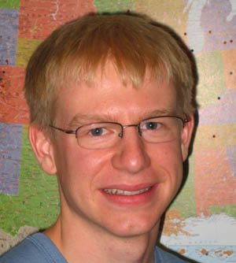
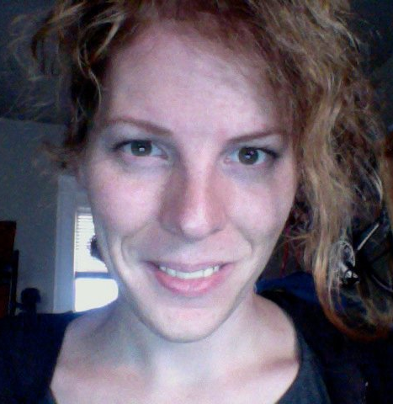
Thank you!
Huge thank-you to your Tas
Two new homeworks
Section taken to the next level
> 500 assignments total
Prompt grading with very few complaints
10 sections Wrote Tetris + job interviews
+ 1 lecture Just took 341 yet moved only 1 hour
+ …

Slide 5
Thank you!
And a huge thank you to all of you
Great attitude about a very different view of software
Good class attendance and questions
Only a few lonely office hours
Occasionally laughed at stuff ☺

Slide 6
[From Lecture 1]
We have 10 weeks to learn the fundamental concepts of programming languages
With hard work, patience, and an open mind, this course makes you a much better programmer
Even in languages we won’t use
Learn the core ideas around which every language is built, despite countless surface-level differences and variations
Poor course summary: “Uses SML, Racket, and Ruby”
Today’s class:
Course mechanics
[A rain-check on motivation]
Dive into ML: Homework 1 due end of next week

Slide 7
[From Lecture 1]
Homework:
Seven total
To be done individually
Doing the homework involves:
Understanding the concepts being addressed
Writing code demonstrating understanding of the concepts
Testing your code to ensure you understand and have correct programs
“Playing around” with variations, incorrect answers, etc.
We grade only (2), but focusing on (2) makes the homework harder
Challenge problems: Low points/difficulty ratio

Slide 8
[From Lecture 1]
Many essential concepts relevant in any programming language
And how these pieces fit together
Use the languages ML, Racket, and Ruby because:
They let many of the concepts “shine”
Using multiple languages shows how the same concept can “look different” or actually be slightly different
In many ways simpler than Java
A big focus on functional programming
Not using mutation (assignment statements) (!)
Using first-class functions (can’t explain that yet)

Slide 9
[From Lecture 1]
Learning to think about software in this “PL” way will make you a better programmer even if/when you go back to old ways
It will also give you the mental tools and experience you need for a lifetime of confidently picking up new languages and ideas
[Somewhat in the style of The Karate Kid movies (1984, 2010)]

Slide 10
[From Lecture 7.5]
A good mechanic might have a specialty, but also understands how “cars” (not 2004 Honda Civics) work
And that the syntax, I mean upholstery color, isn’t essential
A good mechanical engineer really knows how cars work, how to get the most out of them, and how to design better ones
To learn how cars work, it may make sense to start with a classic design rather than the latest model
A popular car may not be a good car for learning how cars work

Slide 11
[From Lecture 7.5]
This course focuses as much as it can on semantics and idioms
Correct reasoning about programs, interfaces, and compilers requires a precise knowledge of semantics
Not “I feel that conditional expressions might work like this”
Not “I like curly braces more than parentheses”
Much of software development is designing precise interfaces; what a PL means is a really good example
Idioms make you a better programmer
Best to see in multiple settings, including where they shine
See Java in a clearer light even if I never show you Java

Slide 12
[From Lecture 7.5]
Why SML, Racket, and Ruby are a useful combination for us
dynamically typed statically typed
functional Racket SML
object-oriented Ruby Java
ML: polymorphic types, pattern-matching, abstract types & modules
Racket: dynamic typing, “good” macros, minimalist syntax, eval
Ruby: classes but not types, very OOP, mixins
[and much more]
Really wish we had more time:
Haskell: laziness, purity, type classes, monads
Prolog: unification and backtracking
[and much more]

Slide 13
[From Lecture 7.5]
No such thing as a “best” PL
There are good general design principles for PLs
A good language is a relevant, crisp interface for writing software
Software leaders should know PL semantics and idioms
Learning PLs is not about syntactic tricks for small programs
Functional languages have been on the leading edge for decades
Ideas get absorbed by the mainstream, but very slowly
Meanwhile, use the ideas to be a better C/Java/PHP hacker

Slide 14
Benefits of No Mutation
[This is from memory; I may have forgotten some]
Can freely alias or copy values/objects: Lecture 3
More functions/modules are equivalent: Lectures 3, 12
No need to make local copies of data: Lecture 14
Depth subtyping is sound: Lecture 25
State updates are appropriate when you are modeling a phenomenon that is inherently state-based
Performing a fold over a collection (e.g., summing a list) isn't!

Slide 15
Some other highlights
Function closures are really powerful and convenient…
… and implementing them is not magic
Datatypes and pattern-matching are really convenient…
… and exactly the opposite of OO decomposition
Sound static typing prevents certain errors…
… and is inherently approximate
Subtyping and generics allow different kinds of code reuse…
… and combine synergistically
Modularity is really important; languages can help

Slide 16
From the syllabus
[Caveat: I wrote the goals, so not surprising I hope we met them.]
Successful course participants will:
Internalize an accurate understanding of what functional and object-oriented programs mean
Develop the skills necessary to learn new programming languages quickly
Master specific language concepts such that they can recognize them in strange guises
Learn to evaluate the power and elegance of programming languages and their constructs
Attain reasonable proficiency in the ML, Racket, and Ruby languages and, as a by-product, become more proficient in languages they already know

Slide 17
From the "so-called experts" ☺
Once a decade or so, ACM/IEEE updates a "standard CS curriculum"
A specification of what every CS undergraduate degree should teach its students
The next version will come out in 2013
The PL/Compilers area will be significantly revised
And, uh, apparently I'm in charge of that ☺
Worked with a committee of 10 "experts" and incorporated feedback from another 7 "reviewers"
First draft will be public February 2012
Let's take a sneak peek and see how we did on the "core learning outcomes" for the PL area…

Slide 18
Not bad
These outcomes are for a curriculum, not necessarily a course
[In separate document; not in slides or posted]
I think this quarter's CSE341 hit 9 out of 13 directly
Brushed up on another 2, as do other courses
Other 2 covered in CSE351

Slide 19
What next?
CSE401 Compilers is a natural choice I highly recommend
Stay in touch
Tell me when 341 helps you out with something cool
Ask me cool PL questions
Don't be a stranger: let me know how the rest of your time in CSE (and beyond!) goes… I really do like to know
Oh, but first…

Slide 20
Course evaluations
I am going to distribute course evaluation forms so you may rate the quality of this course. Your participation is voluntary, and you may omit specific items if you wish. To ensure confidentiality, do not write your name on the forms. There is a possibility your handwriting on the yellow written comment sheet will be recognizable; however, I will not see the results of this evaluation until after the quarter is over and you have received your grades. Please be sure to use a No. 2 PENCIL ONLY on the scannable form.
I have chosen (name) to distribute and collect the forms. When you are finished, he/she will collect the forms, put them into an envelope and mail them to the Office of Educational Assessment. If there are no questions, I will leave the room and not return until all the questionnaires have been finished and collected.
Thank you for your participation.

