Slide 1
CSE 341
Section 2

Slide 2
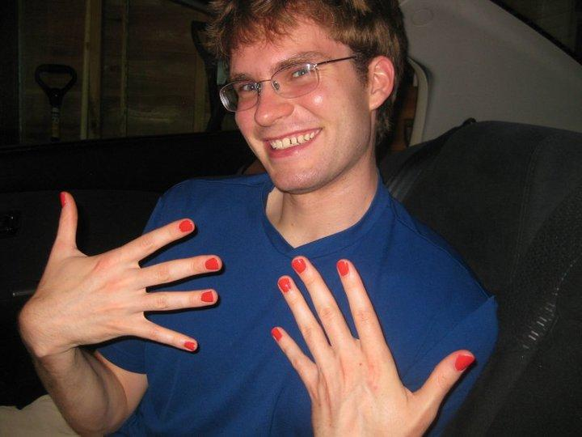
Me
Eric Mullen
(the one with
the nails)
One of the two
section leaders
First year PhD student, doing research in programming languages
I've never been a TA for this PL course before, but...

Slide 3
Type Synonyms
What if I want to call an int * int * int a date?
type date = int * int * int

Slide 4
Generic Types, and Type Generality
What is this 'a thing anyway?
It can stand for any type, but only one type. It is often referred to as a type variable.
You've seen lists, which can hold ints, or strings, but can't hold both at the same time.
Lists have type 'a list

Slide 5
Type Generality, continued
What does it mean for one type to be more general than another?
Type t1 is more general than t2 if you can consistently replace type variables in t1 with types (or type variables) to get t2.

Slide 6
Which is more general?
('a,'b) -> 'a
('a,int) -> 'a
int list -> int
'a list -> int
('a,'b,'b) -> 'a
(int,'b,'c) -> int

Slide 7
Equality types
What if I want to write code that works over any type, but I want to be able to compare whether an 'a is equal to another 'a?

Slide 8
Function Patterns
These are just syntactic sugar, not a fundamentally new concept.
fun isEmpty(l) =
case l of
[] => true
| x::xs => false
fun isEmpty([]) = true
| isEmpty(x::xs) = false

Slide 9
Is if/then/else really necessary?
Suppose I tell you there's a bug in the SML compiler, and you can't use if/then/else any more. Also, I want all of your code checked in and working yesterday. What do you do?

