Slide 1
CSE 341 : Programming Languages Interlude Course Motivation, Midterm Debrief
Zach Tatlock
Spring 2014

Slide 2
Midterm
Friday was
Spent the weekend reflecting.
Learning experience for all of us.
Debrief:
- what we learned
- what we’re going to do moving forward
. . .
interesting?

Slide 3
Midterm: What’s the point?
NO
Sadism?
Flexing some intellectual muscle?
Break spirits so we can reshape them?
Build reputation as a super hardcore prof?

Slide 4
Midterm: What’s the point?
Preparation, study, review.
Feedback for me and feedback for you.
Just one part of demonstrating your ability.
Practice performing under pressure.

Slide 5
Midterm: How did we do?
Preparation, study, review.
Feedback for me and feedback for you.
Just one part of demonstrating your ability.
Practice performing under pressure.

Slide 6
Midterm: Feedback / Analyzing Results
Feedback for me:
- despite best efforts, test a bit long / difficult
- in the end, distribution very informative
- y’all did *extremely* well considering challenge
Feedback for you:
- great job preparing, keep it up!
- pretty good job being strategic, nice work ☺
- opportunity to consider motivations / priorities

Slide 7
Midterm: How did we do?
Preparation, study, review.
Feedback for me and feedback for you.
Just one part of demonstrating your ability.
Practice performing under pressure.

Slide 8
Midterm: Just One Part of Grade

Slide 9
Midterm: Just One Part of Grade
That said, I was once an undergrad myself.
Despair = worst possible midterm outcome.
So:
midterm = max (midterm₀, final)
or (curried):
midterm = max midterm₀ final

Slide 10
Midterm: How did we do?
Preparation, study, review.
Feedback for me and feedback for you.
Just one part of demonstrating your ability.
Practice performing under pressure.
We’re actually in pretty good shape.

Slide 12
I really like studying programming languages.
Super stoked to explore PL with all of you.
Why?

Slide 13
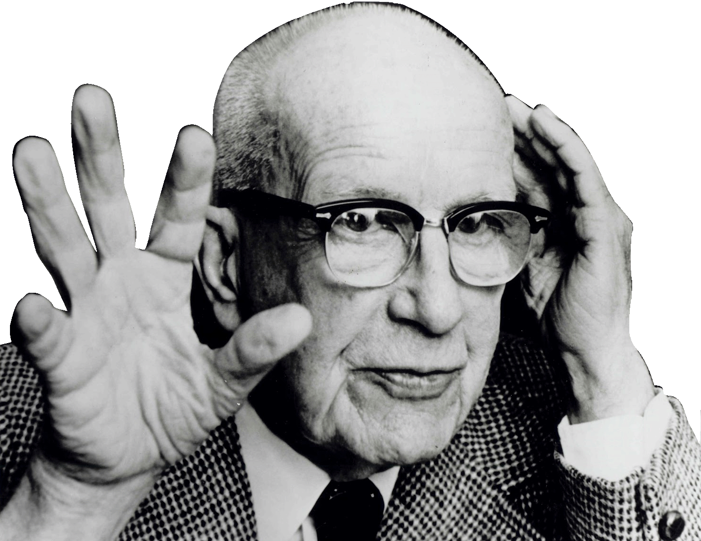
If you are in a shipwreck and all the boats are gone, a piano top buoyant enough to keep you afloat may come along and make a fortuitous life preserver.
This is not to say, though, that the best way to design a life preserver is in the form of a piano top.
I think we are clinging to a great many piano tops in accepting yesterday's fortuitous contrivings as constituting the only means for solving a given problem.
R. Buckminster Fuller

Slide 15
I really like studying programming languages.
Super stoked to explore PL with all of you.
Why?
PL helps us break free to think thoughts, ask questions, and solve problems that would otherwise be inaccessible.

Slide 16
More Detailed Course Motivation
Why learn fundamental concepts that appear in all languages?
Why use languages quite different from C, C++, Java, Python?
Why focus on functional programming?
Why use ML, Racket, and Ruby in particular?
Not: Language X is better than Language Y
[You won’t be tested on this stuff]

Slide 17
Summary
No such thing as a “best” PL
Fundamental concepts easier to teach in some (multiple) PLs
A good PL is a relevant, elegant interface for writing software
There is no substitute for precise understanding of PL semantics
Functional languages have been on the leading edge for decades
Ideas have been absorbed by the mainstream, but very slowly
First-class functions and avoiding mutation increasingly essential
Meanwhile, use the ideas to be a better C/Java/PHP hacker
Many great alternatives to ML, Racket, and Ruby, but each was chosen for a reason and for how they complement each other

Slide 18
What is the best kind of car?
What is the best kind of shoe?

Slide 19
Cars / Shoes
Cars are used for rather different things:
Winning a Formula 1 race
Taking kids to soccer practice
Off-roading
Hauling a mattress
Getting the wind in your hair (some of us…)
Staying dry in the rain
Shoes:
Playing frisbee
Going to a formal
Going to the beach

Slide 20
More on cars
A good mechanic might have a specialty, but also understands how “cars” (not a particular make/model) work
The upholstery color isn’t essential (syntax)
A good mechanical engineer really knows how cars work, how to get the most out of them, and how to design better ones
I don’t have a favorite kind of car or a favorite PL
To learn how car pieces interact, it may make sense to start with a classic design rather than the latest model
A popular car may not be best
May especially not be best for learning how cars work

Slide 21
Why semantics and idioms
This course focuses as much as it can on semantics and idioms
Correct reasoning about programs, interfaces, and compilers requires a precise knowledge of semantics
Not “I feel that conditional expressions might work like this”
Not “I like curly braces more than parentheses”
Much of software development is designing precise interfaces; what a PL means is a really good example
Idioms make you a better programmer
Best to see in multiple settings, including where they shine
See Java in a clearer light even if I never show you Java

Slide 22
Hamlet
The play Hamlet:
Is a beautiful work of art
Teaches deep, eternal truths
Is the source of some well-known sayings
Makes you a better person
Continues to be studied centuries later even though:
The syntax is really annoying to many
There are more popular movies with some of the same lessons
Reading Hamlet will not get you a summer internship

Slide 23
All cars are the same
To make it easier to rent cars, it is great that they all have steering wheels, brakes, windows, headlights, etc.
Yet it is still uncomfortable to learn a new one
Can you be a great driver if you only ever drive one car?
And maybe PLs are more like cars, trucks, boats, and bikes
So are all PLs really the same…

Slide 24
Are all languages the same?
Yes:
Any input-output behavior implementable in language X is implementable in language Y [Church-Turing thesis]
Java, ML, and a language with one loop and three infinitely-large integers are “the same”
Yes:
Same fundamentals reappear: variables, abstraction, one-of types, recursive definitions, …
No:
The human condition vs. different cultures (travel to learn more about home)
The primitive/default in one language is awkward in another
Beware “the Turing tarpit”

Slide 25
Functional Programming
Why spend 60-80% of course using functional languages:
Mutation is discouraged
Higher-order functions are very convenient
One-of types via constructs like datatypes
Because:
These features are invaluable for correct, elegant, efficient software (great way to think about computation)
Functional languages have always been ahead of their time
Functional languages well-suited to where computing is going
Most of course is on (1), so a few minutes on (2) and (3) …

Slide 26
Ahead of their time
All these were dismissed as “beautiful, worthless, slow things PL professors make you learn”
Garbage collection (Java didn’t exist in 1995, PL courses did)
Generics (List<T> in Java, C#), much more like SML than C++
XML for universal data representation (like Racket/Scheme/LISP/…)
Higher-order functions (Ruby, Javascript, C#, …)
Type inference (C#, Scala, …)
Recursion (a big fight in 1960 about this – I’m told ☺)
…

Slide 27
The future may resemble the past
Somehow nobody notices we are right… 20 years later
“To conquer” versus “to assimilate”
Societal progress takes time and muddles “taking credit”
Maybe pattern-matching, currying, hygienic macros, etc. will be next

Slide 28
Recent-ish Surge, Part 1
Other popular functional PLs (alphabetized, pardon omissions)
Clojure http://clojure.org
Erlang http://www.erlang.org
F# http://tryfsharp.org
Haskell http://www.haskell.org
OCaml http://ocaml.org
Scala http://www.scala-lang.org
Some “industry users” lists (surely more exist):
http://www.haskell.org/haskellwiki/Haskell_in_industry
http://ocaml.org/companies.html
In general, see http://cufp.org

Slide 29
Recent-ish Surge, Part 2
Popular adoption of concepts:
C#, LINQ (closures, type inference, …)
Java 8 (closures)
MapReduce / Hadoop
Avoiding side-effects essential for fault-tolerance here
…

Slide 30
Why a surge?
Dan’s best guesses:
Concise, elegant, productive programming
JavaScript, Python, Ruby helped break the Java/C/C++ hegemony
Avoiding mutation is the easiest way to make concurrent and parallel programming easier
In general, to handle sharing in complex systems
Sure, functional programming is still a small niche, but there is so much software in the world today even niches have room

Slide 31
The languages together
SML, Racket, and Ruby are a useful combination for us
dynamically typed statically typed
functional Racket SML
object-oriented Ruby Java
ML: polymorphic types, pattern-matching, abstract types & modules
Racket: dynamic typing, “good” macros, minimalist syntax, eval
Ruby: classes but not types, very OOP, mixins
[and much more]
If we had more time:
Haskell: laziness, purity, type classes, monads
Prolog: unification and backtracking
[and much more]

Slide 32
But why not…
Instead of SML, could use similar languages easy to learn after:
OCaml: yes indeed but would have to port all my materials 😐
And a few small things (e.g., second-class constructors)
F#: yes and very cool, but needs a .Net platform
And a few more small things (e.g., second-class constructors, less elegant signature-matching)
Haskell: more popular, cooler types, but lazy semantics and type classes from day 1
Admittedly, SML and its implementations are showing their age (e.g., andalso and less tool support), but it still makes for a fine foundation in statically typed, eager functional programming

Slide 33
But why not…
Instead of Racket, could use similar languages easy to learn after:
Scheme, Lisp, Clojure, …
Racket has a combination of:
A modern feel and active evolution
“Better” macros, modules, structs, contracts, …
A large user base and community (not just for education)
An IDE tailored to education
Could easily define our own language in the Racket system
Would rather use a good and vetted design

Slide 34
But why not…
Instead of Ruby, could use another language:
Python, Perl, JavaScript are also dynamically typed, but are not as “fully” OOP, which is what I want to focus on
Python also does not have (full) closures
JavaScript also does not have classes but is OOP
Smalltalk serves our OOP needs
But implementations merge language/environment
Less modern syntax, user base, etc.

Slide 35
Is this real programming?
The way we use ML/Racket/Ruby can make them seem almost “silly” precisely because lecture and homework focus on interesting language constructs
“Real” programming needs file I/O, string operations, floating-point, graphics, project managers, testing frameworks, threads, build systems, …
Many elegant languages have all that and more
Including Racket and Ruby
If we used Java the same way, Java would seem “silly” too

Slide 36
A note on reality
Reasonable questions when deciding to use/learn a language:
What libraries are available for reuse?
What tools are available?
What can get me a job?
What does my boss tell me to do?
What is the de facto industry standard?
What do I already know?
Our course by design does not deal with these questions
You have the rest of your life for that
And technology leaders affect the answers

