Slide 1
CSE341: Programming Languages Lecture 26 Course Victory Lap
Dan Grossman
Spring 2016

Slide 2
Final Exam
As also indicated in class-list email:
Next Monday, 8:30-10:20
Intention is to focus primarily on material since the midterm
Including topics on homeworks and not on homeworks
May also have a little ML, just like the course has had
You will need to write code and English

Slide 3
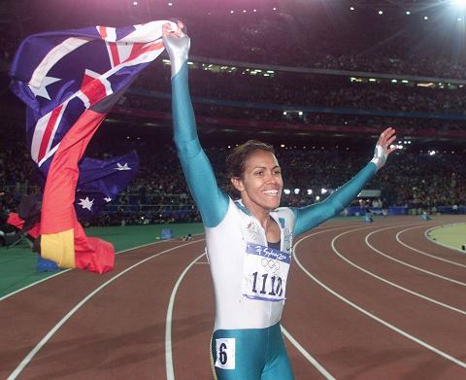
Victory Lap
A victory lap is an extra trip
around the track
By the exhausted victors (us) ☺
Review course goals
Slides from Introduction and Course-Motivation
Some big themes and perspectives
Stuff for five years from now more than for the final
Do your course evaluations!!!

Slide 4
Thank you!
Huge thank-you to your TAs
Great team effort
Deep understanding of material despite all having different 341 instructors
Great sections, timely grading, etc., etc.

Slide 5
Thank you!
And a huge thank you to all of you
Great attitude about a very different view of software
Good class attendance and questions
Occasionally laughed at stuff ☺
Computer science ought to be challenging and fun!

Slide 6
[From Lecture 1]
Many essential concepts relevant in any programming language
And how these pieces fit together
Use ML, Racket, and Ruby languages:
They let many of the concepts “shine”
Using multiple languages shows how the same concept can “look different” or actually be slightly different
In many ways simpler than Java
Big focus on functional programming
Not using mutation (assignment statements) (!)
Using first-class functions (can’t explain that yet)
But many other topics too

Slide 7
[From Lecture 1]
Learning to think about software in this “PL” way will make you a better programmer even if/when you go back to old ways
It will also give you the mental tools and experience you need for a lifetime of confidently picking up new languages and ideas
[Somewhat in the style of The Karate Kid movies (1984, 2010)]

Slide 8
[From Course Motivation]
No such thing as a “best” PL
Fundamental concepts easier to teach in some (multiple) PLs
A good PL is a relevant, elegant interface for writing software
There is no substitute for precise understanding of PL semantics
Functional languages have been on the leading edge for decades
Ideas have been absorbed by the mainstream, but very slowly
First-class functions and avoiding mutation increasingly essential
Meanwhile, use the ideas to be a better C/Java/PHP hacker
Many great alternatives to ML, Racket, and Ruby, but each was chosen for a reason and for how they complement each other

Slide 9
[From Course Motivation]
SML, Racket, and Ruby are a useful combination for us
dynamically typed statically typed
functional Racket SML
object-oriented Ruby Java
ML: polymorphic types, pattern-matching, abstract types & modules
Racket: dynamic typing, “good” macros, minimalist syntax, eval
Ruby: classes but not types, very OOP, mixins
[and much more]
Really wish we had more time:
Haskell: laziness, purity, type classes, monads
Prolog: unification and backtracking
[and much more]

Slide 10
Benefits of No Mutation
[An incomplete list]
Can freely alias or copy values/objects: Unit 1
More functions/modules are equivalent: Unit 4
No need to make local copies of data: Unit 5
Depth subtyping is sound: Unit 8
State updates are appropriate when you are modeling a phenomenon that is inherently state-based
A fold over a collection (e.g., summing a list) is not!

Slide 11
Some other highlights
Function closures are really powerful and convenient…
… and implementing them is not magic
Datatypes and pattern-matching are really convenient…
… and exactly the opposite of OOP decomposition
Sound static typing prevents certain errors…
… and is inherently approximate
Subtyping and generics allow different kinds of code reuse…
… and combine synergistically
Modularity is really important; languages can help

Slide 12
From the syllabus
Successful course participants will:
Internalize an accurate understanding of what functional and object-oriented programs mean
Develop the skills necessary to learn new programming languages quickly
Master specific language concepts such that they can recognize them in strange guises
Learn to evaluate the power and elegance of programming languages and their constructs
Attain reasonable proficiency in the ML, Racket, and Ruby languages and, as a by-product, become more proficient in languages they already know

Slide 13
The End
This really is my favorite course and it probably always will be
☺
Don’t be a stranger!
Time for ask-me-anything questions?

