Slide 1
CSE 341 Section 1
Nick Mooney
Spring 2017
Adapted from slides by Nicholas Shahan, Josiah Adams, Cody A. Schroeder, and Dan Grossman

Slide 2
Hi, I’m Nick!
3rd year undergrad, but this is my second to last quarter hopefully (woooo!)
I like computer security and summer camp
Office hours = my favorite time of the week, please stop by!
Tuesdays, 12pm-1pm, CSE 021
Took this course with Dan previously
I’m really excited to have the opportunity to TA it!

Slide 3
Today’s Agenda
ML Development Workflow
Emacs
Using use
The REPL
More ML
Shadowing Variables
Debugging Tips
Boolean Operations
Comparison Operations

Slide 4
Emacs
Recommended (not required) editor for this course
Powerful, but the learning curve can at first be intimidating
Helpful resources
CSE 341 Emacs Guide
Google it!
/r/emacs Foot Pedals???
Mike Ernst literally has foot pedals
It’s like a spaceship
Course staff, or ask around in the labs
(I learned from the official Emacs tutorial – “C-h t”)

Slide 5
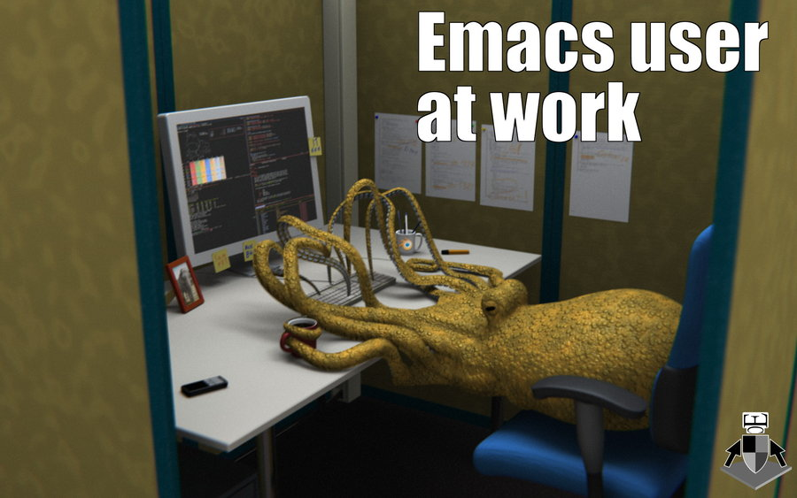
Quick Emacs Demo
Image credit: http://earlcolour.deviantart.com/art/emacs-user-at-work-195326745
Notes:
Demo Topics
Note: Installation instructions & guide found on course website
Control and Meta keys
Buffers C-x o, C-b
SML C-c C-s
Open / Save / Close C-x C-f / C-x C-s / C-x k
Highlight C-SPACE
Cut / Copy / Paste C-w / M-w / C-y
Undo C-x u

Slide 6
Using use
use "foo.sml";
Enters bindings from the file foo.sml
Like typing the variable bindings one at a time in sequential order into the REPL (more on this in a moment)
Result is () bound to variable it
Ignorable

Slide 7
The REPL
Read-Eval-Print-Loop is well named
Conveniently run programs: C-c C-s
Useful to quickly try something out
Save code for reuse by moving it into a persistent .sml file
Expects semicolons
For reasons discussed later, it’s dangerous to reuse use without restarting the REPL session
End the REPL session with C-d
Notes:
(short REPL demo)

Slide 8
Shadowing of Variable Bindings
val a = 1; (* a -> 1 *)
val b = a * 10; (* a -> 1, b -> 10 *)
val a = 2; (* a -> 2, b -> 10 *)
Expressions in variable bindings are evaluated “eagerly”
Before the variable binding “finishes”
Afterwards, the expression producing the value is irrelevant
Multiple variable bindings to the same variable name, or “shadowing”, is allowed
When looking up a variable, ML uses the most recent binding by that name in the current environment
Remember, there is no way to “assign to” a variable in ML
Can only shadow it in a later environment
After binding, a variable’s value is an immutable constant
Notes:
NOTE: relationship between variable bindings and the environment
(Emphasize this now to lay the foundation for first-class functions)
Shadowing doesn’t destroy the existing binding, just makes it inaccessible

Slide 9
Try to Avoid Shadowing
val x = "Hello World";
val x = 2; (* is this a type error? *)
val res = x * 2; (* is this 4 or a type error? *)
Shadowing can be confusing and is often poor style
Why? Reintroducing variable bindings in the same REPL session may..
make it seem like wrong code is correct; or
make it seem like correct code is wrong.
Notes:
No errors but it is bad style

Slide 10
Using a Shadowed Variable
Is it ever possible to use a shadowed variable? Yes! And no…
It can be possible to uncover a shadowed variable when the latest binding goes out of scope
val x = "Hello World";
fun add1(x : int) = x + 1; (* shadow x in func body *)
val y = add1 2;
val z = x ^ "!!"; (* "Hello World!!" *)

Slide 11
Use use Wisely
Warning: Variable shadowing makes it dangerous to call use more than once without restarting the REPL session.
It may be fine to repeatedly call use in the same REPL session, but unless you know what you’re doing, be safe!
Ex: loading multiple distinct files (with independent variable bindings) at the beginning of a session
The behavior of use is well-defined, but even expert programmers can get confused
Restart your REPL session before repeated calls to use

Slide 12
Debugging Errors
Your mistake could be:
Syntax: What you wrote means nothing or not the construct you intended
Type-checking: What you wrote does not type-check
Evaluation: It runs but produces wrong answer, or an exception, or an infinite loop
Keep these straight when debugging even if sometimes one kind of mistake appears to be another
Notes:
The error messages you get is just ML’s best guess at the problem.
It’s up to you to ultimately diagnose and fix.
ML’s error messages leave something to be desired.

Slide 13
Play Around
Best way to learn something: Try lots of things and don’t be afraid of errors
Work on developing resilience to mistakes
Slow down
Don’t panic
Read what you wrote very carefully
Maybe watching me make a few mistakes will help…
Notes:
(interactively correct all mistakes in errors.sml)

Slide 14
Boolean Operations
Operation | Syntax | Type-checking | Evaluation
andalso | e1 andalso e2 | e1 and e2 must have type bool | Same as Java’s e1 && e2
orelse | e1 orelse e2 | e1 and e2 must have type bool | Same as Java’s e1 || e2
not | not e1 | e1 must have type bool | Same as Java’s !e1
not is just a pre-defined function, but andalso and orelse must be built-in operations since they cannot be implemented as a function in ML.
Why? Because andalso and orelse “short-circuit” their evaluation and may not evaluate both e1 and e2.
Be careful to always use andalso instead of and.
and is completely different. We will get back to it later.

Slide 15
Style with Booleans
Language does not need andalso , orelse , or not
Using more concise forms generally much better style
And definitely please do not do this:
(* e1 andalso e2 *)
if e1
then e2
else false
(* e1 orelse e2 *)
if e1
then true
else e2
(* not e1 *)
if e1
then false
else true
(* just say e (!!!) *)
if e
then true
else false

Slide 16
Comparisons
For comparing int values:
= <> > < >= <=
You might see weird error messages because comparators can be used with some other types too:
> < >= <= can be used with real, but not a mixture of 1 int and 1 real
= <> can be used with any “equality type” but not with real
Let’s not discuss equality types yet

