Slide 1
CSE 341
Section 3
Justin Harjanto

Slide 2
Agenda
HW2 Issues
SML Docs for HW3
More functions
Java 8 Streams

Slide 3
The problem
fun earlier x = ... other x ...
fun later x = ... other x ...
fun other x = earlier x ... later x ...
The above doesn’t work because earlier and later don’t have reference to the other binding!

Slide 4
Solutions?
If earlier and later aren’t used anywhere else, then have other define them locally instead!
fun other x = let
fun earlier x ...
fun later x ...
in
earlier x ... later x ...
end

Slide 5
Or… use mutual recursion!
In HW2, there are some problems where you want this
This is a common idiom in SML and other languages
Mutual recursion uses the and keyword
fun even 0 = true
| even n = odd (n - 1)
and odd 0 = false
| odd n = even (n - 1)

Slide 6
SML Docs
Useful skill to look at docs!
Don’t want to reimplement something that’s already in standard lib
Two of the most useful pages for this next homework:
http://sml-family.org/Basis/string.html
http://sml-family.org/Basis/list.html

Slide 7
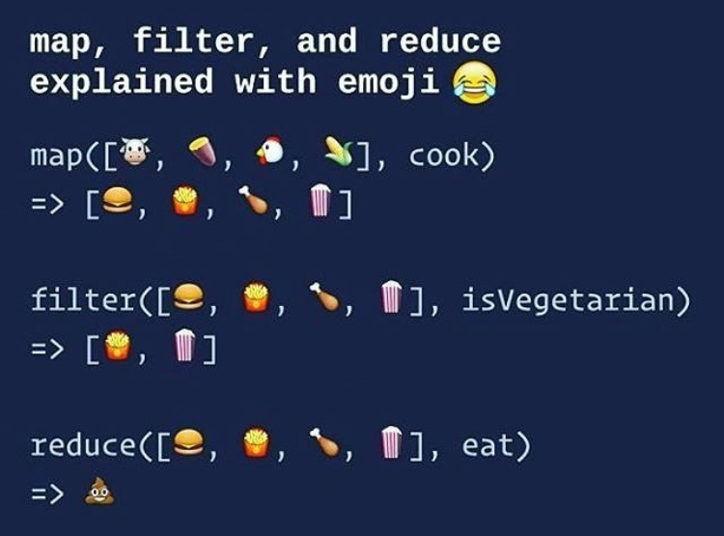

Slide 8
Higher Order Functions
See code!

