Slide 1
CSE373: Data Structures & Algorithms Lecture 19: Minimum Spanning Trees
Nicki Dell
Spring 2014

Slide 2
Announcements
Homework 5 is out
Due Wednesday May 28th
Partner selection due Wednesday May 21st
Ask your partner about late days before you start

Slide 3
Minimum Spanning Trees
The minimum-spanning-tree problem
Given a weighted undirected graph, compute a spanning tree of minimum weight

Slide 4
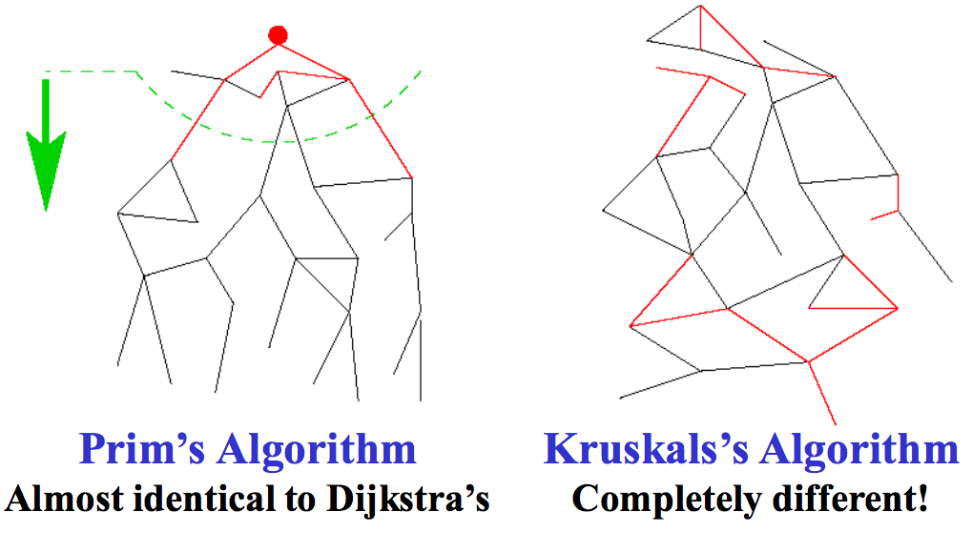
Two different approaches

Slide 5
Prim’s Algorithm Idea

Slide 6
Prim’s vs. Dijkstra’s
Recall:
Dijkstra picked the unknown vertex with smallest cost where
cost = distance to the source.
Prim’s pick the unknown vertex with smallest cost where
cost = distance from this vertex to the known set
(in other words, the cost of the smallest edge connecting this vertex to the known set)
Otherwise identical ☺

Slide 7
Prim’s Algorithm
For each node v, set v.cost = ∞ and v.known = false
Choose any node v
Mark v as known
For each edge (v,u) with weight w, set u.cost=w and u.prev=v
While there are unknown nodes in the graph
Select the unknown node v with lowest cost
Mark v as known and add (v, v.prev) to output
For each edge (v,u) with weight w,
if(w < u.cost) {
u.cost = w;
u.prev = v;
}

Slide 8
Prim’s Example
∞
∞
2
A
B
1
1
∞
2
5
E
∞
1
1
D
3
C
5
∞
∞
2
6
G
vertex | known? | cost | prev
A |  | ??
B |  | ??
C |  | ??
D |  | ??
E |  | ??
F |  | ??
G |  | ??
∞
10
F

Slide 9
Prim’s Example
0
2
2
A
B
1
1
∞
2
5
E
1
1
1
D
3
C
5
2
∞
2
6
G
vertex | known? | cost | prev
A | Y | 0
B |  | 2 | A
C |  | 2 | A
D |  | 1 | A
E |  | ??
F |  | ??
G |  | ??
∞
10
F

Slide 10
Prim’s Example
0
2
2
A
B
1
1
1
2
5
E
1
1
1
D
3
C
5
2
5
2
6
G
vertex | known? | cost | prev
A | Y | 0
B |  | 2 | A
C |  | 1 | D
D | Y | 1 | A
E |  | 1 | D
F |  | 6 | D
G |  | 5 | D
6
10
F

Slide 11
Prim’s Example
0
2
2
A
B
1
1
1
2
5
E
1
1
1
D
3
C
5
2
5
2
6
G
vertex | known? | cost | prev
A | Y | 0
B |  | 2 | A
C | Y | 1 | D
D | Y | 1 | A
E |  | 1 | D
F |  | 2 | C
G |  | 5 | D
2
10
F

Slide 12
Prim’s Example
0
1
2
A
B
1
1
1
2
5
E
1
1
1
D
3
C
5
2
3
2
6
G
vertex | known? | cost | prev
A | Y | 0
B |  | 1 | E
C | Y | 1 | D
D | Y | 1 | A
E | Y | 1 | D
F |  | 2 | C
G |  | 3 | E
2
10
F

Slide 13
Prim’s Example
0
1
2
A
B
1
1
1
2
5
E
1
1
1
D
3
C
5
2
3
2
6
G
vertex | known? | cost | prev
A | Y | 0
B | Y | 1 | E
C | Y | 1 | D
D | Y | 1 | A
E | Y | 1 | D
F |  | 2 | C
G |  | 3 | E
2
10
F

Slide 14
Prim’s Example
0
1
2
A
B
1
1
1
2
5
E
1
1
1
D
3
C
5
2
3
2
6
G
vertex | known? | cost | prev
A | Y | 0
B | Y | 1 | E
C | Y | 1 | D
D | Y | 1 | A
E | Y | 1 | D
F | Y | 2 | C
G |  | 3 | E
2
10
F

Slide 15
Prim’s Example
0
1
2
A
B
1
1
1
2
5
E
1
1
1
D
3
C
5
2
3
2
6
G
vertex | known? | cost | prev
A | Y | 0
B | Y | 1 | E
C | Y | 1 | D
D | Y | 1 | A
E | Y | 1 | D
F | Y | 2 | C
G | Y | 3 | E
2
10
F

Slide 16
Analysis
Correctness
A bit tricky
Intuitively similar to Dijkstra
Run-time
Same as Dijkstra
O(|E|log|V|) using a priority queue
Costs/priorities are just edge-costs, not path-costs

Slide 17
A cable company wants to connect five villages to their network which currently extends to the town of Avonford. What is the minimum length of cable needed?
Another Example
Brinleigh
5
Cornwell
3
4
8
6
8
Avonford
Fingley
Donster
7
5
4
2
Edan

Slide 18
Prim’s Algorithm
Model the situation as a graph and find the MST that connects all the villages (nodes).
B
5
C
3
4
8
6
8
A
D
7
F
5
4
2
E

Slide 19
Prim’s Algorithm
Select any vertex
A
Select the shortest edge connected to that vertex
AB 3
B
5
C
3
4
8
6
8
A
D
7
F
5
4
2
E

Slide 20
Prim’s Algorithm
Select the shortest
edge that connects
an unknown vertex to
any known vertex.
AE 4
B
5
C
3
4
8
6
8
A
D
7
F
5
4
2
E

Slide 21
Prim’s Algorithm
Select the shortest
edge that connects
an unknown vertex to
any known vertex.
ED 2
B
5
C
3
4
8
6
8
A
D
7
F
5
4
2
E

Slide 22
Prim’s Algorithm
Select the shortest
edge that connects
an unknown vertex to
any known vertex.
DC 4
B
5
C
3
4
8
6
8
A
D
7
F
5
4
2
E

Slide 23
Prim’s Algorithm
Select the shortest
edge that connects
an unknown vertex to
any known vertex.
EF 5
B
5
C
3
4
8
6
8
A
D
7
F
5
4
2
E

Slide 24
Prim’s Algorithm
All vertices have been
connected.
The solution is
AB 3
AE 4
ED 2
DC 4
EF 5
Total weight of tree: 18
B
5
C
3
4
8
6
8
A
D
7
F
5
4
2
E

Slide 25
Minimum Spanning Tree Algorithms
Prim’s Algorithm for Minimum Spanning Tree
Similar idea to Dijkstra’s Algorithm but for MSTs.
Both based on expanding cloud of known vertices
(basically using a priority queue instead of a DFS stack)
Kruskal’s Algorithm for Minimum Spanning Tree
Another, but different, greedy MST algorithm.
Uses the Union-Find data structure.

Slide 26
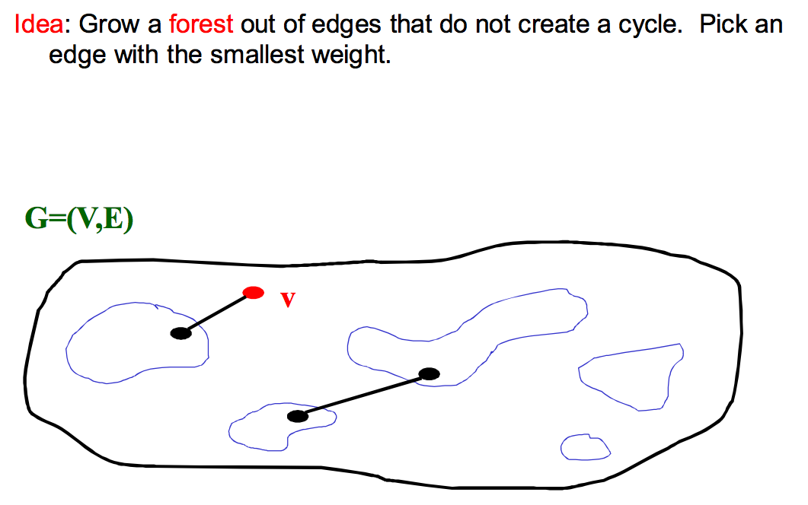
Kruskal’s Algorithm

Slide 27
Kruskal’s Algorithm Pseudocode
Sort edges by weight (better: put in min-heap)
Each node in its own set
While output size < |V|-1
Consider next smallest edge (u,v)
if find(u) and find(v) indicate u and v are in different sets
output (u,v)
union(find(u),find(v))
Recall invariant:
u and v in same set if and only if connected in output-so-far

Slide 28
Kruskal’s Example
2
Edges in sorted order:
1: (A,D), (C,D), (B,E), (D,E)
2: (A,B), (C,F), (A,C)
3: (E,G)
5: (D,G), (B,D)
6: (D,F)
10: (F,G)
A
B
1
1
5
2
E
1
1
D
3
C
5
2
6
G
10
F
Output:
Note: At each step, the union/find sets are the trees in the forest

Slide 29
Kruskal’s Example
2
Edges in sorted order:
1: (A,D), (C,D), (B,E), (D,E)
2: (A,B), (C,F), (A,C)
3: (E,G)
5: (D,G), (B,D)
6: (D,F)
10: (F,G)
A
B
1
1
5
2
E
1
1
D
3
C
5
2
6
G
10
F
Output: (A,D)
Note: At each step, the union/find sets are the trees in the forest

Slide 30
Kruskal’s Example
2
Edges in sorted order:
1: (A,D), (C,D), (B,E), (D,E)
2: (A,B), (C,F), (A,C)
3: (E,G)
5: (D,G), (B,D)
6: (D,F)
10: (F,G)
A
B
1
1
5
2
E
1
1
D
3
C
5
2
6
G
10
F
Output: (A,D), (C,D)
Note: At each step, the union/find sets are the trees in the forest

Slide 31
Kruskal’s Example
2
Edges in sorted order:
1: (A,D), (C,D), (B,E), (D,E)
2: (A,B), (C,F), (A,C)
3: (E,G)
5: (D,G), (B,D)
6: (D,F)
10: (F,G)
A
B
1
1
5
2
E
1
1
D
3
C
5
2
6
G
10
F
Output: (A,D), (C,D), (B,E)
Note: At each step, the union/find sets are the trees in the forest

Slide 32
Kruskal’s Example
2
Edges in sorted order:
1: (A,D), (C,D), (B,E), (D,E)
2: (A,B), (C,F), (A,C)
3: (E,G)
5: (D,G), (B,D)
6: (D,F)
10: (F,G)
A
B
1
1
5
2
E
1
1
D
3
C
5
2
6
G
10
F
Output: (A,D), (C,D), (B,E), (D,E)
Note: At each step, the union/find sets are the trees in the forest

Slide 33
Kruskal’s Example
2
Edges in sorted order:
1: (A,D), (C,D), (B,E), (D,E)
2: (A,B), (C,F), (A,C)
3: (E,G)
5: (D,G), (B,D)
6: (D,F)
10: (F,G)
A
B
1
1
5
2
E
1
1
D
3
C
5
2
6
G
10
F
Output: (A,D), (C,D), (B,E), (D,E)
Note: At each step, the union/find sets are the trees in the forest

Slide 34
Kruskal’s Example
2
Edges in sorted order:
1: (A,D), (C,D), (B,E), (D,E)
2: (A,B), (C,F), (A,C)
3: (E,G)
5: (D,G), (B,D)
6: (D,F)
10: (F,G)
A
B
1
1
5
2
E
1
1
D
3
C
5
2
6
G
10
F
Output: (A,D), (C,D), (B,E), (D,E), (C,F)
Note: At each step, the union/find sets are the trees in the forest

Slide 35
Kruskal’s Example
2
Edges in sorted order:
1: (A,D), (C,D), (B,E), (D,E)
2: (A,B), (C,F), (A,C)
3: (E,G)
5: (D,G), (B,D)
6: (D,F)
10: (F,G)
A
B
1
1
5
2
E
1
1
D
3
C
5
2
6
G
10
F
Output: (A,D), (C,D), (B,E), (D,E), (C,F)
Note: At each step, the union/find sets are the trees in the forest

Slide 36
Kruskal’s Example
2
Edges in sorted order:
1: (A,D), (C,D), (B,E), (D,E)
2: (A,B), (C,F), (A,C)
3: (E,G)
5: (D,G), (B,D)
6: (D,F)
10: (F,G)
A
B
1
1
5
2
E
1
1
D
3
C
5
2
6
G
10
F
Output: (A,D), (C,D), (B,E), (D,E), (C,F), (E,G)
Note: At each step, the union/find sets are the trees in the forest

Slide 37
Kruskal’s Algorithm Analysis
Idea: Grow a forest out of edges that do not grow a cycle, just like for the spanning tree problem.
But now consider the edges in order by weight
So:
Sort edges: O(|E|log |E|) (next course topic)
Iterate through edges using union-find for cycle detection almost O(|E|)
Somewhat better:
Floyd’s algorithm to build min-heap with edges O(|E|)
Iterate through edges using union-find for cycle detection and deleteMin to get next edge O(|E| log |E|)
Not better worst-case asymptotically, but often stop long before considering all edges.

Slide 38
Kruskal’s Algorithm
List the edges in order of size:
ED 2
AB 3
AE 4
CD 4
BC 5
EF 5
CF 6
AF 7
BF 8
CF 8
B
5
C
3
4
8
6
8
A
D
7
F
5
4
2
E

Slide 39
Kruskal’s Algorithm
Select the edge
with min cost
ED 2
B
5
C
3
4
8
6
8
A
D
7
F
5
4
2
E

Slide 40
Kruskal’s Algorithm
Select the next
minimum cost
edge that does not
create a cycle
ED 2
AB 3
B
5
C
3
4
8
6
8
A
D
7
F
5
4
2
E

Slide 41
Kruskal’s Algorithm
Select the next
minimum cost
edge that does not
create a cycle
ED 2
AB 3
CD 4 (or AE 4)
B
5
C
3
4
8
6
8
A
D
7
F
5
4
2
E

Slide 42
Kruskal’s Algorithm
Select the next
minimum cost
edge that does not
create a cycle
ED 2
AB 3
CD 4
AE 4
B
5
C
3
4
8
6
8
A
D
7
F
5
4
2
E

Slide 43
Kruskal’s Algorithm
Select the next
minimum cost
edge that does not
create a cycle
ED 2
AB 3
CD 4
AE 4
BC 5 – forms a cycle
EF 5
B
5
C
3
4
8
6
8
A
D
7
F
5
4
2
E

Slide 44
Kruskal’s Algorithm
All vertices have been
connected.
The solution is
ED 2
AB 3
CD 4
AE 4
EF 5
Total weight of tree: 18
B
5
C
3
4
8
6
8
A
D
7
F
5
4
2
E

Slide 45
Done with graph algorithms!
Next lecture…
Sorting
More sorting
Even more sorting
☺

