Slide 1
CSE373: Data Structures and Algorithms Lecture 4: Asymptotic Analysis
Nicki Dell
Spring 2014

Slide 2
Efficiency
What does it mean for an algorithm to be efficient?
We primarily care about time (and sometimes space)
Is the following a good definition?
“An algorithm is efficient if, when implemented, it runs quickly on real input instances”
Where and how well is it implemented?
What constitutes “real input?”
How does the algorithm scale as input size changes?

Slide 3
Gauging efficiency (performance)
Uh, why not just run the program and time it?
Too much variability, not reliable or portable:
Hardware: processor(s), memory, etc.
OS, Java version, libraries, drivers
Other programs running
Implementation dependent
Choice of input
Testing (inexhaustive) may miss worst-case input
Timing does not explain relative timing among inputs (what happens when n doubles in size)
Often want to evaluate an algorithm, not an implementation
Even before creating the implementation (“coding it up”)

Slide 4
Comparing algorithms
When is one algorithm (not implementation) better than another?
Various possible answers (clarity, security, …)
But a big one is performance: for sufficiently large inputs, runs in less time (our focus) or less space
We will focus on large inputs because probably any algorithm is “plenty good” for small inputs (if n is 10, probably anything is fast)
Time difference really shows up as n grows
Answer will be independent of CPU speed, programming language, coding tricks, etc.
Answer is general and rigorous, complementary to “coding it up and timing it on some test cases”
- Can do analysis before coding!

Slide 5
We usually care about worst-case running times
Has proven reasonable in practice
Provides some guarantees
Difficult to find a satisfactory alternative
What about average case?
Difficult to express full range of input
Could we use randomly-generated input?
May learn more about generator than algorithm

Slide 6
Example
2
3
5
16
37
50
73
75
126
Find an integer in a sorted array
// requires array is sorted
// returns whether k is in array
boolean find(int[]arr, int k){
???
}

Slide 7
Linear search
2
3
5
16
37
50
73
75
126
Find an integer in a sorted array
Best case?
k is in arr[0]
6ish steps
= O(1)
Worst case?
k is not in arr
6ish*(arr.length)
= O(arr.length)
// requires array is sorted
// returns whether k is in array
boolean find(int[]arr, int k){
for(int i=0; i < arr.length; ++i)
if(arr[i] == k)
return true;
return false;
}

Slide 8
Binary search
2
3
5
16
37
50
73
75
126
Find an integer in a sorted array
Can also be done non-recursively but “doesn’t matter” here
// requires array is sorted
// returns whether k is in array
boolean find(int[]arr, int k){
return help(arr,k,0,arr.length);
}
boolean help(int[]arr, int k, int lo, int hi) {
int mid = (hi+lo)/2; // i.e., lo+(hi-lo)/2
if(lo==hi) return false;
if(arr[mid]==k) return true;
if(arr[mid]< k) return help(arr,k,mid+1,hi);
else return help(arr,k,lo,mid);
}

Slide 9
Binary search
Best case: 8ish steps = O(1)
Worst case: T(n) = 10ish steps + T(n/2) where n is hi-lo
O(log n) where n is array.length
Solve recurrence equation to know that…
// requires array is sorted
// returns whether k is in array
boolean find(int[]arr, int k){
return help(arr,k,0,arr.length);
}
boolean help(int[]arr, int k, int lo, int hi) {
int mid = (hi+lo)/2;
if(lo==hi) return false;
if(arr[mid]==k) return true;
if(arr[mid]< k) return help(arr,k,mid+1,hi);
else return help(arr,k,lo,mid);
}

Slide 10
Solving Recurrence Relations
Determine the recurrence relation. What is the base case?
T(n) = 10 + T(n/2) T(1) = 8
“Expand” the original relation to find an equivalent general expression in terms of the number of expansions.
T(n) = 10 + 10 + T(n/4)
= 10 + 10 + 10 + T(n/8)
= …
= 10k + T(n/(2^{k}))
Find a closed-form expression by setting the number of expansions to a value (e.g. 1) which reduces the problem to a base case
n/(2^{k}) = 1 means n = 2^{k} means k = log₂ n
So T(n) = 10 log₂ n + T(1)
So T(n) = 10 log₂ n + 8 (get to base case and do it)
So T(n) is O(log n)

Slide 11
Ignoring constant factors
So binary search is O(log n) and linear is O(n)
But which is faster?
Could depend on constant factors
How many assignments, additions, etc. for each n
E.g. T(n) = 5,000,000n vs. T(n) = 5n²
And could depend on overhead unrelated to n
E.g. T(n) = 5,000,000 + log n vs. T(n) = 10 + n
But there exists some n₀ such that for all n > n₀ binary search wins
Let’s play with a couple plots to get some intuition…

Slide 12
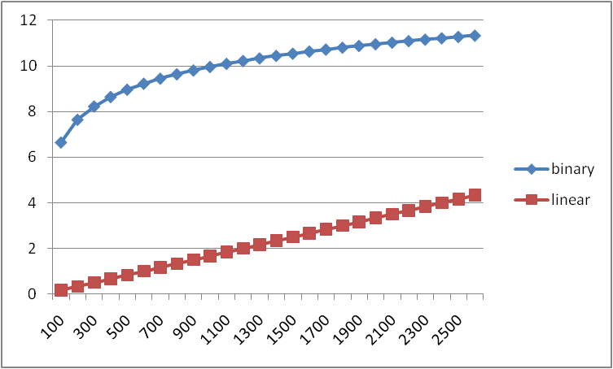
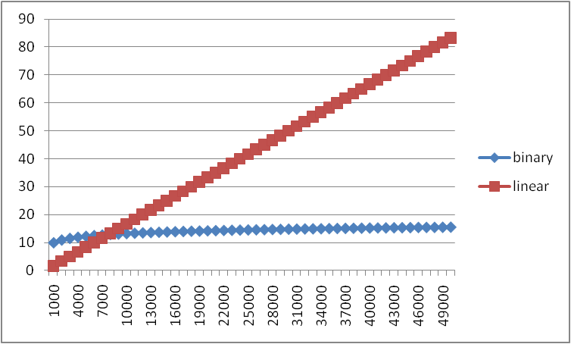
Example
Let’s try to “help” linear search
Run it on a computer 100x as fast (say 2014 model vs. 1994)
Use a new compiler/language that is 3x as fast
Be a clever programmer to eliminate half the work
So doing each iteration is 600x as fast as in binary search

Slide 13
Big-Oh relates functions
We use O on a function f(n) (for example n²) to mean the set of functions with asymptotic behavior less than or equal to f(n)
So (3n²+17) is in O(n²)
3n²+17 and n² have the same asymptotic behavior
Confusingly, we also say/write:
(3n²+17) is O(n²)
(3n²+17) = O(n²)
But we would never say O(n²) = (3n²+17)

Slide 14
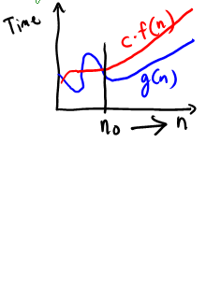
Big-O, formally
Definition: g(n) is in O( f(n) ) if there exist
positive constants c and n₀ such that
g(n) ≤ c f(n) for all n ≥ n₀
To show g(n) is in O( f(n) ), pick a c large enough to “cover the constant factors” and n₀ large enough to “cover the lower-order terms”
Example: Let g(n) = 3n²+17 and f(n) = n²
c=5 and n₀ =10 is more than good enough
(3*10²)+17 ≤ 5*10² so 3n²+17 is O(n²)
This is “less than or equal to”
So 3n²+17 is also O(n⁵) and O(2^{n}) etc.
But usually we’re interested in the tightest upper bound.

Slide 15
Example 1, using formal definition
Let g(n) = 1000n and f(n) = n²
To prove g(n) is in O(f(n)), find a valid c and n₀
The “cross-over point” is n=1000
g(n) = 1000*1000 and f(n) = 1000²
So we can choose n₀=1000 and c=1
Many other possible choices, e.g., larger n₀ and/or c
Definition: g(n) is in O( f(n) ) if there exist
positive constants c and n₀ such that
g(n) ≤ c f(n) for all n ≥ n₀

Slide 16
Example 2, using formal definition
Let g(n) = n⁴ and f(n) = 2^{n}
To prove g(n) is in O(f(n)), find a valid c and n₀
We can choose n₀=20 and c=1
g(n) = 20⁴ vs. f(n) = 1*2²⁰
Note: There are many correct possible choices of c and n₀
Definition: g(n) is in O( f(n) ) if there exist
positive constants c and n₀ such that
g(n) ≤ c f(n) for all n ≥ n₀

Slide 17
What’s with the c
The constant multiplier c is what allows functions that differ only in their largest coefficient to have the same asymptotic complexity
Consider:
g(n) = 7n+5
f(n) = n
These have the same asymptotic behavior (linear)
So g(n) is in O(f(n)) even through g(n) is always larger
The c allows us to provide a coefficient so that g(n) ≤ c f(n)
In this example:
To prove g(n) is in O(f(n)), have c = 12, n₀ = 1
(7*1)+5 ≤ 12*1

Slide 18
What you can drop
Eliminate coefficients because we don’t have units anyway
3n² versus 5n² doesn’t mean anything when we have not specified the cost of constant-time operations
Eliminate low-order terms because they have vanishingly small impact as n grows
Do NOT ignore constants that are not multipliers
n³ is not O(n²)
3^{n} is not O(2^{n})
(This all follows from the formal definition)

Slide 19
More Asymptotic Notation
Upper bound: O( f(n) ) is the set of all functions asymptotically less than or equal to f(n)
g(n) is in O( f(n) ) if there exist constants c and n₀ such that
g(n) ≤ c f(n) for all n ≥ n₀
Lower bound: Ω( f(n) ) is the set of all functions asymptotically greater than or equal to f(n)
g(n) is in Ω( f(n) ) if there exist constants c and n₀ such that
g(n) ≥ c f(n) for all n ≥ n₀
Tight bound: θ( f(n) ) is the set of all functions asymptotically equal to f(n)
g(n) is in θ( f(n) ) if both g(n) is in O( f(n) ) and
g(n) is in Ω( f(n) )

Slide 20
Correct terms, in theory
A common error is to say O( f(n) ) when you mean θ( f(n) )
Since a linear algorithm is also O(n⁵), it’s tempting to say “this algorithm is exactly O(n)”
That doesn’t mean anything, say it is θ(n)
That means that it is not, for example O(log n)
Less common notation:
“little-oh”: intersection of “big-Oh” and not “big-Theta”
For all c, there exists an n₀ such that… ≤
Example: array sum is o(n²) but not o(n)
“little-omega”: intersection of “big-Omega” and not “big-Theta”
For all c, there exists an n₀ such that… ≥
Example: array sum is ω(log n) but not ω(n)

Slide 21
What we are analyzing
The most common thing to do is give an O upper bound to the worst-case running time of an algorithm
Example: binary-search algorithm
Common: O(log n) running-time in the worst-case
Less common: θ(1) in the best-case (item is in the middle)
Less common (but very good to know): the find-in-sorted-array problem is Ω(log n) in the worst-case
No algorithm can do better
A problem cannot be O(f(n)) since you can always make a slower algorithm

Slide 22
Other things to analyze
Space instead of time
Remember we can often use space to gain time
Average case
Sometimes only if you assume something about the probability distribution of inputs
Sometimes uses randomization in the algorithm
Will see an example with sorting
Sometimes an amortized guarantee
Average time over any sequence of operations
Will discuss in a later lecture

Slide 23
Summary
Analysis can be about:
The problem or the algorithm (usually algorithm)
Time or space (usually time)
Or power or dollars or …
Best-, worst-, or average-case (usually worst)
Upper-, lower-, or tight-bound (usually upper or tight)

Slide 24
Big-Oh Caveats
Asymptotic complexity focuses on behavior for large n and is independent of any computer / coding trick
But you can “abuse” it to be misled about trade-offs
Example: n^{1/10} vs. log n
Asymptotically n^{1/10} grows more quickly
But the “cross-over” point is around 5 * 10¹⁷
So if you have input size less than 2⁵⁸, prefer n^{1/10}
For small n, an algorithm with worse asymptotic complexity might be faster
If you care about performance for small n then the constant factors can matter

Slide 25
Addendum: Timing vs. Big-Oh Summary
Big-oh is an essential part of computer science’s mathematical foundation
Examine the algorithm itself, not the implementation
Reason about (even prove) performance as a function of n
Timing also has its place
Compare implementations
Focus on data sets you care about (versus worst case)
Determine what the constant factors “really are”

