Slide 1
AVL Tree
2014.1.23
Iris Jiaonghong Shi

Slide 2
AVL tree operations
AVL find:
Same as BST find
AVL insert:
First BST insert, then check balance and potentially “fix” the AVL tree
Four different imbalance cases
AVL delete:
The “easy way” is lazy deletion
Otherwise, do the deletion as binary search tree and check balance.

Slide 3
Insert, summarized
Insert as in a BST
Check back up path for imbalance, which will be 1 of 4 cases:
Node’s left-left grandchild is too tall
Node’s left-right grandchild is too tall
Node’s right-left grandchild is too tall
Node’s right-right grandchild is too tall
Only one case occurs because tree was balanced before insert
After the appropriate single or double rotation, the smallest-unbalanced subtree has the same height as before the insertion
So all ancestors are now balanced

Slide 4
Node’s left-left grandchild is too tall

Slide 5
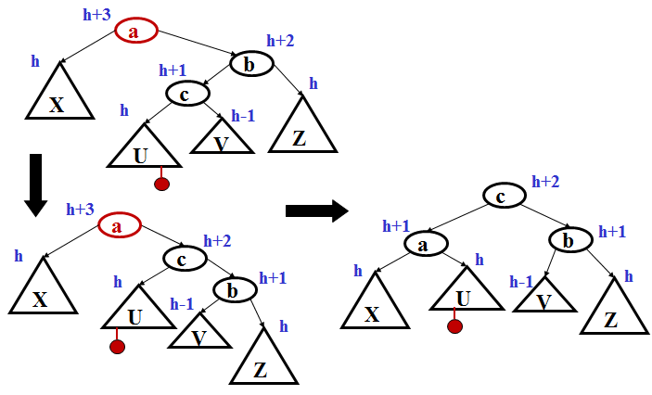
Node’s right-left grandchild is too tall

Slide 6
Example: Insert
Warm up: 2, 5, 6, 8, 9, 7
Example in the book:
3,2,1,4,5,6,7
16,15,14,13,12,11,10,8,9
An avl applet to play with:
http://www.site.uottawa.ca/~stan/csi2514/applets/avl/BT.html

Slide 7
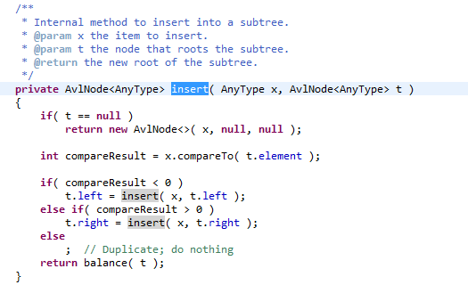
Insert

Slide 8
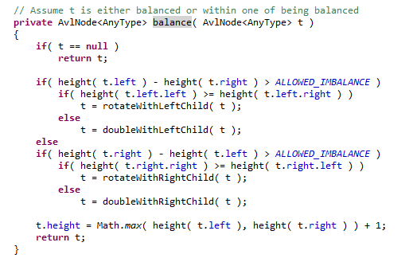
Balance

Slide 9
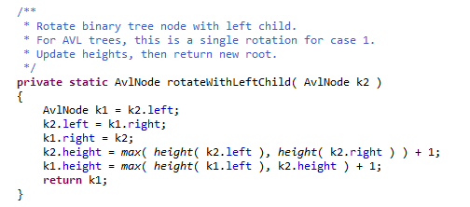
Node’s left-left grandchild is too tall: rotateWithLeftChild

Slide 10
Node’s right-left grandchild is too tall: doubleWithLeftChild

Slide 11
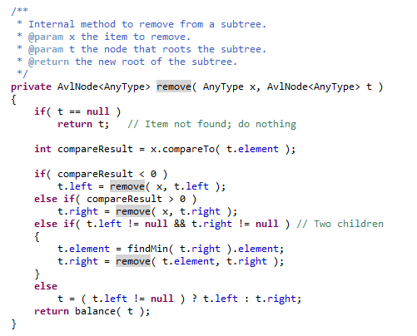
Remove: BST+balance

Slide 12
Example(Cont.)
Insert:
3,2,1,4,5,6,7
16,15,14,13,12,11,10,8,9
Delete( assume replace by leftMax)
7,5

Slide 13
Q&A
Thank you!

