Slide 1
CSE 373 Optional Section Disjoint Sets & Homework 4
February 13, 2014
Nicholas Shahan & A. Conrad Nied

Slide 2
Agenda
Disjoint Sets Review
Homework 4 Examples

Slide 3
Disjoint Sets Review
OUTBREAK trailer
Interactive Example

Slide 4
HW4: Representation?
What data structures do we want?
Java Collections
HashMap, HashSet, Arrays, ArrayList, etc.
Examples:
Two arrays, for vertical and horizontal walls
A Class for maze walls, stored in a HashSet

Slide 5
HW4: What Numbers Matter?
How many rooms are in the maze?
Height or Number of Rows
Width or Number of Columns
How many interior walls?
How many exterior walls?

Slide 6
HW4: By The Numbers
For a maze with 4 rows and 5 columns:
20 total rooms
49 walls
31 interior walls
16 vertical interior walls (4 x 4)
15 horizontal interior walls (3 x 5)

Slide 7
HW4: By The Numbers
For a maze with 3 rows and 7 columns:
21 total rooms
52 walls
32 interior walls
18 vertical interior walls (3 x 6)
14 horizontal interior walls (2 x 7)

Slide 8
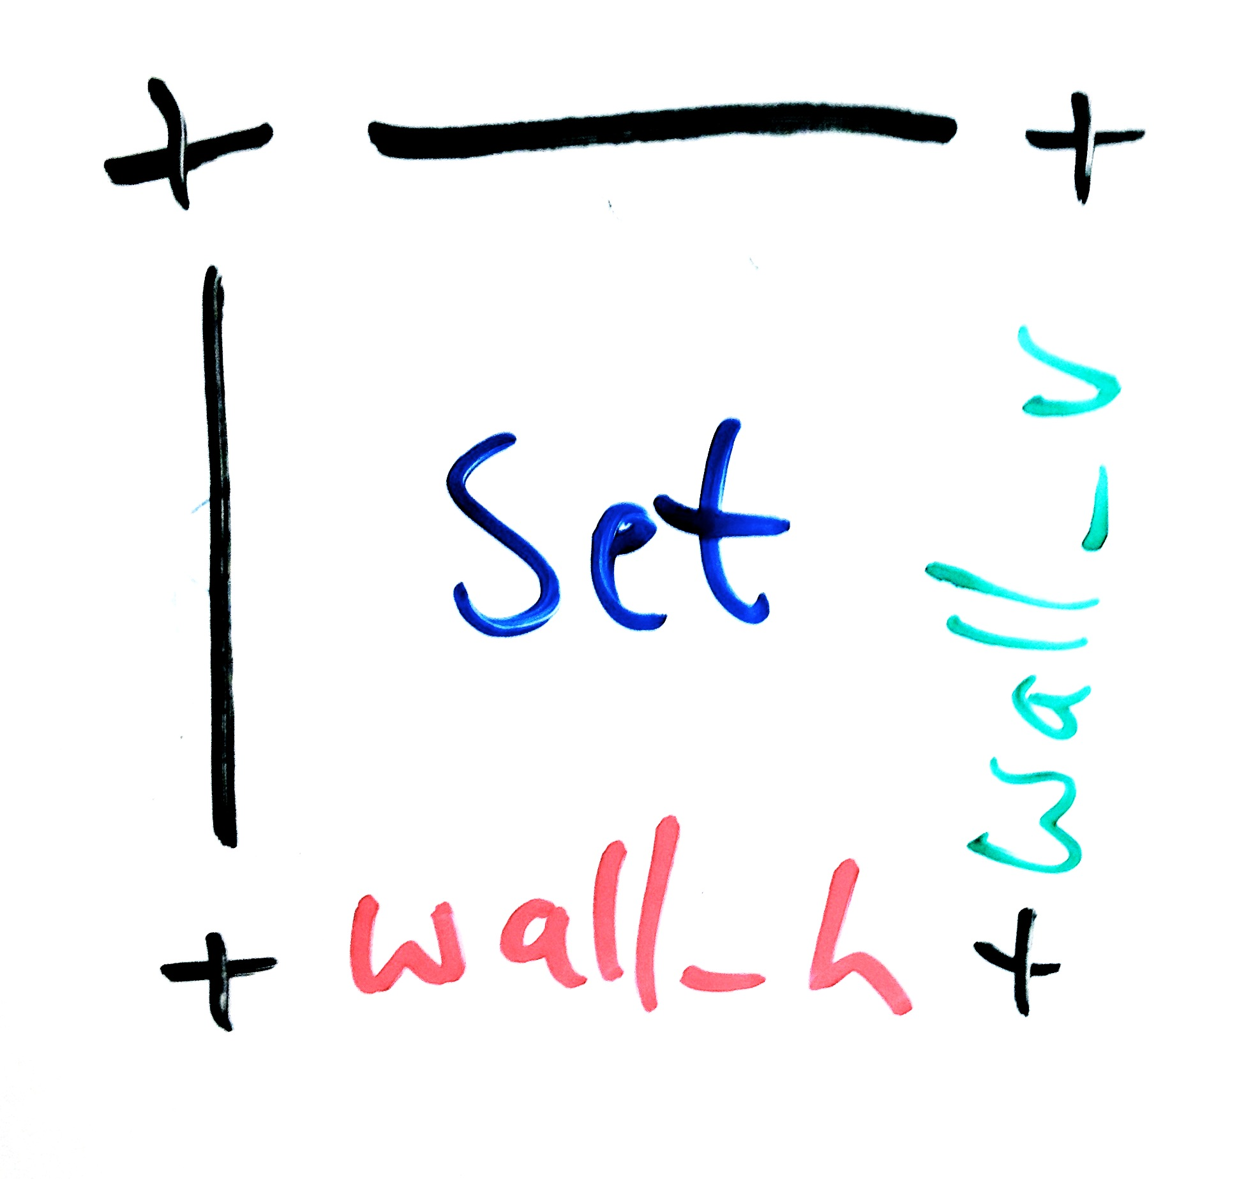
HW4: Consistent Identification
One Example: Each room is responsible for knowing its set and its walls left of and below it.

Slide 9
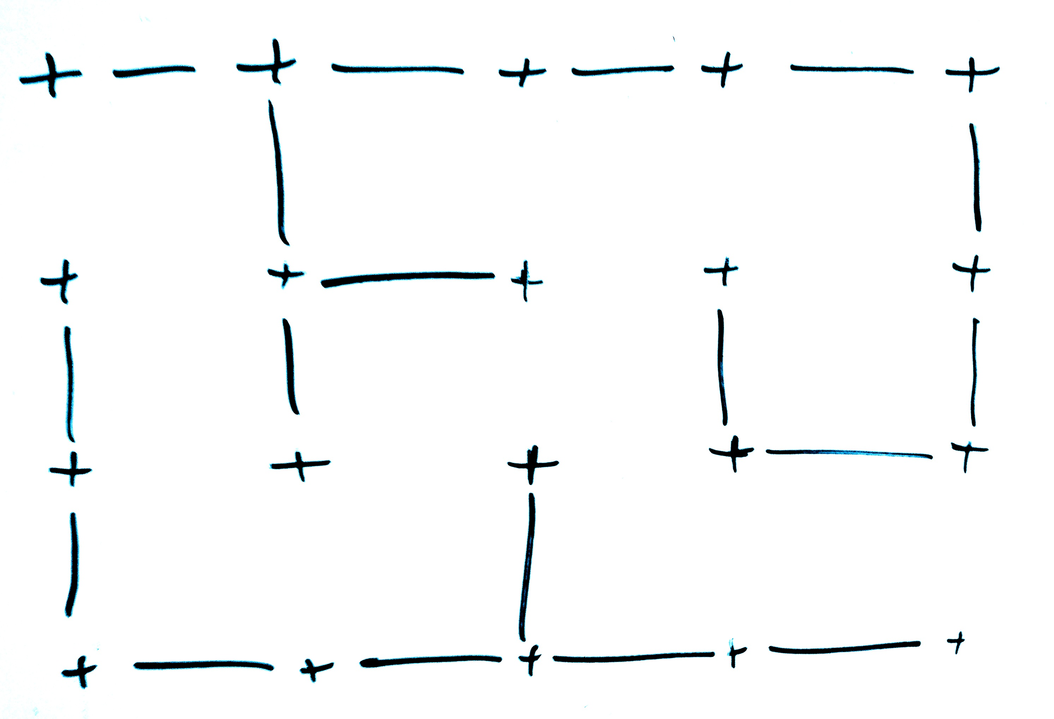
HW4: Example Maze
height = 3, width = 4

Slide 10
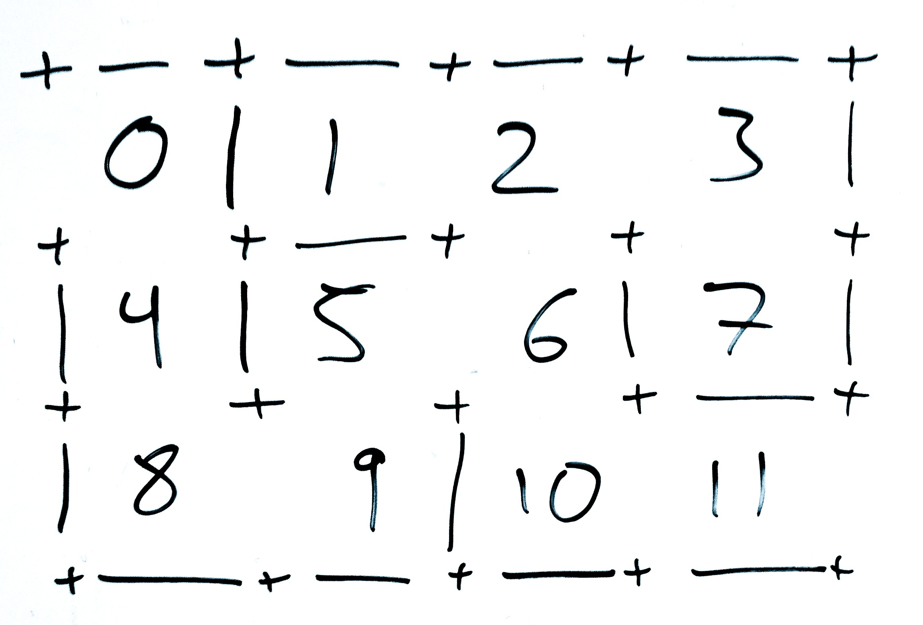
HW4: Example Maze
Number the rooms

Slide 11
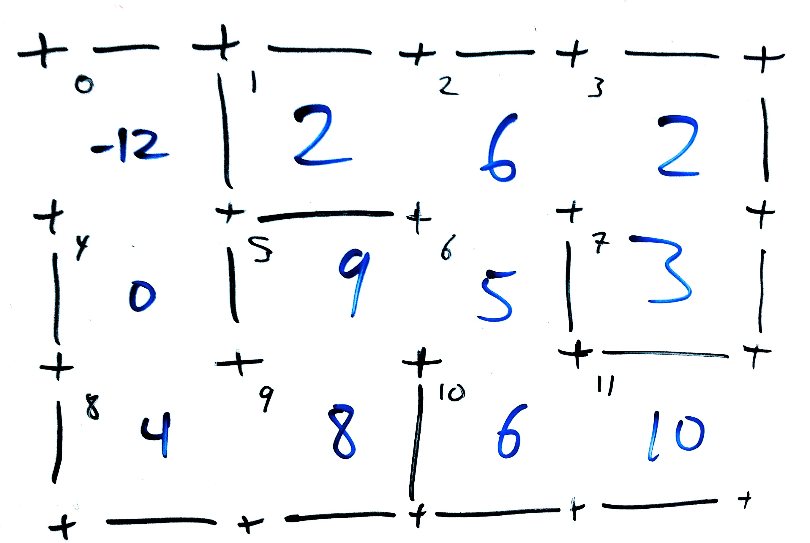
HW4: Example Maze
After uniting all of the nodes, the Disjoint Sets array looks like this:

Slide 12
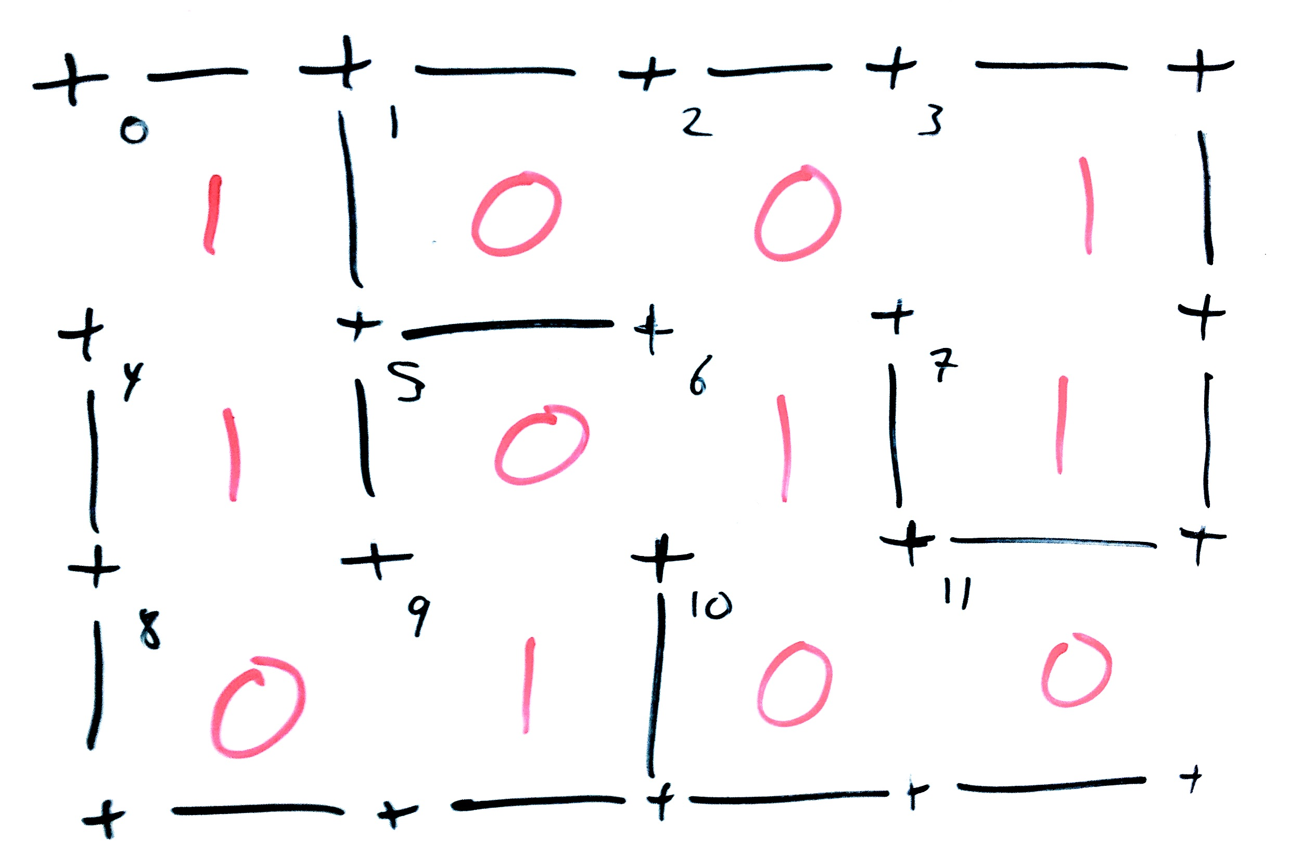
HW4: Example Maze
The walls to the left of each room are valued as such (1 means that the wall is in the maze)

Slide 13
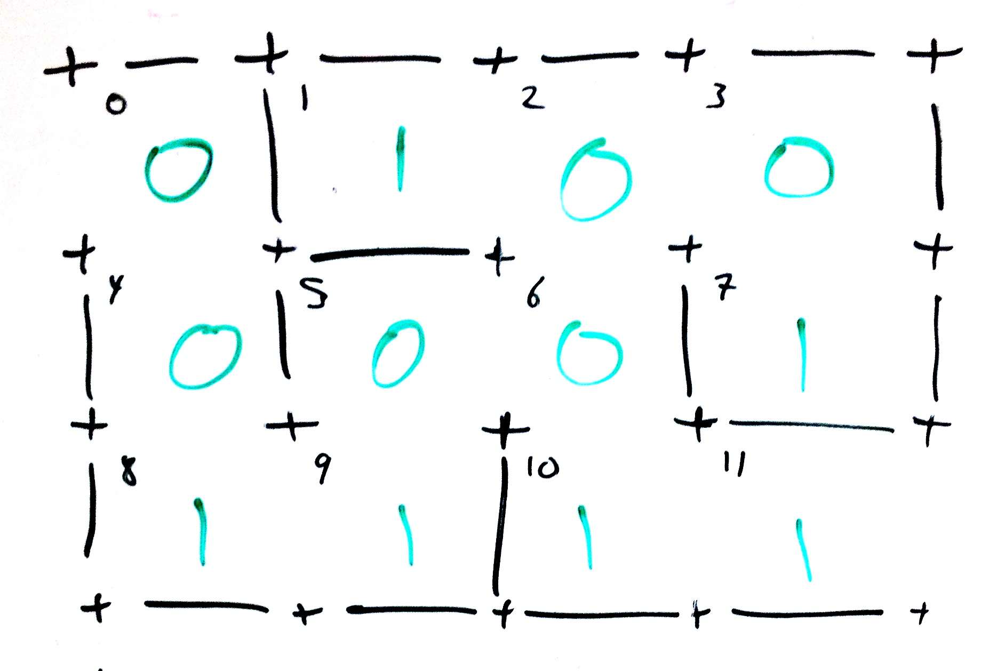
HW4: Example Maze
Likewise, for the horizontal walls below each room:

Slide 14
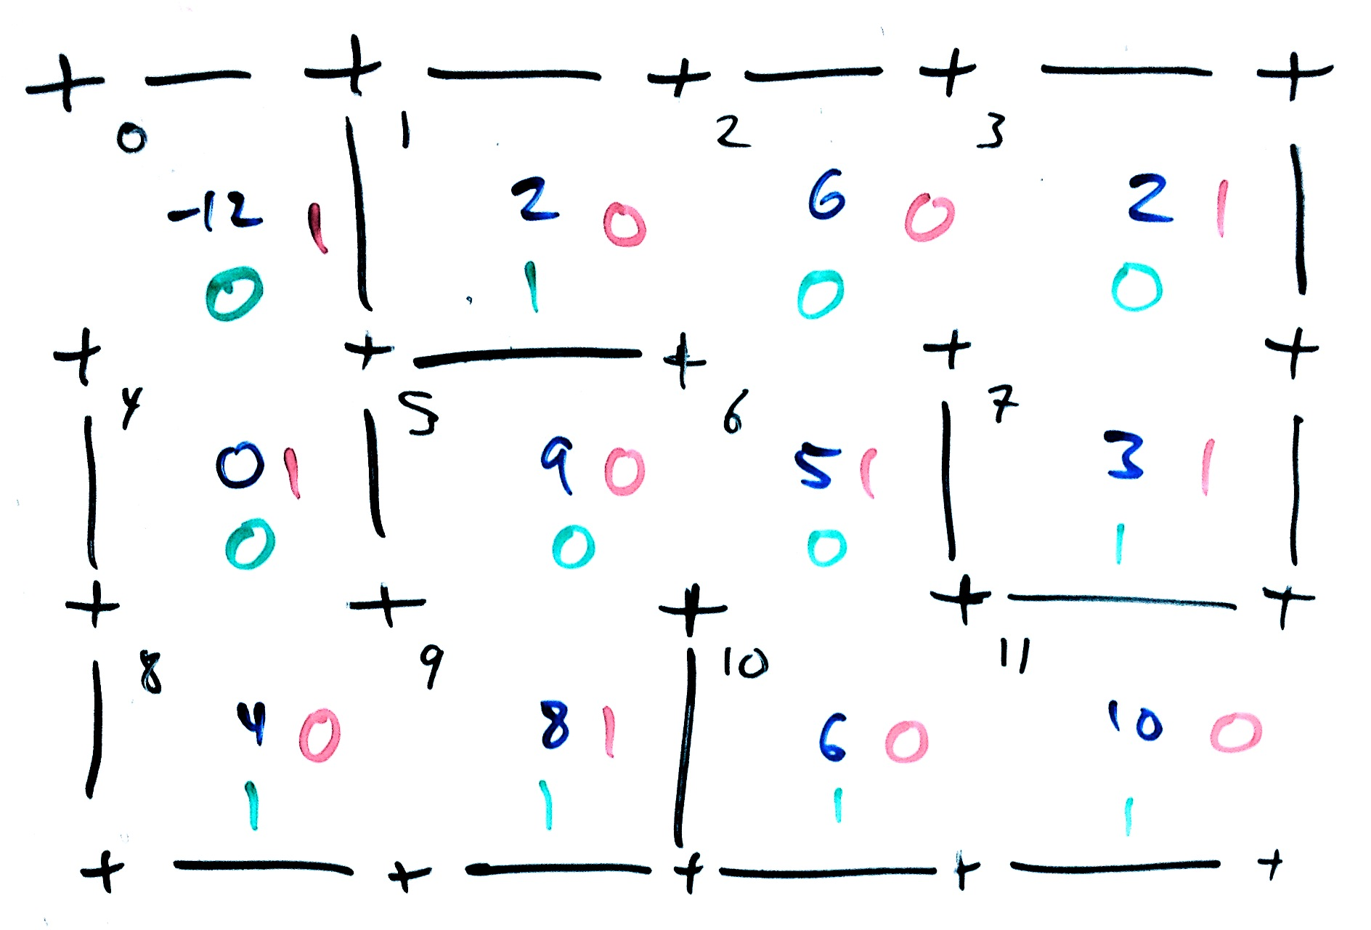
HW4: Example Maze
All together, the numbers for the rooms and the walls look like this:

Slide 15
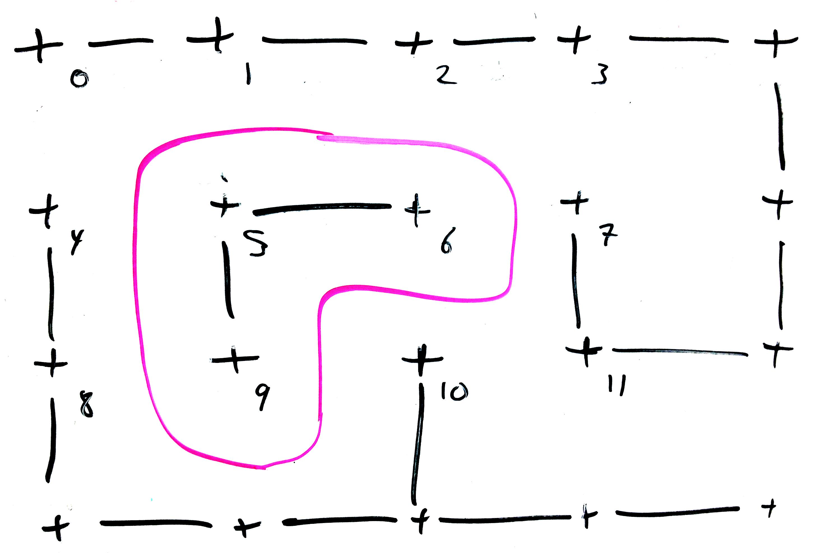
HW4: Don’t Create Cycles
Every time you remove an interior wall it is possible that you created a cycle:

Slide 16
HW4: Example Maze
With 3 arrays that look like this:

Slide 17
HW4: MazeBuilder
Find wall to remove
Find at random, rooms, walls, and/or neighbors
Make sure you want to remove it
Its neighbors are disjoint but adjacent
Its not exterior
Check if you should continue removing walls
“Until all are one…”

Slide 18
HW4: MazeBuilder
To print your mazes:
Make the top row of walls
For each row
Make a row of rooms and vertical walls
Make a row of horizontal walls below this row of rooms
Make the bottom row of walls
Make sure that you have an opening at the entrance and exit

Slide 19
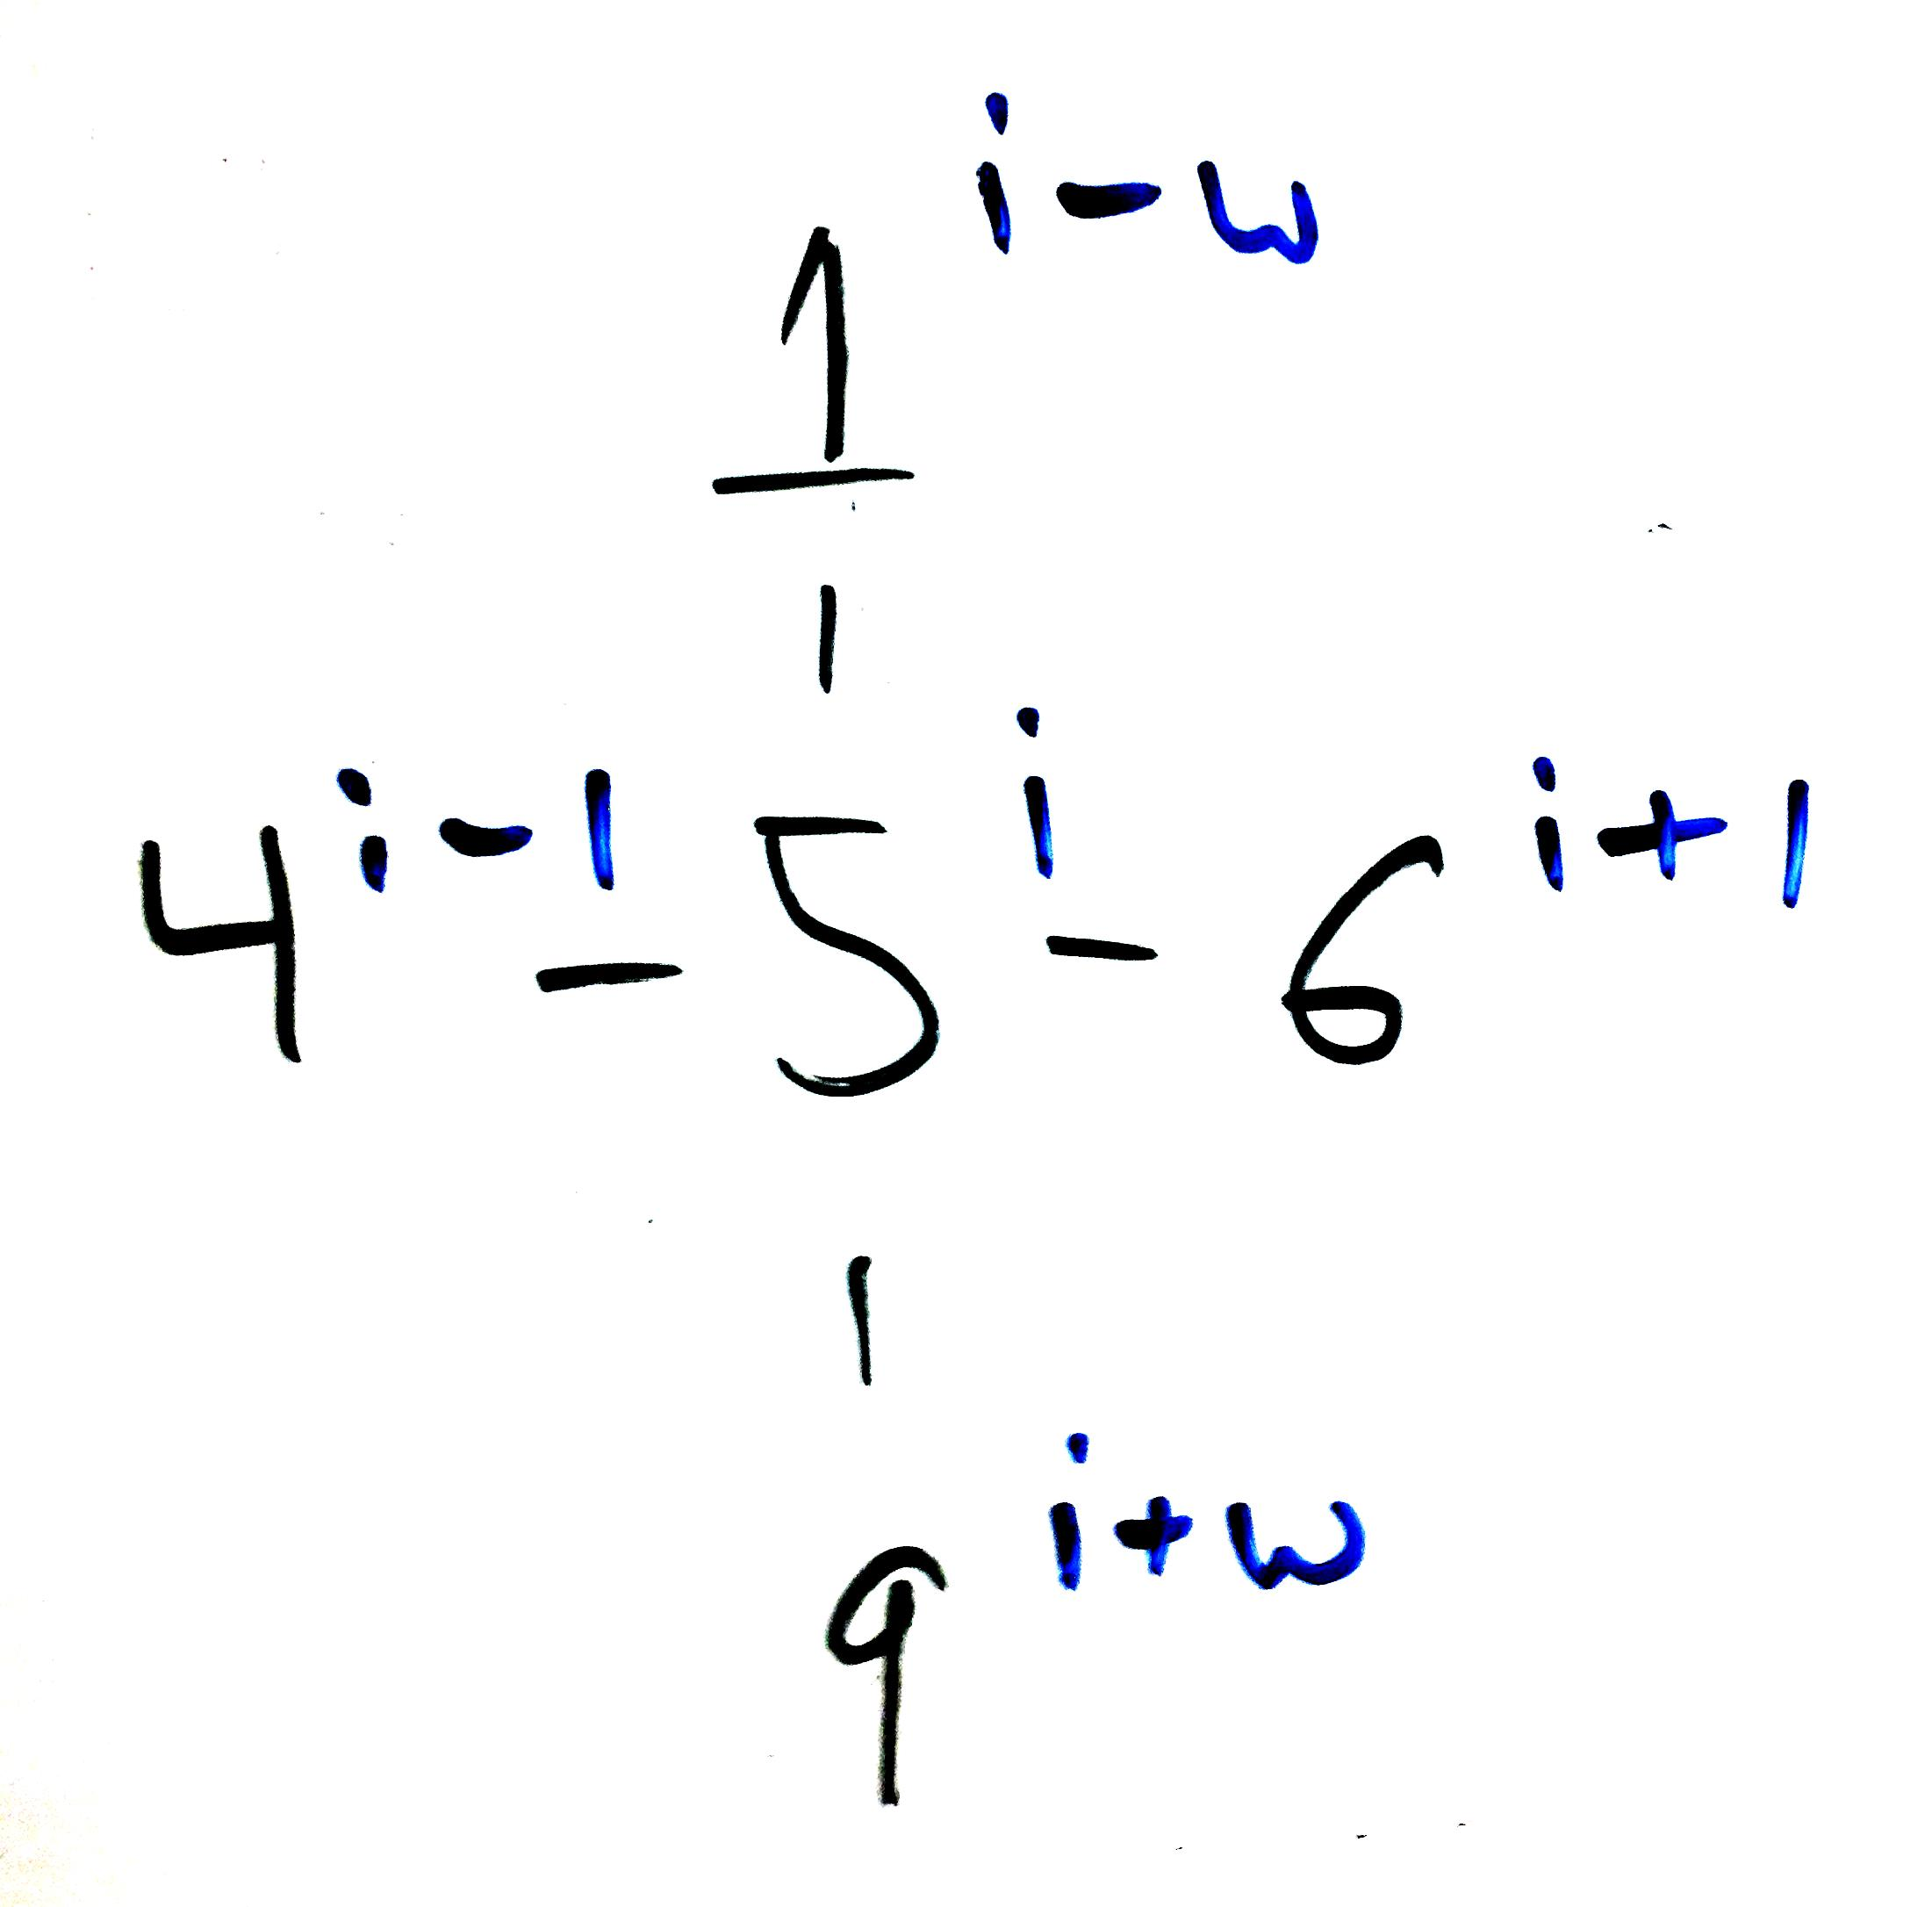
HW4: Locations
Checking for adjacency where w is the width and i is the index of your room. Make sure to not modify or jump over exterior walls.

Slide 20
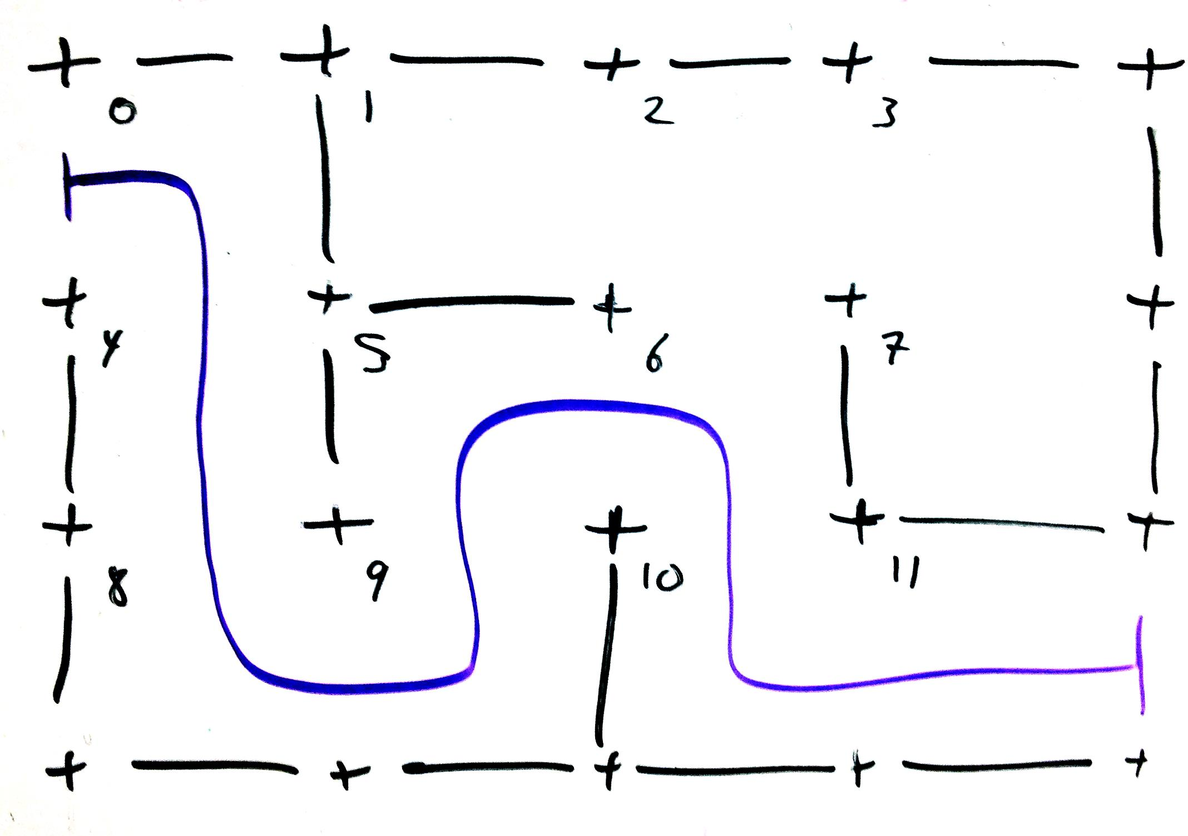
HW4: MazeSolver
The solution is 0 4 8 9 5 6 10 11

