Slide 1
CSE373: Data Structure & Algorithms Lecture 24: Memory Hierarchy and Data Locality
Aaron Bauer
Winter 2014

Slide 2
Why memory hierarchy/locality?
One of the assumptions that Big-O makes is that all operations take the same amount of time
Is this really true?

Slide 3
Where are these values in memory?
Ref | Loc | Value
x | 0 | 8
y | 1 | 16
 | 2 | …
 | …
a[0] | 1000
a[1] | 1001
… | … | …
a[999] | 1999
 | …
top | 3000 | 5000
 | …
val | 5000 | 7
next | 5001 | 7000
 | …
val | 7000 | 24
next | 7001
int x = 8;
int y = 2 * x;
int[] a = new int[1000];
z = a[0] + a[1] + a[999];
ListNode top = new ListNode(7);
top.next = new ListNode(24);
ListNode temp = top.next;

Slide 4
Definitions
A cycle (for our purposes) is the time it takes to execute a single simple instruction (e.g. adding two registers together)
Memory latency is the time it takes to access memory

Slide 5
Time to access:
~16-64+ registers
1 ns per instruction
CPU
SRAM
8 KB - 4 MB
Cache
2-10 ns
Main Memory
DRAM
2-10 GB
40-100 ns
a few
milliseconds
(5-10 million ns)
Disk
many GB

Slide 6
What does this mean?
It is much faster to do: Than: 5 million arithmetic ops 1 disk access 2500 L2 cache accesses 1 disk access 400 main memory accesses 1 disk access
Why are computers build this way?
Physical realities (speed of light, closeness to CPU)
Cost (price per byte of different storage technologies)
Under the right circumstances, this kind of hierarchy can simulate storage with access time of highest (fastest) level and size of lowest (largest) level

Slide 7
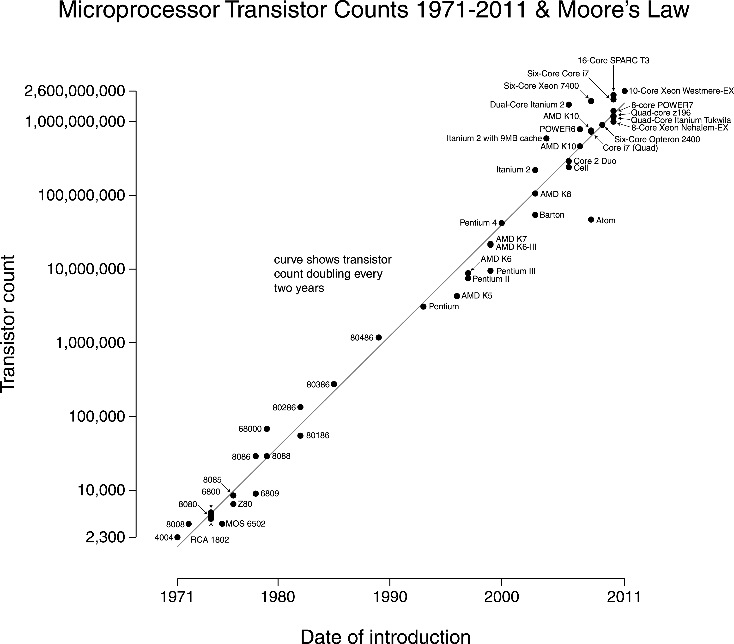

Slide 8
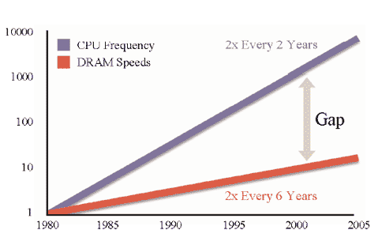
Processor-Memory Performance Gap

Slide 9
What can be done?
Goal: attempt to reduce the accesses to slower levels
How?

Slide 10
So, what can we do?
The hardware automatically moves data from main memory into the caches for you
Replacing items already there
Algorithms are much faster if “data fits in cache” (often does)
Disk accesses are done by software (e.g. ask operating system to open a file or database to access some records)
So most code “just runs,” but sometimes it’s worth designing algorithms / data structures with knowledge of memory hierarchy
To do this, we need to understand locality

Slide 11
Locality
Temporal Locality (locality in time)
If an item (a location in memory) is referenced, that same location will tend to be referenced again soon.
Spatial Locality (locality in space)
If an item is referenced, items whose addresses are close by tend to be referenced soon.

Slide 12
How does data move up the hierarchy?
Moving data up the hierarchy is slow because of latency (think distance to travel)
Since we’re making the trip anyway, might as well carpool
Get a block of data in the same time we could get a byte
Sends nearby memory because
It’s easy
Likely to be asked for soon (think fields/arrays)
Once a value is in cache, may as well keep it around for a while; accessed once, a value is more likely to be accesses again in the near future (as opposed to some random other value)
Spatial Locality
Temporal Locality

Slide 13
Cache Facts
Every level is a sub-set of the level below
Definitions:
Cache hit – address requested is in the cache
Cache miss – address requested is NOT in the cache
Block or page size – the number of contiguous bytes moved from disk to memory
Cache line size – the number of contiguous bytes move from memory to cache

Slide 14
Examples
x = a + 6
y = a + 5
z = 8 * a
x = a[0] + 6
y = a[1] + 5
z = 8 * a[2]

Slide 15
Examples
x = a + 6
y = a + 5
z = 8 * a
x = a[0] + 6
y = a[1] + 5
z = 8 * a[2]
miss
miss
hit
hit
hit
hit

Slide 16
Examples
x = a + 6
y = a + 5
z = 8 * a
x = a[0] + 6
y = a[1] + 5
z = 8 * a[2]
miss
miss
hit
hit
hit
hit
temporal locality
spatial
locality

Slide 17
Locality and Data Structures
Which has (at least the potential) for better spatial locality, arrays or linked lists?
cache line size
cache line size

Slide 18
Locality and Data Structures
Which has (at least the potential) for better spatial locality, arrays or linked lists?
e.g. traversing elements
Only miss on first item in a cache line
miss
hit
hit
hit
miss
hit
hit
cache line size
cache line size

Slide 19
Locality and Data Structures
Which has (at least the potential) for better spatial locality, arrays or linked lists?
e.g. traversing elements

Slide 20
Locality and Data Structures
Which has (at least the potential) for better spatial locality, arrays or linked lists?
e.g. traversing elements
Miss on every item (unless more than one randomly happen to be in the same cache line)
miss
hit
miss
hit
miss
hit
miss
hit

Slide 21
Where is the locality?
for (i = 1; i < 100; i++) {
a = a * 7;
b = b + x[i];
c = y[5] + d;
}

Slide 22
Where is the locality?
for (i = 1; i < 100; i++) {
a = a * 7;
b = b + x[i];
c = y[5] + d;
}

Slide 23
Where is the locality?
for (i = 1; i < 100; i++) {
a = a * 7;
b = b + x[i];
c = y[5] + d;
}
Temporal Locality

Slide 24
Where is the locality?
for (i = 1; i < 100; i++) {
a = a * 7;
b = b + x[i];
c = y[5] + d;
}
Temporal Locality
Spatial Locality

Slide 25
SQL (Structured Query Language)
Age: 40 years
Developer: ISO
Paradigms: declarative
Type system: static
Used as a database query language
Declarative paradigm perfect for this application
Using SQL is both easy and very powerful
If you have a lot of data, definitely consider using free database software like MySQL

Slide 26
Python
Age: 23 years
Developer: Python Software Foundation
Paradigm: imperative, object-oriented, functional, procedural
Type system: dynamic, duck
Has a Read-Eval-Print-Loop (REPL)
Useful for experimenting or one-off tasks
Scripting language
Supports “scripts,” small programs run without compilation
Often used in web development or scientific/numeric computing
Variables don’t have types, only values have types
Whitespace has semantic meaning
Lack of variable types and compile-time checks mean more may be required of documentation and testing
Python is my language of choice for accomplishing small tasks

Slide 27
JavaScript
Age: 19 years
Developer: Mozilla Foundation
Paradigm: imperative, object-oriented, functional, procedural
Type system: dynamic, duck
Also a scripting language (online/browser REPLs exist)
Primary client-side language of the web
Does inheritance through prototypes rather than classes
Objects inherit by cloning the behavior of existing objects
Takes a continue at any cost approach
Shared by many web-focused languages (PHP, HTML)
Things that would be errors in other languages don’t stop execution, and are allowed to fail silently
JavaScript is nice for simple things, immediately running on the web is great, but doing larger/more complex software is terrible

Slide 28
PHP
Age: 19 years
Developer: The PHP Group
Paradigm: imperative, object-oriented, functional, procedural
Type system: dynamic
Works with Apache (>50% all websites), so very common server-side language
Minimal type system, lots of strange behavior, just awful
I’ve never used it and I never will (hopefully)

Slide 29
PHP example
$a = md5('240610708');
$b = md5('QNKCDZO');
echo "$a\n";
echo "$b\n";
echo "\n";
var_dump($a == $b);

Slide 30
LOLCODE
Age: 7 years
An example of an esoteric programming language
HAI
CAN HAS STDIO?
PLZ OPEN FILE "LOLCATS.TXT"?
AWSUM THX
VISIBLE FILE
O NOES
INVISIBLE "ERROR!"
KTHXBYE
HAI
CAN HAS STDIO?
IM IN YR LOOP UPPIN YR VAR TIL BOTH SAEM VAR AN 10
VISIBLE SUM OF VAR AN 1
IM OUTTA YR LOOP
KTHXBYE

