Slide 1
CSE373: Data Structures & Algorithms Lecture 23: Intro to Artificial Intelligence and Game Theory
Based on slides adapted Luke Zettlemoyer, Dan Klein, Pieter Abbeel, Dan Weld, Stuart Russell or Andrew Moore
1

Slide 2
Game Playing State-of-the-Art
Checkers: Chinook ended 40-year-reign of human world champion Marion Tinsley in 1994. Used an endgame database defining perfect play for all positions involving 8 or fewer pieces on the board, a total of 443,748,401,247 positions. Checkers is now solved!
Chess: Deep Blue defeated human world champion Gary Kasparov in a six-game match in 1997. Deep Blue examined 200 million positions per second, used very sophisticated evaluation and undisclosed methods for extending some lines of search up to 40 ply. Current programs are even better, if less historic.
Othello: Human champions refuse to compete against computers, which are too good.
Go: Human champions are beginning to be challenged by machines, though the best humans still beat the best machines. In go, b > 300, so most programs use pattern knowledge bases to suggest plausible moves, along with aggressive pruning.

Slide 3
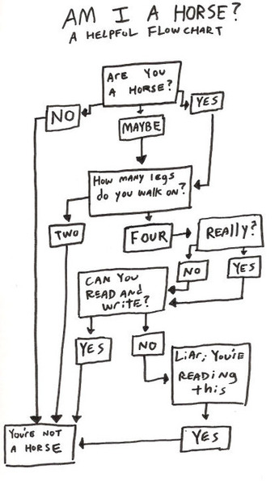
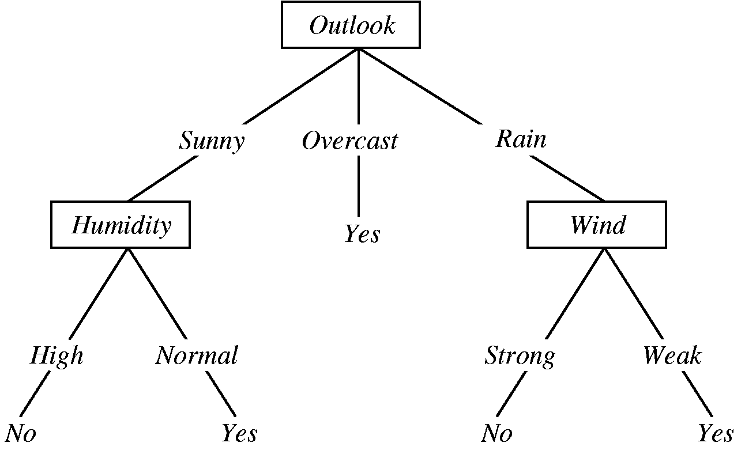
Decision Trees
- Graph like computational structure used to assess
potential decisions.

Slide 4
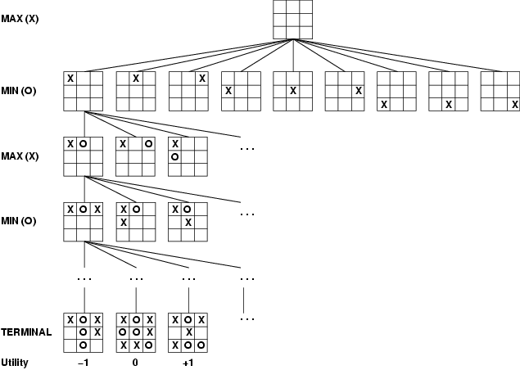

Slide 5
Game Playing
Many different kinds of games
Choices:
Deterministic or stochastic?
One, two, or more players?
Perfect information (can you see the state)?
Want algorithms for calculating a strategy which recommends a move in each state. We will try to combine the algorithms and structures we have seen thus far.

Slide 6
Deterministic Games
Many possible formalizations, one is:
States: S (start at s₀)
Players: P = {1...N} (usually take turns)
Actions: A (may depend on player / state)
Transition Function: S x A → S
Solution for a player is a policy: S → A
Notes:
Work tic-tac-toe example?

Slide 7
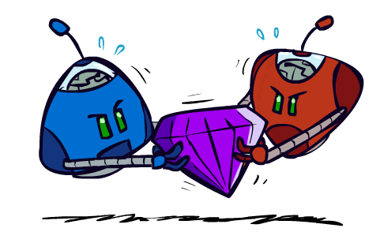
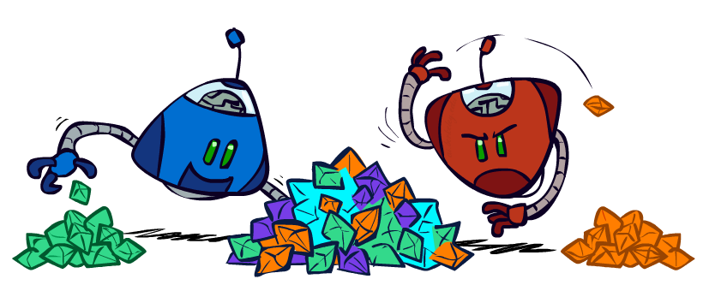
Zero-Sum Games
Zero-Sum Games
Players have opposite utilities (values on outcomes)
Lets us think of a single value that one maximizes and the other minimizes
Adversarial, pure competition
General Games
Players have independent utilities (values on outcomes)
Cooperation, indifference, competition, & more are possible

Slide 8
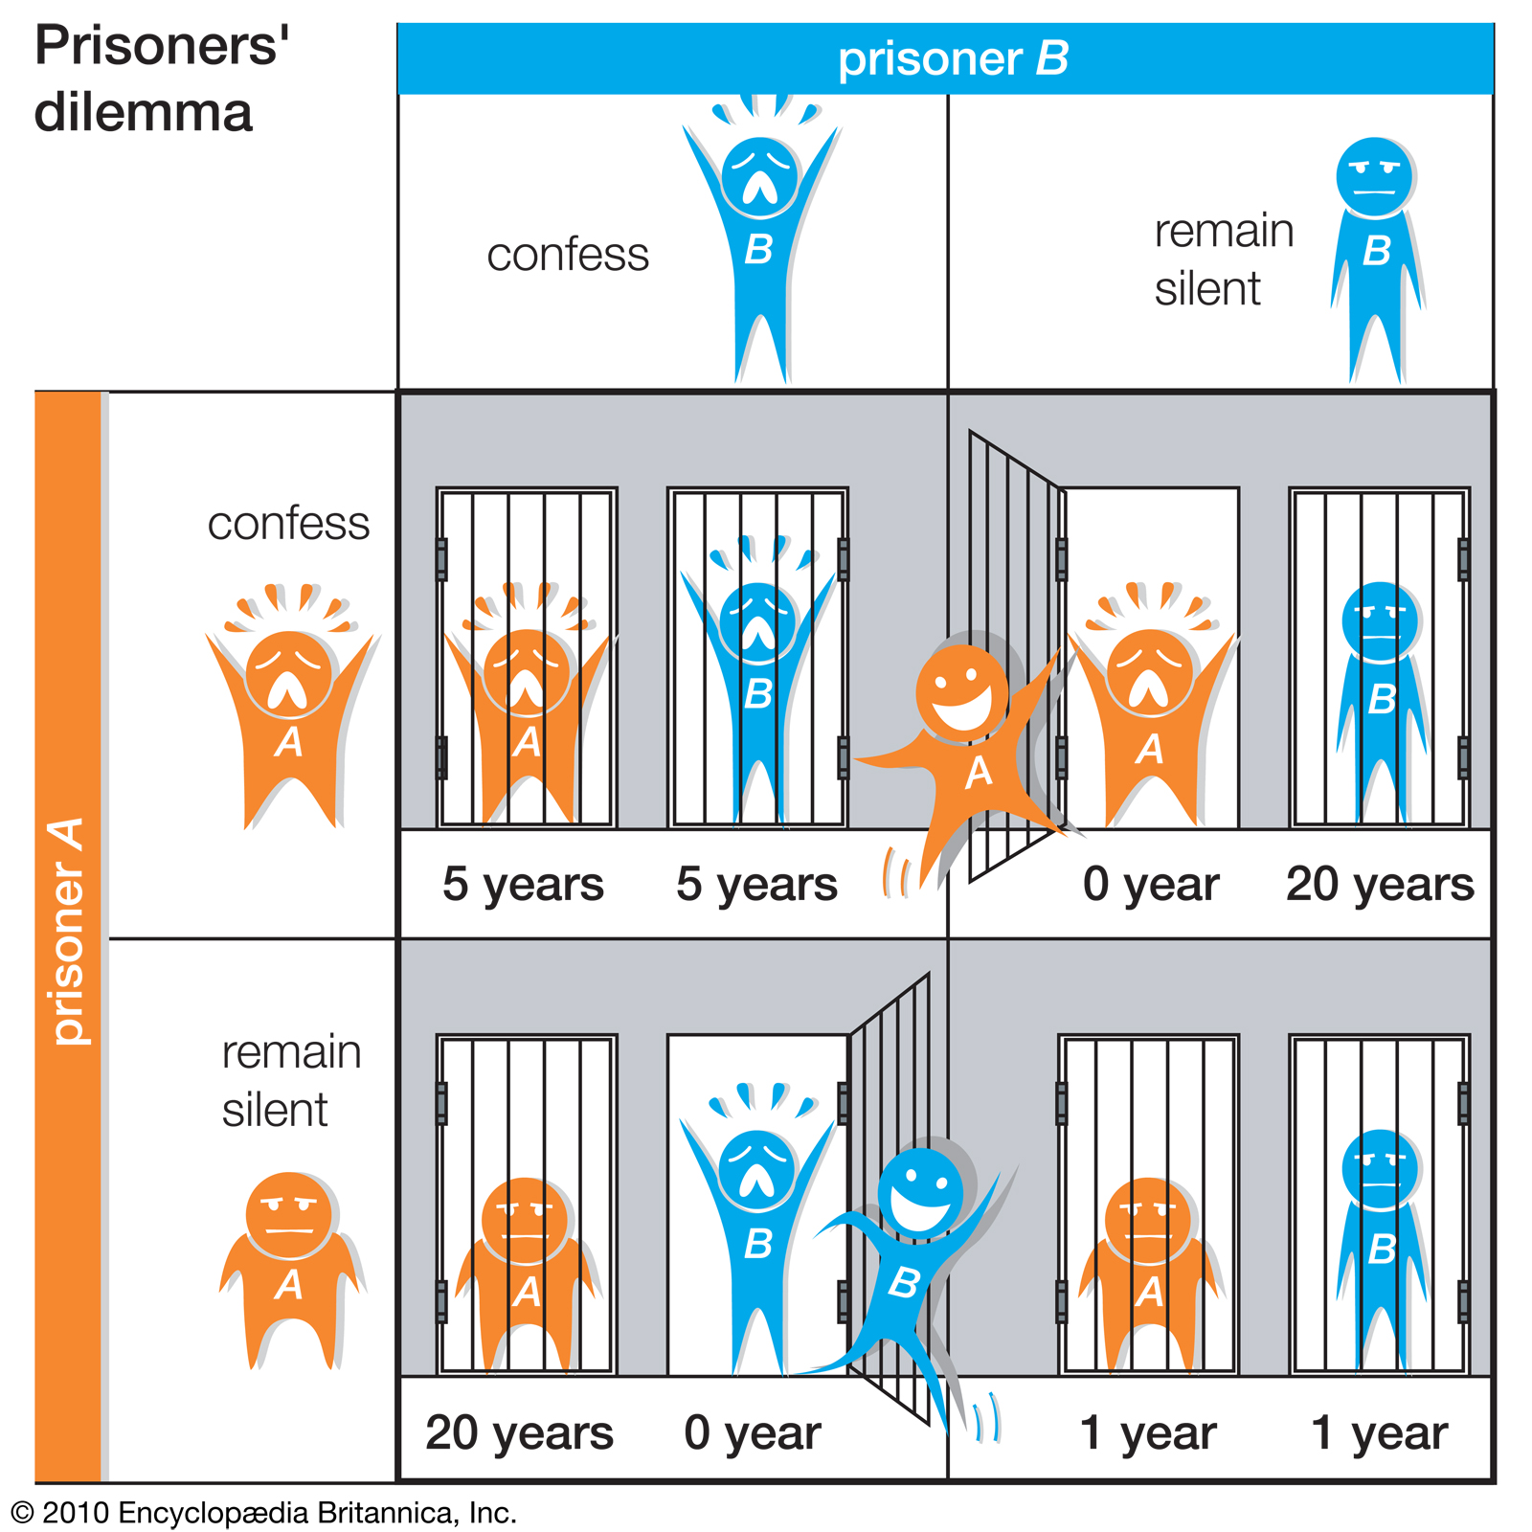
Non Zero-Sum Games
Two criminals are taken in, each prisoner is in solitary confinement with no means of communicating with the other.
The prosecutors lack sufficient evidence to convict the pair on the principal charge. They hope to get both sentenced to a year in prison on a lesser charge.
Each prisoner may either betray the other by testifying that the other committed the crime, or to cooperate with the other by remaining silent. What should you do?

Slide 9
Tic-tac-toe Game Tree

Slide 10
Adversarial Search (Minimax)
Deterministic, zero-sum games:
Tic-tac-toe, chess, checkers
One player maximizes result
The other minimizes result
Minimax search:
A state-space search tree
Players alternate turns
Compute each node’s minimax value: the best achievable utility against a rational (optimal) adversary
Minimax values: computed recursively
5
max
2
5
min
8
2
5
6
Terminal values: part of the game
Slide from Dan Klein & Pieter Abbeel - ai.berkeley.edu

Slide 11
Minimax Implementation
def max-value(state):
initialize v = -∞
for each successor of state:
v = max(v, min-value(successor))
return v
def min-value(state):
initialize v = +∞
for each successor of state:
v = min(v, max-value(successor))
return v
Slide from Dan Klein & Pieter Abbeel - ai.berkeley.edu

Slide 12
Minimax Implementation (Dispatch)
def value(state):
if the state is a terminal state: return the state’s value
if the next agent is MAX: return max-value(state)
if the next agent is MIN: return min-value(state)
def max-value(state):
initialize v = -∞
for each successor of state:
v = max(v, min-value(successor))
return v
def min-value(state):
initialize v = +∞
for each successor of state:
v = min(v, max-value(successor))
return v
Slide from Dan Klein & Pieter Abbeel - ai.berkeley.edu
Notes:
Pick an order for two reasons: sequential processor and pruning

Slide 13
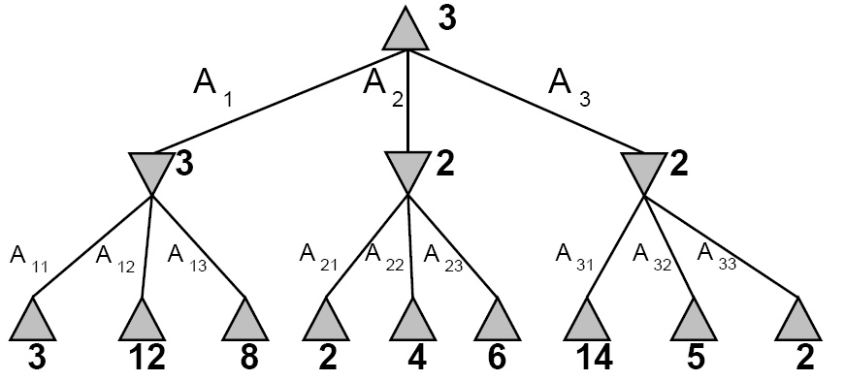
Concrete Minimax Example
max
min
Notes:
what if we had more than two players?

Slide 14
Minimax Properties
Optimal?
b = branching factor
m = moves (depth)
Yes, against perfect player. Otherwise?
max
Time complexity
Space complexity?
O(b^{m})
min
O(bm)
10
10
9
100
For chess, b ≈ 35, m ≈ 100
Exact solution is completely infeasible
But, do we need to explore the whole tree?

Slide 15
Tic-Tac-Toe is easy, what about Chess?
We know chess is NP-Hard (EXP-complete to be precise), but can we still write a good chess solver?
Assuming 50-move-rule, games are of finite length: average game is about 40 moves, with about 30 possible moves per turn.
Some estimate about 10¹²⁰ reasonable games of chess (called the Shannon Number)
This decision tree is way too big to create
We must use better heuristics than just decision trees to successfully play chess

Slide 16
A Few Optimizations
Transposition Table
Store lookup table for similar looking parts of the table
Iterative Deepening
Don’t search entire tree all at once, incrementally increase search space
Aspiration Windows
Make educated guesses about future search space
Alpha-Beta Pruning
Prune branches that cannot result in the optimal solution

Slide 17
α-β Pruning
General configuration
α is the best value that MAX can get at any choice point along the current path
If n becomes worse than α, MAX will avoid it, so can stop considering n’s other children
Define β similarly for MIN
Player
Opponent
α
Player
Opponent
n

Slide 18
Pruning Example
3
[-∞,2]
?
Progress of search…
Notes:
\alpha - value of the best (highest value) choice along the current path for MAX
\beta - value of the vest (lowest value) choice along the current path for MIN
this figure

Slide 19
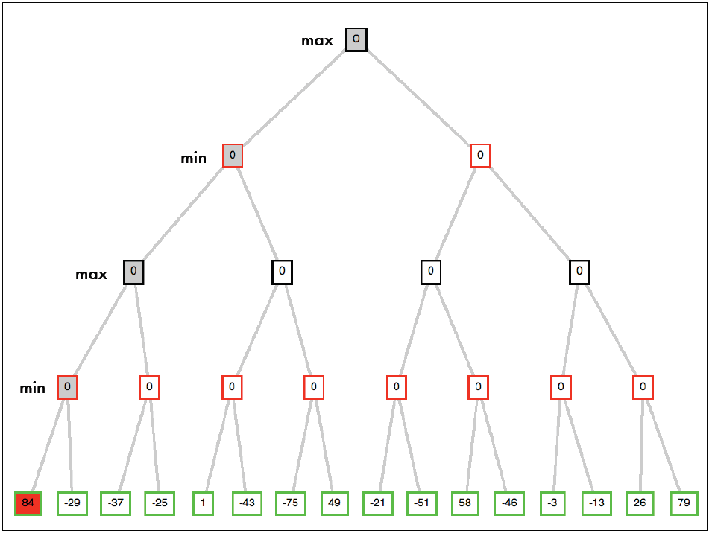

Slide 20
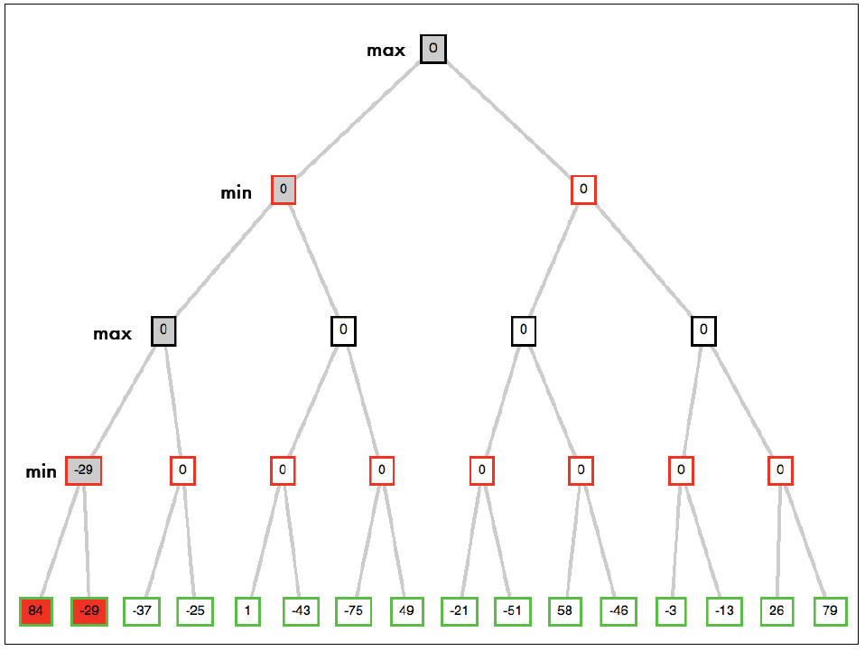

Slide 21
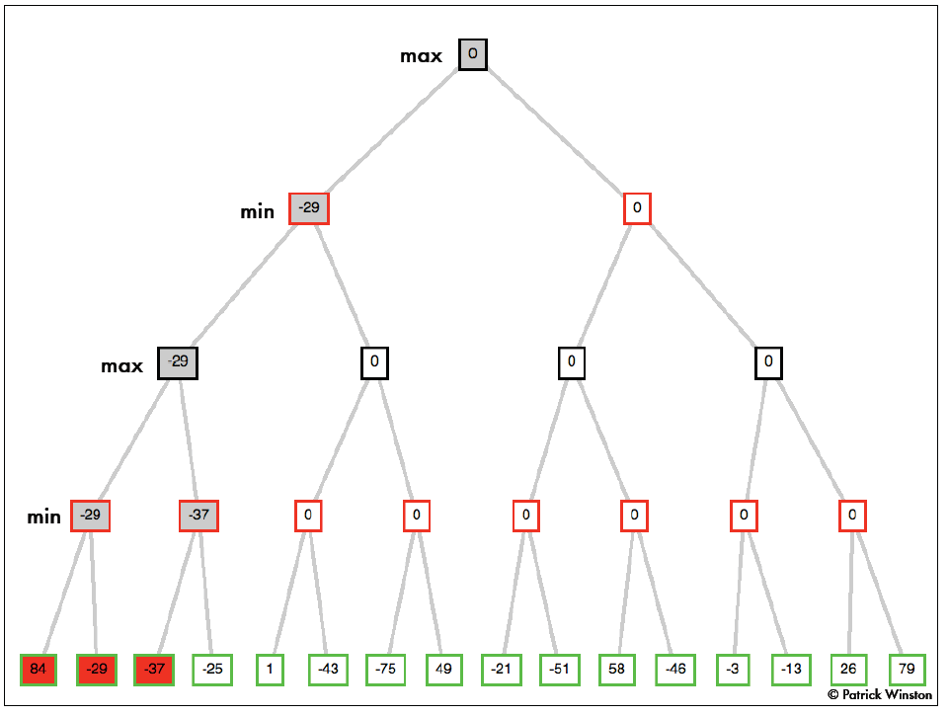

Slide 22
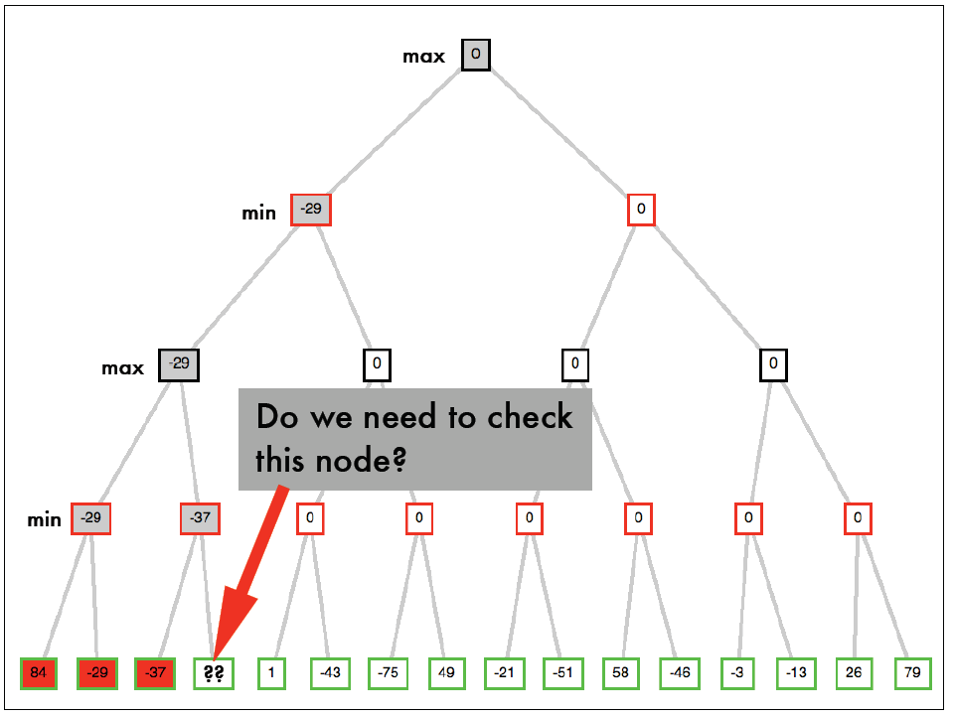

Slide 23
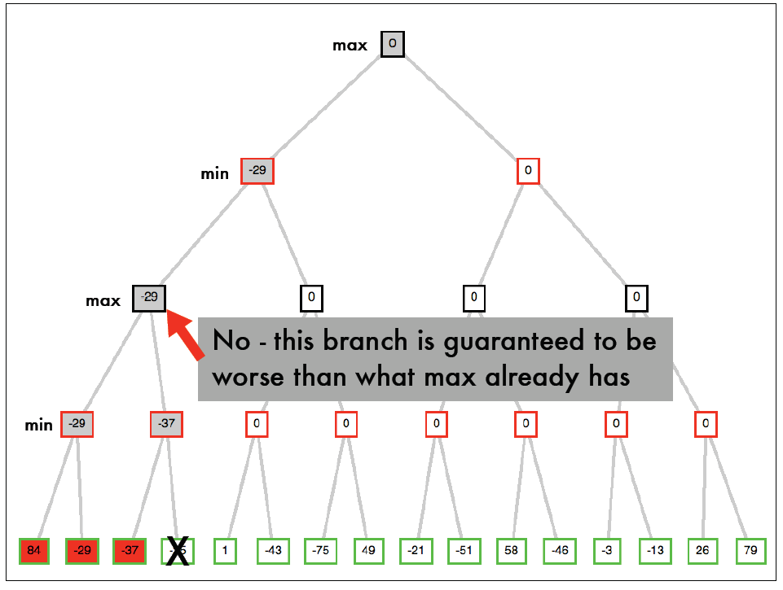

Slide 24
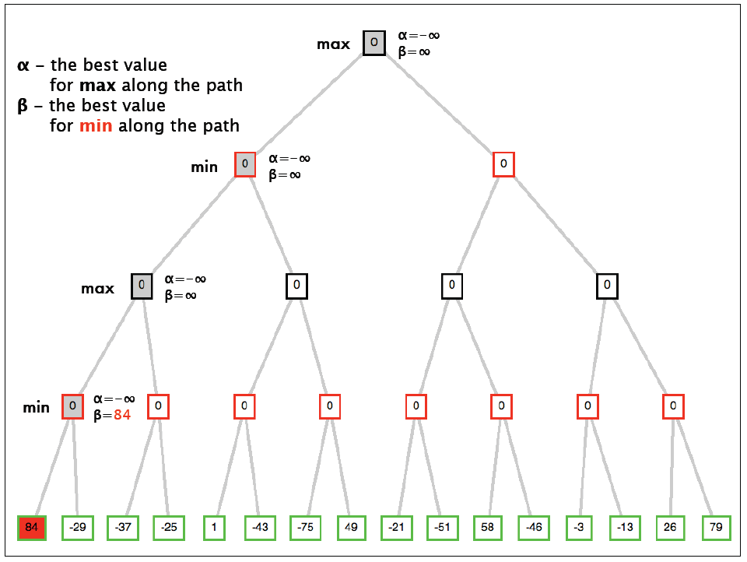

Slide 25
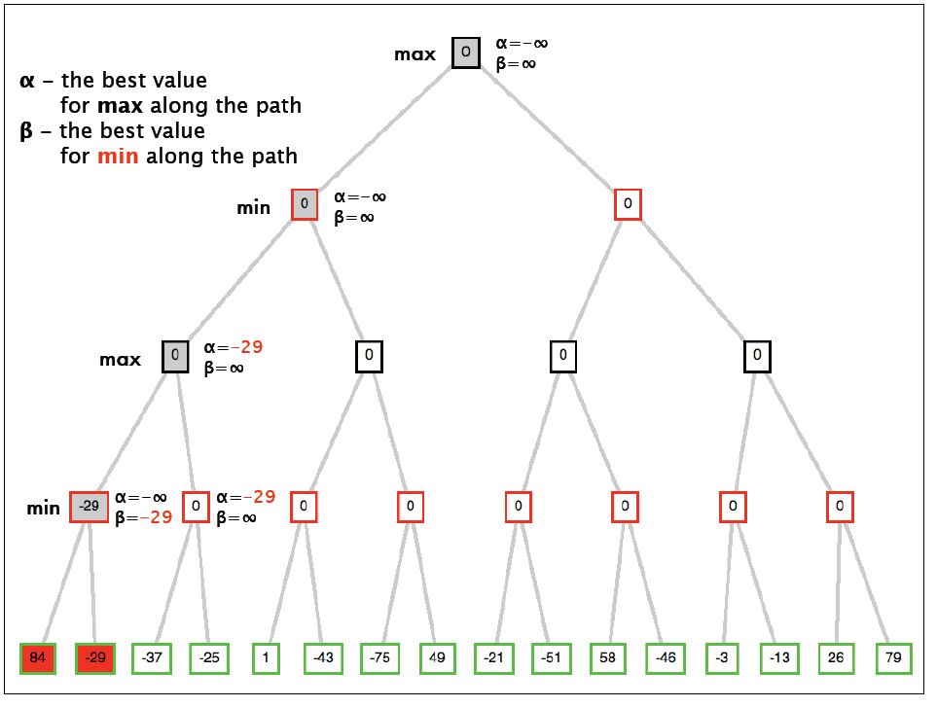

Slide 26
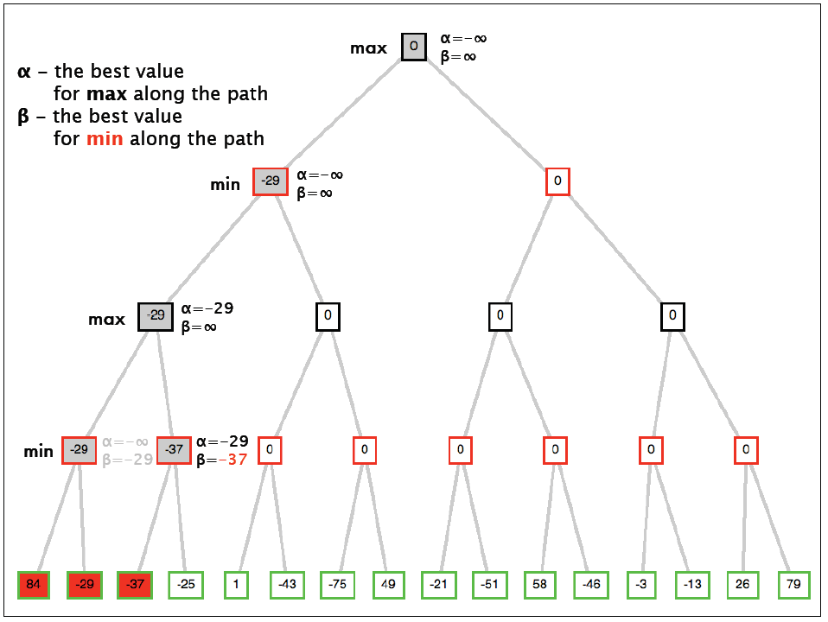

Slide 27
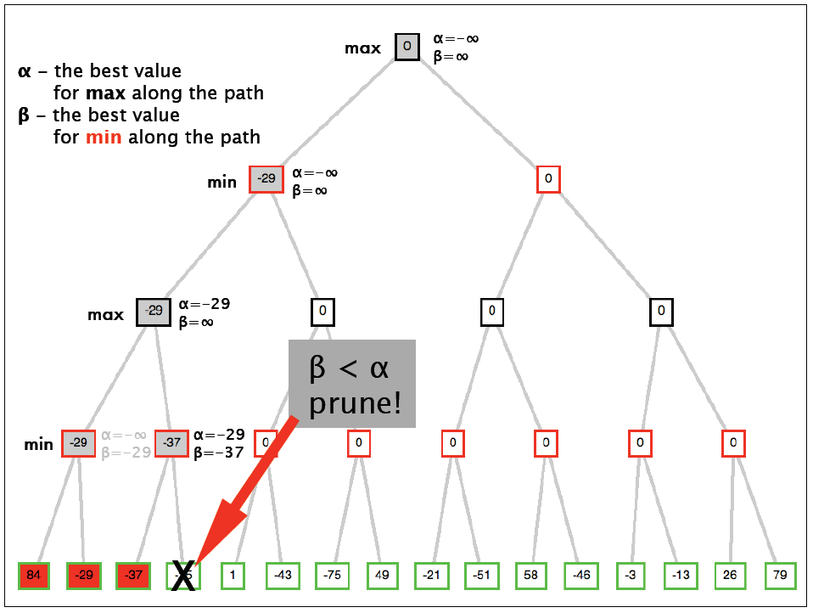

Slide 28
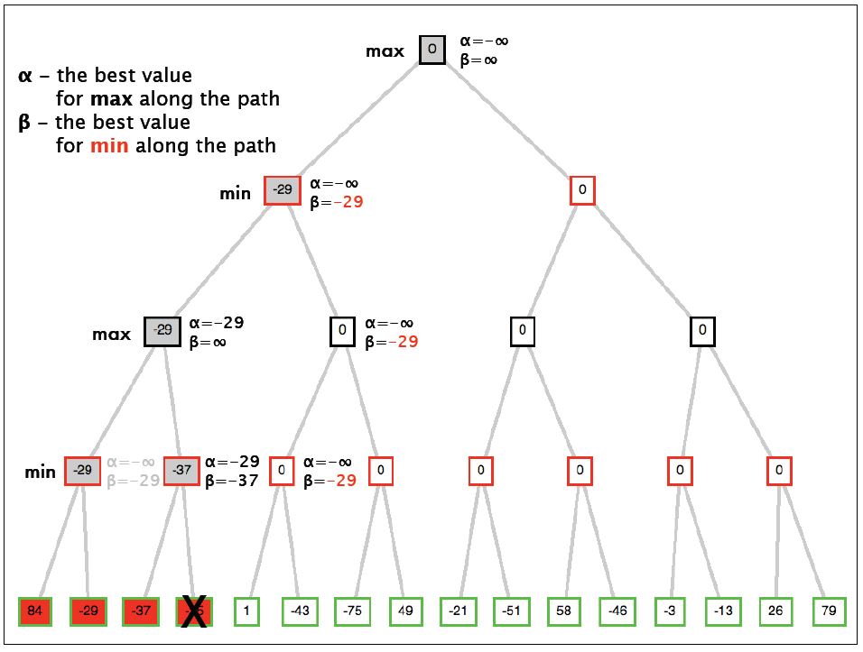

Slide 29
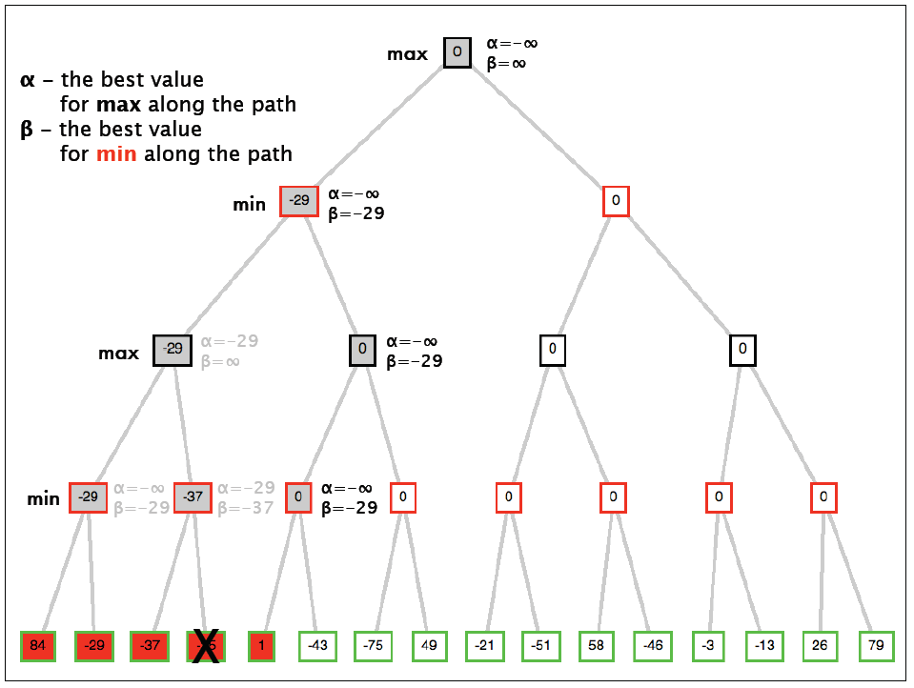

Slide 30
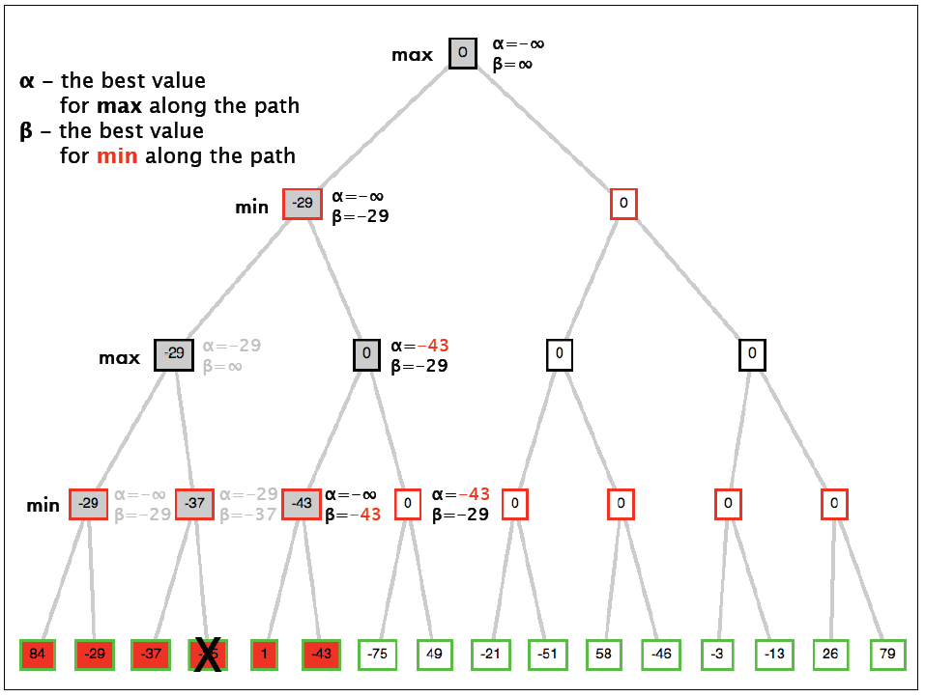

Slide 31
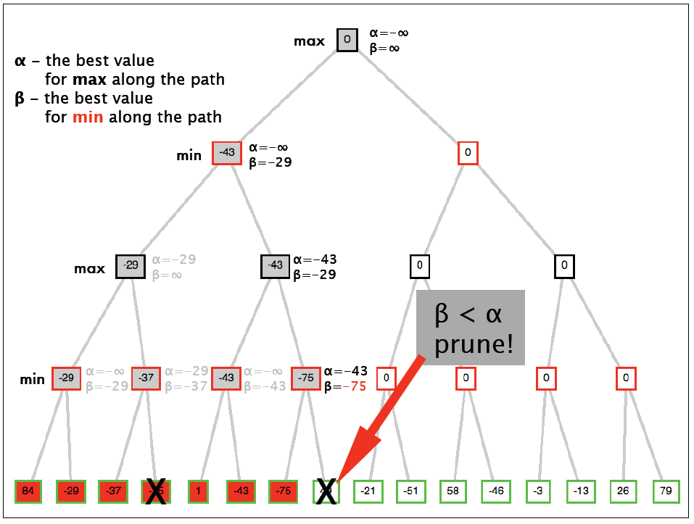

Slide 32
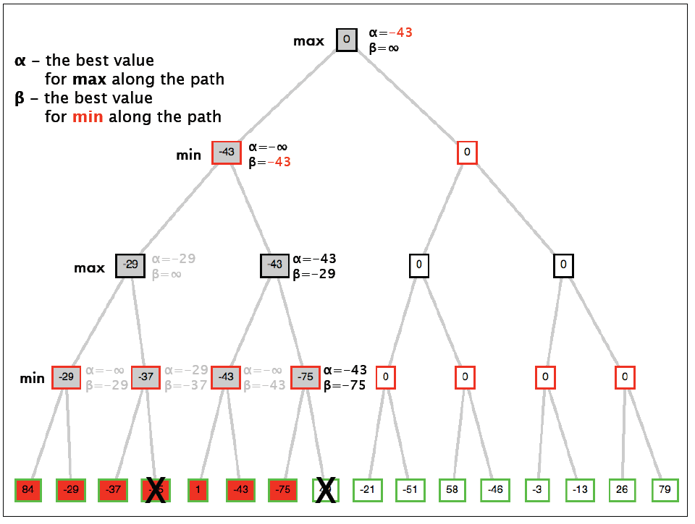

Slide 33
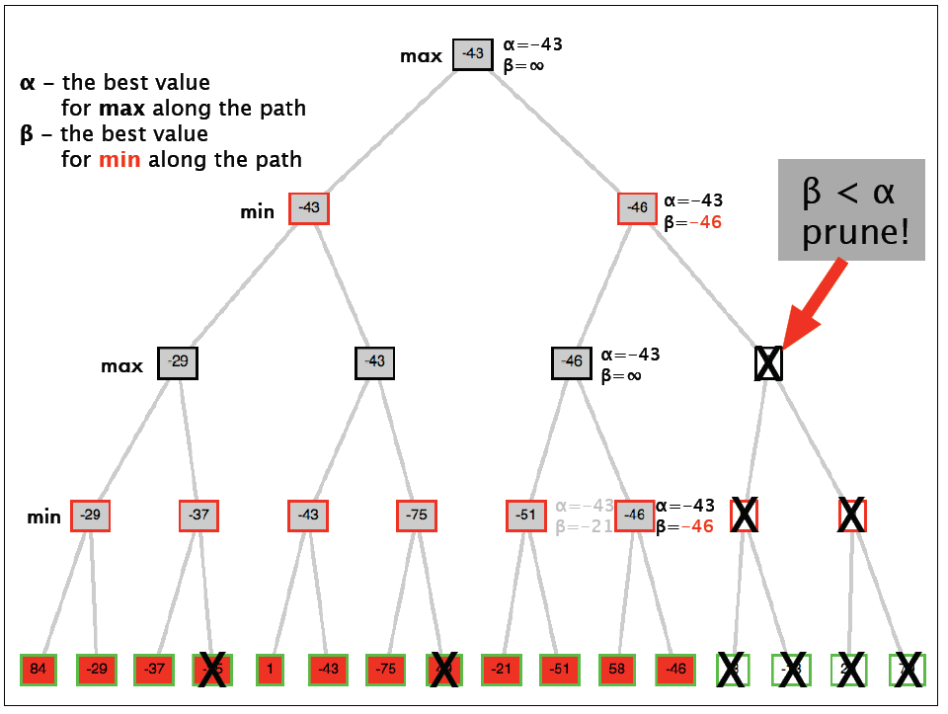

Slide 34
Alpha-Beta Pruning Properties
This pruning has no effect on final result at the root
Values of intermediate nodes might be wrong!
but, they are bounds
Good child ordering improves effectiveness of pruning
With “perfect ordering”:
Time complexity drops to O(b^{m/2})
Doubles solvable depth!
Full search of, e.g. chess, is still hopeless…

Slide 35
Alpha-Beta Implementation
α: MAX’s best option on path to root
β: MIN’s best option on path to root
def max-value(state, α, β):
initialize v = -∞
for each successor of state:
v = max(v,
value(successor, α, β))
if v ≥ β return v
α = max(α, v)
return v
def min-value(state , α, β):
initialize v = +∞
for each successor of state:
v = min(v, value(successor, α, β))
if v ≤ α return v
β = min(β, v)
return v
Slide from Dan Klein & Pieter Abbeel - ai.berkeley.edu
Notes:
Pick an order for two reasons: sequential processor and pruning

