Slide 1
CSE373: Data Structures & Algorithms Lecture 23: Course Victory Lap
Kevin Quinn
Fall 2015

Slide 2
Today
Rest-of-course logistics: exam, etc.
Review of main course themes
Course evaluations
Thoughtful and constructive feedback deeply appreciated
(Including what you liked)

Slide 3
Final Exam
As also indicated on the web page:
Next Tuesday, 2:30-4:20
Cumulative but topics post-midterm worth about 2/3 of the points
Not unlike the midterms in style, structure, etc.
Tough-but-fair exams are the most equitable approach
And/but 110 minutes will make a big difference

Slide 4
Post Midterm Topics
Sorting
Minimum Spanning Trees
Parallelism And Concurrency
Problem Solving
Perserving Abstractions

Slide 5
Sorting
Properties and runtimes of varying sorting algorithms
How much extra space required? In place?
Partially sorted? Reverse order?
Homework 6 is great to help prepare
Given a following block mystery psuedocode, determine which sorting algorithm it is
Non-comparison based sorts (bucket sort and radix sort)

Slide 6
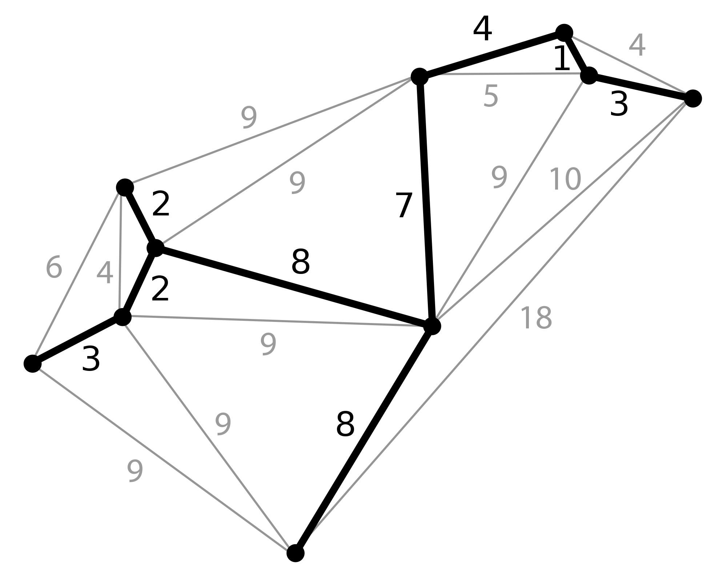
Minimum Spanning Trees
How to build from a graph
Kruscal’s vs Primm’s algorithms and their runtimes
Primm’s: Modified Dijkstras running in O(Elog(V))
Kruscal’s: Using Disjoin sets, O(Elog(E))

Slide 7
Parallelism and Concurrency
What is the difference?
Maps and Reductions
Map: Applying a function to all of the values in a collection, resulting in a identical length collection.
Map([1,2,3,4,5,6], +1) = [2,3,4,5,6,7]
Reduction: Applying a function to a collection to reduce it to a single value.
Reduce([1,2,3,4,5,6], leftmost even number) = 2
Work: How long it takes 1 processor to execute a sequentially execute a block of code
Span: how long it takes infinite processors to execute a block of code

Slide 8
Preserving Abstraction
Copy in vs. Copy out
To protect internal structures from being modified by clients
Private and Final fields
How do they impact immutability?
Hiding unnecessary information from Clients
For example: A client generally does not need to know that your Disjoint sets are being represented as Uptrees
Another example: Java’s HashTable does not tell you what hashcode they are using. Why?

Slide 9
Problem Solving
Lots of different metrics for determine which solution is “best”
For example, solve the following problem first by optimizing for time, then by optimizing solely for space:
Given a list of Strings representing States of birth for students at a highschool. For the most common State, output all the students who were born there.

Slide 10
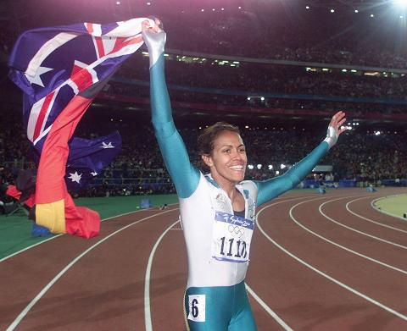
Victory Lap
A victory lap is an extra trip
around the track
By the exhausted victors
(that’s us) ☺
Review course goals
Slides from Lecture 1
What makes CSE373 special

Slide 11
Thank you!
Big thank-you to your TAs: Rocne
Hunter
Hunter 2.0
Bessie
Rahul
Johnson
Eden
Megan
Mauricio
Andy!

Slide 12
Thank you!
And huge thank you to all of you
Great attitude
Good class attendance and questions for the largest-ever CSE373
Thoughts on how to “make it feel smaller” appreciated
Occasionally laughed at stuff

Slide 13
Now three slides, completely unedited, from Lecture 1
Hopefully they make more sense now
Hopefully we succeeded

Slide 14
Data Structures
Introduction to Algorithm Analysis
Lists, Stacks, Queues
Trees, Hashing, Dictionaries
Heaps, Priority Queues
Sorting
Disjoint Sets
Graph Algorithms
May have time for other brief exposure to topics, maybe parallelism

Slide 15
What 373 is about
Deeply understand the basic structures used in all software
Understand the data structures and their trade-offs
Rigorously analyze the algorithms that use them (math!)
Learn how to pick “the right thing for the job”
More thorough and rigorous take on topics introduced in CSE143 (plus more new topics)
Practice design, analysis, and implementation
The elegant interplay of “theory” and “engineering” at the core of computer science
More programming experience (as a way to learn)

Slide 16
Goals
Be able to make good design choices as a developer, project manager, etc.
Reason in terms of the general abstractions that come up in all non-trivial software (and many non-software) systems
Be able to justify and communicate your design decisions
Kevin’s take:
Key abstractions used almost every day in just about anything related to computing and software
It is a vocabulary you are likely to internalize permanently

Slide 17
Where next?
Hopefully cse373 will not be your last exposure to computer science. There are lots of other awesome computer science courses for non-cse majors!
- CSE 154: Web Programming
- Developing Websites and client and server side software
- CSE 374: Intermediate programming Concepts and Tools - Concepts of lower-level programming (C/C++) and explicit
memory management
- CSE 417: Algorithms and Computational Complexity
- NP Complete problems, undecidable problems, graph theory and complexity
- CSE 415: Introduction to Artificial Intelligence
Knowledge representation, logical and probabilistic reasoning, learning, language understanding, intro to game theory

Slide 18
So many other resources outside of UW
Coursera Python Coursehttps://www.coursera.org/specializations/python
Machine learning course:
https://www.coursera.org/learn/machine-learning
Computer Security:
https://www.coursera.org/course/security
Computational Neuroscience:
https://www.coursera.org/course/compneuro
Principles of Computing (Great next step for math lovers):
https://www.coursera.org/course/principlescomputing1

Slide 19
Learn a new Language!
Haskell: http://learnyouahaskell.com/chapters
C++: http://www.learncpp.com/
Scala: http://www.scala-lang.org/documentation/
Ruby: https://www.codecademy.com/learn/ruby
PHP: https://www.codecademy.com/learn/php
Racket: https://learnxinyminutes.com/docs/racket/
There are resources of 100’s of languages online. Pick one and mess with it!

Slide 20
Learn to code games!
Using Unity: https://www.udemy.com/unitycourse/
Using ActionScript: https://www.siteground.com/tutorials/actionscript/
Make an Android App (using mostly Java):
http://developer.android.com/training/basics/firstapp/index.html

Slide 21
So much more!
Create an account on StackOverflow
Ask and answer questions!
Subscribe to the Programming subreddit (the people are only a little pretentious ☺)
Fork peoples projects on github and read their code
Contribute to open source projects
Participate in a hackathon
Learn how to write scripts to automate things you don’t like spending time on!

Slide 22
Finally, thanks for the opportunity to work with you all!

