Slide 1
CSE 421
Divide and Conquer
Yin Tat Lee

Slide 2
Announcements
From Jan 31 (next mon), all lectures and OH will be in person.
There will be recording (Panopto or zoom).
If you feel sick, don’t go to the class.
Midterm is in person.
Feb 4 (next Friday)
Open book and notes (hard copies only)
Coverage: All topics through divide and conquer
If you cannot attend the midterm, please contact me ASAP.
HW4 is out!

Slide 3
HW2 Comments
What are not considered as a proof?
You just describe what your algorithm does.
Bad: We explores edges in alphabetical order, so the output is correct.
You can always look at lecture notes to see how things are proved.
Techniques:
Induction (Key: Come up with a good hypothesis)
Contradiction (If the output is wrong, what do we contradicts to?)
I changed the guideline to
Discuss runtime
Prove correctness
Still, the most important thing is to come up with a right algorithm. You are doing a great job here.

Slide 4
Divide and Conquer Approach

Slide 5
Divide and Conquer
We reduce a problem to several subproblems.
Typically, each sub-problem is
at most a constant fraction of
the size of the original problem
Recursively solve each subproblem
Merge the solutions
Examples:
Mergesort, Binary Search, Strassen’s Algorithm,
n
Log n levels
n/2
n/2
n/4

Slide 6
A Classical Example: Merge Sort
A
sort
recursively
Split to $n/2$
merge

Slide 7
Why Balanced Partitioning?
An alternative "divide & conquer" algorithm:
Split into n-1 and 1
Sort each sub problem
Merge them
Runtime
$$T\left(n\right)=T\left(n−1\right)+T\left(1\right)+n$$
Solution:
$$T\left(n\right)=n+T\left(n−1\right)+T\left(1\right)$$
$$=n+n−1+ T\left(n−2\right)$$
$$=n+n−1+n−2+T\left(n−3\right)$$
$$=n+n−1+n−2+…+1=O(n^{2})$$

Slide 8
Reinventing Mergesort
Suppose we've already invented Bubble-Sort, and we know it takes $n^{2}$
Try just one level of divide & conquer:
Bubble-Sort (first n/2 elements)
Bubble-Sort (last n/2 elements)
Merge results
Time: $2 T(n/2) + n = n2/2 + n ≪ n2$
Almost twice as fast!
D&C in a
nutshell

Slide 9
Reinventing Mergesort
Why quick sort is better?
“the more dividing and conquering, the better”
Two levels of D&C would be almost 4 times faster, 3 levels almost 8, etc., even though overhead is growing.
Best is usually full recursion down to a small constant size (balancing "work" vs "overhead").
In the limit: you’ve just rediscovered mergesort!
Even unbalanced partitioning is good, but less good
Bubble-sort improved with a 0.1/0.9 split:
$${\left(.1n\right)}^{2} + {\left(.9n\right)}^{2} + n = .82n2 + n$$
The 18% savings compounds significantly if you carry recursion to more levels, actually giving $O(n\log{n})$, but with a bigger constant.
This is why Quicksort with random splitter is good – badly unbalanced splits are rare, and not instantly fatal.
In C++, stdlib do quick sort for $n>16$ and insertion sort for $n≤16$.
See https://www.youtube.com/watch?v=FJJTYQYB1JQ

Slide 10
Finding the Root of a Function

Slide 11
Finding the Root of a Function
Given a continuous function f and two points $a<b$ such that
$$f\left(a\right)≤0$$
$$f\left(b\right)≥0$$
Goal: Find a point $c$ where $f\left(c\right)$ is close to $0$.
$f$ has a root in $[a,b]$ by
intermediate value theorem
Note that roots of $f$ may be irrational,
So, we want to approximate
the root with an arbitrary precision!
$$f(x)=\sin\left(x\right)−\frac{100}{\sqrt{x}}+x^{4}$$
a
b

Slide 12
A Naive Approach
Suppose we want $ε$ approximation to a root.
Divide $[a,b]$ into $n=\frac{b−a}{ε}$ intervals. For each interval check
$$f\left(x\right)≤0,f\left(x+ε\right)≥0$$
This runs in time $O\left(n\right)=O(\frac{b−a}{ε})$
Can we do faster?
a
b

Slide 13
Divide & Conquer (Binary Search)
Bisection ($a,b,ε$)
if $\left(b−a\right)<ε$ then
return $a$;
else
$m←(a+b)/2$;
if $f\left(m\right)≤0$ then
return Bisection($m,b,ε$);
else
return Bisection($a,m,ε$);
a
c
b

Slide 14
Time Analysis
Let $n=\frac{b−a}{ε}$ be the # of intervals and $c=(a+b)/2$
Always half of the intervals lie to
the left and half lie to the right of c
So,
$T\left(n\right)=T\left(\frac{n}{2}\right)+O(1)$
i.e., $T\left(n\right)=O(\log{n)=O(\log{(\frac{b−a}{ε})})}$
a
c
b
n/2
n/2
For $d$ dimension ,
“Binary search” can be used to minimize convex functions.
The current best algorithms take $O(d^{3}\log^{O\left(1\right)}{(d/ε)})$ time.

Slide 15
Fast Exponentiation

Slide 16
Fast Exponentiation
Power($a,n$)
Input: integer $n≥0$ and number $a$
Output: $a^{n}$
Obvious algorithm
$n−1$ multiplications
Observation:
if $n$ is even, then $a^{n}=a^{n/2}⋅a^{n/2}$.

Slide 17
Divide & Conquer (Repeated Squaring)
Is there any problem in the program?
Power($a,n$) {
if ($n=0$)
return $1$
else if ($n$ is even)
return Power($a,n/2$)• Power($a,n\text{/2}$)
else
return Power($a,(n−1)/2$)• Power($a,(n−1)\text{/2}$) • $a$
}
$k=Power(a,n/2)$; return $k\text{•}k$;
$k=Power(a,(n−1)/2)$; return $k\text{•}k\text{•}a$;
Time (# of multiplications):
$T\left(n\right)≤T(\left.\left\lfloor n/2\right.\right\rfloor )+2$ for $n≥1$
$T\left(0\right)=0$
Solving it, we have
$T\left(n\right)≤T(\left.\left\lfloor n/2\right.\right\rfloor )+2≤T(\left.\left\lfloor n/4\right.\right\rfloor )+2+2$
$≤⋯≤T\left(1\right)+2+⋯+2≤2\log_{2}{n}$.
$\log_{2}(n)$ copies

Slide 18
Quiz

Slide 19
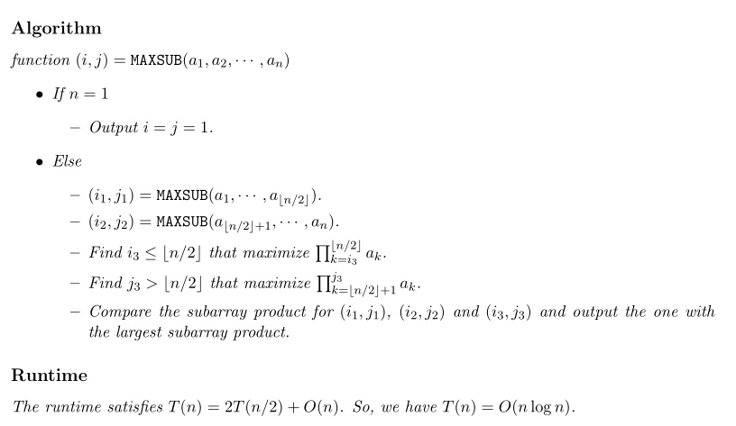
Quiz

Slide 20
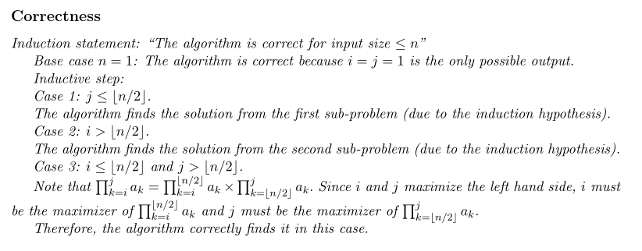
Quiz

Slide 21
Master Theorem

Slide 22
Master Theorem
Suppose $T\left(n\right)=a T\left(\frac{n}{b}\right)+cn^{k}$ for all $n>b.$ Then,
If $a<b^{k}$ then $T\left(n\right)=Θ\left(n^{k}\right)$
If $a=b^{k}$ then $T\left(n\right)=Θ\left(n^{k}log n\right)$
If $a>b^{k}$ then $T\left(n\right)=Θ\left(n^{\log_{b}a}\right)$
Works even if it is $\left\lceil \frac{n}{b}\right\rceil$ instead of $\frac{n}{b}.$
We also need $a≥1,b>1 , k≥0$.

Slide 23
Master Theorem
Suppose $T\left(n\right)=a T\left(\frac{n}{b}\right)+cn^{k}$ for all $n>b.$ Then,
If $a<b^{k}$ then $T\left(n\right)=Θ\left(n^{k}\right)$
If $a=b^{k}$ then $T\left(n\right)=Θ\left(n^{k}log n\right)$
If $a>b^{k}$ then $T\left(n\right)=Θ\left(n^{\log_{b}a}\right)$
Example: For mergesort algorithm we have
$$T\left(n\right)=2T\left(\frac{n}{2}\right)+O\left(n\right).$$
So, $k=1,a=b^{k}$ and $T\left(n\right)=Θ(n\log{n)}$

Slide 24
Proving Master Theorem
Problem size
$$T\left(n\right)=aT(n/b)+cn^{k}$$
# probs
cost
$$n$$
$$a$$
$$1$$
$$cn^{k}$$
$$n/b$$
$$a$$
$$a⋅c{\left(n/b\right)}^{k}$$
$$d=\log_{b}n$$
$$n/b^{2}$$
$$a2$$
$$a^{2}⋅c{\left(n/b^{2}\right)}^{k}$$
$$a^{d}⋅c{\left(n/b^{d}\right)}^{k}$$
$$1$$
$$ad$$
$$T\left(n\right)=\sum_{i=0}^{d=\log_{b}{n}}{a^{i}c{\left(\frac{n}{b^{i}}\right)}^{k}}$$

Slide 25
Master Theorem
Suppose $T\left(n\right)=a T\left(\frac{n}{b}\right)+cn^{k}$ for all $n>b.$ Then,
If $a<b^{k}$ then $T\left(n\right)=Θ\left(n^{k}\right)$
If $a=b^{k}$ then $T\left(n\right)=Θ\left(n^{k}log n\right)$
If $a>b^{k}$ then $T\left(n\right)=Θ\left(n^{\log_{b}a}\right)$
# of problems increases slower
than the decreases of cost.
First term dominates.
# of problems increases faster
than the decreases of cost
Last term dominates.

