Slide 1
CSE 421
Max Flow Algorithms
Yin Tat Lee

Slide 2
Notations
Given a directed graph $G$ with integral capacity $0≤c_{e}≤U$.
Input size is $O(m\log{U})$.
We call a runtime
${\left(mU\right)}^{O(1)}$ is pseudo polynomial.
${\left(m\log{U}\right)}^{O(1)}$ is weakly polynomial.
$m^{O(1)}$ is strongly polynomial.
Ford Fulkerson takes $O\left(mF\right)=O(mnU)$. (Pseudo Polynomial).
Dependence on $U$ is bad because $U$ can be much larger than $m$.

Slide 3
Weakly polynomial: Capacity Scaling Question: How to improve 𝑈 dependence?
Idea: Handle edges with large capacity first.

Slide 4
Capacity Scaling
Let $G_{f}(D)$ be the residual $G_{f}$ with all edges $<D$ capacity removed.
Algorithm:
Set $D=U$
While $D≥1$
While there is $s$-$t$ path $p$ in $G_{f}(D)$
Augment along $p$ by lowest edge capacity in $G_{f}(D)$
Set $D←\left\lfloor D/2\right\rfloor$
Correctness:
When $D=1$, the inner loop is simply Ford Fulkerson.
Hence, at termination, we have a maxflow.

Slide 5
Capacity Scaling
4
a
x
5
3
3
7
4
7
s
b
y
t
6
1
4
6
5
c
z

Slide 6
Capacity Scaling
100
a
x
101
011
011
111
100
111
s
b
y
t
110
001
100
110
101
c
z

Slide 7
Capacity Scaling Bit 1
100
a
x
101
011
011
111
100
111
s
b
y
t
110
001
100
110
101
c
z
Capacity on each edge is at most 1
(either 0 or 1 times Δ=4)

Slide 8
Capacity Scaling Bit 1
100
a
x
101
011
011
1/111
1/100
1/111
s
b
y
t
1/110
001
100
1/110
1/101
c
z
O(nm) time

Slide 9
Capacity Scaling Bit 2
100
a
x
101
011
011
10/111
10/100
10/111
s
b
y
t
10/110
001
100
10/110
10/101
c
z
Residual capacity across min cut is at most m
(either 0 or 1 times Δ=2)

Slide 10
Capacity Scaling Bit 2
01/100
a
x
10/101
01/011
01/011
10/111
10/100
11/111
s
b
y
t
10/110
001
100
10/110
10/101
c
z
Residual capacity across min cut is at most m
⇒ ≤ m augmentations

Slide 11
Capacity Scaling Bit 3
010/100
a
x
100/101
010/011
010/011
100/111
100/100
110/111
s
b
y
t
100/110
100
001
100/110
100/101
c
z
Residual capacity across min cut is at most m
(either 0 or 1 times Δ=1)

Slide 12
Capacity Scaling Bit 3
010/100
a
x
101/101
010/011
011/011
101/111
100/100
111/111
s
b
y
t
101/110
100
001/001
110/110
101/101
c
z
After ≤ m augmentations

Slide 13
Capacity Scaling Final
2/4
a
x
5/5
2/3
3/3
5/7
4/4
7/7
s
b
y
t
5/6
4
6/6
1/1
5/5
c
z

Slide 14
Capacity Scaling
Lemma: When the inner loop terminates for some $D$,
$$val\left(f^{∗}\right)≤val\left(f\right)+Dm$$
Proof:
When the inner loop terminates, there is no $s$-$t$ path in$G_{f}(D)$.
Let $S$ be the set of vertices reachable from $s$ in $G_{f}(D)$.
Note that $cap\left(S,\overline{S}\right)≤val\left(f\right)+Dm$.
Hence, $val\left(f^{∗}\right)≤val\left(f\right)+Dm$.
Notes:
Draw a picture and explain cap(S, S bar) <= val(f) + Dm.

Slide 15
Capacity Scaling
Corollary: Inner loop takes $O(m)$ steps.
Proof:
Each step, $val(f)$ is increased by at least $D$.
But $val\left(f^{∗}\right)≤val\left(f\right)+2Dm$ at the beginning.
Hence, there are at most $2m$ steps.
Theorem: Capacity scaling takes $O(m^{2}\log{U})$ time.
Proof:
Outer loop has $O(\log{U})$ steps.
Inner loop has $O(m)$ steps.
Each step takes $O(m)$ time.
Algorithm:
Set $D=U$
While $D≥1$
While there is $s$-$t$ path $p$ in $G_{f}\left(D\right)$
Augment along $p$ by lowest edge capacity in $G_{f}(D)$
$D←\left\lfloor D/2\right\rfloor$

Slide 16
Strongly polynomial: Edmonds-Karp Algorithm Question: Can we pick better paths to augment?
Idea: Shortest Path!

Slide 17
Edmonds-Karp Algorithm
Use a shortest augmenting path (via Breadth First Search in residual graph)
Lemma:
Let $f$ be a flow and $P$ a shortest augmenting path.
Then no vertex is closer to $s$ in $G_{f}$ after augmentation along $P$.
Proof: Augmentation along $P$ only
deletes forward edges
no new (hence no shorter) path created
adds back edges that go to previous vertices along $P$
BFS is unchanged, since $v$ visited before $(u,v)$ examined
s
v
a back edge
u

Slide 18
Theorem
Edmonds-Karp performs $O(mn)$ flow augmentations
Proof:
Call $\left(u,v\right)$ critical for augmenting path $P$ if it’s closest to $s$ with min residual capacity.
It will disappear from $G_{f}$ after augmenting along $P$.
For $(u,v)$ to be critical again, the $(u,v)$ edge must re-appear in $G_{f}$ but that will only happen when the distance to $u$ has increased by $2$ (next slide)
It won’t be critical again until farther from $s$ so each edge critical at most $n/2$ times.
Corollary: Total time is $O(m^{2}n)$.

Slide 19
Distance for bottleneck edges
Let $d_{f}(s,v)$ be the distance from $s$ to $v$ on $G_{f}$.
Shortest s-t path $P$ in $G_{f}$
>c_{P}
>c_{P}
c_{P}
c_{P}
s
u
v
x
w
t
bottleneck edge
After augmenting along $P$
$d_{f}\left(s,v\right)=d_{f}\left(s,u\right)+1$ since this is a shortest path
>0
>0
s
u
v
x
w
t
For $(u,v)$ to be bottleneck again for some flow $f′$
s
u
v
x
w
t
$$d_{f^{′}}\left(s,u\right)=d_{f^{′}}\left(s,v\right)+1≥d_{f}\left(s,v\right)+1=d_{f}\left(s,u\right)+2$$

Slide 20
Faster Strongly polynomial: Dinic algorithm Question: What is better than 1 shortest paths?
Idea: Multiple Shortest Paths!

Slide 21
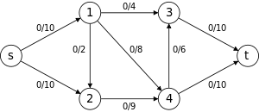
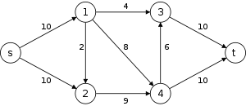
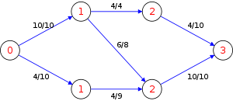
Dinic’s algorithm
Send as many shortest paths as possible at the same time.
$$G$$
$$G_{f}$$
distance to $s$
Keep on forward edges

Slide 22
Dinic’s algorithm
Let $f$ be some flow.
The level graph $L_{f}$ is the graph with edges given by
$$\{\left(u,v\right)∈G_{f}:d_{G_{f}}\left(s,v\right)=d_{G_{f}}\left(s,u\right)\}$$
We call $f′$ is a blocking flow in $L_{f}$ if
$\{e∈L_{f}:f^{′}\left(e\right)<c_{G_{f}}\left(e\right)\}$ has no $s$-$t$ path.
Algorithm:
$f=0$
While there is $s$-$t$ path $p$ in $G_{f}$
Compute the level graph $L_{f}$
Find a blocking flow $f′$.
Update $f←f+f′$.

Slide 23
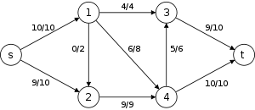
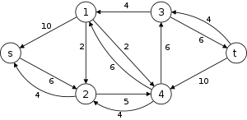
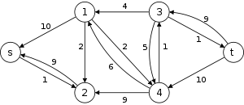
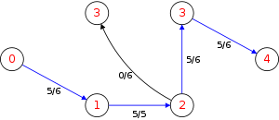
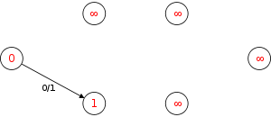
Dinic’s algorithm
Send as many shortest paths as possible at the same time.
$$G$$
$$G_{f}$$
$$L_{f}$$

Slide 24
Dinic’s algorithm
Lemma: $d_{G_{f}}(s,t)$ increase every iteration.
Proof (Draft):
If distance doesn’t change, a shortest path on the new graphs must be on the level graph.
But there is no s-t path in the level graph after sending the blocking flow.
Corollary: There are at most $n$ iterations.
Proof:
$s$-$t$ distance is bounded by $n$ and is increased by $1$ every step.
We can find blocking flow in $O(mn)$ time picking path 1 by 1.
Hence, Dinic’s algorithm takes $O(mn^{2})$ time.

Slide 25
Link Cut Tree
There are a data structure that supports the following.
make_tree(): Return a new vertex in a singleton tree.
link(v,w,x): Make vertex v a new child of vertex w. Set the edge capacity to x.
cut(v): Delete the edge between v and its parent.
find_root(v) – Return the root of the tree that contains v.
find_min(v) – Return the edge with minimum capacity on the v-root path.
subtract(v,x) – Subtract x from the capacity on the v-root path.
Furthermore, all steps takes $O(\log{n})$ time.
With this, we can send a flow in $O(\log{n})$ time in the level graph.
Hence, Dinic’s algorithm takes $O(mn\log{n})$ time.

Slide 26
Can we do it even faster?

Slide 27
Runtimes…
Unfortunately, this slide was made in 2011 (during my undergrad).
Undirected graph
$mn^{1/3}/ε^{11/3}$ [Christiano-Kelner-Madry-Spielman-Teng 2011]
$mn^{1/3}/ε^{2/3}$ [Lee-Rao-Srivastava 2013]
$m/ε^{2}$ [Sherman 2013, Kelner-Lee-Orecchia-Sidford 2014]
$m/ε$ [Sherman 2017]
$m+\sqrt{mn}/ε$ [Sidford-Tian 2020]
Directed graph
$m^{10/7}U^{1/7}$ [Madry 2013, Madry 2016]
$m\sqrt{n}$ [Lee-Sidford 2013]
$m^{11/8}U^{1/4}$ [Liu-Sidford 2020]
$m^{4/3}U^{1/3}$ [Liu-Sidford 2020, Kathuria 2020]
$m+n^{1.5}$ [Brand-Lee-Liu-Saranurak-Sidford-Song-Wang 2021]
$m^{3/2−1/328}$ [Gao-Liu-Peng 2021]
$m^{3/2−1/58}$ [Brand-Gao-Jambulapati-Lee-Liu-Peng-Sidford 2021]
$O\left({mn}^{2}U\right) \text{[}\text{Dantzig}\text{ ′51]}$
$O\left(mn U\right) \text{[}\text{Ford} \text{Fulkerson}\text{ ′56]}$
$O\left(m^{2}n\right)\text{[}\text{Dinitz}\text{ ′70, }\text{Edmonds} \text{Karp}\text{ ′72]}$
$O\left({mn}^{2}\right) \text{[}\text{Dinitz}\text{ ′70]}$
$O\left(m^{2}\log{U}\right) \text{[}\text{Edmonds} \text{Karp}\text{ ′72, }\text{Dinitz}\text{ ′73] }$
$O\left(mn\log{U}\right)\text{[}\text{Dinitz}\text{ ′73, }\text{Gabow}\text{ ′85] }$
$O\left(n^{3}\right) \text{[}\text{Karzanov}\text{ ′74]}$
$O\left(n^{2}\sqrt{m}\right) \text{[}\text{Cherkassky}\text{ ′77] }$
$O\left(mn\log^{2}{n}\right) \text{[}\text{Galil} \text{Naamad}\text{ ′80]}$
$O\left(mn\log{n}\right) \text{[}\text{Sleator} \text{Tarjan}\text{ ′83]}$
$O\left(mn\log\left(\frac{n^{2}}{m}\right)\right) \text{[}\text{Goldberg} \text{Tarjan}\text{ ′88]}$
$O\left(mn +n^{2}\log{U}\right)\text{[}\text{Ahuja} \text{Orlin}\text{ ′89]}$
$O\left(mn\log\left(\frac{n \sqrt{\log{U}}}{m + 2}\right)\right) \text{[}\text{Ahuja} \text{Orlin} \text{Tarjan}\text{ ′89]}$
$O\left(mn +n^{\frac{8}{3}}\log{n}\right)\text{[}\text{Alon}\text{ ′90]}$
$O\left(mn + n^{2}\log^{2}{n}\right)\text{[}\text{Cheriyan} \text{Hagerup}\text{ ′95]}$
$O\left(\frac{n^{3}}{\log{n}}\right) \text{[}\text{Cheriyan} \text{Hagerup} \text{Mehlhorn}\text{ ′96]}$
$O\left(mn + n^{2+ε}\right) \text{[}\text{King} \text{Rao} \text{Tarjan}\text{ ′92]}$
$O\left(mn\log_{\frac{m}{n}}{\log^{2+ε}{n}}\right)\text{[}\text{Phillips} \text{Westbrook}\text{ ′93]}$
$O\left(mn\left(\log_{\frac{m}{n\log{n}}}n \right)\right) [King Rao Tarjan ′94]$
$O\left(m⋅\min\left(n^{\frac{2}{3}},m^{\frac{1}{2}}\right)\log\left(\frac{n^{2}}{m}\right)\log{U}\right)$ $[Goldberg Rao ′98]$
Previous Best: $\tilde{O}(min(m^{1.5},mn^{2/3}))$ [Even-Tarjan 75, Goldberg-Rao 89]

Slide 28
Shortest Path and Maxflow?
Given an undirected graph with unit capacity and unit length.
What is the relation between shortest path and maxflow?
Let $ℱ$ be the set of $s$-$t$ flow with value $1$.
Shortest path problem: $\min_{f∈ℱ}{||f||_{1}}$.
Maxflow problem: $\min_{f∈ℱ}{||f||_{∞}}$.
Solving maxflow via shortest path is like using $ℓ_{1}$ problem to approximate $ℓ_{∞}$ problem.

Slide 29
Shortest Path and Maxflow?
Fact: $\min_{f∈ℱ}{||f||_{2}}$ can be solved in $O(m\log{m})$ time.
[Spielman-Teng 2003]
Instead of augmenting using shortest path,
“augment” using $ℓ_{2}$ flow.
This gives $m\sqrt{n}$ time algorithm. (2014)

Slide 30
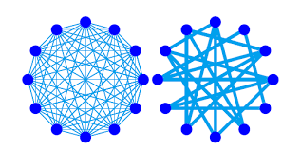
Approximate Graphs with Sparse Graphs
Every graph $G$ can be approximated by a sparse graph $G′$:
$G′$ has $O(n)$ edges
$cap_{G}\left(S,\overline{S}\right)=(1±\frac{1}{2})cap_{G^{′}}\left(S,\overline{S}\right)$ for all set $S$.
Using this, one can “find” the augmenting path on the sparse graph.
This gives $m+n^{3/2}$ time algorithm. (2020)

Slide 31
Creating shortcut in the graph
Instead of looking at all vertices all the time,
we can random sample some vertices and shortcut the graph.
This gives $m^{3/2−1/58}$ time algorithm. (2022)

Slide 32
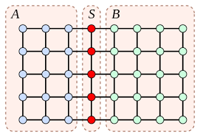
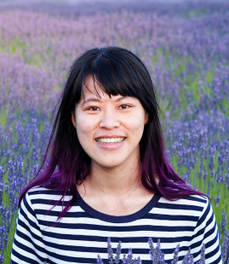
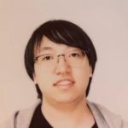
How about simpler graphs?
Many graphs in practice has structures.
One common class is planar graphs.
For these graphs,
we can solve maxflow in nearly linear time (2009)
we can solve mincost flow in nearly linear time (2022)
Guanghao Ye
(was a 421 student)
Sally Dong

