Slide 1
Survey
I will start at 1:35. Please fill in the form in the meantime.
Your opinion is important.
https://uw.iasystem.org/survey/253736

Slide 2
CSE 421
Linear Programs
Yin Tat Lee

Slide 3
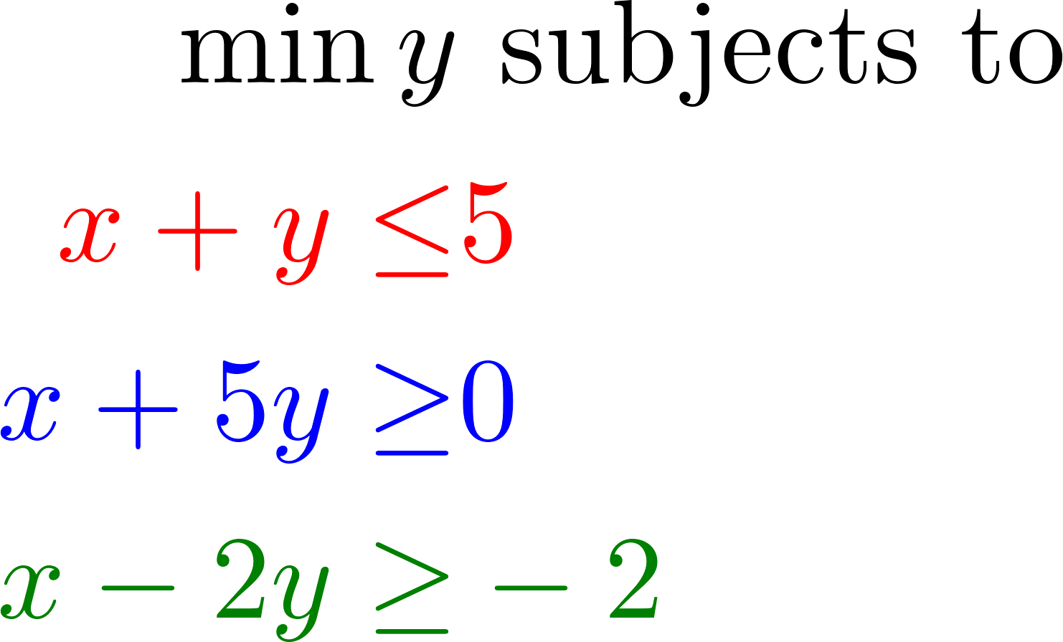
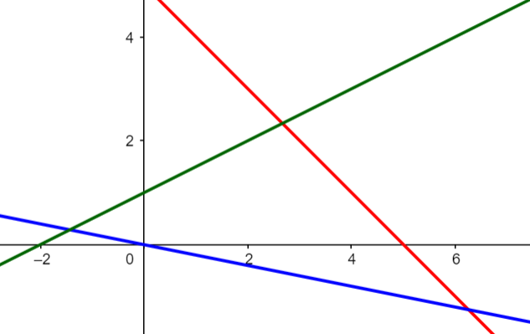
Linear Programming
Optimize a linear function subject to linear inequalities.
$$\max{c_{1}x_{1}+c_{2}x_{2}+⋯+c_{n}x_{n}}$$
subjects to
$$a_{i1}x_{1}+a_{i2}x_{2}+⋯+a_{in}x_{n}≤b_{i}$$
for $i=1,2,⋯,m$
Example:

Slide 4
Applications of Linear Programming
Generalizes: Ax=b, shortest path, max-flow, matching, minimum spanning tree, Dynamic Decision Problem, …
Why significant?
We can solve linear programming in polynomial time.
We can model many practical problems with a linear model and solve it with linear programming
Linear Programming in Practice:
There are very fast implementations: CPLEX, Gorubi, ….
CPLEX can solve LPs with millions of variables/constraints in seconds

Slide 5
Example 1: Diet Problem
Suppose you want to schedule a diet for yourself. There are four category of food: veggies, meat, fruits, and dairy. Each category has its own (p)rice, (c)alories and (h)appiness per pound:
Linear Modeling: Consider a linear model: If we eat 0.5lb of meat and 0.2lb of fruits we will be $0.5{ h}_{m}+0.2 h_{f}$ happy
You should eat at most 2000 calories to be healthy
You can spend 20 dollars a day on food.
Goal: Maximize happiness?
 | veggies | meat | fruits | dairy
price | $$p_{v}$$ | $$p_{m}$$ | $$p_{f}$$ | $$p_{d}$$
calorie | $$c_{v}$$ | $$c_{m}$$ | $$c_{f}$$ | $$c_{d}$$
happiness | $$h_{v}$$ | $$h_{m}$$ | $$h_{f}$$ | $$h_{d}$$

Slide 6
Diet Problem by LP
You should eat at most 2000 calories to be healthy
You can spend 20 dollars a day on food.
Goal: Maximize happiness?
 | veggies | meat | fruits | dairy
price | $$p_{v}$$ | $$p_{m}$$ | $$p_{f}$$ | $$p_{d}$$
calorie | $$c_{v}$$ | $$c_{m}$$ | $$c_{f}$$ | $$c_{d}$$
happiness | $$h_{v}$$ | $$h_{m}$$ | $$h_{f}$$ | $$h_{d}$$
$$\max{ x_{v}h_{v}+x_{m}h_{m}+x_{f}h_{f}+x_{d}h_{d}} \\ s.t. x_{v}p_{v}+x_{m}p_{m}+x_{f}p_{f}+x_{d}p_{d}≤20 \\ x_{v}c_{v}+x_{m}c_{m}+x_{f}c_{f}+x_{d}c_{d}≤2000 \\ x_{v},x_{m},x_{f},x_{d}≥0$$
#pounds of veggies, meat, fruits, dairy to eat per day

Slide 7
Diet Problem by LP
George Stigler (graduated from UW, a 1982 Nobel Laureate in economics) studied this.
See the precise linear program here.
Annual Foods (in 1944 money):
Wheat Flour (Enriched): $10.8
Liver (Beef): $0.69
Cabbage: $4.09
Spinach: $1.83
Navy Beans, Dried: $22.3
(In today's dollar, 1.6 dollar per day)
Foie Linéaire à la Stigler

Slide 8
How to Design an LP?
Define the set of variables
Put constraints on your variables,
should they be nonnegative?
Write down the constraints
If a constraint is not linear try to approximate it with a linear constraint
Write down the objective function
If it is not linear approximation with a linear function
Decide if it is a minimize/maximization problem

Slide 9
Example 2: Max Flow
Define the set of variables
For every edge $e$ let $x_{e}$ be the flow on the edge $e$
Put constraints on your variables
$x_{e}≥0$ for all edge e (The flow is nonnegative)
Write down the constraints
$x_{e}≤c(e)$ for every edge e, (Capacity constraints)
$\sum_{e out of v}{x_{e}}=\sum_{e in to v}{x_{e}}$ $∀v≠s,t$ (Conservation constraints)
Write down the objective function
$\sum_{e out of s}{x_{e}}$
Decide if it is a minimize/maximization problem
max

Slide 10
Example 2: Max Flow
$$\max{ \sum_{e out of s}{x_{e}}} \\ s.t. \sum_{e out of v}{x_{e}=\sum_{e in to v}{x_{e}}} ∀v≠s,t$$
$$x_{e}≤c\left(e\right) ∀e$$
$$x_{e}≥0 ∀e$$

Slide 11
Example 3: Min Cost Flow
Suppose we can route 100 gallons of water from $s$ to $t.$
But for every pipe edge $e$ we have to pay $p\left(e\right)$
for each gallon of water that we send through $e.$
Goal: Send 100 gallons of water from $s$ to $t$ with minimum possible cost
$$\min{ \sum_{e∈E}{{p\left(e\right)⋅x}_{e}}} \\ s.t. \sum_{e out of v}{x_{e}=\sum_{e in to v}{x_{e}}} ∀v≠s,t \\ \sum_{e out of s}{x_{e}=100}$$
$$x_{e}≤c\left(e\right) ∀e$$
$$x_{e}≥0 ∀e$$

Slide 12
Example 4: Circuit Evaluation
Given a circuit $C$ with inputs $x_{i}$.
Goal: Output the result of the circuit.
y
y
y
AND
OR
NOT
$$x_{1}$$
$$x_{2}$$
$$x_{1}$$
$$x_{2}$$
$$x_{1}$$
$$y≤x_{1}$$
$$y≤x_{2}$$
$$y≥x_{1}+x_{2}−1$$
$$y≥0$$
$$y≥x_{1}$$
$$y≥x_{2}$$
$$y≤x_{1}+x_{2}$$
$$y≤1$$
$$y=1−x_{1}$$

Slide 13
Example 4: Circuit Evaluation
Define the set of variables
One variable for each input
One variable for each circuit to denote its output
Put constraints on your variables
“Input = Input”
All variables between $0$ and $1$
Write down the constraints
For each gate, write down the inequalities like last slide
Write down the objective function
0
Decide if it is a minimize/maximization problem
max/min
In a sense, every algorithm can be expressed as linear program!

Slide 14
Feasibility Problem
When there is no objective (namely, 0),
any solution satisfies all inequalities is an answer.
Note that feasibility version is not easier.
Reduction:
Suppose we want to solve $\min{c^{⊤}x}$ subjects to $Ax≤b$.
It is same as $\min{0}$ subjects to $Ax≤b$, $c^{⊤}x≤OPT$.

Slide 15
Why can’t we solve 3SAT?
Instead of setting the input variables,
can we simply set the output variables to $1$?
Problem:
If both $x_{1}$ and $x_{2}$ is $\{0,1\}$,
Then $y$ is $x_{1}$ or $x_{2}$.
However, if we only specify $y$,
A feasible point can be fractional.
e.g. For $y=1$.
One solution is $x_{1}=x_{2}=1/2$.
This shows we can solve “fractional 3SAT” using LP.
y
OR
$$x_{1}$$
$$x_{2}$$
$$y≥x_{1}$$
$$y≥x_{2}$$
$$y≤x_{1}+x_{2}$$
$$y≤1$$

Slide 16
Integer Programming
$$\max{c_{1}x_{1}+c_{2}x_{2}+⋯+c_{n}x_{n}}$$
subjects to
$$a_{i1}x_{1}+a_{i2}x_{2}+⋯+a_{in}x_{n}≤b_{i}$$
for $i=1,2,⋯,m$
$x_{i}$ are integer
We can write 3SAT as an integer programming (IP).
So, “IP” is NP-complete.

Slide 17
Universality of Linear Programs
NC = the set of decision problems decidable in $O(\log^{O\left(1\right)}{n})$ time using polynomial many computers.
Theorem: If “LP” is in NC, then P is in NC.
Proof:
Given a decision problem A in P.
We can write A as a circuit of polynomial size.
Then, we can write it as a linear program.
If we can solve linear program in $O(\log^{O\left(1\right)}{n})$ parallel time,
Then, we can decide A in $O(\log^{O\left(1\right)}{n})$ parallel time.
In practice, we can often solve linear program in $O(\log^{2}{n})$ parallel time.

Slide 18
Difficulty of Linear Programs
Before 1979, some believed general linear programs can’t be even solved efficiently.
Now, we still cannot solve it exactly and efficiently.
(one of the 18 unsolved problems in mathematics by Smale)
We can solve it approximately (aka, finding $x$ with $Ax≤b+ε$) in $n^{O(1)}\log\left(1/ε\right).$

Slide 19
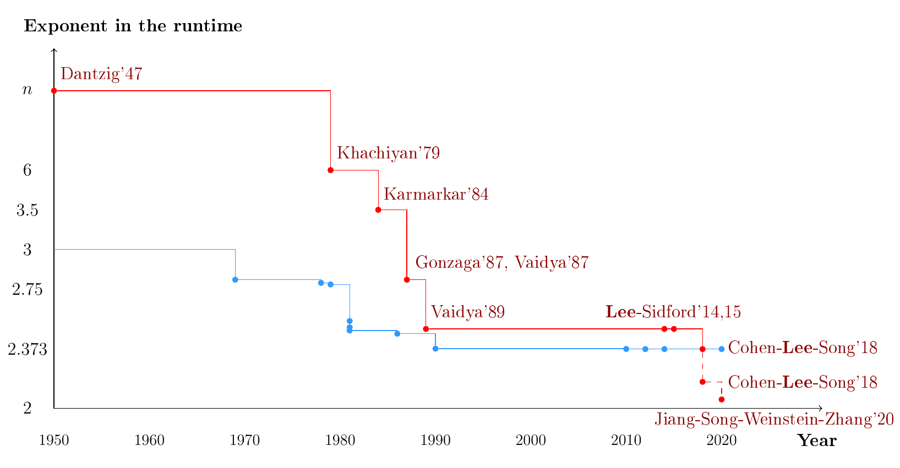
Linear Programs
Linear Systems
If we can solve linear systems in $n^{2}$ time

Slide 20
Going back to basic: verification
Given some $x$, how can we tell if it is an optimal solution?

