Slide 1
CSE 421
Linear Programs
Yin Tat Lee

Slide 2
Linear Program
Consider the linear program (LP)
$$\min_{Ax≥b}{c^{⊤}x}$$
where $A$ is a $m×n$ matrix.
$m$ = the number of constraints
$n$ = the number of variables
Example: Operations Research, Combinatorial Optimization
$$a_{2}^{⊤}x≥b_{2}$$
$$a_{3}^{⊤}x≥b_{3}$$
$$a_{1}^{⊤}x≥b_{1}$$
$m=3$, $n=2$
Example: Flight crew scheduling problem by
$$m=12,750,000,n=837$$

Slide 3
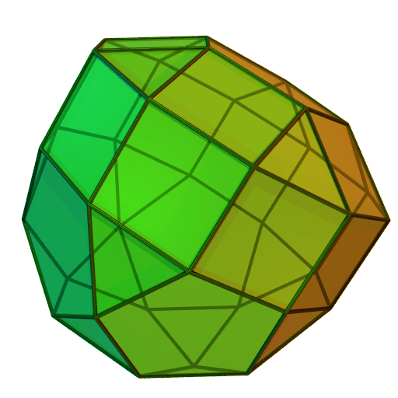
Simplex Method [Dantzig 47]
Initial Vertex
First generation of LP solver.
Efficient in practice
Exponential time in worst case
When applied to MaxFlow,
it is exactly augmenting path.

Slide 4
Ellipsoid Method [Shor; Nemirovski-Yudin; Khachiyan 70s]
Source: New York Times
First polynomial time algorithm for LP.
Very important in theory.
Slow in practice.
$$K=\left\{Ax≥b,c^{⊤}x≤OPT\right\}$$

Slide 5
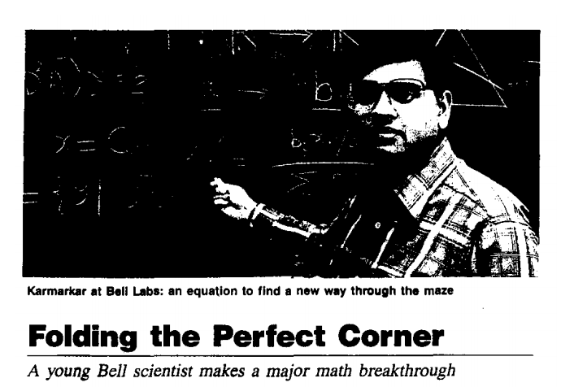
Interior Point Methods [Karmarkar 1984]
Simplex Method
Interior Point Methods
Source: Time Magazine
++++++++++++++++
+++++++++++++++++
+
++++++++++++
++++++++++++
+++++++++++
++++++++++
+++++++++++
Best algorithms in theory and
one of the best in practice

Slide 6
Techniques
+++++++++++++
++++++++++++
+
++++++++
++++++++++
+++++++
++++++
+++++++
$$K=\left\{Ax≥b,c^{⊤}x≤OPT\right\}$$
Simplex Method
is an example of Iterative Method
Ellipsoid Method
is an example of Divide and Conquer
Interior Point Method
is an example of Homotopy Method

Slide 7
Simplex Method

Slide 8
If the polytope is perturbed,
# of steps $≤$ roughly $n^{2}$.

Slide 10
Open Problem:
Can we have a rule to select new vertex such that # of steps are polynomially bounded?

Slide 11
Interior Point Method
+++++++++++++
++++++++++++
+
++++++++
++++++++++
+++++++
++++++
+++++++

Slide 12
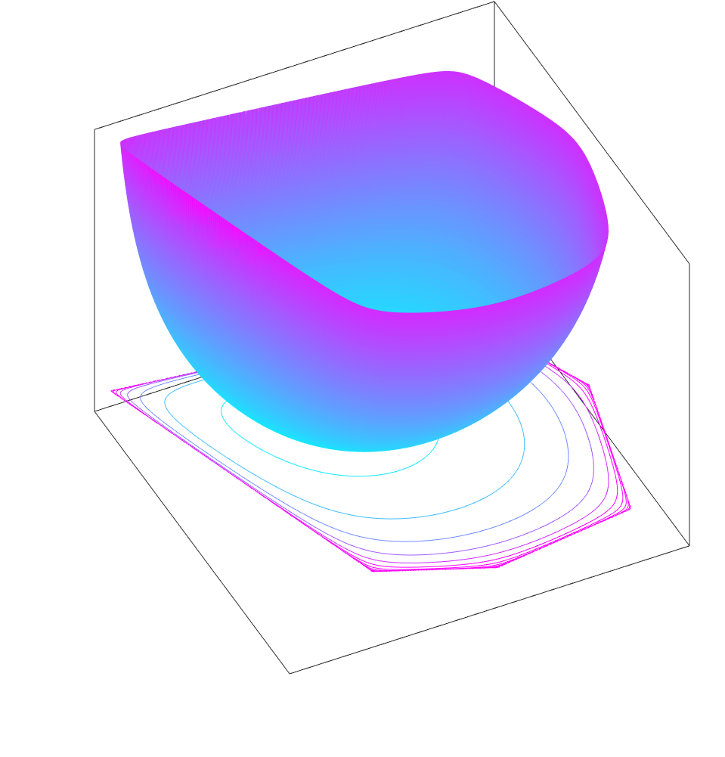
Constrained to Unconstrained
(Barrier Function)
$$\min_{Ax≥b}{c^{⊤}x}≈\min_{x}{c^{⊤}x+p(x)}$$
Difficulties lie in the polytope constraint $\{Ax≥b\}$
Smooth function is easier to minimize
Replace the constraint by a smooth function
Requirements for barrier function:
Smooth
Blow up on the boundary

Slide 13
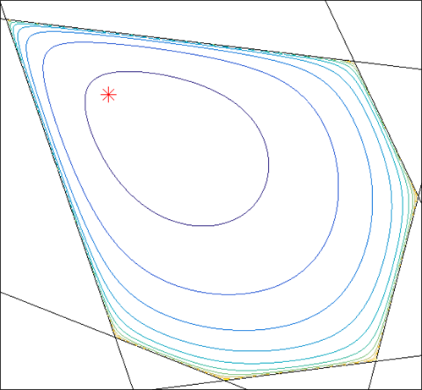
Example: Log Barrier Function
$s_{i}(x)$ is the distance from $x$ to constraint $i$
$p$ blows up when $x$ close to boundary
You can view this “physically”.
$$s_{3}$$
++++++++++++++++++++++++++++++
$$s_{2}$$
$$s_{1}$$
++++++++++++
+
++++++++++++++++++++++++++++
++++++++++++++
++++++++++
++++++++++++

Slide 14
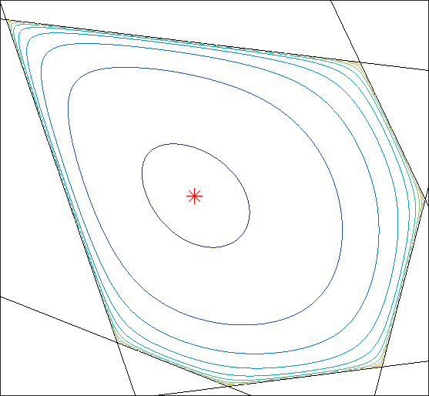
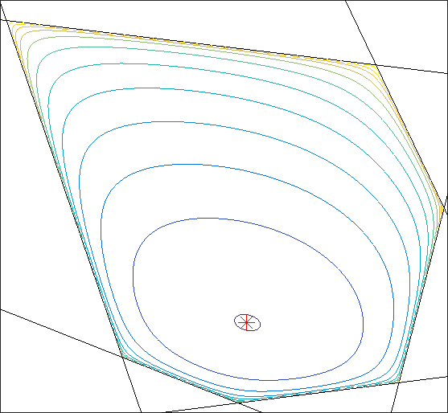
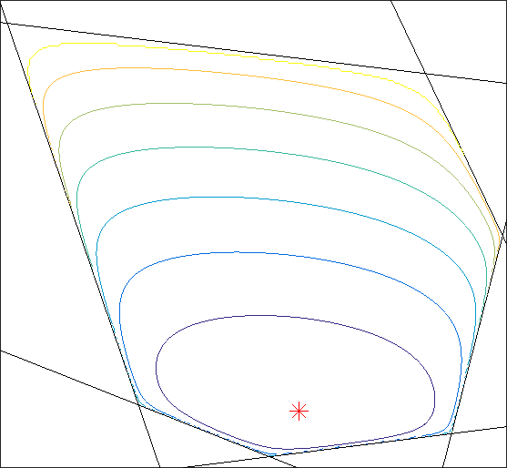
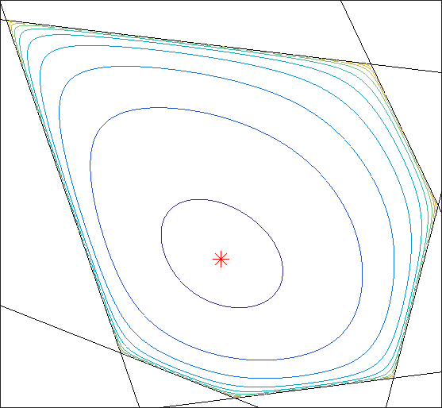
Central Path
($t=$ force)
$$\min_{Ax≥b}{c^{⊤}x}\sim \min_{x}{c^{⊤}x+t⋅p(x)}$$
Repeat
Compute $\min_{x}{c^{⊤}x+t⋅p(x)}$
Decrease $t$
What barrier function $p$should we pick?
Karmarkar used log barrier function.
Nesterov and Nemirovskii used universal barrier function.
$$t=1$$
$$t=8$$
$$t=2$$
$$t=4$$
++++++++++++++++
+++++++++++++++++
+++++++++++++++++++++
+++++++++++++++++++++++
++++++
+++++++
++++++++
+++++++++
+++++++++++++++
+++++++++++++++++
++++++++++++++++++++
+++++++++++++++++++++++
+
+
Central Path
+++++++
++++++++
++++++++++
+
+++++++++++
+
+++++
++++++
+++++++
++++++++
++++++
+++++++
++++++++
+++++++++

Slide 15
Central Path
($t=$ force)
$$\min_{Ax≥b}{c^{⊤}x}\sim \min_{x}{c^{⊤}x+t⋅p(x)}$$
Repeat
Compute $\min_{x}{c^{⊤}x+t⋅p(x)}$
Decrease $t$
What barrier function $p$should we pick?
$p$ is easy to compute
Central path is smooth.
$$t=1$$
$$t=8$$
$$t=2$$
$$t=4$$
+++++++++++++++++++++++
+++++++++
+++++++++++++++++++++++
+
+
Central Path
+
+++++++++++
+
++++++++
+++++++++

Slide 16
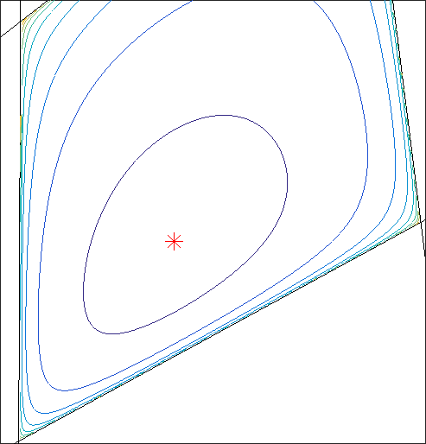
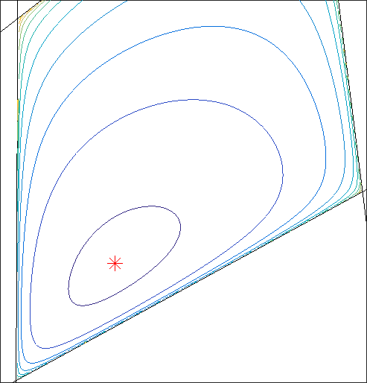
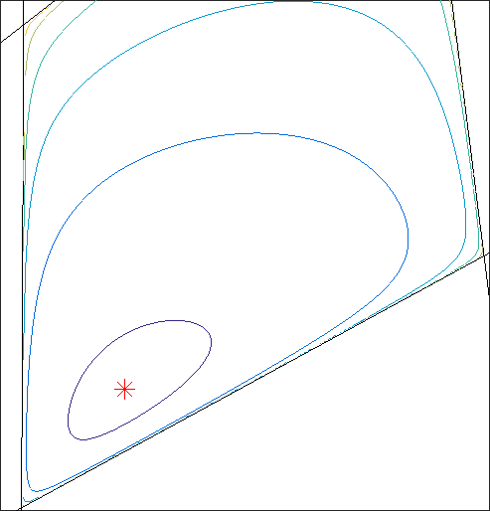
Condition For a Good Barrier Function
$$x−K$$
Observation: easy to optimize over ellipsoid.
Approximate the polytope by ellipsoids!
$$K$$
$$K_{x}$$
$$K_{x}$$
$$E_{x}$$
$$K_{y}$$
$$K_{z}$$
$$E_{y}$$
$$x$$
$$y$$
$$z$$
$$E_{z}$$

Slide 17
Condition For a Good Barrier Function
Observation: easy to optimize over ellipsoid.
Approximate the polytope by ellipsoids!
#iter depends on how well $E$ approximates $K$.
Say $E$ is a $T$-approximation of $K$ if
$E⊂K⊂T⋅E$
IPM takes $T$ iters if $E_{x}$ is a $T$-approximation of $K_{x}$ for all $x$.
$$K_{x}$$
$$x$$
$$E_{x}$$
$$T⋅E_{x}$$

Slide 18
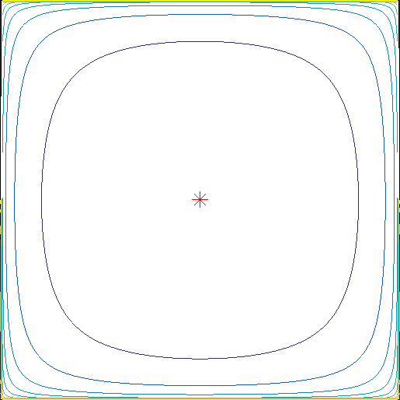
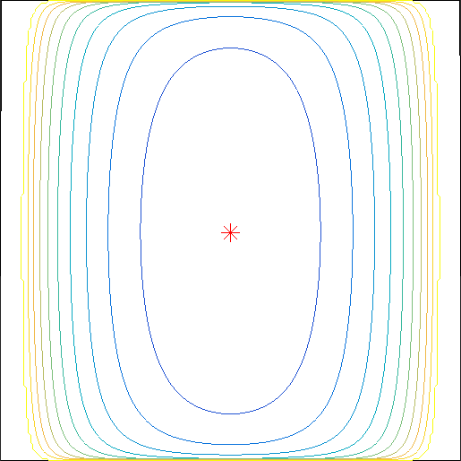
Log Barrier depends on representation
$$\{0≤x≤1,0≤y≤1\}$$
$$\{0≤y≤1,0≤x≤1,0≤x≤1,0≤x≤1,⋯\}$$
repeated
$m$ times
repeated
$m$ times
$$1/\sqrt{m}$$

Slide 19
Condition For a Good Barrier Function
Observation: easy to optimize over ellipsoid.
Approximate the polytope by ellipsoids!
#iter depends on how well $E$ approximates $K$.
Say $E$ is a $T$-approximation of $K$ if
$E⊂K⊂T⋅E$
IPM takes $T$ iters if $E_{x}$ is a $T$-approximation of $K_{x}$ for all $x$.
$$K_{x}$$
$$x$$
$$E_{x}$$
$$T⋅E_{x}$$

Slide 20
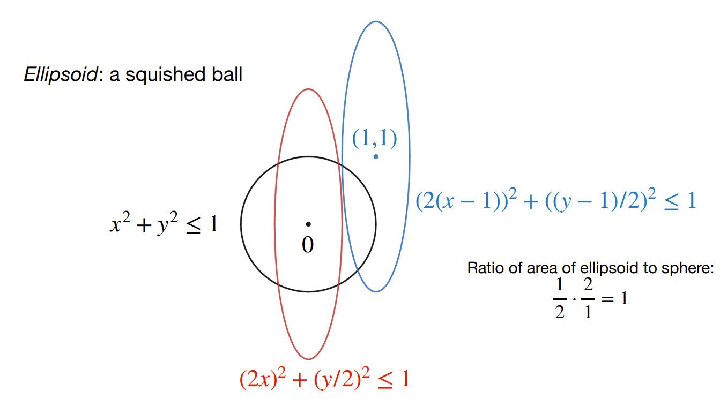
Ellipsoid

Slide 21
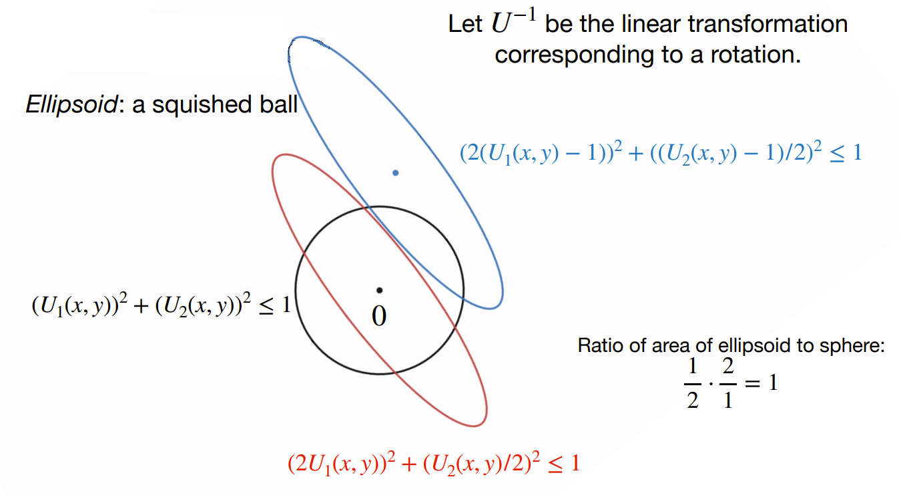
Ellipsoid

Slide 22
John Ellipsoid
For any polytope $K$, let $J(K)$ be the maximum ellipsoid inside $K$.
Theorem
If $K$ is symmetric, $J\left(K\right)$ is a $\sqrt{n}$ approximation of $K$.
Furthermore,
$J\left(K\right)$ can be approximated by solving $\tilde{O}(1)$ linear systems.
$$K$$
$$J(K)$$

Slide 23
John Ellipsoid Barrier
$$p(x)=−log⁡(vol(J\left(K_{x}\right))$$
$J(K_{x})$ is the largest ellipsoid centered at $x$.
It does not depend on representation.
It involves volume computation but is volume of ellipsoid!
Universal barrier involves volume of polytope which is much harder.
(illustration only)
$$K$$

Slide 24
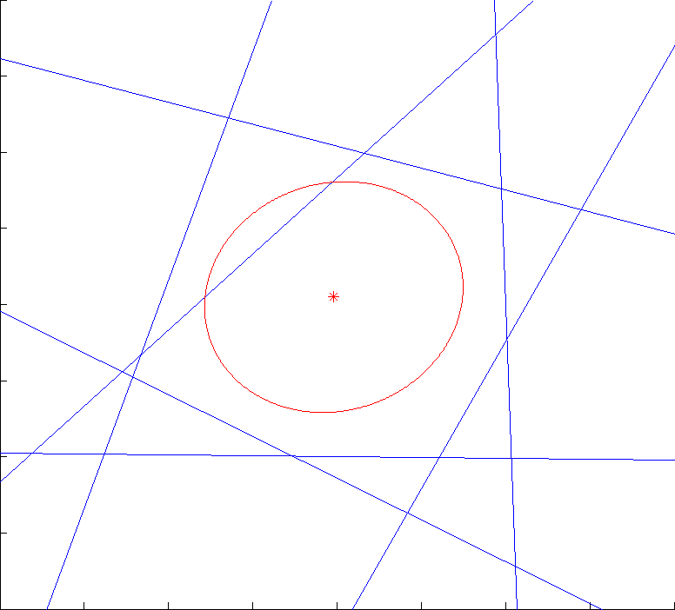
Alternative View
Algorithm:
Update John ellipsoid
Push the cost constraint
Repeat
Notes:
Explain this slowly

Slide 25
Ellipsoid Method
$$K=\left\{Ax≥b,c^{⊤}x≤OPT\right\}$$

Slide 26
Convex Minimization
$f$ is convex if
$$\frac{1}{2}(f\left(x\right)+f\left(y\right))≥f(\frac{x+y}{2})$$
$$x$$
$$y$$
Minimize a general convex function $f$
Assume:
Access the function by computing gradient
$f$ is not exponentially large or the solution is not exponentially far away.
Goal: decrease the error $f\left(x_{k}\right)−OPT$ exponentially.
Consequence: can handle constraints
Example: linear program, logistic regression
Why linear program is a convex function?

Slide 27
Why can we solve in 1 dimension?
Binary search!

Slide 28
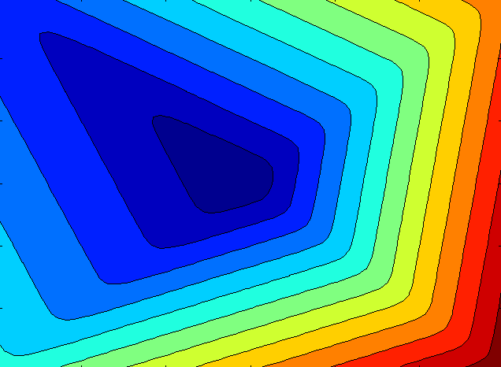
Convexity Allows Us to Cut
How to do binary search in high dimension?

Slide 29
Ellipsoid Method [Shor; Nemirovski-Yudin; Khachiyan 70s]
$$Ω_{1}$$
For $k=0,1,⋯$
Compute gradient at center of $Ω_{k}$
Let $Ω_{k+1}$ be the smallest ellipsoid containing $Ω_{k}∩\{Half Space\}$.
New volume is at most $1−\frac{1}{n}$ of old volume.
$O(n^{2}\log\left(1/ε\right))$ iterations.
$O(n^{2})$ time per iteration.
minimizer
$$Ω_{0}$$

Slide 30
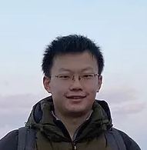
John Ellipsoid Method
John Ellipsoid Method
never throws away information.
For $k=0,1,⋯$
Compute largest ellipsoid inside $Ω_{k}$ (John Ellipsoid)
Compute gradient at the center.
Let $Ω_{k+1}=Ω_{k}∩\{Half Space\}$.
New volume is at most $0.9$ of old volume.
$O(n\log\left(1/ε\right))$ iterations. [Khachiyan 88]
$O(n^{2.88})$ time per iteration. [Nesterov-Nemirovskii 89]
Improved to $O(n^{2.38})$ using slightly different ellipsoid. [Vaidya 89]
Further improved to $O(n^{2})$. [2020]
$$Ω_{1}$$
minimizer
$$Ω_{0}$$
Haotian
UW PhD

