Slide 1
CSE 421
Dynamic Programming
Longest Path and Shortest Path
Yin Tat Lee

Slide 2
Edit Distance
Edit distance. [Levenshtein 1966, Needleman-Wunsch 1970]
Cost = # of gaps + #mismatches.
Applications.
Basis for Unix diff and Word correct in editors.
Speech recognition.
Computational biology.
C
T
G
A
C
C
T
A
C
C
T
-
C
T
G
A
C
C
T
A
C
C
T
C
C
T
G
A
C
T
A
C
A
T
C
C
T
G
A
C
-
T
A
C
A
T
Cost: 5
Cost: 3

Slide 3
DP for Sequence Alignment
Let $OPT(i,j)$ be min cost of aligning $x_{1},…,x_{i}$ and $y_{1},…,y_{j}$
Case 1: OPT matches $x_{i},y_{j}$
Then, pay mis-match cost if $x_{i}≠y_{j}$ + min cost of aligning $x_{1},…,x_{i−1}$ and $y_{1},…,y_{j−1}$ i.e., $OPT(i−1,j−1)$
Case 2: OPT leaves $x_{i}$ unmatched
Then, pay gap cost for $x_{i}$ + $OPT\left(i−1,j\right)$
Case 3: OPT leaves $y_{j}$ unmatched
Then, pay gap cost for $y_{j}$ + $OPT(i,j−1)$

Slide 4
Bottom-up DP
Sequence-Alignment(m, n, x₁x₂...x_{m}, y₁y₂...y_{n}) {
for i = 0 to m
M[0, i] = i
for j = 0 to n
M[j, 0] = j
for i = 1 to m
for j = 1 to n
M[i, j] = min( (x_{i}=y_{j} ? 0:1) + M[i-1, j-1],
1 + M[i-1, j],
1 + M[i, j-1])
return M[m, n]
}
Analysis: $Θ(mn)$ time and space.
Computational biology: m = n = 1,000,000. 1000 billions ops OK,
but 1TB array?

Slide 5
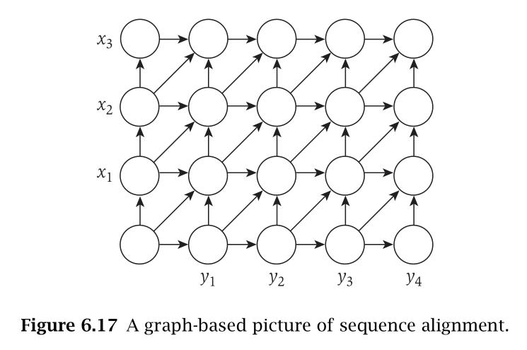
Shortest Path
M[i, j] = min( (x_{i}=y_{j} ? 0:1) + M[i-1, j-1],
1 + M[i-1, j],
1 + M[i, j-1])
Edit distance is the distance between $(0,0)$ and $(m,n)$ of the following graph.
All horizontal edges has cost 1.
All vertical edges has cost $1$.
The cost of edges from $(i−1,j−1)$ to $(i,j)$ is $1_{x_{i}≠y_{j}}$
The graph is a DAG.
Question:
How to recover the alignment
(or how to find the shortest path)
without using $mn$ space?

Slide 6
How to recover the alignment?
Idea 1: Suffices to find the point a shortest path pass on the middle row.
Why?
Divide and Conquer!
Idea 2: $d_{\left(0,0\right)→(m,n)}=\min_{j}{d_{\left(0,0\right)→(m/2,j)}+d_{\left(m/2,j\right)→(m,n)}}$
(m,n)
m/2
(m/2,j)
(0,0)
Find(i₁,j₁,i₂,j₂) { // Due to spacing, ignored boundary cases
Let $k=\left\lfloor (i_{1}+i_{2})/2\right\rfloor$
Compute $d_{\left(i_{1},j_{1}\right)→(k,j_{2})}$ via Dijkstra at (i₁,j₁).
Compute $d_{\left(k,j\right)→(i_{2},j_{2})}$ via Dijkstra at (i₂,j₂) on reversed graph.
Let $k={argmin}_{k}d_{\left(i_{1},j_{1}\right)→(k,j_{2})}+d_{ \left(k,j_{2}\right)→(i_{2},j_{2})}$
$p_{1}=\text{Find}\text{(}\text{i}\text{1}\text{,}\text{j}\text{1}\text{,}\text{k}\text{,}\text{j}\text{)}$
$p_{2}=\text{Find}\text{(}\text{k}\text{,}\text{j}\text{,}\text{i}\text{2}\text{,}\text{j}\text{2}\text{)}$
return $p_{1},p_{2}$
}

Slide 7
Lesson
Advantage of a bottom-up DP:
It is much easier to optimize the space.
By the way, edit distance
can be computed in $O(s×\min\left(m,n\right))$ if edit distance $≤s$
can be computed in $O(\frac{n^{2}}{\log^{2}{n}})$ (1980).
can be approximated by log factor in $O(n^{1+ε})$ (~2010).
cannot be solved in $O(n^{2−δ})$ exactly (2015).
can be approximated by O(1) factor in $O(n^{2−2/7})$ (~2018).
can be approximated by O(1) factor in $O(n^{1+ε})$ (~2020).

Slide 8
Longest Path in a DAG

Slide 9
Longest Path in a DAG
Goal: Given a DAG G, find the longest path.
Recall: A directed graph G is a DAG if it has no cycle.
This problem is NP-hard for general
directed graphs:
It has the Hamiltonian Path as a
special case
₂
₃
₆
₅
₄
₇
₁

Slide 10
DP for Longest Path in a DAG
Q: What is the right ordering?
Remember, we have to use that G is a DAG, ideally in defining the ordering
We saw that every DAG has a topological sorting
So, let’s use that as an ordering.
₂
₃
₆
₅
₄
₁
₂
₃
₄
₅
₆
₇
₇
₁

Slide 11
DP for Longest Path in a DAG
Suppose we have labelled the
vertices such that $(i,j)$ is a
directed edge only if $i<j.$
Let $OPT(j)$ = length of the longest path ending at $j$
Suppose OPT(j) is $\left(i_{1},i_{2}\right),\left(i_{2},i_{3}\right),…,\left(i_{k−1},i_{k}\right),\left(i_{k},j\right),$ then
Obs 1: $i_{1}≤i_{2}≤…≤i_{k}≤j.$
Obs 2: $\left(i_{1},i_{2}\right),\left(i_{2},i_{3}\right),…,\left(i_{k−1},i_{k}\right)$ is the longest path ending at $i_{k}.$
$$OPT\left(j\right)=1+OPT\left(i_{k}\right).$$
₁
₂
₃
₄
₅
₆
₇

Slide 12
DP for Longest Path in a DAG
Suppose we have labelled the vertices such that $(i,j)$ is a directed edge only if $i<j.$
Let $OPT(j)$ = length of the longest path ending at $j$
$OPT\left(j\right)=\left\{\begin{aligned}0 \\ 1+\max_{i:\left(i,j\right) an edge}{OPT(i)}\end{aligned}\right.$
If $j$ is a source
o.w.

Slide 13
Outputting the Longest Path
Let G be a DAG given with a topological sorting:
For all edges $(i,j)$ we have i < j.
Initialize Parent[j]=-1 for all j.
Compute-OPT(j){
if (in-degree(j) == 0)
return 0
if (M[j] == empty)
M[j] = 0;
for all edges (i,j)
if (M[j] < 1+Compute-OPT(i))
M[j] = 1 + Compute-OPT(i)
Parent[j] = i
return M[j]
}
Let k be the maximizer of Compute-OPT(1),…,Compute-OPT(n)
While (Parent[k]!=-1)
Print k
k = Parent[k]
Record the entry that
we used to compute OPT(j)

Slide 14
Exercise: Longest Increasing Subsequence

Slide 15
Longest Increasing Subsequence
Given a sequence of numbers
Find the longest increasing subsequence in $O(n^{2})$ time
41, 22, 9, 15, 23, 39, 21, 56, 24, 34, 59, 23, 60, 39, 87, 23, 90
41, 22, 9, 15, 23, 39, 21, 56, 24, 34, 59, 23, 60, 39, 87, 23, 90

Slide 16
Notes:
Poll Title: Do not modify the notes in this section to avoid tampering with the Poll Everywhere activity. More info at polleverywhere.com/support Find the longest increasing subsequence in 𝑂(𝑛^2) time. https://www.polleverywhere.com/multiple_choice_polls/CviQYafVY6POGzhErxbi0?display_state=chart&activity_state=opened&state=opened&flow=Default&onscreen=persist

Slide 17
DP for LIS
Let OPT(j) be the longest increasing subsequence ending at j.
Observation: Suppose the OPT(j) is the sequence
$$x_{i_{1}}, x_{i_{2}},…,x_{i_{k}},x_{j}$$
Then, $x_{i_{1}}, x_{i_{2}},…,x_{i_{k}}$ is the longest increasing subsequence ending at $x_{i_{k}},$i.e., $OPT\left(j\right)=1+OPT(i_{k})$
$OPT\left(j\right)=\left\{\begin{aligned}1 \\ 1+\max_{i:x_{i}<x_{j}}{OPT(i)}\end{aligned}\right.$
Alternative Soln: This is a special case of Longest path in a DAG: Construct a graph 1,…n where $(i,j)$ is an edge if $i<j$ and $x_{i}<x_{j}.$
How to make it faster?
If $x_{j}<x_{i}$ for all $i<j$
o.w.

Slide 18
Data structure for LIS
We need a data structure with following operations:
Initialize(): Set $x_{1},x_{2},⋯x_{n}$ to $0$ in $O(n)$ time.
Set(j,v): Set $x_{j}$ to $v$ in $O(\log{n})$ time.
Max(a,b): Output $\max_{a≤j≤b}{x_{j}}$ in $O(\log{n})$ time.

Slide 19
Shortest Paths with Negative Edge Weights

Slide 20
Shortest Paths with Neg Edge Weights
Given a weighted directed graph $G=\left(V,E\right)$ and a source vertex $s,$ where the weight of edge (u,v) is $c_{u,v}$ (that can be negative)
Goal: Find the shortest path from s to all vertices of G.
Recall that Dikjstra’s Algorithm fails when weights are negative
1
1
3
-2
3
-2
source
s
2
3
s
2
3
2
-1
-1
2
4
4
Why distance can be negative?
Think distance as cost instead.

Slide 21
Impossibility on Graphs with Neg Cycles
Condition: No solution exists if G has a negative cycle.
This is because we can minimize the length by going over the cycle again and again.
So, suppose G does not have a negative cycle.
1
3
-2
s
2
3
2
-1
4

Slide 22
DP for Shortest Path (First Attempt)
Def: Let $OPT(v)$ be the length of the shortest $s$ - $v$ path
$$OPT\left(v\right)=\left\{\begin{matrix}0 if v=s \\ \min_{u:\left(u,v\right) an edge}{OPT\left(u\right)+c_{u,v}}\end{matrix}\right.$$
The formula is correct. But it is not clear how to compute it.

Slide 23
DP for Shortest Path
Def: Let $OPT(v,i)$ be the length of the shortest $s$ - $v$ path with at most $i$ edges.
Let us characterize $OPT(v,i).$
Case 1: $OPT(v,i)$ path has less than $i$ edges.
Then, $OPT\left(v,i\right)=OPT\left(v,i−1\right).$
Case 2: $OPT(v,i)$ path has exactly $i$ edges.
Let $s,v_{1},v_{2},…,v_{i−1},v$ be the $OPT(v,i)$path with $i$ edges.
Then, $s,v_{1},…,v_{i−1}$ must be the shortest $s$ - $v_{i−1}$ path with at most $i−1$ edges. So,
$$OPT\left(v,i\right)=OPT\left(v_{i−1},i−1\right)+c_{v_{i−1},v}$$

Slide 24
DP for Shortest Path
Def: Let $OPT(v,i)$ be the length of the shortest $s$ - $v$ path with at most $i$ edges.
$$OPT\left(v,i\right)=\left\{\begin{aligned}0 if v=s \\ ∞ if v≠s,i=0 \\ \min{(OPT\left(v,i−1\right),\min_{u:\left(u,v\right) an edge}{OPT\left(u,i−1\right)+c_{u,v}})}\end{aligned}\right.$$
So, for every v, $OPT\left(v,?\right)$ is the shortest path from s to v.
But how long do we have to run?
Since G has no negative cycle, it has at most $n−1$ edges. So,
$OPT(v,n−1)$ is the answer.

Slide 25
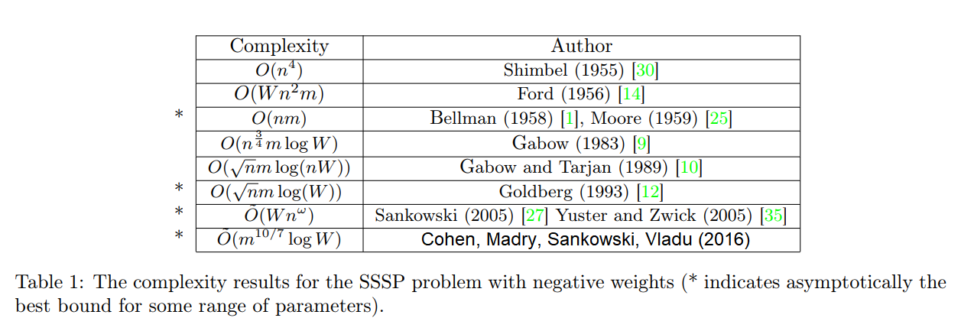
Bellman Ford Algorithm
for v=1 to n
if $v≠s$ then
M[v,0]=$∞$
M[s,0]=0.
for i=1 to n-1
for v=1 to n
M[v,i]=M[v,i-1]
for every edge (u,v)
M[v,i]=min(M[v,i], M[u,i-1]+c_{u,v})
Running Time: $O\left(nm\right)$
Can we test if G has negative cycles?
Yes, run for i=1…3n and see if the M[v,n-1] is different from M[v,3n]

Slide 26
Exercise: Minimum Vertex Cover for Tree

Slide 27
Minimum Vertex Cover for Tree
Given an undirected tree $T=(V,E)$.
We call $S⊂V$ is a vertex cover if every edge touches some vertex in $S$.
Give a linear time algorithm to find the minimum vertex cover of tree.
Answer:
Let $F(v)$ be the size of minimum vertex cover of the subtree at $v$.
Then
$F\left(v\right)=min⁡(\#children\left(v\right)+\sum_{g: grandchild of v}{F\left(g\right)},1+\sum_{c: child of v}{F\left(c\right)}$)

