Slide 1
CSE 421
Dynamic Programming
Yin Tat Lee

Slide 2
Roadmap
This course has the following topics:
Graphs (BFS, DFS)
Greedy Methods
Divide and Conquer
Dynamic Programming
Network Flow
NP completeness
We start network flow on next lecture.
Next lecture is by Sally.
Basic
Techniques
Problems

Slide 3
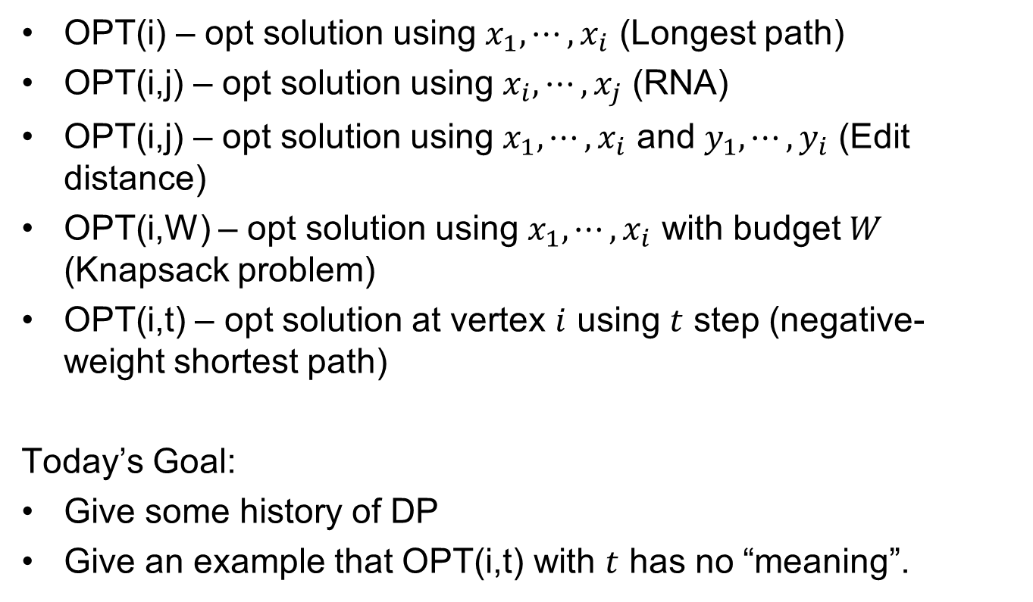
Common Subproblems
OPT(i) – opt solution using $x_{1},⋯,x_{i}$ (Longest path)
OPT(i,j) – opt solution using $x_{i},⋯,x_{j}$ (RNA)
OPT(i,j) – opt solution using $x_{1},⋯,x_{i}$ and $y_{1},⋯,y_{i}$ (Edit distance)
OPT(i,W) – opt solution using $x_{1},⋯,x_{i}$ with budget $W$ (Knapsack problem)
OPT(i,t) – opt solution at vertex $i$ using $t$ step (negative-weight shortest path)
Today’s Goal:
Give some history of DP
Give an example that OPT(i,t) with $t$ has no “meaning”.

Slide 4
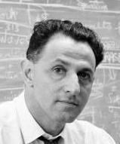
Dynamic Programming
Copy from Bellman’s autobiography
I spent the Fall quarter (of 1950) at RAND. My first task was to find a name for multistage decision processes. An interesting question is, Where did the name, dynamic programming, come from? The 1950s were not good years for mathematical research. We had a very interesting gentleman in Washington named Wilson. He was Secretary of Defense, and he actually had a pathological fear and hatred of the word research. I’m not using the term lightly; I’m using it precisely. His face would suffuse, he would turn red, and he would get violent if people used the term research in his presence. You can imagine how he felt, then, about the term mathematical. The RAND Corporation was employed by the Air Force, and the Air Force had Wilson as its boss, essentially. Hence, I felt I had to do something to shield Wilson and the Air Force from the fact that I was really doing mathematics inside the RAND Corporation. What title, what name, could I choose? In the first place I was interested in planning, in decision making, in thinking. But planning, is not a good word for various reasons. I decided therefore to use the word “programming”. I wanted to get across the idea that this was dynamic, this was multistage, this was time-varying I thought, lets kill two birds with one stone. Lets take a word that has an absolutely precise meaning, namely dynamic, in the classical physical sense. It also has a very interesting property as an adjective, and that is it's impossible to use the word dynamic in a pejorative sense. Try thinking of some combination that will possibly give it a pejorative meaning. It's impossible. Thus, I thought dynamic programming was a good name. It was something not even a Congressman could object to. So I used it as an umbrella for my activities.
In short, his boss hates math.
He needs a cool term, which sounded less math.
Programming refers to a military schedule.
Richard Bellman

Slide 5
Example 1:
Dynamic Decision Problem
(original problem for Dynamic Programming)

Slide 6
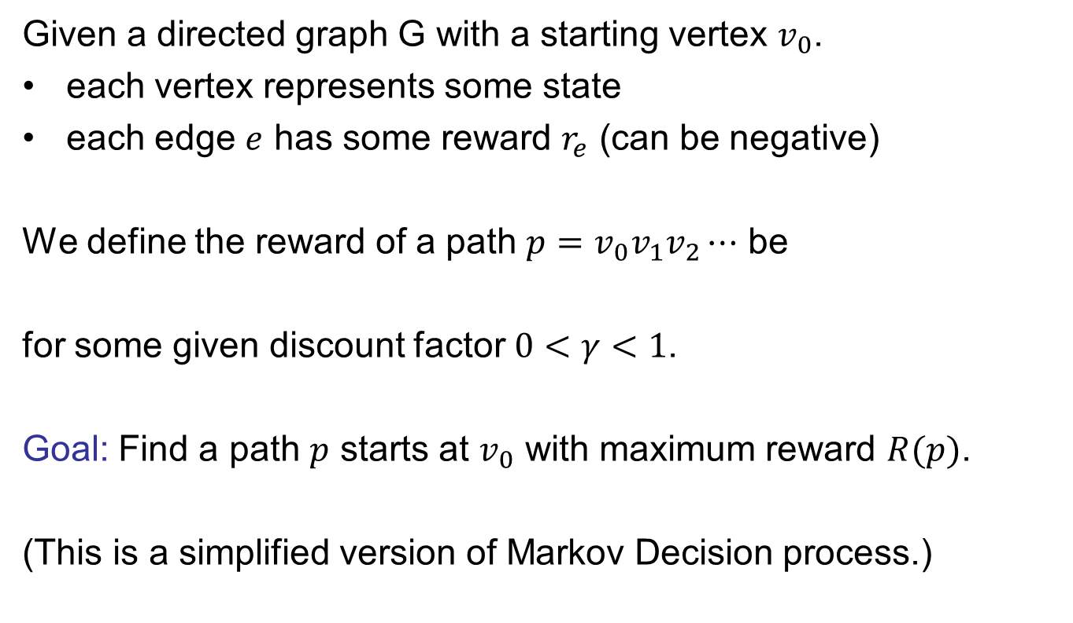
Dynamic Decision Problem
Given a directed graph G with a starting vertex $v_{0}$.
each vertex represents some state
each edge $e$ has some reward $r_{e}$ (can be negative)
We define the reward of a path $p=v_{0}v_{1}v_{2}⋯$ be
for some given discount factor $0<γ<1$.
Goal: Find a path $p$ starts at $v_{0}$ with maximum reward $R(p)$.
(This is a simplified version of Markov Decision process.)

Slide 7
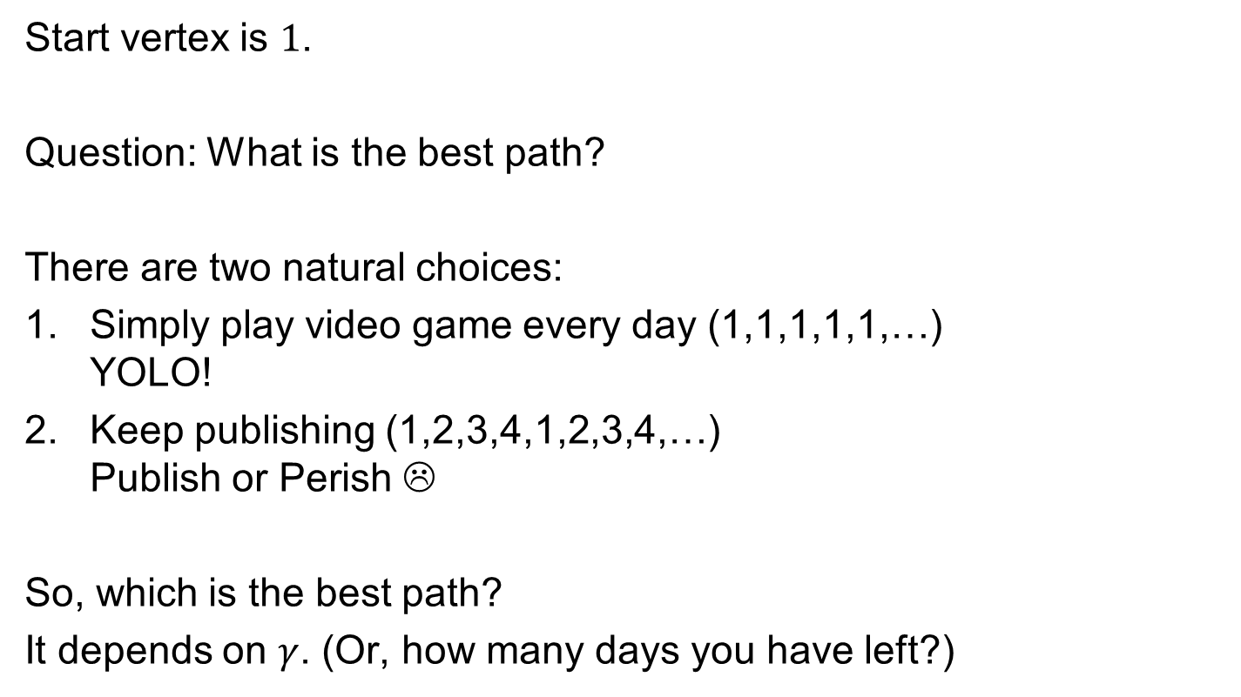
Example
2
Read a book
R = -4
Do a project
R = -2
Video game
R = +1
1
Video game
R = +1
3
Start vertex is $1$.
Question: What is the best path?
There are two natural choices:
Simply play video game every day (1,1,1,1,1,…)
YOLO!
Keep publishing (1,2,3,4,1,2,3,4,…)
Publish or Perish ☹
So, which is the best path?
It depends on $γ$. (Or, how many days you have left?)
Video game
R = +1
Publish
R = 15
Do a project
R = -2
4

Slide 8
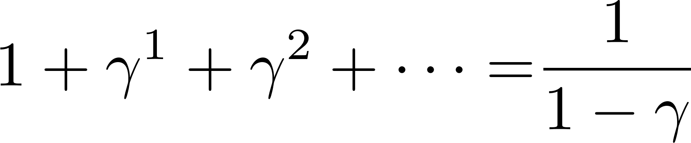
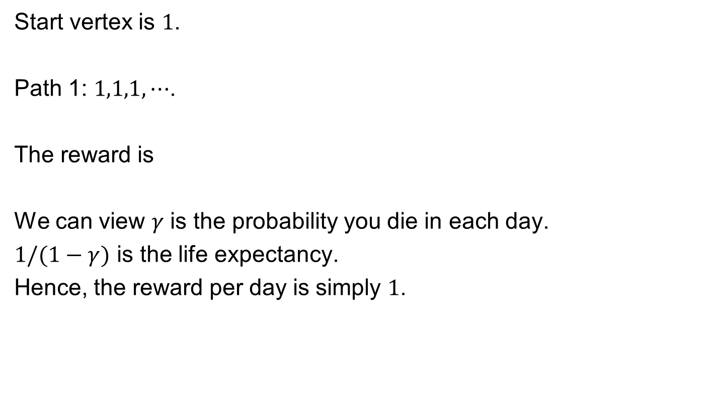
Example
2
Read a book
R = -4
Do a project
R = -2
Video game
R = +1
1
Video game
R = +1
3
Start vertex is $1$.
Path 1: $1,1,1,⋯$.
The reward is
We can view $γ$ is the probability you die in each day.
$1/(1−γ)$ is the life expectancy.
Hence, the reward per day is simply $1$.
Video game
R = +1
Publish
R = 15
Do a project
R = -2
4

Slide 9
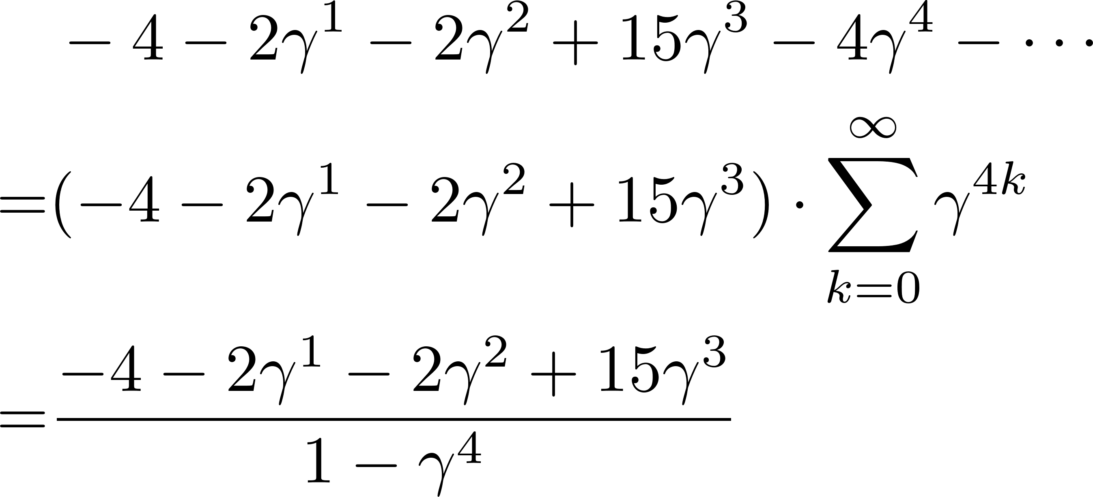
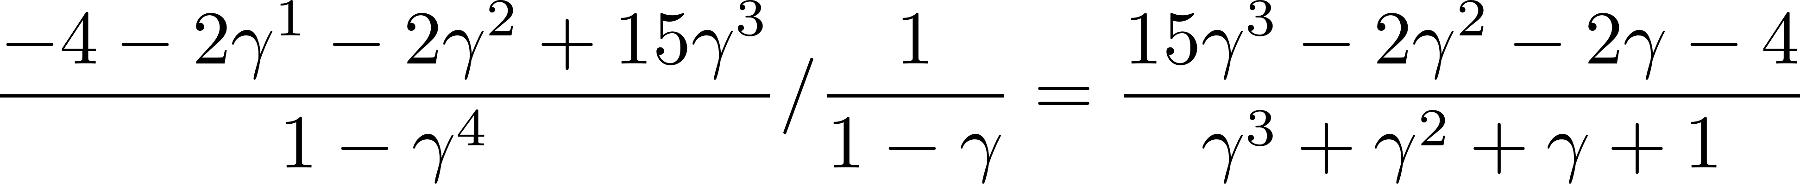

Example
2
Read a book
R = -4
Do a project
R = -2
Video game
R = +1
1
Video game
R = +1
3
Start vertex is $1$.
Path 2: $1,2,3,4,1,2,3,4,⋯$
The reward is
The reward/day is
When $γ≈0$, the reward/day is around $−4$. (worse than Path 1)
When $γ≈1$, the reward/day is around $7/4$. (better than Path 1)
Video game
R = +1
Publish
R = 15
Do a project
R = -2
4

Slide 10
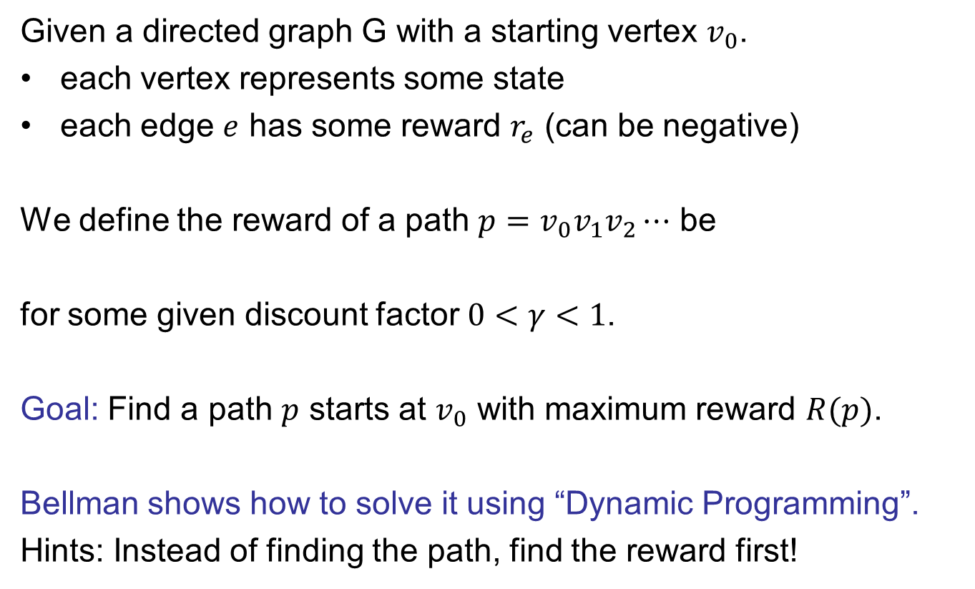
Dynamic Decision Problem
Given a directed graph G with a starting vertex $v_{0}$.
each vertex represents some state
each edge $e$ has some reward $r_{e}$ (can be negative)
We define the reward of a path $p=v_{0}v_{1}v_{2}⋯$ be
for some given discount factor $0<γ<1$.
Goal: Find a path $p$ starts at $v_{0}$ with maximum reward $R(p)$.
Bellman shows how to solve it using “Dynamic Programming”.
Hints: Instead of finding the path, find the reward first!

Slide 11
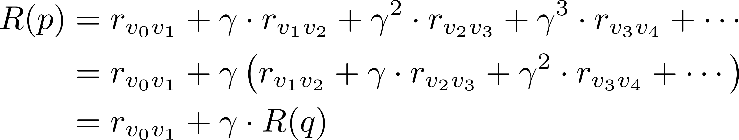
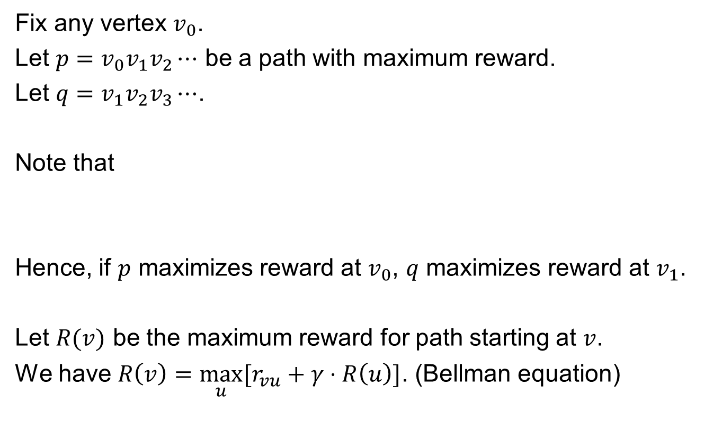
Bellman Equation
Fix any vertex $v_{0}$.
Let $p=v_{0}v_{1}v_{2}⋯$ be a path with maximum reward.
Let $q=v_{1}v_{2}v_{3}⋯$.
Note that
Hence, if $p$ maximizes reward at $v_{0}$, $q$ maximizes reward at $v_{1}$.
Let $R(v)$ be the maximum reward for path starting at $v$.
We have $R\left(v\right)=\max_{u}{[r_{vu}+γ⋅R\left(u\right)]}$. (Bellman equation)
Like last lecture, unclear how to use.

Slide 12
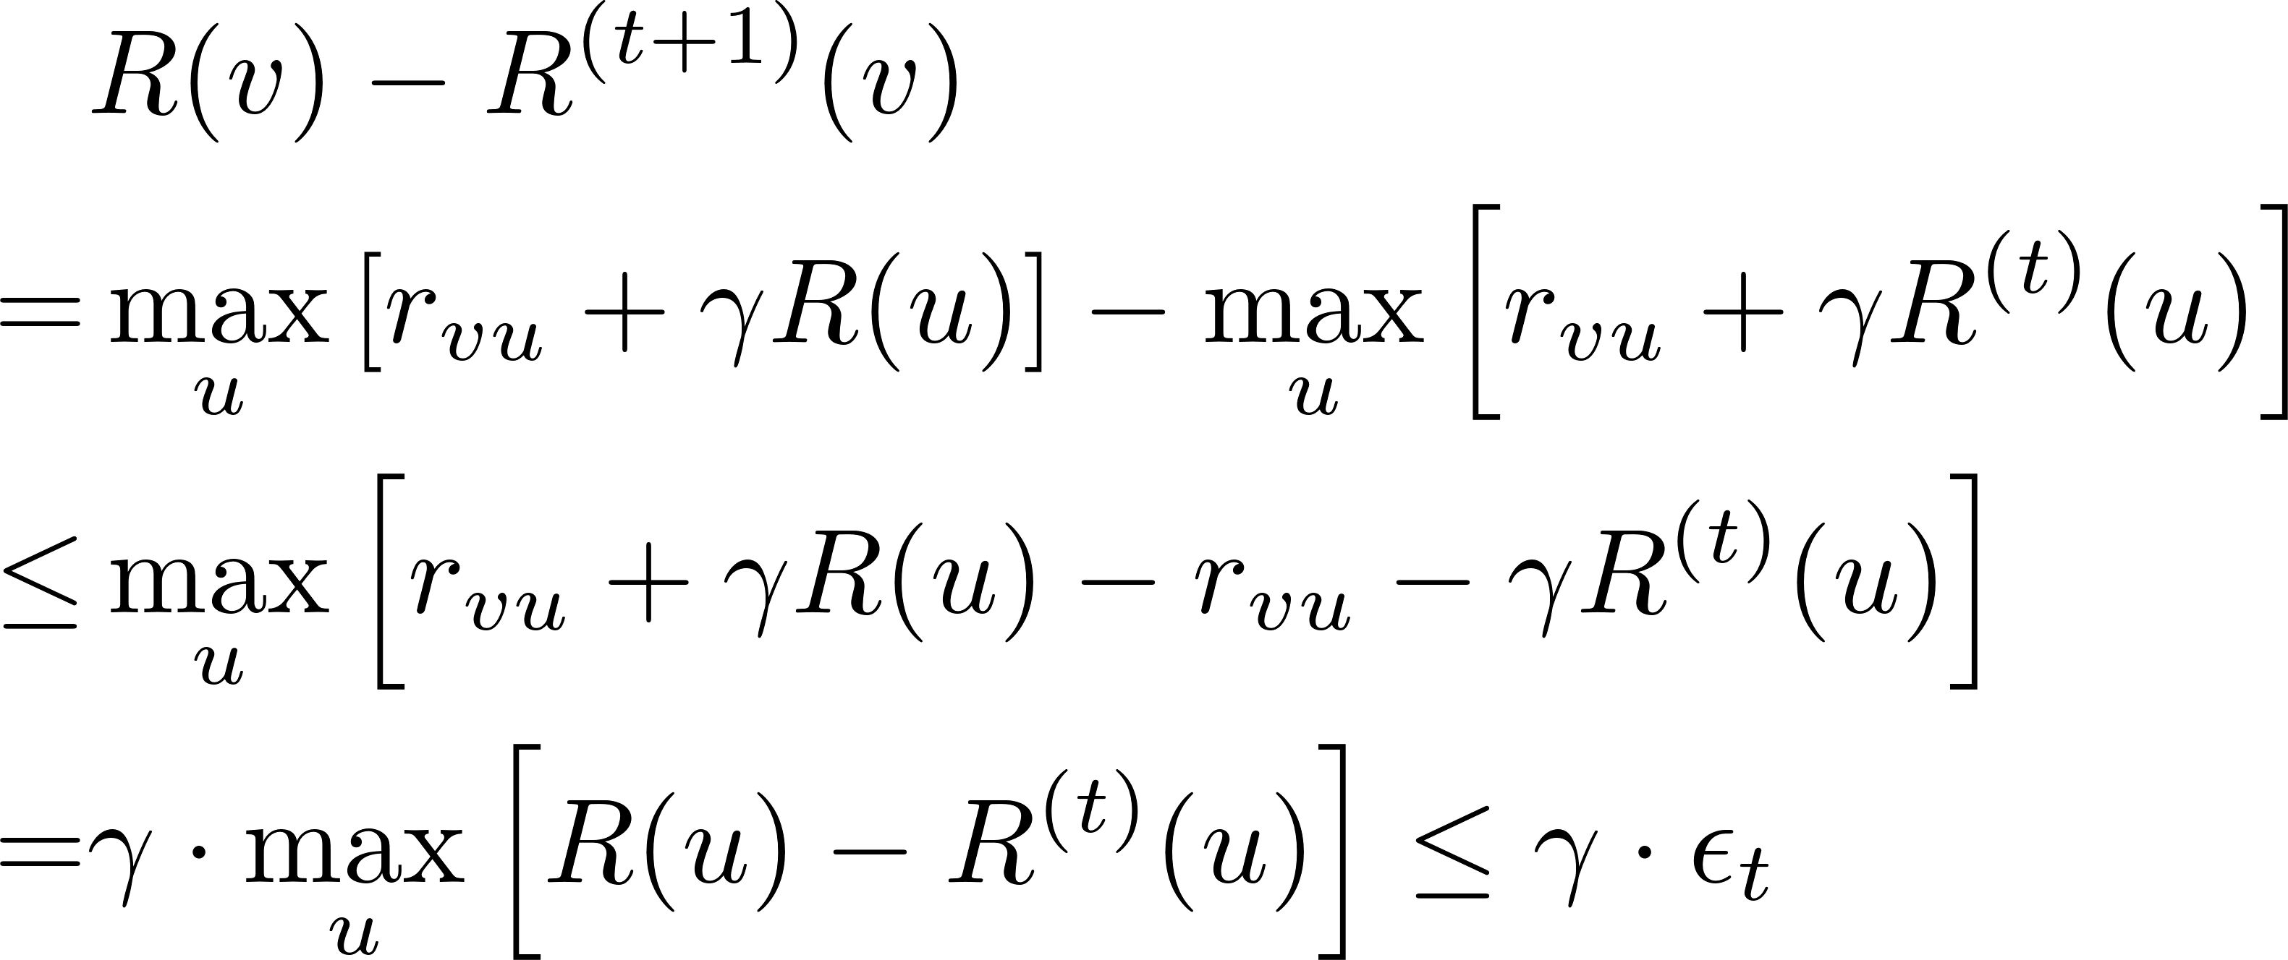
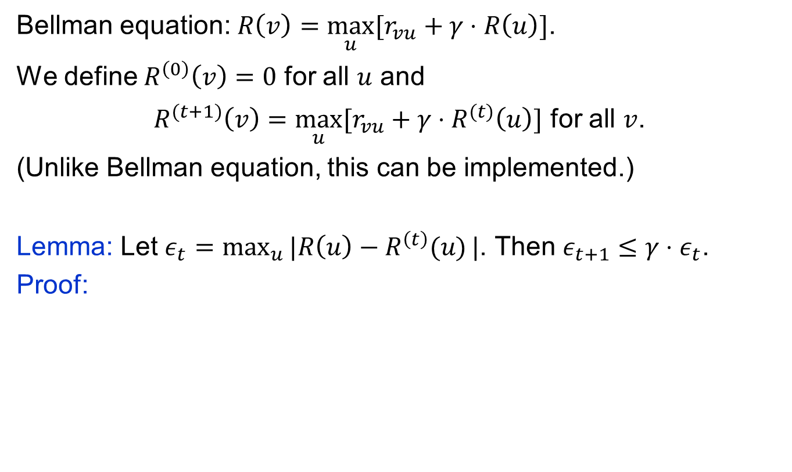
Value Iteration
Bellman equation: $R\left(v\right)=\max_{u}{[r_{vu}+γ⋅R\left(u\right)]}$.
We define $R^{\left(0\right)}\left(v\right)=0$ for all $u$ and
$R^{(t+1)}\left(v\right)=\max_{u}{[r_{vu}+γ⋅R^{(t)}\left(u\right)]}$ for all $v$.
(Unlike Bellman equation, this can be implemented.)
Lemma: Let $ε_{t}=\max_{u}{|R\left(u\right)−R^{\left(t\right)}(u)}|$. Then $ε_{t+1}≤γ⋅ε_{t}$.
Proof:

Slide 13
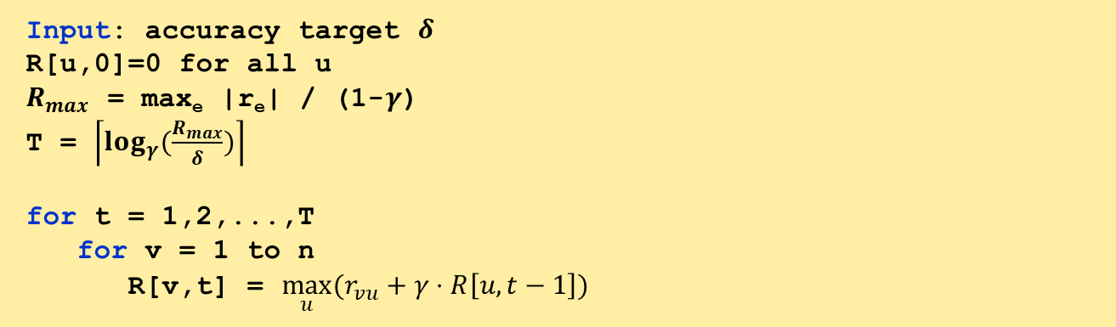
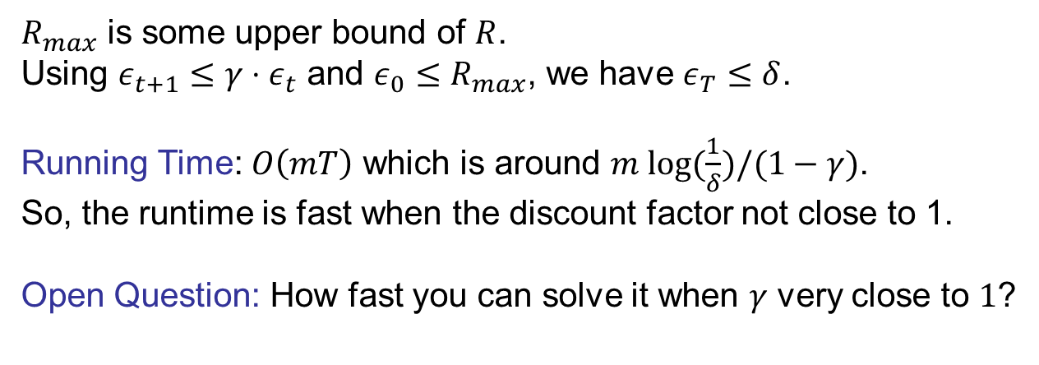
Value Iteration
Input: accuracy target $δ$
R[u,0]=0 for all u
$R_{max}$ = max_{e} |r_{e}| / (1-$γ$)
T = $\left\lceil log_{γ}(\frac{R_{max}}{δ})\right\rceil$
for t = 1,2,...,T
for v = 1 to n
R[v,t] = $\max_{u}{(r_{vu}+γ⋅R\left[u,t−1\right])}$
$R_{max}$ is some upper bound of $R$.
Using $ε_{t+1}≤γ⋅ε_{t}$ and $ε_{0}≤R_{max}$, we have $ε_{T}≤δ$.
Running Time: $O\left(mT\right)$ which is around $m log⁡(\frac{1}{δ})/(1−γ)$.
So, the runtime is fast when the discount factor not close to 1.
Open Question: How fast you can solve it when $γ$ very close to $1$?

Slide 14
Example 2:
Traveling Salesperson Problem
(DP can be used for hard problems)

Slide 15
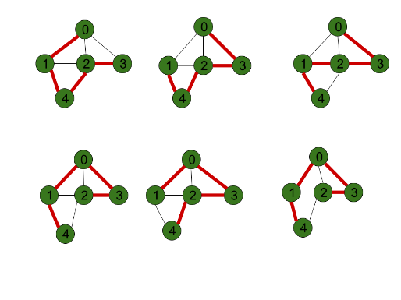
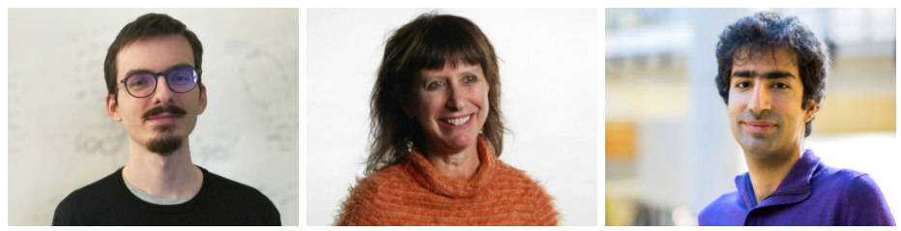
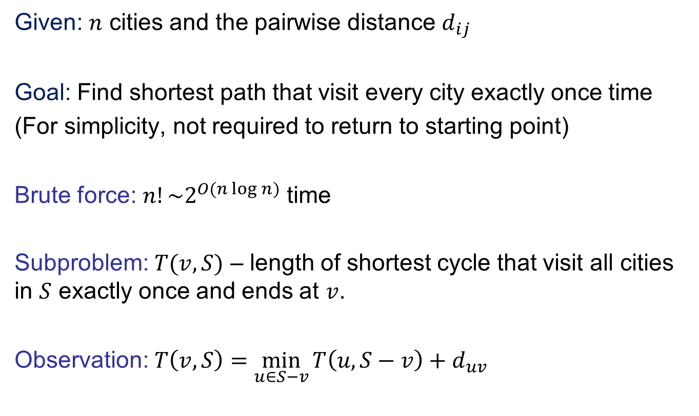
Traveling Salesperson Problem
Given: $n$ cities and the pairwise distance $d_{ij}$
Goal: Find shortest path that visit every city exactly once time
(For simplicity, not required to return to starting point)
Brute force: $n!\sim 2^{O(n\log{n})}$ time
Subproblem: $T(v,S)$ – length of shortest cycle that visit all cities in $S$ exactly once and ends at $v$.
Observation: $T\left(v,S\right)=\min_{u∈S−v}{T\left(u,S−v\right)+d_{uv}}$
They made a breakthrough in 2020 on getting best approximation of metric TSP

Slide 16


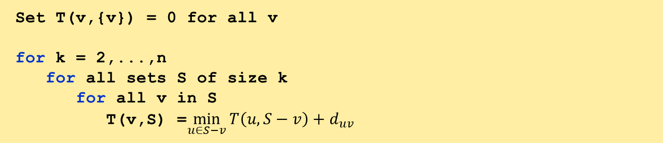
Traveling Salesperson Problem
Brute force: $n!\sim 2^{O(n\log{n})}$ time
Subproblem: $T(v,S)$ – length of shortest cycle that visit all cities in $S$ exactly once and ends at $v$.
Algorithm:
Set T(v,{v}) = 0 for all v
for k = 2,...,n
for all sets S of size k
for all v in S
T(v,S) =$\min_{u∈S−v}{T\left(u,S−v\right)+d_{uv}}$
Runtime: $O(n2^{n})$

Slide 17
Exercise:
Minimum Vertex Cover for Tree

Slide 18
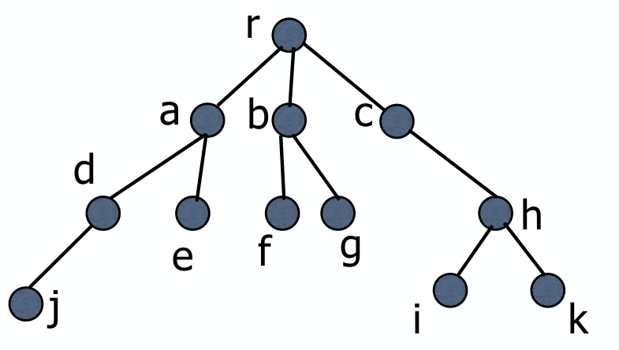
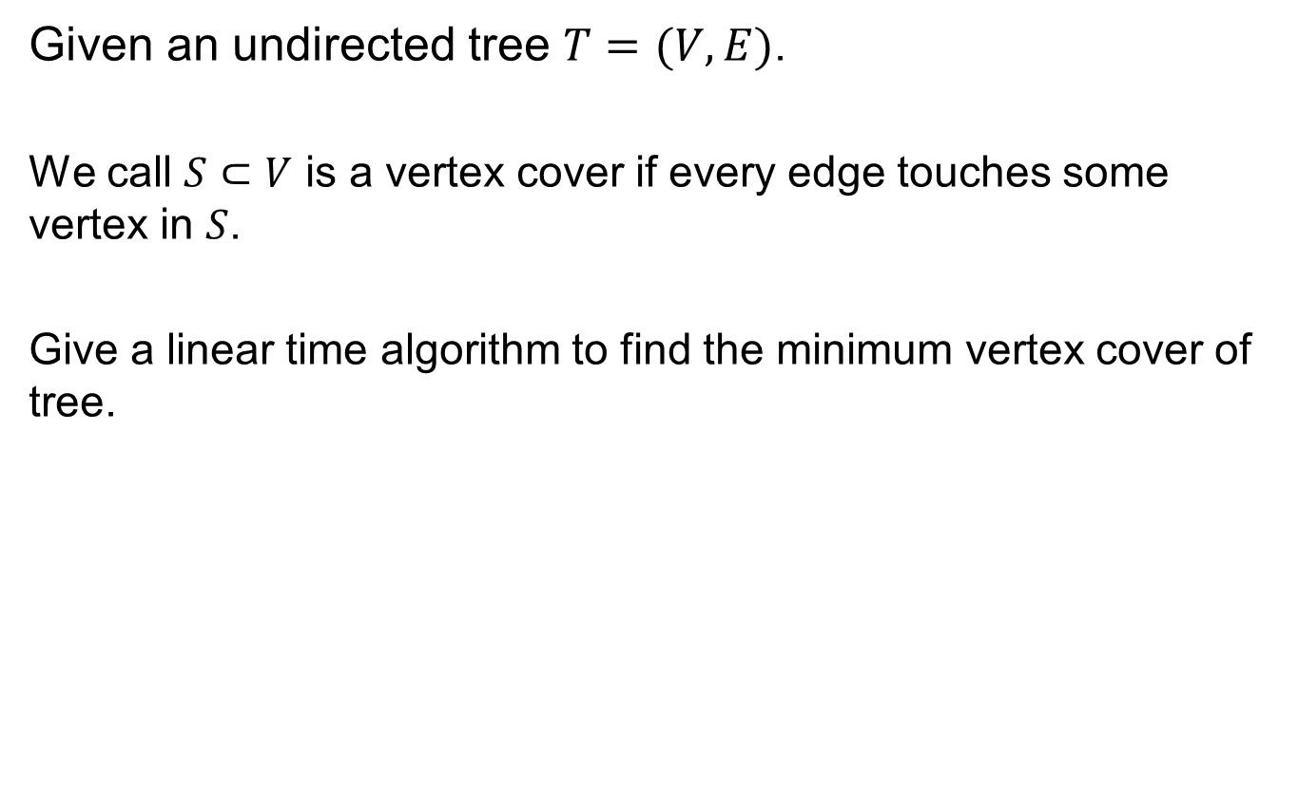
Minimum Vertex Cover for Tree
Given an undirected tree $T=(V,E)$.
We call $S⊂V$ is a vertex cover if every edge touches some vertex in $S$.
Give a linear time algorithm to find the minimum vertex cover of tree.

Slide 19
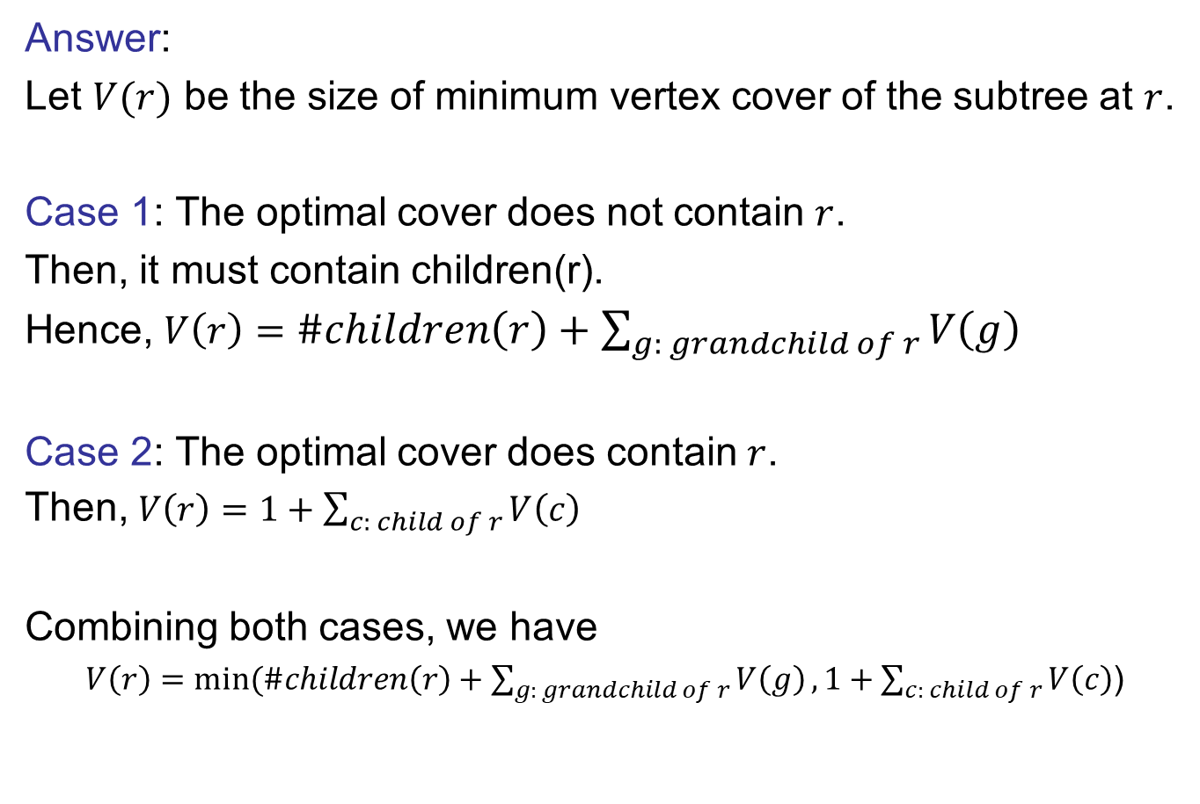
Minimum Vertex Cover for Tree
Answer:
Let $V(r)$ be the size of minimum vertex cover of the subtree at $r$.
Case 1: The optimal cover does not contain $r$.
Then, it must contain children(r).
Hence, $V\left(r\right)=\#children\left(r\right)+\sum_{g: grandchild of r}{V\left(g\right)}$
Case 2: The optimal cover does contain $r$.
Then, $V\left(r\right)=1+\sum_{c: child of r}{V\left(c\right)}$
Combining both cases, we have
$V\left(r\right)=min⁡(\#children\left(r\right)+\sum_{g: grandchild of r}{V\left(g\right)},1+\sum_{c: child of r}{V\left(c\right)}$)

Slide 20
Exercise:
Chain Matrix Multiplication

Slide 21
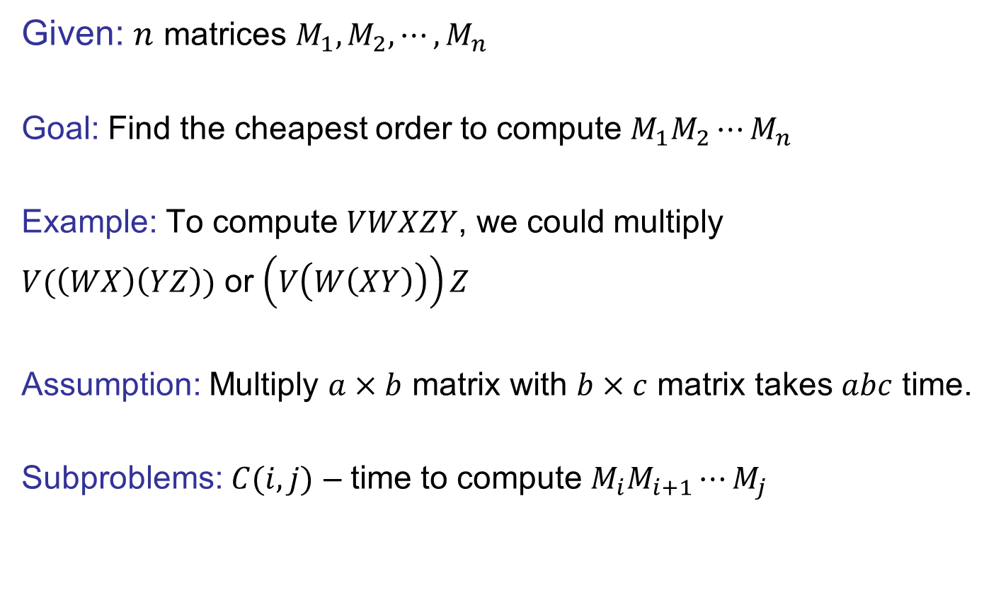
Chain Matrix Multiplication
Given: $n$ matrices $M_{1},M_{2},⋯,M_{n}$
Goal: Find the cheapest order to compute $M_{1}M_{2}⋯M_{n}$
Example: To compute $VWXZY$, we could multiply
$V(\left(WX\right)\left(YZ\right))$ or $\left(V\left(W\left(XY\right)\right)\right)Z$
Assumption: Multiply $a×b$ matrix with $b×c$ matrix takes $abc$ time.
Subproblems: $C(i,j)$ – time to compute $M_{i}M_{i+1}⋯M_{j}$

Slide 22
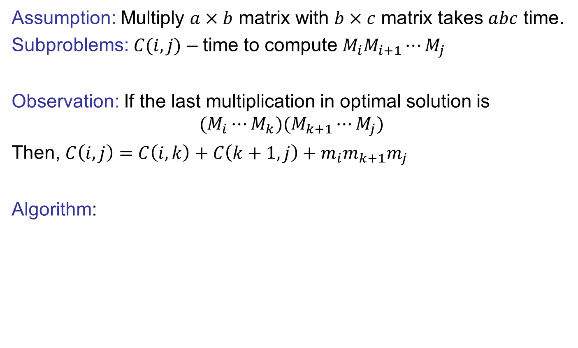
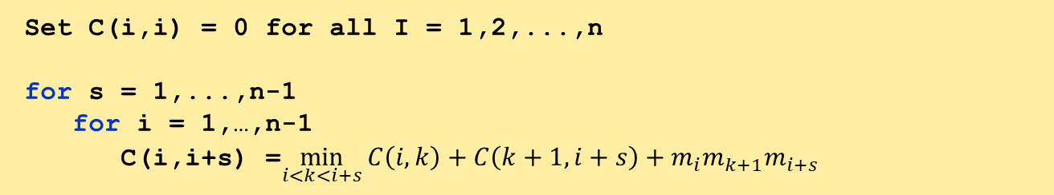
Chain Matrix Multiplication
Assumption: Multiply $a×b$ matrix with $b×c$ matrix takes $abc$ time.
Subproblems: $C(i,j)$ – time to compute $M_{i}M_{i+1}⋯M_{j}$
Observation: If the last multiplication in optimal solution is
$$(M_{i}⋯M_{k})(M_{k+1}⋯M_{j})$$
Then, $C\left(i,j\right)=C\left(i,k\right)+C\left(k+1,j\right)+m_{i}m_{k+1}m_{j}$
Algorithm:
Set C(i,i) = 0 for all I = 1,2,...,n
for s = 1,...,n-1
for i = 1,…,n-1
C(i,i+s) =$\min_{i<k<i+s}{C\left(i,k\right)+C\left(k+1,i+s\right)+m_{i}m_{k+1}m_{i+s}}$

