Slide 1
CSE 451: Operating Systems
Autumn 2013
Module 1
Course Introduction
Ed Lazowska
lazowska@cs.washington.edu
570 Allen Center
Notes:
1

Slide 2
Today’s agenda
Administrivia
  Course overview
    course staff
    general structure
    the text(s)
    policies
    your to-do list
OS overview
  Trying to make sense of the topic

Slide 3
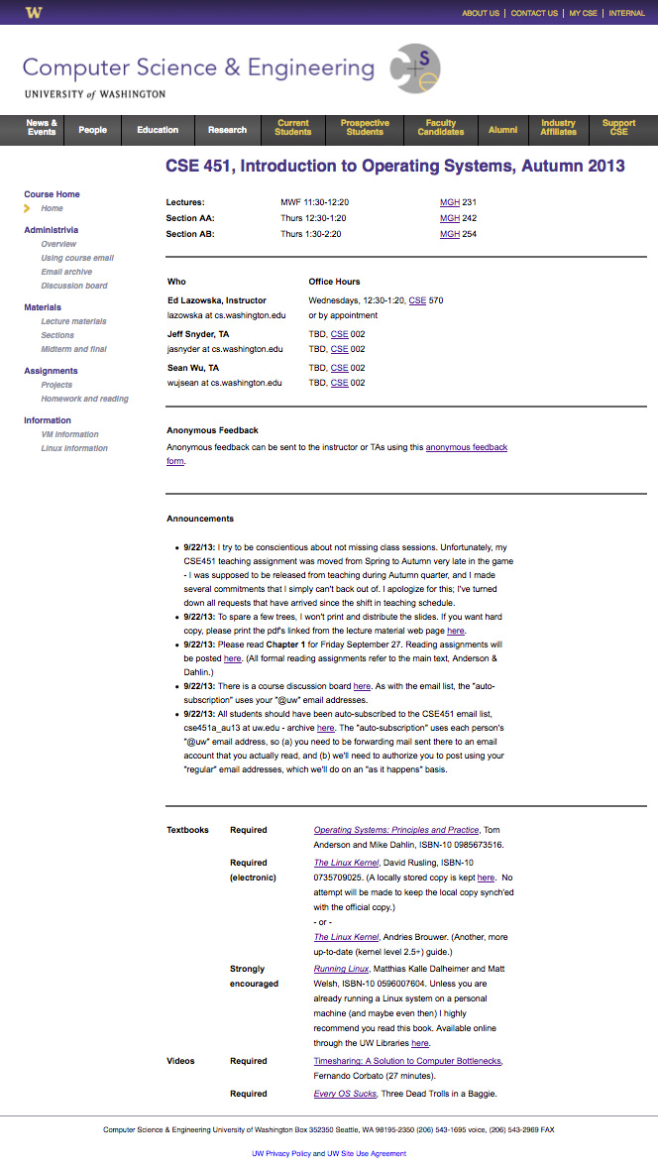
Course overview
Operationally, everything you need to
know will be on the course web page:
http://www.cs.washington.edu/451/
Or on the course email and email archive:
https://mailman1.u.washington.edu/mailman/private/cse451a_au13/
Or on the course discussion board:
https://catalyst.uw.edu/gopost/board/lazowska/34313/

Slide 4

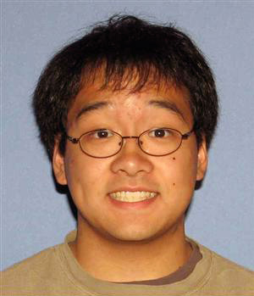
But to tide you over for the next hour …
Course staff
  Ed Lazowska
  Jeff Snyder
  Sean Wu
General Course Structure
  Read the text prior to class
  Class doesn't aim to repeat the text
  Homework exercises to motivate reading by non-saints
  Sections will focus on projects
  You're paying for interaction

Slide 5
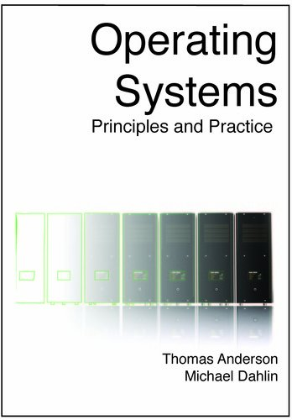
The text

Slide 6
The text
  Really outstanding – written by current experts
    Allows you to actually figure out how things work
    Way better (and way less expensive) than any alternative
  First edition – still has typos
    Try not to resent this; help the authors debug it
  Think of it as helping you to understand, and dig deeper than, the lecture, section, and project material
  Other resources
  Many online; some of them are essential
Policies
  Collaboration vs. cheating
  Projects: late policy

Slide 7
Projects
  Project 0: a C warmup – individual assignment
  Projects 1-3: significant OS “internals” projects to be done in teams of 2
    Adding a system call
    Building a thread package
    Modifying the file system
You’re likely to be happier if you form a team on your own than if we form one for you!
      You’ll need to do this over the weekend
          Project 1 will begin next Friday
          We’ll ask for your input by Sunday night and create teams as needed

Slide 8
Your to-do list …
      Please read the entire course web thoroughly, today
  Be sure you’re on the cse451 email list, and check your email daily
    You should have received email over the weekend!
    Be sure your “@uw” email is being forwarded!
  Please keep up with the reading
  Homework 1 (reading) is posted on the web now
    Due at the start of class Friday
    Project 0 (“warmup”) is posted on the web now
    Will be discussed in section Thursday
    Due at the end of the day next Friday
  Begin coming up with a 2-person team for Projects 1-3

Slide 9
Course registration
  If you’re going to drop, please do it soon!
  If you want to get into the class, be sure you’ve registered with the advisors
    They run the show
    I have a registration sheet here!

Slide 10
More about 451
This is really two “linked” classes:
  A classroom/textbook part (mainly run by me)
  A project part (entirely run by the TAs)
In a perfect world, we would do this as a two-quarter sequence
  The world isn’t perfect …
By the end of the course, you’ll see how it all fits together!
  There will be a lot of work
  You’ll learn a lot, and have a ton of fun
  In the end, you’ll understand much more deeply how computer systems work
“There is no magic”

Slide 11
In this class you will learn:
  what are the major components of most OS’s?
  how are the components structured?
  what are the most important (most common) interfaces?
  what policies are typically used in an OS?
  what algorithms are used to implement these policies?
Philosophy
  You may not ever build an OS
  But as a computer scientist or computer engineer you need to understand the foundations
  Most importantly, operating systems exemplify the sorts of engineering design tradeoffs that you’ll need to make throughout your careers – compromises among and within cost, performance, functionality, complexity, schedule …
  We want you will love this course!
  We want you to remember it in 5 years as one that paid off!

Slide 12
What is an Operating System?
Answers:
  I don't know.
  Nobody knows.
  The book claims to know – read Chapter 1.
  They’re programs – big hairy programs
    The Linux source you'll be compiling has over 1.7M lines of C

Slide 13
What is an Operating System?
Answers:
  I don't know.
  Nobody knows.
  The book claims to know – read Chapter 1.
  They’re programs – big hairy programs
    The Linux source you'll be compiling has over 1.7M lines of C
Okay. What are some goals of an OS?

Slide 14
The traditional picture
Applications
OS
Hardware
“The OS is everything you don’t need to write in order to run your application”
This depiction invites you to think of the OS as a library; we’ll see that
  In some ways, it is:
    all operations on I/O devices require OS calls (syscalls)
  In other ways, it isn't:
    you use the CPU/memory without OS calls
    it intervenes without having been explicitly called

Slide 15
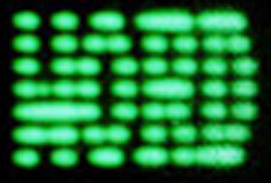
“Everything you don’t have to write”
What is Windows?
Application
DOS
© John DeTreville, Microsoft Corp.

Slide 16
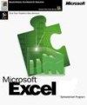

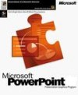
“Everything you don’t have to write”
What is Windows?
Application
…
Application
…
Browser
TCP/IP
File system
COM
…
Installer
Printing
DOS
Windows
© John DeTreville, Microsoft Corp.

Slide 17

“Everything you don’t have to write”
What is .NET?
Application
Internet
© John DeTreville, Microsoft Corp.

Slide 18

“Everything you don’t have to write”
What is .NET?
Application
Bank
eBay
FedEx
Extensibility
Asynchrony
…
magic
XML
…
Device
independence
Identity
& security
Internet
.NET
© John DeTreville, Microsoft Corp.

Slide 19
The OS and hardware
An OS mediates programs’ access to hardware resources (sharing and protection)
  computation (CPU)
  volatile storage (memory) and persistent storage (disk, etc.)
  network communications (TCP/IP stacks, Ethernet cards, etc.)
  input/output devices (keyboard, display, sound card, etc.)
The OS abstracts hardware into logical resources and well-defined interfaces to those resources (ease of use)
  processes (CPU, memory)
  files (disk)
  programs (sequences of instructions)
  sockets (network)

Slide 20
The text says an OS is …
A Referee
  Mediates resource sharing
An Illusionist
  Masks hardware limitations
Glue
  Provides common services

Slide 21
Why bother with an OS?
Application benefits
  programming simplicity
    see high-level abstractions (files) instead of low-level hardware details (device registers)
    abstractions are reusable across many programs
  portability (across machine configurations or architectures)
    device independence: 3com card or Intel card?
User benefits
  safety
    program “sees” its own virtual machine, thinks it “owns” the computer
    OS protects programs from each other
    OS fairly multiplexes resources across programs
  efficiency (cost and speed)
    share one computer across many users
    concurrent execution of multiple programs

Slide 22
The major OS issues
structure: how is the OS organized?
sharing: how are resources shared across users?
naming: how are resources named (by users, by programs)?
protection: how is one user/program protected from another?
security: how is the integrity of the OS and its resources ensured?
performance: how do we make it all go fast?
availability: can you always access the services you need?
reliability: what happens if something goes wrong (either with hardware or with a program)?
extensibility: can we add new features?
communication: how do programs exchange information, including across a network?

Slide 23
More OS issues…
concurrency: how are parallel activities (computation and I/O) created and controlled?
scale: what happens as demands or resources increase?
persistence: how do you make data last longer than program executions?
distribution: how do multiple computers interact with each other?
accounting: how do we keep track of resource usage, and perhaps charge for it?
auditing: can we reconstruct who did what to whom?
There are tradeoffs – not right and wrong!

Slide 24
Hardware/Software Changes with Time
1960s: mainframe computers (IBM)
1970s: minicomputers (DEC)
1980s: microprocessors and workstations (SUN), local-area networking, the Internet
1990s: PCs (rise of Microsoft, Intel, Dell), the Web
2000s:
  Internet Services / Clusters (Amazon)
  General Cloud Computing (Google, Amazon, Microsoft)
  Mobile/ubiquitous/embedded computing (iPod, iPhone, iPad, Android)
2010s: sensor networks, “data-intensive computing,” computers and the physical world (“pervasive computing”)
2020: it’s up to you!!

Slide 25
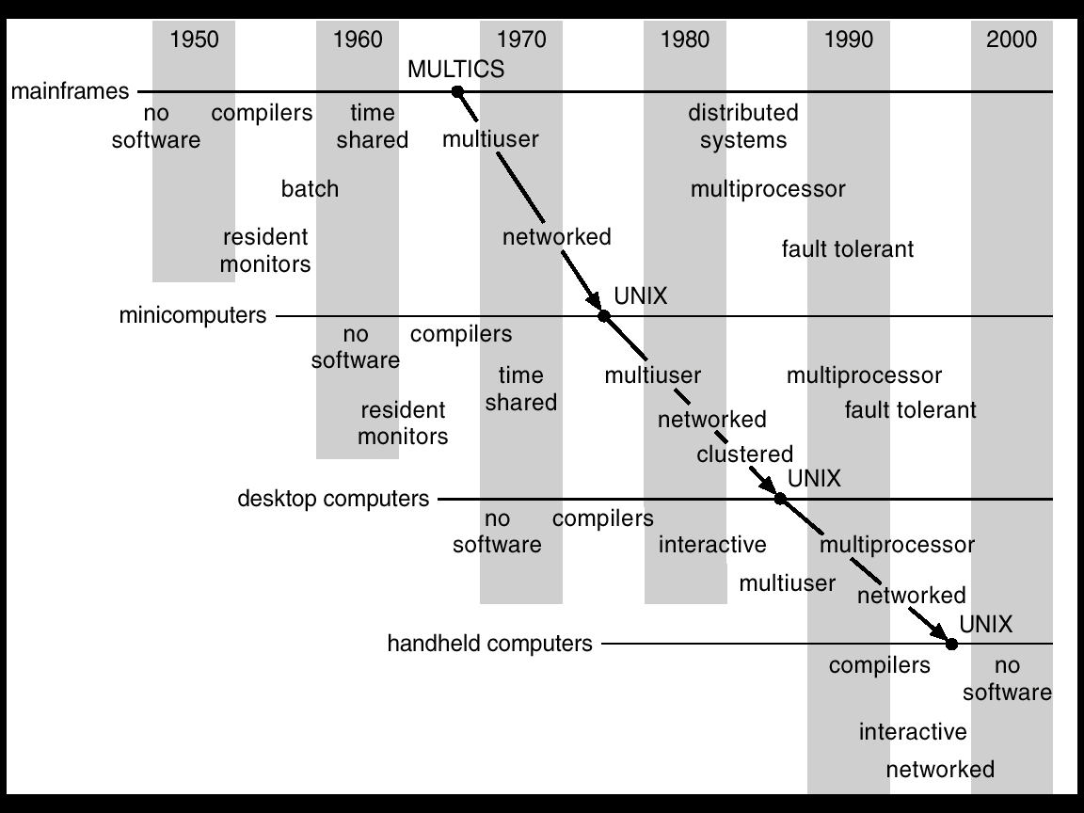
Progression of concepts and form factors
© Silberschatz, Galvin and Gagne

Slide 26
Has it all been discovered?
New challenges constantly arise
  embedded computing (e.g., iPod)
  sensor networks (very low power, memory, etc.)
  peer-to-peer systems
  ad hoc networking
  scalable server farm design and management (e.g., Google)
  software for utilizing huge clusters (e.g., MapReduce, Bigtable)
  overlay networks (e.g., PlanetLab)
  worm fingerprinting
  finding bugs in system code (e.g., model checking)
Old problems constantly re-define themselves
  the evolution of smart phones recapitulated the evolution of PCs, which had recapitulated the evolution of minicomputers, which had recapitulated the evolution of mainframes
  but the ubiquity of PCs re-defined the issues in protection and security, as phones are doing once again

Slide 27
Protection and security as an example
none
OS from my program
your program from my program
my program from my program
access by intruding individuals
access by intruding programs
denial of service
distributed denial of service
spoofing
spam
worms
viruses
stuff you download and run knowingly (bugs, trojan horses)
stuff you download and run obliviously (cookies, spyware)

Slide 28
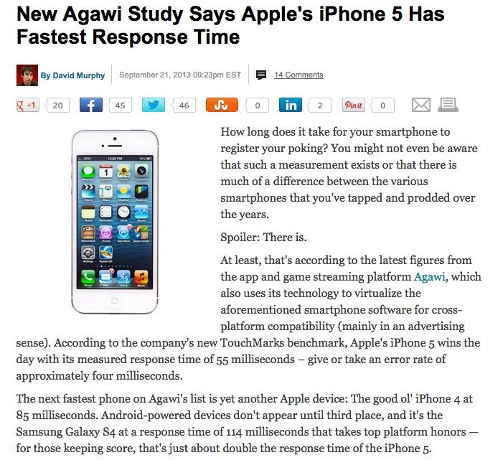
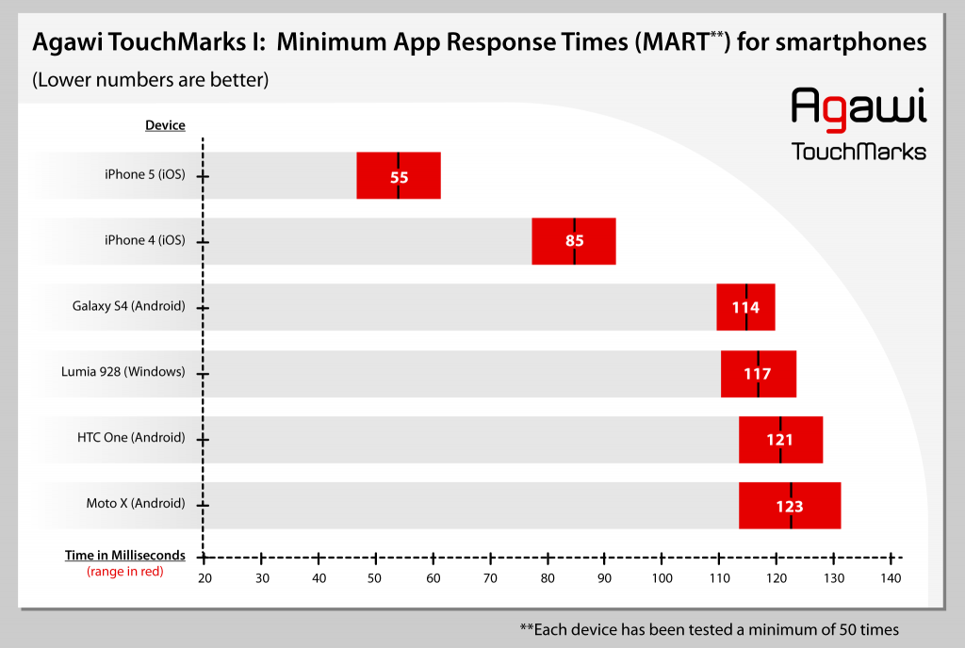
Performance as an example

Slide 29
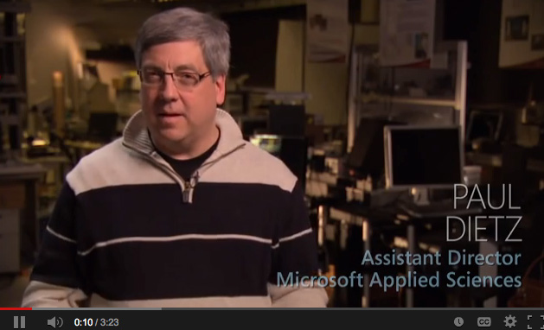
https://www.youtube.com/watch?v=vOvQCPLkPt4

Slide 30
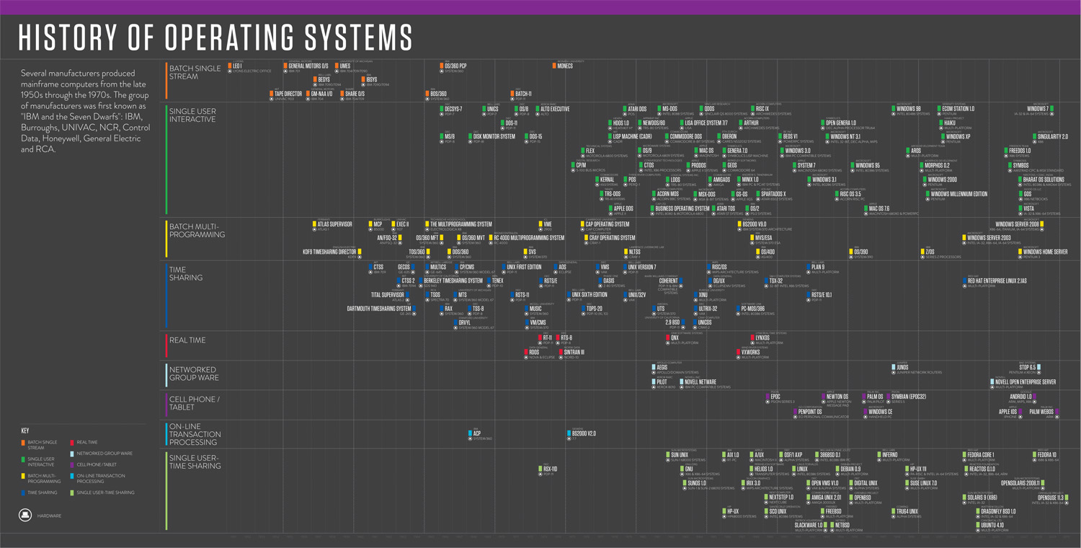
An OS history lesson
Operating systems are the result of a 60 year long evolutionary process.
We'll follow a bit of their evolution
That should help make clear what some of their functions are, and why

Slide 31
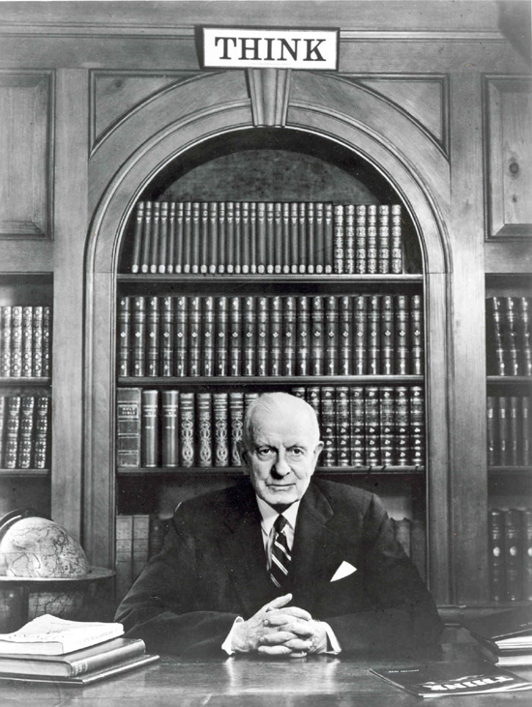
In the Beginning...
1943
  T.J. Watson (created IBM):
  “ I think there is a world market for maybe five
  computers.”
Fast forward … 1950
  There are maybe 20 computers in the world
    They were unbelievably expensive
    Imagine this: machine time is more valuable than person time!
    Ergo: efficient use of the hardware is paramount
  Operating systems are born
    They carry with them the vestiges of these ancient forces

Slide 32
The Primordial Computer
Printer
CPU
Input Device
Disk
Memory

Slide 33
The OS as a linked library
In the very beginning…
  OS was just a library of code that you linked into your program; programs were loaded in their entirety into memory, and executed
    “OS” had an “API” that let you control the disk, control the printer, etc.
  Interfaces were literally switches and blinking lights
  When you were done running your program, you’d leave and turn the computer over to the next person
Recapitulation: Paul Allen writing a bootstrap loader for the Altair as the plane was landing in New Mexico

Slide 34
Asynchronous I/O
The disk was really slow
Add hardware so that the disk could operate without tying up the CPU
  Disk controller
Hotshot programmers could now write code that:
  Starts an I/O
  Goes off and does some computing
  Checks if the I/O is done at some later time
Upside
  Helps increase (expensive) CPU utilization
Downsides
  It's hard to get right
  The benefits are job specific

Slide 35
The OS as a “resident monitor”
Everyone was using the same library of code
Why not keep it in memory?
While we’re at it, make it capable of loading Program 4 while running Program 3 and printing the output of Program 2
  SPOOLing – Simultaneous Peripheral Operations On-Line
What new requirements does this impose?

Slide 36
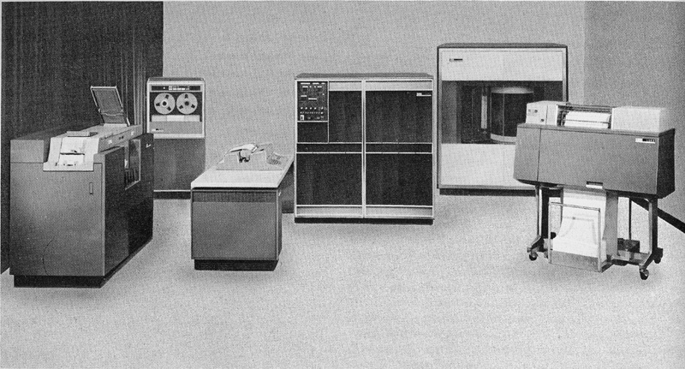
IBM 1401

Slide 37
Multiprogramming
To further increase system utilization, multiprogramming OSs were invented
  keeps multiple runnable jobs loaded in memory at once
  overlaps I/O of one job with computing of another
    while one job waits for I/O completion, another job uses the CPU
  Can get rid of asynchronous I/O within individual jobs
    Life of application programmer becomes simpler; only the OS programmer needs to deal with asynchronous events
  How do we tell when devices are done?
    Interrupts
    Polling
  What new requirements does this impose?

Slide 38
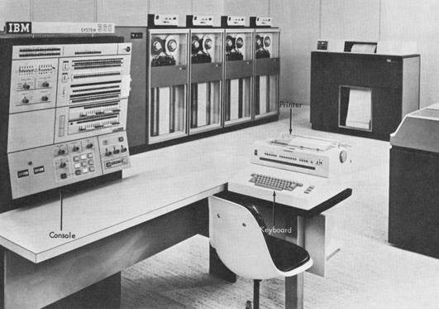
IBM System 360

Slide 39
(An aside on protection)
Applications/programs/jobs execute directly on the CPU, but cannot touch anything except “their own memory” without OS intervention

Slide 40
(An aside on concurrency)
Transistor density continues to increase (Moore’s Law), but individual cores aren’t getting faster – instead, we’re getting more of them (the number doubles on roughly the old 18-month cycle)

Slide 41
The burden is on the programmer to use an ever increasing number of cores
A lot of this course is about concurrency
  It used to be a bit esoteric
  It has now become one of the most important things you'll learn (in any of our courses)

Slide 42
Timesharing
To support interactive use, create a timesharing OS:
  multiple terminals into one machine
  each user has illusion of entire machine to him/herself
  optimize response time, perhaps at the cost of throughput
Timeslicing
  divide CPU equally among the users
  if job is truly interactive (e.g., editor), then can jump between programs and users faster than users can generate load
  permits users to interactively view, edit, debug running programs

Slide 43
MIT CTSS system (operational 1961) was among the first timesharing systems
  only one user memory-resident at a time (32KB memory!)
MIT Multics system (operational 1968) was the first large timeshared system
  nearly all OS concepts can be traced back to Multics!
  “second system syndrome”

Slide 44
CTSS as an illustration of architectural and OS functionality requirements
User program
OS

Slide 45
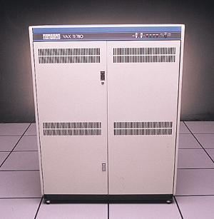
In early 1980s, a single timeshared VAX-11/780 (like the one in the Allen Center atrium) ran computing for all of CSE.
A typical VAX-11/780 was 1 MIPS (1 MHz) and had 1MB of RAM and 100MB of disk.
  An Apple iPhone 5s (A7 processor) is 1.3GHz dual-core (x2600), has 2GB of RAM (x2000),64GB of flash (x640), a quad-core GPU (unheard of).

Slide 46
Parallel systems
Some applications can be written as multiple parallel threads or processes
  can speed up the execution by running multiple threads/processes simultaneously on multiple CPUs [Burroughs D825, 1962]
  need OS and language primitives for dividing program into multiple parallel activities
  need OS primitives for fast communication among activities
    degree of speedup dictated by communication/computation ratio
  many flavors of parallel computers today
    SMPs (symmetric multi-processors)
    MPPs (massively parallel processors)
    NOWs (networks of workstations)
    Massive clusters (Google, Amazon.com, Microsoft)
    Computational grid (SETI @home)

Slide 47
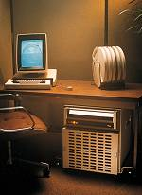
Personal computing
Primary goal was to enable new kinds of applications
Bit mapped display [Xerox Alto,1973]
  new classes of applications
  new input device (the mouse)
Move computing near the display
  why?
Window systems
  the display as a managed resource
Local area networks [Ethernet]
  why?
Effect on OS?

Slide 48
Distributed OS
Distributed systems to facilitate use of geographically distributed resources
  workstations on a LAN
  servers across the Internet
Supports communications between programs
  interprocess communication
    message passing, shared memory
  networking stacks
Sharing of distributed resources (hardware, software)
  load balancing, authentication and access control, …
Speedup isn’t the issue
  access to diversity of resources is goal

Slide 49
Client/server computing
Mail server/service
File server/service
Print server/service
Compute server/service
Game server/service
Music server/service
Web server/service
etc.

Slide 50
Peer-to-peer (p2p) systems
Napster
Gnutella
  example technical challenge: self-organizing overlay network
  technical advantage of Gnutella?
  er … legal advantage of Gnutella?

Slide 51
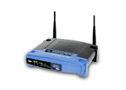
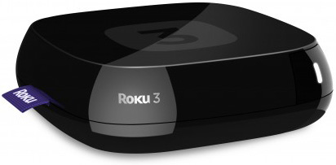
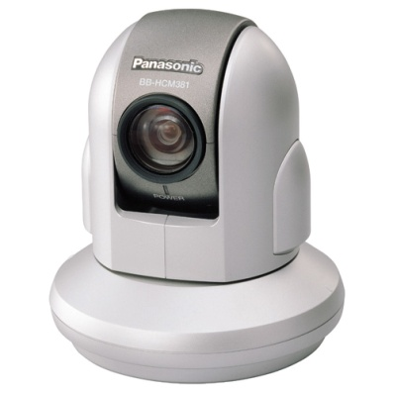
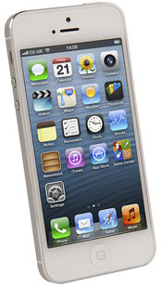
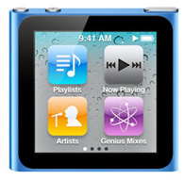
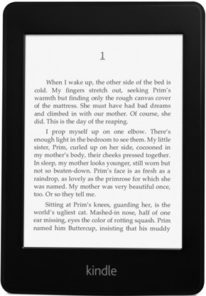
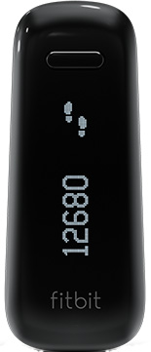
Embedded/mobile/pervasive computing
Pervasive computing
  cheap processors embedded everywhere
  how many are on your body now? in your car?
  cell phones, PDAs, network computers, …
Often constrained hardware resources
  slow processors
  small amount of memory
  no disk
  often only one dedicated application
  limited power
But this is changing rapidly!
  cf. specs of iPhone 5S earlier!

Slide 52
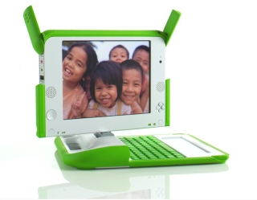
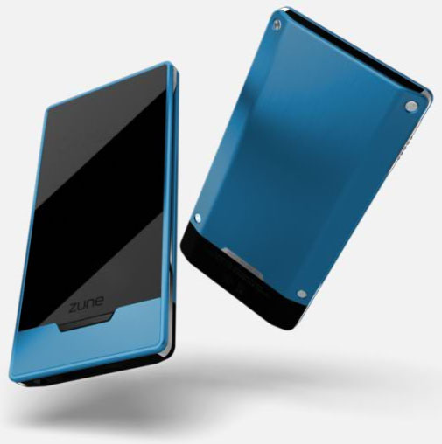

Ad hoc networking

Slide 53
The major OS issues
structure: how is the OS organized?
sharing: how are resources shared across users?
naming: how are resources named (by users, by programs)?
protection: how is one user/program protected from another?
security: how is the integrity of the OS and its resources ensured?
performance: how do we make it all go fast?
availability: can you always access the services you need?
reliability: what happens if something goes wrong (either with hardware or with a program)?
extensibility: can we add new features?
communication: how do programs exchange information, including across a network?

Slide 54
More OS issues…
concurrency: how are parallel activities (computation and I/O) created and controlled?
scale: what happens as demands or resources increase?
persistence: how do you make data last longer than program executions?
distribution: how do multiple computers interact with each other?
accounting: how do we keep track of resource usage, and perhaps charge for it?
auditing: can we reconstruct who did what to whom?
There are tradeoffs – not right and wrong!

