Slide 1
CSE 451: Operating Systems Autumn 2013 Module 3 Operating System Components and Structure
Ed Lazowska
lazowska@cs.washington.edu
Allen Center 570
Notes:
1

Slide 2
OS structure
The OS sits between application programs and the hardware
it mediates access and abstracts away ugliness
programs request services via traps or exceptions
devices request attention via interrupts
P2
P3
P1
P4
dispatch
trap or exception
OS
interrupt
D1
start i/o
D4
D2
D3

Slide 3
User Apps
Firefox
Photoshop
Acrobat
Java
Portable
Application Interface (API)
Operating System
File Systems
Memory Manager
Process Manager
Network Support
Device Drivers
Interrupt Handlers
Boot & Init
Hardware Abstraction Layer
Hardware (CPU, devices)

Slide 4
Command Interpreter
Information Services
Error Handling
Accounting System
File System
Protection System
Memory Management
Secondary Storage Management
Process Management
I/O System

Slide 5
Major OS components
processes/threads
memory
I/O
secondary storage
file systems
protection
shells (command interpreter, or OS UI)
GUI
networking

Slide 6
Process management
An OS executes many kinds of activities:
users’ programs
batch jobs or scripts
system programs
print spoolers, name servers, file servers, network daemons, …
Each of these activities is encapsulated in a process
a process includes the execution context
PC, registers, VM, OS resources (e.g., open files), etc…
plus the program itself (code and data)
the OS’s process module manages these processes
creation, destruction, scheduling, …

Slide 7
Important: Processes vs. Threads
Soon, we will separate the “thread of control” aspect of a process (program counter, call stack) from its other aspects (address space, open files, owner, etc.). And we will allow each {process / address space} to have multiple threads of control.
But for now – for simplicity and for historical reasons – consider each {process / address space} to have a single thread of control.

Slide 8
Program/processor/process
Note that a program is totally passive
just bytes on a disk that encode instructions to be run
A process is an instance of a program being executed by a (real or virtual) processor
at any instant, there may be many processes running copies of the same program (e.g., an editor); each process is separate and (usually) independent
Linux: ps -auwwx to list all processes
process A
process B
code stack PC registers
page tables
resources
code stack PC registers
page tables
resources

Slide 9
States of a user process
running
dispatch
interrupt
ready
trap or exception
interrupt
blocked

Slide 10
Process operations
The OS provides the following kinds operations on processes (i.e., the process abstraction interface):
create a process
delete a process
suspend a process
resume a process
clone a process
inter-process communication
inter-process synchronization
create/delete a child process (subprocess)

Slide 11
Memory management
The primary memory is the directly accessed storage for the CPU
programs must be resident in memory to execute
memory access is fast
but memory doesn’t survive power failures
OS must:
allocate memory space for programs
deallocate space when needed by rest of system
maintain mappings from physical to virtual memory
through page tables
decide how much memory to allocate to each process
a policy decision
decide when to remove a process from memory
also policy

Slide 12
I/O
A big chunk of the OS kernel deals with I/O
hundreds of thousands of lines in Windows, Unix, etc.
The OS provides a standard interface between programs (user or system) and devices
file system (disk), sockets (network), frame buffer (video)
Device drivers are the routines that interact with specific device types
encapsulates device-specific knowledge
e.g., how to initialize a device, how to request I/O, how to handle interrupts or errors
examples: SCSI device drivers, Ethernet card drivers, video card drivers, sound card drivers, …
Note: Windows has ~35,000 device drivers!

Slide 13
Secondary storage
Secondary storage (disk, FLASH, tape) is persistent memory
often magnetic media, survives power failures (hopefully)
Routines that interact with disks are typically at a very low level in the OS
used by many components (file system, VM, …)
handle scheduling of disk operations, head movement, error handling, and often management of space on disks
Usually independent of file system
although there may be cooperation
file system knowledge of device details can help optimize performance
e.g., place related files close together on disk

Slide 14
File systems
Secondary storage devices are crude and awkward
e.g., “write a 4096 byte block to sector 12”
File system: a convenient abstraction
defines logical objects like files and directories
hides details about where on disk files live
as well as operations on objects like read and write
read/write byte ranges instead of blocks
A file is the basic unit of long-term storage
file = named collection of persistent information
A directory is just a special kind of file
directory = named file that contains names of other files and metadata about those files (e.g., file size)
Note: Sequential byte stream is only one possibility!

Slide 15
File system operations
The file system interface defines standard operations:
file (or directory) creation and deletion
manipulation of files and directories (read, write, extend, rename, protect)
copy
lock
File systems also provide higher level services
accounting and quotas
backup (must be incremental and online!)
(sometimes) indexing or search
(sometimes) file versioning

Slide 16
Protection
Protection is a general mechanism used throughout the OS
all resources needed to be protected
memory
processes
files
devices
CPU time
…
protection mechanisms help to detect and contain unintentional errors, as well as preventing malicious destruction

Slide 17
Command interpreter (shell)
A particular program that handles the interpretation of users’ commands and helps to manage processes
user input may be from keyboard (command-line interface), from script files, or from the mouse (GUIs)
allows users to launch and control new programs
On some systems, command interpreter may be a standard part of the OS (e.g., MS DOS, Apple II)
On others, it’s just non-privileged code that provides an interface to the user
e.g., bash/csh/tcsh/zsh on UNIX
On others, there may be no command language
e.g., MacOS

Slide 18
OS structure
It’s not always clear how to stitch OS modules together:
Command Interpreter
Information Services
Error Handling
Accounting System
File System
Protection System
Memory Management
Secondary Storage Management
Process Management
I/O System

Slide 19
OS structure
An OS consists of all of these components, plus:
many other components
system programs (privileged and non-privileged)
e.g., bootstrap code, the init program, …
Major issue:
how do we organize all this?
what are all of the code modules, and where do they exist?
how do they cooperate?
Massive software engineering and design problem
design a large, complex program that:
performs well, is reliable, is extensible, is backwards compatible, …

Slide 20
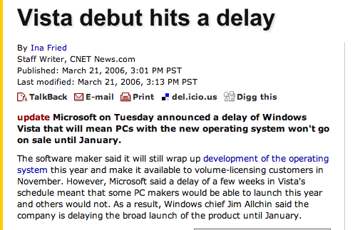

Slide 21
Early structure: Monolithic
Traditionally, OS’s (like UNIX) were built as a monolithic entity:
user programs
everything
OS
hardware

Slide 22
Monolithic design
Major advantage:
cost of module interactions is low (procedure call)
Disadvantages:
hard to understand
hard to modify
unreliable (no isolation between system modules)
hard to maintain
What is the alternative?
find a way to organize the OS in order to simplify its design and implementation

Slide 23
Layering
The traditional approach is layering
implement OS as a set of layers
each layer presents an enhanced ‘virtual machine’ to the layer above
The first description of this approach was Dijkstra’s THE system
Layer 5: Job Managers
Execute users’ programs
Layer 4: Device Managers
Handle devices and provide buffering
Layer 3: Console Manager
Implements virtual consoles
Layer 2: Page Manager
Implements virtual memories for each process
Layer 1: Kernel
Implements a virtual processor for each process
Layer 0: Hardware
Each layer can be tested and verified independently

Slide 24
Problems with layering
Imposes hierarchical structure
but real systems are more complex:
file system requires VM services (buffers)
VM would like to use files for its backing store
strict layering isn’t flexible enough
Poor performance
each layer crossing has overhead associated with it
Disjunction between model and reality
systems modeled as layers, but not really built that way

Slide 25
Hardware Abstraction Layer
An example of layering in modern operating systems
Goal: separates hardware-specific routines from the “core” OS
Provides portability
Improves readability
Core OS
(file system,
scheduler,
system calls)
Hardware Abstraction
Layer
(device drivers,
assembly routines)

Slide 26
Microkernels
Introduced in the late 80’s, early 90’s
recent resurgence of popularity
Goal:
minimize what goes in kernel
organize rest of OS as user-level processes
This results in:
better reliability (isolation between components)
ease of extension and customization
poor performance (user/kernel boundary crossings)
First microkernel system was Hydra (CMU, 1970)
Follow-ons: Mach (CMU), Chorus (French UNIX-like OS), OS X (Apple)

Slide 27
Microkernel structure illustrated
user processes
firefox
powerpoint
user mode
apache
photoshop
itunes
word
file system
network
system processes
paging
threads
scheduling
communication
Kernel mode
microkernel
low-level VM
processor control
protection
hardware
27

Slide 28
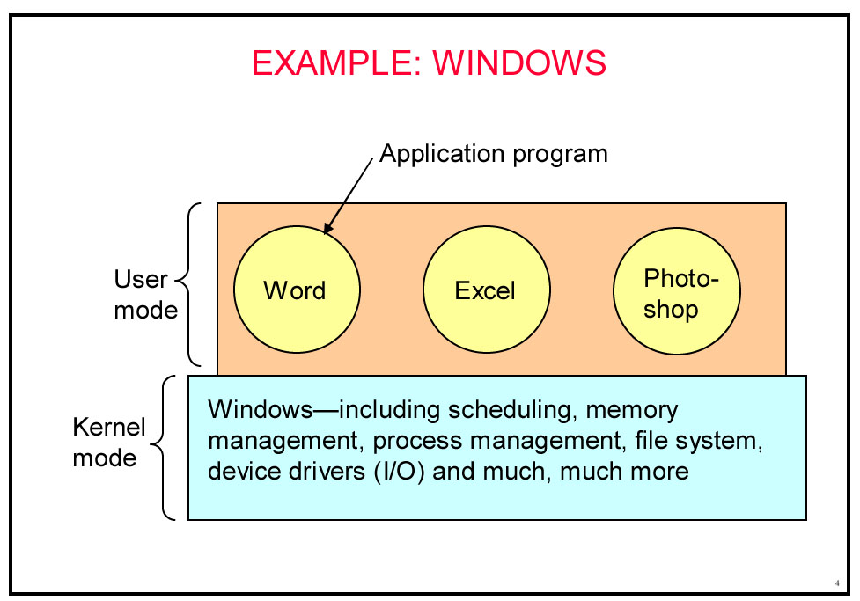
From Andy Tanenbaum

Slide 29
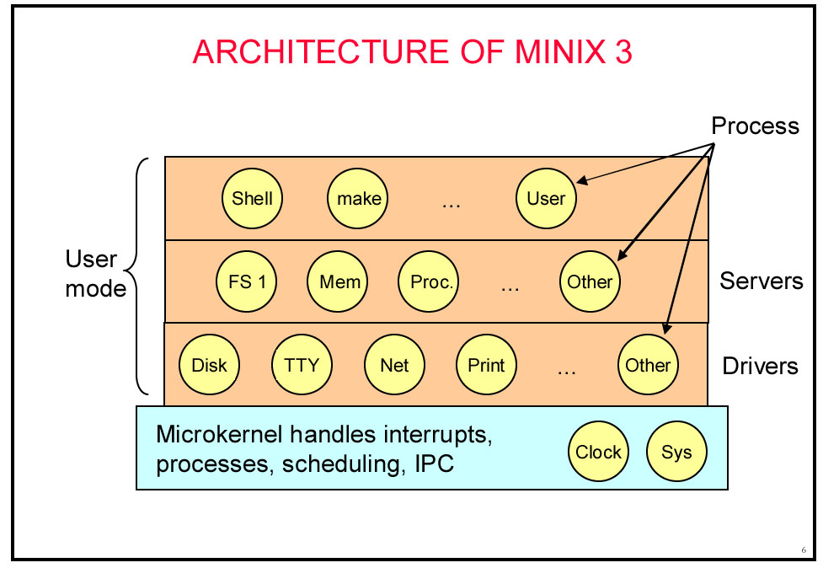
From Andy Tanenbaum

Slide 30
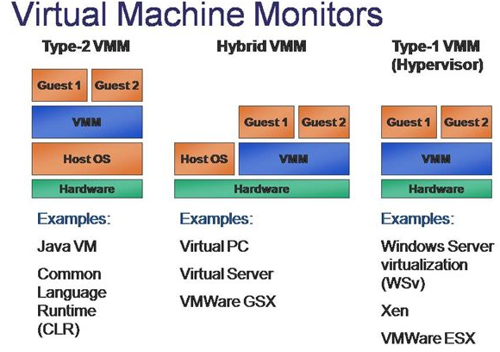
Transparently implement “hardware” in software
Voilà, you can boot a “guest OS”
From http://port25.technet.com/

Slide 31
Summary and Next Module
Summary
OS design has been a evolutionary process of trial and error. Probably more error than success
Successful OS designs have run the spectrum from monolithic, to layered, to micro kernels, to virtual machine monitors
The role and design of an OS are still evolving
It is impossible to pick one “correct” way to structure an OS
Next module
Processes, one of the most fundamental pieces in an OS
What is a process, what does it do, and how does it do it
31

