Slide 1
CSE 451: Operating Systems
Section 8
Project 2b wrap-up, ext2, and Project 3

Slide 2
Project 2b
Make sure to read thoroughly through the requirements for the writeup in part 6 and answer every question
There are multiple ways of measuring throughput that you should discuss
Responses/second
Bytes transferred/second (average throughput per client and total average throughput)
Any lingering questions?

Slide 3
Project 3
Background FS info

Slide 4
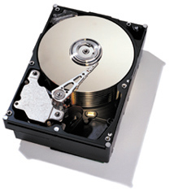
Linux file system layers
Application
User
Files, directories
Kernel
VFS
Inodes, direntries
ext2
ext3
ext4
vfat
Blocks
Buffer cache
← cache for disk blocks
Disk drivers
← “block device”

Slide 5
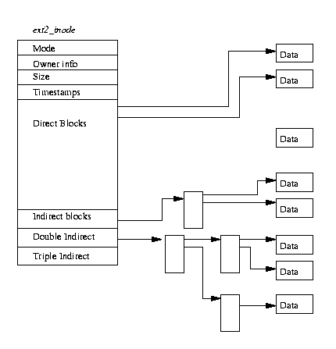
Inodes
Inode: a structure maintaining all metadata about a file (or directory)
Inode number (unique ID of inode)
Permissions, timestamps
Pointers to data blocks
Inode does not contain: name of file
Where is it actually stored?
One or more file names can point (link) to the same inode. When will this occur?

Slide 6
Inode structure
Remember, inodes themselves are stored in blocks
What’s the size of the inode struct?
So how many inside a 1K block?
Max number of inodes (max number of files) usually decided when file system is formatted
mkfs heuristic: create an inode for every three or four data blocks

Slide 7
Directories
Directory entry (“dirent”): stores the file inode number, file name, and file type
Directory entries are stored in data blocks
Directory: A list of directory entries
An inode with a directory i_mode attribute (check LINUX_S_ISDIR()) stores dirents in its data blocks

Slide 8
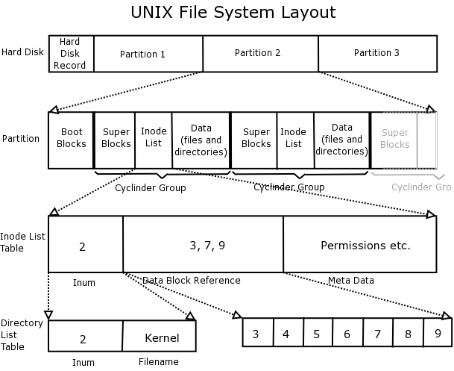
ext2 organization

Slide 9
Superblock
Superblock always starts at byte 1024
Master filesystem structure in ext2
Stores global filesystem constants:
Block size
Inode size
Number of blocks
Number of inodes
…and much more
Do not hardcode filesystem constants into your code! Use superblock information instead.

Slide 10
Block groups
Block groups store:
A copy of the superblock (why?)
The block group descriptor table
Immediately proceeds the superblock
Contains the block numbers of the block bitmap, inode bitmap, and inode table among other things
A block bitmap (used vs. free blocks)
An inode bitmap (used vs. free inodes)
An inode table (the inodes themselves)
The actual data blocks

Slide 11
Data blocks
Blocks for regular files contain file data
Blocks for directories contain directory entries:
#define EXT2_NAME_LEN 255
struct ext2_dir_entry_2 {
__u32 inode; /* Inode number */
__u16 rec_len; /* Directory entry
length */
__u8 name_len; /* Name length */
__u8 file_type;
char name[EXT2_NAME_LEN]; /* File
name */
};
Data block for /
Dir. entry | Field | Value
0 | Inode | 1
 | Name | “.”
1 | Inode | 1
 | Name | “..”
2 | Inode | 2
 | Name | “etc”
3 | Inode | 3
 | Name | “bin”
4 | Inode | 0
 | Name | 0

Slide 12
Example data block usage
For a 4MB file system with 1KB blocks, with hierarchy:
/
etc
passwd
fstab
bin
sh
date
File/Directory | Size | Data Blocks
/ | 4 entries + 1 null entry | 1
/etc | 4 entries + 1 null entry | 1
/bin | 4 entries + 1 null entry | 1
/etc/passwd | 1024 bytes | 1
/etc/fstab | 100 bytes | 1
/bin/sh | 10,000 bytes | 10
/bin/date | 5,000 bytes | 5
 | Total: | 20

Slide 13
For more ext2 reading
A master reference is available at http://www.nongnu.org/ext2-doc/ext2.html
Some other helpful resources:
http://homepage.smc.edu/morgan_david/cs40/analyze-ext2.htm
http://eecs.wsu.edu/~cs460/cs560/ext2fs.html
Wikipedia also has a decent explanation: http://en.wikipedia.org/wiki/Ext2#ext2_data_structures

Slide 14
Project 3: Undelete
Out: Friday 11/17 once we have it ready
Due: Wednesday 12/4 at 11:59pm
Same groups you’ve been with previously
Some serious understanding is required, so read, discuss with your teammates, read some more, discuss, plan, then execute

Slide 15
Project 3: Undelete
Your task: recover deleted files in ext2 file systems
Implement this as a loadable kernel module
How is this possible?
Even if inode links are removed, inodes and data might still be present
Make a best attempt at recovery of lost files—some are corrupted and beyond hope, so you won’t be able to recover them

Slide 16
Project 3: Undelete
Tools at your disposal:
Header files in linux/fs/ext2
Kernel functions for reading/writing files and exploring file system trees
Skeleton code for the kernel module
A utility for creating and mounting ext2 filesystems of various sizes
A program for printing out block information for an ext2 filesystem file

Slide 17
Tips
The filesystem creation tool requires at least 60 1kB blocks or it will fail
Think carefully about how to tell whether an inode is deleted. (Hint: you’ll need to use the inode bitmap)
Do not hardcode any ext2 constants. Use only those provided in headers and those from the superblock
You are permitted to keep only a small fixed number of inodes in memory at once (otherwise recovery of large files would be infeasible)

Slide 18
Tips
Jeff and I will give out some additional test files, but you should also create your own sample file systems using the provided tool
Make sure to restore the accessed and modified times of files as well as their contents
Test file systems with indirect data blocks
Test your code by restoring file systems with things like large deleted JPGs that are easy to check (visually) for corruption

Slide 19
Tips
If your group emails a plan of your approach to the project to Jeff and me by class next Wednesday 11/20, we will review it and give you feedback
Take advantage of this; it will save you a lot of grief leading up to the deadline
Writing a plan is a great way to force yourself to learn the concepts

Slide 20
Questions?

