Slide 1
Internet Advertising
UW CSE454
11/5/09
Mike Mathieu
mike@frontseat.org

Slide 2
Agenda
Industry context
Advertiser view
Publisher view
Audience view
Testing/optimization

Slide 3
I know I’m wasting half of my ad budget. I just don’t know which half.

Slide 4
2009 Global Ad Spend
$458 Billion

Slide 5
Industry Structure
$$$$$
Media
$$
Audience
Advertiser
$
$$$
Ad

Slide 6
The Great Divide
Brand
Direct Response
Emotions
Indirect benefits
Banners, TV, stadiums
Transactions
Gross profits
Search, coupons, 1-800, radio, mail

Slide 7
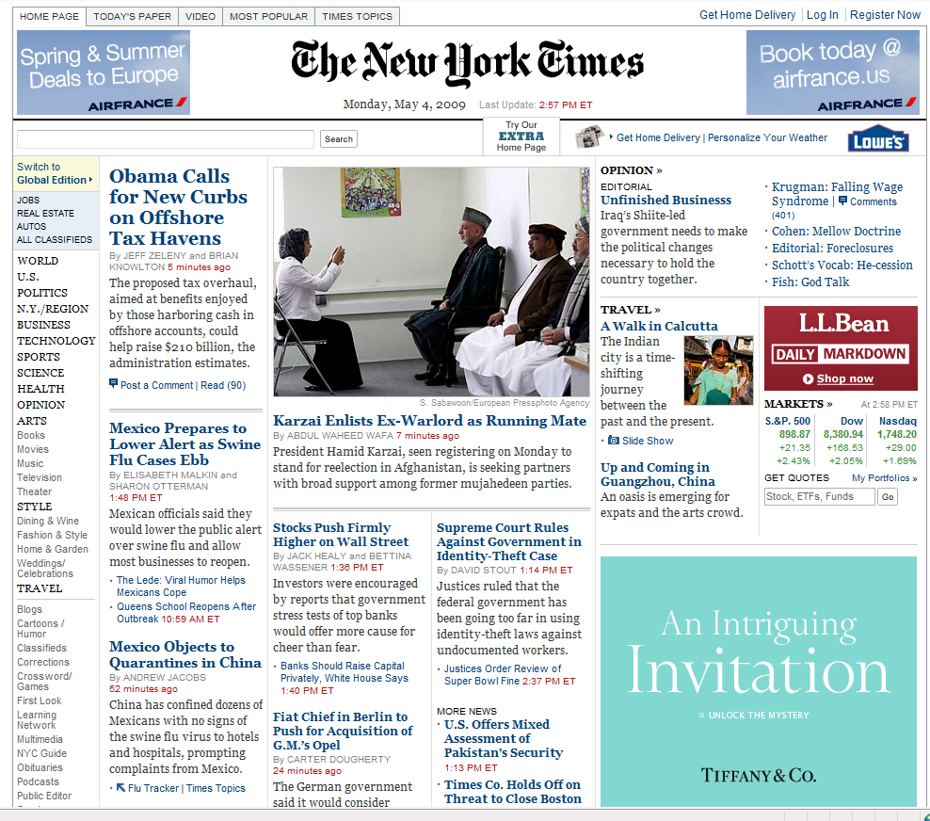
Notes:
Q: Where are the ads?

Slide 8
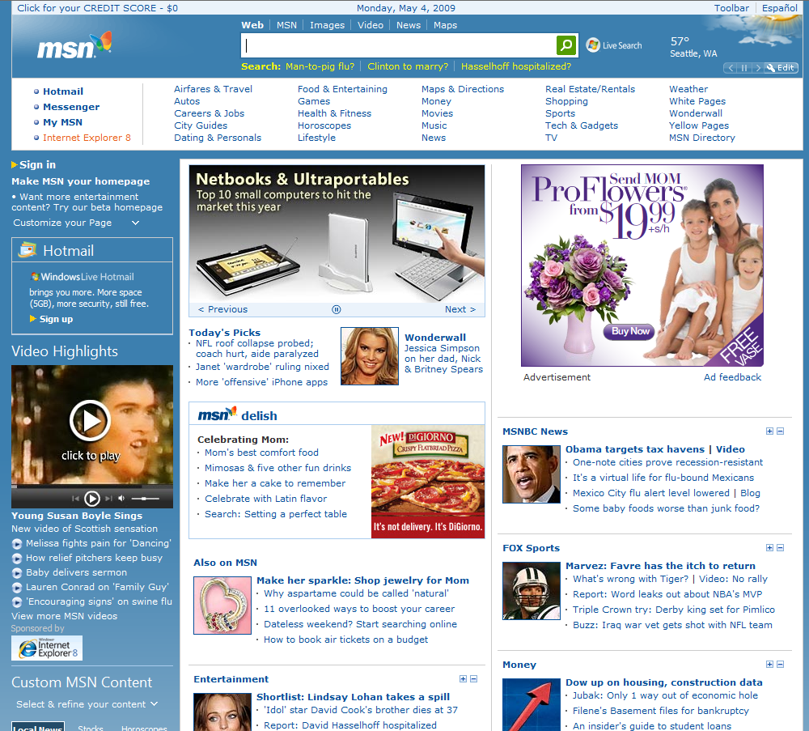
ü
ü
ü
ü
ü
ü
ü
ü
ü
ü
ü
ü
ü
ü
ü
ü
Notes:
Q: Where are the ads?
16 link ads – all direct response
27 more below the fold

Slide 9
Conversion Funnel
Ad Impressions
Clicks
Conversions
Revenue

Slide 10
Monetizing Traffic
TRAFFIC
LANDING PAGES
$ per Transaction
Conversion Rate
Search-Paid
Search-Free
Affiliates
Display Ads
Syndication
Email
Offline
Gross Margin
CTR
CR x CPA = RPV

Slide 11
Share of Voice Costs $$$
Cost Per Action
0%
100%
Reach

Slide 12
Conversion Potential vs. Price

Slide 13
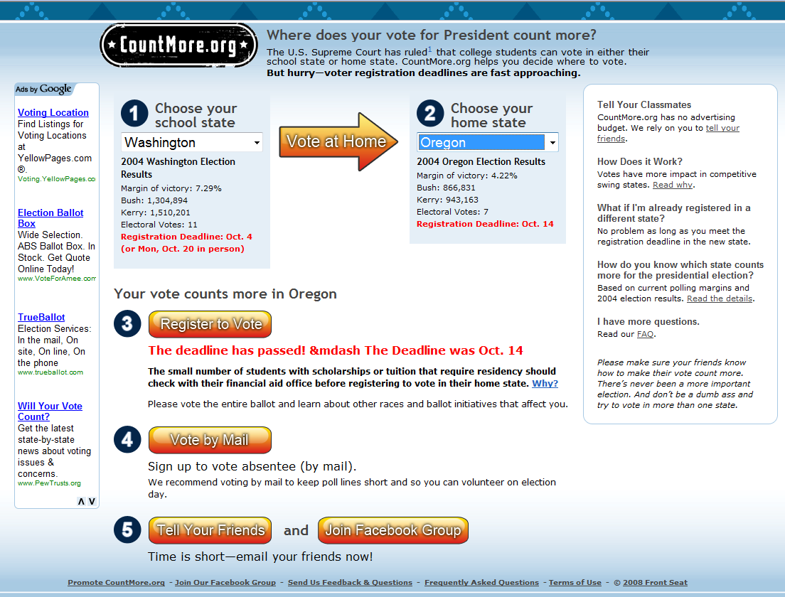
Real World Example

Slide 14

Real World Example
Impressions
4.4M
Clicks
2078
RefSrc on URL
Drop cookie
Pass RefSrc upon conversion
Match with ad spend
Calculate CPA
RegClick
69
Registrations
29
CTR=0.0469%
CPC=$0.65
eCPM=$0.31
CPRegClick=$19.69
CPReg=$46.76

Slide 15
Bid Management
Term | Clicks | CPC | Pos | CR | Leads | CPA | AvgPrice | Revenue | Spend | GM
Nursing School | 5,000 | $1.00 | 1 | 5% | 250 | $20.00 | $7.50 | $1,875 | $5,000 | -63%
Nursing Schools | 5,000 | $2.00 | 3 | 20% | 1,000 | $10.00 | $30.00 | $30,000 | $10,000 | 200%
Total | 10,000 | $1.50 | 2 | 12.5% | 1,250 | $12.00 | $25.50 | $31,875 | $15,000 | 113%
Optimized | 8,000 | $2.43 | 1 | 22% | 1,760 | $11.05 | $30.00 | $52,800 | $19,440 | 172%

Slide 16
Bid Optimization
Find shape of the volume, CR, and price curves as f(pos)
Linear programming to maximize goal (e.g. LTV, gross profit, volume)
Challenges
  Sample size
  Price changes
  Seasonality

Slide 17
Industry Structure
$$$$$
Media
$$
Audience
Advertiser
$
$$$
Ad

Slide 18
Online Advertising Risks
Revenue Share
Cost Per Action (CPA)
Cost Per Click (CPC)
Cost Per Impression (CPM)
Subscription / Sponsorship
Publisher
Balance of Risk
Advertiser

Slide 19
“Low-CPM” Innovation (circa 2001)
CPC Marketplace Formation
Advertiser Growth
  Text-based ads
  Self-serve ads
  RPV optimization
  Keyword suggestion
Increased Bids
  Max Bids
  Keyword opacity
Click Volume
  Syndication
  Text ad network
  International
Better Matches
  Landing page analysis
  Ad inhibition

Slide 20
RPV Optimization:
Problems with Sort by CPC
Example Term: "mba"
Ad Title | Univ. of Phx: Online MBA | Univ. of Washington MBA
Ad Body | 100% online university. Fully accredited. | Foster School of business. Top 30 ranked.
CPC | $10.00 | $0.50
CTR | 0.01% | 4%
Position | #1 | #10
RPV | $0.0010 | $0.0200

Slide 21
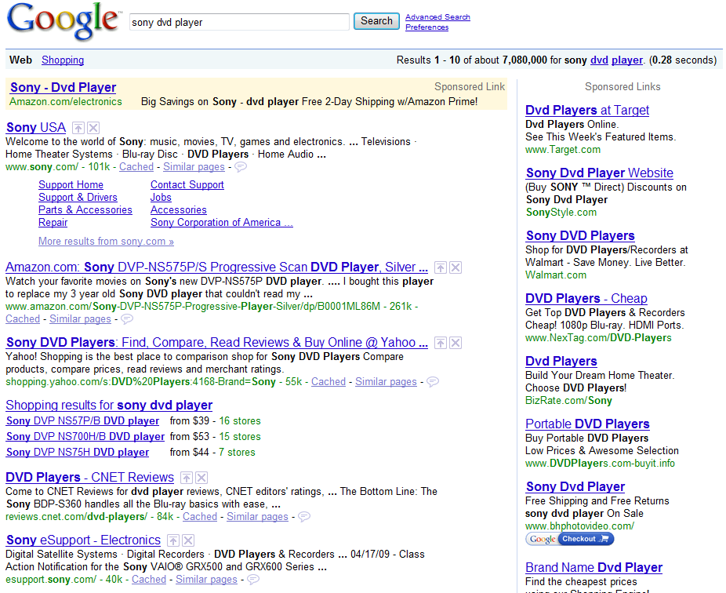
RPV Optimization
Sort by (CPC_Bid x CTR)
Notes:
Enables fully self-serve ads

Slide 22
Keyword Opacity
 | Impr | CTR | Clicks | CPC | CR | Leads | CPA | Spend
Nursing School | 100,000 | 5% | 5,000 | $1.00 | 5% | 250 | $20.00 | $5,000
Nursing Schools | 10,000 | 50% | 5,000 | $2.00 | 20% | 1,000 | $10.00 | $10,000
Total | 110,000 | 9% | 10,000 | $1.50 | 12.5% | 1,250 | $12.00 | $15,000
MatchDriver | 110,000 | 9% | 10,000 | $2.00 | 12.5% | 1,250 | $16.00 | $20,000

Slide 23
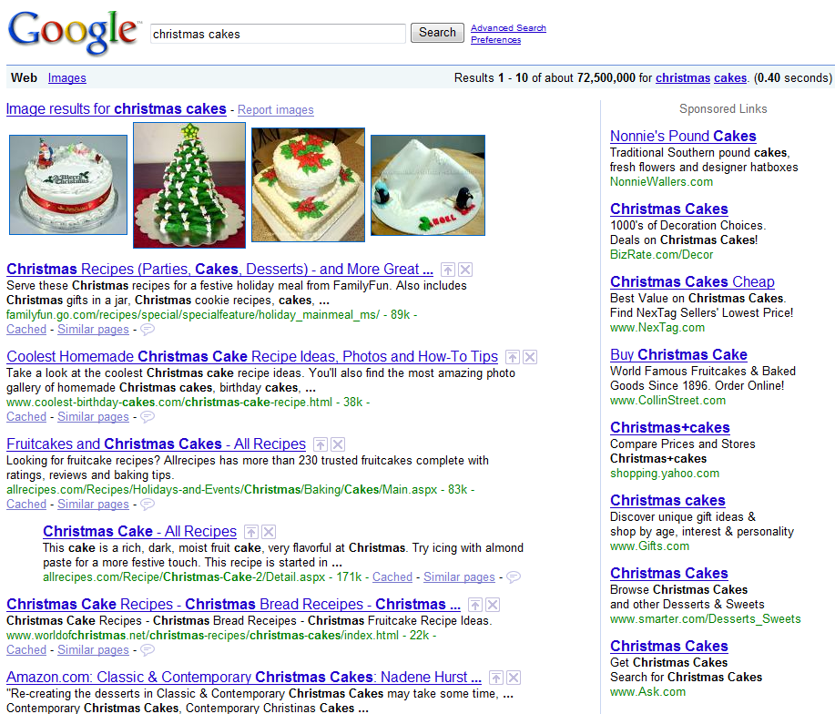
Landing Page Analysis
What?? No “Christmas”

Slide 24
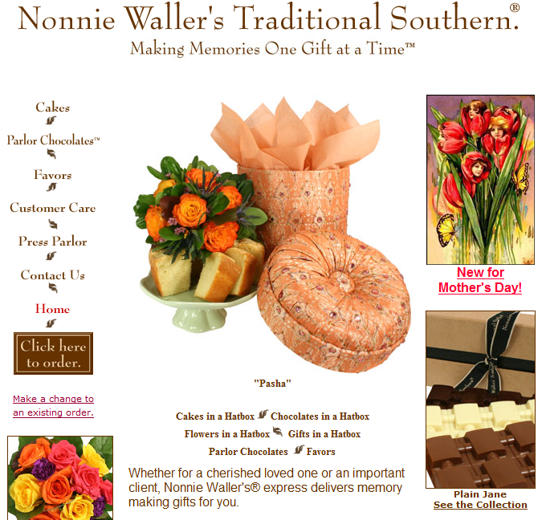
Landing Page Analysis
No “Christmas” here either!

Slide 25
Industry Structure
$$$$$
Media
$$
Audience
Advertiser
$
$$$
Ad

Slide 26
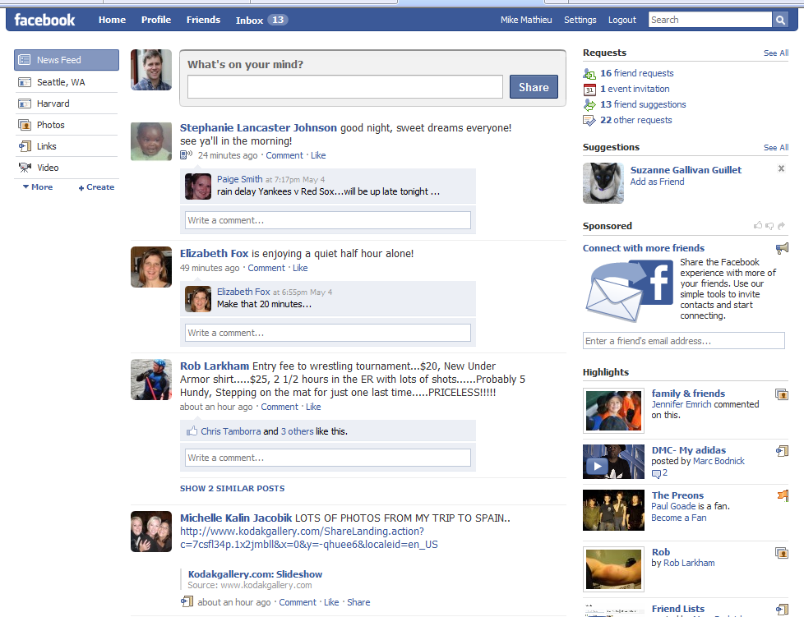
End Users
Don’t bug me
Unless I like what
you have to offer

Slide 27
Better Matching
Context detection
  GPS, location
  App vs. content
  Info seeker vs. transactor
  Calendars/schedules/events
  Social networks/status
  Twitter - now
  Behavioral – esp. w/knowledge of specific site behaviors
  Contextual
Privacy
  Google “AOL search data”

Slide 28
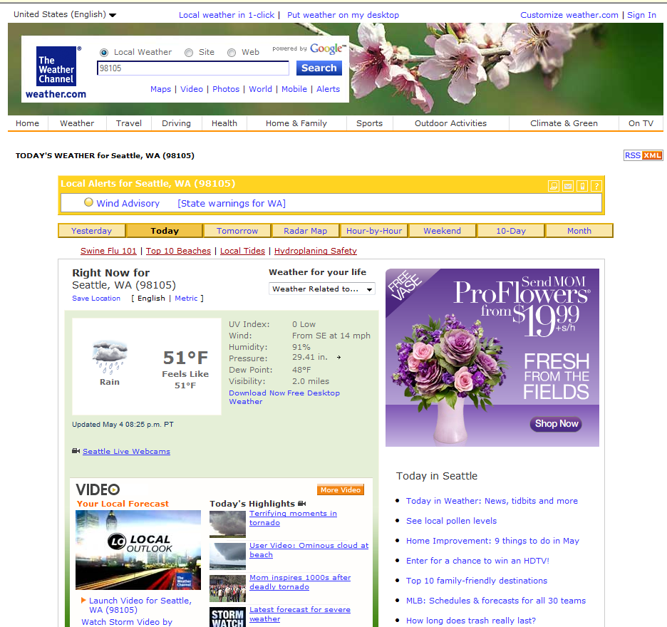
Context?
Flowers
Mentos gum
Trial Prep
Credit score
Cosmetics
Hampton Inns
WeightWatchers
Vacation Home Rentals
Home Depot
Web Hosting
WebMD
Colon Cleanse – Warning
My Teeth Aren’t Yellow
Classmates.com

Slide 29
Testing

Slide 30
Testing
TRAFFIC
LANDING PAGES
$ per Transaction
Conversion Rate
Search-Paid
Search-Free
Affiliates
Display Ads
Syndication
Email
Offline
Gross Margin
CTR
CR x CPA = RPV

Slide 31
Testing

Slide 32
Testing
Sort by (CPC_Bid x CTR)
Notes:
Enables fully self-serve ads

Slide 33
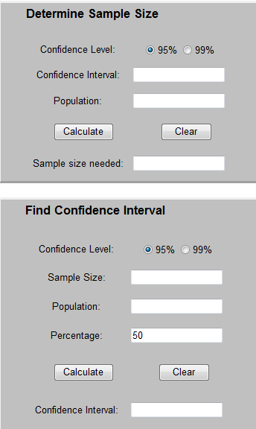
Testing
Sample Size, margin of error, confidence
x = Z(^{c}/₁₀₀)²r(100-r)
n = ^{N x}/_{((N-1)E}² _{+ x)}
E = Sqrt[^{(N - n)x}/_{n(N-1)}]

Slide 34
Sample Size Problems
So many ideas, so little to sample…
  Disproportionate advantage to scale
Multivariate testing
  Taguchi Method
    Method for calculating signal-to-noise ratio of different parameters in an experimental design
    Allows optimization with A/B test of each cross-product

Slide 35
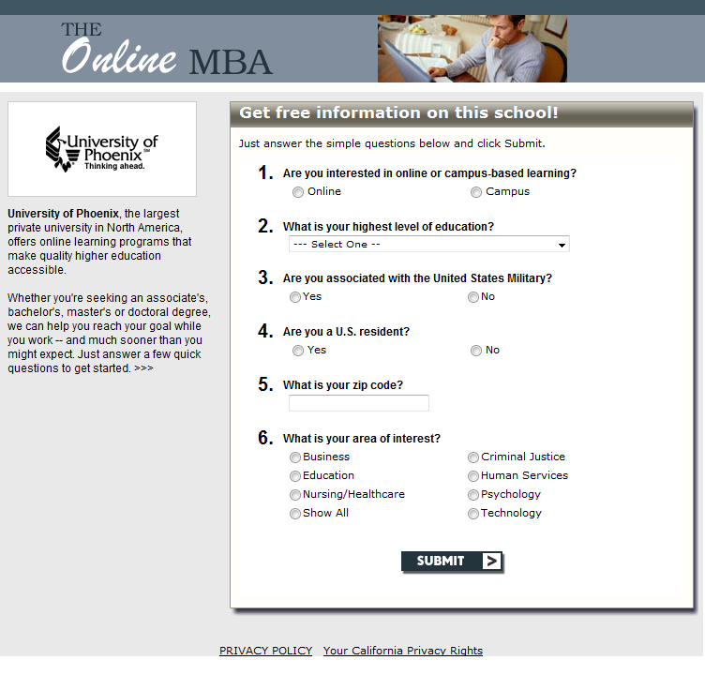
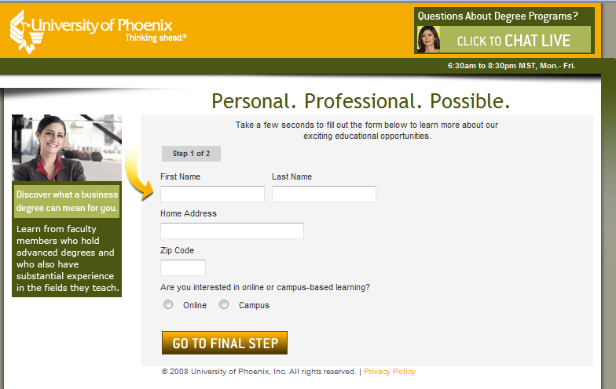
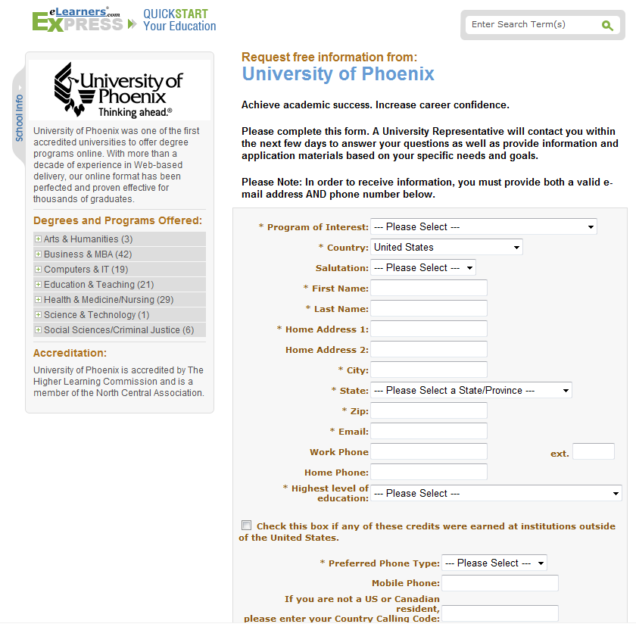

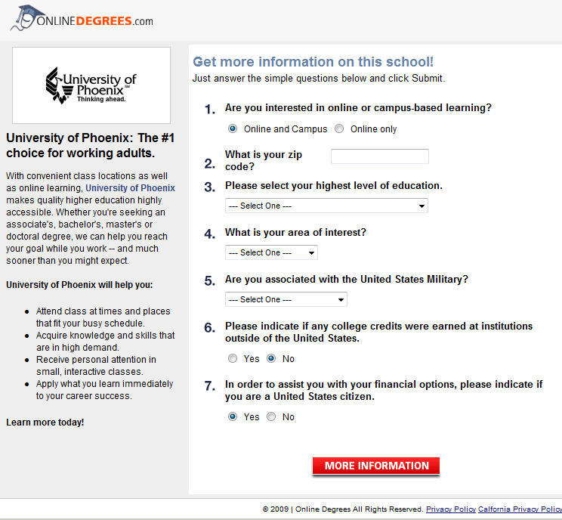
Testing

Slide 36
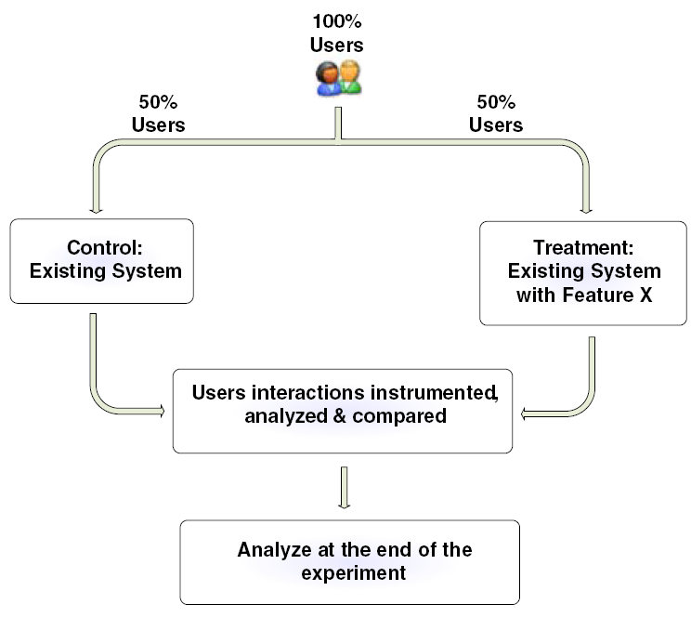
A/B Split Test

Slide 37
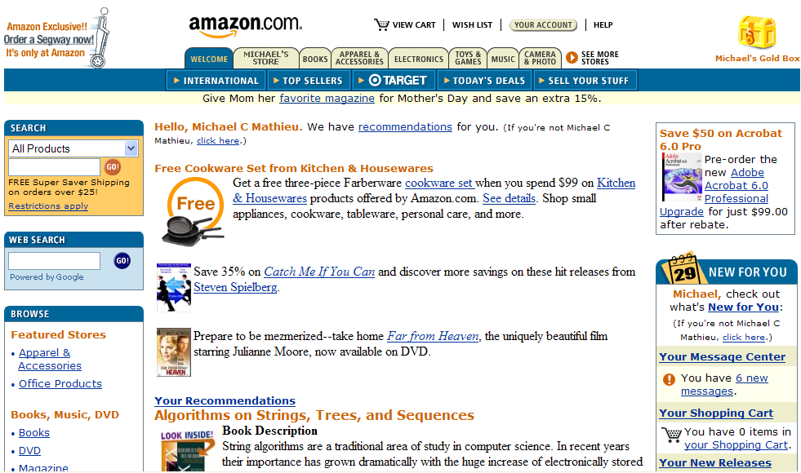
Repetition

Slide 39



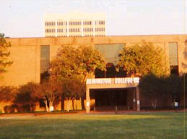
Professional Photos
Before
After
We observed an immediate 30% increase in conversion rates

Slide 40
Fact Sheet Design
Existing Schools (n=1,428) | CR
Best | 51.1%
Worst | 0.4%
Average | 11.6%
Test | # Schools | CR Lift
Professional photo | 1 | 30%
More RFI buttons | 3 | 21%
Marketing voice, more programs listed | 1 | 28%
Photos + Marketing voice, more programs | 1 | 50%

Slide 41
Analytics
Idea
Test
Analyze
Pick
Winner
Try Again

Slide 42
Opportunities
Advertisers
  Low-RPV
  Minimize waste
  10x simplicity
Publishers / Search Engines / Ad Networks
  Scaling local, hyperlocal
  Other value judgments than rank
    Under-monetized sites
    Audience prediction
    Duplicate detection
  Google’s path to lead gen
  Advertiser behavioral tracking

Slide 43
Further Reading
Sample size calculators
  www.ezsurvey.com/samplesize.html
  www.surveysystem.com/sscalc.htm
Google Analytics – www.google.com/analytics
Taguchi Method commercial products/whitepapers
  www.vertster.com
  www.omniture.com/en/products/conversion/testandtarget
Online marketing sites
  searchengineland.com
  searchenginewatch.com
  www.marketingsherpa.com
  www.dmnews.com
  www.imediaconnection.com
  www.iab.net (industry group)

