Slide 1
Machine Learning
CSE 454

Slide 2
Today’s Outline
Brief supervised learning review
Evaluation
Overfitting
Ensembles
Learners: The more the merrier
Co-Training
(Semi) Supervised learning with few labeled training ex
Clustering
No training examples

Slide 3
Types of Learning
Supervised (inductive) learning
Training data includes desired outputs
Semi-supervised learning
Training data includes a few desired outputs
Unsupervised learning
Training data does not include desired outputs
Reinforcement learning
Rewards from sequence of actions

Slide 4
Supervised Learning
Inductive learning or “Prediction”:
Given examples of a function (X, F(X))
Predict function F(X) for new examples X
Classification
F(X) = Discrete
Regression
F(X) = Continuous
Probability estimation
F(X) = Probability(X):

Slide 5
Classifier
Hypothesis:
Function for labeling examples
0.0 1.0 2.0 3.0
+
+
Label: +
?
+
+
Label: -
-
+
+
-
-
-
-
+
+
-
?
?
-
+
-
-
+
-
-
+
+
+
-
?
-
0.0 1.0 2.0 3.0 4.0 5.0 6.0

Slide 6
Bias
The nice word for prejudice is “bias”.
What kind of hypotheses will you consider?
What is allowable range of functions you use when approximating?
What kind of hypotheses do you prefer?
One idea: Prefer “simplest” hypothesis that is consistent with the data

Slide 7
Naïve Bayes
Probabilistic classifier:
P(C_{i} | Example)
Bias: Assumes all features are conditionally independent given class
Therefore, we then only need to know P(e_{j} | c_{i}) for each feature and category

Slide 8
Naïve Bayes for Text
Modeled as generating a bag of words for a document in a given category
Assumes that word order is unimportant, only cares whether a word appears in the document
Smooth probability estimates with Laplace m-estimates assuming a uniform distribution over all words (p = 1/|V|) and m = |V|
Equivalent to a virtual sample of seeing each word in each category exactly once.

Slide 9
Naïve Bayes
Pop. | Seat | Lang. | Class
Y | Y | N | County
Y | Y | Y | County
Y | N | Y | Country
N | N | Y | Country
Country vs. County
Population
Seat
Language
Probability(Seat | County) = ??
Probability(Seat | Country) = ??

Slide 10
Naïve Bayes
Pop. | Seat | Lang. | Class
Y | Y | N | County
Y | Y | Y | County
Y | N | Y | Country
N | N | Y | Country
Country vs. County
Population
Seat
Language
Probability(Seat | County) = 2 + 1 / 2 + 1 = 1.0
Probability(Seat | Country) = ??

Slide 11
Naïve Bayes
Pop. | Seat | Lang. | Class
Y | Y | N | County
Y | Y | Y | County
Y | N | Y | Country
N | N | Y | Country
Country vs. County
Population
Seat
Language
Probability(Seat | County) = 2 + 1/ 2 + 2 = 0.75
Probability(Seat | Country) = 0 + 1 / 2 + 2 = 0.25

Slide 12
Probabilities: Important Detail!
P(spam | E₁ … E_{n}) = Π P(spam | E_{i})
i
Any more potential problems here?
We are multiplying lots of small numbers Danger of underflow!
0.5⁵⁷ = 7 E -18
Solution? Use logs and add!
p₁ * p₂ = e ^{log(p1)+log(p2)}
Always keep in log form

Slide 13
Multi-Class Categorization
Pick the category with max probability
Create many 1 vs other classifiers
Classes = City, County, Country
Classifier 1 = {City} {County, Country}
Classifier 2 = {County} {City, Country}
Classifier 3 = {Country} {City, County}

Slide 14
Multi-Class Categorization
Use a hierarchical approach (wherever hierarchy available)
Entity
Person Location
Scientist Artist City County Country

Slide 15
Today’s Outline
Brief supervised learning review
Evaluation
Overfitting
Ensembles
Learners: The more the merrier
Co-Training
(Semi) Supervised learning with few labeled training ex
Clustering
No training examples

Slide 16
Experimental Evaluation
Question: How do we estimate the performance of classifier on unseen data?
Can’t just at accuracy on training data – this will yield an over optimistic estimate of performance
Solution: Cross-validation
Note: this is sometimes called estimating how well the classifier will generalize

Slide 17
Evaluation: Cross Validation
Partition examples into k disjoint sets
Now create k training sets
Each set is union of all equiv classes except one
So each set has (k-1)/k of the original training data
← Train →
Test
Test
…
Test

Slide 18
Cross-Validation (2)
Leave-one-out
Use if < 100 examples (rough estimate)
Hold out one example, train on remaining examples
10-fold
If have 100-1000’s of examples
M of N fold
Repeat M times
Divide data into N folds, do N fold cross-validation

Slide 19
Today’s Outline
Brief supervised learning review
Evaluation
Overfitting
Ensembles
Learners: The more the merrier
Co-Training
(Semi) Supervised learning with few labeled training ex
Clustering
No training examples

Slide 20
Overfitting Definition
Hypothesis H is overfit when ∃ H’ and
H has smaller error on training examples, but
H has bigger error on test examples
Causes of overfitting
Noisy data, or
Training set is too small
Large number of features
Big problem in machine learning
One solution: Validation set

Slide 21
Overfitting
On training data
On test data
Accuracy
0.9
0.8
0.7
0.6
Model complexity (e.g., number of nodes in decision tree)

Slide 22
Validation/Tuning Set
Split data into train and validation set
Score each model on the tuning set, use it to pick the ‘best’ model
Test
Tune
Tune
Tune

Slide 23
Early Stopping
On training data
On test data
On validation data
Accuracy
Remember this and use it as the final classifier
0.9
0.8
0.7
0.6
Model complexity (e.g., number of nodes in decision tree)

Slide 24
Extra Credit Ideas
Different types of models
Support Vector Machines (SVMs), widely used in web search
Tree-augmented naïve Bayes
Feature construction

Slide 25
Support Vector Machines
Which one is best hypothesis?

Slide 26
Support Vector Machines
Largest distance to neighboring data points
SVMs in Weka: SMO

Slide 27
Tree Augmented Naïve Bayes (TAN) [Friedman,Geiger & Goldszmidt 1997]
Class
Value
…
F 1
F 2
F 3
F N-2
F N-1
F N
Models limited set of dependencies
Guaranteed to find best structure
Runs in polynomial time

Slide 28
Construct Better Features
Key to machine learning is having good features
In industrial data mining, large effort devoted to constructing appropriate features
Ideas??

Slide 29
Possible Feature Ideas
Look at capitalization (may indicated a proper noun)
Look for commonly occurring sequences
E.g. New York, New York City
Limit to 2-3 consecutive words
Keep all that meet minimum threshold (e.g. occur at least 5 or 10 times in corpus)

Slide 30
Today’s Outline
Brief supervised learning review
Evaluation
Overfitting
Ensembles
Learners: The more the merrier
Co-Training
(Semi) Supervised learning with few labeled training ex
Clustering
No training examples

Slide 31
Ensembles of Classifiers
Traditional approach: Use one classifier
Alternative approach: Use lots of classifiers
Approaches:
Cross-validated committees
Bagging
Boosting
Stacking

Slide 32
Voting

Slide 33
Ensembles of Classifiers
Assume
Errors are independent (suppose 30% error)
Majority vote
Probability that majority is wrong…
= area under binomial distribution
Prob 0.2
0.1
Ensemble of 21
classifiers
Number of classifiers in error
If individual area is 0.3
Area under curve for ≥11 wrong is 0.026
Order of magnitude improvement!

Slide 34
Constructing Ensembles
Cross-validated committees
Partition examples into k disjoint equiv classes
Now create k training sets
Each set is union of all equiv classes except one
So each set has (k-1)/k of the original training data
Now train a classifier on each set
Holdout

Slide 35
Ensemble Construction II
Bagging
Generate k sets of training examples
For each set
Draw m examples randomly (with replacement)
From the original set of m examples
Each training set corresponds to
63.2% of original (+ duplicates)
Now train classifier on each set
Intuition: Sampling helps algorithm become more robust to noise/outliers in the data

Slide 36
Ensemble Creation III
Boosting
Maintain prob distribution over set of training ex
Create k sets of training data iteratively:
On iteration i
Draw m examples randomly (like bagging)
But use probability distribution to bias selection
Train classifier number i on this training set
Test partial ensemble (of i classifiers) on all training exs
Modify distribution: increase P of each error ex
Create harder and harder learning problems...
“Bagging with optimized choice of examples”

Slide 37
Ensemble Creation IV Stacking
Train several base learners
Next train meta-learner
Learns when base learners are right / wrong
Now meta learner arbitrates
Train using cross validated committees
Meta-L inputs = base learner predictions
Training examples = ‘test set’ from cross validation

Slide 38
Today’s Outline
Overfitting
Ensembles
Learners: The more the merrier
Co-Training
Supervised learning with few labeled training ex
Clustering
No training examples

Slide 39
Today’s Outline
Brief supervised learning review
Evaluation
Overfitting
Ensembles
Learners: The more the merrier
Co-Training
(Semi) Supervised learning with few labeled training ex
Clustering
No training examples

Slide 40
Co-Training Motivation
Learning methods need labeled data
Lots of <x, f(x)> pairs
Hard to get… (who wants to label data?)
But unlabeled data is usually plentiful…
Could we use this instead??????
Semi-supervised learning

Slide 41
Co-training
Suppose
Have little labeled data + lots of unlabeled
Each instance has two parts:
x = [x1, x2]
x1, x2 conditionally independent given f(x)
Each half can be used to classify instance
∃f1, f2 such that f1(x1) ~ f2(x2) ~ f(x)
Both f1, f2 are learnable
f1 ∈ H1, f2 ∈ H2, ∃ learning algorithms A1, A2

Slide 42
Co-training Example
Prof. Domingos
Students: Parag,…
Projects: SRL, Data mining
I teach a class on
data mining
CSE 546: Data Mining
Course Description:…
Topics:…
Homework: …
Jesse
Classes taken:
1. Data mining
2. Machine learning
Research: SRL

Slide 43
Without Co-training
f₁(x₁) ~ f₂(x₂) ~ f(x)
A₁ learns f₁ from x₁
A₂ learns f₂ from x₂
A Few Labeled
Instances
<[x₁, x₂], f()>
A₂
f₂
A₁
}
f₁
f’
[x₁, x₂]
Bad!! Not using
Unlabeled Instances!
Combine with ensemble?
Unlabeled Instances

Slide 44
Co-training
f₁(x₁) ~ f₂(x₂) ~ f(x)
A₁ learns f₁ from x₁
A₂ learns f₂ from x₂
A Few Labeled
Instances
<[x₁, x₂], f()>
A₁
f₁
f₂
[x₁, x₂]
A₂
<[x₁, x₂], f₁(x₁)>
Hypothesis
Unlabeled Instances
Lots of Labeled Instances

Slide 45
Observations
Can apply A₁ to generate as much training data as one wants
If x₁ is conditionally independent of x₂ / f(x),
then the error in the labels produced by A₁
will look like random noise to A₂ !!!
Thus no limit to quality of the hypothesis A₂ can make

Slide 46
Co-training
f₁(x₁) ~ f₂(x₂) ~ f(x)
A₁ learns f₁ from x₁
A₂ learns f₂ from x₂
Lots of
A Few Labeled
Instances
<[x₁, x₂], f()>
f₂
A₁
f₁
f₂
f₁
f₂
[x₁, x₂]
A₂
<[x₁, x₂], f₁(x₁)>
Hypothesis
Unlabeled Instances
Lots of Labeled Instances

Slide 47
It really works!
Learning to classify web pages as course pages
x1 = bag of words on a page
x2 = bag of words from all anchors pointing to a page
Naïve Bayes classifiers
12 labeled pages
1039 unlabeled

Slide 48
Today’s Outline
Brief supervised learning review
Evaluation
Overfitting
Ensembles
Learners: The more the merrier
Co-Training
(Semi) Supervised learning with few labeled training ex
Clustering
No training examples

Slide 49
Clustering Outline
Motivation
Document Clustering
Offline evaluation
Grouper I
Grouper II
Evaluation of deployed systems

Slide 50
Low Quality of Web Searches
System perspective:
small coverage of Web (<16%)
dead links and out of date pages
limited resources
IR perspective
(relevancy of doc ~ similarity to query):
very short queries
huge database
novice users

Slide 51
Document Clustering
User receives many (200 - 5000) documents from Web search engine
Group documents in clusters
by topic
Present clusters as interface

Slide 52
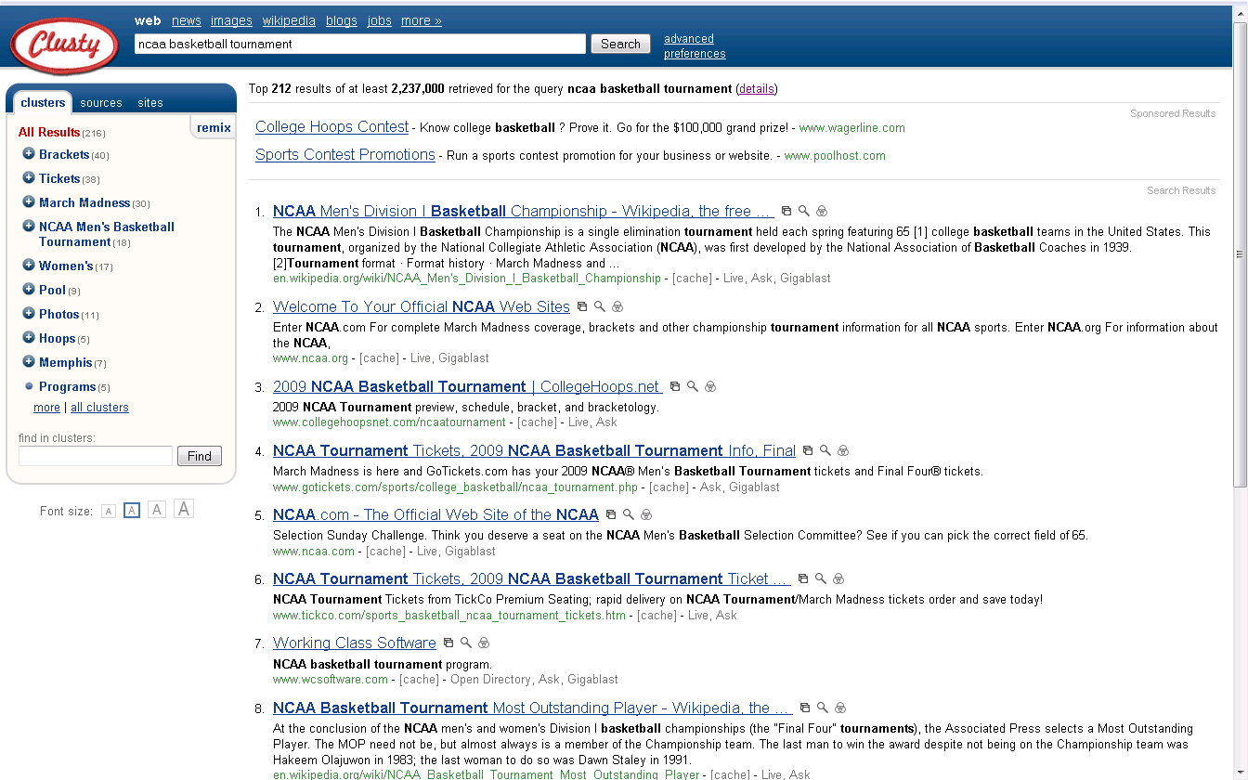

Slide 53
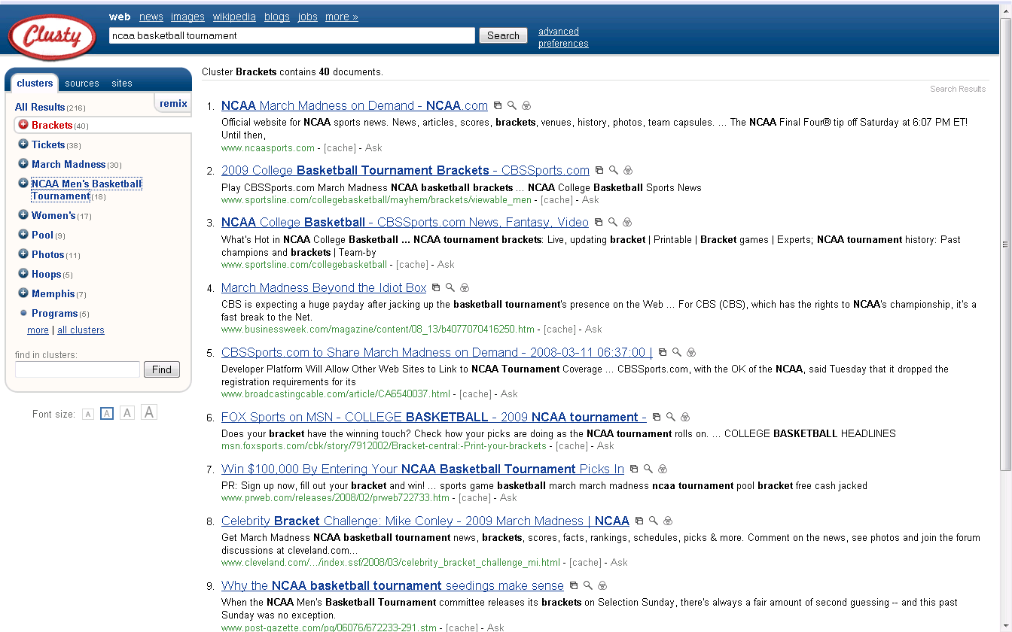

Slide 54
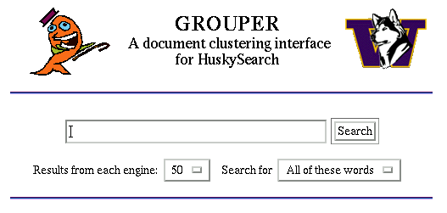
Grouper
www.cs.washington.edu/research/clustering

Slide 56
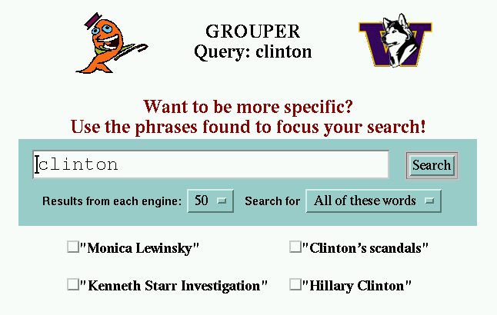

Slide 59
Desiderata
Coherent cluster
Speed
Browsable clusters
Naming

Slide 60
Main Questions
Is document clustering feasible for Web search engines?
Will the use of phrases help in achieving high quality clusters?
Can phrase-based clustering be done quickly?

Slide 61
1. Clustering
group together similar items (words or documents)
Notes:
I will start by motivating the work
next describe the Novel algorithm we developed
and then describe the experimental evaluation and present our results

Slide 62
Clustering Algorithms
Hierarchical Agglomerative Clustering
O(n²)
Linear-time algorithms
K-means (Rocchio, 66)
Single-Pass (Hill, 68)
Fractionation (Cutting et al, 92)
Buckshot (Cutting et al, 92)
Notes:
The linear algorithm here will be used later as the basis for comparison

Slide 63
Basic Concepts - 1
Hierarchical vs. Flat
Notes:
I will start by motivating the work
next describe the Novel algorithm we developed
and then describe the experimental evaluation and present our results

Slide 64
Basic Concepts - 2
hard clustering:
each item in only one cluster
soft clustering:
each item has a probability of membership in each cluster
disjunctive / overlapping clustering:
an item can be in more than one cluster
Notes:
I will start by motivating the work
next describe the Novel algorithm we developed
and then describe the experimental evaluation and present our results

Slide 65
Basic Concepts - 3
distance / similarity function
(for documents)
dot product of vectors
number of common terms
co-citations
access statistics
share common phrases
Notes:
I will start by motivating the work
next describe the Novel algorithm we developed
and then describe the experimental evaluation and present our results

Slide 66
Basic Concepts - 4
What is “right” number of clusters?
apriori knowledge
default value: “5”
clusters up to 20% of collection size
choose best based on external criteria
Minimum Description Length
Global Quality Function
no good answer
Notes:
I will start by motivating the work
next describe the Novel algorithm we developed
and then describe the experimental evaluation and present our results

Slide 67
K-means
Works when we know k, the number of clusters
Idea:
Randomly pick k points as the “centroids” of the k clusters
Loop:
∀ points, add to cluster w/ nearest centroid
Recompute the cluster centroids
Repeat loop (until no change)
Iterative improvement of the objective function:
Sum of the squared distance from each point
to the centroid of its cluster
Slide from Rao Kambhampati

Slide 68
K-means Example
For simplicity, 1-dimension objects and k=2.
Numerical difference is used as the distance
Objects: 1, 2, 5, 6,7
K-means:
Randomly select 5 and 6 as centroids;
=> Two clusters {1,2,5} and {6,7}; meanC1=8/3, meanC2=6.5
=> {1,2}, {5,6,7}; meanC1=1.5, meanC2=6
=> no change.
Aggregate dissimilarity
(sum of squares of distanceeach point of each cluster from its cluster center--(intra-cluster distance)
= 0.5²+ 0.5²+ 1²+ 0²+1² = 2.5
|1-1.5|²
Slide from Rao Kambhampati

Slide 69
K Means Example (K=2)
Pick seeds
Reassign clusters
Compute centroids
Reasssign clusters
x
x
x
Compute centroids
x
x
x
Reassign clusters
Converged!
Slide from Rao Kambhampati
[From Mooney]

Slide 70
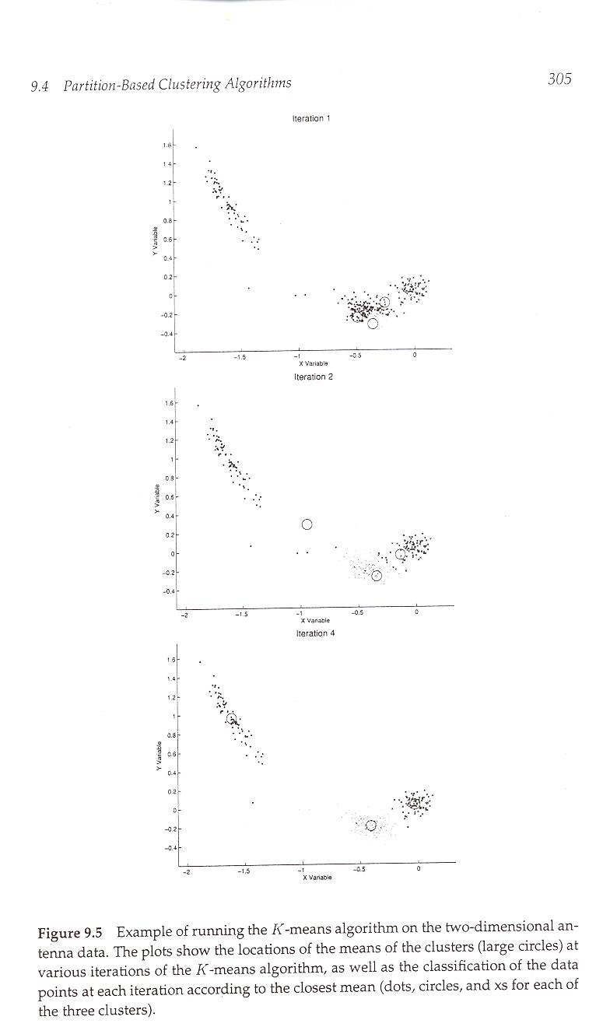
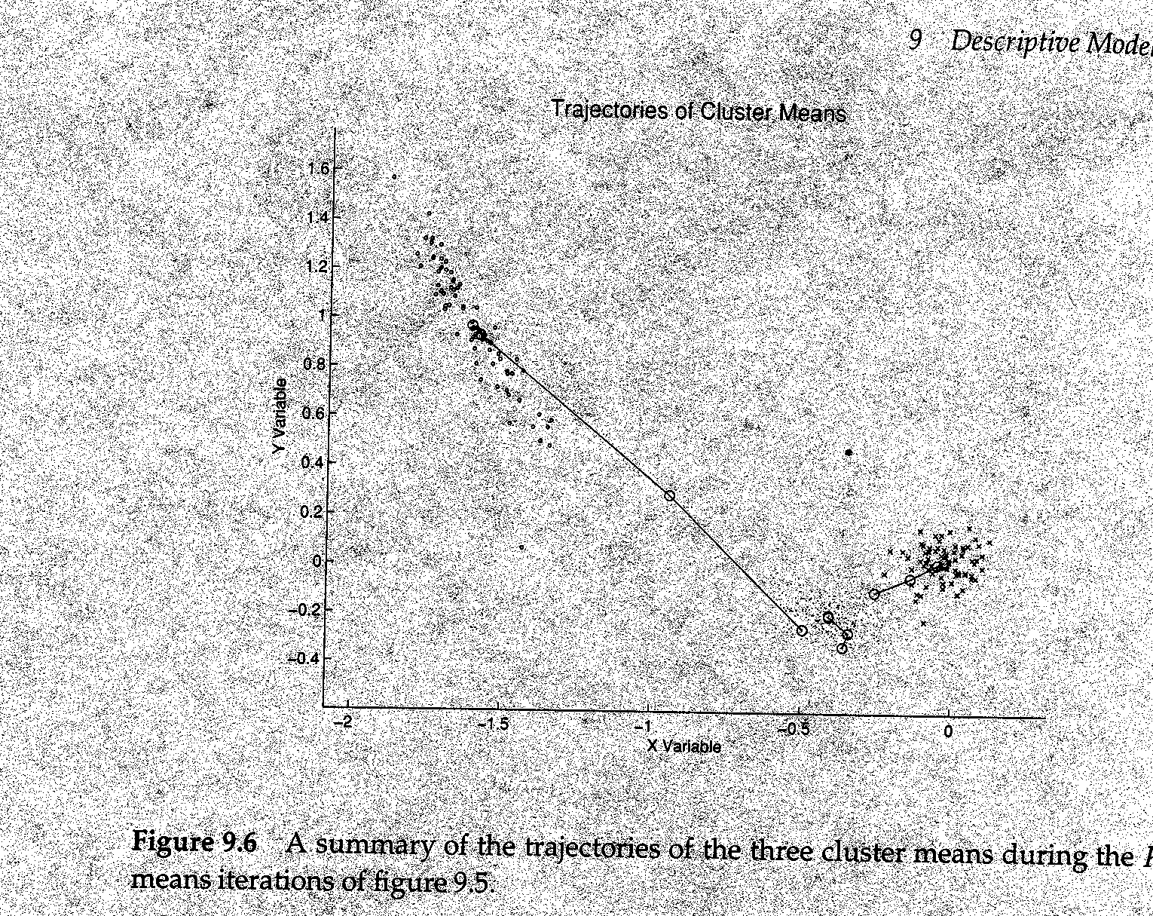
Example of K-means in operation
[From Hand et. Al.]
Slide from Rao Kambhampati

Slide 71
Time Complexity
Assume computing distance between two instances is O(m) where m is the dimensionality of the vectors.
Reassigning clusters: O(kn) distance computations, or O(knm).
Computing centroids: Each instance vector gets added once to some centroid: O(nm).
Assume these two steps are each done once for I iterations: O(Iknm).
Linear in all relevant factors, assuming a fixed number of iterations,
more efficient than O(n²) HAC (to come next)
Slide from Rao Kambhampati

Slide 72
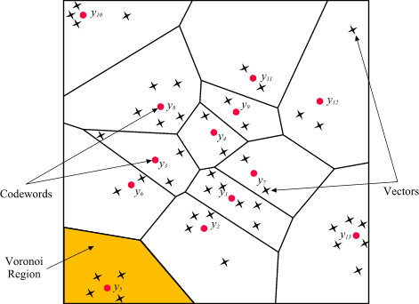
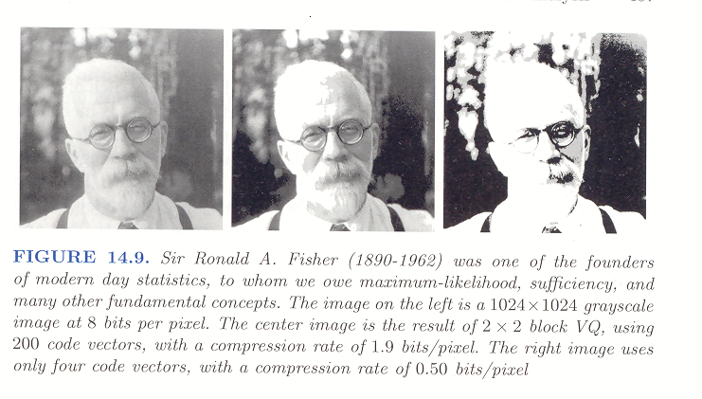
Vector Quantization: K-means as Compression
Slide from Rao Kambhampati

Slide 73
Problems with K-means
Why not the minimum value?
Need to know k in advance
Could try out several k?
Cluster tightness increases with increasing K.
Look for a kink in the tightness vs. K curve
Tends to go to local minima that are sensitive to the starting centroids
Try out multiple starting points
Disjoint and exhaustive
Doesn’t have a notion of “outliers”
Outlier problem can be handled by K-medoid or neighborhood-based algorithms
Assumes clusters are spherical in vector space
Sensitive to coordinate changes, weighting etc.
Example showing
sensitivity to seeds
In the above, if you start
with B and E as centroids
you converge to {A,B,C}
and {D,E,F}
If you start with D and F
you converge to
{A,B,D,E} {C,F}
Slide from Rao Kambhampati

Slide 74
Hierarchical Clustering
Agglomerative
bottom-up
Initialize: - each item a cluster
Iterate: - select two most similar clusters
- merge them
Halt: when have required # of clusters
Notes:
I will start by motivating the work
next describe the Novel algorithm we developed
and then describe the experimental evaluation and present our results

Slide 75
Bottom Up Example

Slide 76
Hierarchical Clustering
Divisive
top-bottom
Initialize: -all items one cluster
Iterate: - select a cluster (least coherent)
- divide it into two clusters
Halt: when have required # of clusters
Notes:
I will start by motivating the work
next describe the Novel algorithm we developed
and then describe the experimental evaluation and present our results

Slide 77
Top Down Example

Slide 78
HAC Similarity Measures
Single link
Complete link
Group average
Ward’s method
Notes:
I will start by motivating the work
next describe the Novel algorithm we developed
and then describe the experimental evaluation and present our results

Slide 79
Single Link
cluster similarity = similarity of two most similar members
Notes:
I will start by motivating the work
next describe the Novel algorithm we developed
and then describe the experimental evaluation and present our results

Slide 80
Single Link
O(n²)
chaining:
bottom line:
simple, fast
often low quality
Notes:
I will start by motivating the work
next describe the Novel algorithm we developed
and then describe the experimental evaluation and present our results

Slide 81
Complete Link
cluster similarity = similarity of two least similar members
Notes:
I will start by motivating the work
next describe the Novel algorithm we developed
and then describe the experimental evaluation and present our results

Slide 82
Complete Link
worst case O(n³)
fast algo requires O(n²) space
no chaining
bottom line:
typically much faster than O(n³),
often good quality
Notes:
I will start by motivating the work
next describe the Novel algorithm we developed
and then describe the experimental evaluation and present our results

Slide 83
Group Average
cluster similarity = average similarity of all pairs
Notes:
I will start by motivating the work
next describe the Novel algorithm we developed
and then describe the experimental evaluation and present our results

Slide 84
HAC Often Poor Results - Why?
Often produces single large cluster
Work best for:
spherical clusters; equal size; few outliers
Text documents:
no model
not spherical; not equal size; overlap
Web:
many outliers; lots of noise

Slide 85
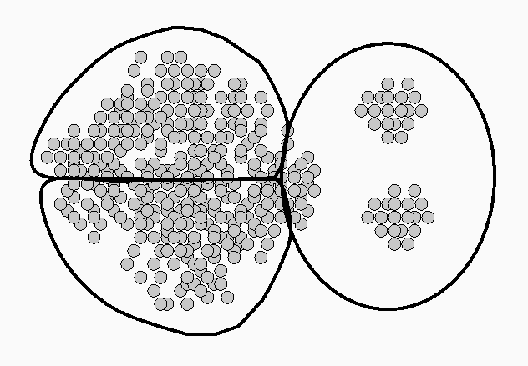
Example: Clusters of Varied Sizes
k-means; complete-link; group-average:
single-link: chaining,
but succeeds on this example

Slide 86
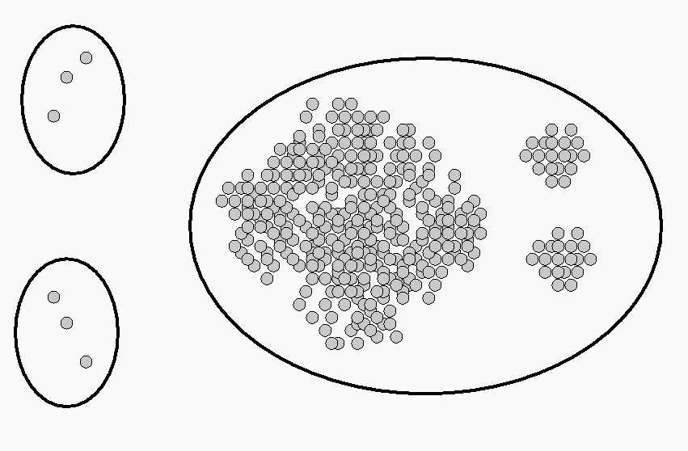
Example - Outliers
HAC:

Slide 87
Suffix Tree Clustering (KDD’97; SIGIR’98)
Most clustering algorithms aren’t specialized for text: Model document as set of words
STC: document = sequence of words

Slide 88
STC Characteristics
Coherent
phrase-based
overlapping clusters
Speed and Scalability
linear time; incremental
Browsable clusters
phrase-based
simple cluster definition
Notes:
Mention which we need, which we would like, which is unique to web
coherence - relevant documents appear together and separate from the irrelevant ones. The quality of the clustering
we want the algorithm to be able to produce overlapping clusters and not be confined to a partition. especially important in retrieved doc sets. For two reasons - docs often refer to more than one topic, often are similar to other docs in different, equally important ways. If the algorithm makes a mistake - less harmful
speed - need a fast algorithm (linear time) but also have these unique issues for the web.
Summeries - to be able to make use of the clusters we need to find features to represent to the user

Slide 89
STC - Central Idea
Identify base clusters
a group of documents that share a phrase
use a suffix tree
Merge base clusters as needed

Slide 90
STC - Outline
Three logical steps:
“Clean” documents
Use a suffix tree to identify base clusters - a group of documents that share a phrase
Merge base clusters to form clusters

Slide 91
Step 1 - Document “Cleaning”
Identify sentence boundaries
Remove
HTML tags,
JavaScript,
Numbers,
Punctuation

Slide 92
Suffix Tree (Weiner, 73; Ukkonen, 95; Gusfield, 97)
Example - suffix tree of the string: (1) "cats eat cheese"
Notes:
Sentence = document
tree of suffixes
sentence has three suffixes
lets look at the tree
nodes
information on edges
phrases containing one or more words
tags
now lets look whathappens id we add tow more documents/sentences to the tree...

Slide 93
Example - suffix tree of the strings:
(1) "cats eat cheese",
(2) "mice eat cheese too" and
(3) "cats eat mice too"
Notes:
Added two more docs . They are …
inserted all there suffixes.
Compact tree - some edges were broken
label of node is concatenation of labels on edges from root
each node represents a phrase - its label
and also a group of documents which contain that phrase
hense it is a base cluster
all nodes in ST are BC
all BC containing 2 or more docs are nodes

Slide 94
Step 2 - Identify Base Clusters via Suffix Tree
Build one suffix tree from all sentences of all documents
Suffix tree node = base cluster
Score all nodes
Traverse tree and collect top k (500) base clusters
Notes:
Why we collect only top k:
two reasons -
for speed and complexity issues of the third step
because we want to present to the user something that is comprehensible, and we can't do that if too many features are used - too confusing

Slide 95
Step 3 - Merging Base Clusters
Motivation: similar documents share multiple phrases
Merge base clusters based on the overlap of their document sets
Example (query: “salsa”)
“tabasco sauce” docs: 3,4,5,6
“hot pepper” docs: 1,3,5,6
“dance” docs: 1,2,7
“latin music” docs: 1,7,8

Slide 96
Average Precision - WSR-SNIP
16% increase over k-means (not stat. sig.)
Notes:
How do they compare in terms of ceherent as mesured using average precision
For the document collection
explain why 86% of optimal

Slide 97
Average Precision - WSR-DOCS
45% increase over k-means (stat. sig.)
Notes:
How do they compare in terms of ceherent as mesured using average precision
For the document collection
explain why 86% of optimal

Slide 98
Grouper II
Dynamic Index:
Non-merged based clusters
Multiple interfaces:
List, Clusters + Dynamic Index (key phrases)
Hierarchical:
Interactive “Zoom In” feature
(similar to Scatter/Gather)

Slide 99
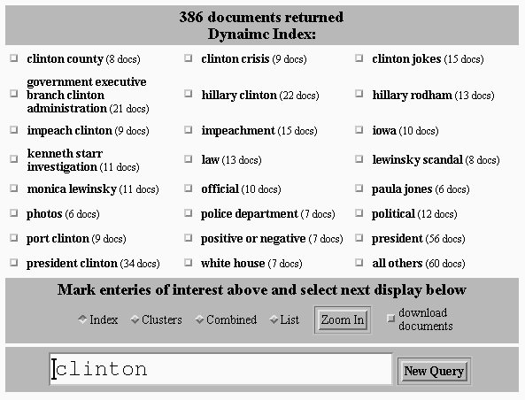

Slide 100
Evaluation - Log Analysis

Slide 101
Northern Light
“Custom Folders”
20000 predefined topics in a manually developed hierarchy
Classify document into topics
Display “dominant” topics in search results

Slide 102
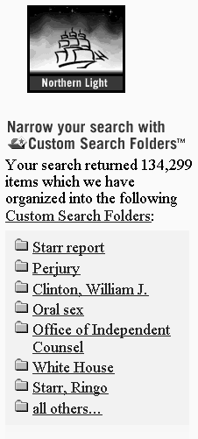
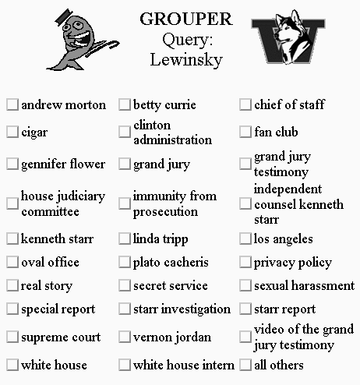

Slide 103
Summary
Post-retrieval clustering
to address low precision of Web searches
STC
phrase-based; overlapping clusters; fast
Offline evaluation
Quality of STC,
advantages of using phrases vs. n-grams, FS
Deployed two systems on the Web
Log analysis: Promising initial results
www.cs.washington.edu/research/clustering

Slide 104
Cool Topic
Internet allows creation of knowledge
Aka structured data
Two dominant techniques
ML-based information extraction
Google scholar, product search
Zoominfo
Flipdog
Collaborative content authoring
Wikipedia
Summitpost
Amazon reviews (and votes on usefulness)
How integrate the techniques?

Slide 105
Integration Today
ML first – creates a seed to attract users
Humans act as proofreaders
Zoominfo
Zillow zestimates
dblife.cs.wisc.edu
Surely we can do better than this!?

Slide 106
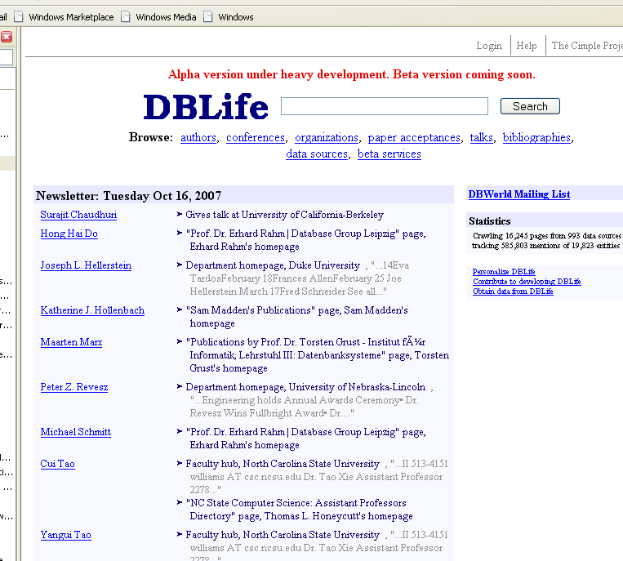
DBLife

Slide 107
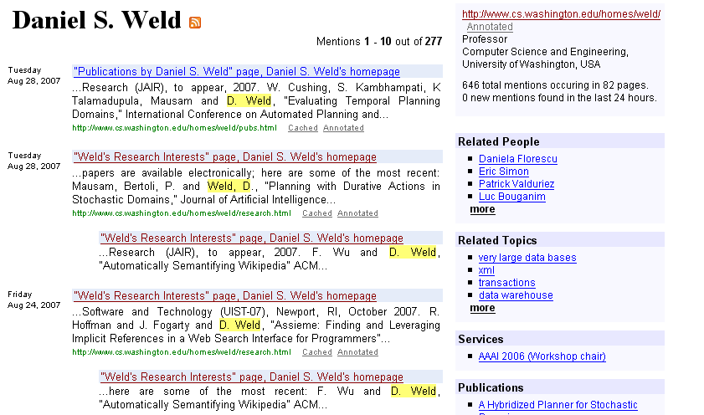

Slide 108
Total > Sum of Parts
Human corrections
→ training data
→ improved ML output
Active learning to prioritize corrections
Track author (and ML extractor) reputations
Learn policy where ML can overwrite human
Insert javascript code to encourage human fact checking
Realtime-ML to create “author helper”

Slide 109
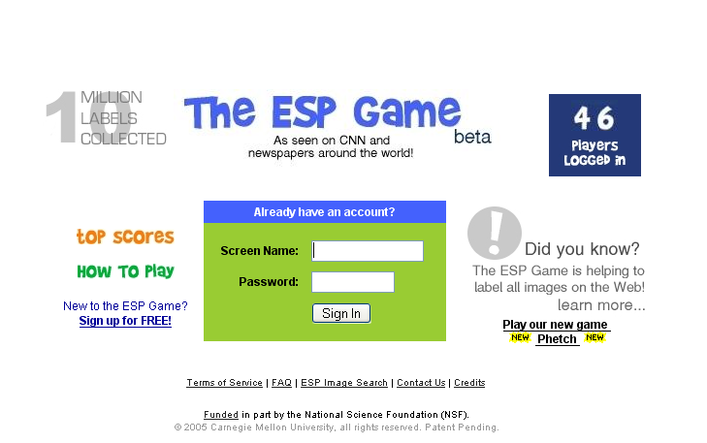
ESP Game

Slide 110
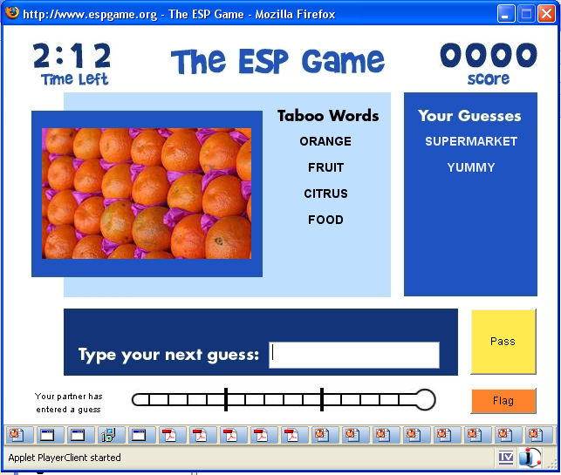

Slide 111
How Does this Fit In?

