Slide 1
Image Stitching II
Ali Farhadi
CSE 455
Several slides from Rick Szeliski, Steve Seitz, Derek Hoiem, and Ira Kemelmacher

Slide 2
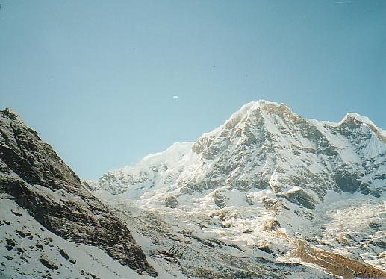
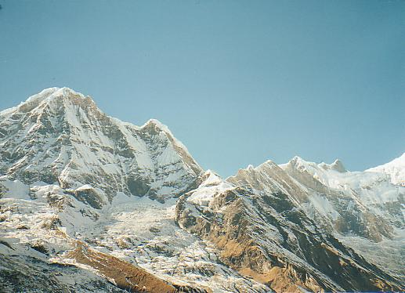
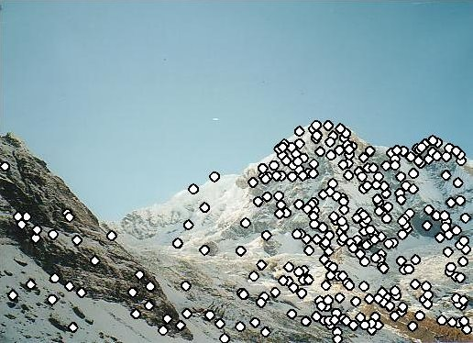
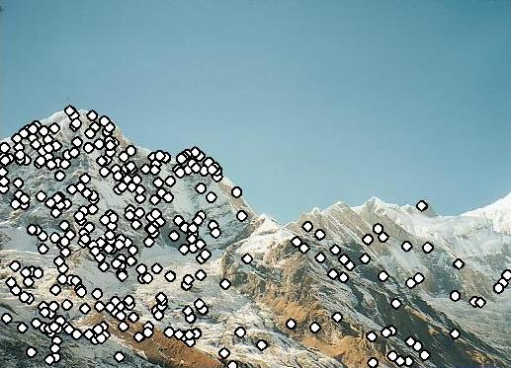
RANSAC for Homography
Initial Matched Points

Slide 3
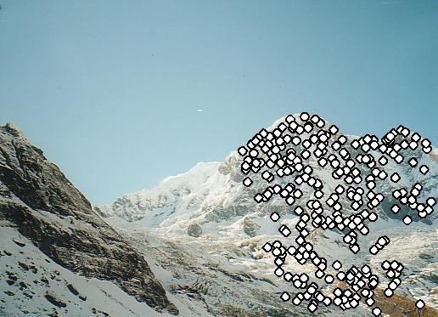
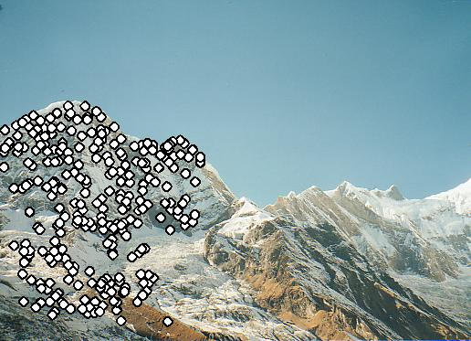
RANSAC for Homography
Final Matched Points

Slide 4
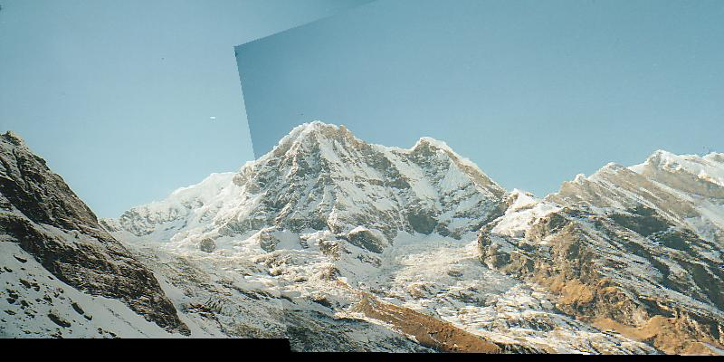
RANSAC for Homography

Slide 5
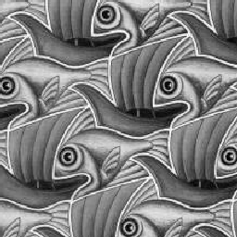
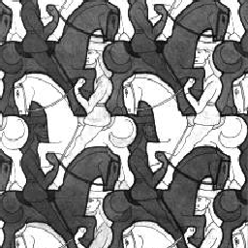
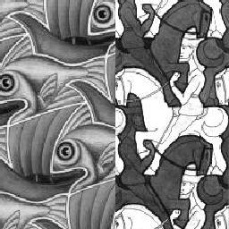
Image Blending

Slide 6
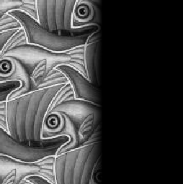
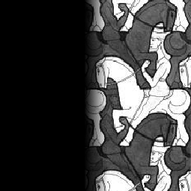
Feathering
+
1
1
0
0
=

Slide 7
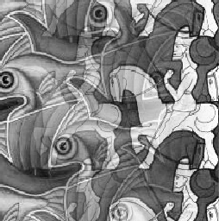
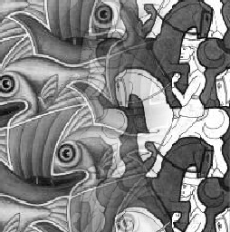
Effect of window (ramp-width) size
1
left
1
right
0
0

Slide 8
Effect of window size
1
1
0
0

Slide 9
Good window size
1
0
“Optimal” window: smooth but not ghosted
Doesn’t always work...

Slide 10
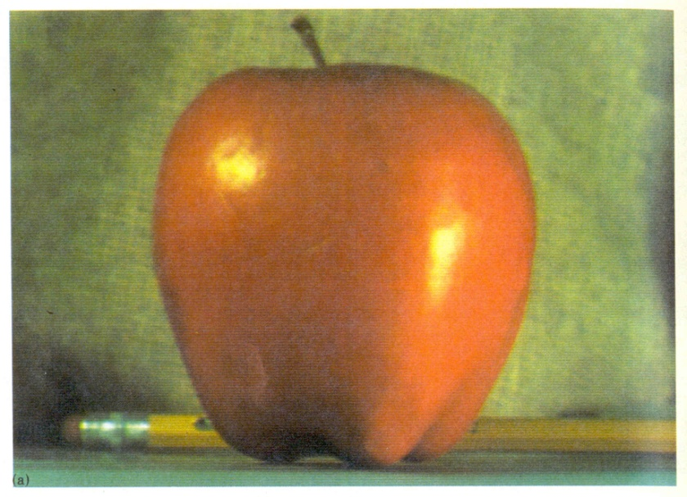
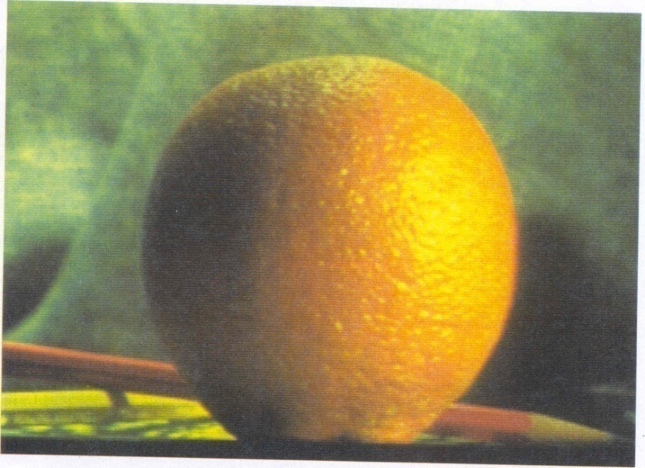
Pyramid blending
Create a Laplacian pyramid, blend each level
Burt, P. J. and Adelson, E. H., A multiresolution spline with applications to image mosaics, ACM Transactions on Graphics, 42(4), October 1983, 217-236.

Slide 11
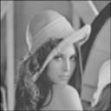
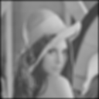
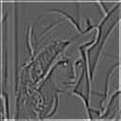
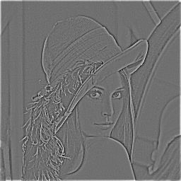
The Laplacian Pyramid
Gaussian Pyramid
Laplacian Pyramid
-
=
-
=
-
=

Slide 12
Laplacian
level
4
Laplacian
level
2
Laplacian
level
0
left pyramid
right pyramid
blended pyramid

Slide 13
Laplacian image blend
Compute Laplacian pyramid
Compute Gaussian pyramid on weight image
Blend Laplacians using Gaussian blurred weights
Reconstruct the final image

Slide 14
Multiband Blending with Laplacian Pyramid
At low frequencies, blend slowly
At high frequencies, blend quickly
1
0
1
0
1
0
Left pyramid
blend
Right pyramid

Slide 15
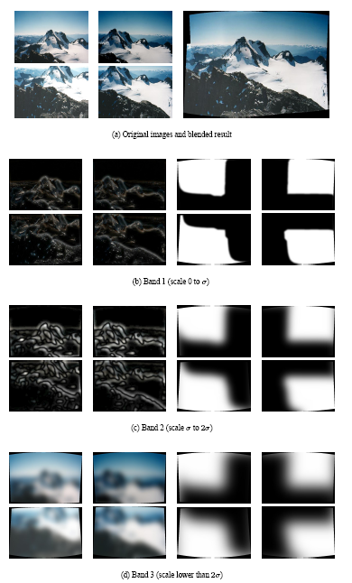
Multiband blending
Laplacian pyramids
Compute Laplacian pyramid of images and mask
Create blended image at each level of pyramid
Reconstruct complete image

Slide 16
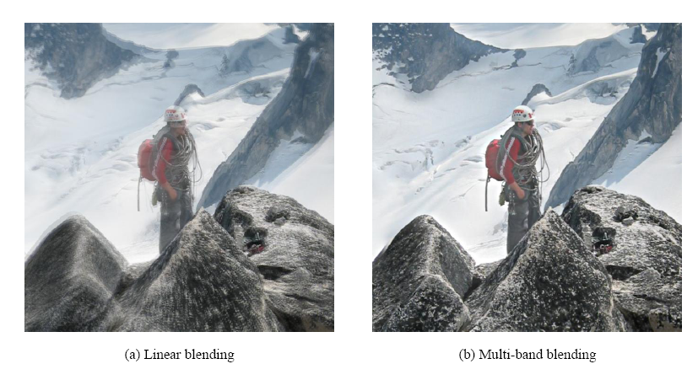
Blending comparison (IJCV 2007)

Slide 17
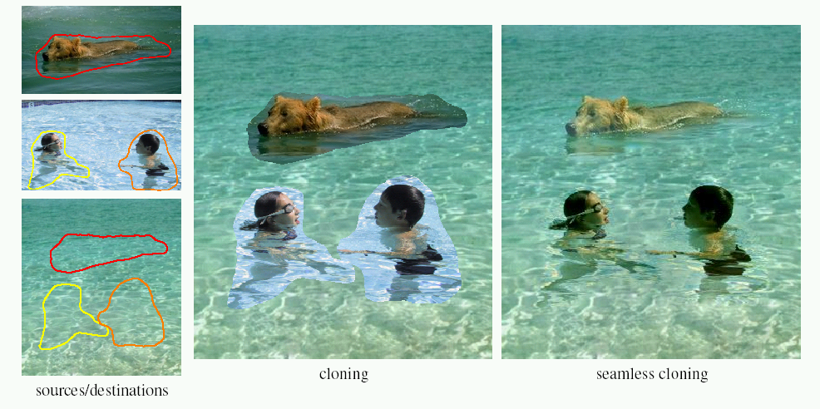
Poisson Image Editing
For more info: Perez et al, SIGGRAPH 2003
http://research.microsoft.com/vision/cambridge/papers/perez_siggraph03.pdf

Slide 18
Alpha Blending
I₃
p
I₁
Optional: see Blinn (CGA, 1994) for details:
http://ieeexplore.ieee.org/iel1/38/7531/00310740.pdf?isNumber=7531&prod=JNL&arnumber=310740&arSt=83&ared=87&arAuthor=Blinn%2C+J.F.
I₂
Encoding blend weights: I(x,y) = (αR, αG, αB, α)
color at p =
Implement this in two steps:
1. accumulate: add up the (α premultiplied) RGBα values at each pixel
2. normalize: divide each pixel’s accumulated RGB by its α value
Notes:
A: render as black

Slide 19
Choosing seams
Easy method
Assign each pixel to image with nearest center
im1
im2
x
x
Image 2
Image 1

Slide 20
Choosing seams
Easy method
Assign each pixel to image with nearest center
Create a mask:
Smooth boundaries ( “feathering”):
Composite
im1
im2
x
x
Image 2
Image 1

Slide 21
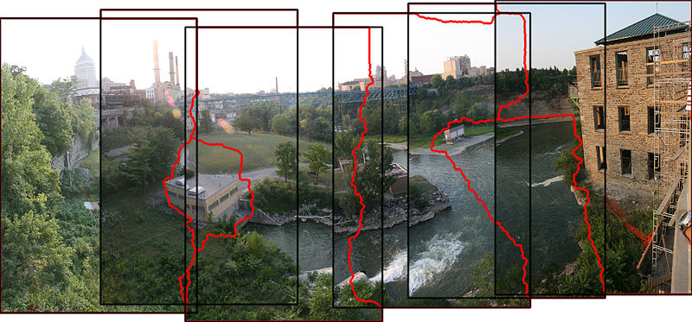
Choosing seams
Better method: dynamic program to find seam along well-matched regions
Illustration: http://en.wikipedia.org/wiki/File:Rochester_NY.jpg

Slide 22
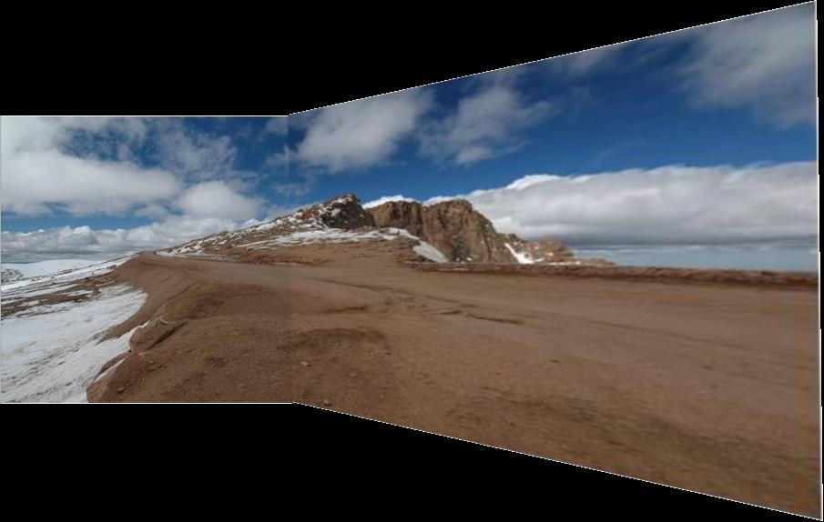
Gain compensation
Simple gain adjustment
Compute average RGB intensity of each image in overlapping region
Normalize intensities by ratio of averages

Slide 23
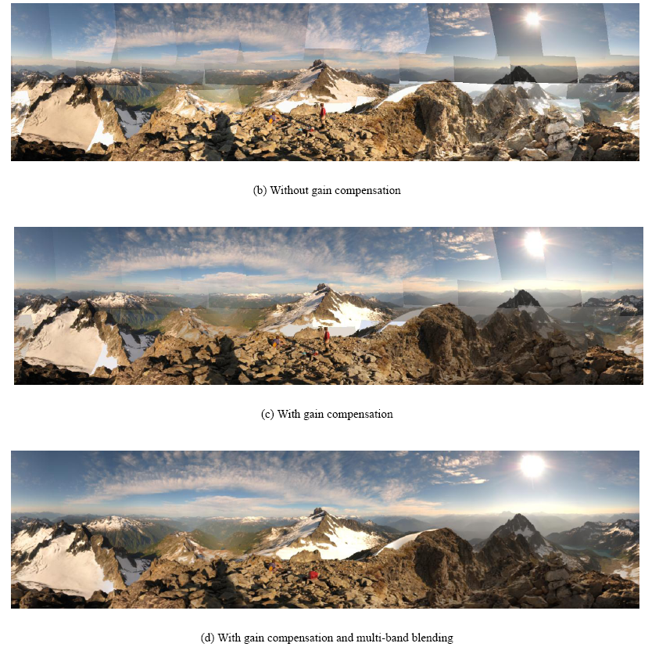
Blending Comparison

Slide 24
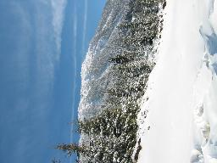
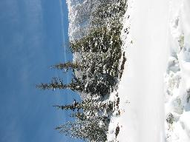
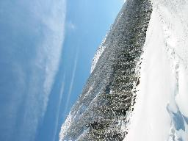
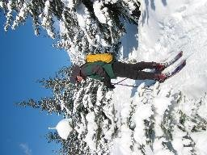
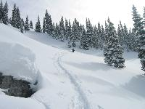
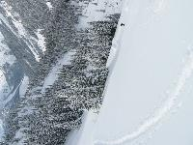
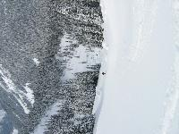
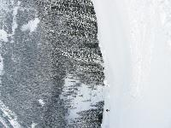
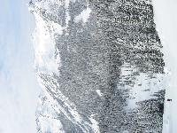
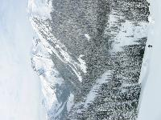
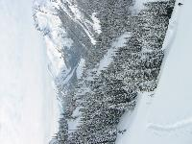
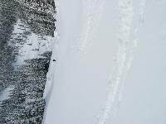
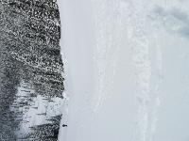
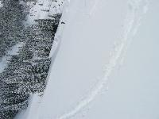
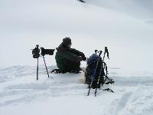
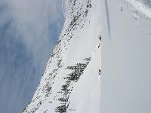
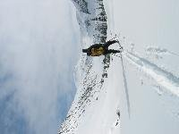
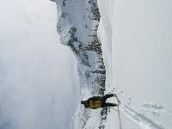
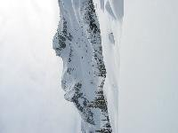
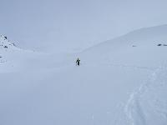
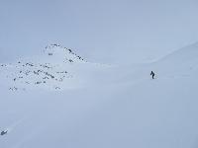
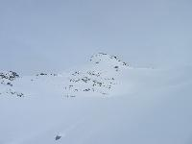
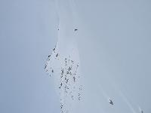
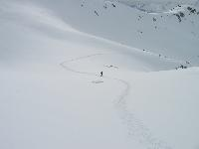
Recognizing Panoramas
Some of following material from Brown and Lowe 2003 talk
Brown and Lowe 2003, 2007

Slide 25
Recognizing Panoramas
Input: N images
Extract SIFT points, descriptors from all images
Find K-nearest neighbors for each point (K=4)
For each image
Select M candidate matching images by counting matched keypoints (m=6)
Solve homography H_{ij} for each matched image

Slide 26
Recognizing Panoramas
Input: N images
Extract SIFT points, descriptors from all images
Find K-nearest neighbors for each point (K=4)
For each image
Select M candidate matching images by counting matched keypoints (m=6)
Solve homography H_{ij} for each matched image
Decide if match is valid (n_{i} > 8 + 0.3 n_{f} )
# inliers
# keypoints in overlapping area

Slide 27
Recognizing Panoramas (cont.)
(now we have matched pairs of images)
Find connected components

Slide 28
Finding the panoramas

Slide 29
Finding the panoramas

Slide 30
Finding the panoramas

Slide 31
Recognizing Panoramas (cont.)
(now we have matched pairs of images)
Find connected components
For each connected component
Solve for rotation and f
Project to a surface (plane, cylinder, or sphere)
Render with multiband blending

