Slide 1
Reconstruction
CSE 455
Linda Shapiro

Slide 2
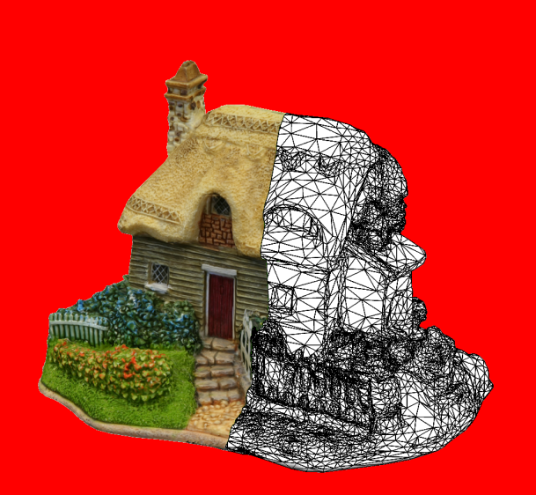
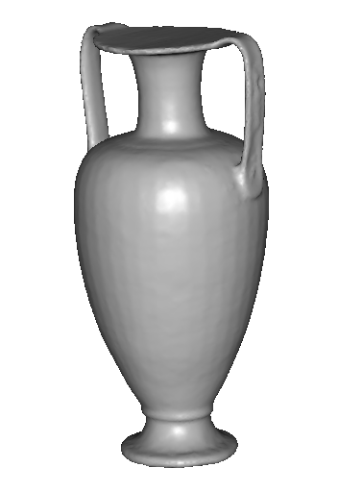
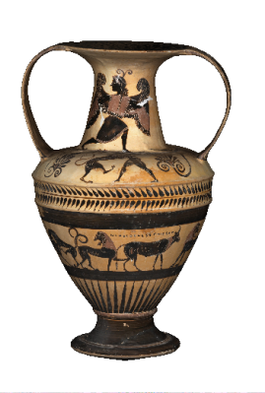
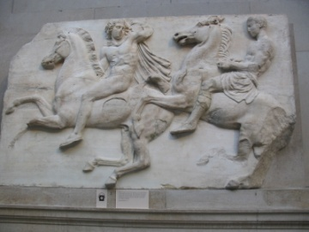
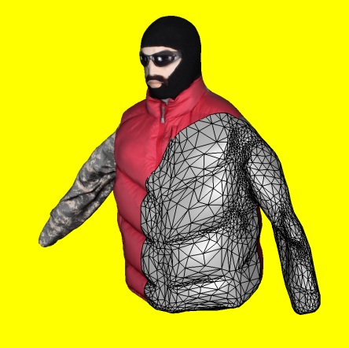
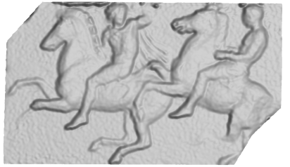
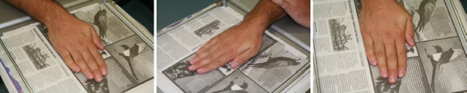
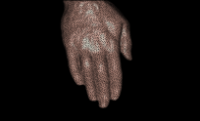
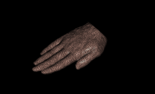
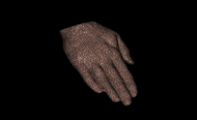
3D model
“Digital copy” of real object
Allows us to
  Inspect details of object
  Measure properties
  Reproduce in different material
Many applications
  Cultural heritage preservation
  Computer games and movies
  City modelling
  E-commerce

Slide 3
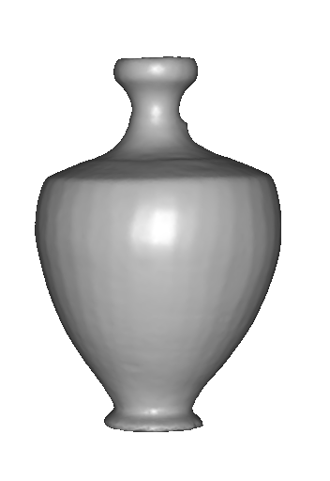
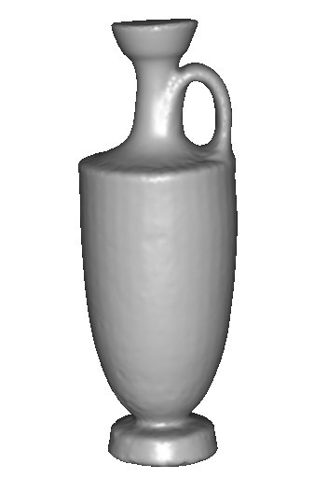
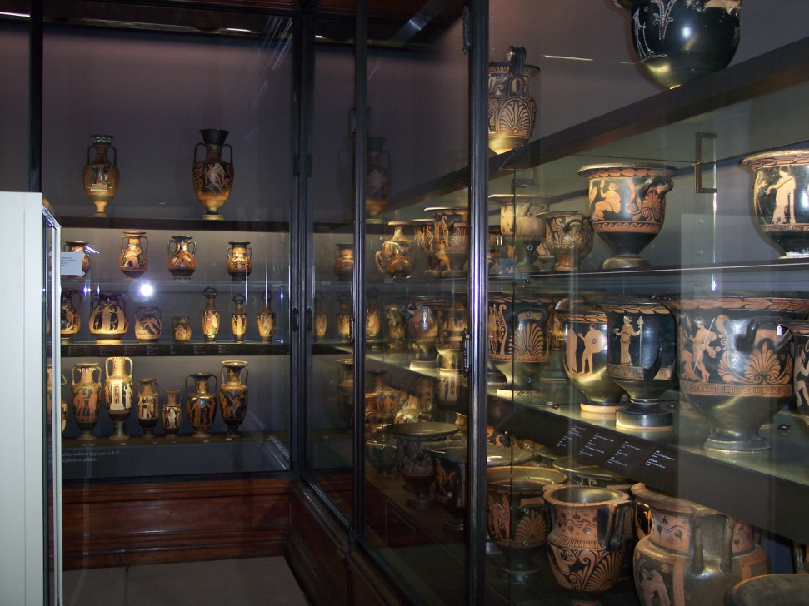
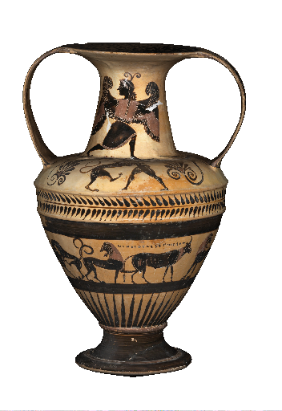
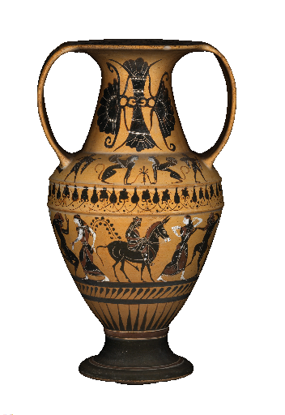
Applications: cultural heritage
SCULPTEUR European project
Notes:
To sum up,

Slide 4
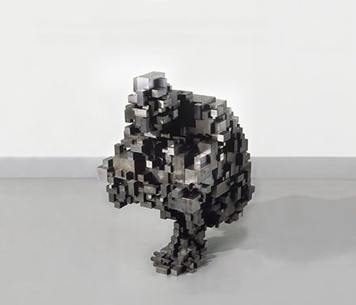
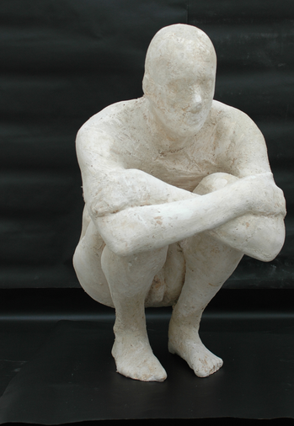
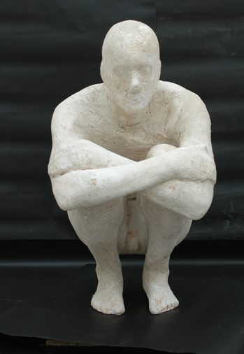
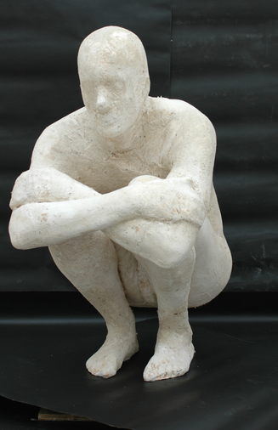
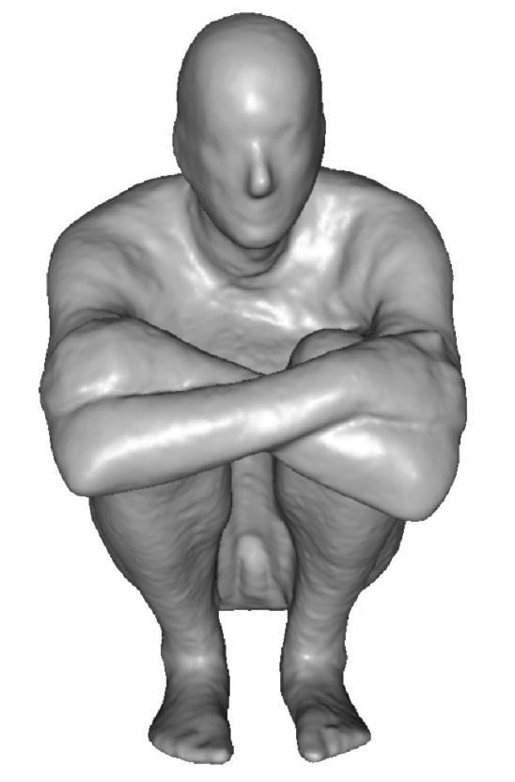
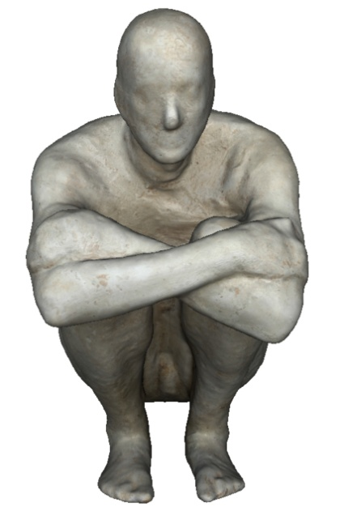
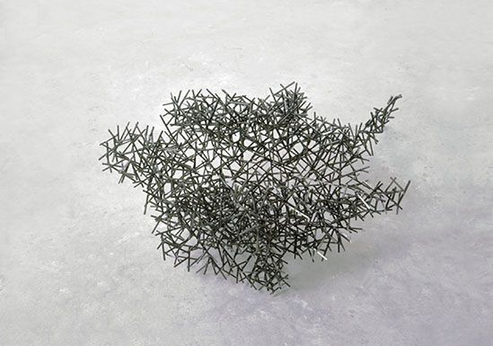
Applications: art
Block Works Precipitate III 2004
Mild steel blocks 80 x 46 x 66 cm
Domain Series Domain VIII Crouching
1999 Mild steel bar 81 x 59 x 63 cm

Slide 5
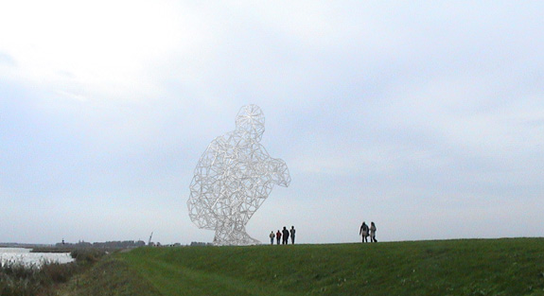
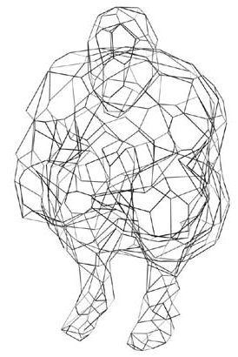
Applications: structure engineering
BODY / SPACE / FRAME, Antony Gormley, Lelystad, Holland
Notes:
To sum up,

Slide 6
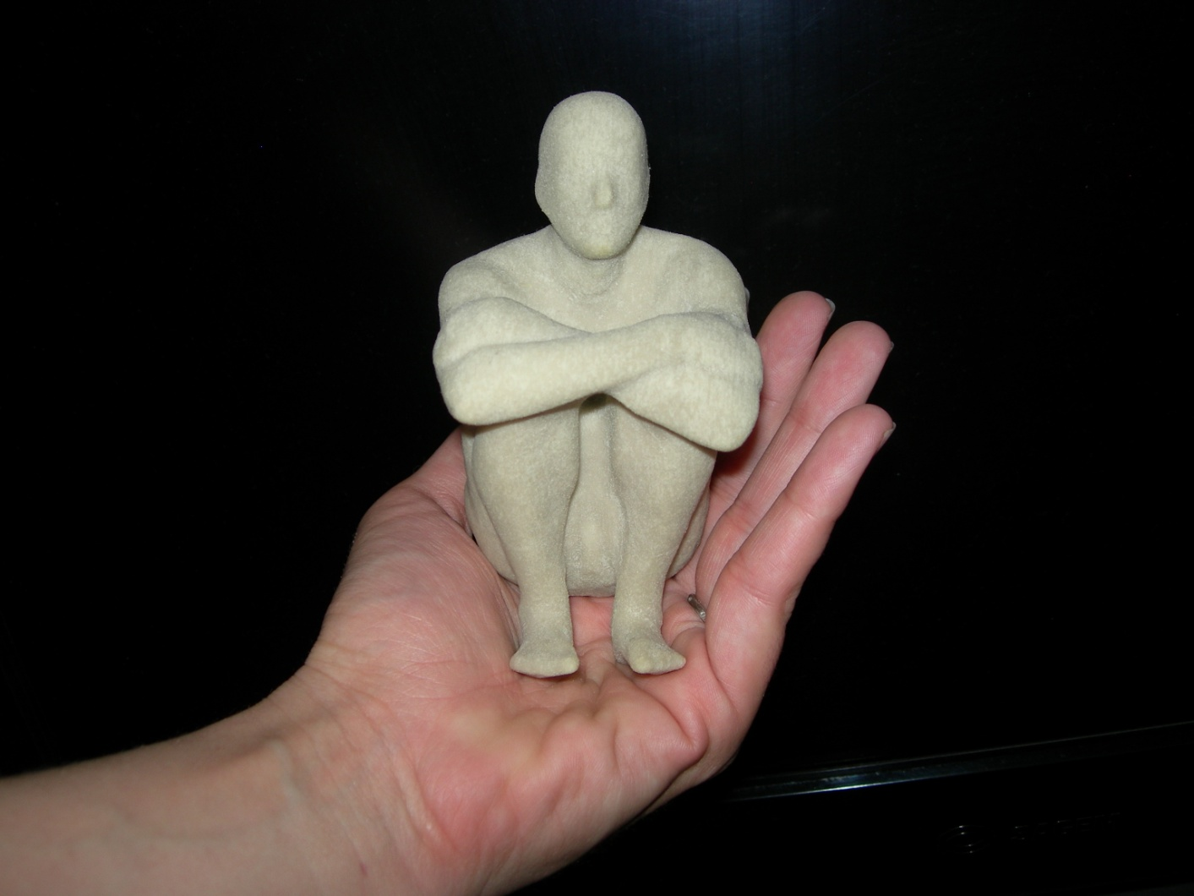
Applications: art
Notes:
To sum up,

Slide 7
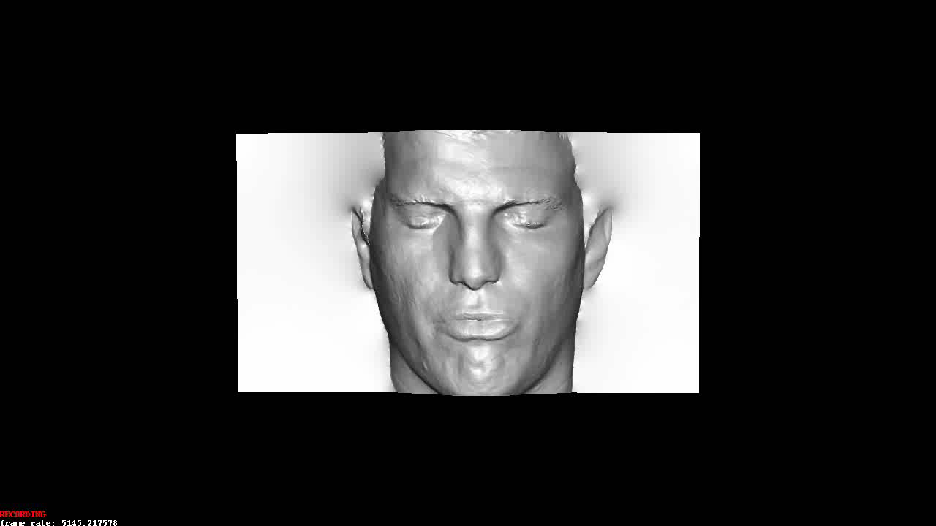
Applications: computer games
Notes:
To sum up,

Slide 8
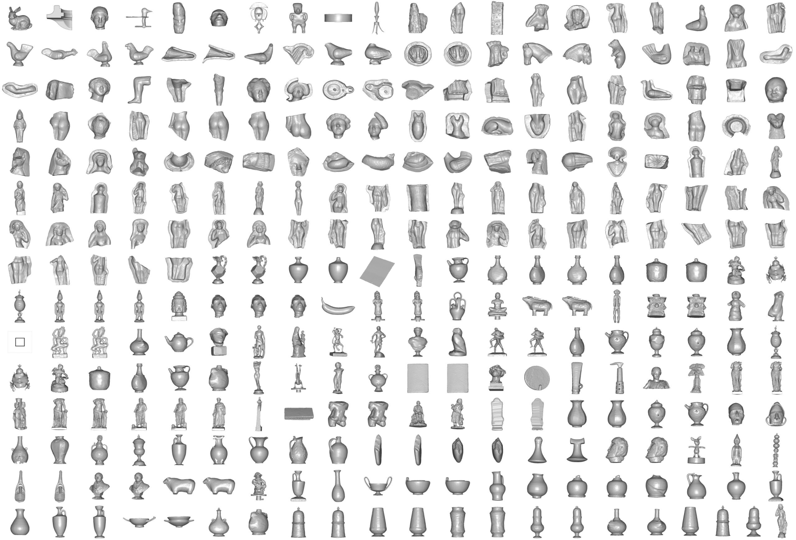
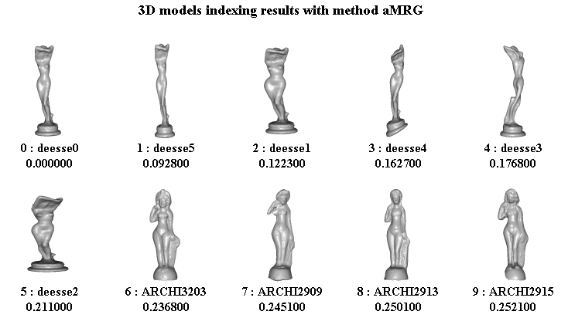
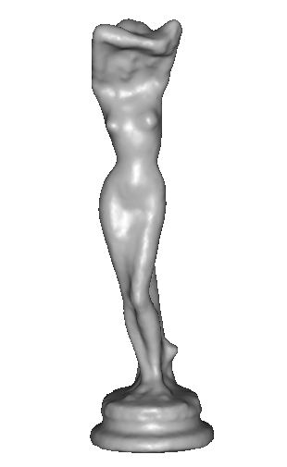
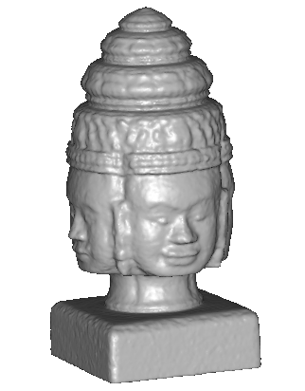
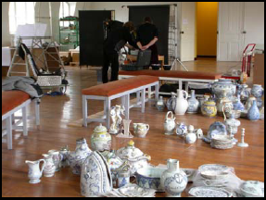
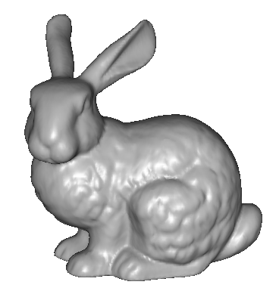
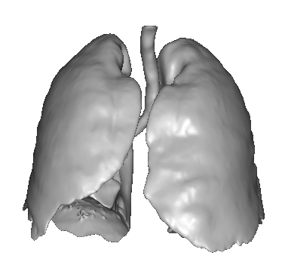
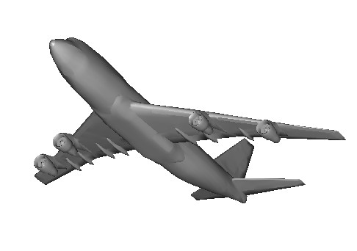
Applications: 3D indexation
? ?
? ? ?
?
? ?
?
SCULPTEUR European project
medical, industrial and cultural heritage indexation

Slide 9
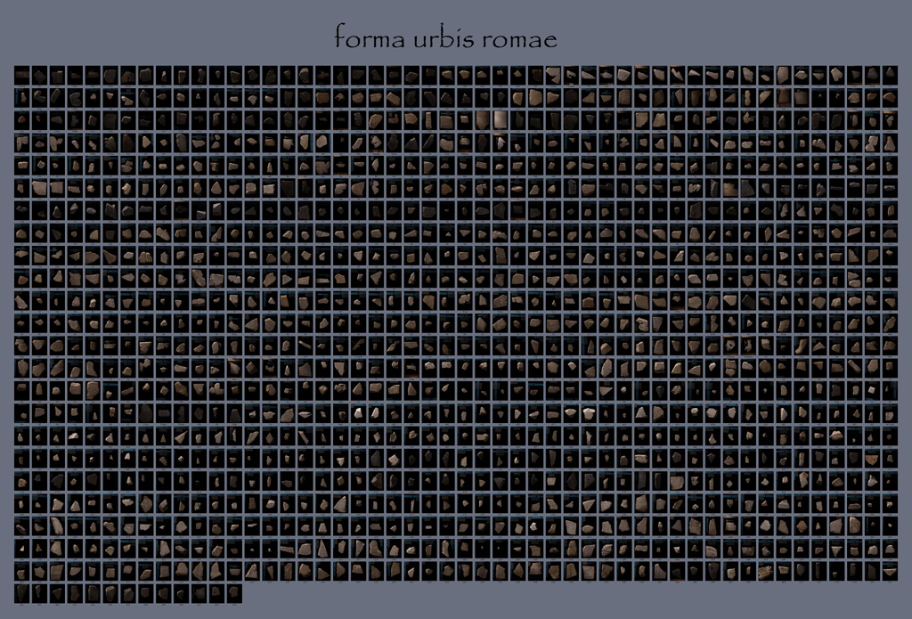
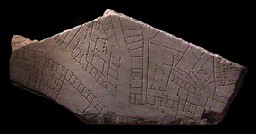
Applications: archaeology
“forma urbis romae” project
Fragments of the City: Stanford's Digital Forma Urbis Romae Project
David Koller, Jennifer Trimble, Tina Najbjerg, Natasha Gelfand, Marc Levoy
Proc. Third Williams Symposium
on Classical Architecture,
Journal of Roman Archaeology
supplement, 2006.
1186 fragments

Slide 10
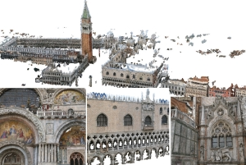
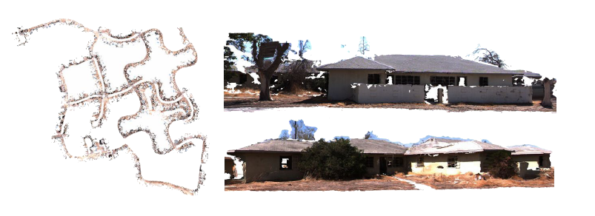
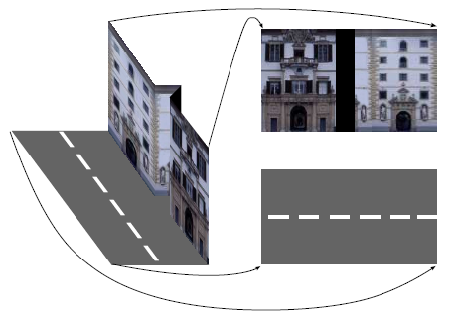

Applications: large scale modelling
[Furukawa10]
[Pollefeys08]
[Cornelis08]
[Goesele07]

Slide 11
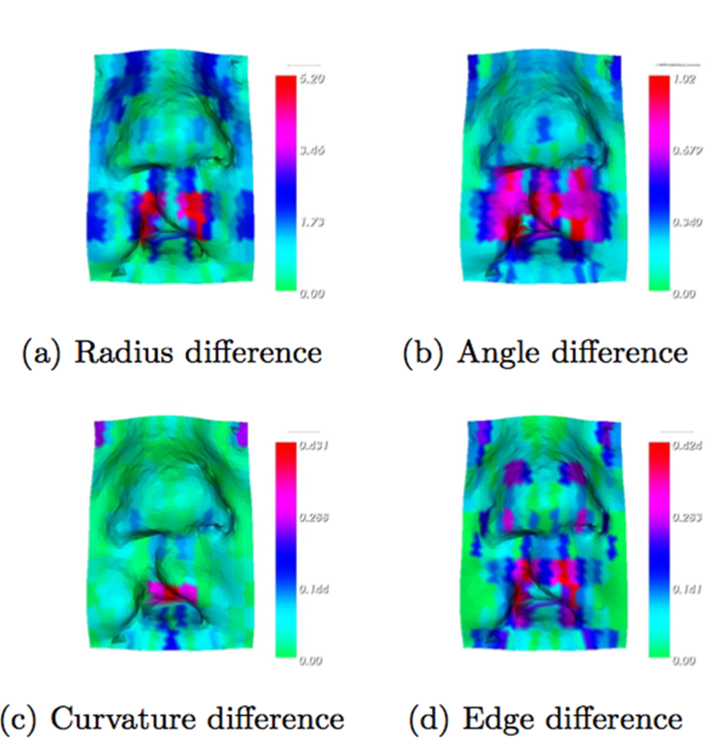
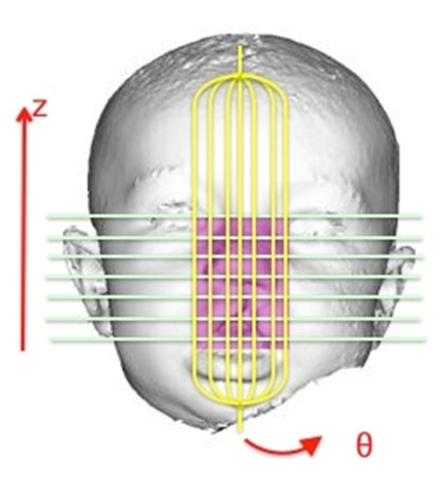
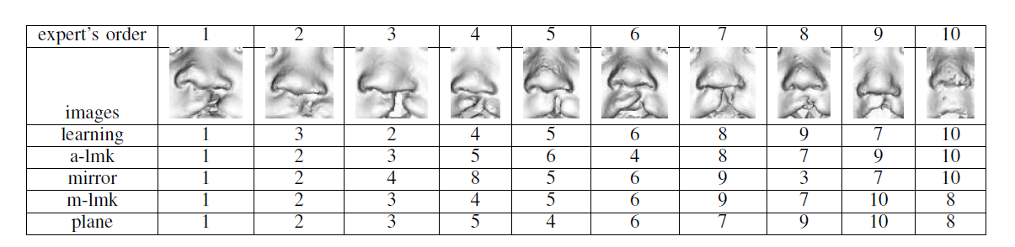
Applications: Medicine

Slide 12
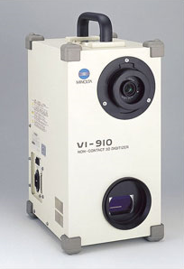
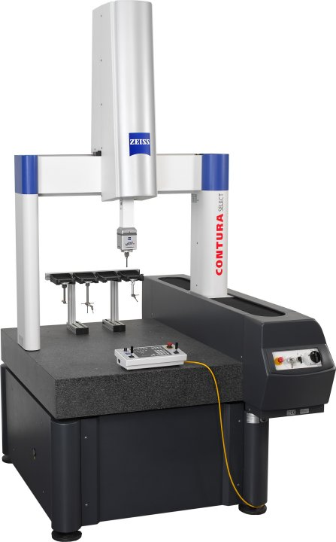

Scanning technologies
Laser scanner, coordinate measuring machine
  Very accurate
  Very Expensive
  Complicated to use
Minolta
“Michelangelo” project
Contura CMM

Slide 13
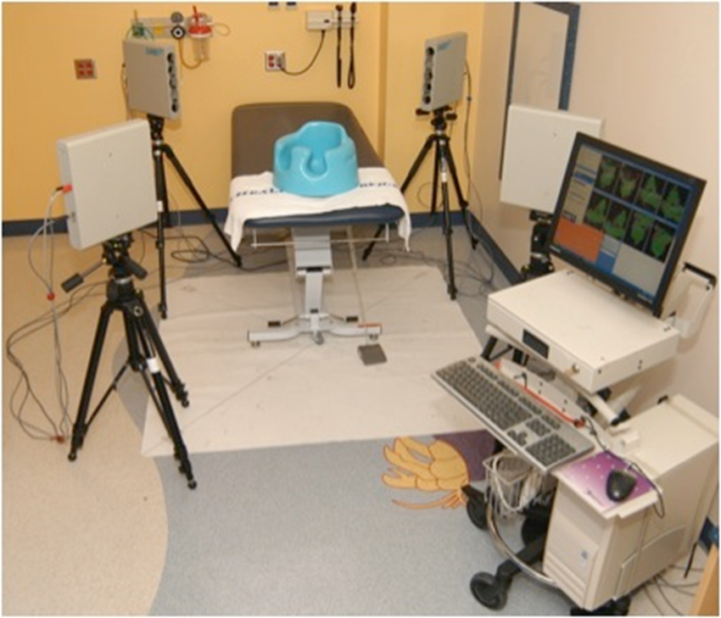
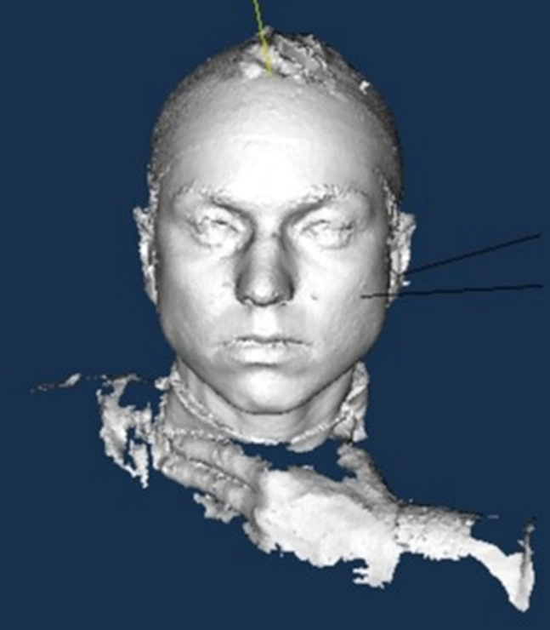
Medical Scanning System

Slide 14
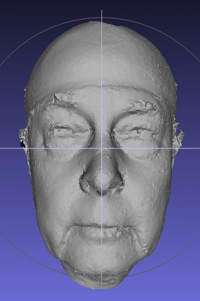
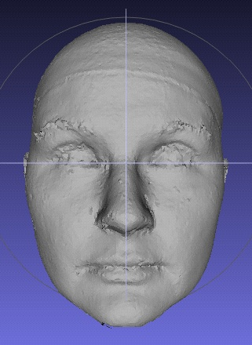
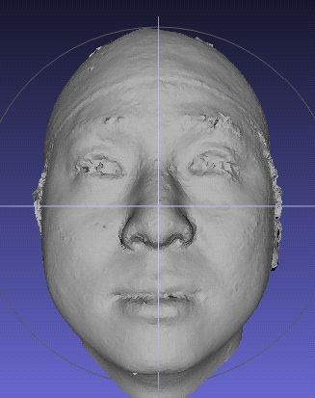
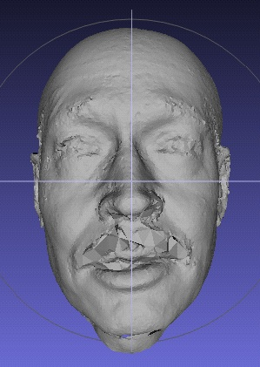




The “Us” Data Set (subset)

Slide 15


3d shape from photographs
“Estimate a 3d shape that would generate the input photographs given the same material, viewpoints and illumination”
viewpoint
?
geometry
material
illumination
image

Slide 16
Photometric Stereo
Estimate the surface normals of a given scene given multiple 2D images taken from the same viewpoint, but under different lighting conditions.
Basic photometric stereo required a Lambertian reflectance model:
I = ρ n · v
where I is pixel intensity, n is the normal, v is the lighting direction, and ρ is diffuse albedo constant, which is a reflection coefficient.

Slide 17

Basic Photometric Stereo

Slide 18

Basic Photometric Stereo

Slide 19
Basic Photometric Stereo
K light sources
Lead to K images R₁(p,q), ...,R_{K}(p,q) each from just one of the light sources being on
For any (p,q), we get K intensities I₁,...I_{K}
Leads to a set of linear equations of the form
I_{k} = ρn•v_{k}
Solving leads to a surface normal map.

Slide 20


Photometric Stereo
Inputs
3D normals

Slide 21
3d shape from photographs
Photograph based 3d reconstruction is:
  practical
  fast
  non-intrusive
  low cost
  Easily deployable outdoors
  “low” accuracy
  Results depend on material properties

Slide 22

Reconstruction
Generic problem formulation: given several images of the same object or scene, compute a representation of its 3D shape

Slide 23
Reconstruction
Generic problem formulation: given several images of the same object or scene, compute a representation of its 3D shape
“Images of the same object or scene”
  Arbitrary number of images (from two to thousands)
  Arbitrary camera positions (camera network or video sequence)
  Calibration may be initially unknown
“Representation of 3D shape”
  Depth maps
  Meshes
  Point clouds
  Patch clouds
  Volumetric models
  Layered models

Slide 24




Multiple-baseline stereo
I1
I2
I10
M. Okutomi and T. Kanade, “A Multiple-Baseline Stereo System,” IEEE Trans. on Pattern Analysis and Machine Intelligence, 15(4):353-363 (1993).

Slide 25






Reconstruction from silhouettes
Can be computed robustly
Can be computed efficiently
background
+
foreground
background
foreground
-
=

Slide 26
Reconstruction from Silhouettes
The case of binary images: a voxel is photo-consistent if it lies inside the object’s silhouette in all views
Binary Images

Slide 27
Reconstruction from Silhouettes
The case of binary images: a voxel is photo-consistent if it lies inside the object’s silhouette in all views
voxel space
Binary Images
Finding the silhouette-consistent shape (visual hull):
  Backproject each silhouette
  Intersect backprojected volumes

Slide 28





Calibrated Image Acquisition
Selected Dinosaur Images
Calibrated Turntable
360° rotation (21 images)
Selected Flower Images

Slide 29
Space Carving in General
Image 1
Image N
…...
Space Carving Algorithm
  Initialize to a volume V containing the true scene
  Choose a voxel on the outside of the volume
  Project to visible input images
  Carve if not photo-consistent (inside object’s silhouette)
  Repeat until convergence
K. N. Kutulakos and S. M. Seitz, A Theory of Shape by Space Carving, ICCV 1999

Slide 30

Our 4-camera light-striping stereo system
(now deceased)
cameras
projector
rotation
table
3D
object

Slide 31

Calibration Object
The idea is to snap
images at different
depths and get a
lot of 2D-3D point
correspondences.

Slide 32


Slide 33


Slide 34


Slide 35


Slide 36
3D space is made up of many cubes.
image plane
depth map
(u,v,d)
(
((x,y,z)
one of many cubes
in virtual 3D cube space
OUTSIDE

Slide 37


Slide 38


Slide 40


Slide 41


Slide 42


Slide 43


Slide 44


Slide 45




More: Space Carving Results: African Violet
Input Image (1 of 45)
Reconstruction
Reconstruction
Reconstruction
Source: S. Seitz

Slide 46



More: Space Carving Results: Hand
Input Image
(1 of 100)
Views of Reconstruction

Slide 47


Stereo from community photo collections
Up to now, we’ve always assumed that camera calibration is known
For photos taken from the Internet, we need structure from motion techniques to reconstruct both camera positions and 3D points

Slide 48




Slide 49


Head Reconstruction from Uncalibrated Internet Photos
Input: Internet photos in different poses and expressions
Output: 3D model of the head
work of
Shu Liang

Slide 50
Pose Clusters
clustered
in 2D
how they
will fit in 3D
find the
person
rigid head
alignment
arrows
show
sharper
regions
pixel level
alignment

Slide 51

Photometric Stereo on frontal pose
Frontal view photos to n x p matrix Q. n: number of photos, p: number of pixels of the facial mask.
Using Singular Valued Decomposition, Q = LN, where L is the lighting and N is the surface normals. Only the 1st 4 components are used.
images
warped to
frontal view
reconstructed
using 4
components
Expression normalization by low-rank approximation. The first row shows the warped images, the 2nd row shows the the low rank approximated images. Note how the lighting is mostly preserved, but the facial expression is normalized.
Kemelmacher-Shlizerman I. et al., Face Reconstruction in the Wild, ICCV 2011

Slide 52
Photometric Stereo on frontal pose
Use SVD to compute 3D surface normals
2. Compute 3d depth map from the surface normals
3D shapes
generated from
frontal pose
shown from 2
different views

Slide 53
Boundary-Value Growing
There are ambiguities in scale between the poses.
These have to be resolved by a process that uses
neighboring poses to solve ambiguities.

Slide 54
Results

