Slide 1
Computer Vision CSE 455 Linda Shapiro Professor of Computer Science & Engineering Professor of Electrical Engineering

Slide 2
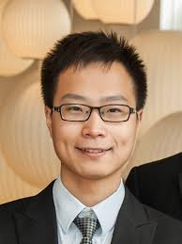
Course Information
Time:
TTH: 10:00 to 11:20
Location:
Zoom lectures: https://washington.zoom.us/s/553420896
Contact:
shapiro@cs.uw.edu , CSE 634
TAs:
Bindita Chaudhuri ADD PHOTOS
bindita@cs.washington.edu
Beibin Li
beibin@cs.washington.edu
Shima Nofallah
shima@cs.Washington.edu
Website:
https://courses.cs.washington.edu/courses/cse455/20sp/

Slide 3
Topics
Introduction
Color and Texture
Image Coordinates, Transforms, and Resizing
Filters and Convolutions
Edges and Lines
Interest Operators, Image Matching, Image Stitching
Motion, Optical Flow
3D Depth Perception
Stereo
Machine Learning Overview including Neural Nets
Object Detection and Recognition with ML
Convolutional Neural Networks
CNN Applications

Slide 4
Grading (tentative)
Seven regular assignments (80%)
One Course Project (20%)
NO EXAMS (Yay!)

Slide 5
Assignments
Build a vision library from the ground up
Mostly in C
Play with advanced tools, neural networks
Beginning: lots of skeleton code, explanations
End: less guidance, more experimentation

Slide 6
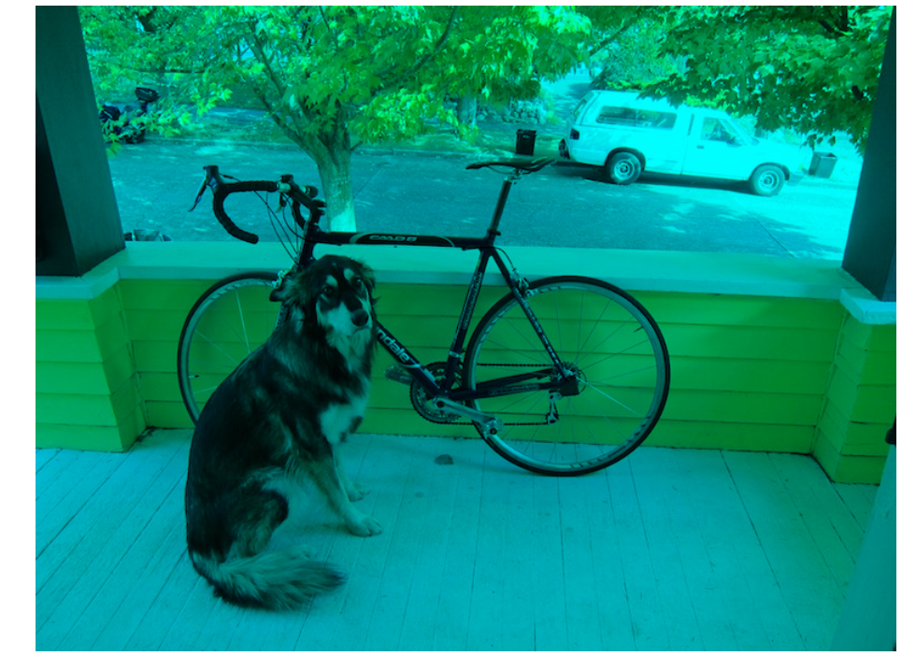
Assignment 0: Fun with Color

Slide 7
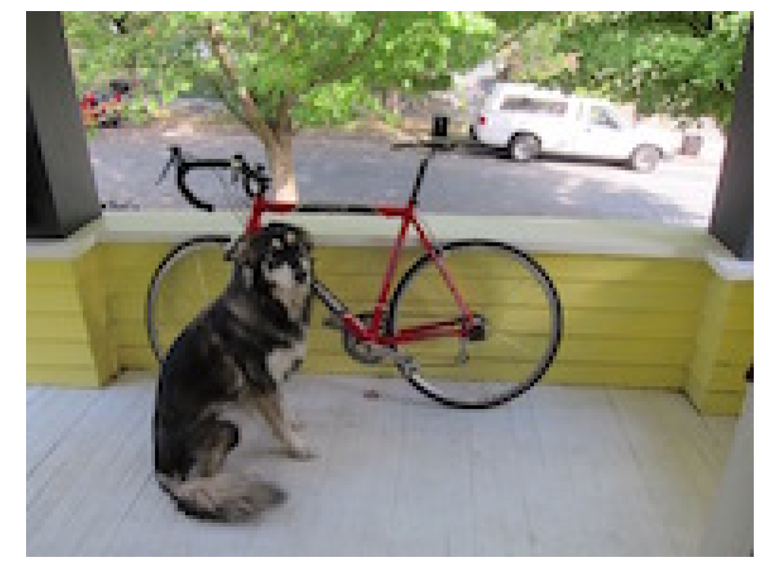
Assignment 1: Image Resizing

Slide 8
Assignment 2: Image Filtering

Slide 9
Assignment 3: Panorama Stitching

Slide 10
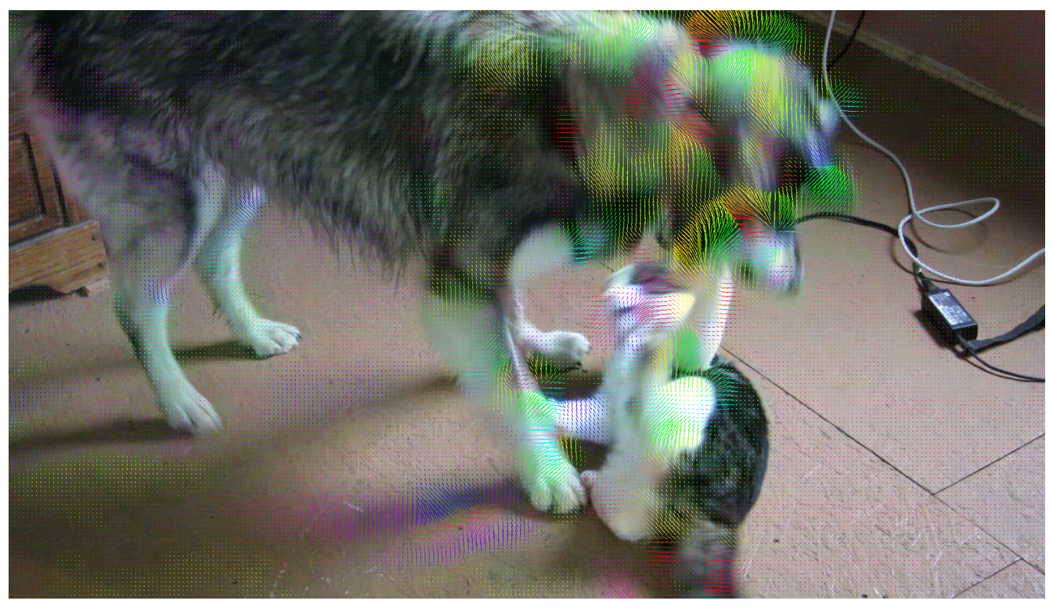
Assignment 4: Optical Flow

Slide 11
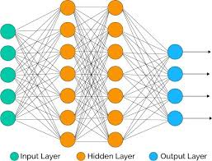
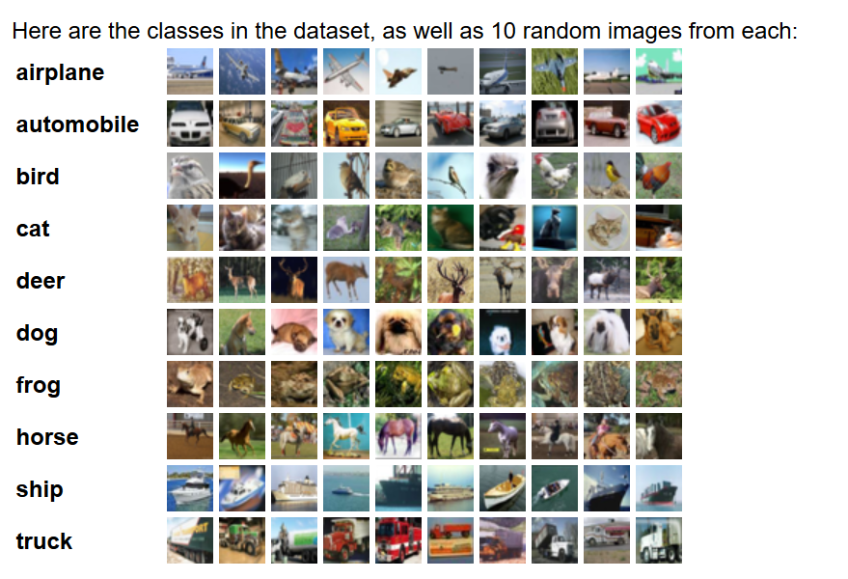
Assignment 5: Neural Networks

Slide 12
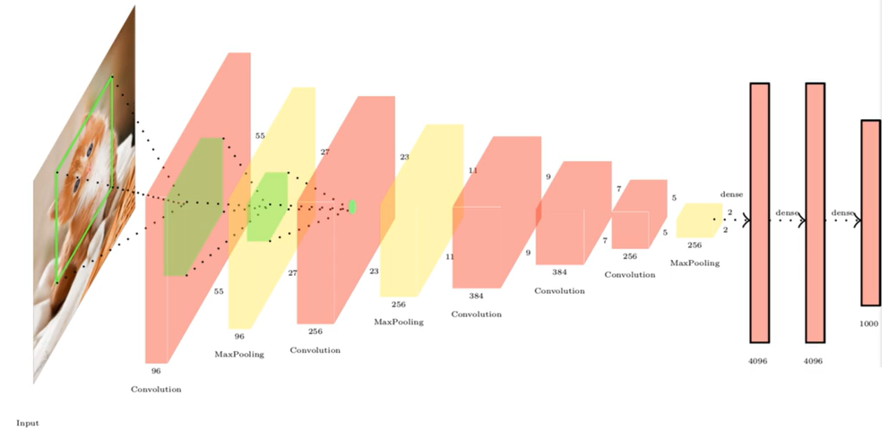
Assignment 6: PyTorch

Slide 13
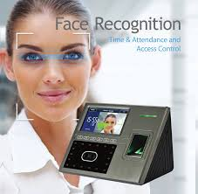
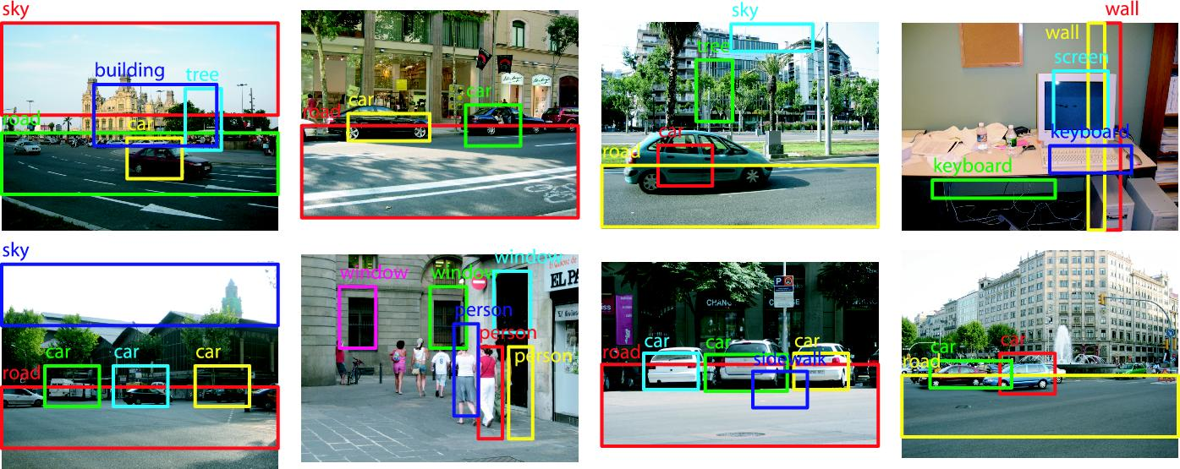
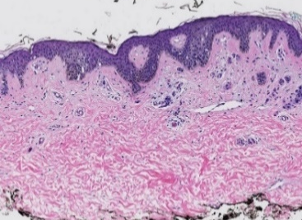
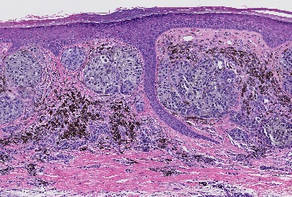
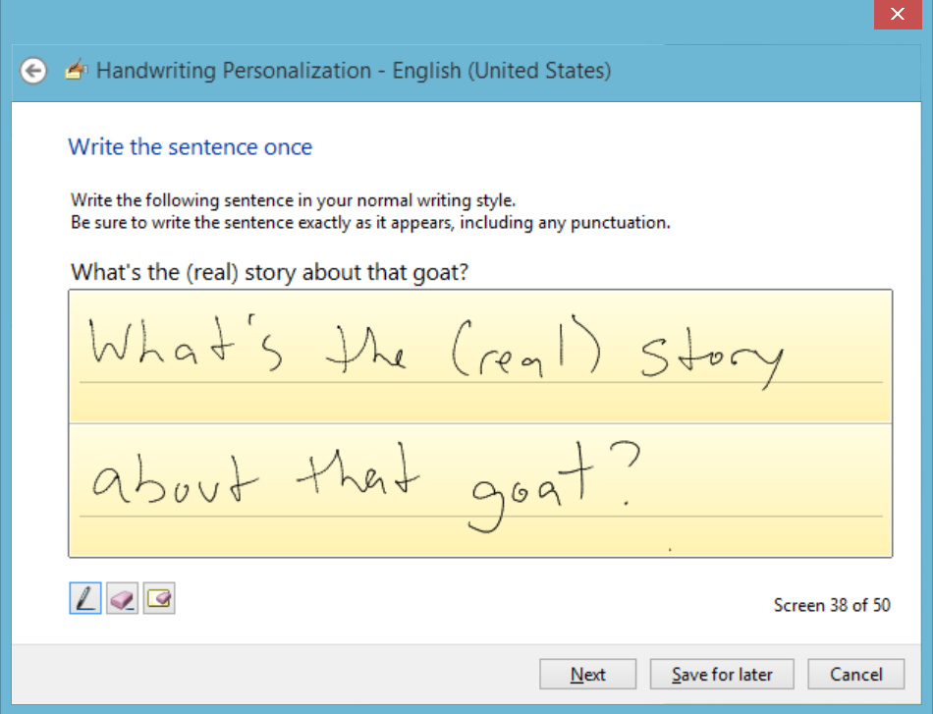
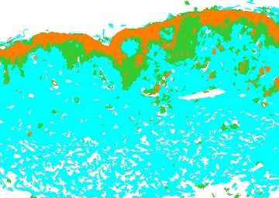
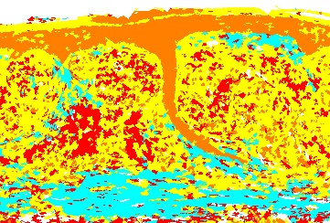
Final Course Project: Machine Learning for Some Kind of Application
b
d
a
c

Slide 14
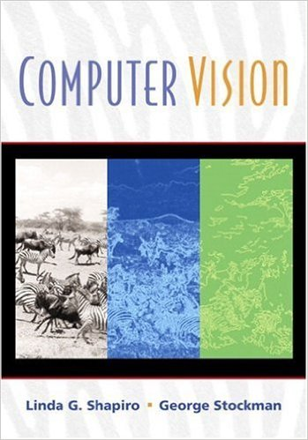
Books
Older, but designed
for undergrads and
has the basics. Chapters
available from our web
page.
Newest and available
as a pdf online.

Slide 15
Notes:
Why?

Slide 16
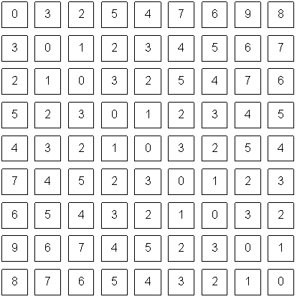
Notes:
pixels

