Slide 1
Computer Vision CSE 455 More Matching Linda Shapiro Professor of Computer Science & Engineering Professor of Electrical Engineering

Slide 2
Review
Descriptors
Matching

Slide 3
Simple Normalized Descriptor
interest point neighborhood around normalized neighborhood
interest point around interest point
56 200
201 200
85 101 105
145 1
0 1
116 100 96
201
The simple descriptor just subtracts the center value from each of the neighbors, including itself to normalize for lighting and exposure.
We can store this as a 1D vector to be efficient:
156 145 1 155 0 1 116 100 96

Slide 4
Properties of our Descriptor
Translation Invariant
Not scale invariant
Not rotation invariant
Somewhat invariant to lighting changes
Let’s look at the SIFT descriptor, because it is heavily used, even without using the SIFT key point detector.
It already solves the scale problem by computing at multiple scales and keeping track.

Slide 5
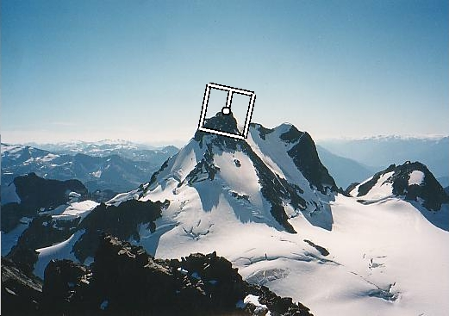
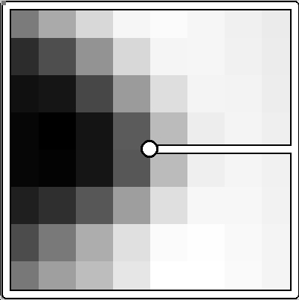
Rotation invariance
CSE 576: Computer Vision
Rotate patch according to its dominant gradient orientation
This puts the patches into a canonical orientation.
Image from Matthew Brown
Notes:
5

Slide 6
Orientation Normalization
Compute orientation histogram
Select dominant orientation
Normalize: rotate to fixed orientation
[Lowe, SIFT, 1999]
0
2
π
T. Tuytelaars, B. Leibe

Slide 7
Once we have found the key points and a dominant orientation for each,
we need to describe the (rotated and scaled) neighborhood about each.
128-dimensional vector

Slide 8
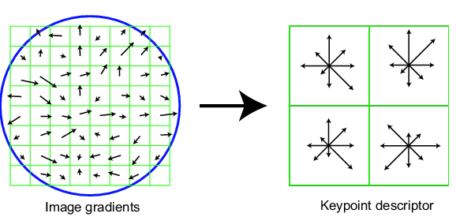
SIFT descriptor
Full version
Divide the 16x16 window into a 4x4 grid of cells (2x2 case shown below)
Compute an orientation histogram for each cell
16 cells * 8 orientations = 128 dimensional descriptor
Adapted from slide by David Lowe

Slide 9
SIFT descriptor
Full version
Divide the 16x16 window into a 4x4 grid of cells
Compute an orientation histogram for each cell
16 cells * 8 orientations = 128 dimensional descriptor
8 8 . . . 8

Slide 10
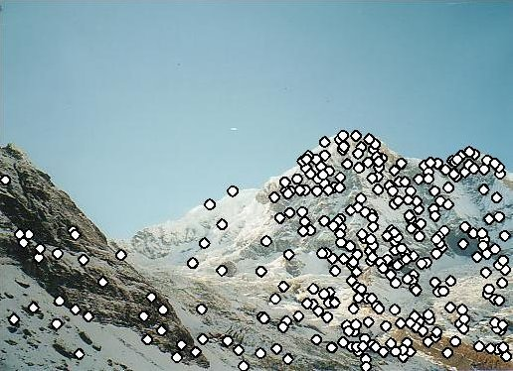
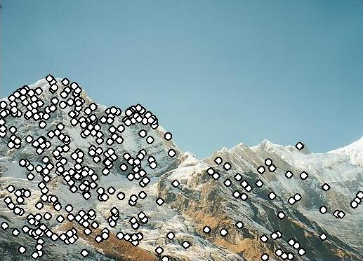
Matching with Features
Detect feature points in both images

Slide 11
Matching with Features
Detect feature points in both images
Find corresponding pairs

Slide 12
Find the best matches
For each descriptor a in A, find its best match b in B
And store it in a vector of matches
Note: this is abstract; see code for details.
A B M
i j
i
j

Slide 13
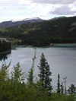
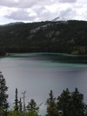
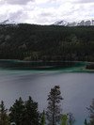
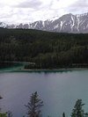
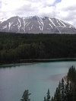
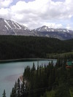
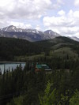
Larger Goal: Combine two or more overlapping images to make one larger image
Add example
Slide credit: Vaibhav Vaish

Slide 14
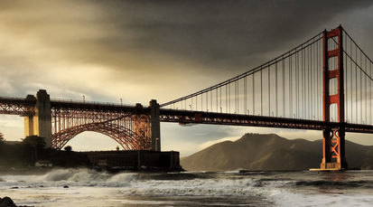
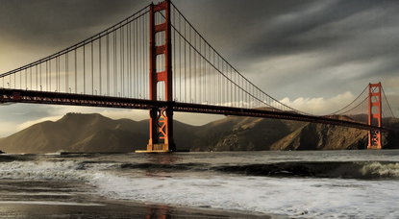
Simple case: translations
Displacement of match i =
Mean displacement =

Slide 15
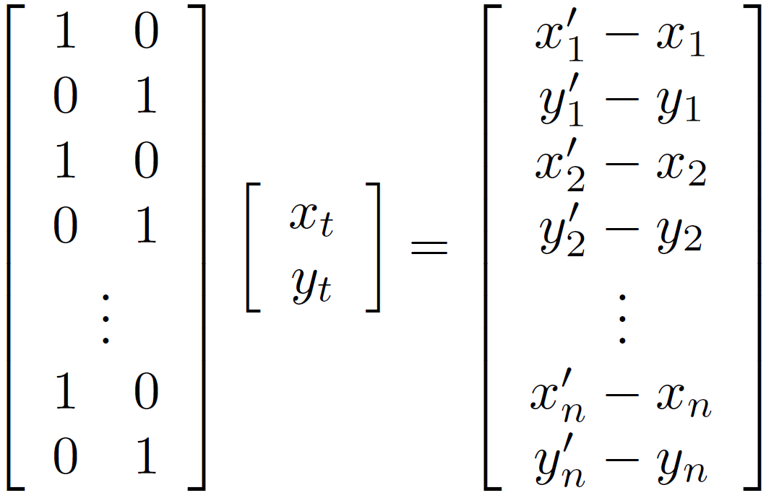
Solving for translations
Using least squares
2n x 2
2 x 1
2n x 1

Slide 16
Least squares
Find t that minimizes
To solve, form the normal equations

Slide 17
Affine transformations
How many unknowns?
How many equations per match?
x´ = ax + by + c; y´ = dx + ey +f
How many matches do we need?

Slide 18
Affine transformations
Residuals:
Cost function:

Slide 19
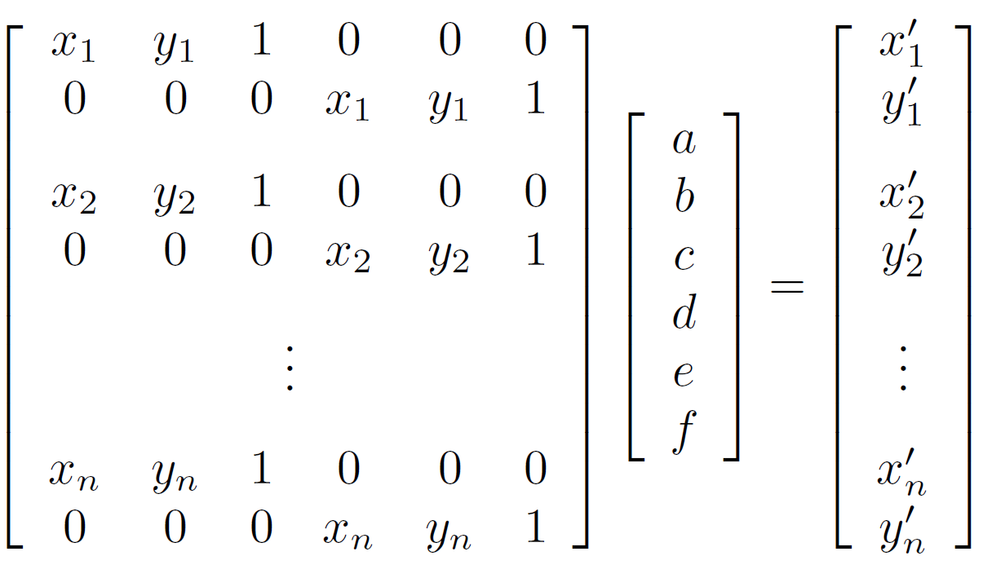
Affine transformations
Matrix form
2n x 6
6 x 1
2n x 1

Slide 20
Solving for homographies
Why is this now a variable and not just 1?
A homography is a projective object, in that it has no scale.
It is represented by the above matrix, up to scale.
One way of fixing the scale is to set one of the coordinates to 1,
though that choice is arbitrary.
But that’s what most people do and your assignment code does.

Slide 21
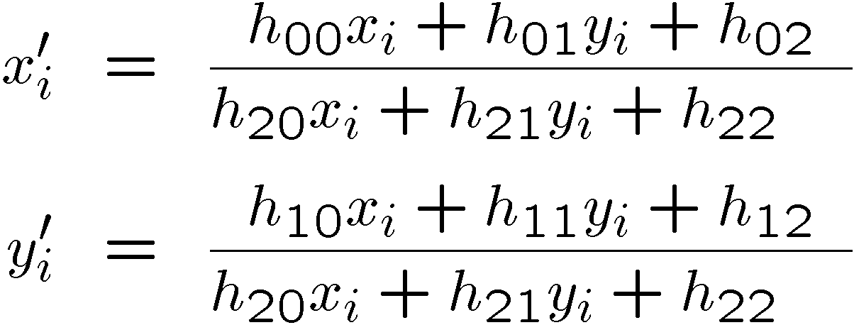
Solving for homographies
Why the division?

Slide 22
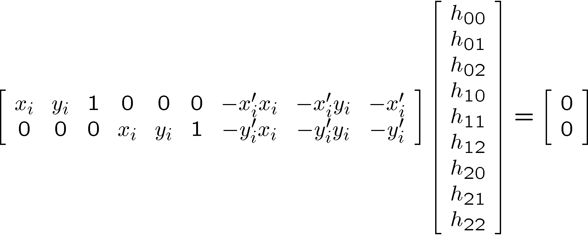
Solving for homographies
This is just for one pair of points.

Slide 23
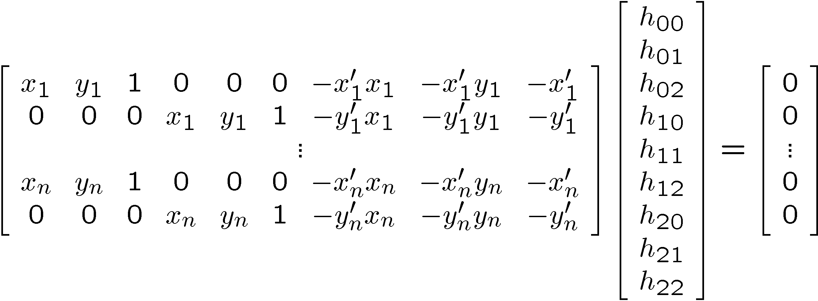
Direct Linear Transforms (n points)
2n × 9
9
2n
Defines a least squares problem:
Since is only defined up to scale, solve for unit vector
Solution: = eigenvector of with smallest eigenvalue
Works with 4 or more points

Slide 24
Direct Linear Transforms
Why could we not solve for the homography in exactly the same way we did for the affine transform, ie.

Slide 25
Answer from Sameer Agarwal (Dr. Rome in a Day)
For an affine transform, we have equations of the form Ax_{i} + b = y_{i}, solvable by linear regression.
For the homography, the equation is of the form
Hx̃_{i} ̴ ỹ_{i} (homogeneous coordinates)
and the ̴ means it holds only up to scale. The affine solution does not hold.

Slide 26
Matching features
What do we do about the “bad” matches?

Slide 27
RAndom SAmple Consensus
Select one match, count inliers
Inliers: matches that agree with a given match or (later) homography

Slide 28
RAndom SAmple Consensus
Select one match, count inliers

Slide 29
Least squares fit (from inliers)
Find “average” translation vector

Slide 30
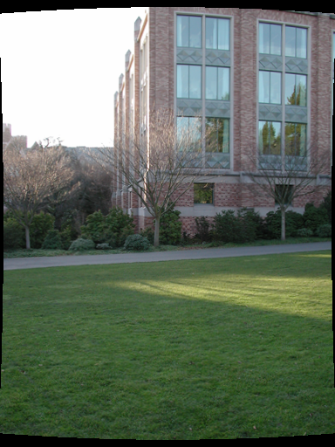
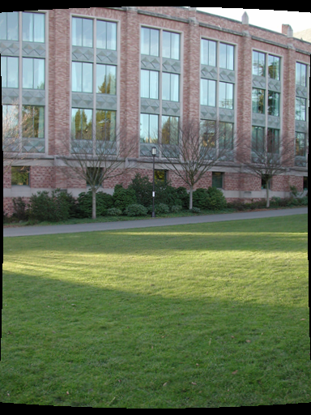

Slide 31
RANSAC for estimating homography
RANSAC loop:
Select four feature pairs (at random)
Compute homography H (exact)
Compute inliers where ||p_{i}´, H p_{i}|| < ε
Keep largest set of inliers
Re-compute least-squares H estimate using all of the inliers

Slide 32
Simple example: fit a line
Rather than homography H (8 numbers) fit y=ax+b (2 numbers a, b) to 2D pairs
32

Slide 33
Simple example: fit a line
Pick 2 points
Fit line
Count inliers
3 inliers
33

Slide 34
Simple example: fit a line
Pick 2 points
Fit line
Count inliers
4 inliers
34

Slide 35
Simple example: fit a line
Pick 2 points
Fit line
Count inliers
9 inliers
35

Slide 36
Simple example: fit a line
Pick 2 points
Fit line
Count inliers
8 inliers
36

Slide 37
Simple example: fit a line
Use biggest set of inliers
Do least-square fit
37

Slide 38
What still needs to be fixed?
The planar projections may not work so well
Your homework has extra credit for using cylindrical projections instead.
Here’s the idea.

Slide 39
Panorama algorithm:
Find corners in both images Calculate descriptors Match descriptors RANSAC to find homography Stitch together images with homography

Slide 40
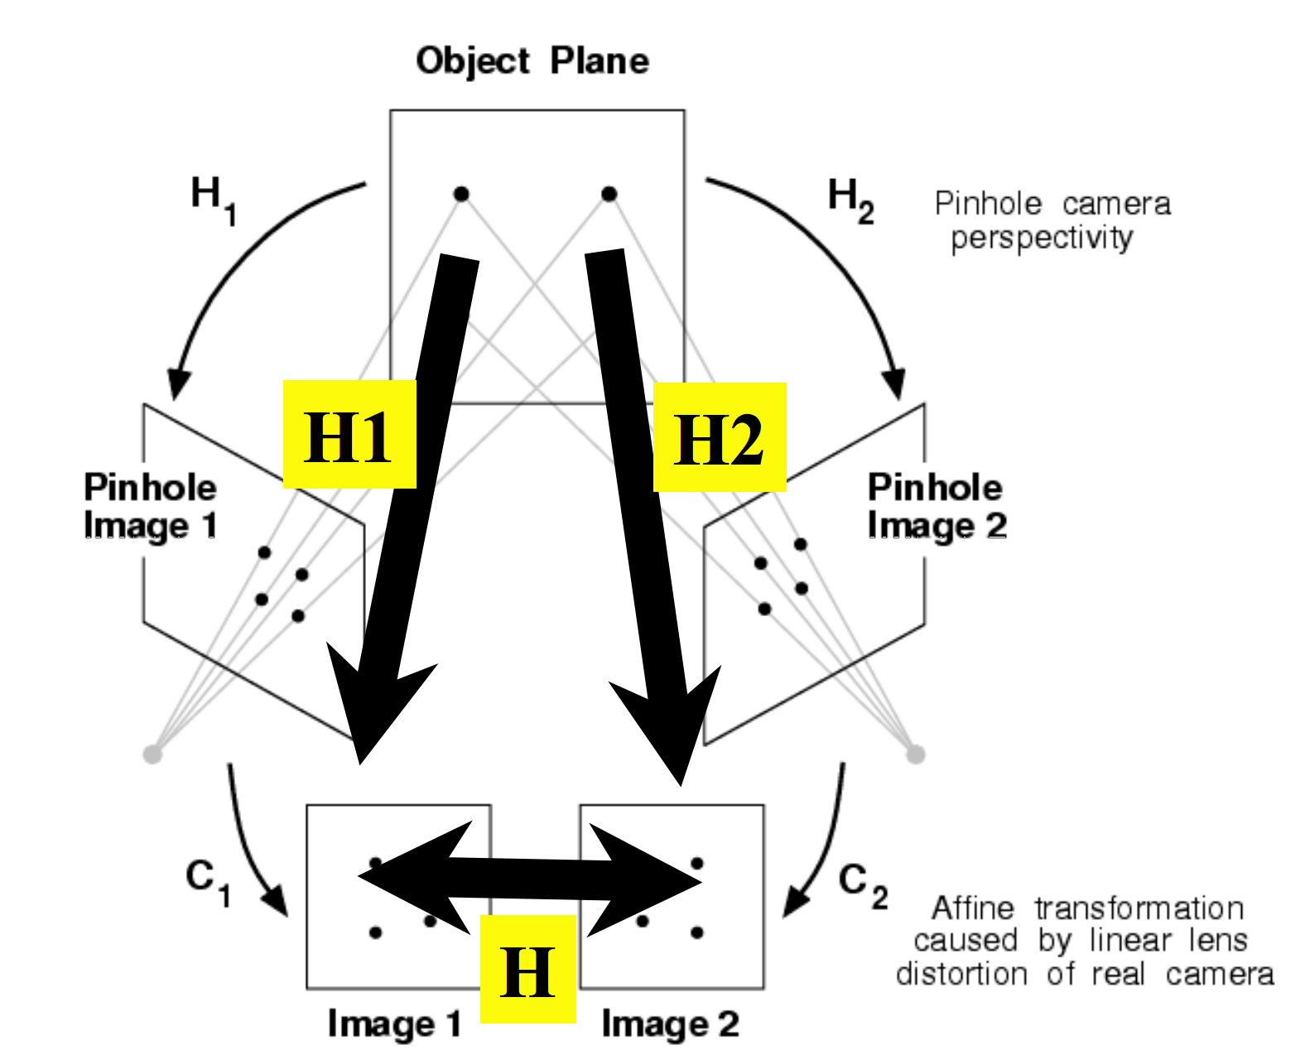
Stitching panoramas:
We know homography is right choice under certain assumption:
Assume we are taking multiple images of planar object
3D
homography H

Slide 41
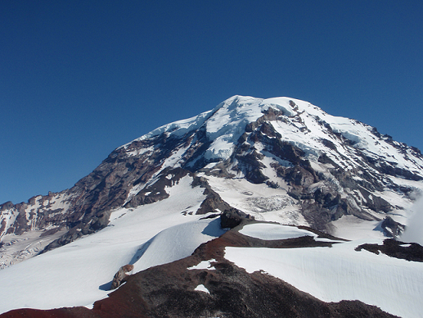
In practice:

Slide 42
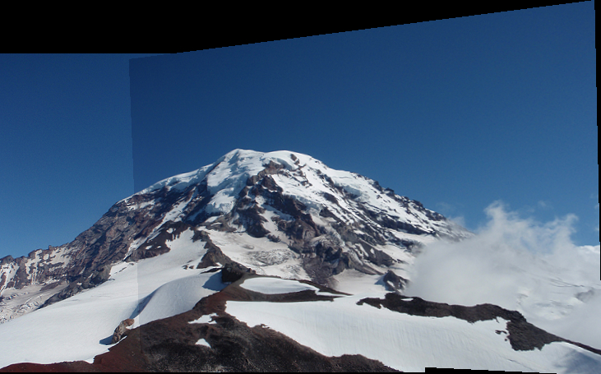
In practice:

Slide 43
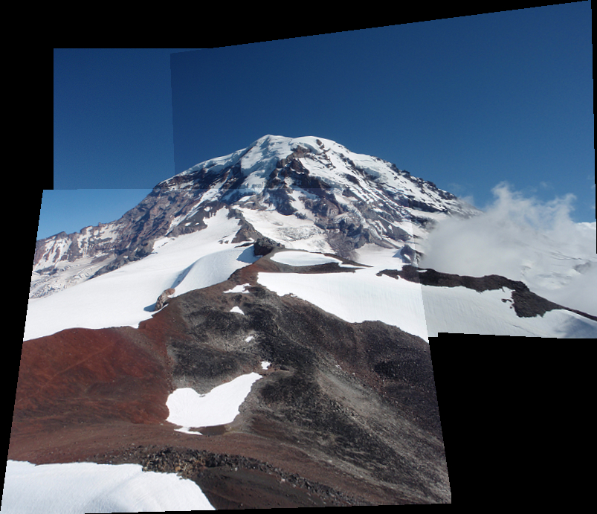
In practice:

Slide 44
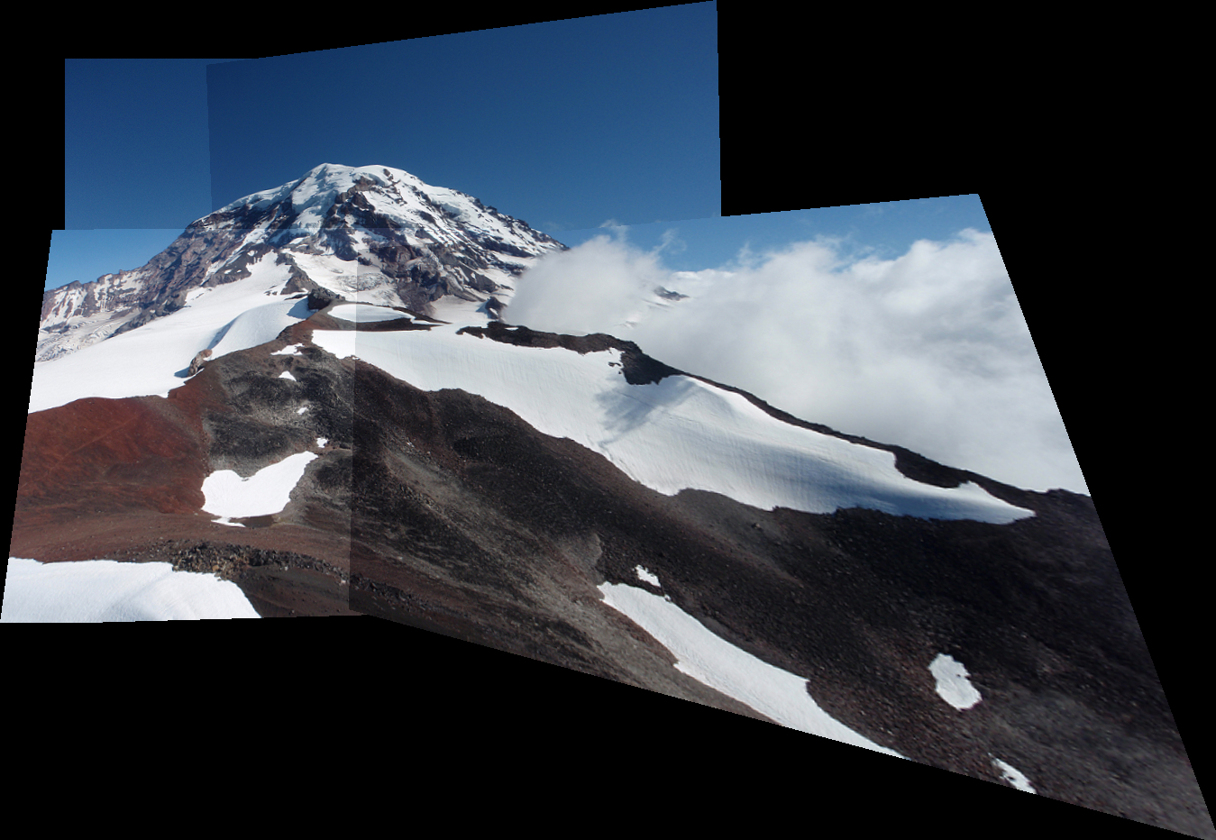
In practice:

Slide 45
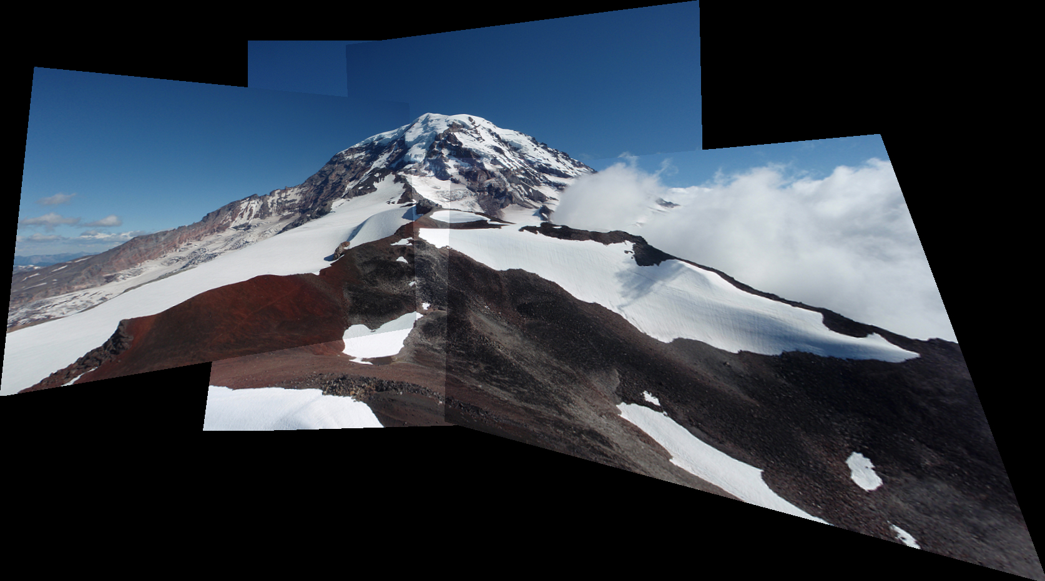
In practice:

Slide 46
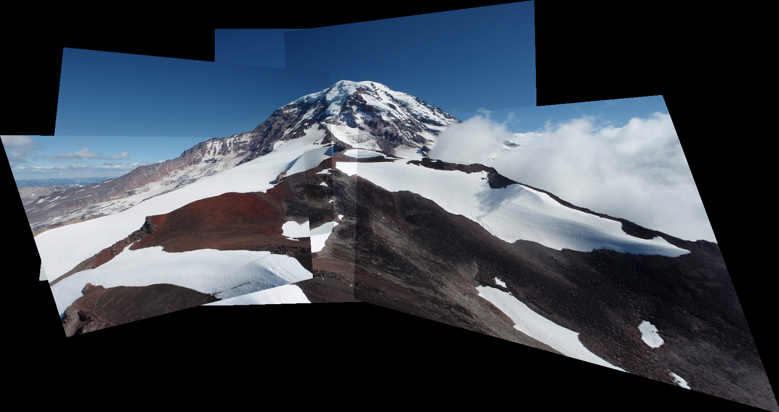
In practice:

Slide 47
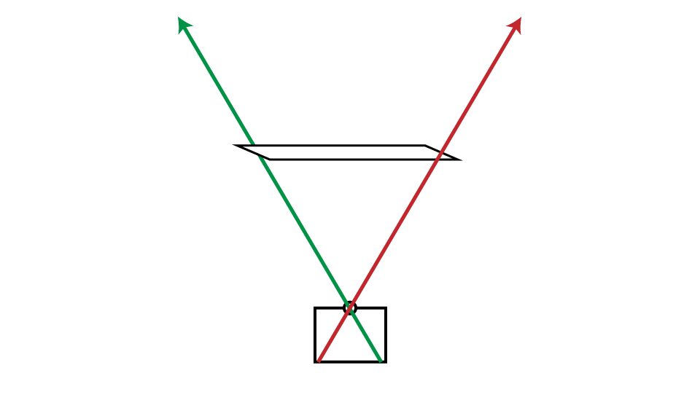
What’s happening?

Slide 48
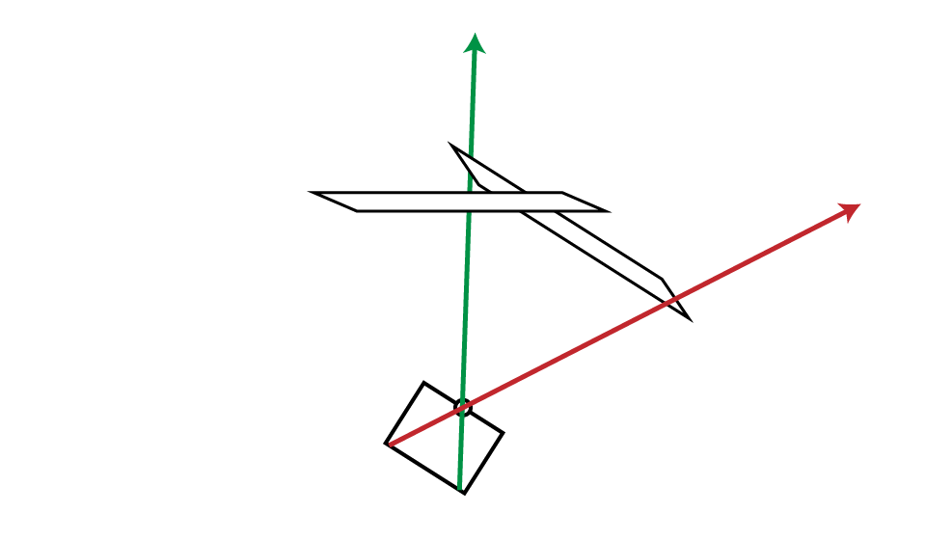
What’s happening?

Slide 49
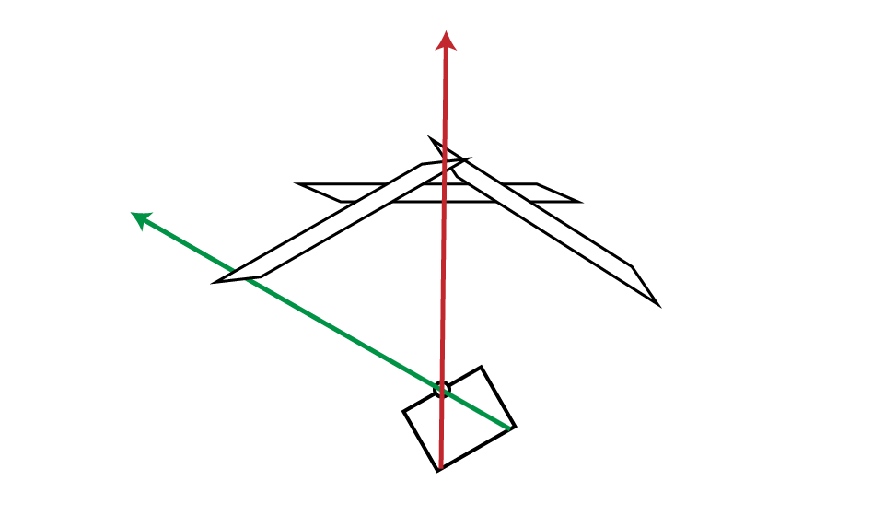
What’s happening?

Slide 50
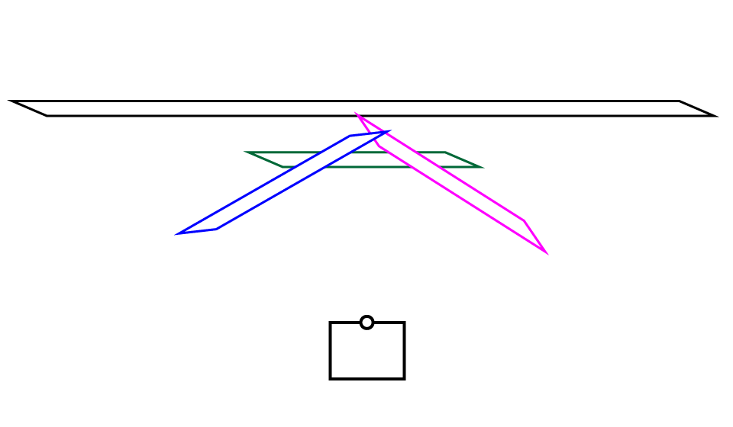
What’s happening?

Slide 51
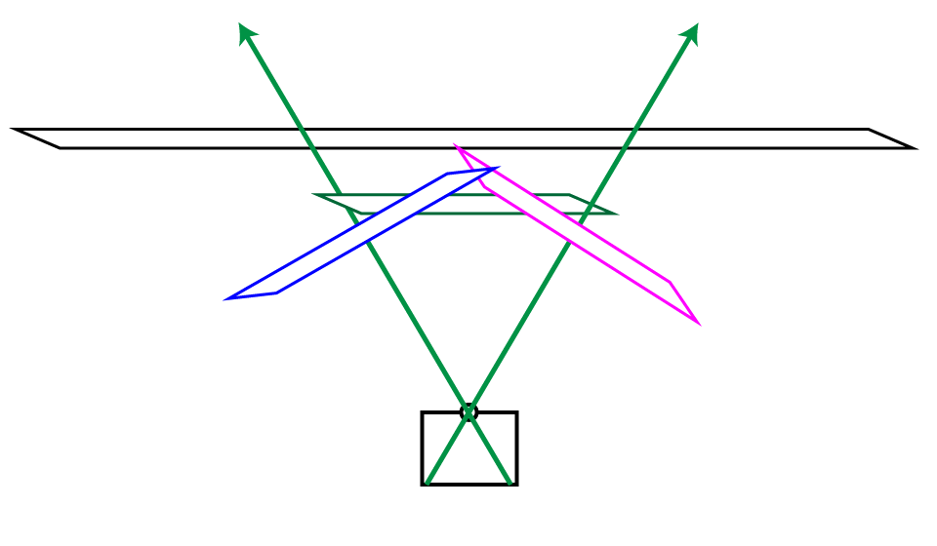
What’s happening?

Slide 52
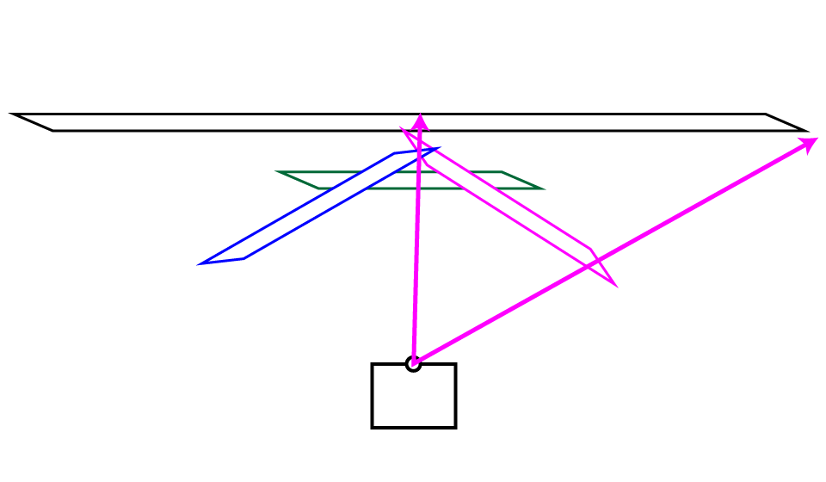
What’s happening?

Slide 53
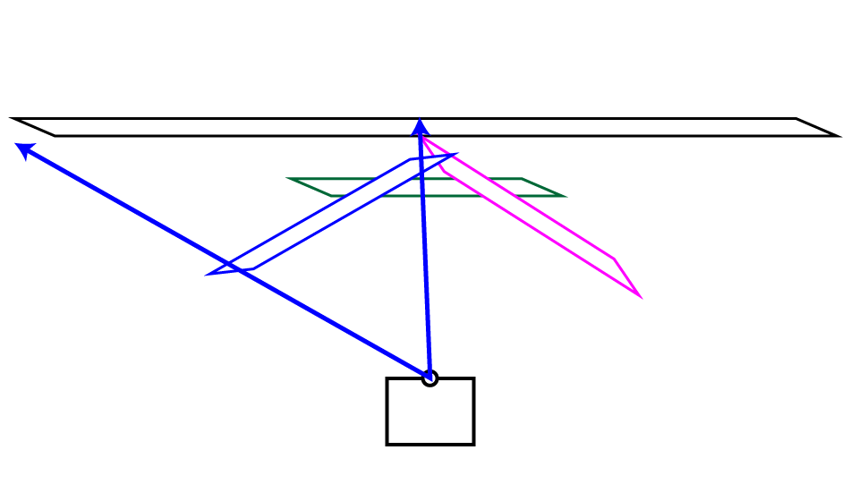
What’s happening?

Slide 54
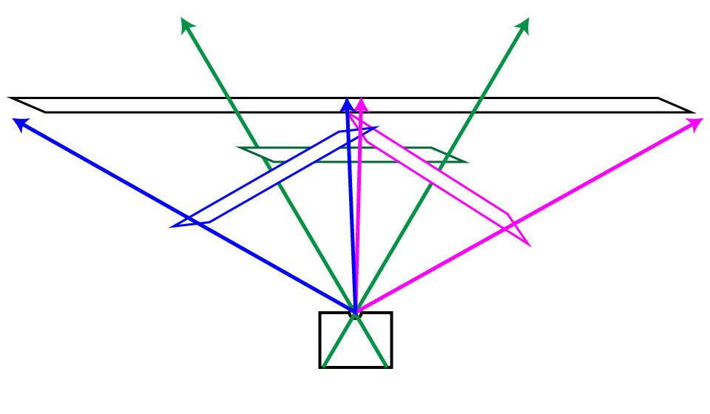
What’s happening?

Slide 55
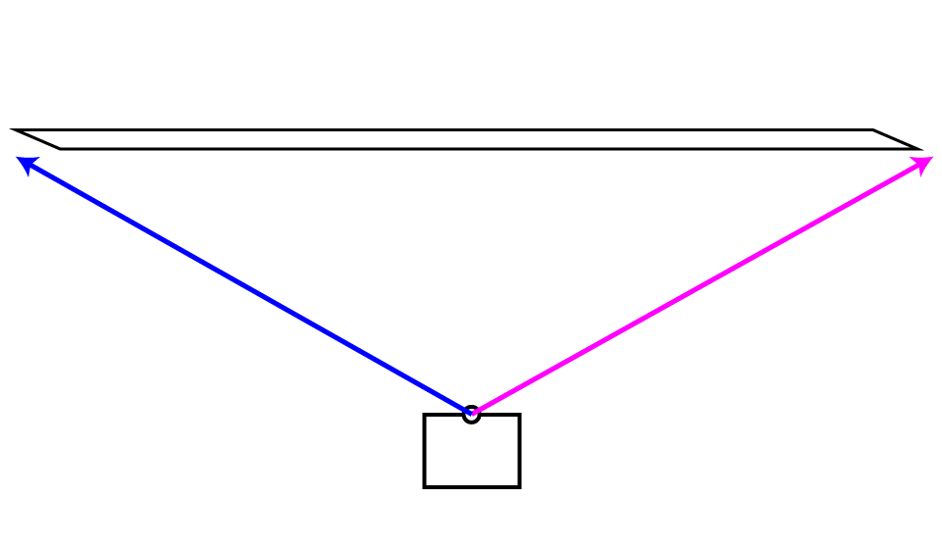
What’s happening?

Slide 56
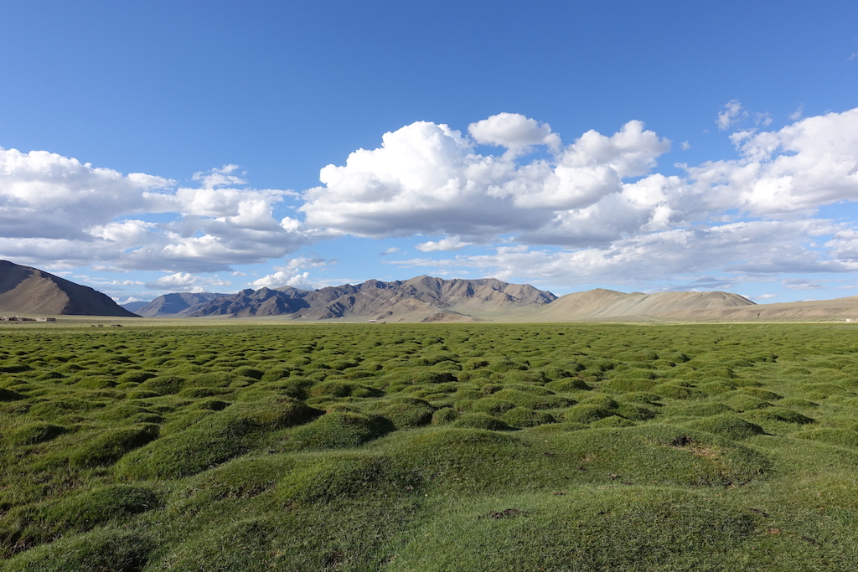
Very bad for big panoramas!

Slide 57
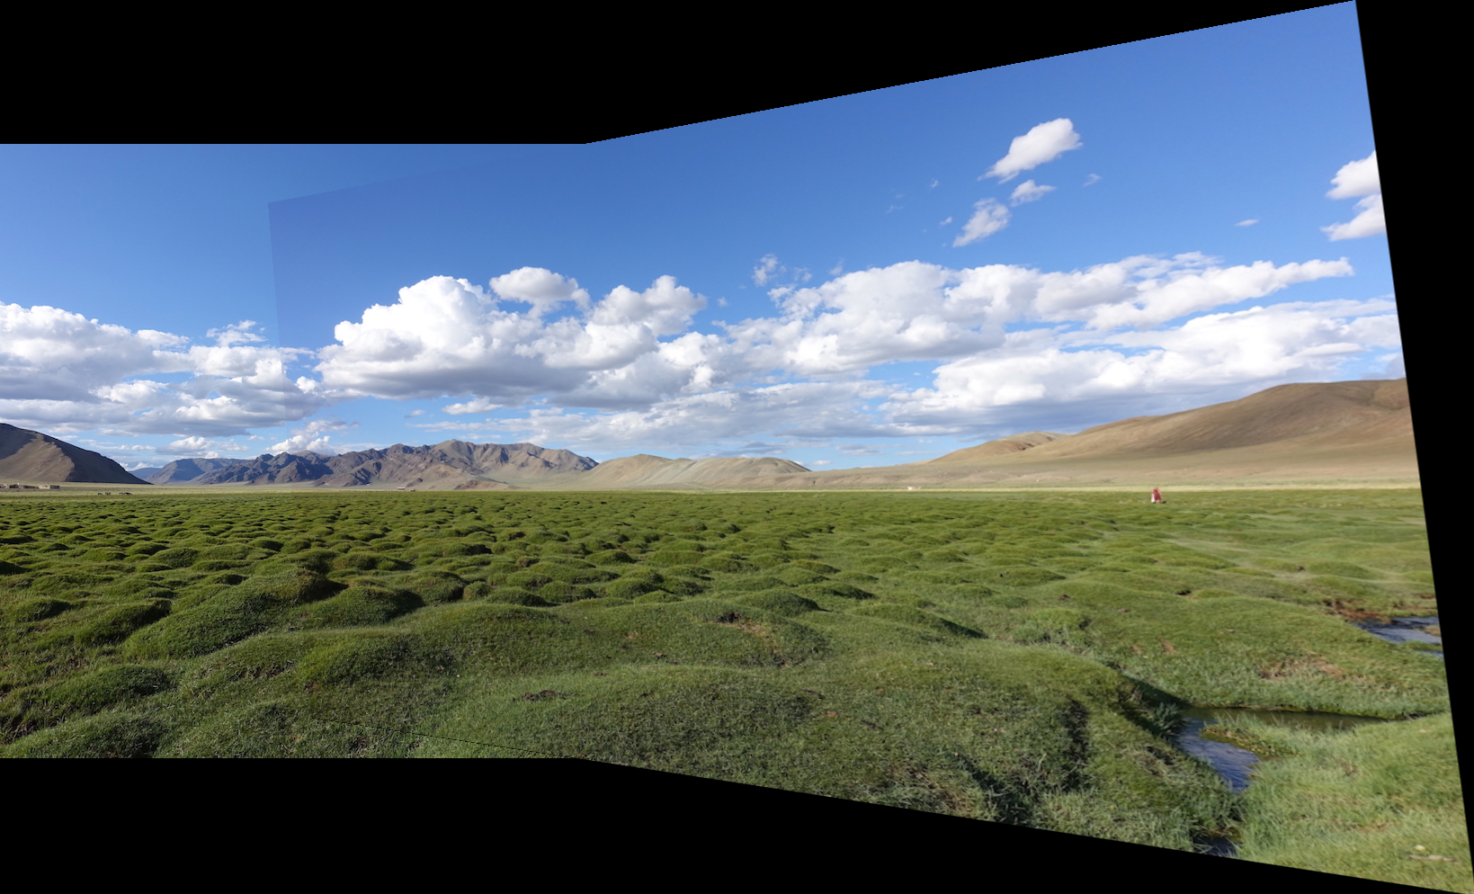
Very bad for big panoramas!

Slide 58
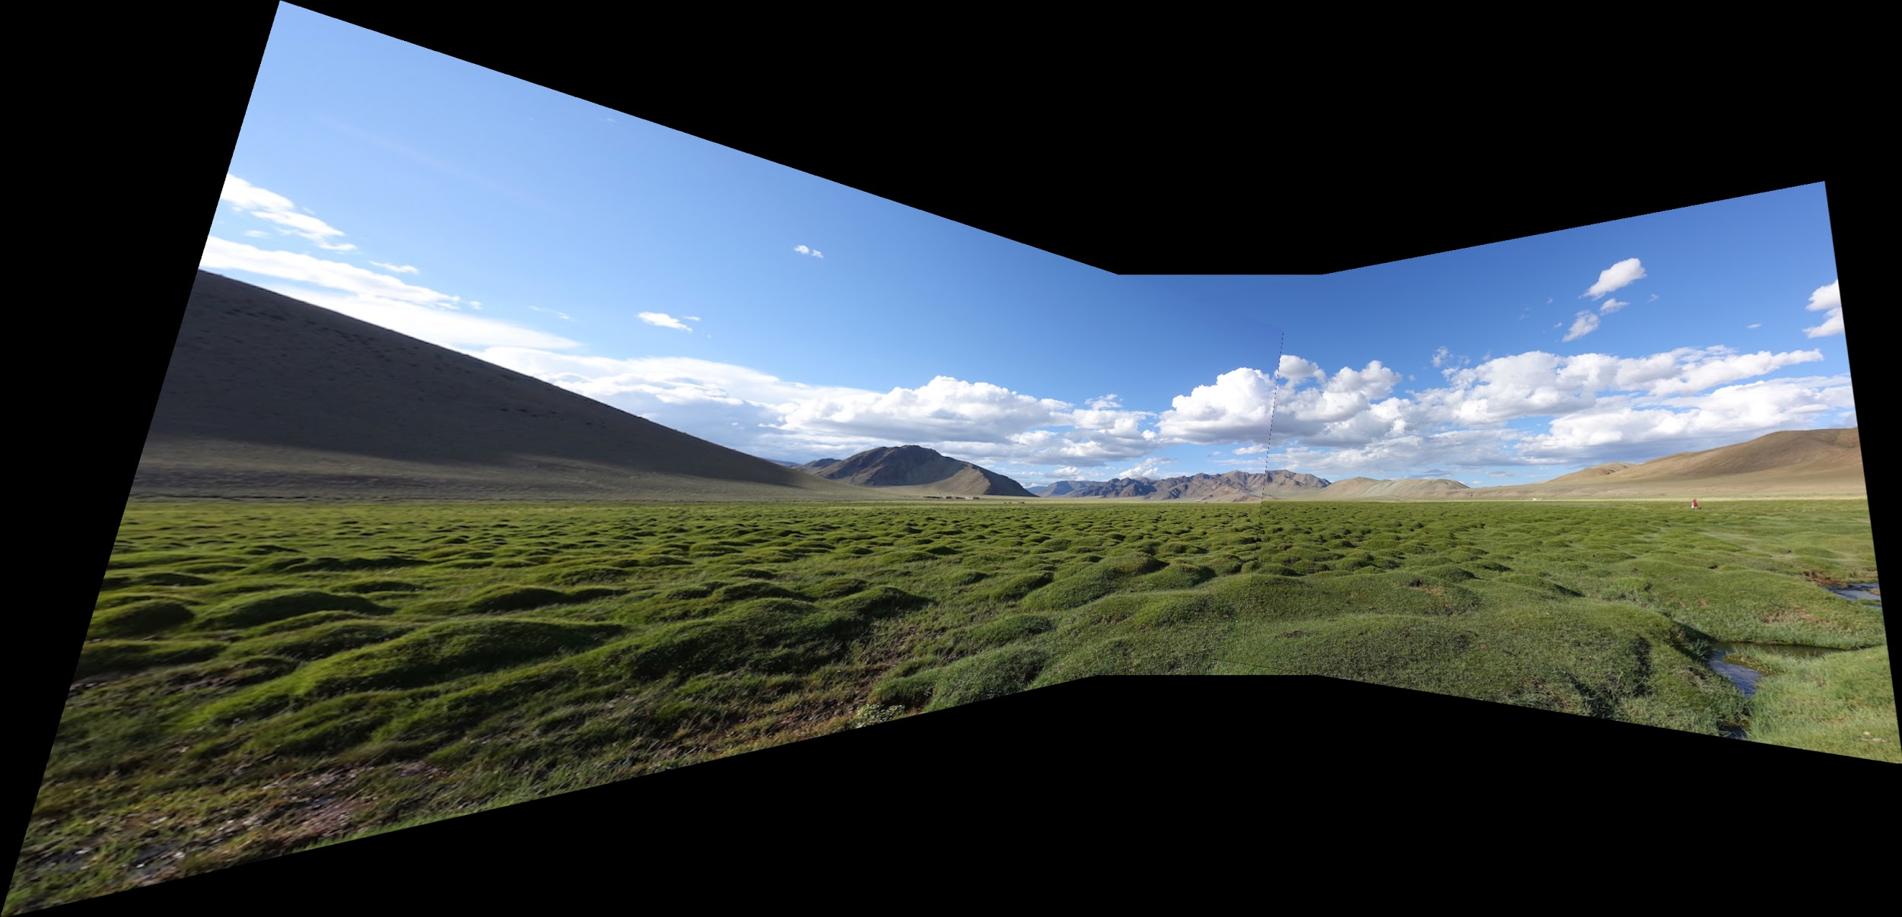
Very bad for big panoramas!

Slide 59
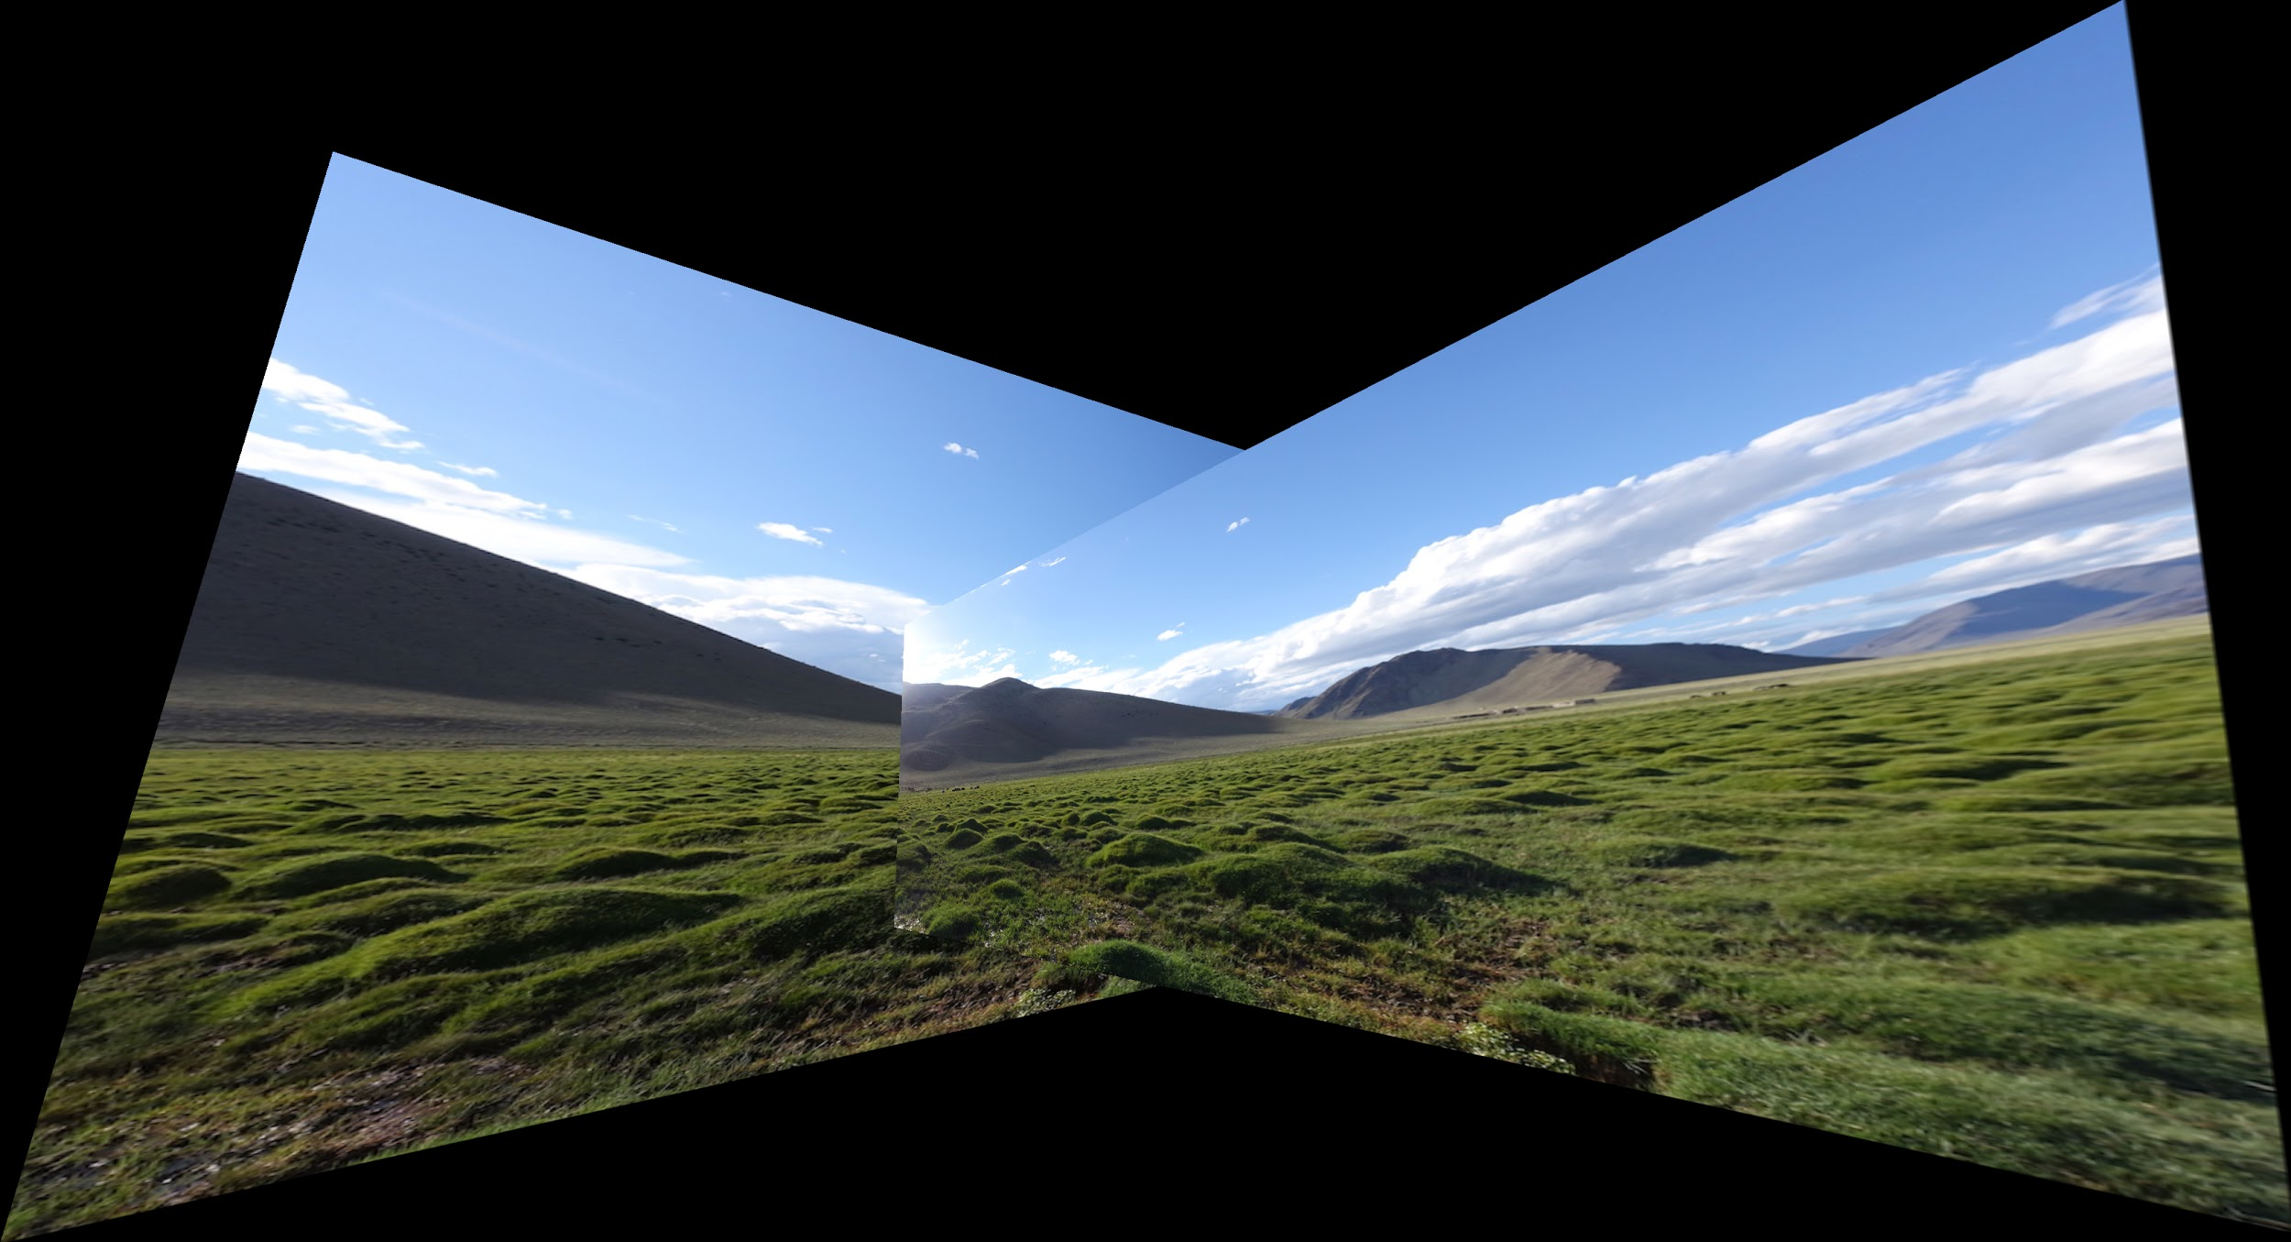
Fails :-(

Slide 60
How do we fix it? Cylinders!

Slide 61
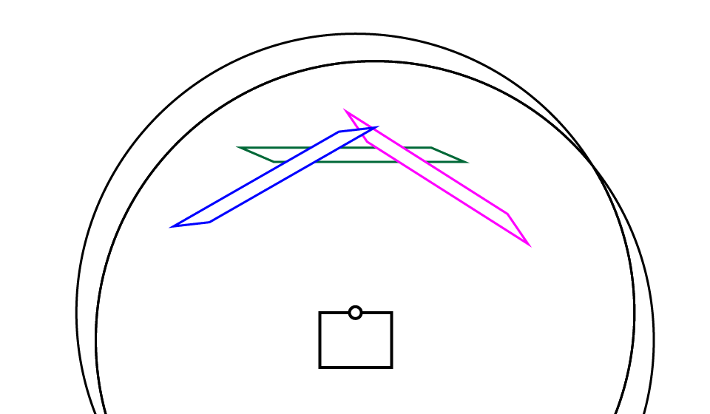
How do we fix it? Cylinders!

Slide 62
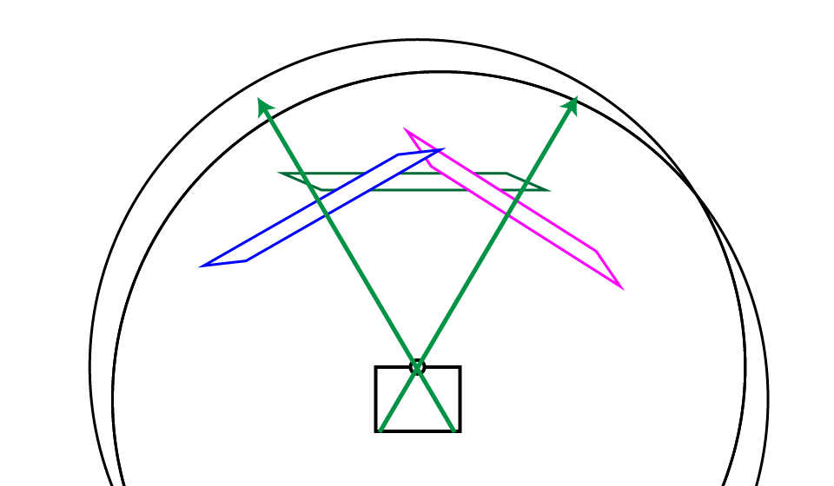
How do we fix it? Cylinders!

Slide 63
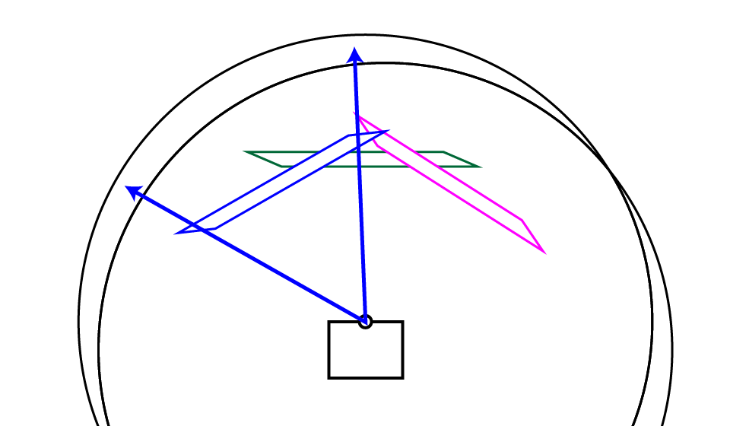
How do we fix it? Cylinders!

Slide 64
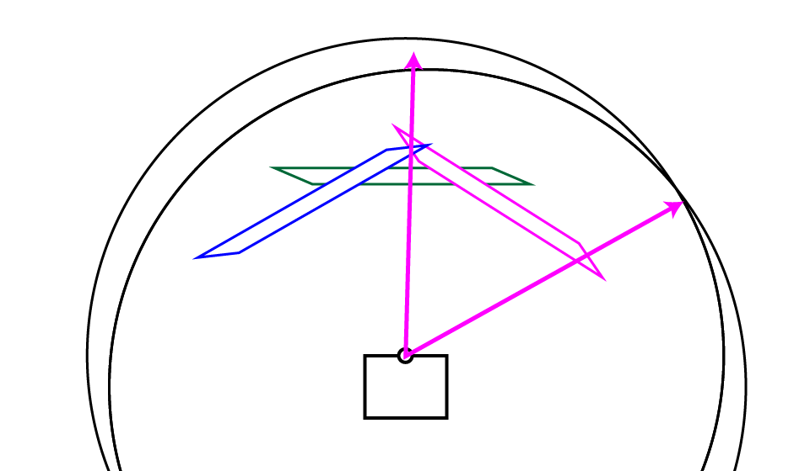
How do we fix it? Cylinders!

Slide 65
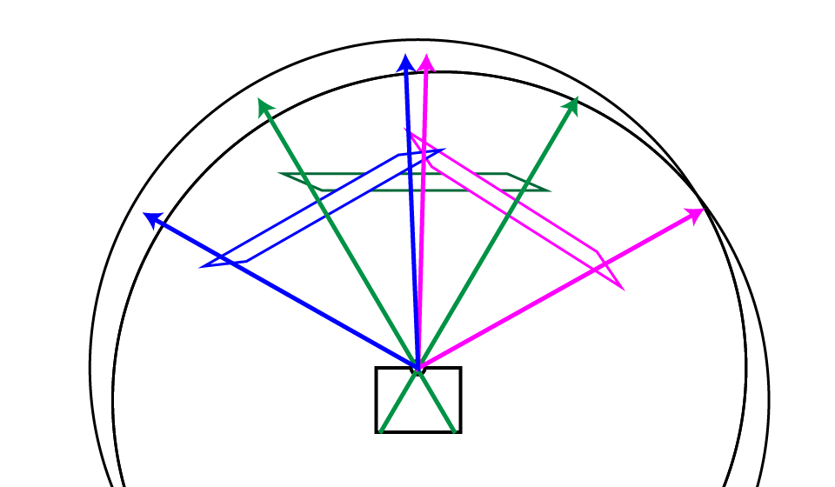
How do we fix it? Cylinders!

Slide 66
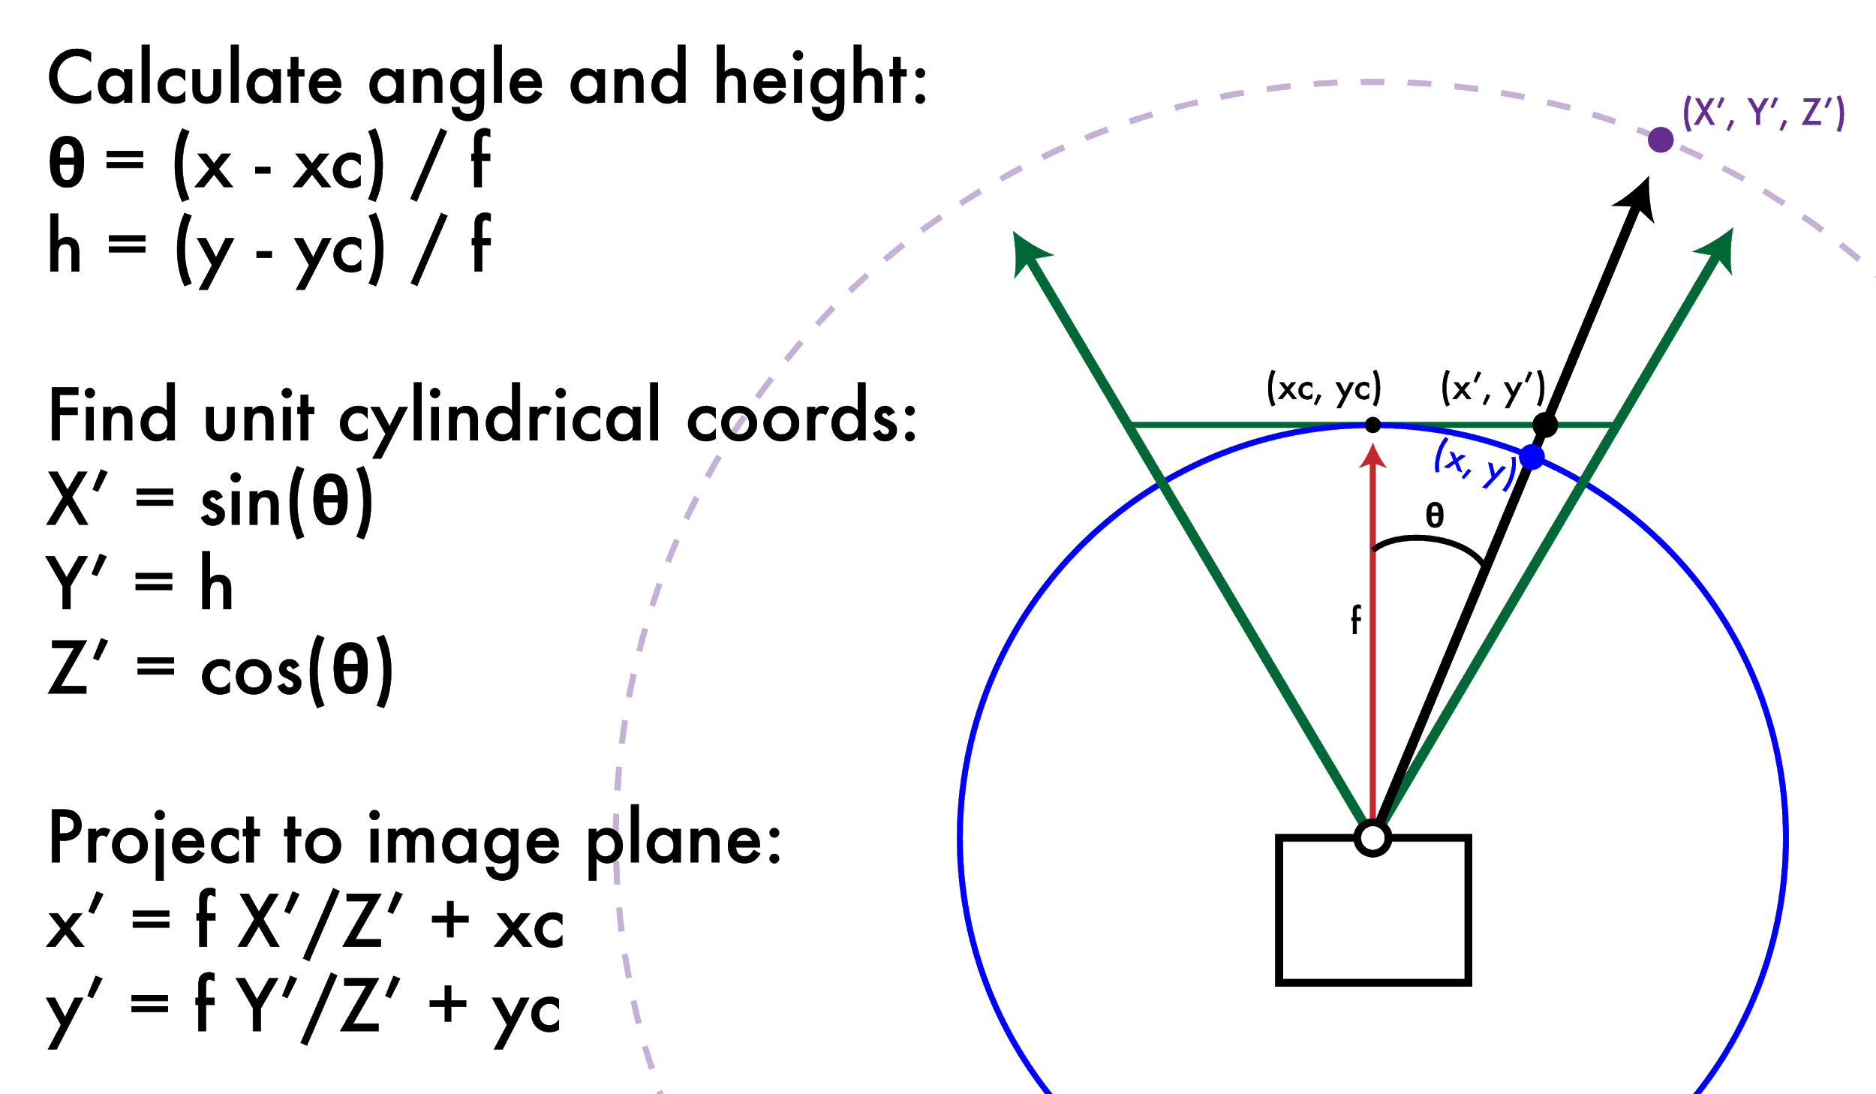
How do we fix it? Cylinders!
(xc,yc) = center of projection and f = focal length of camera

Slide 67
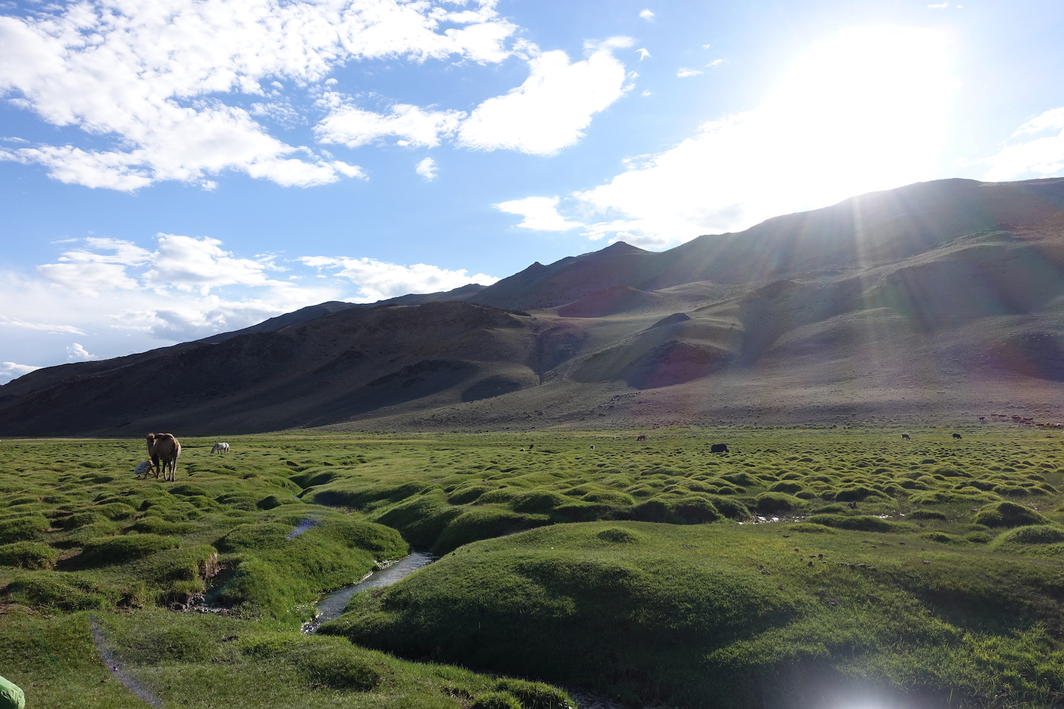
Dependant on focal length!

Slide 68
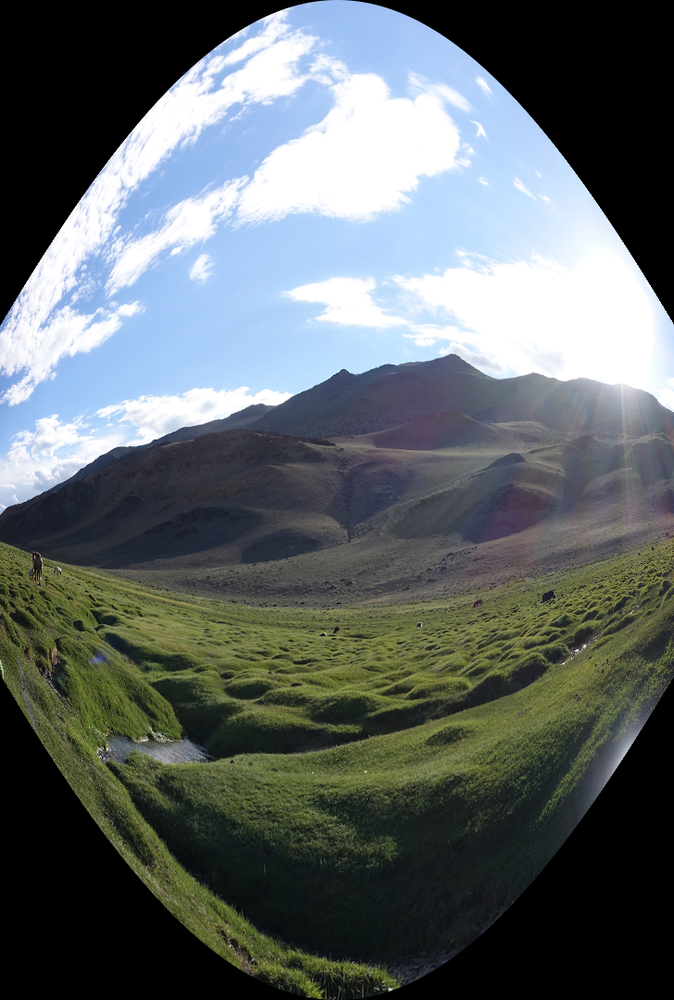
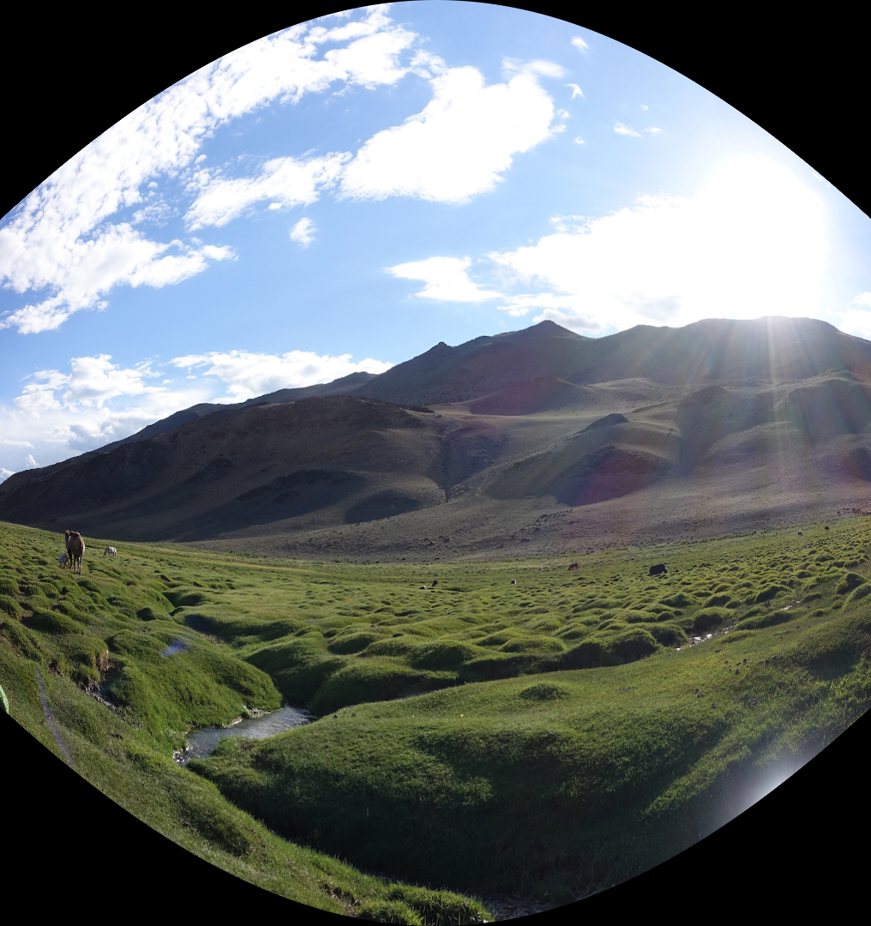
f = 300 f = 500

Slide 69
f = 1000

Slide 70
f = 1400

Slide 71
f = 10,000

Slide 72
f = 10,000

Slide 73
Does it work?

Slide 74
Does it work?

Slide 75
Does it work?

Slide 76
Does it work?

Slide 77
Does it work?

Slide 78
Does it work? Yay!

Slide 79
Where are we?
We are going to build a panorama from two (or more) images.
We need to learn about
Finding interest points
Describing small patches about such points
Finding matches between pairs of such points on two images, using the descriptors
Selecting the best set of matches and saving them
Constructing homographies (transformations) from one image to the other and picking the best one
Stitching the images together to make the panorama

Slide 80
RANSAC for Homography
Initial Matched Points

Slide 81
RANSAC for Homography
Final Matched Points

Slide 82
RANSAC for Homography

Slide 83
Image Blending
What’s wrong?

Slide 84
Feathering
+
1
1
0
ramp
0
=

Slide 85
Effect of window (ramp-width) size
1
left
1
right
0
0

Slide 86
Effect of window size
1
1
0
0

Slide 87
Good window size
1
What can we do
instead?
0
“Optimal” window: smooth but not ghosted
Doesn’t always work...

Slide 88
Pyramid blending
apple
orange
Create a Laplacian pyramid, blend each level
Burt, P. J. and Adelson, E. H., A Multiresolution Spline with Application to Image Mosaics, ACM Transactions on Graphics, 42(4), October 1983, 217-236. http://persci.mit.edu/pub_pdfs/spline83.pdf

Slide 89
Alpha Blending
I₃
p
I₁
Optional: see Blinn (CGA, 1994) for details:
http://ieeexplore.ieee.org/iel1/38/7531/00310740.pdf?isNumber=7531&prod=JNL&arnumber=310740&arSt=83&ared=87&arAuthor=Blinn%2C+J.F.
I₂
Encoding blend weights: I(x,y) = (αR, αG, αB, α )
color at p =
Implement this in two steps:
1. accumulate: add up the (α premultiplied) RGB values at each pixel
2. normalize: divide each pixel’s accumulated RGB by its α value
Notes:
A: render as black

Slide 90
Gain Compensation: Getting rid of artifacts
Simple gain adjustment
Compute average RGB intensity of each image in overlapping region
Normalize intensities by ratio of averages

Slide 91
Blending Comparison

Slide 92
Recognizing Panoramas
Some of following material from Brown and Lowe 2003 talk
Brown and Lowe 2003, 2007

Slide 93
Recognizing Panoramas
Input: N images
Extract SIFT points, descriptors from all images
Find K-nearest neighbors for each point (K=4)
For each image
Select M candidate matching images by counting matched keypoints (m=6)
Solve homography H_{ij} for each matched image

Slide 95
Recognizing Panoramas
Input: N images
Extract SIFT points, descriptors from all images
Find K-nearest neighbors for each point (K=4)
For each image
Select M candidate matching images by counting matched keypoints (m=6)
Solve homography H_{ij} for each matched image
Decide if match is valid (n_{i} > 8 + 0.3 n_{f} )
# inliers
# keypoints in overlapping area

Slide 96
Recognizing Panoramas (cont.)
(now we have matched pairs of images)
Make a graph of matched pairs
Find connected components of the graph

Slide 97
Finding the panoramas

Slide 98
Finding the panoramas

Slide 99
Recognizing Panoramas (cont.)
(now we have matched pairs of images)
Find connected components
For each connected component
Solve for rotation and f
Project to a surface (plane, cylinder, or sphere)
Render with multiband blending

Slide 100
Finding the panoramas

Slide 101
Homework 3
CREATING PANORAMAS!

Slide 102
Useful structures (defined in image.h)
Data structure for an point
typedef struct{
float x, y;
} point;
Data structure for a descriptor
typedef struct{
point p; <-pixel location
int n; <-size of data
float *data;
} descriptor;
Data structure for a match
typedef struct{
point p, q; <-matching
points
int ai, bi; <-matching indices of descriptor arrays
float distance; <-dist.
between matching descriptors
} match;

Slide 103
Overall algorithm
image panorama_image(image a, image b, float sigma, float thresh, int nms, float inlier_thresh, int iters, int cutoff)
{
// Calculate corners and descriptors descriptor *ad = harris_corner_detector(a, sigma, thresh, nms, &an);
descriptor *bd = harris_corner_detector(b, sigma, thresh, nms, &bn);
// Find matches
match *m = match_descriptors(ad, an, bd, bn, &mn);
// Run RANSAC to find the homography
matrix H = RANSAC(m, mn, inlier_thresh, iters, cutoff);
// Stitch the images together with the homography
image combine = combine_images(a, b, H);
return combine;
}

Slide 104
1. Harris corner detection
TODO #1.1: Compute structure matrix S
TODO #1.2: Compute cornerness response map R from structure matrix S
TODO #1.3: Find local maxes in map R using non-maximum suppression
TODO #1.4: Compute descriptors for final corners

Slide 105
TODO #1.1: structure matrix
Compute Ix and Iy using Sobel filters from HW2
Create an empty image of 3 channels
Assign channel 1 to Ix²
Assign channel 2 to Iy²
Assign channel 3 to Ix * Iy
Compute weighted sum of neighbors
smooth the image with a gaussian of given sigma

Slide 106
TODO #1.2: response map
For each pixel of the given structure matrix S:
Get Ix², Iy² and IxIy from the 3 channels
Compute Det(S) = Ix² * Iy² – IxIy * IxIy
Compute Tr(S) = Ix² + Iy²
Compute R = Det(S) – 0.06 * Tr(S) * Tr(S)

Slide 107
TODO #1.3: NMS
For each pixel ‘p’ of the given response map R
get value(p)
loop over all neighboring pixels ‘q’ in a 2w+1 window
+/- w around the current pixel location
if value(q) > value (p), value(p) = -99999 (very low)
set ‘p’ to value(p)

Slide 108
TODO #1.4: corner descriptors
Given: Response map after NMS
Initialize count; loop over each pixel
if pixel value > threshold, increment count
Initialize descriptor array of size ‘count’
Loop over each pixel again
if pixel value > threshold, create descriptor for that pixel
use make_descriptor() defined in panorama_helpers.c
add this new descriptor to the array

Slide 109
2. Matching descriptors
TODO #2.1: Find best matches from descriptor array “a” to descriptor array “b”
TODO #2.2: Eliminate duplicate matches to ensure one-to-one match between “a” and “b”

Slide 110
TODO #2.1: best matches
For each descriptor ‘a_{r}’ in array ‘a’:
initialize min_distance and best_index
for each descriptor ‘b_{s}’ in array ‘b’:
compute L1 distance between a_{r} and b_{s}
sum of absolute differences
if distance < min_distance:
update min_distance and best_index

Slide 111
TODO #2.2: remove duplicates
Initialize an array of 0s called ‘seen’
Loop over all matches:
if b-index of current match is ≠1 in ‘seen’
set the corresponding value in ‘seen’ to 1
retain the match
else, discard the match

Slide 112
3. Perform RANSAC
TODO #3.1: Implement projecting a point given a homography
TODO #3.2: Compute inliers from an array of matches (using 3.1)
TODO #3.3: Implement RANSAC algorithm

Slide 113
TODO #3.1: point projection
Given point p, set matrix c_{3x1} = [x-coord, y-coord,1]
Compute M_{3x1} = H_{3x3}* c_{3x1} with given Homography
Compute x,y coordinates of a point ’q’:
x-coord: M[0] / M[2]
y-coord: M[1] / M[2]
Return point ‘q’

Slide 114
TODO #3.2: model inliers
Loop over each match from array of matches (starting from end):
project point ‘p’ of match using given ‘H’
compute L2 distance between point ‘q’ of match and the projected point
if distance < given threshold:
it is an inlier; bring match to the front of array
update inlier count

Slide 115
TODO #3.3: implement RANSAC
For each iteration:
compute homography with 4 random matches
call compute_homography() with argument 4
if homography is empty matrix, continue
else compute inliers with this homography
if #inliers > max_inliers:
compute new homography with all inliers
update best_homography with this new homography
update max_inliers with #inliers computed with this new homography unless new homography is empty
if updated max_inliers > given cutoff: return best_homography
Return best_homography

Slide 116
4. Combine images
Project corners of image ‘b’ and create a big empty image ‘c’ to place image ‘a’ and projected ‘b’. This part is given in the code.
For each pixel in image ‘a’, get pixel value and assign it to ‘c’ after proper offset
For each pixel in image ’c’ within projected bounds:
project to image ‘b’ using given homography
get pixel value at projected location using bilinear interpolation
assign the value to ’c’ after proper offset

Slide 117
5. Extra Credit
Stitch together more than 2 images to create a big panorama. See rainier_panorama() in tryhw3.py
…
2 images 3 images

Slide 118
6. Super Extra Credit
Implement cylindrical projection for an image
See lecture slides for the formula

Slide 119
Have Fun

