Slide 1
Recall
Application layer protocols are often part of an “app”
  But don’t need a GUI, e.g., DNS
app
User-level
HTTP
OS
TCP
IP
(NIC)
802.11

Slide 2
Recall (2)
Application layer messages are often split over multiple packets
  Or may be aggregated in a packet …
HTTP
802.11
IP
TCP
HTTP
802.11
IP
TCP
HTTP
802.11
IP
TCP
HTTP

Slide 3
Application Communication Needs
Vary widely with app; must build on Transport services
Later
Web
Message reliability!
Series of variable length, reliable request/reply exchanges
Skype
DNS
Real-time (unreliable) stream delivery
Short, reliable request/reply exchanges
TCP
UDP
UDP

Slide 4
Evolution of Internet Applications
Always changing, and growing …
???
Traffic
Web (Video)
P2P (BitTorrent)
Web (CDNs)
Web (HTTP)
News (NTTP)
Email
Email (SMTP)
File Transfer (FTP)
Telnet
Secure Shell (ssh)
1970
1980
1990
2000
2010

Slide 5
Evolution of Internet Applications (2)
For a peek at the state of the Internet:
  Akamai’s State of the Internet Report (quarterly)
  Cisco’s Visual Networking Index
  Mary Meeker’s Internet Report
Robust Internet growth, esp. video, wireless and mobile
  Most traffic is video, will be 90% of Internet in a few years
  Wireless traffic will soon overtake wired traffic
  Mobile traffic is still a small portion (15%) of overall
  Growing attack traffic from China, also U.S. and Russia

Slide 6
Topic
The DNS (Domain Name System)
  Human-readable host names, and more
  Part 1: the distributed namespace
www.uw.edu?
128.94.155.135
Network
Notes:
CN5E slides #5-10

Slide 7

Names and Addresses
Names are higher-level identifiers for resources
Addresses are lower-level locators for resources
  Multiple levels, e.g. full name → email → IP address → Ethernet address
Resolution (or lookup) is mapping a name to an address
Name, e.g.
“Andy Tanenbaum,”
or “flits.cs.vu.nl”
Address, e.g.
“Vrijie Universiteit, Amsterdam”
or IPv4 “130.30.27.38”
Lookup
Directory

Slide 8
Before the DNS – HOSTS.TXT
Directory was a file HOSTS.TXT regularly retrieved for all hosts from a central machine at the NIC (Network Information Center)
Names were initially flat, became hierarchical (e.g., lcs.mit.edu) ~85
Neither manageable nor efficient as the ARPANET grew …

Slide 9
DNS
A naming service to map between host names and their IP addresses (and more)
  www.uwa.edu.au → 130.95.128.140
Goals:
  Easy to manage (esp. with multiple parties)
  Efficient (good performance, few resources)
Approach:
  Distributed directory based on a hierarchical namespace
  Automated protocol to tie pieces together

Slide 10
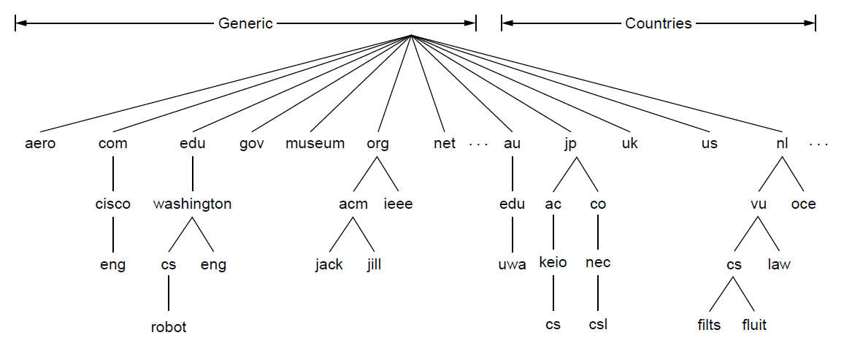
DNS Namespace
Hierarchical, starting from “.” (dot, typically omitted)
Notes:
CN5E slides #7-4. Spell out name robot.cs.washington.edu

Slide 11
TLDs (Top-Level Domains)
Run by ICANN (Internet Corp. for Assigned Names and Numbers)
  Starting in ‘98; naming is financial, political, and international ☺
22+ generic TLDs
  Initially .com, .edu , .gov., .mil, .org, .net
  Added .aero, .museum, etc. from ’01 through .xxx in ’11
  Different TLDs have different usage policies
~250 country code TLDs
  Two letters, e.g., “.au”, plus international characters since 2010
  Widely commercialized, e.g., .tv (Tuvalu)
  Many domain hacks, e.g., instagr.am (Armenia), goo.gl (Greenland)

Slide 12
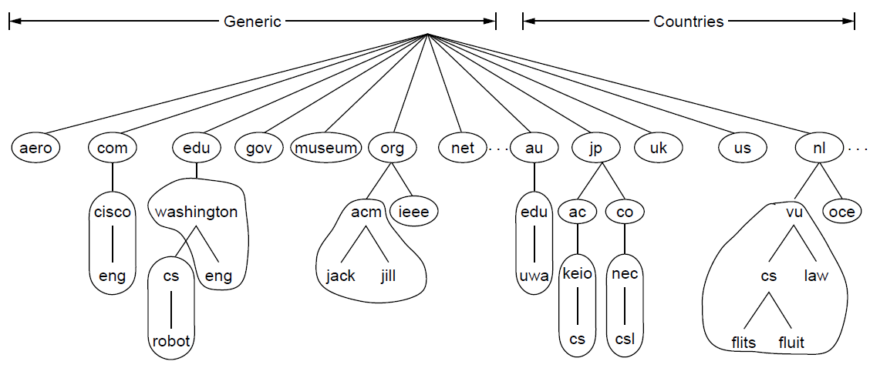
DNS Zones
A zone is a contiguous portion of the namespace
Delegation
A zone
Notes:
CN5E slides #7-8

Slide 13
DNS Zones (2)
Zones are the basis for distribution
  EDU Registrar administers .edu
  UW administers washington.edu
  CS&E administers cs.washington.edu
Each zone has a nameserver to contact for information about it
  Zone must include contacts for delegations, e.g., .edu knows nameserver for washington.edu

Slide 14
DNS Resource Records
A zone is comprised of DNS resource records that give information for its domain names
Type | Meaning
SOA | Start of authority, has key zone parameters
A | IPv4 address of a host
AAAA (“quad A”) | IPv6 address of a host
CNAME | Canonical name for an alias
MX | Mail exchanger for the domain
NS | Nameserver of domain or delegated subdomain
Notes:
CN5E figures #7-4

Slide 15
DNS Resolution
DNS protocol lets a host resolve any host name (domain) to IP address
If unknown, can start with the root nameserver and work down zones
Let’s see an example first …

Slide 16
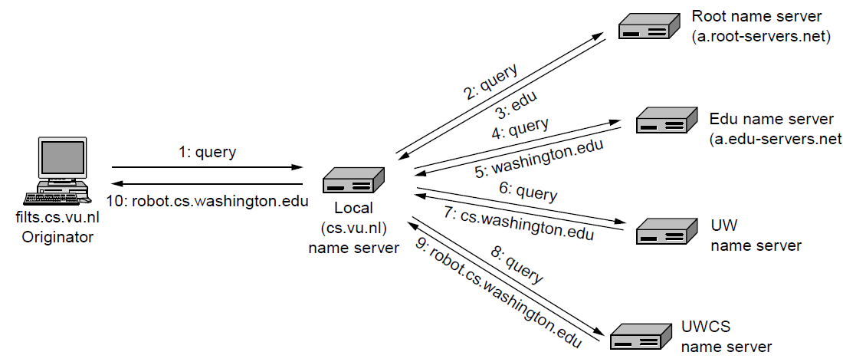
DNS Resolution (2)
flits.cs.vu.nl resolves robot.cs.washington.edu
Notes:
CN5E slides #10-88

Slide 17
Caching
Resolution latency should be low
  Adds delay to web browsing
Cache query/responses to answer future queries immediately
  Including partial (iterative) answers
  Responses carry a TTL for caching
query
out
Cache
response
Nameserver
Notes:
CN5E slides #10-88

Slide 18
Caching (2)
flits.cs.vu.nl now resolves eng.washington.edu
  And previous resolutions cut out most of the process
I know the server for washington.edu!
1: query
2: query
Cache
4: eng.washington.edu
3: eng.washington.edu
Local nameserver
(for cs.vu.nl)
UW nameserver
(for washington.edu)
Notes:
CN5E slides #10-88

Slide 19
Local Nameservers
Local nameservers typically run by IT (enterprise, ISP)
  But may be your host or AP
  Or alternatives e.g., Google public DNS
Clients need to be able to contact their local nameservers
  Typically configured via DHCP

Slide 20
Root Nameservers
Root (dot) is served by 13 server names
  a.root-servers.net to m.root-servers.net
  All nameservers need root IP addresses
  Handled via configuration file (named.ca)
There are >250 distributed server instances
  Highly reachable, reliable service
  Most servers are reached by IP anycast (Multiple locations advertise same IP! Routes take client to the closest one. See §5.2.9)
  Servers are IPv4 and IPv6 reachable

Slide 21
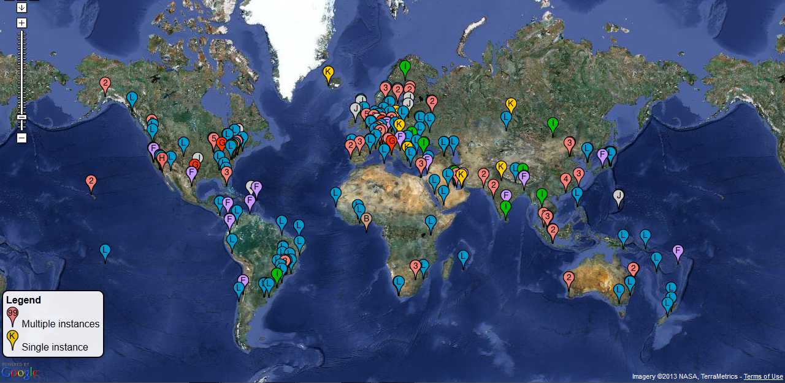
Root Server Deployment
Source: http://www.root-servers.org. Snapshot on 27.02.12. Does not represent current deployment.
Notes:
Permission via http://www.google.com/permissions/geoguidelines.html and root-servers.org:
bmanning@vacation.karoshi.com
7:42 PM (16 hours ago)
to me, comments
the map is dynamic, so if you do take a snapshot, please ensure correct attribution
and timestamp. clearly note that the data was a snapshot in time and does not
represent current deployment.
/bill
> I'd like your permission to use the map at http://www.root-servers.org in
> slides and videos as part of a Course course "Introduction to Computer
> Networks" that is used online and at universities.
>
> Is that OK?
>
> Thanks,
>
> David

