Slide 1
Network Layer Overview

Slide 2
Where we are in the Course
Starting the Network Layer!
  Builds on the link layer. Routers send packets over multiple networks
Application
Transport
Network
Link
Physical

Slide 3
Why do we need a Network layer?
We can already build networks with links and switches and send frames between hosts …

Slide 4
Shortcomings of Switches
Don’t scale to large networks
  Blow up of routing table, broadcast
Table for all destinations in the world!
Broadcast new destinations to the whole world!

Slide 5

Shortcomings of Switches (2)
Don’t work across more than one link layer technology
  Hosts on Ethernet + 3G + 802.11 …
Can we play too?
Go away!

Slide 6
Shortcomings of Switches (3)
Don’t give much traffic control
  Want to plan routes / bandwidth
That was lame.

Slide 7
Network Layer Approach
Scaling:
  Hierarchy, in the form of prefixes
Heterogeneity:
  IP for internetworking
Bandwidth Control:
  Lowest-cost routing
  Later QOS (Quality of Service)

Slide 8
Topics
Network service models
  Datagrams (packets), virtual circuits
IP (Internet Protocol)
  Internetworking
  Forwarding (Longest Matching Prefix)
  Helpers: ARP and DHCP
  Fragmentation and MTU discovery
  Errors: ICMP (traceroute!)
IPv6, the future of IP
NAT, a “middlebox”
Routing algorithms
This
time
Next
time

Slide 9
Routing vs. Forwarding
Routing is the process of deciding in which direction to send traffic
  Network wide (global) and expensive
Which way?
Which way?
Which way?

Slide 10
Routing vs. Forwarding (2)
Forwarding is the process of sending a packet on its way
  Node process (local) and fast
Forward!
packet

Slide 11
Our Plan
Forwarding this time
  What routers do with packets
Routing next time
  Logically this comes first
  But ignore it for now

Slide 12
Network Services (§5.1)

Slide 13
Topic
What kind of service does the Network layer provide to the Transport layer?
  How is it implemented at routers?
Service? What’s he talking about?
Notes:
Icon from Cisco icon library.

Slide 14


Two Network Service Models
Datagrams, or connectionless service
  Like postal letters
  (This one is IP)
Virtual circuits, or connection-oriented service
  Like a telephone call
Notes:
Icons

Slide 15
Store-and-Forward Packet Switching
Both models are implemented with store-and-forward packet switching
  Routers receive a complete packet, storing it temporarily if necessary before forwarding it onwards
  We use statistical multiplexing to share link bandwidth over time

Slide 16
Store-and-Forward (2)
Switching element has internal buffering for contention
Input
. . .
Output
. . .
. . .
. . .
Fabric
Output Buffer
Input Buffer

Slide 17
Store-and-Forward (3)
Simplified view with per port output buffering
  Buffer is typically a FIFO (First In First Out) queue
  If full, packets are discarded (congestion, later)
Router
Router
=
Queued
Packets
(FIFO) Queue

Slide 18
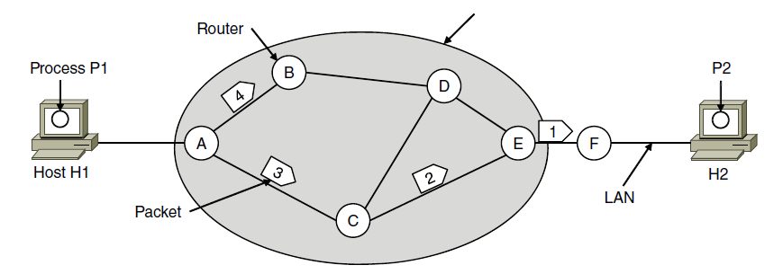
Datagram Model
Packets contain a destination address; each router uses it to forward each packet, possibly on different paths
ISP’s equipment
Notes:
CN5E slides #5-5

Slide 19
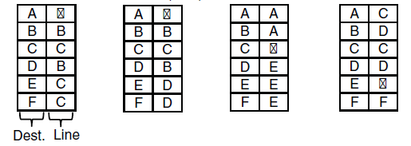
Datagram Model (2)
Each router has a forwarding table keyed by address
  Gives next hop for each destination address; may change
A’s table (initially) A’s table (later) C’s Table E’s Table
B
B
Notes:
CN5E slides #5-5

Slide 20
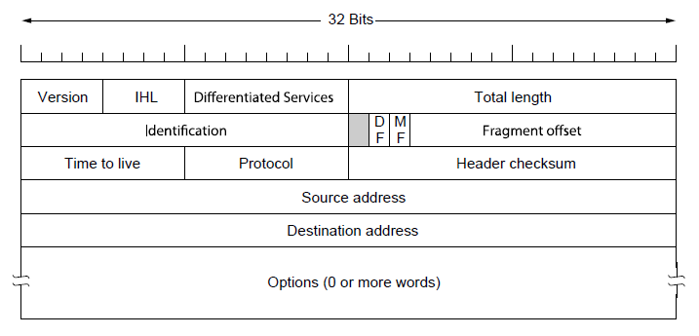
IP (Internet Protocol)
Network layer of the Internet, uses datagrams (next)
  IPv4 carries 32 bit addresses on each packet (often 1.5 KB)
Payload (e.g., TCP segment)
Notes:
CN5E slides #5-62

Slide 21
Virtual Circuit Model
Three phases:
  Connection establishment, circuit is set up
    Path is chosen, circuit information stored in routers
  Data transfer, circuit is used
    Packets are forwarded along the path
  Connection teardown, circuit is deleted
    Circuit information is removed from routers
Just like a telephone circuit, but virtual in the sense that no bandwidth need be reserved; statistical sharing of links

Slide 22
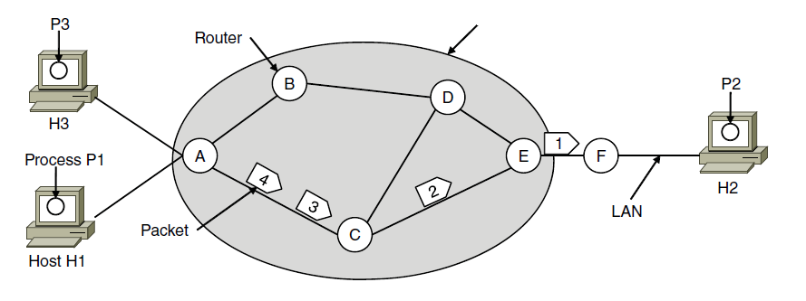
Virtual Circuits (2)
Packets only contain a short label to identify the circuit
  Labels don’t have any global meaning, only unique for a link
ISP’s equipment
Notes:
CN5E slides #5-6

Slide 23

Virtual Circuits (3)
Each router has a forwarding table keyed by circuit
  Gives output line and next label to place on packet
Circuit #1
H1
1
F
A’s table C’s Table E’s Table
5
5
H3
1
F
Circuit #2

Slide 24
Virtual Circuits (4)
Each router has a forwarding table keyed by circuit
  Gives output line and next label to place on packet
Circuit #1
H1
1
5
1
1
F
A’s table C’s Table E’s Table
5
5
H3
1
2
2
2
F
Circuit #2

Slide 25
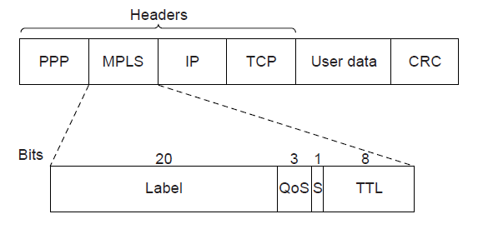
MPLS (Multi-Protocol Label Switching, §5.6.5)
A virtual-circuit like technology widely used by ISPs
  ISP sets up circuits inside their backbone ahead of time
  ISP adds MPLS label to IP packet at ingress, undoes at egress
Notes:
CN5E slides #5-75

Slide 26
Datagrams vs Virtual Circuits
Complementary strengths
Issue | Datagrams | Virtual Circuits
Setup phase | Not needed | Required
Router state | Per destination | Per connection
Addresses | Packet carries full address | Packet carries short label
Routing | Per packet | Per circuit
Failures | Easier to mask | Difficult to mask
Quality of service | Difficult to add | Easier to add

Slide 27
Internetworking (§5.5, 5.6.1)

Slide 28

Topic
How do we connect different networks together?
  This is called internetworking
  We’ll look at how IP does it
Hi there!
Hi yourself

Slide 29
How Networks May Differ
Basically, in a lot of ways:
  Service model (datagrams, VCs)
  Addressing (what kind)
  QOS (priorities, no priorities)
  Packet sizes
  Security (whether encrypted)
Internetworking hides the differences with a common protocol. (Uh oh.)

Slide 30
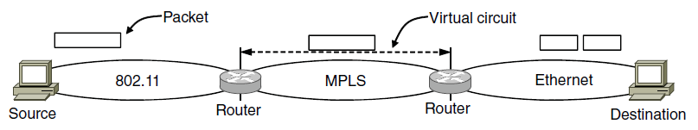
Connecting Datagram and VC networks
An example to show that it’s not so easy
  Need to map destination address to a VC and vice-versa
  A bit of a “road bump”, e.g., might have to set up a VC
Bump!
Bump!
Notes:
CN5E #5-53

Slide 31


Internetworking – Cerf and Kahn
Pioneered by Cerf and Kahn, the “fathers of the Internet”
  In 1974, later led to TCP/IP
Tackled the problems of interconnecting networks
  Instead of mandating a single network technology
Vint Cerf
Bob Kahn
© 2009 IEEE
© 2009 IEEE

Slide 32
Internet Reference Model
IP is the “narrow waist” of the Internet
  Supports many different links below and apps above
4. Application
SMTP
HTTP
RTP
DNS
3. Transport
TCP
UDP
2. Internet
IP
Ethernet
3G
1. Link
Cable
DSL
802.11

Slide 33
IP as a Lowest Common Denominator
Suppose only some networks support QOS or security etc.
  Difficult for internetwork to support
Pushes IP to be a “lowest common denominator” protocol
  Asks little of lower-layer networks
  Gives little as a higher layer service

Slide 34
IPv4 (Internet Protocol)
Various fields to meet straightforward needs
  Version, Header (IHL) and Total length, Protocol, and Header Checksum
Payload (e.g., TCP segment)
Notes:
CN5E slides #5-62

Slide 35
IPv4 (2)
Network layer of the Internet, uses datagrams
  Provides a layer of addressing above link addresses (next)
Payload (e.g., TCP segment)
Notes:
CN5E slides #5-62

Slide 36
IPv4 (3)
Some fields to handle packet size differences (later)
  Identification, Fragment offset, Fragment control bits
Payload (e.g., TCP segment)
Notes:
CN5E slides #5-62

Slide 37
IPv4 (4)
Other fields to meet other needs (later, later)
  Differentiated Services, Time to live (TTL)
Later, with QOS
Later, with ICMP
Payload (e.g., TCP segment)
Notes:
CN5E slides #5-62

Slide 38
IP Forwarding (§5.6.1-5.6.2)

Slide 39
Topic
How do routers forward packets?
  We’ll look at how IP does it
  (We’ll cover routing later)
Forward!
packet
Notes:
Icon from Cisco icon library.

Slide 40
Recap
We want the network layer to:
  Scale to large networks
    Using addresses with hierarchy
  Support diverse technologies
    Internetworking with IP
  Use link bandwidth well
    Lowest-cost routing
This
lecture
Next
lecture
Next
week

Slide 41
IP Addresses
IPv4 uses 32-bit addresses
  Later we’ll see IPv6, which uses 128-bit addresses
Written in “dotted quad” notation
  Four 8-bit numbers separated by dots
8 bits
8 bits
8 bits
8 bits
aaaaaaaabbbbbbbbccccccccdddddddd ↔ A.B.C.D
00010010000111110000000000000001 ↔

Slide 42
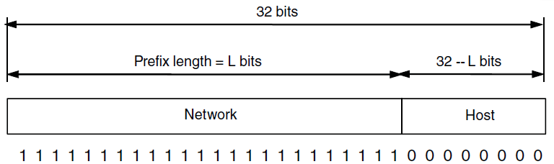
IP Prefixes
Addresses are allocated in blocks called prefixes
  Addresses in an L-bit prefix have the same top L bits
  There are 2^{32-L} addresses aligned on 2^{32-L} boundary
Notes:
CN5E slides #5-63

Slide 43
IP Prefixes (2)
Written in “address/length” notation
  Address is lowest address in the prefix, length is prefix bits
  E.g., 128.13.0.0/16 is 128.13.0.0 to 128.13.255.255
  So a /24 (“slash 24”) is 256 addresses, and a /32 is one address
000100100001111100000000xxxxxxxx ↔
↔ 128.13.0.0/16
Notes:
CN5E slides #5-63

Slide 44
Classful IP Addressing
Originally, IP addresses came in fixed size blocks with the class/size encoded in the high-order bits
  They still do, but the classes are now ignored
0
8
16
24
32 bits
1
10
110
Class A, 2²⁴ addresses
Class B, 2¹⁶ addresses
Class C, 2⁸ addresses
Network portion
Host portion

Slide 45
IP Forwarding
All addresses on one network belong to the same prefix
Node uses a table that lists the next hop for prefixes
Prefix | Next Hop
192.24.0.0/19 | D
192.24.12.0/22 | B
A
D
B
C

Slide 46
Longest Matching Prefix
Prefixes in the table might overlap!
  Combines hierarchy with flexibility
Longest matching prefix forwarding rule:
  For each packet, find the longest prefix that contains the destination address, i.e., the most specific entry
  Forward the packet to the next hop router for that prefix

Slide 47
Longest Matching Prefix (2)
192.24.63.255
More
specific
Prefix | Next Hop
192.24.0.0/19 | D
192.24.12.0/22 | B
/19
192.24.15.255
/22
192.24.12.0
192.24.6.0 →
192.24.16.32 →
192.24.0.0
IP address

Slide 48
Host/Router Distinction
In the Internet:
  Routers do the routing
  Hosts send remote traffic to the nearest router
Not for my network? Send it to the router
It’s my job to know which way to go …

Slide 49
Host Forwarding Table
Give using longest matching prefix
  0.0.0.0/0 is a default route that catches all IP addresses
Prefix | Next Hop
My network prefix | Send to that IP
0.0.0.0/0 | Send to my router

Slide 50
Flexibility of Longest Matching Prefix
Can provide default behavior, with less specifics
  To send traffic going outside an organization to a border router
Can special case behavior, with more specifics
  For performance, economics, security, …

Slide 51
Performance of Longest Matching Prefix
Uses hierarchy for a compact table
  Relies on use of large prefixes
Lookup more complex than table
  Used to be a concern for fast routers
  Not an issue in practice these days

Slide 52
Other Aspects of Forwarding
It’s not all about addresses …
Payload (e.g., TCP segment)
Notes:
CN5E slides #5-62

Slide 53
Other Aspects (2)
Decrement TTL value
  Protects against loops
Checks header checksum
  To add reliability
Fragment large packets
  Split to fit it on next link
Send congestion signals
  Warns hosts of congestion
Generates error messages
  To help mange network
Handle various options
Coming
later

Slide 54
Helping IP with ARP, DHCP (§5.6.4)

Slide 55
Topic
Filling in the gaps we need to make for IP forwarding work in practice
  Getting IP addresses (DHCP) »
  Mapping IP to link addresses (ARP) »
What’s my IP?
What link layer address do I use?
Notes:
Icon from Cisco icon library.

Slide 56
Getting IP Addresses
Problem:
  A node wakes up for the first time …
  What is its IP address? What’s the IP address of its router? Etc.
  At least Ethernet address is on NIC
Hey, where am I?

Slide 57
Getting IP Addresses (2)
Manual configuration (old days)
  Can’t be factory set, depends on use
A protocol for automatically configuring addresses (DHCP)
  Shifts burden from users to IT folk
What’s my IP?
Use A.B.C.D

Slide 58
DHCP
DHCP (Dynamic Host Configuration Protocol), from 1993, widely used
It leases IP address to nodes
Provides other parameters too
  Network prefix
  Address of local router
  DNS server, time server, etc.

Slide 59
DHCP Protocol Stack
DHCP is a client-server application
  Uses UDP ports 67, 68
DHCP
UDP
IP
Ethernet

Slide 60
DHCP Addressing
Bootstrap issue:
  How does node send a message to DHCP server before it is configured?
Answer:
  Node sends broadcast messages that delivered to all nodes on the network
  Broadcast address is all 1s
  IP (32 bit): 255.255.255.255
  Ethernet (48 bit): ff:ff:ff:ff:ff:ff

Slide 61
DHCP Messages
Client
Server
One link
Notes:
Icons from cisco icon library

Slide 62
DHCP Messages (2)
Client
Server
discover
Broadcast
offer
request
ack
Notes:
Icons from cisco icon library

Slide 63
DHCP Messages (3)
To renew an existing lease, an abbreviated sequence is used:
  request, followed by ack
Protocol also supports replicated servers for reliability

Slide 64
Sending an IP Packet
Problem:
  A node needs Link layer addresses to send a frame over the local link
  How does it get the destination link address from a destination IP address?
Uh oh …
My IP is 1.2.3.4
Notes:
Icons from cisco icon library

Slide 65
ARP (Address Resolution Protocol)
Node uses to map a local IP address to its Link layer addresses
Link layer
Source
Ethernet
Dest.
Ethernet
Source IP
Dest.
IP
Payload …
From
NIC
From
DHCP
From ARP

Slide 66
ARP Protocol Stack
ARP sits right on top of link layer
  No servers, just asks node with target IP to identify itself
  Uses broadcast to reach all nodes
ARP
Ethernet

Slide 67
ARP Messages
Node
Target
One link
Notes:
Icons from cisco icon library

Slide 68
ARP Messages (2)
Node
Target
Request
Broadcast
Who has IP 1.2.3.4?
reply
I do at 1:2:3:4:5:6
Notes:
Icons from cisco icon library

Slide 69
Discovery Protocols
Help nodes find each other
  There are more of them!
    E.g., zeroconf, Bonjour
Often involve broadcast
  Since nodes aren’t introduced
  Very handy glue
Notes:
Icons from cisco icon library

Slide 70
Packet Fragmentation(§5.5.5)

Slide 71
Topic
How do we connect networks with different maximum packet sizes?
  Need to split up packets, or discover the largest size to use
Take that
It’s too big!
Big packet

Slide 72
Packet Size Problem
Different networks have different maximum packet sizes
  Or MTU (Maximum Transmission Unit)
  E.g., Ethernet 1.5K, WiFi 2.3K
Prefer large packets for efficiency
  But what size is too large?
  Difficult because node does not know complete network path

Slide 73
Packet Size Solutions
Fragmentation (now)
  Split up large packets in the network if they are too big to send
  Classic method, dated
Discovery (next)
  Find the largest packet that fits on the network path and use it
  IP uses today instead of fragmentation

Slide 74
IPv4 Fragmentation
Routers fragment packets that are too large to forward
Receiving host reassembles to reduce load on routers
Fragment!
Reassemble!
Fits on first link

Slide 75
IPv4 Fragmentation Fields
Header fields used to handle packet size differences
  Identification, Fragment offset, MF/DF control bits
Payload (e.g., TCP segment)
Notes:
CN5E slides #5-62

Slide 76
IPv4 Fragmentation Procedure
Routers split a packet that is too large:
  Typically break into large pieces
  Copy IP header to pieces
  Adjust length on pieces
  Set offset to indicate position
  Set MF (More Fragments) on all pieces except last
Receiving hosts reassembles the pieces:
  Identification field links pieces together, MF tells receiver when it has all pieces

Slide 77
IPv4 Fragmentation (2)
ID = 0x12ef
Data Len = 2300
Offset = 0
MF = 0
Before
MTU = 2300
(Ignore length of headers)
ID =
Data Len =
Offset =
MF =
ID =
Data Len =
Offset =
MF =
After
MTU = 1500

Slide 78
IPv4 Fragmentation (3)
ID = 0x12ef
Data Len = 2300
Offset = 0
MF = 0
Before
MTU = 2300
ID = 0x12ef
Data Len = 1500
Offset = 0
MF = 1
ID = 0x12ef
Data Len = 800
Offset = 1500
MF = 0
After
MTU = 1500

Slide 79
IPv4 Fragmentation (4)
It works!
  Allows repeated fragmentation
But fragmentation is undesirable
  More work for routers, hosts
  Tends to magnify loss rate
  Security vulnerabilities too

Slide 80
Path MTU Discovery
Discover the MTU that will fit
  So we can avoid fragmentation
  The method in use today
Host tests path with large packet
  Routers provide feedback if too large; they tell host what size would have fit

Slide 81
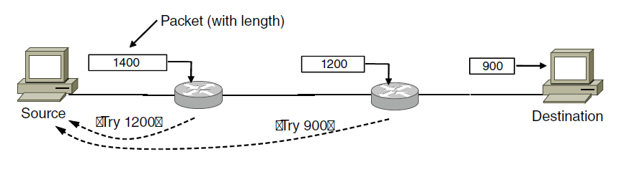
Path MTU Discovery (2)
MTU=1400
MTU=1200 bytes
MTU=900
Try 1200
Try 900
Notes:
CN5E slides #5-58. Draw in sequence of packets and feedback.

Slide 82
Path MTU Discovery (3)
Test #1
Test #2
Test #3
MTU=1400
MTU=1200 bytes
MTU=900
Try 1200
Try 900
Notes:
CN5E slides #5-58

Slide 83
Path MTU Discovery (4)
Process may seem involved
  But usually quick to find right size
Path MTU depends on the path and so can change over time
  Search is ongoing
Implemented with ICMP (next)
  Set DF (Don’t Fragment) bit in IP header to get feedback messages

Slide 84
Error Handling with ICMP (§5.6.4)

Slide 85
Topic
What happens when something goes wrong during forwarding?
  Need to be able to find the problem
What happened?
Yikes!
XXXXXXX

Slide 86
Internet Control Message Protocol
ICMP is a companion protocol to IP
  They are implemented together
  Sits on top of IP (IP Protocol=1)
Provides error report and testing
  Error is at router while forwarding
  Also testing that hosts can use

Slide 87
ICMP Errors
When router encounters an error while forwarding:
  It sends an ICMP error report back to the IP source address
  It discards the problematic packet; host needs to rectify
Oh, now I see …
Report then toss it!
XXXXXXX
ICMP report

Slide 88
ICMP Message Format
Each ICMP message has a Type, Code, and Checksum
Often carry the start of the offending packet as payload
Each message is carried in an IP packet
Notes:
Draw ICMP message format

Slide 89
ICMP Message Format (2)
Each ICMP message has a Type, Code, and Checksum
Often carry the start of the offending packet as payload
Each message is carried in an IP packet
Portion of offending packet,
starting with its IP header
Src=router, Dst=A
Protocol = 1
Type=X, Code=Y
Src=A, Dst=B
XXXXXXXXXXXXXXX
IP header
ICMP header
ICMP data

Slide 90
Example ICMP Messages
Name | Type / Code | Usage
Dest. Unreachable (Net or Host) | 3 / 0 or 1 | Lack of connectivity
Dest. Unreachable (Fragment) | 3 / 4 | Path MTU Discovery
Time Exceeded (Transit) | 11 / 0 | Traceroute
Echo Request or Reply | 8 or 0 / 0 | Ping
Testing, not a forwarding error: Host sends Echo Request, and destination responds with an Echo Reply

Slide 91
Traceroute
IP header contains TTL (Time to live) field
  Decremented every router hop, with ICMP error if it hits zero
  Protects against forwarding loops

Slide 92
Traceroute (2)
Traceroute repurposes TTL and ICMP functionality
  Sends probe packets increasing TTL starting from 1
  ICMP errors identify routers on the path
Local
Host
. . .
Remote
Host
1 hop
2 hops
3 hops
N-1 hops
N hops
Notes:
Icons from Cisco icon library, http://www.cisco.com/web/about/ac50/ac47/2.html.

Slide 93
IP Version 6 (§5.6.3)

Slide 94

Topic
IP version 6, the future of IPv4 that is now (still) being deployed
Why do I want IPv6 again?

Slide 95
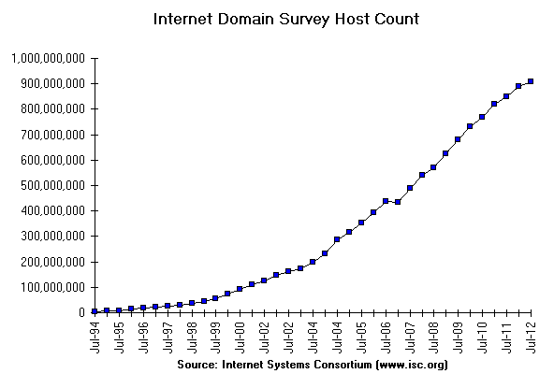
Internet Growth
At least a billion Internet hosts and growing …
And we’re using 32-bit addresses!
Notes:
Graph from http://www.isc.org/solutions/survey with permission via http://www.isc.org/solutions/survey/faq:
Can I have permission to reproduce your data or charts?
You have permission to reproduce our data provided that you mention the source as "Source: Internet Systems Consortium, Inc. (http://www.isc.org/)". However you must ask our permission to publish derivative works based on our data. In those cases you must say your data or charts are "Based on data from Internet Systems Consortium, Inc. (http://www.isc.org/)"

Slide 96

The End of New IPv4 Addresses
Now running on leftover blocks held by the regional registries; much tighter allocation policies
Exhausted
on 4/11
and 9/12!
ARIN
(US, Canada)
APNIC
(Asia Pacific)
ISPs
Companies
IANA
(All IPs)
RIPE
(Europe)
LACNIC
(Latin Amer.)
Exhausted
on 2/11!
AfriNIC
(Africa)
End of the world ? 12/21/12?
Notes:
Icon from openclipart

Slide 97
IP Version 6 to the Rescue
Effort started by the IETF in 1994
  Much larger addresses (128 bits)
  Many sundry improvements
Became an IETF standard in 1998
  Nothing much happened for a decade
  Hampered by deployment issues, and a lack of adoption incentives
  Big push ~2011 as exhaustion looms

Slide 98
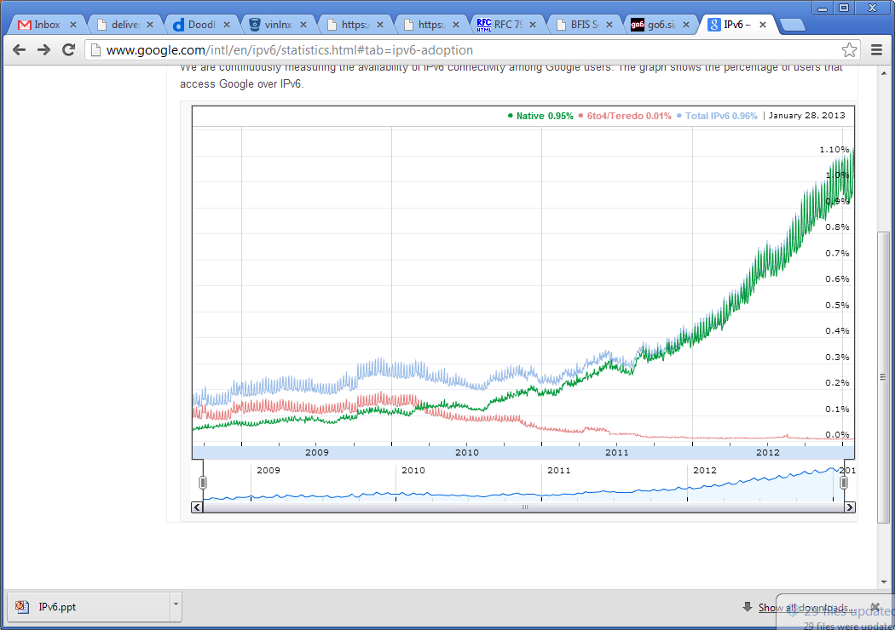

IPv6 Deployment
Time for
growth!
Percentage of users accessing Google via IPv6
Source: Google IPv6 Statistics, 30/1/13
Notes:
Graph from google public data graph, icon from isoc

Slide 99
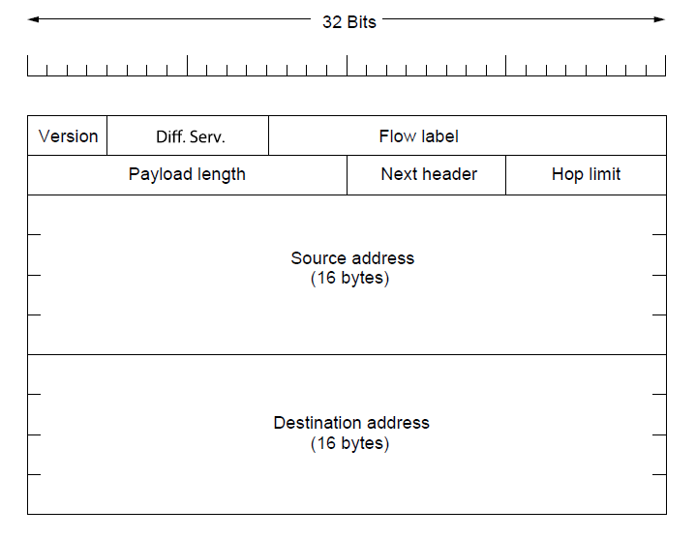
IPv6
Features large addresses
  128 bits, most of header
New notation
  8 groups of 4 hex digits (16 bits)
  Omit leading zeros, groups of zeros
32 bits
Notes:
CN5E slides #5-71

Slide 100
IPv6 (2)
32 bits
Lots of other, smaller changes
  Streamlined header processing
  Flow label to group of packets
  Better fit with “advanced” features (mobility, multicasting, security)
Notes:
CN5E slides #5-71

Slide 101
IPv6 Transition
The Big Problem:
  How to deploy IPv6?
  Fundamentally incompatible with IPv4
Dozens of approaches proposed
  Dual stack (speak IPv4 and IPv6)
  Translators (convert packets)
  Tunnels (carry IPv6 over IPv4) »

Slide 102
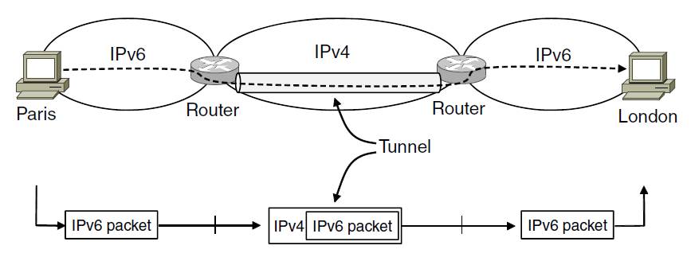
Tunneling
Native IPv6 islands connected via IPv4
  Tunnel carries IPv6 packets across IPv4 network
Notes:
CN5E slides #5-54

Slide 103
Tunneling (2)
Tunnel acts as a single link across IPv4 network
User
Tunnel
User

Slide 104
Tunneling (3)
Tunnel acts as a single link across IPv4 network
  Difficulty is to set up tunnel endpoints and routing
User
Tunnel
User
IPv6
IPv6
IPv6
IPv6
IPv6
IPv6
IPv4
IPv4
Link
Link
Link
Link
Link
Link
Native IPv6
Native IPv4
Native IPv6

Slide 105
Network Address Translation (§5.6.2)

Slide 106
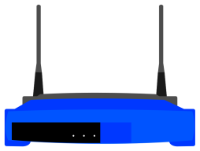
Topic
What is NAT (Network Address Translation)? How does it work?
  NAT is widely used at the edges of the network, e.g., homes
I’m a NAT box too!
Internet
Notes:
Icon from openclipart

Slide 107
Layering Review
Remember how layering is meant to work?
  “Routers don’t look beyond the IP header.” Well …
App
App
Router
TCP
TCP
IP
IP
IP
IP
IP
IP
802.11
802.11
Ethernet
802.11
Ethernet
802.11

Slide 108
Middleboxes
Sit “inside the network” but perform “more than IP” processing on packets to add new functionality
  NAT box, Firewall / Intrusion Detection System
App
Middlebox
App
TCP
App / TCP
TCP
IP
IP
IP
IP
IP
IP
802.11
802.11
Ethernet
802.11
Ethernet
802.11

Slide 109
Middleboxes (2)
Advantages
  A possible rapid deployment path when there is no other option
  Control over many hosts (IT)
Disadvantages
  Breaking layering interferes with connectivity; strange side effects
  Poor vantage point for many tasks

Slide 110
NAT (Network Address Translation) Box
NAT box connects an internal network to an external network
  Many internal hosts are connected using few external addresses
  Middlebox that “translates addresses”
Motivated by IP address scarcity
  Controversial at first, now accepted

Slide 111
NAT (2)
Common scenario:
  Home computers use “private” IP addresses
  NAT (in AP/firewall) connects home to ISP using a single external IP address
Unmodified computers at home
Looks like one
computer outside
ISP
NAT box

Slide 112
How NAT Works
Keeps an internal/external table
  Typically uses IP address + TCP port
  This is address and port translation
Need ports to make mapping 1-1 since there are fewer external IPs
What host thinks
What ISP thinks
Internal IP:port | External IP : port
192.168.1.12 : 5523 | 44.25.80.3 : 1500
192.168.1.13 : 1234 | 44.25.80.3 : 1501
192.168.2.20 : 1234 | 44.25.80.3 : 1502

Slide 113
How NAT Works (2)
Internal → External:
  Look up and rewrite Source IP/port
External
destination
IP=X, port=Y
Internal
source
Internal IP:port | External IP : port
192.168.1.12 : 5523 | 44.25.80.3 : 1500
Src =
NAT box
Src =
Dst =
Dst =

Slide 114
How NAT Works (3)
External → Internal
  Look up and rewrite Destination IP/port
External
source
IP=X, port=Y
Internal
destination
Internal IP:port | External IP : port
192.168.1.12 : 5523 | 44.25.80.3 : 1500
Src =
NAT box
Src =
Dst =
Dst =

Slide 115
How NAT Works (4)
Need to enter translations in the table for it to work
  Create external name when host makes a TCP connection
External
destination
IP=X, port=Y
Internal
source
Internal IP:port | External IP : port
192.168.1.12 : 5523
Src =
NAT box
Src =
Dst =
Dst =

Slide 116
NAT Downsides
Connectivity has been broken!
  Can only send incoming packets after an outgoing connection is set up
  Difficult to run servers or peer-to-peer apps (Skype) at home
Doesn’t work so well when there are no connections (UDP apps)
Breaks apps that unwisely expose their IP addresses (FTP)

Slide 117
NAT Upsides
Relieves much IP address pressure
  Many home hosts behind NATs
Easy to deploy
  Rapidly, and by you alone
Useful functionality
  Firewall, helps with privacy
Kinks will get worked out eventually
  “NAT Traversal” for incoming traffic

