Slide 1
Where we are in the Course
Starting the Application Layer!
  Builds distributed “network services” (DNS, Web) on Transport services
Application
Transport
Network
Link
Physical

Slide 2
Evolution of Internet Applications
Always changing, and growing …
???
Traffic
Web (Video)
P2P (BitTorrent)
Web (CDNs)
Web (HTTP)
News (NTTP)
Email
Email (SMTP)
File Transfer (FTP)
Telnet
Secure Shell (ssh)
1970
1980
1990
2000
2010

Slide 3
Evolution of Internet Applications (2)
For a peek at the state of the Internet:
  Akamai’s State of the Internet Report (quarterly)
  Cisco’s Visual Networking Index
  Mary Meeker’s Internet Report
Robust Internet growth, esp. video, wireless and mobile
  Most traffic is video, will be 90% of Internet in a few years
  Wireless traffic will soon overtake wired traffic
  Mobile traffic is still a small portion (15%) of overall
  Growing attack traffic from China, also U.S. and Russia

Slide 4
Topic
The DNS (Domain Name System)
  Human-readable host names, and more
  Part 1: the distributed namespace
www.uw.edu?
128.94.155.135
Network
Notes:
CN5E slides #5-10

Slide 5

Names and Addresses
Names are higher-level identifiers for resources
Addresses are lower-level locators for resources
  Multiple levels, e.g. full name → email → IP address → Ethernet address
Resolution (or lookup) is mapping a name to an address
Name, e.g.
“Andy Tanenbaum,”
or “flits.cs.vu.nl”
Address, e.g.
“Vrijie Universiteit, Amsterdam”
or IPv4 “130.30.27.38”
Lookup
Directory

Slide 6
Before the DNS – HOSTS.TXT
Directory was a file HOSTS.TXT regularly retrieved for all hosts from a central machine at the NIC (Network Information Center)
Names were initially flat, became hierarchical (e.g., lcs.mit.edu) ~85
Neither manageable nor efficient as the ARPANET grew …

Slide 7
DNS
A naming service to map between host names and their IP addresses (and more)
  www.uwa.edu.au → 130.95.128.140
Goals:
  Easy to manage (esp. with multiple parties)
  Efficient (good performance, few resources)
Approach:
  Distributed directory based on a hierarchical namespace
  Automated protocol to tie pieces together

Slide 8
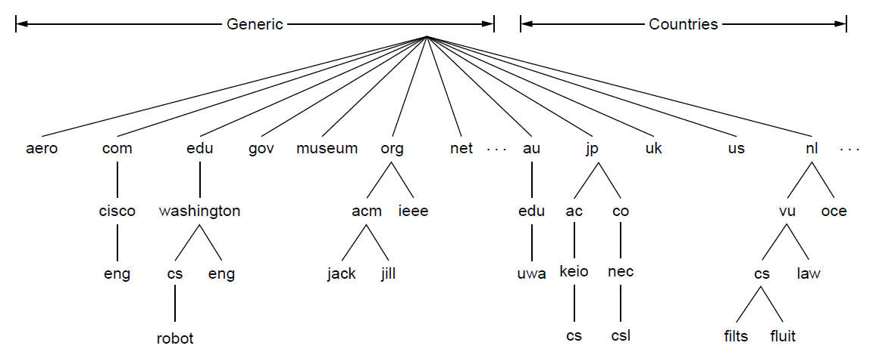
DNS Namespace
Hierarchical, starting from “.” (dot, typically omitted)
Notes:
CN5E slides #7-4. Spell out name robot.cs.washington.edu

Slide 9
TLDs (Top-Level Domains)
Run by ICANN (Internet Corp. for Assigned Names and Numbers)
  Starting in ‘98; naming is financial, political, and international ☺
22+ generic TLDs
  Initially .com, .edu , .gov., .mil, .org, .net
  Added .aero, .museum, etc. from ’01 through .xxx in ’11
  Different TLDs have different usage policies
~250 country code TLDs
  Two letters, e.g., “.au”, plus international characters since 2010
  Widely commercialized, e.g., .tv (Tuvalu)
  Many domain hacks, e.g., instagr.am (Armenia), goo.gl (Greenland)

Slide 10
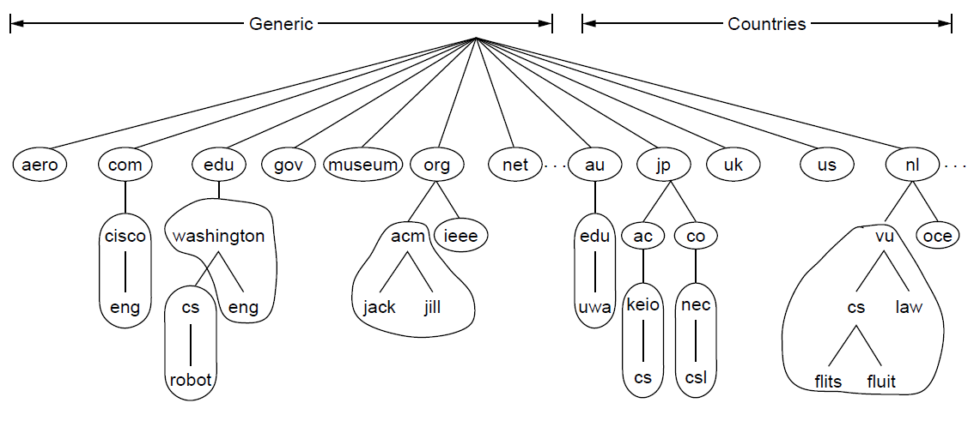
DNS Zones
A zone is a contiguous portion of the namespace
Delegation
A zone
Notes:
CN5E slides #7-8

Slide 11
DNS Zones (2)
Zones are the basis for distribution
  EDU Registrar administers .edu
  UW administers washington.edu
  CS&E administers cs.washington.edu
Each zone has a nameserver to contact for information about it
  Zone must include contacts for delegations, e.g., .edu knows nameserver for washington.edu

Slide 12
DNS Resource Records
A zone is comprised of DNS resource records that give information for its domain names
Type | Meaning
SOA | Start of authority, has key zone parameters
A | IPv4 address of a host
AAAA (“quad A”) | IPv6 address of a host
CNAME | Canonical name for an alias
MX | Mail exchanger for the domain
NS | Nameserver of domain or delegated subdomain
Notes:
CN5E figures #7-4

Slide 13
DNS Resolution
DNS protocol lets a host resolve any host name (domain) to IP address
If unknown, can start with the root nameserver and work down zones
Let’s see an example first …

Slide 14
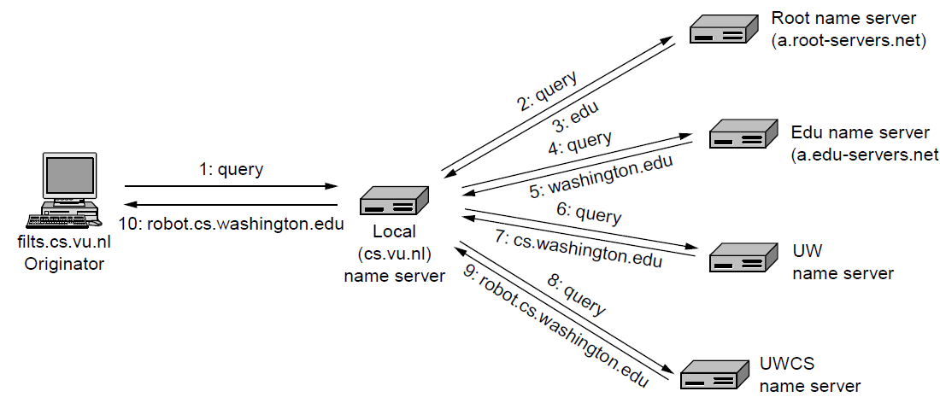
DNS Resolution (2)
flits.cs.vu.nl resolves robot.cs.washington.edu
Notes:
CN5E slides #10-88

Slide 15
Iterative vs. Recursive Queries
Recursive query
  Nameserver completes resolution and returns the final answer
  E.g., flits → local nameserver
Iterative query
  Nameserver returns the answer or who to contact next for the answer
  E.g., local nameserver → all others

Slide 16
Iterative vs. Recursive Queries (2)
Recursive query
  Lets server offload client burden (simple resolver) for manageability
  Lets server cache over a pool of clients for better performance
Iterative query
  Lets server “file and forget”
  Easy to build high load servers

Slide 17
Caching
Resolution latency should be low
  Adds delay to web browsing
Cache query/responses to answer future queries immediately
  Including partial (iterative) answers
  Responses carry a TTL for caching
query
Cache
out
response
Nameserver
Notes:
CN5E slides #10-88

Slide 18
Caching (2)
flits.cs.vu.nl now resolves eng.washington.edu
  And previous resolutions cut out most of the process
I know the server for washington.edu!
1: query
Cache
2: query
4: eng.washington.edu
3: eng.washington.edu
Local nameserver
(for cs.vu.nl)
UW nameserver
(for washington.edu)
Notes:
CN5E slides #10-88

Slide 19
Local Nameservers
Local nameservers typically run by IT (enterprise, ISP)
  But may be your host or AP
  Or alternatives e.g., Google public DNS
Clients need to be able to contact their local nameservers
  Typically configured via DHCP

Slide 20
Root Nameservers
Root (dot) is served by 13 server names
  a.root-servers.net to m.root-servers.net
  All nameservers need root IP addresses
  Handled via configuration file (named.ca)
There are >250 distributed server instances
  Highly reachable, reliable service
  Most servers are reached by IP anycast (Multiple locations advertise same IP! Routes take client to the closest one. See §5.x.x)
  Servers are IPv4 and IPv6 reachable

Slide 21
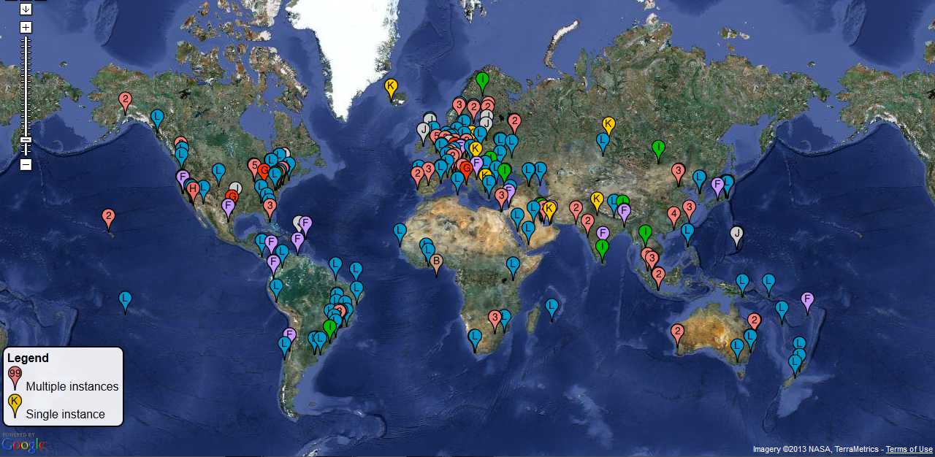
Root Server Deployment
Source: http://www.root-servers.org. Snapshot on 27.02.12. Does not represent current deployment.
Notes:
Permission via http://www.google.com/permissions/geoguidelines.html and root-servers.org:
bmanning@vacation.karoshi.com
7:42 PM (16 hours ago)
to me, comments
the map is dynamic, so if you do take a snapshot, please ensure correct attribution
and timestamp. clearly note that the data was a snapshot in time and does not
represent current deployment.
/bill
> I'd like your permission to use the map at http://www.root-servers.org in
> slides and videos as part of a Course course "Introduction to Computer
> Networks" that is used online and at universities.
>
> Is that OK?
>
> Thanks,
>
> David

Slide 22

DNS Protocol (3)
Security is a major issue
  Compromise redirects to wrong site!
  Not part of initial protocols ..
DNSSEC (DNS Security Extensions)
  Long under development, now partially deployed. We’ll look at it later
Um, security??
Notes:
Image from pixabay

Slide 23
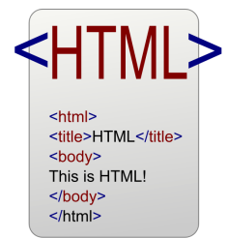
Topic
HTTP, (HyperText Transfer Protocol)
  Basis for fetching Web pages
request
Network
Notes:
Icon from openclipart.org

Slide 24
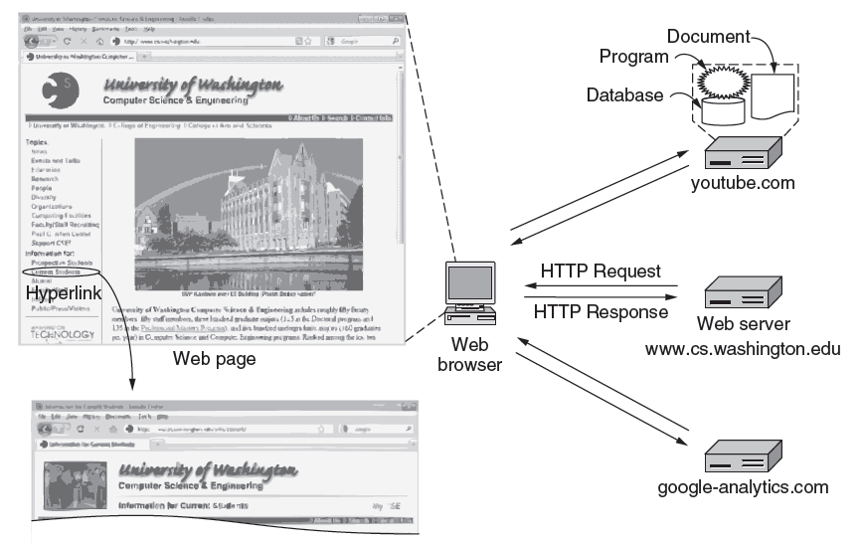
Web Context
Page as a set of related HTTP transactions
HTTP request
HTTP response
Notes:
CN5E slide #7-25

Slide 25
Web Protocol Context
HTTP is a request/response protocol for fetching Web resources
  Runs on TCP, typically port 80
  Part of browser/server app
browser
server
request
HTTP
HTTP
response
TCP
TCP
IP
IP
802.11
802.11

Slide 26
Fetching a Web page with HTTP
Start with the page URL:
  http://en.wikipedia.org/wiki/Vegemite
Steps:
  Resolve the server to IP address (DNS)
  Set up TCP connection to the server
  Send HTTP request for the page
  (Await HTTP response for the page)
  Execute / fetch other Web resources / render
  Clean up any idle TCP connections
Protocol
Server
Page on server
**

Slide 27
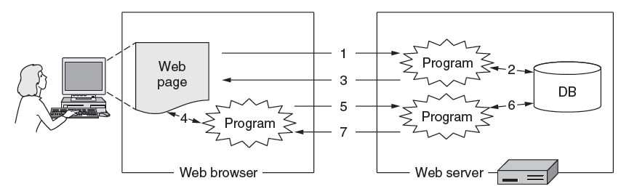
Static vs Dynamic Web pages
Static web page is a file contents, e.g., image
Dynamic web page is the result of program execution
  Javascript on client, PHP on server, or both
Notes:
CN5E slides #7-34

Slide 28
Evolution of HTTP
Consider security (SSL/TLS for HTTPS) later
Proliferation of content types and browser/server scripting technologies
SPDY
(HTTP 2.0)
1.1 developed
(persistent connections)
1.0 developed
RFC 2616
RFC 2965
0.9
RFC 2068, 2109
Cookies
SSL 2.0
RFC 1945
1990
1995
2000
2005
2010

Slide 29
HTTP Protocol
Originally a simple protocol, with many options added over time
  Text-based commands, headers
Try it yourself:
  As a “browser” fetching a URL
  Run “telnet en.wikipedia.org 80”
  Type “GET /wiki/Vegemite HTTP/1.0” to server followed by a blank line
  Server will return HTTP response with the page contents (or other info)
Notes:
Show a live demo

Slide 30
HTTP Protocol (2)
Commands used in the request
Method | Description
GET | Read a Web page
HEAD | Read a Web page's header
POST | Append to a Web page
PUT | Store a Web page
DELETE | Remove the Web page
TRACE | Echo the incoming request
CONNECT | Connect through a proxy
OPTIONS | Query options for a page
Fetch
page
Upload
data
Notes:
CN5E figures #7-40

Slide 31
HTTP Protocol (3)
Codes returned with the response
Code | Meaning | Examples
1xx | Information | 100 = server agrees to handle client's request
2xx | Success | 200 = request succeeded; 204 = no content present
3xx | Redirection | 301 = page moved; 304 = cached page still valid
4xx | Client error | 403 = forbidden page; 404 = page not found
5xx | Server error | 500 = internal server error; 503 = try again later
Yes!
Notes:
CN5E figures #7-41

Slide 32
HTTP Protocol (4)
Many header fields specify capabilities and content
  E.g., Content-Type: text/html, Cookie: lect=8-4-http
Function | Example Headers
Browser capabilities (client → server) | User-Agent, Accept, Accept-Charset, Accept-Encoding, Accept-Language
Caching related (mixed directions) | If-Modified-Since, If-None-Match, Date, Last-Modified, Expires, Cache-Control, ETag
Browser context (client → server) | Cookie, Referer, Authorization, Host
Content delivery (server → client) | Content-Encoding, Content-Length, Content-Type, Content-Language, Content-Range, Set-Cookie
Notes:
CN5E slides #7-46

Slide 33
PLT (Page Load Time)
PLT is the key measure of web performance
  From click until user sees page
  Small increases in PLT decrease sales
PLT depends on many factors
  Structure of page/content
  HTTP (and TCP!) protocol
  Network RTT and bandwidth

Slide 34
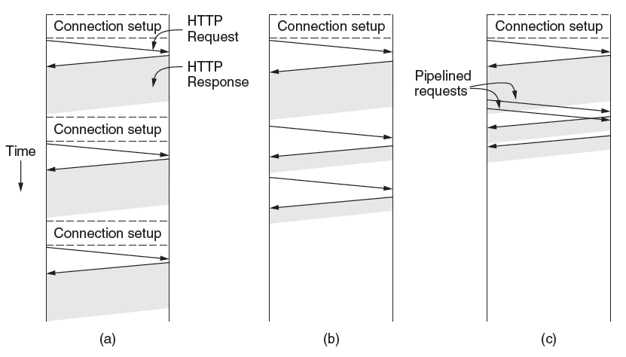
Early Performance
HTTP/1.0 used one TCP connection to fetch one web resource
  Made HTTP very easy to build
  But gave fairly poor PLT…
Notes:
CN5E slides #7-43

Slide 35
Early Performance (2)
Many reasons why PLT is larger than necessary
  Sequential request/responses, even when to different servers
  Multiple TCP connection setups to the same server
  Multiple TCP slow-start phases
Network is not used effectively
  Worse with many small resources / page
Notes:
CN5E slides #7-43

Slide 36
Ways to Decrease PLT
Reduce content size for transfer
  Smaller images, gzip
Change HTTP to make better use of available bandwidth
Change HTTP to avoid repeated transfers of the same content
  Caching, and proxies
Relocate content to reduce RTT
  CDNs [later]

Slide 37
Parallel Connections
One simple way to reduce PLT
  Browser runs multiple (8, say) HTTP instances in parallel
  Server is unchanged; already handled concurrent requests for many clients
How does this help?
  Single HTTP wasn’t using network much …
  So parallel connections aren’t slowed much
  Pulls in completion time of last fetch

Slide 38
Persistent Connections
Parallel connections compete with each other for network resources
  1 parallel client ≈ 8 sequential clients?
  Exacerbates network bursts, and loss
Persistent connection alternative
  Make 1 TCP connection to 1 server
  Use it for multiple HTTP requests

Slide 39
Persistent Connections (2)
Pipelined requests per connection
Sequential requests per connection
One request per connection
Notes:
CN5E slides #7-43

Slide 40
Persistent Connections (3)
Widely used as part of HTTP/1.1
  Supports optional pipelining
  PLT benefits depending on page structure, but easy on network
Issues with persistent connections
  How long to keep TCP connection?
  Can it be slower? (Yes. But why?)

Slide 41
Web Caching
Users often revisit web pages
  Big win from reusing local copy!
  This is caching
Key question:
  When is it OK to reuse local copy?
Local copies
Cache
Network
Server

Slide 42
Web Caching (2)
Locally determine copy is still valid
  Based on expiry information such as “Expires” header from server
  Or use a heuristic to guess (cacheable, freshly valid, not modified recently)
  Content is then available right away
Cache
Network
Server

Slide 43
Web Caching (3)
Revalidate copy with server
  Based on timestamp of copy such as “Last-Modified” header from server
  Or based on content of copy such as “Etag” header from server
  Content is available after 1 RTT
Cache
Network
Server

Slide 44
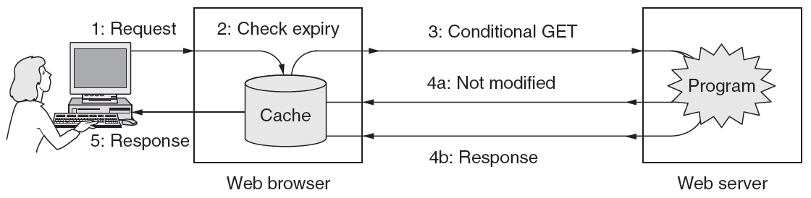
Web Caching (4)
Putting the pieces together:
Notes:
CN5E slides #7-47

Slide 45
Web Proxies
Place intermediary between pool of clients and external web servers
  Benefits for clients include greater caching and security checking
  Organizational access policies too!
Proxy caching
  Clients benefit from a larger, shared cache
  Benefits limited by secure and dynamic content, as well as “long tail”

Slide 46
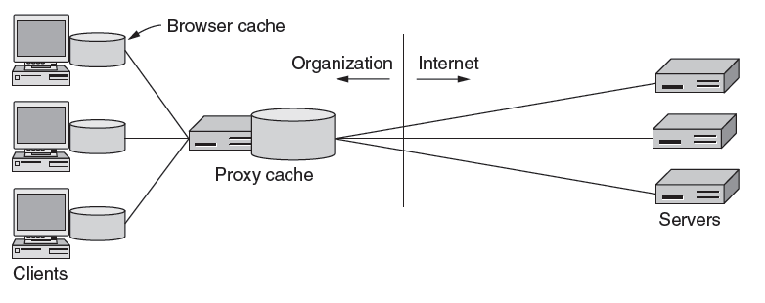
Web Proxies (2)
Clients contact proxy; proxy contacts server
Cache
Near client
Far from client
Notes:
CN5E figures #7-69

Slide 47
Context
As the web took off in the 90s, traffic volumes grew and grew. This:
  Concentrated load on popular servers
  Led to congested networks and need to provision more bandwidth
  Gave a poor user experience
Idea:
  Place popular content near clients
  Helps with all three issues above

Slide 48
Before CDNs
Sending content from the source to 4 users takes 4 x 3 = 12 “network hops” in the example
User
. . .
Source
User
Notes:
Go over paths
Icons from Cisco icon library, http://www.cisco.com/web/about/ac50/ac47/2.html. “Cisco icons are globally recognized and generally accepted as standard for network icon topologies. You may use them freely, but you may not alter them.”

Slide 49
After CDNs
Sending content via replicas takes only 4 + 2 = 6 “network hops”
User
. . .
Replica
Source
User
Notes:
Circle replica
Icons from Cisco icon library, http://www.cisco.com/web/about/ac50/ac47/2.html. “Cisco icons are globally recognized and generally accepted as standard for network icon topologies. You may use them freely, but you may not alter them.”

Slide 50
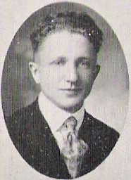
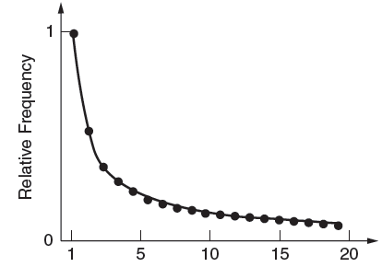
Popularity of Content
Zipf’s Law: few popular items, many unpopular ones; both matter
George Zipf (1902-1950)
Zipf popularity
(kth item is 1/k)
Rank
Source: Wikipedia
Notes:
CN5E slides #7-78

Slide 51
How to place content near clients?
Use browser and proxy caches
  Helps, but limited to one client or clients in one organization
Want to place replicas across the Internet for use by all nearby clients
  Done by clever use of DNS

Slide 52
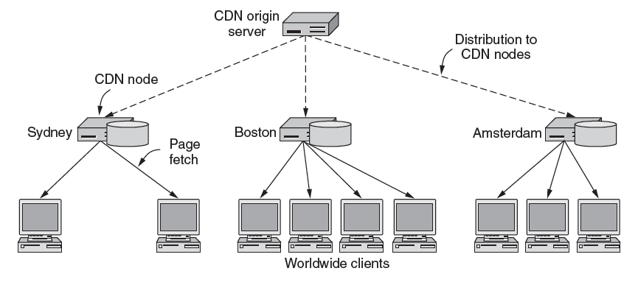
Content Delivery Network
Notes:
CN5E slides #7-81

Slide 53
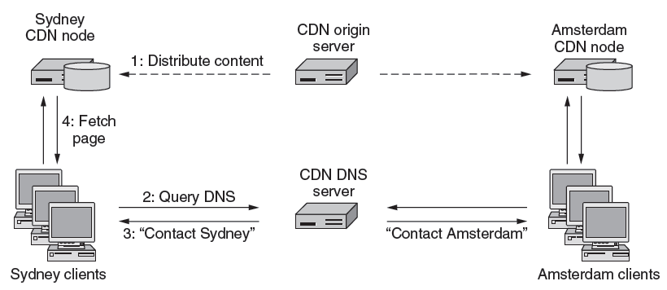
Content Delivery Network (2)
DNS resolution of site gives different answers to clients
  Tell each client the site is the nearest replica (map client IP)
Notes:
CN5E slides #7-82

Slide 54
Business Model
Clever model pioneered by Akamai
  Placing site replica at an ISP is win-win
  Improves site experience and reduces bandwidth usage of ISP
User
Consumer
site
ISP
. . .
Replica
User
Notes:
Icons from Cisco icon library, http://www.cisco.com/web/about/ac50/ac47/2.html

