Slide 1
CSE 564: Computer Security and Privacy
Winter 2015
Franzi Roesner
(franzi@cs.washington.edu)

Slide 2
Today
Introductions
Course Overview
Security/Privacy Teaser
Security Mindset

Slide 3
Course Staff
Instructor: Franzi (franzi@cs.washington.edu)
Office hours: Mondays 1:30-2:30pm (and by appointment)
Location: CSE 654
TA: Paul Vines (plvines@cs.washington.edu)
Graduate student in the security lab
Office hours: TBD

Slide 4
Course Goals
Teach or sharpen a security mindset (challenge assumptions, think critically)
Introduce a broad range of security & privacy topics, and bring you to the forefront of research on those topics
Ultimately design better systems
Provide background and perspective for your research – in security or otherwise!

Slide 5
Course Non-Goals
Learn any specific security/privacy technologies
Cryptography
Yoshi is teaching a crypto course next quarter
Dan Boneh (Stanford) has a good Coursera crypto course: https://www.coursera.org/course/crypto

Slide 6
Class Format
Two meetings per week: T/Th 10:30am
Research-focused course
Mainly discussions of papers (2 per class)
3-4 people to lead the discussion for each class (2x per quarter), but everyone should come prepared to discuss the assigned papers
Participation counts for a non-negligible portion of your grade
One guest lecture: Xi Wang (2/5/2015)

Slide 7
Class Resources
Webpage: http://courses.cs.washington.edu/courses/cse564/15wi/
Reading schedule and deadlines
Links to everything
Catalyst discussion board
Mainly for reading writeups
Catalyst dropbox
For assignments, including project checkpoints

Slide 8
Evaluation
45%: Project
5%: Proposal
5%: Checkpoint
5%: Draft
15%: Oral presentation
15%: Final report
45%: Assignments
20%: Security reviews (2)
10%: Attack lab
15%: Reading discussion board posts
10%: Class participation

Slide 9
Class Participation
An important part of your grade
Because:
We would like you to read and think about papers throughout the quarter
Important to learn to discuss papers
Expectations
Ask questions, raise issues, think critically
Learn to express your opinion
Respect and invite other people’s opinions

Slide 10
Paper Writeups
Due at 8 am before every class
You have 4 “freebies” (but remember that there are 2 per class)
Short: one paragraph per paper (2 paragraphs total)
Say something original! For example:
Paper summary, key points
Evaluation, opinions, response to others’ opinions
Questions for discussion, responses to others’ questions
Open research questions
Broader implications, relationships with previous papers
Graded on scale of 0-2

Slide 11
Security Reviews
Goal: learn to evaluate potential security and/or privacy issues with new technologies
For example, something you see in the news, on social media, in stores, etc.
2-3 pages, submit to Catalyst dropbox
You may work individually or in groups of 2
Follow specific format on website (more details later today)

Slide 12
Attack Lab
Goals:
Teach you some practical security-related skills.
Show you how easy it is to break a system!
Help you remember not to make those mistakes in the systems you build yourselves ☺
You may work individually or in groups of 2
Details TBD

Slide 13
Project
Groups of 2-3 people (talk to me for exceptions).
Topic:
Choose from a list of topics, or come up with your own.
Can be related to your ongoing research.
Can be related to a project in another course.
Must be related to computer security and/or privacy.
I encourage you to come talk to me about ideas.
Types of projects: Design/Build, Analyze, Measure, HCI

Slide 14
Project
Final deliverables:
Conference-style report (at most 12 pages) and presentation.
Milestones (see course website for deadlines)
Group formation
Project proposal
Checkpoint
Draft
Presentation
Final report
Summary of contributions
Project presentations: March 16, 2015 between 8:30am-12:20pm

Slide 15
Let’s Get Started
What is computer security?
What is privacy?
Why haven’t we solved this?
Game: spot the fake!
(with thanks/apologies to Avi Rubin)

Slide 16
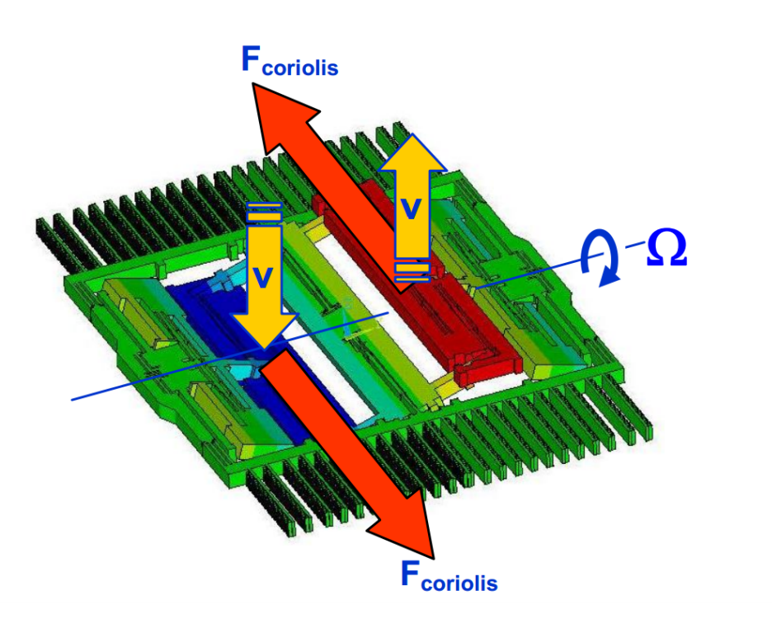
Gyroscope Eavesdropping
Notes:
http://crypto.stanford.edu/gyrophone/

Slide 17
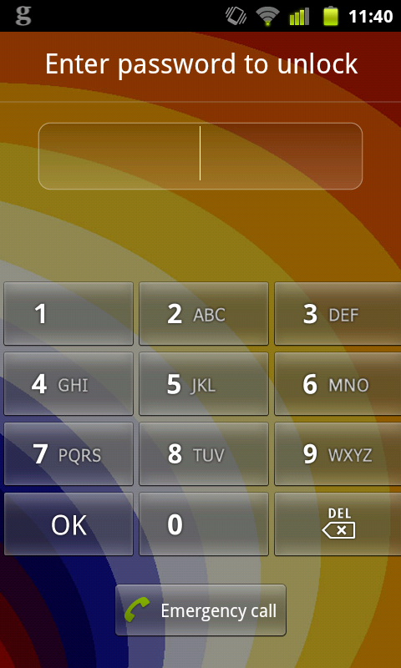
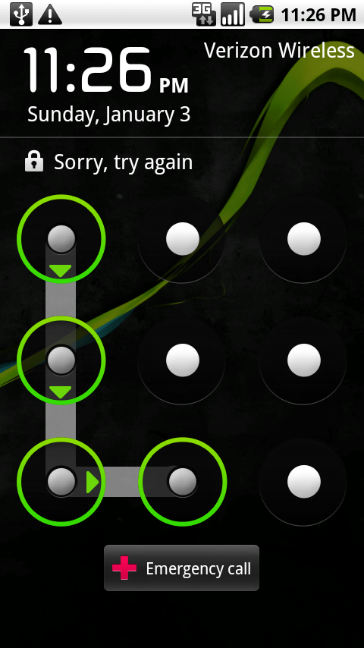
Accelerometer Eavesdropping
Notes:
http://www.cs.swarthmore.edu/~aviv/papers/aviv-acsac12-accel.pdf

Slide 18
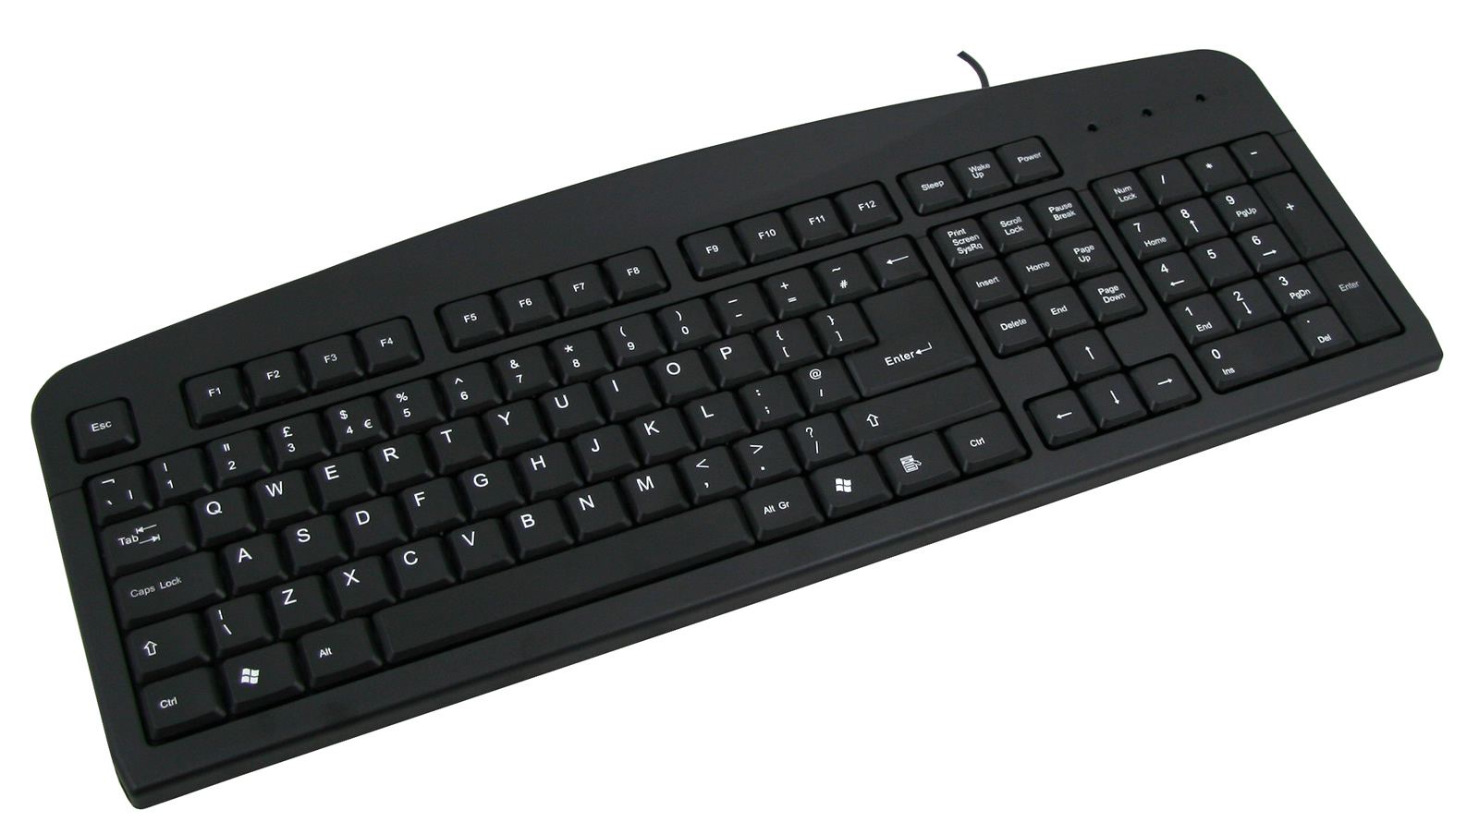
Keyboard Eavesdropping
Notes:
http://www.cs.berkeley.edu/~tygar/papers/Keyboard_Acoustic_Emanations_Revisited/ccs.pdf
http://lasec.epfl.ch/keyboard/ (electromagnetic)

Slide 19
Audio from Video
Notes:
http://people.csail.mit.edu/mrub/VisualMic/

Slide 20
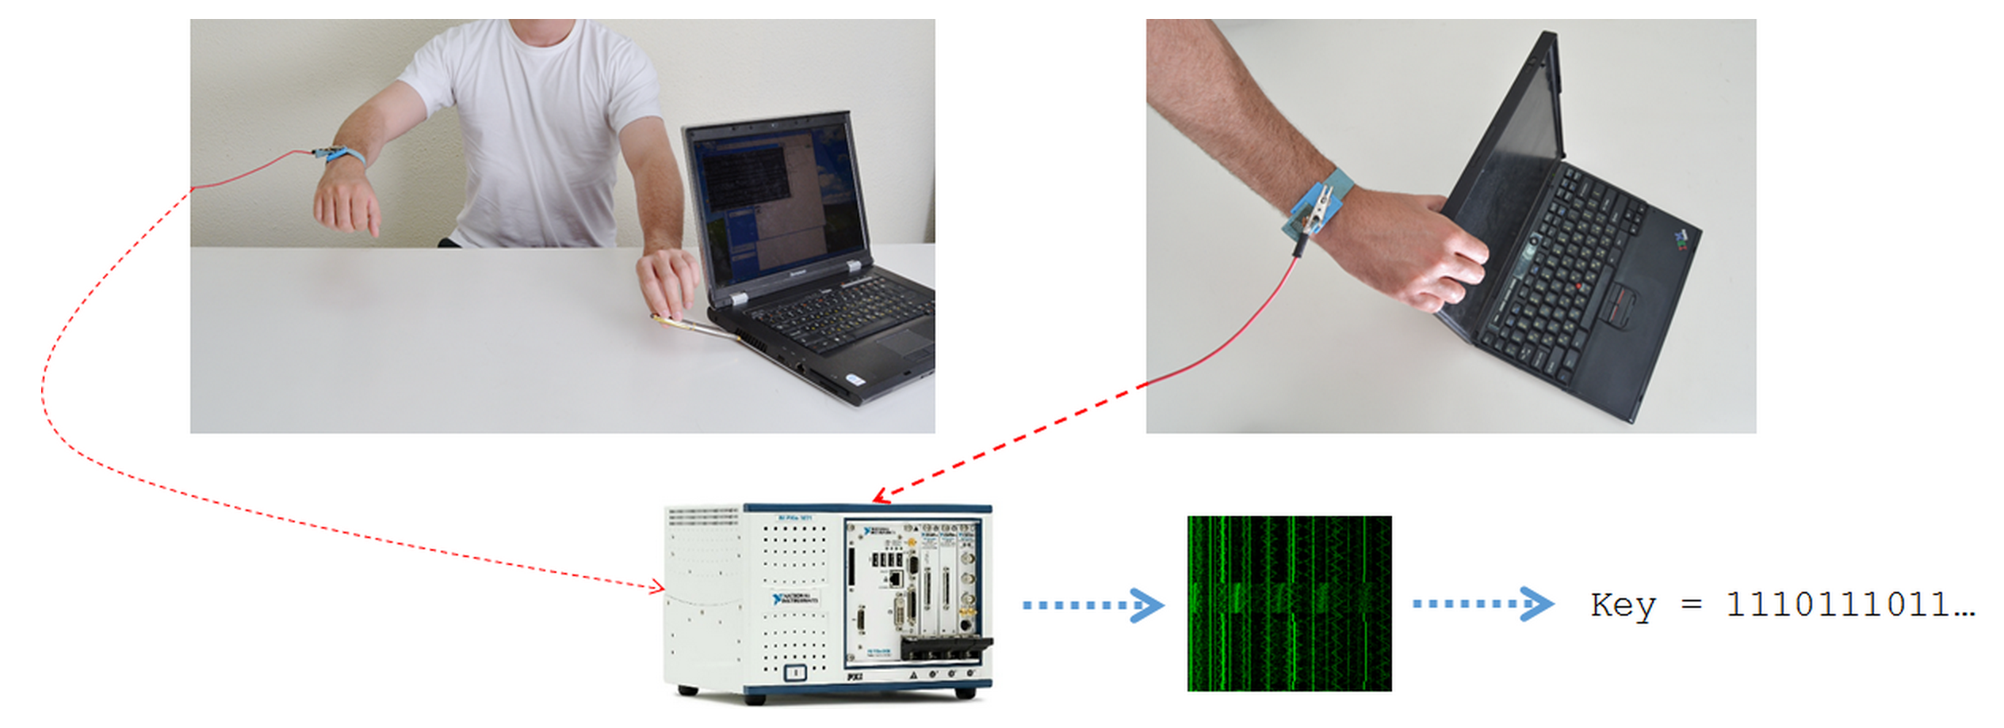
Key Extraction
Notes:
http://www.tau.ac.il/~tromer/handsoff/
Our attacks use novel side channels and are based on the observation that the "ground" electric potential in many computers fluctuates in a computation-dependent way. An attacker can measure this signal by touching exposed metal on the computer's chassis with a plain wire, or even with a bare hand. The signal can also be measured at the remote end of Ethernet, VGA or USB cables.
The attacker can measure the chassis potential by merely touching a conductive part of the laptop chassis with his hand, while surreptitiously measuring his own body potential relative to the ground potential of the room. (This attack is especially effective in hot weather, since sweaty fingers offer lower electric resistance.)

Slide 21
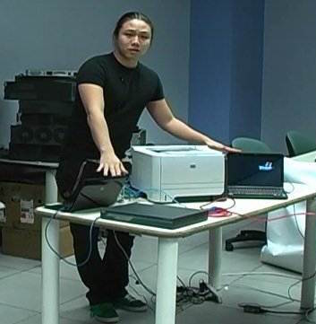
Exploding Devices
Notes:
http://ids.cs.columbia.edu/sites/default/files/CuiPrintMeIfYouDare.pdf
http://ids.cs.columbia.edu/sites/default/files/ndss-2013.pdf
http://homes.cs.washington.edu/~yoshi/papers/HomeAutomation.pdf

Slide 22
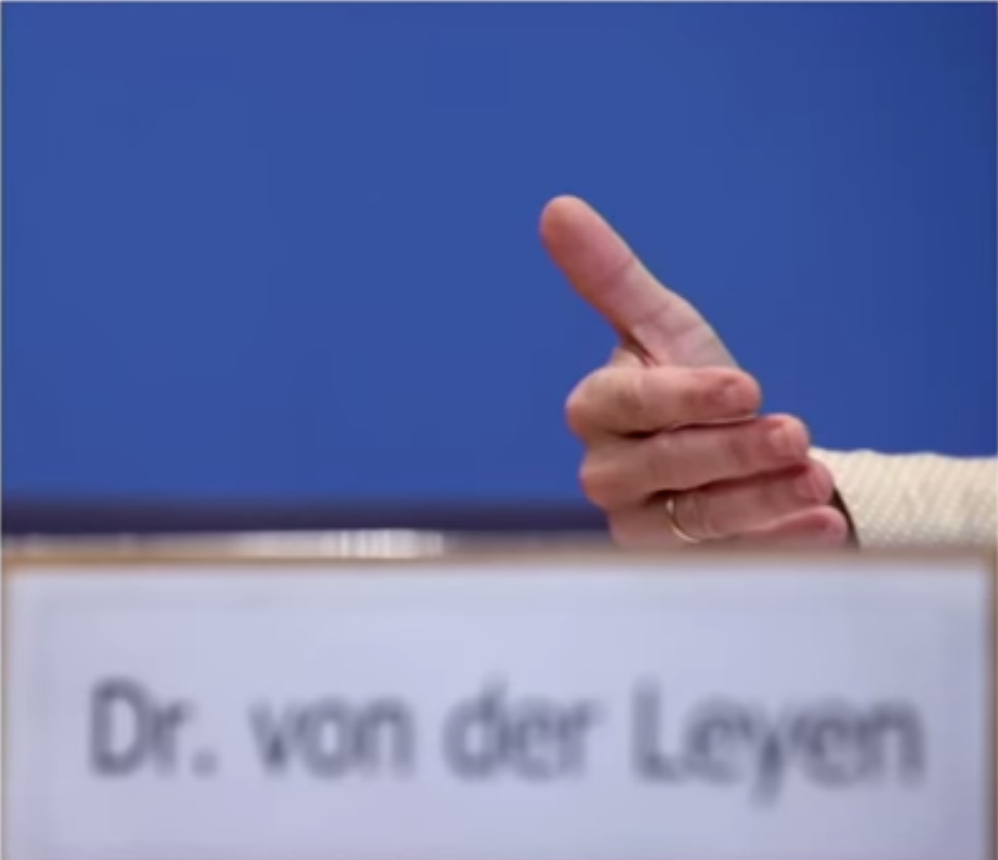
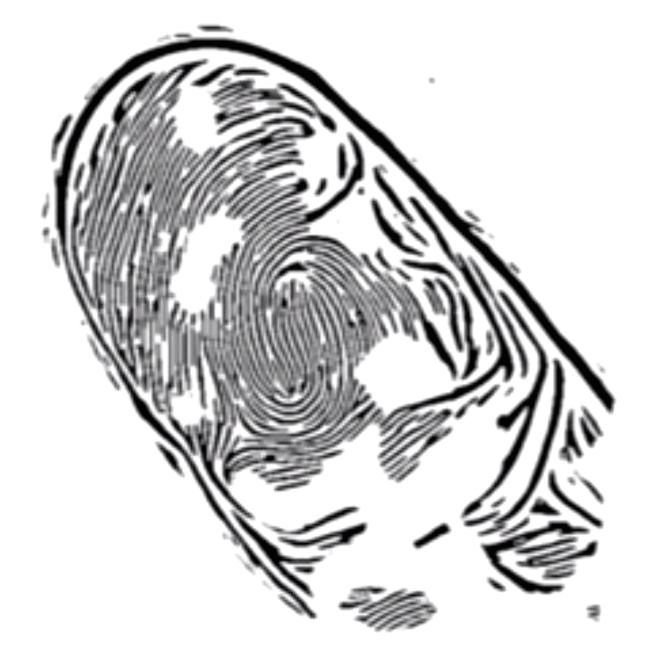
Fingerprints from Photos
Notes:
https://www.youtube.com/watch?v=pIY6k4gvQsY&list=PLhcowWio4HvYr2BW739VTvfM9DdJArxzH&index=2

Slide 23
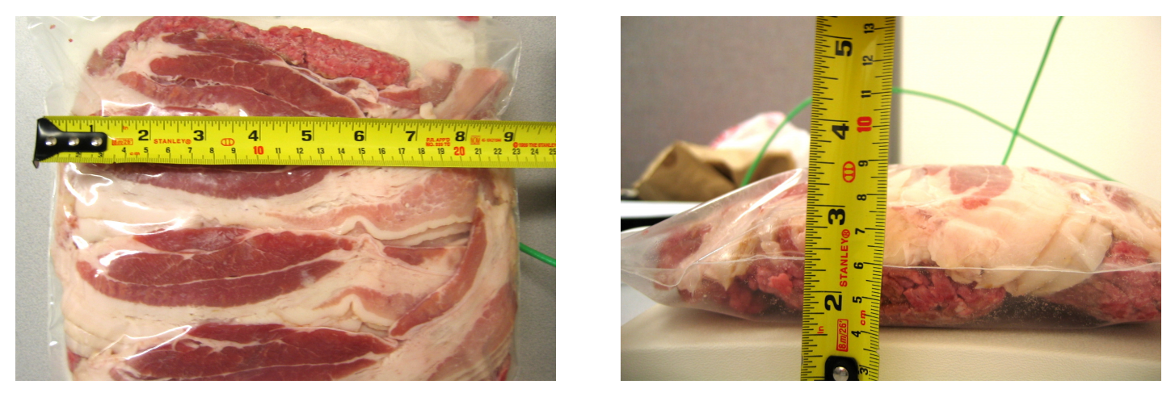
Hacking Defibrillators
Notes:
http://www.secure-medicine.org/public/publications/icd-study.pdf

Slide 24
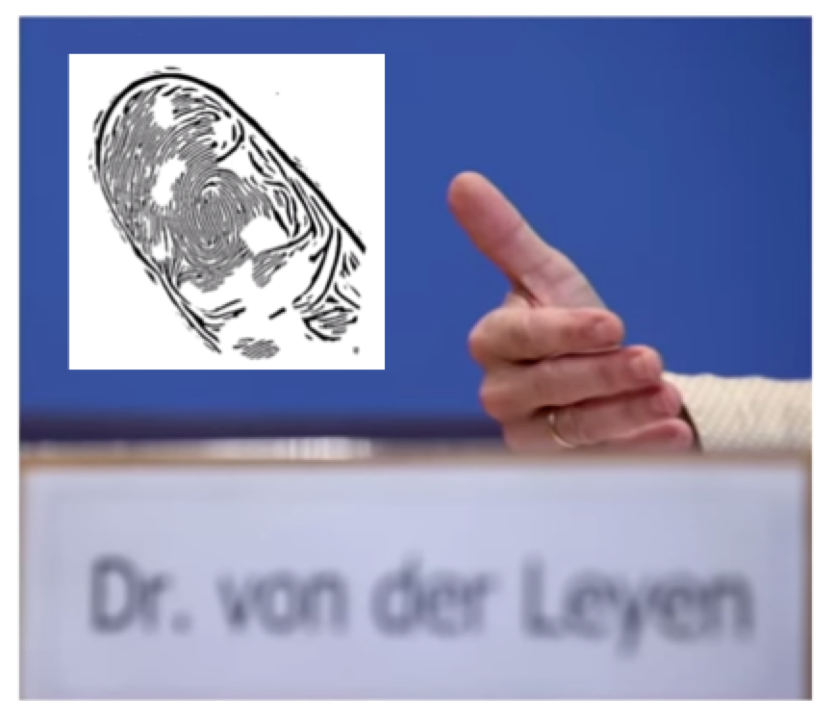
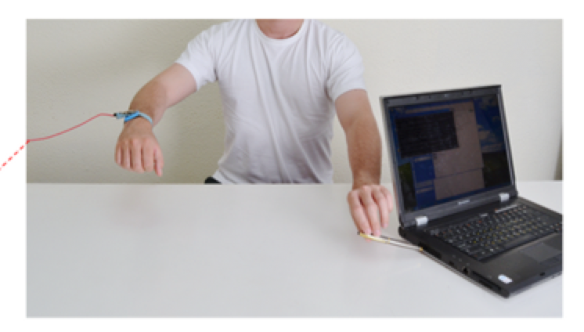
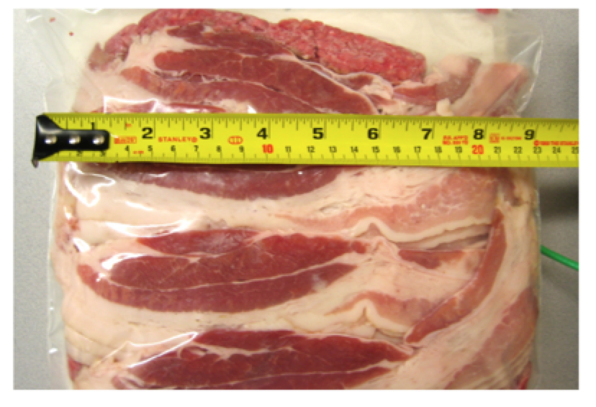
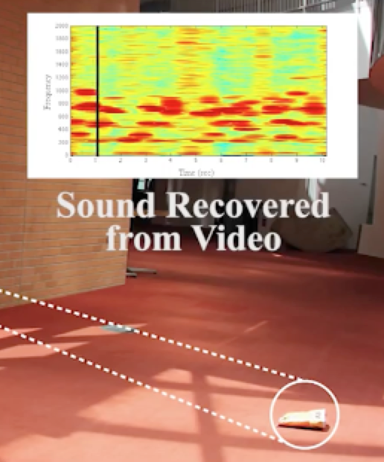
Spot the Fake
gyroscope
explosions
fingerprint
video->audio
key extraction
defibrillator
accelerometer
keyboards

Slide 25
Computer Security & Privacy
Why I love it:
Critical lens
Breadth and flexibility
Problems that really matter for people
Fun! (Lets you be a little sneaky)
Variety of approaches: system design/building, attacks, measurements, human factors

Slide 26
Security Mindset
Thinking critically about designs, challenging assumptions
Being curious, thinking like an attacker
“That new product X sounds awesome, I can’t wait to use it!” versus “That new product X sounds cool, but I wonder what would happen if someone did Y with it…”
Why it’s important
Technology changes, so learning to think like a security person is more important than learning specifics of today
Will help you design better systems/solutions
Interactions with broader context: law, policy, ethics, etc.
Notes:
(Something about curiosity – talk about Karl)

Slide 27
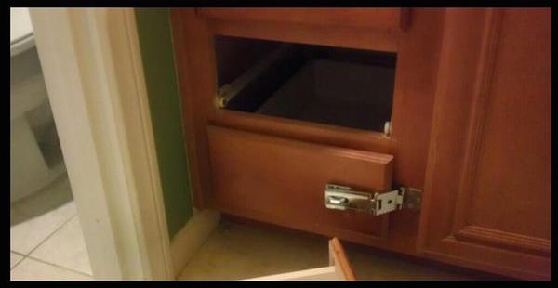
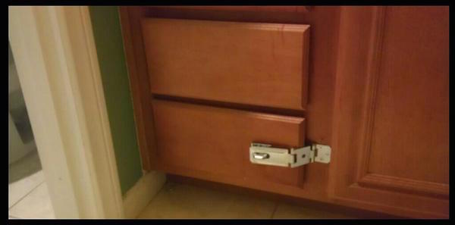
Example

Slide 28
Security Reviews
Assets (what should be protected)
Adversaries (possible attackers)
Threats (actions by adversaries to exploit system)
Vulnerabilities (weaknesses of system)
Risk (how important are assets, how likely is exploit)
Defenses

Slide 29
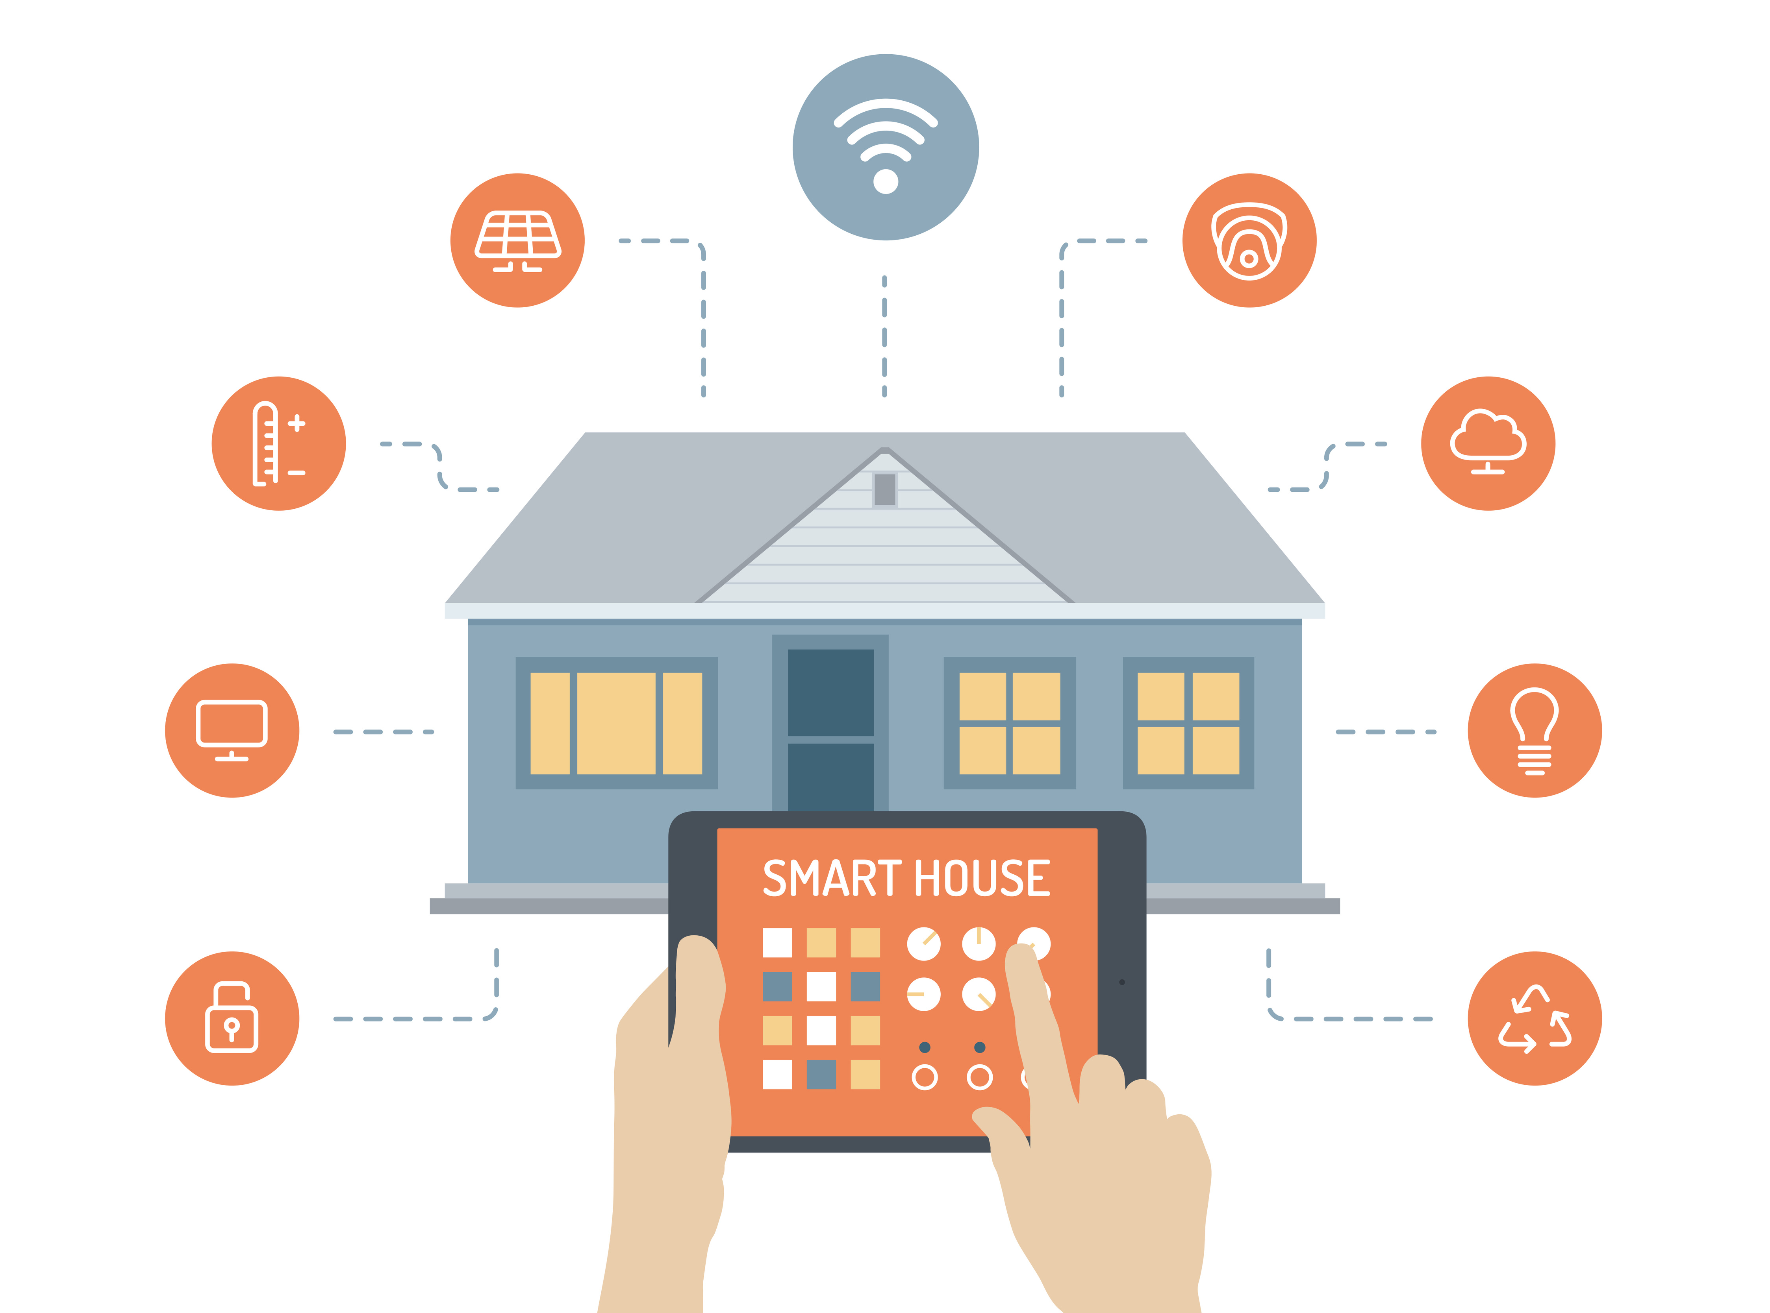
Example Security Review
Assets, Adversaries, Threats, Vulnerabilities, Risk, Defenses?

Slide 30
Spot the Fake
gyroscope
explosions
fingerprint
video->audio
key extraction
defibrillator
accelerometer
keyboards

Slide 31
Reminders
Fill out the pre-course survey
Sign up to lead discussions (2 slots)
Reading writeups due at 8am Thursday
Come see me after class if you’re not yet registered for the course but want to be

