Slide 1
Structure From Motion
Ali Farhadi
CSE 576
Several slides from Steve Seitz, Rick Szeliski, Martial Hebert, and Noha Snavely

Slide 2
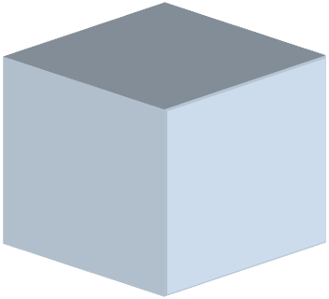
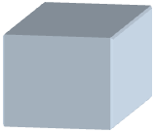

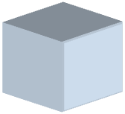
Structure from motion
aka “bundle adjustment” (texts: Zisserman; Faugeras)
p₄
p₁
p₃
minimize
p₂
g (R, T, P)
p₅
p₇
p₆
Camera 1
Camera 3
R₁,t₁
R₃,t₃
Camera 2
R₂,t₂
Notes:
Structure from motion solves the following problem:
Given a set of images of a static scene with 2D points in correspondence, shown here as color-coded points, find…
a set of 3D points P and
a rotation R and position t of the cameras that explain the observed correspondences. In other words, when we project a point into any of the cameras, the reprojection error between the projected and observed 2D points is low.
This problem can be formulated as an optimization problem where we want to find the rotations R, positions t, and 3D point locations P that minimize sum of squared reprojection errors f. This is a non-linear least squares problem and can be solved with algorithms such as Levenberg-Marquart. However, because the problem is non-linear, it can be susceptible to local minima. Therefore, it’s important to initialize the parameters of the system carefully. In addition, we need to be able to deal with erroneous correspondences.

Slide 3
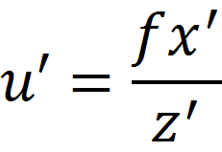
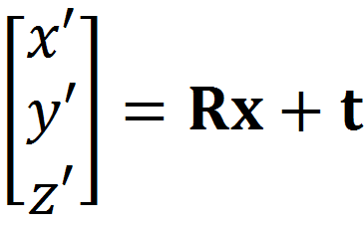
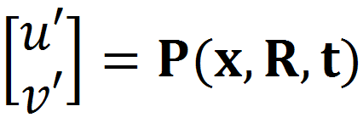
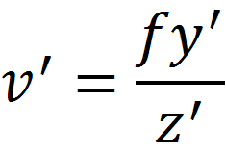
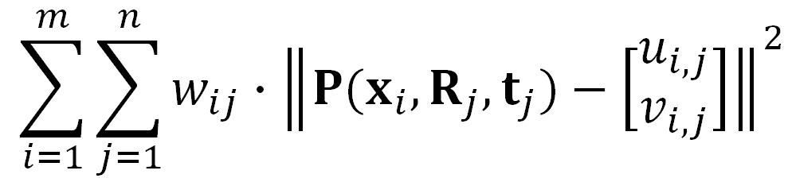

SfM objective function
Given point x and rotation and translation R, t
Minimize sum of squared reprojection errors:
predicted
image location
observed
image location

Slide 4
Solving structure from motion
Minimizing g is difficult:
  g is non-linear due to rotations, perspective division
  lots of parameters: 3 for each 3D point, 6 for each camera
  difficult to initialize
  gauge ambiguity: error is invariant to a similarity transform (translation, rotation, uniform scale)
Many techniques use non-linear least-squares optimization (bundle adjustment)
  Levenberg-Marquardt is a popular algorithm
  http://en.wikipedia.org/wiki/Levenberg-Marquardt_algorithm
Good code online
  Bundler: http://phototour.cs.washington.edu/bundler/
  Multicore: http://grail.cs.washington.edu/projects/mcba/

Slide 5
Suppose we know 3D points and affine camera parameters …
then, we can compute the observed 2d positions of each point
3D Points (3xn)
Camera Parameters (2mx3)
2D Image Points (2mxn)

Slide 6
What if we instead observe corresponding 2d image points?
Can we recover the camera parameters and 3d points?
cameras (2 m)
points (n)
What rank is the matrix of 2D points?
Notes:
The measurement matrix D = MS must have rank 3!

Slide 7
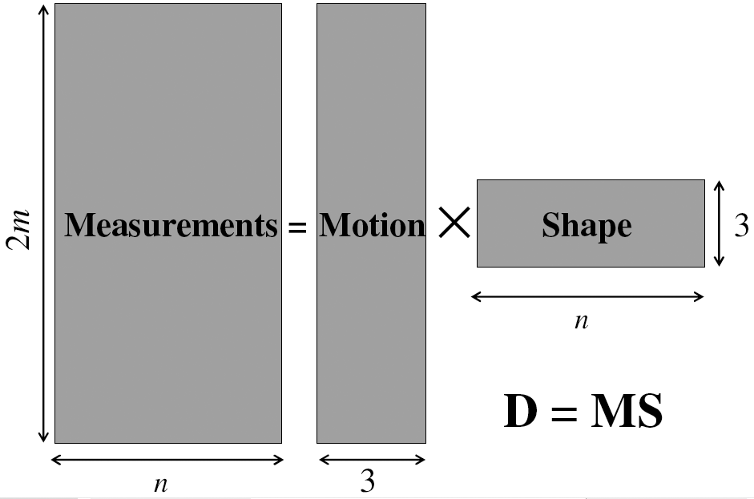
Factorizing the measurement matrix
Source: M. Hebert

Slide 8
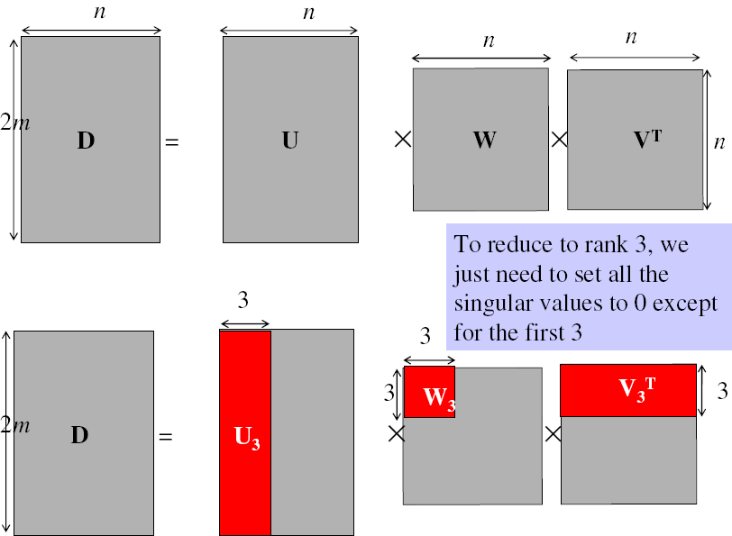
Factorizing the measurement matrix
Singular value decomposition of D:
Source: M. Hebert

Slide 9
Factorizing the measurement matrix
Singular value decomposition of D:
Source: M. Hebert

Slide 10
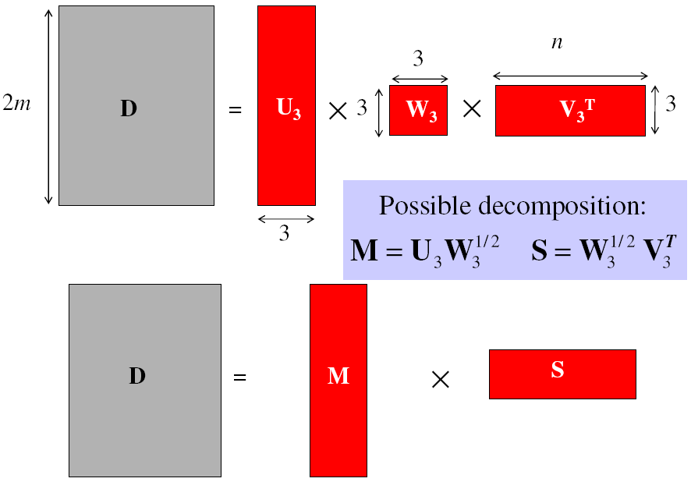
Factorizing the measurement matrix
Obtaining a factorization from SVD:
Source: M. Hebert

Slide 11
Factorizing the measurement matrix
Obtaining a factorization from SVD:
This decomposition minimizes
|D-MS|²
Source: M. Hebert

Slide 12
Algorithm summary
Given: m images and n features x_{ij}
For each image i, center the feature coordinates
Construct a 2m × n measurement matrix D:
  Column j contains the projection of point j in all views
  Row i contains one coordinate of the projections of all the n points in image i
Factorize D:
  Compute SVD: D = U W V^{T}
  Create U₃ by taking the first 3 columns of U
  Create V₃ by taking the first 3 columns of V
  Create W₃ by taking the upper left 3 × 3 block of W
Create the motion and shape matrices:
  M = U₃W₃^{½} and S = W₃^{½} V₃^{T} (or M = U₃ and S = W₃V₃^{T})
Source: M. Hebert

Slide 13
Structure from motion
aka “bundle adjustment” (texts: Zisserman; Faugeras)
p₄
p₁
p₃
minimize
p₂
g (R, T, P)
p₅
p₇
p₆
Camera 1
Camera 3
R₁,t₁
R₃,t₃
Camera 2
R₂,t₂
Notes:
Structure from motion solves the following problem:
Given a set of images of a static scene with 2D points in correspondence, shown here as color-coded points, find…
a set of 3D points P and
a rotation R and position t of the cameras that explain the observed correspondences. In other words, when we project a point into any of the cameras, the reprojection error between the projected and observed 2D points is low.
This problem can be formulated as an optimization problem where we want to find the rotations R, positions t, and 3D point locations P that minimize sum of squared reprojection errors f. This is a non-linear least squares problem and can be solved with algorithms such as Levenberg-Marquart. However, because the problem is non-linear, it can be susceptible to local minima. Therefore, it’s important to initialize the parameters of the system carefully. In addition, we need to be able to deal with erroneous correspondences.

Slide 14

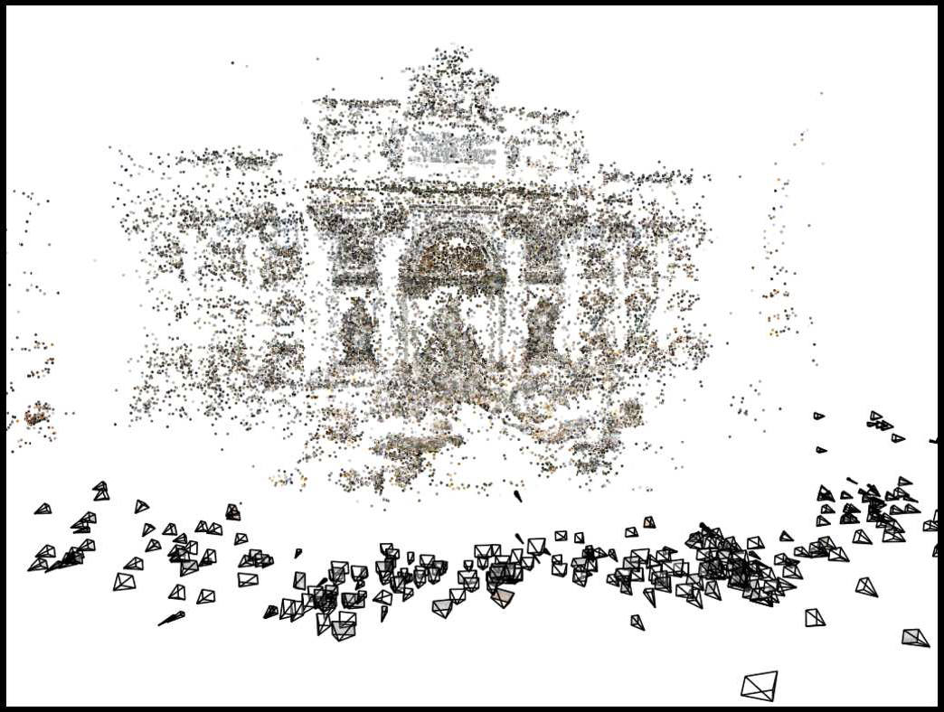
Structure from motion
Images on the Internet
Computed 3D structure

Slide 15
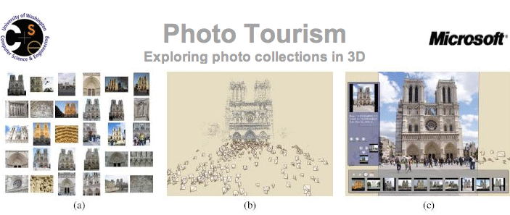
Photo tourism video: http://www.youtube.com/watch?v=5Ji84zb2r8s
Photosynth: http://photosynth.net/

Slide 16


Slide 17
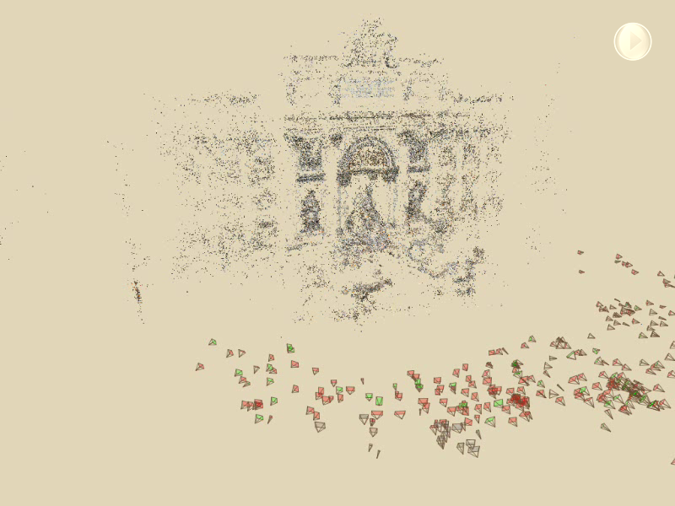

Slide 18
Scene reconstruction
Automatically estimate
  position, orientation, and focal length of cameras
  3D positions of feature points
Feature detection
Incremental structure from motion
Pairwise
feature matching
Correspondence estimation
Notes:
Again, the goal of the reconstruction procedure is to automatically estimate the relative positions and orientations, as well as the focal length or zoom, of each of the photographs in a connected component of the scene. The process consists of four steps: detecting features in each of the input photos; matching features between each pair of photos; grouping the matches into correspondences across multiple photos; and using the correspondences to estimate the geometry of the scene and the cameras in a technique known as structure from motion.
I’ll now describe each of these steps in more detail.
[Structure from motion techniques for unordered image collections have also been developed by others, such as Brown and Lowe and Schaffalitzky and Zisserman, and the basic pipeline of our system closely follows that of Brown and Lowe. To our knowledge, our system is the first to have been demonstrated on large collections of photos from the Internet.]

Slide 19
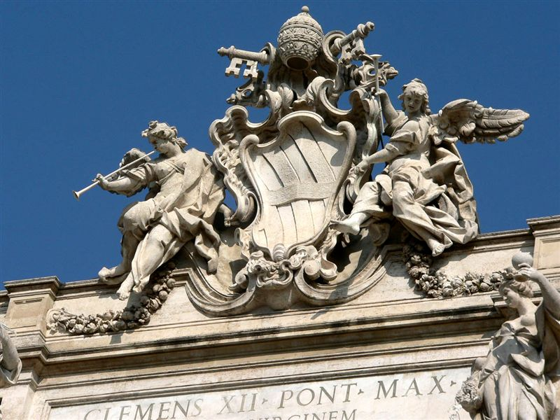
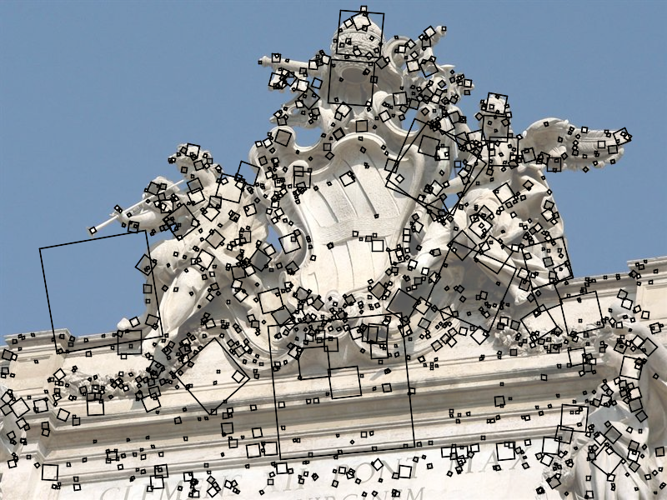
Feature detection
Detect features using SIFT [Lowe, IJCV 2004]
Notes:
The core of the reconstruction process is the ability to reliably match feature points between images. Fortunately, over the last few years feature detection and matching techniques have improved dramatically. Many different technique exist – we use SIFT, or scale-invariant feature transform, developed by David Lowe. SIFT is designed to be invariant to image scale and rotation, as well as affine changes in image intensity.
Here is an image from the Trevi Fountain, and here are the features SIFT detects in the image, shown as square patches. The squares are scaled and rotated to reflect the scale and orientation of the features.

Slide 20
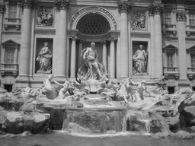
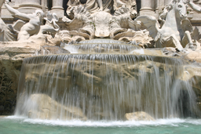
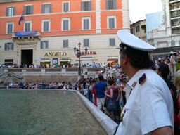
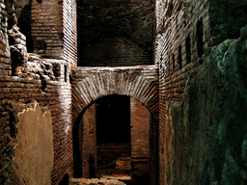
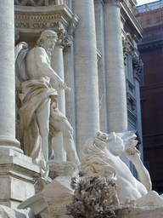
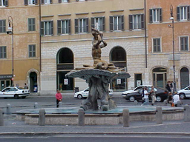
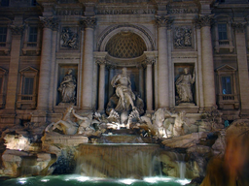
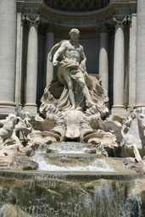
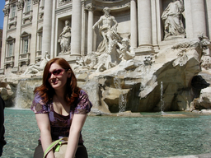
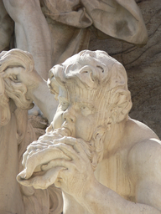
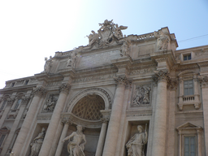
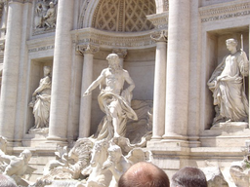
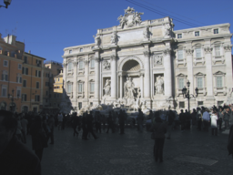
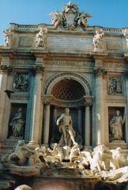
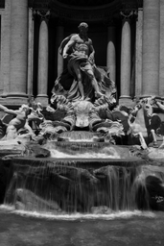
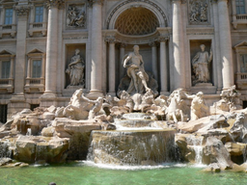
Feature detection
Detect features using SIFT [Lowe, IJCV 2004]
Notes:
So, we begin by detecting SIFT features in each photo.
[We detect SIFT features in each photo, resulting in a set of feature locations and 128-byte feature descriptors…]

Slide 21
Feature detection
Detect features using SIFT [Lowe, IJCV 2004]

Slide 22
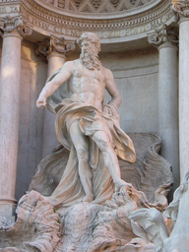
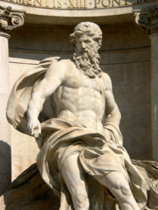
Correspondence estimation
Link up pairwise matches to form connected components of matches across several images
Image 1
Image 2
Image 3
Image 4
Notes:
The next step of our reconstruction algorithm is to link up matches between pairs of images into correspondences between multiple images, by finding connected components of matches. Suppose among these images, these features are matched only between consecutive pairs of images, perhaps because the scales of the images are so different. During correspondence estimation we link these matches and consider them to be 2D projections of a single 3D point in the scene.

Slide 23
Feature matching
Match features between each pair of images
Notes:
Next, we match features across each pair of photos using approximate nearest neighbor matching.

Slide 24
Feature matching
Refine matching using RANSAC [Fischler & Bolles 1987]
Notes:
The matches are refined by using RANSAC, which is a robust model-fitting technique, to estimate a fundamental matrix between each pair of matching images and keeping only matches consistent with that fundamental matrix.
We then link connected components of pairwise feature matches together to form correspondences across multiple images.
Once we have correspondences, we run structure from motion to recover the camera and scene geometry. Structure from motion solves the following problem:

Slide 25
Incremental structure from motion
Notes:
To help get good initializations for all of the parameters of the system, we reconstruct the scene incrementally, starting from two photographs and the points they observe.

Slide 26
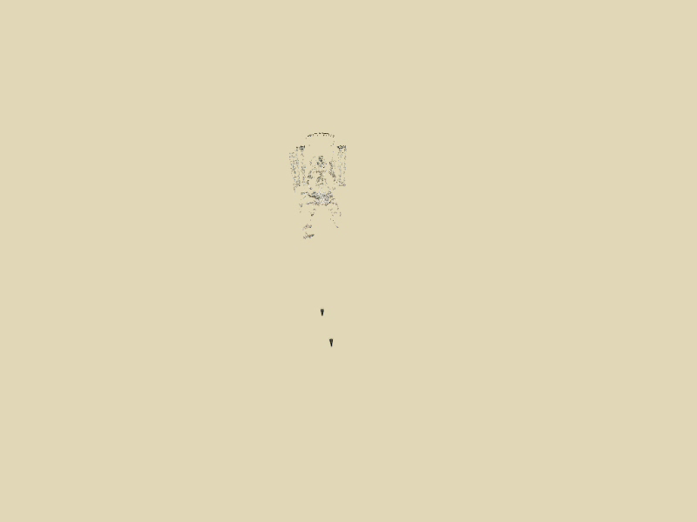
Incremental structure from motion
Notes:
We then add several photos at a time to the reconstruction, refine the model, and repeat until no more photos match any points in the scene.

Slide 27
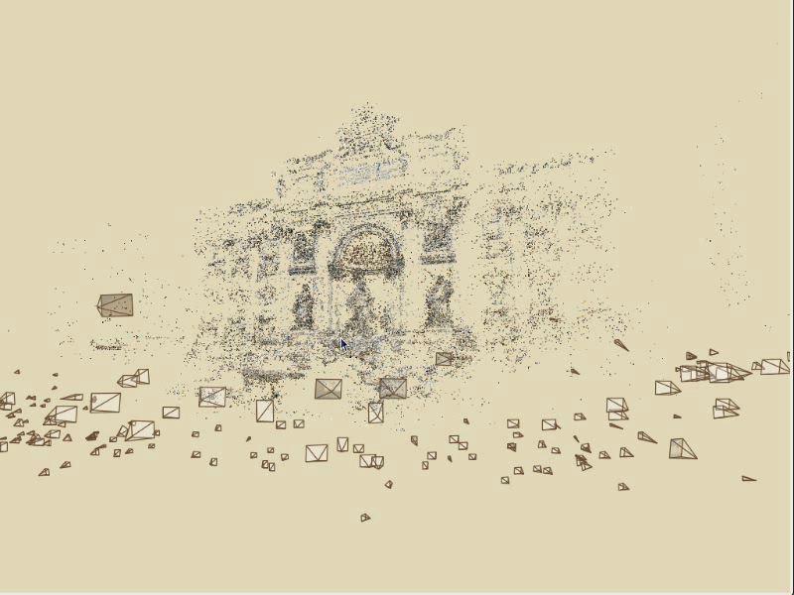
Photo Explorer

Slide 28
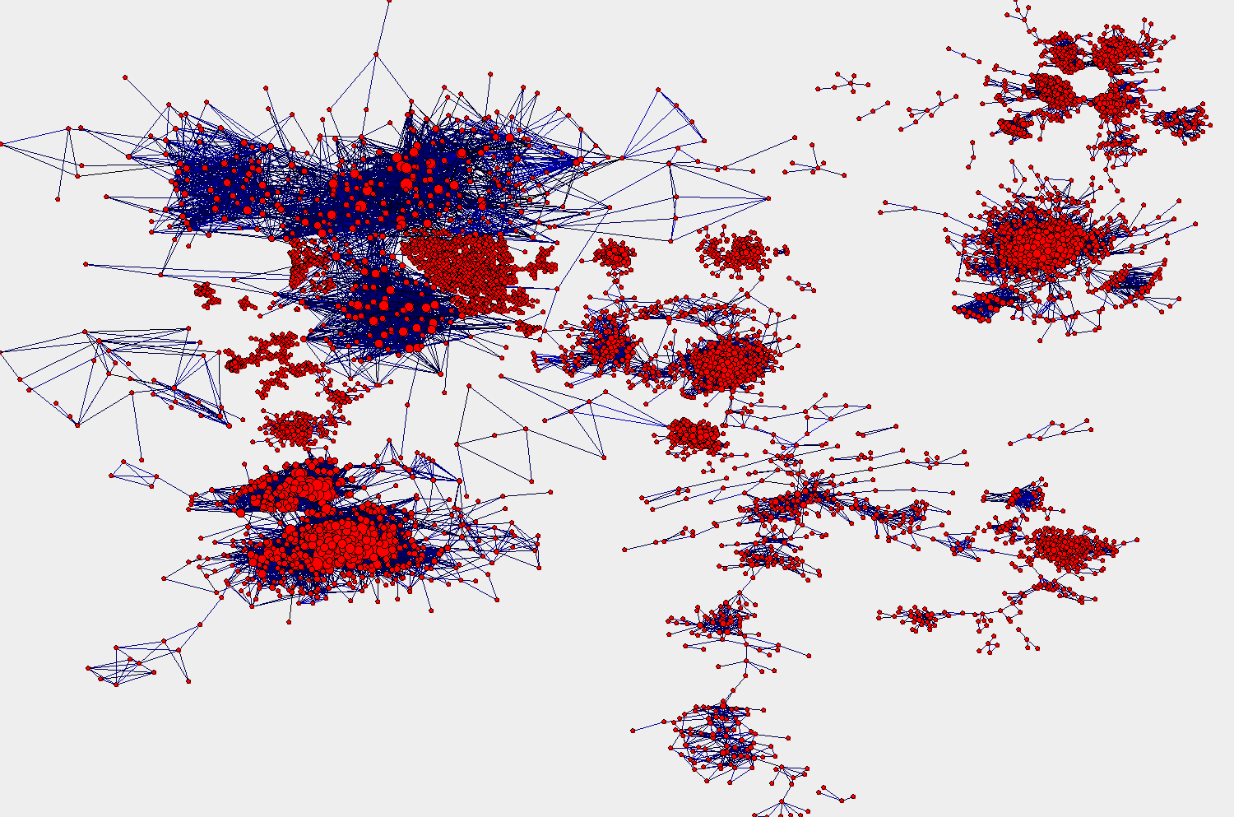
Coliseum
(outside)
St. Peters (inside)
Coliseum
(inside)
St. Peters (outside)
Il Vittoriano
Trevi Fountain
Forum

Slide 29
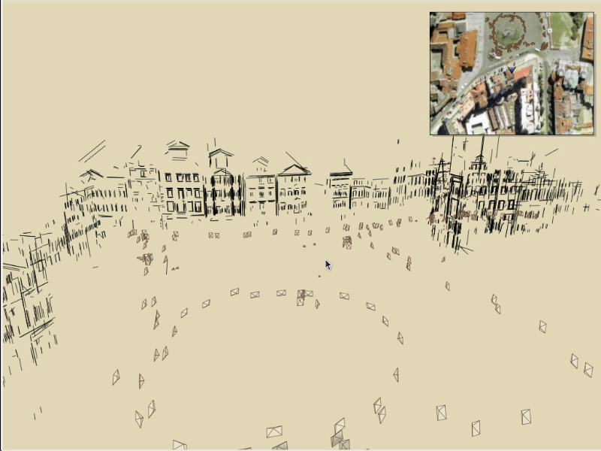
Navigation: Prague Old Town Square
Notes:
Now we’ll move on to another dataset to demonstrate some more of the navigation features of our system.
This is a reconstruction of the Old Town Square in Prague from about 200 photos, shown inside our photo explorer. An overhead map is shown in the upper right corner.
For this dataset, we render the scene using 3D line segments and add color to the scene by projecting blurred, partially transparent versions of the photos onto detected planes.
The user can select photos from the map, and the map tracks the movement of the virtual camera. Here the user selects a building to see a better picture.
Now here’s another example of relation-based browsing – the user can click on the “move right” button to move right to the next building in the row of façades.
Now the user clicks on the zoom out button to see more of the scene.

Slide 30
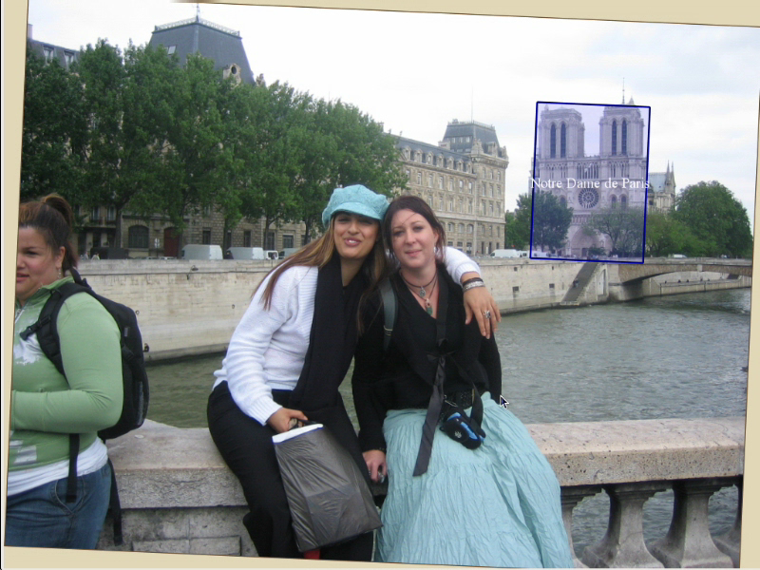
Hierarchical annotations

Slide 31
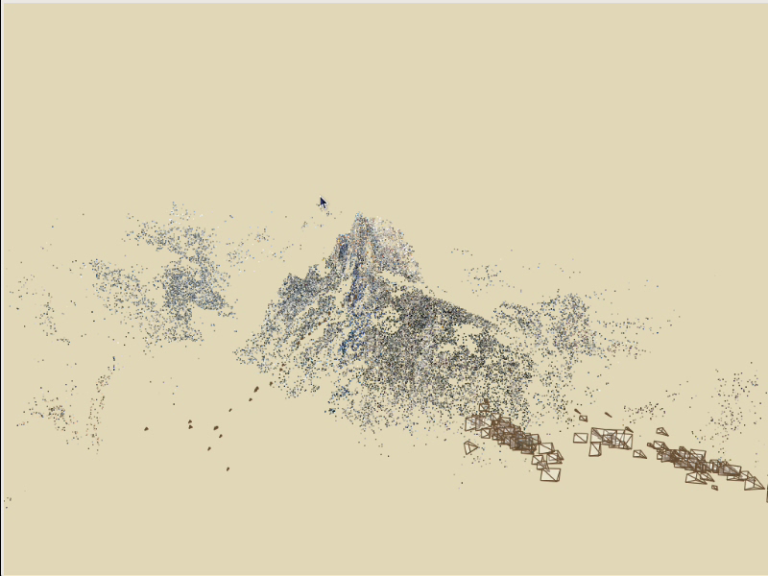
Locking the camera (stabilization)

Slide 32
Applications

Slide 33
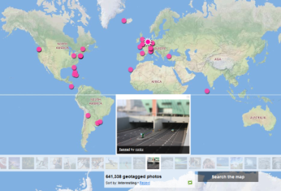
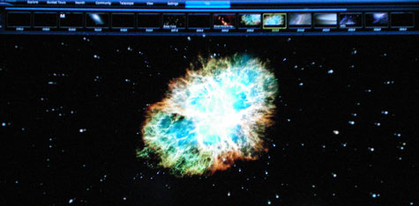
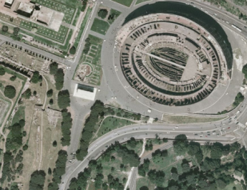
Community photo collections
“Wikipedia for photos” – visual record of world through community of photographers
  Geograph British Isles http://www.geograph.org.uk/
Users can tag and comment on photos, link to other content
  World-wide telescope
“Where should I take a photo?”
  http://photocitygame.com/

Slide 34

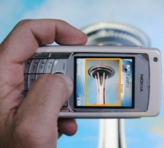
Community photo collections
Leveraging large databases of photos, large number of users
  Annotations / augmented reality

Slide 35
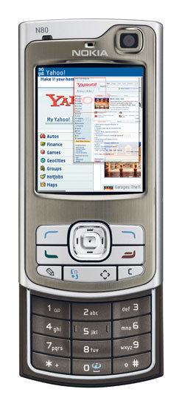

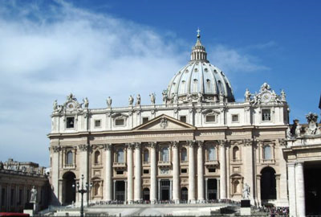
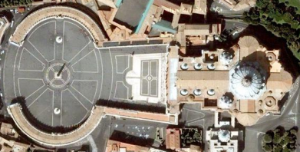
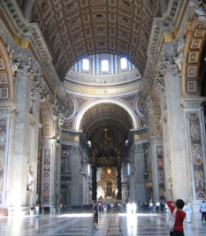
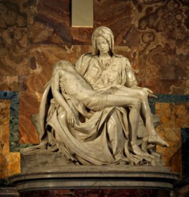

Virtual tour guide scenario
St. Peter’s Basilica
Built: 1506-1626
http://en.wikipedia.org/wiki/St._Peter's_Basilica
St. Peter’s Basilica
Built: 1506-1626

Slide 36
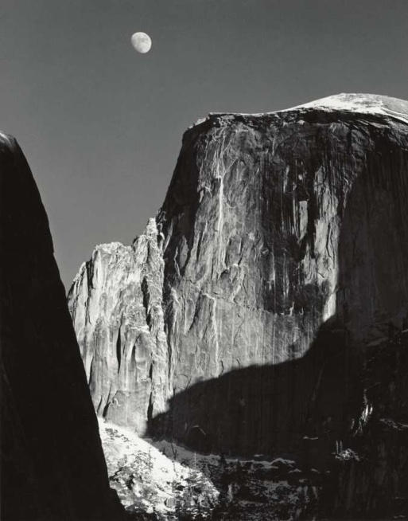



Rephotography
Topographic data courtesy USGS

