Slide 1
Basics for
Convolutional Neural Network
Beibin Li
2021-05

Slide 2
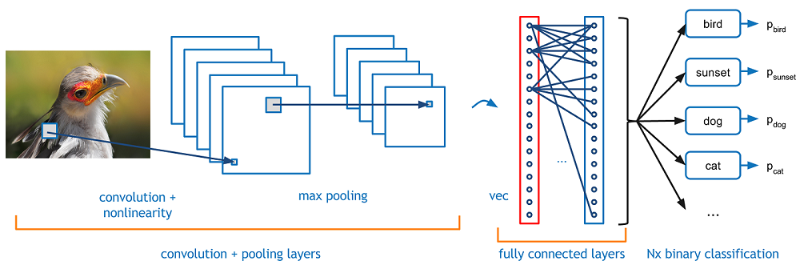
CNN

Slide 3
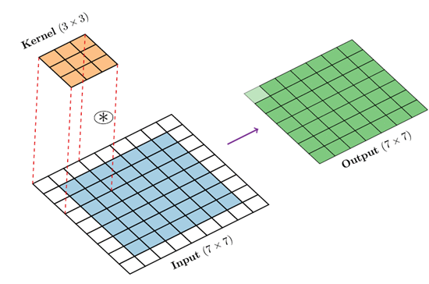
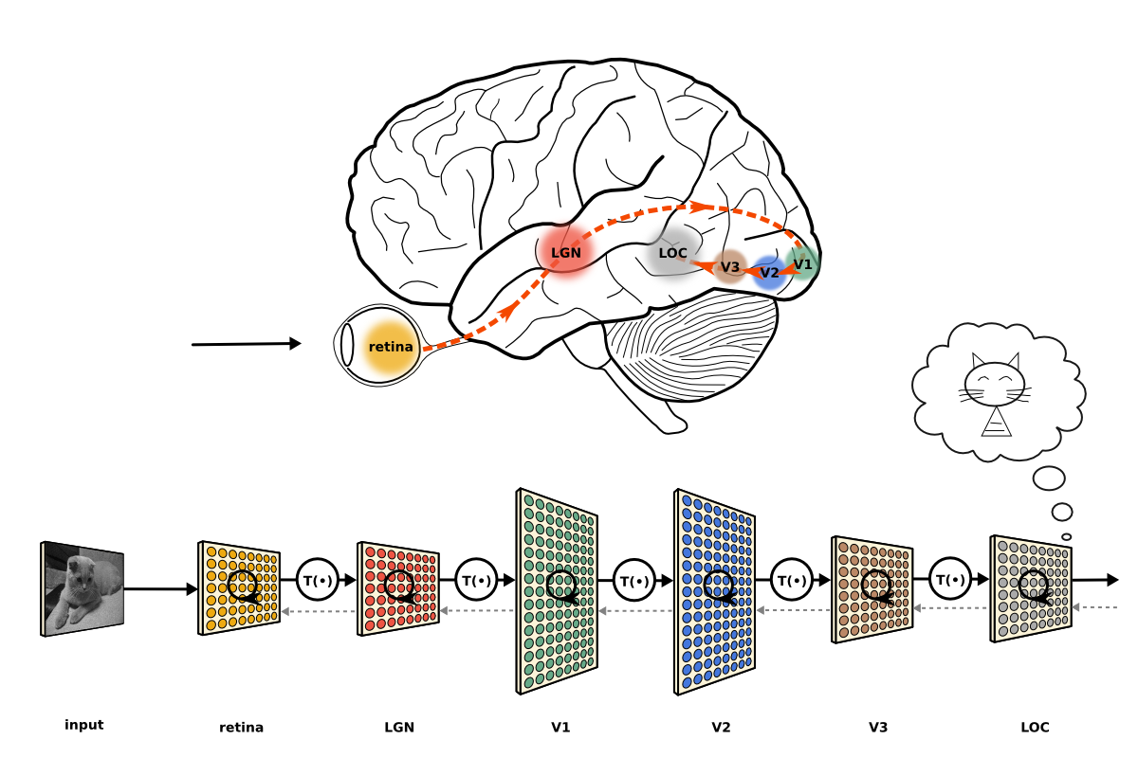
Convolution Operation
Nowadays, we learn kernels from the data.

Slide 4
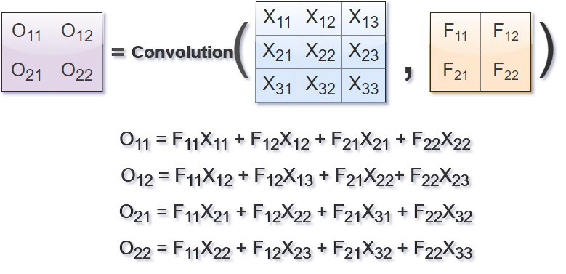
Learning
Details:
https://www.slideshare.net/EdwinEfranJimnezLepe/example-feedforward-backpropagation
https://medium.com/@2017csm1006/forward-and-backpropagation-in-convolutional-neural-network-4dfa96d7b37e

Slide 5
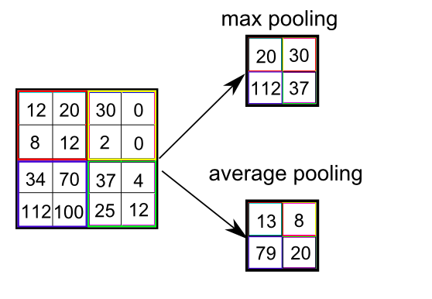
Pooling
e.g. kernel size = 2, stride = 2 for both width and height.
The kernel size for pooling can be an even number.

Slide 6
CNN Structures
Image Classification

Slide 7
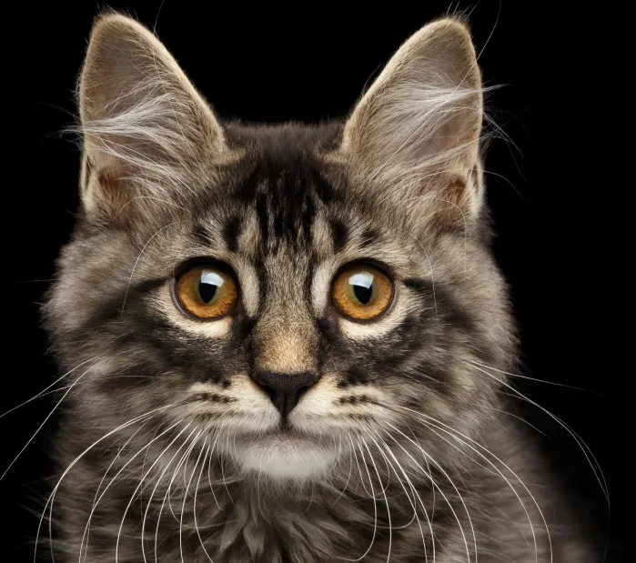
Image Classification
CU
Convolutional
Unit
FC
Fully-connected
Or Linear Layer
DU
Down-sampling
Unit
GAP
Global Avg.
Pooling
CU
DU
CU
DU
CU
GAP
FC
Cat
28 x 28
= [28]²
[28]²
[14]²
[14]²
[7]²
[7]²
[1]²

Slide 8
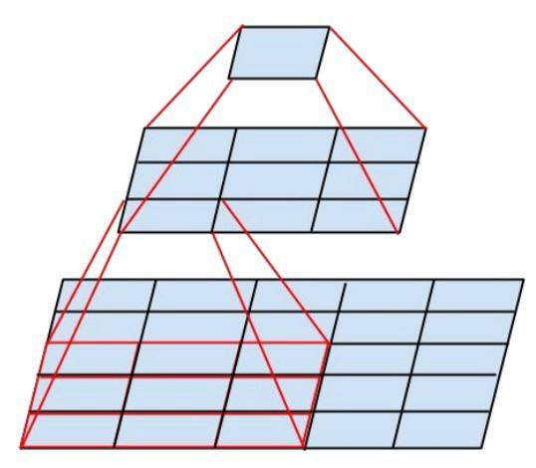
Convolutional Unit (CU) - VGG
3x3 Conv Layer
3x3 Conv Layer
Image Source (Inception): Szegedy, Christian, et al. "Rethinking the inception architecture for computer vision." CVPR. 2016.

Slide 9
Basic Block in ResNet
ResNet: He, Kaiming, et al. "Deep residual learning for image recognition." CVPR. 2016.
3x3 Conv Layer
Residual Connection
Element-wise addition of input and output
Improves gradient flow and accuracy
In ResNet-18 and ResNet-34
Still computationally expensive
Hard to train very deep networks (> 100 layers)
3x3 Conv Layer

Slide 10
Bottleneck in ResNet
1x1 Conv Layer
Used in ResNet-50, ResNet-101, ResNet-152, etc...
Computationally Efficient
Influence:
Bottleneck unit with Depth-wise convs
MobileNetv2
ShuffleNetv2
MobileNetv2: Sandler, Mark, et al. "Mobilenetv2: Inverted residuals and linear bottlenecks." CVPR, 2018.
ShuffleNetv2: Ma, Ningning, et al. "Shufflenet v2: Practical guidelines for efficient cnn architecture design." ECCV, 2018.
3x3 Depth-Conv Layer
1x1 Conv Layer

Slide 11
CNN Structures
Semantic Segmentation

Slide 12
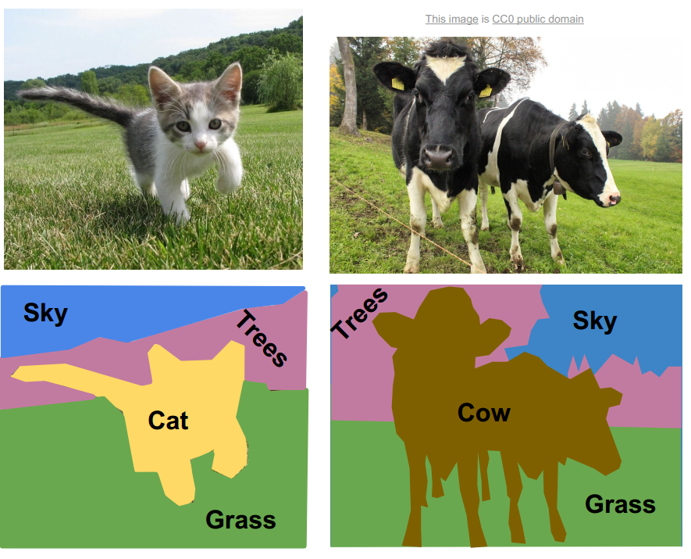

Slide 13
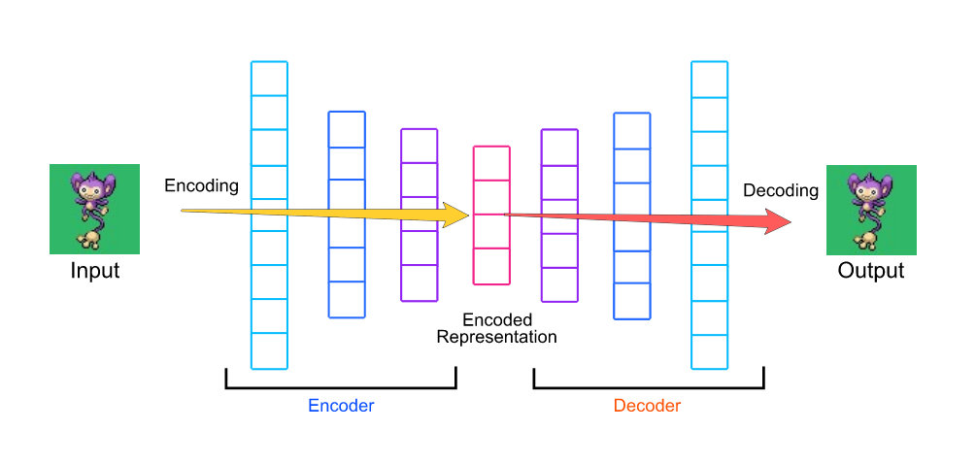
Encoder-Decoder

Slide 14
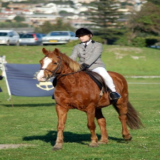
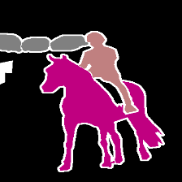
Encoder-Decoder in Semantic Segmentation
CU
DU
CU
DU
CU
CU
UU
CU
UU
UU
Up-sampling
Unit
CU
Convolutional
Unit
FC
Fully-connected
Or Linear Layer
DU
Down-sampling
Unit
GAP
Global Avg.
Pooling

Slide 15
U-Net
CU
DU
CU
DU
CU
CU
UU
CU
UU
UU
Up-sampling
Unit
CU
Convolutional
Unit
FC
Fully-connected
Or Linear Layer
DU
Down-sampling
Unit
GAP
Global Avg.
Pooling

Slide 16
Deep Learning Libraries

Slide 17
Homework 5
Convolutional Neural Networks
In PyTorch

Slide 18
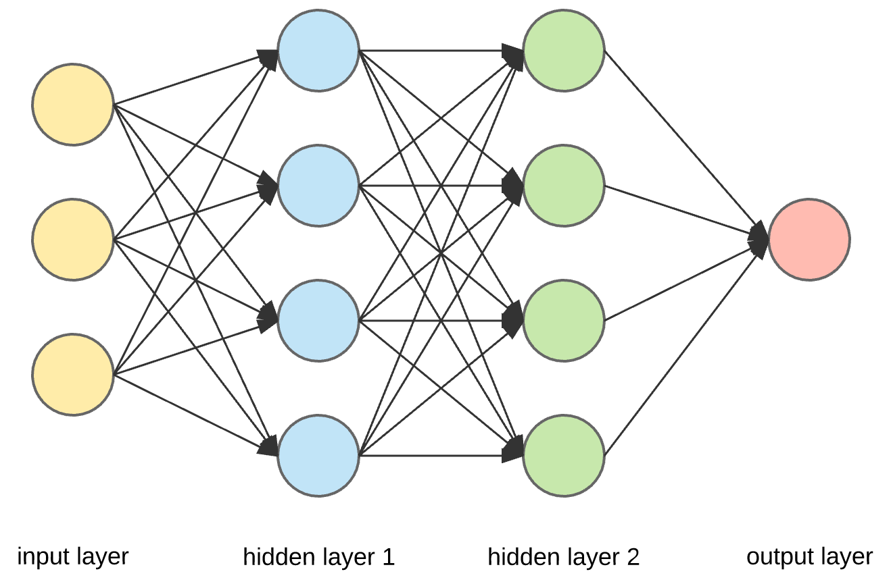
Neural Network (Q1)

Slide 19
Convolutional Neural Network (Q2)
Conv
Pool
FC
Cross Entropy

Slide 20
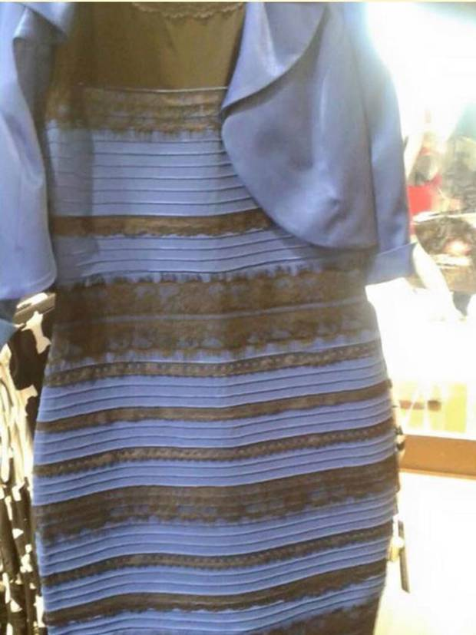
Yellow or Blue?

Slide 21
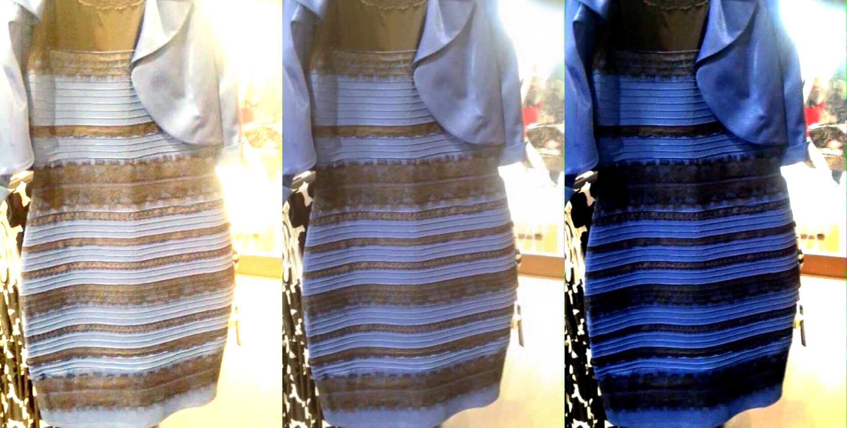
Color Normalization (Q3)

Slide 22
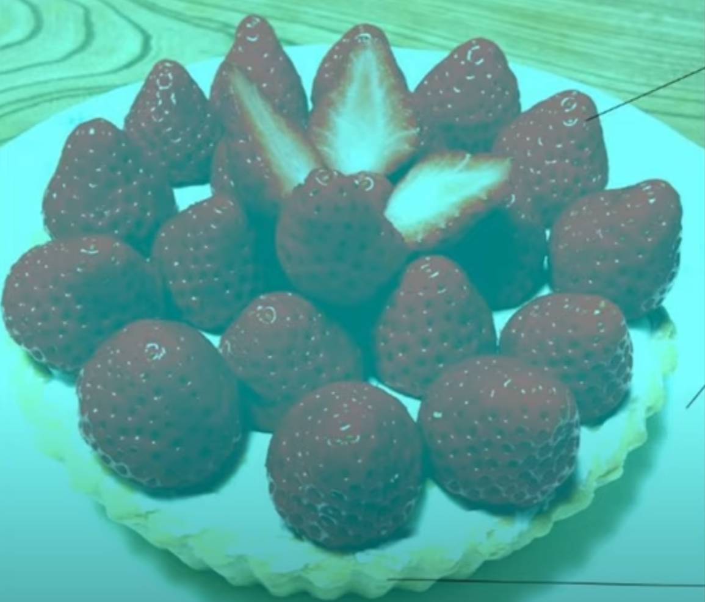
What’s the Color of the Strawberry

Slide 23
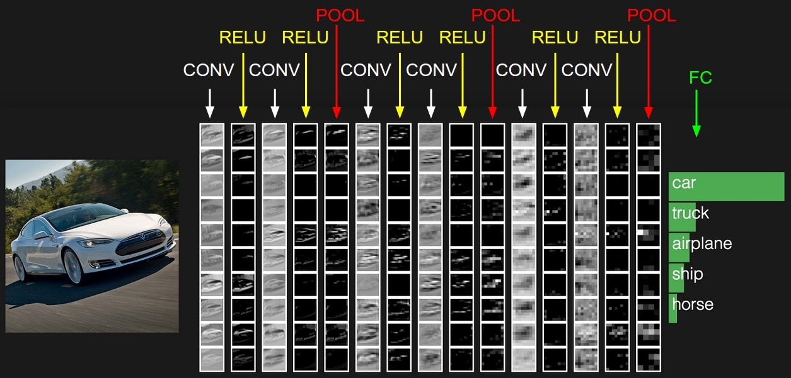
Deep Convolutional Neural Network (Q4)

Slide 24
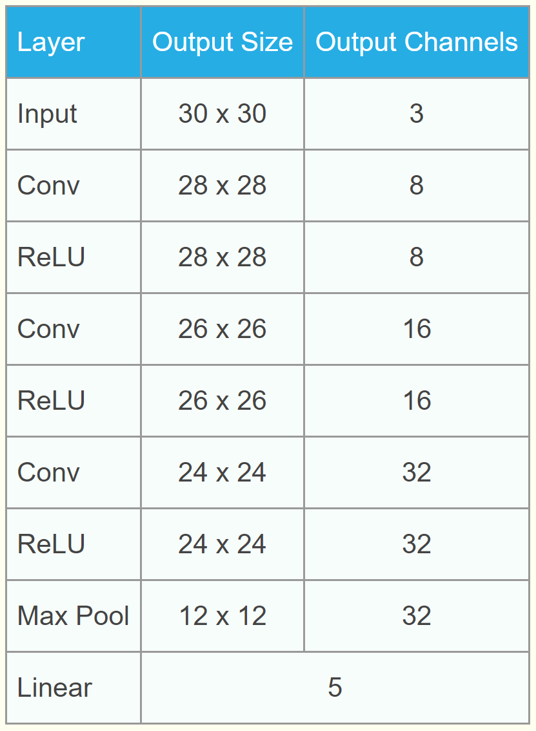
Make the Design More Flexible
Input:
[8, 16, 32, "pool"]

Slide 25
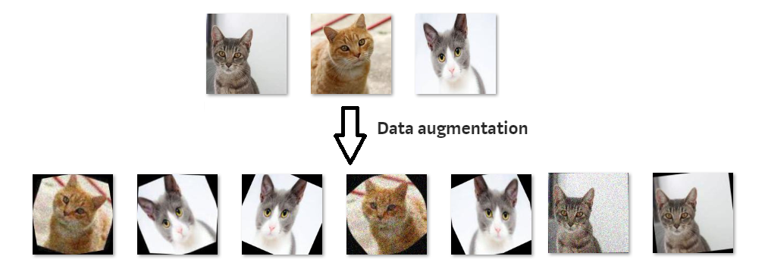
Data Augmentation (Q5)
Random Affine Transformation

