Slide 1
An Overview of Data Provenance
Why – How – Where

Slide 2
What’s up with this presentation?
Cannibalized from:
Val Tannen’s EDBT and AMW 2010 tutorials
Peter Buneman and Wang-Chiew Tan’s SIGMOD 2007 tutorial
Julie and Nodira’s 590q presentation ☺

Slide 3
Provenance
Data provenance
[BunemanKhannaTan01]: aims to explain how a particular result was derived.
Data-intensive science
Worry about provenance
provenance, n.
The fact of coming from some particular source or quarter;
origin, derivation [Oxford English Dictionary]

Slide 4
Terminology
Cf. Peter Buneman
Pedigree is for dogs
Lineage is for kings
Provenance is for art

Slide 5
Motivation
Data integration [WangMadnick90, LeeBressanMadnick98]
Data Warehousing [CuiWidonWiener00]
Scientific Data Management [BunemanKhannaTan01]
Determines trust on results
Ensure reliability, quality of data
Repeatability/verifiability
Avoid effort duplication
Understanding transport of annotations

Slide 6
Example of Data Provenance
A typical question:
For a given database query Q, a database D and a tuple t in the output of Q(D), which parts of D “contribute” to t?
The question can be applied to attribute values, tables, etc.
R
Emp Dept
John D01
Susan D02
Anna D04
S
Did Mgr
D01 Mary
D02 Ken
D03 Ed
Emp Dept Mgr
John D01 Mary
Susan D02 Ken
Q
Q = select r.A, r.B, s.C
from R r, S s
where r.B = s.B

Slide 7
Timeline
1990
1997
2000
2001
2002
2003
A Polygen Model for Heterogeneous Database Systems: The Source Tagging Perspective. Y. R. Wang and
S. E. Madnick. VLDB 1990.
Supporting Fine-grained Data Lineage in a Database Visualization Environment. A. Woodruff and
M. Stonebraker. ICDE 1997.
Tracing the Lineage of View Data in a Warehousing Environment. Y. Cui, J. Widom and J. L. Wiener. TODS 2000.
Why and Where: A Characterization of Data Provenance. P. Buneman, S. Khanna, Tan. ICDT 2001.
On Propagation of Deletions and Annotations through Views. P. Buneman, S. Khanna, Tan. PODS 2002.
Containment of Relational Queries with Annotation Propagation. Tan. DBPL 2003.

Slide 8
Timeline
1990
1997
2000
2001
2002
2003
2004
2006
2007
2009
An Annotation Management System for Relational Databases. D. Bhagwat, L. Chiticariu, Tan, G. Vijayvargiya.
VLDB 2004, VLDB Journal 2005.
MONDRIAN: Annotating and Querying Databases through Colors and Blocks. ICDE 2006.
Provenance in Curated Databases. P. Buneman, A. Chapman and J. Cheney. SIGMOD 2006.
Annotation propagation revisited for key preserving views. Gao Cong, Wenfei Fan, Floris Geerts. CIKM 2006.
ULDBs: Databases with Uncertainty and Lineage. O. Benjelloun, A.D. Sarma, A. Y. Halevy, and J. Widom. VLDB 2006.
Debugging Schema Mappings with Routes. L. Chiticariu and Tan. VLDB 2006.
On the Expressiveness of Implicit Provenance in Query and Update Languages. P. Buneman, J. Cheney
and S. Vansummeren. ICDT 2007.
Intentional Associations Between Data and Metadata. D. Srivastava and Y. Velegrakis. SIGMOD 2007.
Provenance Semirings. T. J. Green, G. Karvounarakis and V. Tannen. PODS 2007.
Annotated XML: Queries and Provenance: J. N. Foster, T. J. Green, V. Tannen. PODS 2008.
Containment of Conjunctive Queries on Annotated Relations: T. J. Green, ICDT 2009

Slide 9
Two Approaches
Eager or annotation-based
Changes the transformation from Q to Q’ to carry extra information
Source data not needed after transformation
Lazy or non-annotation based
Q is unchanged
Good when extra storage is an issue
Recomputation and access to source required
Q
Extra
information
Annotation-based
Q’

Slide 10
Types of Provenance
Why
“What DB tuples contribute to the presence of each result tuple?”
How
“By what process is each output tuple produced from the DB instance?”
Where
“Where (from what attribute of what tuple) does each output tuple value come from?”

Slide 11
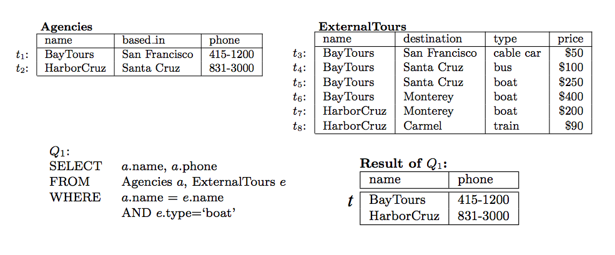
Lineage
Lineage for an output tuple t is a subset of the input tuples which are relevant to the output tuple
Lineage: {t1, t5, t6}
Problem: Not very precise.
e.g. lineage above does not specify that t5 and t6 do not both need to exist.

Slide 12
Why provenance
Witness of t: Any subset of the database sufficient to reconstruct tuple t in the query result.
{t1, t5}
{t1, t6}
{t1, t2, t6, t8}
Witness basis: Leaves of the “proof tree” showing how result tuple t is generated
{{t1, t5}, {t1, t6}}

Slide 13
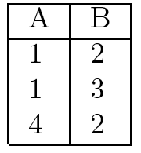
Why: Query Rewriting
t1
t
t2
t3
Why(Q, I, t): {{t1}}
Why(Q’, I, t): {{t1}, {t1, t2}}
Minimal witness basis:
Minimal witnesses in the witness basis

Slide 14
The View Deletion Problem
D a database instance and V=Q(D) a view defined over D.
Find a set of tuples ΔD to remove from D so that a specific tuple t is removed from the view
Minimize the number of side-effects in the view
View side-effect problem
Hard: queries with joins and projection or union
PTIME: the rest
Minimize the number of tuples deleted from D
Source side-effect problem
Same dichotomy
[BunemanKhannaTan. PODS02]

Slide 15
How provenance
Identifies “witness tuples” and the operations performed on them to produce each result tuple
Expresses operations using provenance semirings
MERGE (+): union or projection
JOIN (•): joins

Slide 16
Propagating Annotations
R
A B C
…
a b c
…
R S
A B C D E
…
a b c d e
…
Join (on B)
S
D B E
…
d b e
…
The annotation means joint use of the data annotated by p and the data annotated by r

Slide 17
Propagating Annotations (2)
R
A B C
…
a b c
…
R S
A B C
…
a b c
…
p + r
Union
S
A B C
…
a b c
…
The annotation p + r means alternative use of the data annotated by p and the data annotated by r

Slide 18
Propagating Annotations (3)
R
A B C
…
a b c₁
…
a b c₂
…
a b c₃
π_{AB}R
A B
p
Project
…
a b
…
p + r + s
r
s
+ denotes alternative use of data

Slide 19
An example (SPJU)
Q = σ_{C=e}π_{AC}(π_{AC}R π_{BC}R π_{AC}R π_{BC}R)
R
A B C
a b c
d b e
f g e
p
A C
r
a c
a e
d c
d e
f e
s
For selection, multiply with annotation 0 and 1.

Slide 20
Summary of approach
Space of annotations K
K-relations: every tuple annotated with elements from K
Binary operations on K
• : joint use (join)
+ : alternative use (union/projection)
Special annotations 0 and 1 in K
Absent tuples ← 0
1 is a neutral annotation
What are the laws of (K,+,•,0,1)?

Slide 21
Annotated Relational Algebra
DBMS query optimizers assume certain equivalences:
Union is associative, commutative
Join is associative, commutative, distributes over union
Projections/selections commute with each other and with union/join (when applicable)
No idempotence to allow for bag semantics
Equivalent queries should produce the same annotations
Proposition: Above identities hold for queries on K-relations iff (K,+,•,0,1) is a commutative semiring

Slide 22
Commutative Semirings?
An algebraic structure (K,+,•,0,1) where:
K is the domain
+ is associative, commutative, with 0 identity
• is associative with 1 identity
• distributes over +
a•0=0•a=0
• is also commutative
semiring

Slide 23
Back to example
R
Q
A B C
A C
a b c
d b e
f g e
p
a c
a e
d c
d e
f e
r
s

Slide 24
Applying the laws: polynomials
R
Q
A B C
A C
a b c
d b e
f g e
p
a e
d e
f e
pr
r
2r² + rs
s
rs + 2s²
Polynomials with coefficients in and annotation tokens as indeterminates p, r, s capture a very general form of provenance

Slide 25
How to read this provenance
R
Q
A B C
A C
a b c
d b e
f g e
p
a e
d e
f e
pr
r
2r² + rs
s
rs + 2s²
3 ways to derive (d e)
2 of the ways use only r, but they use it twice
the 3rd uses r once and s once

Slide 26
Deletion Propagation
R
Q
Q
Q
A B C
A C
A C
A C
a b c
d b e
f g e
p
a e
d e
f e
pr
a e
d e
f e
0
f e
2s²
r
2r² + rs
0
s
rs + 2s²
2s²
Delete (d b e) from R
Set r to 0!

Slide 27
Some useful commutative semirings
Set Semantics
Bag Semantics
Probabilistic events
Access Control
Public
Top Secret

Slide 28
Provenance with semirings
R
Q
A B C
A C
a b c
d b e
f g e
p
…
d e
…
r
{r,s}
{{r},{r,s}}
{{r}}
s
Lineage Semiring:
Why provenance Semiring:
Minimal witness Semiring:

Slide 29
Provenance Hierarchy
“One semiring to rule them all” – V. Tannen
2x²y + xy + 5y² + z
most informative
x²y + xy + y² + z
3xy + 5y + z
xy + y + z
least informative
xyz
y + z
Semiring homomorphism h : K₁→ K₂

Slide 30
Example: distrust scores
Semiring:
Tokens: X={p,r,s}
Assignment function f : X → K

Slide 31
Example: Access Control
where
a c
a e
d c
d e
f e
2p²
a b c
d b e
f g e
p
pr
q
pr
r
s
2r²+rs
2s²+rs
p=P, r=S, s=T
a c
a e
d c
d e
f e
P
a b c
d b e
f g e
P
S
S
q
Evaluate with p=P, r=S, s=T
using min for “+”, max for “•”
S
T
S
T
User with secret clearance

Slide 32
Where Provenance
Identifies “witness cells”
Important for annotations
SELECT * FROM R WHERE A <> 5
UNION
SELECT A, 7 AS B FROM R WHERE A= 5
R
A B
4
5 6
A B
4
5 7
?
UPDATE R SET B=7 WHERE A=5

Slide 33
Color Algebra [Geerts, Kementsietsidis, Milano 06]
A
B
A
B
P[Q]
3
4
3
4
5
6
5
7
SELECT * FROM R WHERE A <> 5
UNION
SELECT A, 7 AS B FROM R WHERE A= 5
Q =

Slide 34
Color Algebra
A
B
A
B
P[Q]
3
4
3
4
5
6
5
7
Q =
UPDATE R SET B=7 WHERE A=5

Slide 35
Where Provenance and Semirings
R^{u}
A^{x} B^{y} C¹
π_{AC}(π_{AB}R (π_{BC}R S))
…
a¹ b¹ c¹
…
A¹ C¹
…
a¹ c¹
…
u²p²xy² + uvpmxyz
S^{v}
B¹ C¹
…
b^{z} c¹
…
m
1 is a neutral annotation, used when we don’t bother to track data

Slide 36
Different Annotations → Different Tuples
R
π_{C}σ_{C=e}π_{AC}(π_{AB}R π_{BC}R)
A B C
a b c
d b e^{z}
f g e^{w}
p
C
r
e^{z}
e^{w}
pr+r²
s
s²

Slide 37
Wrap up: Issues and Directions
Archiving
Compression
Generalizations
Program Slicing [Cheney07]
“Negative” Provenance
Why Not? [SIGMOD09], Artemis [PVLDB09]
Causality? ☺

Slide 38
The end

