Slide 1
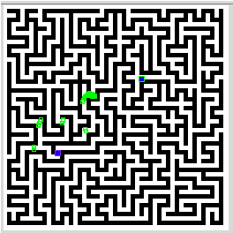
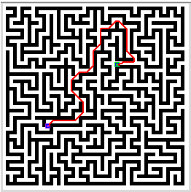
Dijkstra and A* Implementation
Andrew Lewis

Slide 2
Dijkstra
Uses state storage – most values initialized
[distance of path, visited?, previous node, in unvisited[]?, heuristic value, tentative dist]
Unvisited[] starts empty
Saves a lot of time
Ends when empty (or goal found)
Heuristic function returns 0
Constructs path using the state array

Slide 3
A*
Inherits Dijkstra
Only change label and heuristic function
Heuristic function returns distance to goal
5 Lines
class Astar2(Dijkstra):
label = "A*"
def heuristic(self, nodeID, goalID):
myFrisbee = euclidDist(nodeID, goalID, self.graph)
return myFrisbee

Slide 4
Challenges
Using the right values in loops and conditions
Still doesn’t find a path on first request

